Slide 1

LOGO
商务/科技幻灯片模板下载
纯免费PPT即点即下载，无注册、无套路
http://gitppt.com
不信你试试（狗头）
PPT模板下载：www.1ppt.com/moban/ 行业PPT模板：www.1ppt.com/hangye/
节日PPT模板：www.1ppt.com/jieri/ PPT素材下载：www.1ppt.com/sucai/
PPT背景图片：www.1ppt.com/beijing/ PPT图表下载：www.1ppt.com/tubiao/
优秀PPT下载：www.1ppt.com/xiazai/ PPT教程： www.1ppt.com/powerpoint/
Word教程： www.1ppt.com/word/ Excel教程：www.1ppt.com/excel/
资料下载：www.1ppt.com/ziliao/
PPT课件下载：www.1ppt.com/kejian/
范文下载：www.1ppt.com/fanwen/
第一PPT模板网
www.1ppt.com

Slide 2

纯免费PPT即点即下载，无注册、无套路
http://gitppt.com
不信你试试（狗头）
Buyers complete 80% of the buying cycle before interacting with sales.
—Source: HBR, Gartner
www.1ppt.com
*

Slide 3

Today’s Buyer
纯免费PPT即点即下载，无注册、无套路
http://gitppt.com
不信你试试（狗头）
Leverages the social web
Does their own research
Owns the buying process
Is impatient
Avoids risk
Expects immediate value
www.1ppt.com
*
Notes:
59% engaged with a peer who had addressed the challenge
48% followed industry conversations on the topic
37% posted questions on social networking sites looking for suggestions/feedback
20% connected directly with potential solution providers via social networking channels
Source: DemandGen

Slide 4
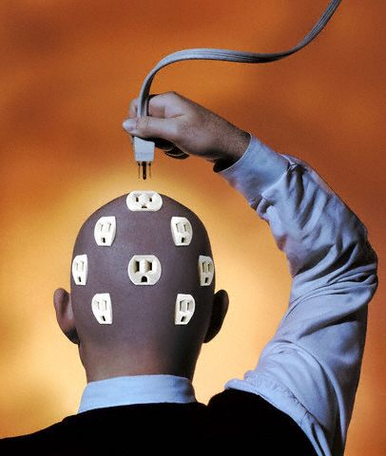
Sales is Often Disconnected
纯免费PPT即点即下载，无注册、无套路
http://gitppt.com
不信你试试（狗头）
www.1ppt.com
*

Slide 5

Use Social to Connect on a Personal Level
纯免费PPT即点即下载，无注册、无套路
http://gitppt.com
不信你试试（狗头）
www.1ppt.com
*

Slide 6
纯免费PPT即点即下载，无注册、无套路
http://gitppt.com
不信你试试（狗头）
www.1ppt.com
*

Slide 7
Success Requires…
纯免费PPT即点即下载，无注册、无套路
http://gitppt.com
不信你试试（狗头）
Business
Acumen
People Skills
Social Media Savvy
Sales
Skills
www.1ppt.com
*

Slide 8
And…
纯免费PPT即点即下载，无注册、无套路
http://gitppt.com
不信你试试（狗头）
Have a plan
Define your prospect
Pick the RIGHT tools
Implement consistently
Measure and track
www.1ppt.com
*

Slide 9
纯免费PPT即点即下载，无注册、无套路
http://gitppt.com
不信你试试（狗头）

Slide 10
纯免费PPT即点即下载，无注册、无套路
http://gitppt.com
不信你试试（狗头）
www.1ppt.com
*

Slide 11

纯免费PPT即点即下载，无注册、无套路
http://gitppt.com
不信你试试（狗头）
www.1ppt.com
*

Slide 12
Go Deeper
纯免费PPT即点即下载，无注册、无套路
http://gitppt.com
不信你试试（狗头）
www.1ppt.com
*

Slide 13
纯免费PPT即点即下载，无注册、无套路
http://gitppt.com
不信你试试（狗头）
www.1ppt.com
*

Slide 14
Big News!
纯免费PPT即点即下载，无注册、无套路
http://gitppt.com
不信你试试（狗头）
SunTrust Banks, Inc. : March 09, 2012
SunTrust Names Anil Cheriyan New Chief Information Officer
ATLANTA, March 9, 2012/PRNewswire/ -- SunTrust Banks, Inc. (NYSE: STI) today announced that Anil Cheriyan has been named the Company's new Chief Information Officer. He will join SunTrust on April 2, 2012, and report to Chairman and Chief Executive Officer William H. Rogers, Jr.
Mr. Cheriyan succeeds Tim Sullivan, who has served as Chief Information Officer since 2003 and is retiring.
www.1ppt.com
*

Slide 15

纯免费PPT即点即下载，无注册、无套路
http://gitppt.com
不信你试试（狗头）

Slide 16
纯免费PPT即点即下载，无注册、无套路
http://gitppt.com
不信你试试（狗头）
84% of the time an executive will take a meeting when someone from inside their organization (a credible sponsor) makes the introduction.
Source: Selling to the C-Suite
www.1ppt.com
*

Slide 17


Are you ready to move the conversation forward?
纯免费PPT即点即下载，无注册、无套路
http://gitppt.com
不信你试试（狗头）

