Slide 1

纯免费PPT即点即下载，无注册、无套路
http://gitppt.com
不信你试试（狗头）

Slide 2
OFC214
Microsoft Office Project Server 2007: Overview
纯免费PPT即点即下载，无注册、无套路
http://gitppt.com
不信你试试（狗头）
Eray Chou
Program Manager
Microsoft Services US

Slide 3

What is Office Project Server 2007?
纯免费PPT即点即下载，无注册、无套路
http://gitppt.com
不信你试试（狗头）
Key Component of the Microsoft Office Enterprise Project Management Solution
Project, Program, Portfolio Management
Centralized Resource Management
Enterprise Business Intelligence
Collaboration
Notes:
© 2006 Microsoft Corporation. All rights reserved. Microsoft, Windows, Windows Vista and other product names are or may be registered trademarks and/or trademarks in the U.S. and/or other countries.
The information herein is for informational purposes only and represents the current view of Microsoft Corporation as of the date of this presentation. Because Microsoft must respond to changing market conditions, it should not be interpreted to be a commitment on the part of Microsoft, and Microsoft cannot guarantee the accuracy of any information provided after the date of this presentation.
MICROSOFT MAKES NO WARRANTIES, EXPRESS, IMPLIED OR STATUTORY, AS TO THE INFORMATION IN THIS PRESENTATION.

Slide 4














The Microsoft Office Enterprise Project Management Solution Today
纯免费PPT即点即下载，无注册、无套路
http://gitppt.com
不信你试试（狗头）
More Productive Projects
Easily Create Enterprise Project Plans
Team Participation
Centrally Store Projects,
Resources & Reporting
Project Documents,
Issues/Risks & Tasks
Get more from your
IT Investments
Line of Business Systems

Slide 5





Microsoft Office Enterprise Project Management Solution Key Areas
纯免费PPT即点即下载，无注册、无套路
http://gitppt.com
不信你试试（狗头）
Align all work with your strategic objectives
Enable faster and
broader adoption
Scale to support
distributed organizations
Easily integrate and automate your processes
Notes:
© 2006 Microsoft Corporation. All rights reserved. Microsoft, Windows, Windows Vista and other product names are or may be registered trademarks and/or trademarks in the U.S. and/or other countries.
The information herein is for informational purposes only and represents the current view of Microsoft Corporation as of the date of this presentation. Because Microsoft must respond to changing market conditions, it should not be interpreted to be a commitment on the part of Microsoft, and Microsoft cannot guarantee the accuracy of any information provided after the date of this presentation.
MICROSOFT MAKES NO WARRANTIES, EXPRESS, IMPLIED OR STATUTORY, AS TO THE INFORMATION IN THIS PRESENTATION.

Slide 6





















In 2006, an Enterprise Solution
纯免费PPT即点即下载，无注册、无套路
http://gitppt.com
不信你试试（狗头）
LOB:
ERP
CRM
Front-
end
Capabilities
Services
Scheduling
Task Assignment
Timesheet
Capabilities
Resource Plans
Event/Notifications
Reporting
Portfolio Gov
Data Warehouse
Budgeting
Security
Portfolio Selection
Platform
Notes:
© 2006 Microsoft Corporation. All rights reserved. Microsoft, Windows, Windows Vista and other product names are or may be registered trademarks and/or trademarks in the U.S. and/or other countries.
The information herein is for informational purposes only and represents the current view of Microsoft Corporation as of the date of this presentation. Because Microsoft must respond to changing market conditions, it should not be interpreted to be a commitment on the part of Microsoft, and Microsoft cannot guarantee the accuracy of any information provided after the date of this presentation.
MICROSOFT MAKES NO WARRANTIES, EXPRESS, IMPLIED OR STATUTORY, AS TO THE INFORMATION IN THIS PRESENTATION.

Slide 7
Visibility and Insights
Align all work with your strategic objectives
纯免费PPT即点即下载，无注册、无套路
http://gitppt.com
不信你试试（狗头）
Scenario
Features
Analytics for end-users with
Microsoft Office tools
Project Center
Visual Reports
PWA Portfolio Analyzer
Budget Tracking
Cost Resources
Multi Currency
Financial control
Enterprise reports with
Microsoft SQL Server
Cube Building Service
Reporting Data Service
Reporting Wizard
Enterprise Reports
PWA Proposals
Operations Work
Resource Plans
Organizational visibility
Background Cell Highlighting
Multiple Level Undo
Change Highlighting
Task Drivers
Transparent scheduling
Builder
Optimizer
Dashboard
Microsoft Portfolio Server (UMT)
Notes:
© 2006 Microsoft Corporation. All rights reserved. Microsoft, Windows, Windows Vista and other product names are or may be registered trademarks and/or trademarks in the U.S. and/or other countries.
The information herein is for informational purposes only and represents the current view of Microsoft Corporation as of the date of this presentation. Because Microsoft must respond to changing market conditions, it should not be interpreted to be a commitment on the part of Microsoft, and Microsoft cannot guarantee the accuracy of any information provided after the date of this presentation.
MICROSOFT MAKES NO WARRANTIES, EXPRESS, IMPLIED OR STATUTORY, AS TO THE INFORMATION IN THIS PRESENTATION.

Slide 8
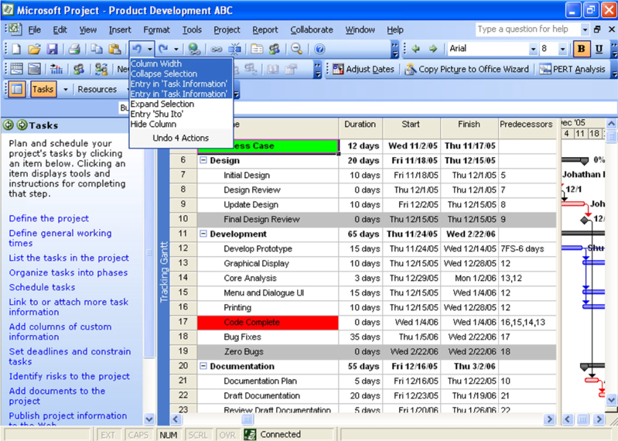

Multiple Level Undo
纯免费PPT即点即下载，无注册、无套路
http://gitppt.com
不信你试试（狗头）
Select set of actions to Undo
Beta software, subject to change
Notes:
© 2006 Microsoft Corporation. All rights reserved. Microsoft, Windows, Windows Vista and other product names are or may be registered trademarks and/or trademarks in the U.S. and/or other countries.
The information herein is for informational purposes only and represents the current view of Microsoft Corporation as of the date of this presentation. Because Microsoft must respond to changing market conditions, it should not be interpreted to be a commitment on the part of Microsoft, and Microsoft cannot guarantee the accuracy of any information provided after the date of this presentation.
MICROSOFT MAKES NO WARRANTIES, EXPRESS, IMPLIED OR STATUTORY, AS TO THE INFORMATION IN THIS PRESENTATION.

Slide 9

Project Server 2007 BI Platform
SQL database
纯免费PPT即点即下载，无注册、无套路
http://gitppt.com
不信你试试（狗头）
Dedicated SQL database for Reporting
Three core schemas
  EPM data
  Timesheet data
  Collaboration data
Core EPM Schema
Timesheet Schema
Collaboration Schema

Slide 10








Project Server 2007 Architecture
纯免费PPT即点即下载，无注册、无套路
http://gitppt.com
不信你试试（狗头）
Microsoft Office Project
Professional 2007
Microsoft Internet
Explorer 6
Web
Services
HTTP/SOAP
Cache
Project Web Access
UI Tier
SOAP
Server
Eventing
System
PSI
Server
Queuing
System
Project
Server Platform
Draft
Published
Reporting
Archive
Notes:
© 2006 Microsoft Corporation. All rights reserved. Microsoft, Windows, Windows Vista and other product names are or may be registered trademarks and/or trademarks in the U.S. and/or other countries.
The information herein is for informational purposes only and represents the current view of Microsoft Corporation as of the date of this presentation. Because Microsoft must respond to changing market conditions, it should not be interpreted to be a commitment on the part of Microsoft, and Microsoft cannot guarantee the accuracy of any information provided after the date of this presentation.
MICROSOFT MAKES NO WARRANTIES, EXPRESS, IMPLIED OR STATUTORY, AS TO THE INFORMATION IN THIS PRESENTATION.

Slide 11
Customized Application Migration
纯免费PPT即点即下载，无注册、无套路
http://gitppt.com
不信你试试（狗头）
Project 2003 | Project 2007
PDS Calls | Map to PSI Calls
PDS Extensions | Map to PSI Calls New Web Service against Report DB
Database Triggers | Server Side Events
ASP Pages | Web Parts ASP.Net Pages
Notes:
© 2006 Microsoft Corporation. All rights reserved. Microsoft, Windows, Windows Vista and other product names are or may be registered trademarks and/or trademarks in the U.S. and/or other countries.
The information herein is for informational purposes only and represents the current view of Microsoft Corporation as of the date of this presentation. Because Microsoft must respond to changing market conditions, it should not be interpreted to be a commitment on the part of Microsoft, and Microsoft cannot guarantee the accuracy of any information provided after the date of this presentation.
MICROSOFT MAKES NO WARRANTIES, EXPRESS, IMPLIED OR STATUTORY, AS TO THE INFORMATION IN THIS PRESENTATION.

Slide 12
Workflow Authoring Tools
纯免费PPT即点即下载，无注册、无套路
http://gitppt.com
不信你试试（狗头）
Microsoft Office SharePoint Designer 2007
Visual Studio (Pro-Dev)
Development Model
Wizard-based workflow designer
Development Model
Visual workflow designer
Activities
Re-use OOB/deployed activities
Activities
Re-use OOB/deployed activities
Can author new activities
Forms
Autogenerated Forms
-InfoPath
-ASPX
Forms
Designed Forms
-InfoPath
-ASPX
Deployment
Workflow authored live
against server
Runtime compilation
Deployment
Solutions package generated
Box administrator installable
Notes:
© 2006 Microsoft Corporation. All rights reserved. Microsoft, Windows, Windows Vista and other product names are or may be registered trademarks and/or trademarks in the U.S. and/or other countries.
The information herein is for informational purposes only and represents the current view of Microsoft Corporation as of the date of this presentation. Because Microsoft must respond to changing market conditions, it should not be interpreted to be a commitment on the part of Microsoft, and Microsoft cannot guarantee the accuracy of any information provided after the date of this presentation.
MICROSOFT MAKES NO WARRANTIES, EXPRESS, IMPLIED OR STATUTORY, AS TO THE INFORMATION IN THIS PRESENTATION.

Slide 13




The 2007 Microsoft Office System Clients. Servers. Solutions.
纯免费PPT即点即下载，无注册、无套路
http://gitppt.com
不信你试试（狗头）
Install Beta 2 today!
It’s in your attendee bag
Learn more at the Office System TLC
Demo Stations / Hands-on-Labs / Chalk-talks
Talk
Lab
Demo
Get more information
http://www.microsoft.com/office/preview/default.mspx
http://msdn.microsoft.com/office/
Notes:
© 2006 Microsoft Corporation. All rights reserved. Microsoft, Windows, Windows Vista and other product names are or may be registered trademarks and/or trademarks in the U.S. and/or other countries.
The information herein is for informational purposes only and represents the current view of Microsoft Corporation as of the date of this presentation. Because Microsoft must respond to changing market conditions, it should not be interpreted to be a commitment on the part of Microsoft, and Microsoft cannot guarantee the accuracy of any information provided after the date of this presentation.
MICROSOFT MAKES NO WARRANTIES, EXPRESS, IMPLIED OR STATUTORY, AS TO THE INFORMATION IN THIS PRESENTATION.

