Slide 1
Creating Sustainable Change through Organizational Alignment and Managing an Increasingly Diverse Workforce
February 18, 2008
纯免费PPT即点即下载，无注册、无套路
http://gitppt.com
不信你试试（狗头）
NASSCOM India Leadership Forum 2008

Slide 2
Business Events have Huge Change Management Implications
纯免费PPT即点即下载，无注册、无套路
http://gitppt.com
不信你试试（狗头）
Transactions
Transformation & Expansion
Post Merger Alignment
Combines two legacy organizations to realize synergies
Change in
Ownership
Alters ownership, priorities of operations and deliverables
Restructuring
Realign units for better performance &quality
Outsourcing
Transitions services and transactions to external providers
Cost
Optimization
Reduces costs and associated resources
Technology
Implementation
Realigns application portfolios, automates transactions
Innovation & Growth
Focuses on generating new ideas and products
Global Expansion
Sources new markets or talent for top-line growth or for cost arbitrage
Commitment: Do we have leadership commitment and stakeholder support?
Capability: Do we have the resources and capabilities to achieve this?
Communication : How, what and when should we communicate?
Consequence: Are we measuring and rewarding desired behavior?
Culture/ Org.: What cultural nuances should we take into account?

Slide 3
Change Challenges Clients Typically Face during Transformation
纯免费PPT即点即下载，无注册、无套路
http://gitppt.com
不信你试试（狗头）
Change challenges/risks companies typically experience | Recommended best practices
Define success as “get the technology up”, instead of defining success as “end-users adopted desired behaviors” : | Ensure project team and sponsors define success as behavior change Clearly define desired behaviors (e.g. “stop/start/continue” doing) Define and track metrics indicating adoption of desired behavior Develop “consequence management” plan to encourage desired behaviors and discourage unwanted behaviors
Stakeholders, especially managers, are resistant to the change (e.g. using work-arounds or continue to use old system), or have emotional reactions to the change | Conduct a stakeholder analysis to understand which and how employees are impacted, their concerns, how to best address those concerns Develop “what’s in it for me” messages tailored to managers and other key stakeholder groups Conduct workshop to support “personal transitions” Develop tailored and timely 2-way communications
Insufficient engagement from sponsors and leaders : | Develop strategy for involving sponsors and leaders in leading the change and holding them accountable for the results Provide sponsors and leaders with on-boarding and skill-building sessions Hold regular check-ins with sponsors and leaders
Insufficient Change Management capability and/or resources on client team | Outline the role and required skills of Change Team members and select and fully staff based on the role profile(s) Provide Change Team with on-boarding and skill-building sessions Hold regular reviews of change management lessons learned

Slide 4

Managing Change…
纯免费PPT即点即下载，无注册、无套路
http://gitppt.com
不信你试试（狗头）
Change is …
Events
Situational
Outcome-oriented
Relatively Quick
Transition is …
Experiences
Psychological
Process-based
Gradual & Slow

Slide 5
The Human Dynamic in Change
纯免费PPT即点即下载，无注册、无套路
http://gitppt.com
不信你试试（狗头）
Commitment
Early euphoria
“It is the right thing to do”
“ We will succeed”
“Change is exciting”
“Our company is taking a bold step”
Adaptation
Fear/uncertainty
“Train is leaving, I better get on”
“It’s hard, but we can do it”
Organization Momentum
“What does this mean for me?”
“What are my priorities now?”
Paralysis
Withdrawal
“I can’t act with all this uncertainty”
“My highest priority is to stay on top of the integration news”
“I’ll do what is necessary to survive”
Departure
“This is not something I want to be part of”
Time

Slide 6

纯免费PPT即点即下载，无注册、无套路
http://gitppt.com
不信你试试（狗头）

Slide 7
Engaging Employees Across Diverse Geographies
纯免费PPT即点即下载，无注册、无套路
http://gitppt.com
不信你试试（狗头）
National Culture
Organizational Culture
Practices
Values
Family
School
Work

Slide 8
Engaging Employees in Transition
纯免费PPT即点即下载，无注册、无套路
http://gitppt.com
不信你试试（狗头）
Sell the “What’s in it for me?”
  — Motivate employees with the right messages
  — Give employees a reason to care
Brand the culture
  — Re-define expectations and commitments
  — Educate and promote the value to employees
Sustain employee behavior change
  — Keep the brand alive
  — Actively measure and manage
Align programs, communications, and delivery
  — Create a consistent experience
  — Reward/reinforce the right behaviors

Slide 9
Definition of Engagement
纯免费PPT即点即下载，无注册、无套路
http://gitppt.com
不信你试试（狗头）
Engagement is a state of emotional and intellectual engagement
Engagement
How much I want to and actually do improve our business results.
Commitment
How much I want to be here.
Satisfaction
How much I like
things here.
Three key behaviors that
indicate strong engagement
Say!, Stay!, Strive!

Slide 10
Integration of Internal & External Brand
纯免费PPT即点即下载，无注册、无套路
http://gitppt.com
不信你试试（狗头）
Best employer branding then is a way to brand your entire annual investment in people in order to get employees moving in the same direction toward some greater outcome than the sum of the silos.
The key thing helping employees see the connection
between the promise for them and the promise for
customers that they are charged with delivering
“Value Proposition”
What do you want of me?
What’s in it for me?
External Brand Positioning
Internal Brand Positioning
The promise statement that
appears in your external
marketing (To Customers)
Brand promise that aligns
and compliments the external
promise (To Employees)

Slide 11
Southwest Airlines’ Case
纯免费PPT即点即下载，无注册、无套路
http://gitppt.com
不信你试试（狗头）
Southwest Airlines is known for its unique business culture and outstanding performance for a length of time.
Profit in 2001: US$ 511 million (profitable for 29 consecutive years)
Fewest customer complaints (2000, 2001)
Employees: 34,000
Highest load factor* in industry (70.5%, 2000)
High retention rate (93% in 2000, 96% in 2001)
Employer of choice by Fortune (‘97 ~ ‘01)
*Percentage of paying customers over available seats

Slide 12
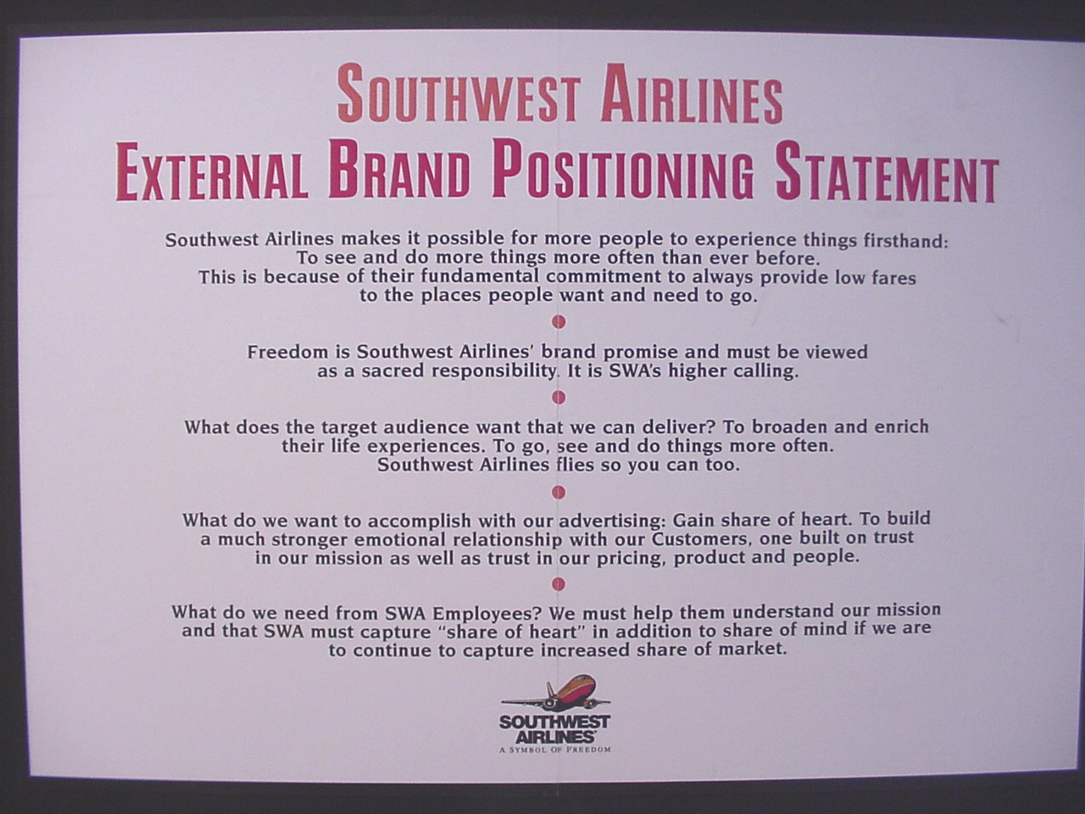
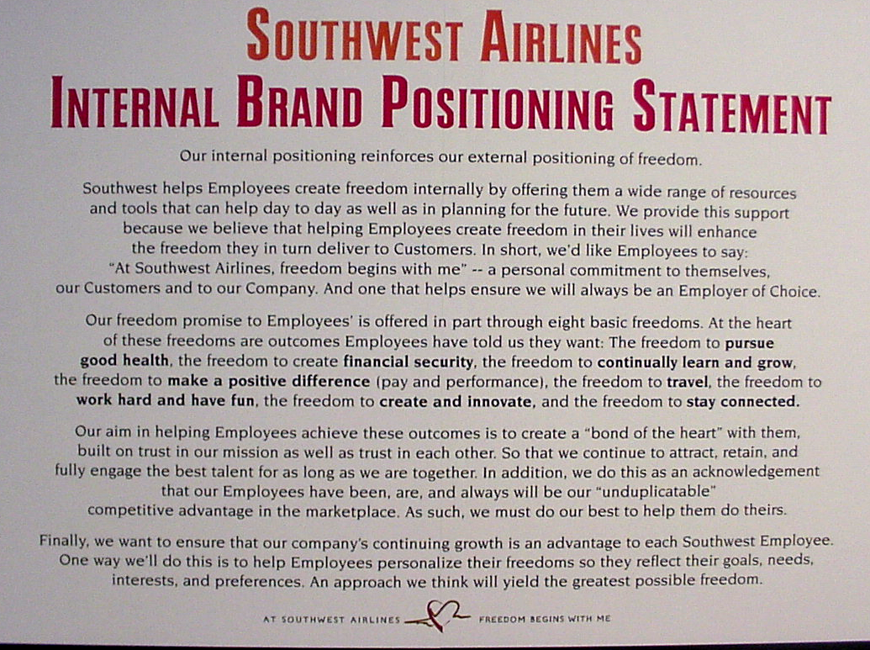
SWA’s Employer Brand
纯免费PPT即点即下载，无注册、无套路
http://gitppt.com
不信你试试（狗头）
“FREEDOM”
The Glue
To Customers
To Employees
“The Freedom to Fly”
“Freedom Begins With Me”

