Slide 1
纯免费PPT即点即下载，无注册、无套路
http://gitppt.com
不信你试试（狗头）
201X DESIGN
PPT Demo Home
Notes:
备注有修改模板提示，让你轻松完成模板修改。
如果你要删除所有的备注文字说明，直接打开文件 —— 点击检查问题 —— 检查文档 —— 在弹出的对话框中点击检查 —— 在检查结束后演示文稿备注 —— 点击全部删除就可轻松完成。

Slide 2
纯免费PPT即点即下载，无注册、无套路
http://gitppt.com
不信你试试（狗头）
Contents
PART ONE
PART TWO
PART THREE
PART FOUR
Notes:
【使用提示】此页为目录页，如果你的目录页多余四项，你可以复制本页PPT，继续添加你的标题。如果你的目录少于四项，直接删除后合理排列就可。

Slide 3
纯免费PPT即点即下载，无注册、无套路
http://gitppt.com
不信你试试（狗头）
PART ONE
Notes:
【使用提示】本页为第一章节的目录过渡页，直接修改文字即可

Slide 4



纯免费PPT即点即下载，无注册、无套路
http://gitppt.com
不信你试试（狗头）
Data chart sample
Perfect Theme
Perfect Theme
Perfect Theme
The word "design" needs a redesign. Designers need to be thinking not
The word "design" needs a redesign. Designers need to be thinking not
The word "design" needs a redesign. Designers need to be thinking not
Notes:
【使用提示】三组数据图表，注意本页数据图表是可以编辑图表，直接右键就可以编辑数据，直接在excel图表里修改数据
注意：必须是office PPT 2007版本才支持图表编辑

Slide 5



纯免费PPT即点即下载，无注册、无套路
http://gitppt.com
不信你试试（狗头）
Text sample
STEP 1
STEP 2
STEP 3
STEP 4
The word "design" needs a redesign. Designers need to be thinking not
The word "design" needs a redesign. Designers need to be thinking not
The word "design" needs a redesign. Designers need to be thinking not
The word "design" needs a redesign. Designers need to be thinking not
Notes:
【使用提示】本页是计划、项目步骤、关键节点等时间轴展示，直接修改文字即可

Slide 6
纯免费PPT即点即下载，无注册、无套路
http://gitppt.com
不信你试试（狗头）
Data chart sample
The word "design" needs a redesign. Designers need to be thinking not about the medium that they're serving but more about the process to get to something that is tangibly made to serve people's needs.
75%
62%
24%
Perfect Theme
Perfect Theme
Perfect Theme
The word "design" needs a redesign. Designers need to be thinking not
The word "design" needs a redesign. Designers need to be thinking not
The word "design" needs a redesign. Designers need to be thinking not
Notes:
【使用提示】三组创意图形展示，修改方法如下：
如果你要修改黄色部分的大小，直接选中黄色部分后，会出现黄色的正方形图标，直接拖动黄色小点，黄色部分会变化，拖动完毕后，直接在上方有一个旋转的箭头处，按照鼠标左键就可以旋转，旋转到水平就可。

Slide 7
纯免费PPT即点即下载，无注册、无套路
http://gitppt.com
不信你试试（狗头）
Data chart sample
The word "design" needs a redesign. Designers need to be thinking not about the medium that they're serving but more about the process to get to something that is tangibly made to serve people's needs.
Perfect Theme
Perfect Theme
Perfect Theme
Perfect Theme
The word "design" needs a redesign. Designers need to be thinking not
The word "design" needs a redesign. Designers need to be thinking not
The word "design" needs a redesign. Designers need to be thinking not
The word "design" needs a redesign. Designers need to be thinking not
Notes:
【使用提示】四项关键文本文字展示，直接修改文字就可。

Slide 8
纯免费PPT即点即下载，无注册、无套路
http://gitppt.com
不信你试试（狗头）
PART TWO
Notes:
【使用提示】本页为第二章节过渡页，直接修改文字即可。如果你的过渡页不够用，其实可以复制过渡页，随意选中六边形拖动到合理位置，变换不同的版面设计就可。

Slide 9
纯免费PPT即点即下载，无注册、无套路
http://gitppt.com
不信你试试（狗头）
Data chart sample
The word "design" needs a redesign. Designers need to be thinking not about the medium that they're serving but more about the process to get to something that is tangibly made to serve people's needs.
Perfect Theme
The word "design" needs a redesign. Designers need to be thinking not
TEXT HERE
Perfect Theme
The word "design" needs a redesign. Designers need to be thinking not
Notes:
【使用提示】两组关键文本数据展示。直接直观的对比两组数据

Slide 10
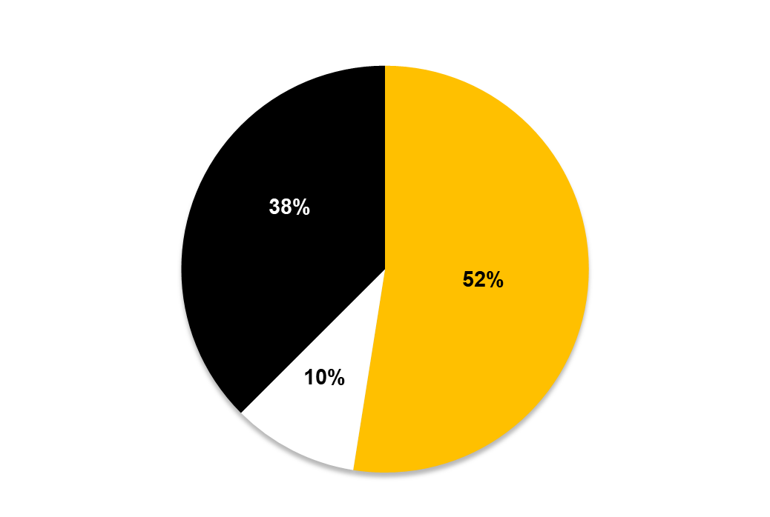
纯免费PPT即点即下载，无注册、无套路
http://gitppt.com
不信你试试（狗头）
Data chart sample
Perfect Theme
The word "design" needs a redesign. Designers need to be thinking not about the medium.
Perfect Theme
The word "design" needs a redesign. Designers need to be thinking not about the medium.
Perfect Theme
The word "design" needs a redesign. Designers need to be thinking not about the medium.
Notes:
【使用提示】圆饼图，三组数据的展示，这是一个可编辑的图表，直接选中图表右键编辑数据，就可以打开excel编辑数据，右边是三组图表的补充文字说明。

Slide 11
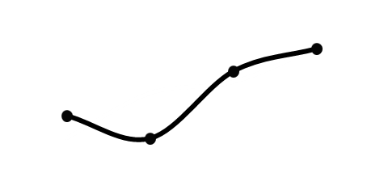

纯免费PPT即点即下载，无注册、无套路
http://gitppt.com
不信你试试（狗头）
Text sample
Text sample
Sales text sample
The word "design" needs a redesign. Designers need to be thinking not about the medium that they're serving but more about the process to get to something that is tangibly made to serve people's needs.
Text sample
Sales text sample
The word "design" needs a redesign. Designers need to be thinking not about the medium that they're serving but more about the process to get to something that is tangibly made to serve people's needs.
Notes:
【使用提示】两组折线图对比，可以是两组数据的同期或环比数据展示，比如年度、月度、也可以是人员数据、比如离职率，多种应用都可展示。右边文字是图表的文字说明展示。

Slide 12
纯免费PPT即点即下载，无注册、无套路
http://gitppt.com
不信你试试（狗头）
Text sample
The word "design" needs a redesign. Designers need to be thinking not about the medium that they're serving but more about the process to get to something that is tangibly made to serve people's needs.
24%
53%
76%
12%
Perfect Theme
Perfect Theme
Perfect Theme
Perfect Theme
Notes:
【使用提示】四组文字数据排版展示

Slide 13
纯免费PPT即点即下载，无注册、无套路
http://gitppt.com
不信你试试（狗头）
PART THREE
Notes:
【使用提示】第三章节的过渡页设计，直接在文本框内替换修改文字就可以啦。

Slide 14
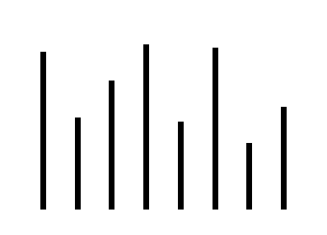

纯免费PPT即点即下载，无注册、无套路
http://gitppt.com
不信你试试（狗头）
Data chart sample
Sales text sample
Sales text sample
Sales text sample
Sales text sample
The word “design” needs a redesign. Designers need to be thinking not about the medium .
The word “design” needs a redesign. Designers need to be thinking not about the medium .
TEXT
TEXT
TEXT
Notes:
【使用提示】两组数据的对比直观展示设计，可以对比展示任何数据。两组图表为柱形图、圆环图均是可编辑的图表，直接右键编辑数据。

Slide 15
纯免费PPT即点即下载，无注册、无套路
http://gitppt.com
不信你试试（狗头）
Data chart sample
Text sample
The word "design" needs a redesign. Designers need to be thinking not .
Text sample
The word "design" needs a redesign. Designers need to be thinking not .
Text sample
The word "design" needs a redesign. Designers need to be thinking not .
Notes:
【使用提示】三组时间轴的文字展示。

Slide 16
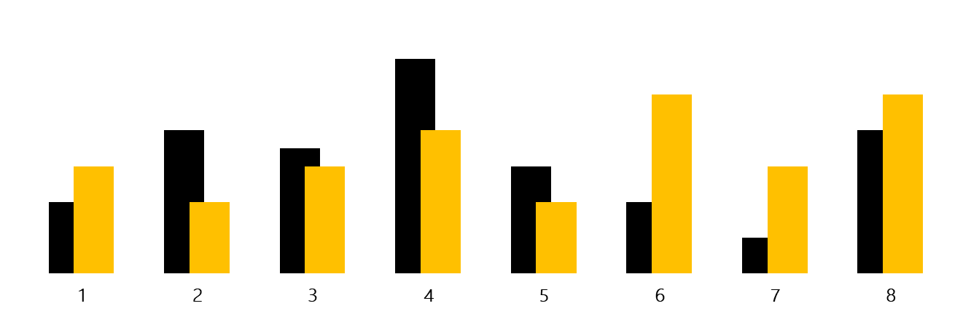
纯免费PPT即点即下载，无注册、无套路
http://gitppt.com
不信你试试（狗头）
Data chart
The word "design" needs a redesign. Designers need to be thinking not about the medium that they're serving but more about the process to get to something that is tangibly made to serve people's needs.
Notes:
【使用提示】八组柱形图的数据替班，直接右键编辑数据，打开excel图表后编辑数据就可。

Slide 17
纯免费PPT即点即下载，无注册、无套路
http://gitppt.com
不信你试试（狗头）
Data chart sample
The word "design" needs a redesign. Designers need to be thinking not about the medium that they're serving but more about the process to get to something that is tangibly made to serve people's needs.
The word "design" needs a redesign. Designers need to .
The word "design" needs a redesign. Designers need to .
76%
The word "design" needs a redesign. Designers need to .
The word "design" needs a redesign. Designers need to .
Text sample
The word "design" needs a redesign. Designers need to .
The word "design" needs a redesign. Designers need to .
Notes:
【使用提示】关键数据的辅助文字排版说明

Slide 18
纯免费PPT即点即下载，无注册、无套路
http://gitppt.com
不信你试试（狗头）
PART FOUR
Notes:
【使用提示】第四章节的过渡页展示，直接修改文字就可。

Slide 19

纯免费PPT即点即下载，无注册、无套路
http://gitppt.com
不信你试试（狗头）
Data chart sample
Text sample
The word “design” needs a redesign. Designers need to be thinking not about the medium that they‘re serving .
Text sample
The word “design” needs a redesign. Designers need to be thinking not about the medium that they‘re serving .
Text sample
Text sample
The word “design” needs a redesign. Designers need to be thinking not about the medium that they‘re serving .
The word "design" needs a redesign. Designers need to be thinking not about the medium that they're serving but more about the process to get to something that is tangibly made to serve people's needs.
Notes:
【使用提示】文本排版展示，修改文字就可

Slide 20
纯免费PPT即点即下载，无注册、无套路
http://gitppt.com
不信你试试（狗头）
Data chart sample
2015 Perfect Theme
The word "design" needs a redesign. Designers need to be thinking not about the medium that they're serving but more about the process to get to something that is tangibly made to serve people's needs.
$23983
$2983
2014 Perfect Theme
The word "design" needs a redesign. Designers need to be thinking not about the medium that they're serving but more about the process to get to something that is tangibly made to serve people's needs.
Notes:
【使用提示】两组图形展示，修改方法
如果要修改黄色部分的线条长短，直接选中黄线条后，在对角处鼠标前后拖动，如果黄色部分超出黑色底边，简单调整就可。

Slide 21
纯免费PPT即点即下载，无注册、无套路
http://gitppt.com
不信你试试（狗头）
Data chart sample
The word "design" needs a redesign. Designers need to be thinking not about the medium that they're serving but more about the process to get to something that is tangibly made to serve people's needs.
S
SWOT
The word "design" needs a redesign. Designers need to be thinking not about the medium that they're serving but more about the process to get to something that is tangibly made to serve people's needs.
W
The word "design" needs a redesign. Designers need to be thinking not about the medium that they're serving but more about the process to get to something that is tangibly made to serve people's needs.
O
The word "design" needs a redesign. Designers need to be thinking not about the medium that they're serving but more about the process to get to something that is tangibly made to serve people's needs.
T
Notes:
【使用提示】SWOT常用的分析工具使用排版

Slide 22

纯免费PPT即点即下载，无注册、无套路
http://gitppt.com
不信你试试（狗头）
Data chart sample
The word "design" needs a redesign. Designers need to be thinking not about the medium that they're serving but more about the process to get to something that is tangibly made to serve people's needs.
Text sample
The word "design" needs a redesign. Designers need to be thinking not about the medium that they're serving but more about the process to get to something that is tangibly made to serve people's needs.
The word "design" needs a redesign. Designers need to be thinking not about the medium that .
Notes:
【使用提示】图文排版展示，左边图片直接右键更改图片功能替换需要的图片，右边是图片的文字说明展示。

Slide 23
纯免费PPT即点即下载，无注册、无套路
http://gitppt.com
不信你试试（狗头）
Thank You
PPT Demo Home
Notes:
欢迎购买PPT演示之家工作室《纯正欧美风商务实用总结模板》。
备注有修改模板提示，让你轻松完成模板修改。
有需要，请在工作日9:00-18:00联系我们。客服QQ237485059
如果你要删除所有的备注文字说明，直接打开文件 —— 点击检查问题 —— 检查文档 —— 在弹出的对话框中点击检查 —— 在检查结束后演示文稿备注 —— 点击全部删除就可轻松完成。

