Slide 1

Starbucks Nutrition facts

Slide 2

‘One of the greatest love affairs of all time is between you and your coffee. There's not a day that goes by when you don't wake up and gaze lovingly at your favorite mug, or daydream about your run to get a cold brew. Your heart is full of butterflies when you imagine your go-to barista sliding your drink across the counter and into your welcoming hands. But it’s not just any coffee that you're in love with — it’s Starbucks’ full menu of tasty drinks that’s brought you here, looking for cute Starbucks captions that’ll espresso your true feelings.’
Elitedaily.com, by Marisa casciano
I can relate to these feeling so strongly as that is what Starbucks is to me. I’m so happy I live in a world where Starbucks exists.

Slide 3
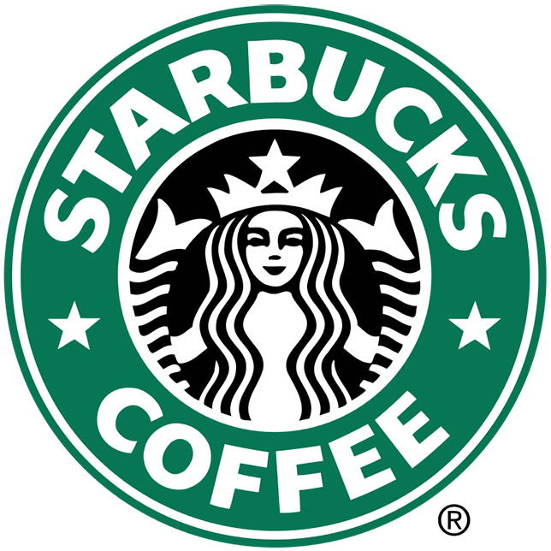
Starbucks originally opened in Seattle, Washington, on March 30, 1971. It was founded by business partners Jerry Baldwin, Zev Siegl and Gordon Bowker who first met as students at the University of San Francisco. It has become the world's largest coffeehouse chain.
Since 1971, Starbucks Coffee Company has been committed to ethically sourcing and roasting high quality arabica coffee in the world. Today, with stores around the globe, the company is the premier roaster and retailer of specialty coffee in the world. As of November 2021, the company had 33,833 stores in 80 countries.

Slide 4
“Starbucks believes that wellness is the journey to a happy, healthy life through daily choices, whether it’s a favorite beverage or a wholesome meal option.”
“To inspire and nurture the human spirit – one person, one cup, and one neighborhood at a time.” is their mission.
In 2013, Starbucks Coffee Company announced it will include calorie information on menu boards at all company-operated and licensed U.S. Starbucks stores. They stated,
“Menu labeling is yet another step to extend our commitment to wellness, ensuring our customers and partners (employees) have the information they need to make informed decisions and understand all the ways that they can customize their Starbucks® beverages to be within their desired calorie range,” said Mary Wagner, PhD and senior vice president, Global Research & Development at Starbucks.
Let’s find out nutrition facts in Starbucks drinks.

Slide 5
We will use ‘Starbucks - Nutrition Facts and Analysis’ dataset on Kaggle to analyze nutrition facts in Starbucks drinks.
The data shows ‘Espresso Drinks' are more popular.
https://www.kaggle.com/datasets/starbucks/starbucks-menu

Slide 6
White Chocolate Mocha shows most calories.

Slide 7
Further,
Heatmap shows sugar , cholesterol, Total carbohydrates have strong correlation with calories.
Where as Protein, trans fat, total fat shows medium correlation with calories.

Slide 8
Calories vs Sugars (g)

Slide 9
Calories vs Total Carbohydrates (g)

Slide 10
Calories vs Cholesterol (mg)

Slide 11

Let’s find which beverages have more sugar, Total carbohydrates and cholesterol.

Slide 12
Avg Sugar for Beverage: Java Chip Beverage shows highest Sugar.

Slide 13
Avg Cholesterol for Beverage: Java Chip Beverage shows highest Cholesterol

Slide 14
Avg Carbs for Beverage: Java Chip Beverage shows highest Carbohydrates.

Slide 15
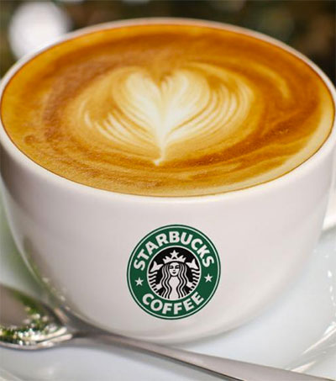
Conclusion:
The data shows that calories have strong correlation with sugar, cholesterol, Total carbohydrates.
Caffeine has the negative relationship with Calories.
Protein, trans fat, total fat shows more than 50% positive correlation with calories.
So, look for these figures next time when you buy a Starbucks Coffee!

