Slide 1
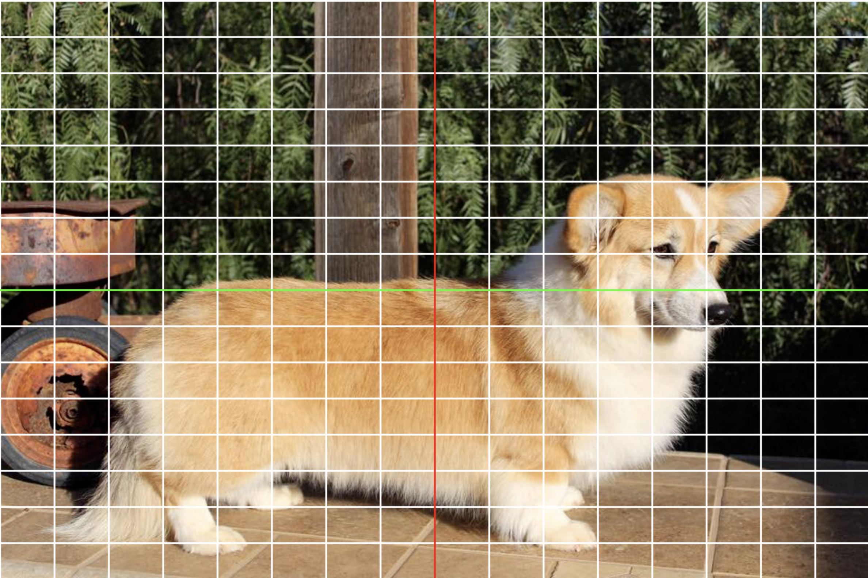
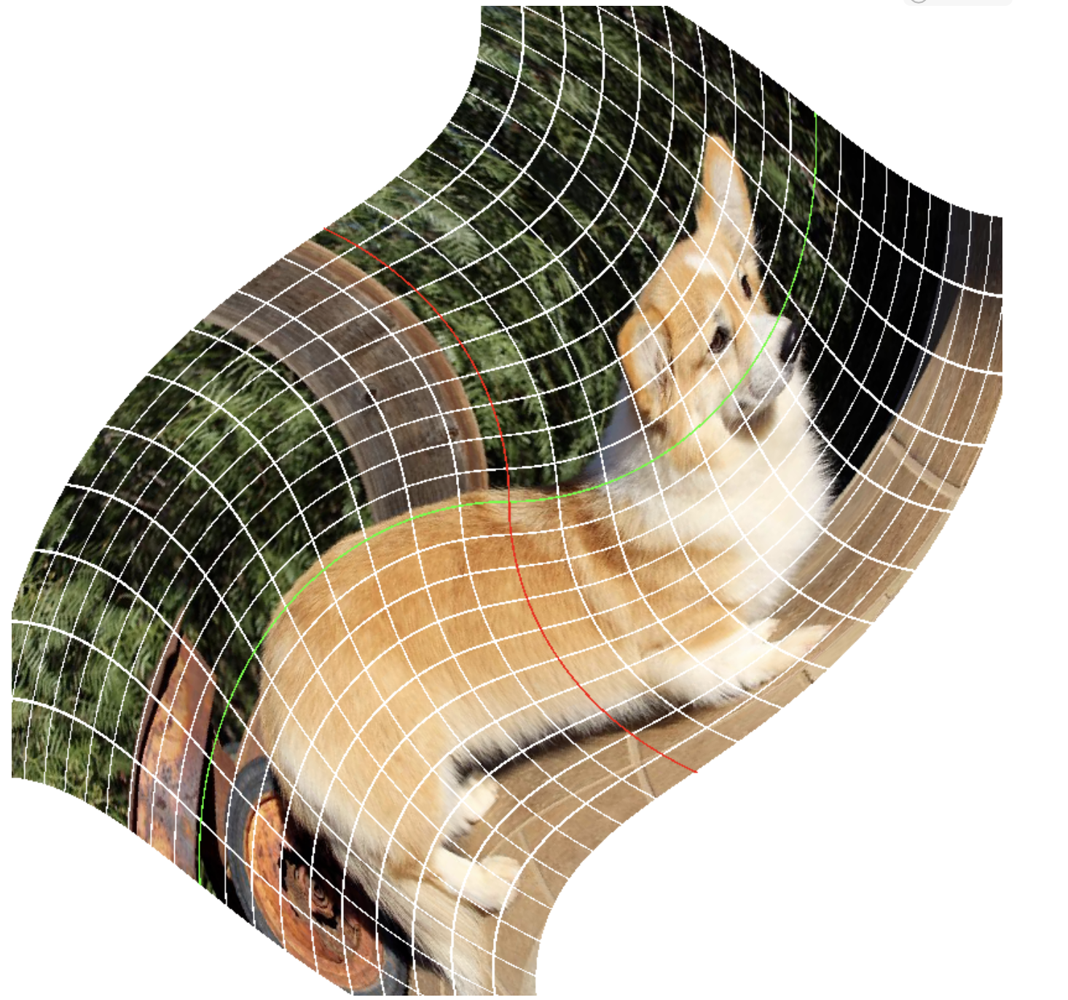
(1,1)
(1,cols)
(1,1)
(800,1)
(i,j)
(rows/2, cols/2)
(rows,1)
(cols,1)
(800,1)
(800,800)
transform_xy_to_ij
(-1,1)
(0, 1)
(1,1)
(-1,1)
(1,1)
T⁻¹
T⁻¹( ) =
(x,y)
(0,0)
We apply T⁻¹ to every
pixel to look up the color
(-1,-1)
(1,-1)
(-1,-1)
(0,-1)
(1,-1)

Slide 2
Transformations and their inverses
  Coordinate Transformations
  We’ve chosen to backwards to grab the pixel because we want to know where it comes from
    split output into pixels
  Commutative Diagrams
  Inverse of a Transformation
  Breakdown (as in failure) of an inverse
    collapsing shear
    singular matrices
  Solving systems
    Linear equations
    Solving Systems f(x) = y for nonlinear
  The Jacobian matrix = the local linear thing (as clear as possible)
    failure/breakdown = singular jacobian by the way

