Slide 1
House Price Index and Venue Based Location Selection
Capstone Project for Applied Data Science course by IBM/Coursera
Ravindranath Rao
February 2, 2020

Slide 2
Introduction: Business Problem
Retiree Needs:
Place similar to current living place
Based on individual preferences
Cost of living
Ease of moving out, if needed
House Price Index (HPI)
HPI can be used to evaluate whether place is worth moving in without incurring a huge financial loss. The project tries to cluster Richmond area neighborhoods with Northern Virginia neighborhoods, based on Venues. Then, show areas with HPI and Venue along with cluster information, for making a informed decision about where to move within Richmond.

Slide 3
DATA
NOVA_city_richmond_selected.csv
HPI_AT_BDL_ZIP5_2018_VA.csv

Slide 4
Methodology
Using nova_data, call FourSquare API to get Venue details for each Zip Code.
Once Venue data is obtained, do following steps:
1. Identify top 10 Venues for each Neighborhood.
2. Normalize the data,
3. Use K-Mean clustering to cluster the data
4. Show cluster on a folium map.
5. Create range for HPI

Slide 5
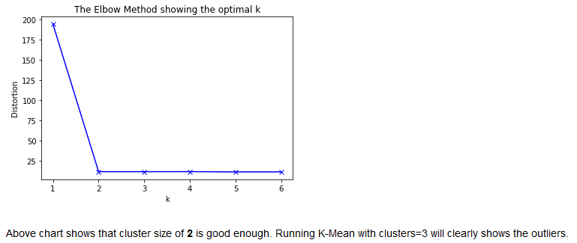
Result
Elbow Method:

Slide 6
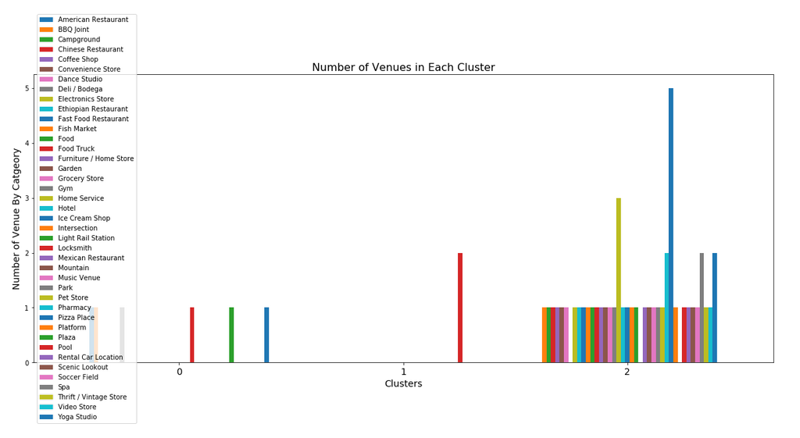
Result

Slide 7
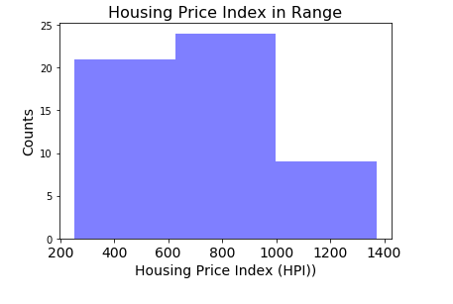
Result

Slide 8
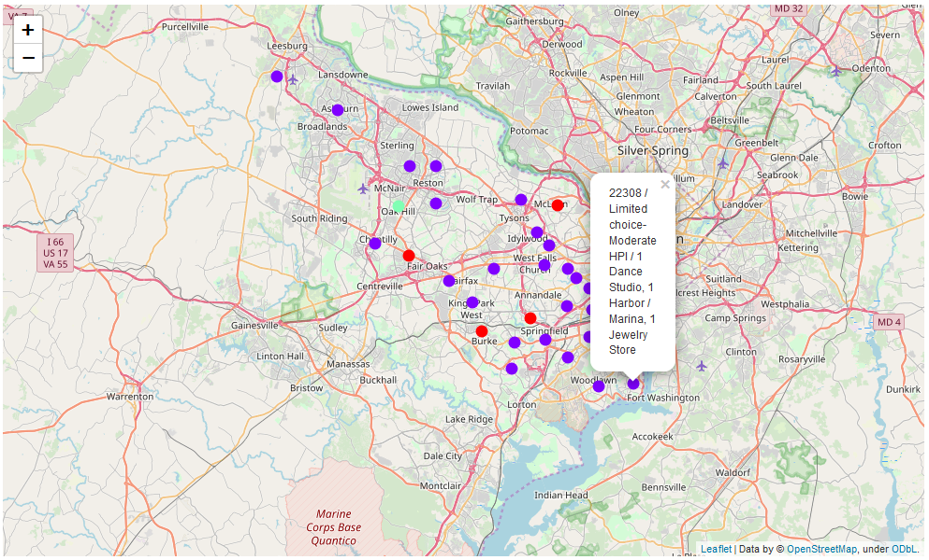
Result
Folium map with cluster and labels overlayed

Slide 9
Discussion
Similarity in neighborhood of Richmond and NoVA
Shows, it is easier for people in Northern Virginia to retire in Richmond as similar amenities are available in Richmond.
Many areas in Richmond have positive price change and higher HPI.
Additional attributes like house price, specific amenities like transit services, night life, golf courses etc.. can be considered, based on individual preferences.
The result clearly shows that clustering techniques can be easily and accurately used to identify the place to retire.

Slide 10
Conclusion
Moving to closer place which meets the needs is one option. For people in NoVA area, Richmond, VA ,seems to match the criteria mentioned.
The NoVA and Richmond area resemble each other. This is shown by the optimum cluster value being just 2. It also within 100 miles from NoVA. Retirees can get best of both places.
Methodology as a backend for web page
The criterion of retirement place selection varies from individual to individual.

Slide 11
Reference
1. Kiplinger Finance Magazine: https://www.kiplinger.com/slideshow/retirement/T006-S002-12-smart-places-to-retire/index.html
2. HPI Definition: https://www.investopedia.com/terms/h/house-price-index-hpi.asp
3. Virginia zipcode level geo spatial data: https://public.opendatasoft.com/explore/dataset/us-zip-code-latitude-and-longitude/table/
4. FHFA House Price Index: https://www.fhfa.gov/DataTools/Downloads/Pages/House-Price-Index-Datasets.aspx#qpo
5. NOVA Wiki: https://en.wikipedia.org/wiki/Northern_Virginia
6. Washington Metroploitan Area Wiki https://en.wikipedia.org/wiki/Washington_metropolitan_area
7. Forsquare API: https://developer.foursquare.com/docs

