Slide 1
Capstone Project
Neighbourhood Battle Dublin

Slide 2
Introduction: Business Problem
In recent years Migrations to Ireland are increased and most of the migrant are based at Dublin location. Due to increased housing prices in Dublin city area, people are preferring to locate little away from Dublin, but they find difficult to locate good restaurants or grocery store near their homes. In such scenario, restaurants like Asian, Chinese or Italian cuisine or even a grocery restaurant would be blessing for people and they won’t need to visit Dublin city centre always.

Slide 3
Data
Dublin has postal districts 1-24 or Greater Dublin with 4 major regions can be scrapped from below sites,
https://en.wikipedia.org/wiki/List_of_Irish_counties_by_population
https://en.wikipedia.org/wiki/County_Dublin
For the problem mentioned we would need data
Location data for Dublin postal districts and greater Dublin
Venues data around all Dublin postal districts and for Greater Dublin regions
Also population data for 4 major regions of Dublin

Slide 4
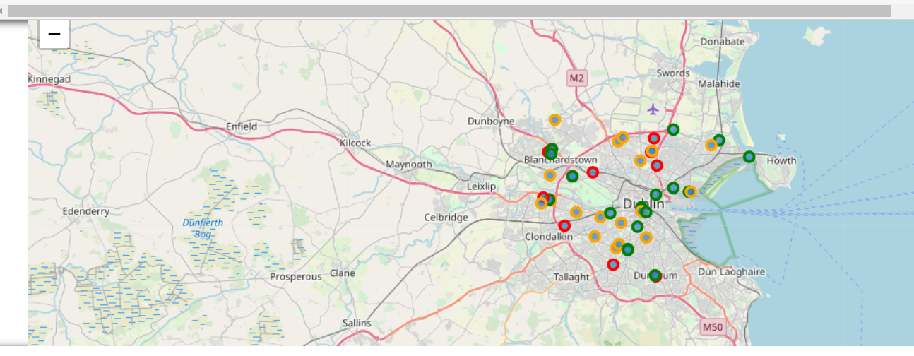
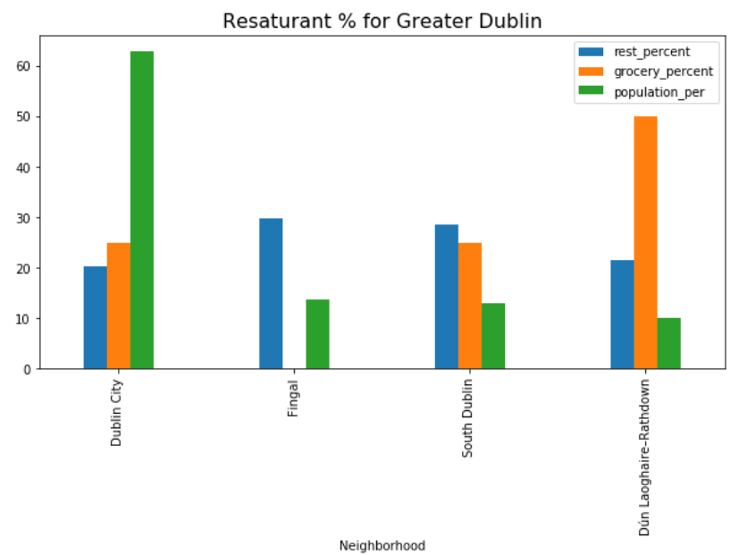

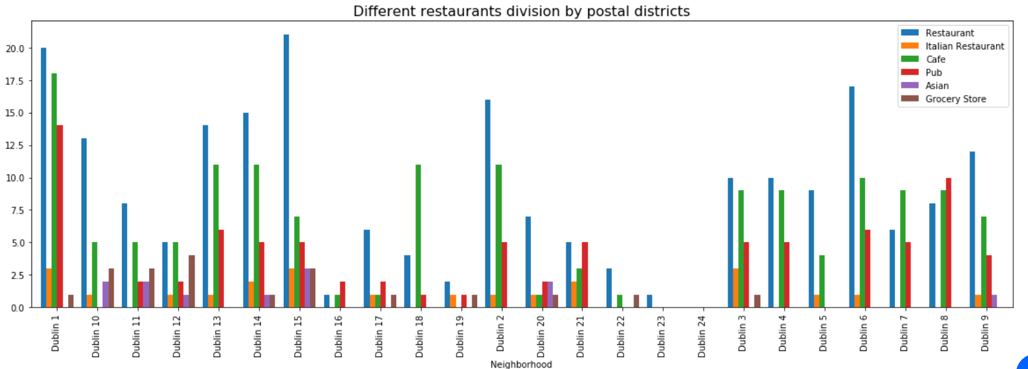
Results/Analysis
Fingal,Dublin4,8
Planning a food or food store business in Dublin?
Which area will be less competitive yet have good potential?

Slide 5
Analysis - Discussions
Overall Asian Restaurants have less/0 existence in Dublin City (Dublin 1, Dublin 2) , Fingal and Dun-Laghorie areas, region which has plenty of restaurants and cafe otherwise.
Assuming Asian migrated peoples are settling in Dublin 15, Dublin 2, Dublin 4 postal districts majorly, hence Dubin2 and Dublin4 can be a good potential area for Asian restaurant
Also map shows less Asian restaurants in overall Dublin, specifically in Dublin City.

Slide 6
Conclusion
Dublin City, Fingal and Dun-Laghorie would be potential regions to open a Asian Restaurant
Assuming increasing population in Dublin 4, Dublin 8 and Fingal region, Asian restaurants would have good potential in these areas of Dublin

