Slide 1
Version Control
Managing codebases since 1990

Slide 2
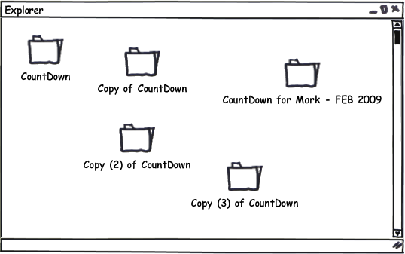
What’s Version Control?
Version Control (VCS) is software you can use to track changes to a project over time, consolidate changes between contributors, and backup your work.
If you don’t use a VCS, you could end up like this:

Slide 3
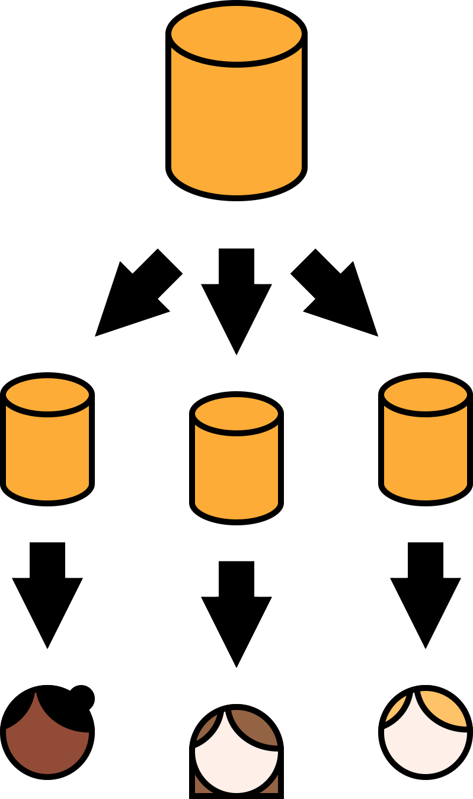
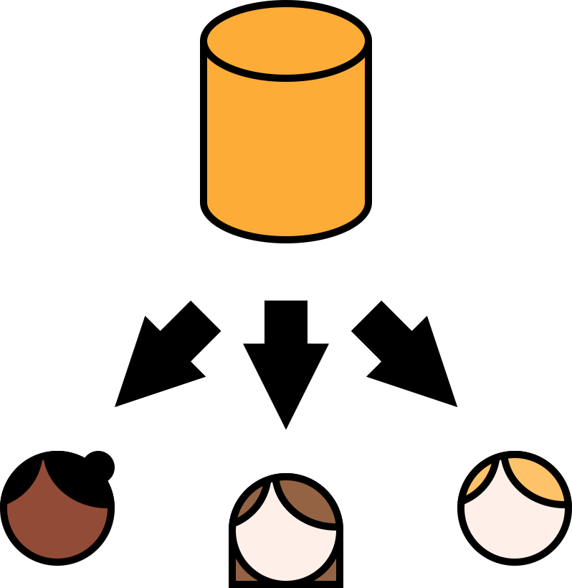
Types of Version Control
Centralized (CVCS)
Changes tracked against central remote repository
Cannot maintain local tree
Helpful for large projects
Distributed (DVCS)
Local tree synced to remote tree
Great for projects with many contributors, inconsistent network access, and a reliance on derivation

Slide 4
Types of Version Control
Examples of CVCS
Examples of DVCS
Subversion (SVN)
Team Foundation Server (TFS)
The original — CVS!
Git — The most popular system for hobbyists, small teams and open source projects
Mercurial — An alternative to Git
Perforce

Slide 5
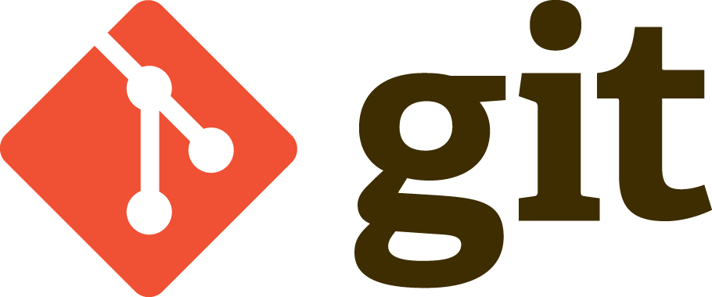
Developed in 2005 to replace the VCS for the Linux project
Popularity soared in 2008 after the release of GitHub, a social coding and remote source code host

Slide 6
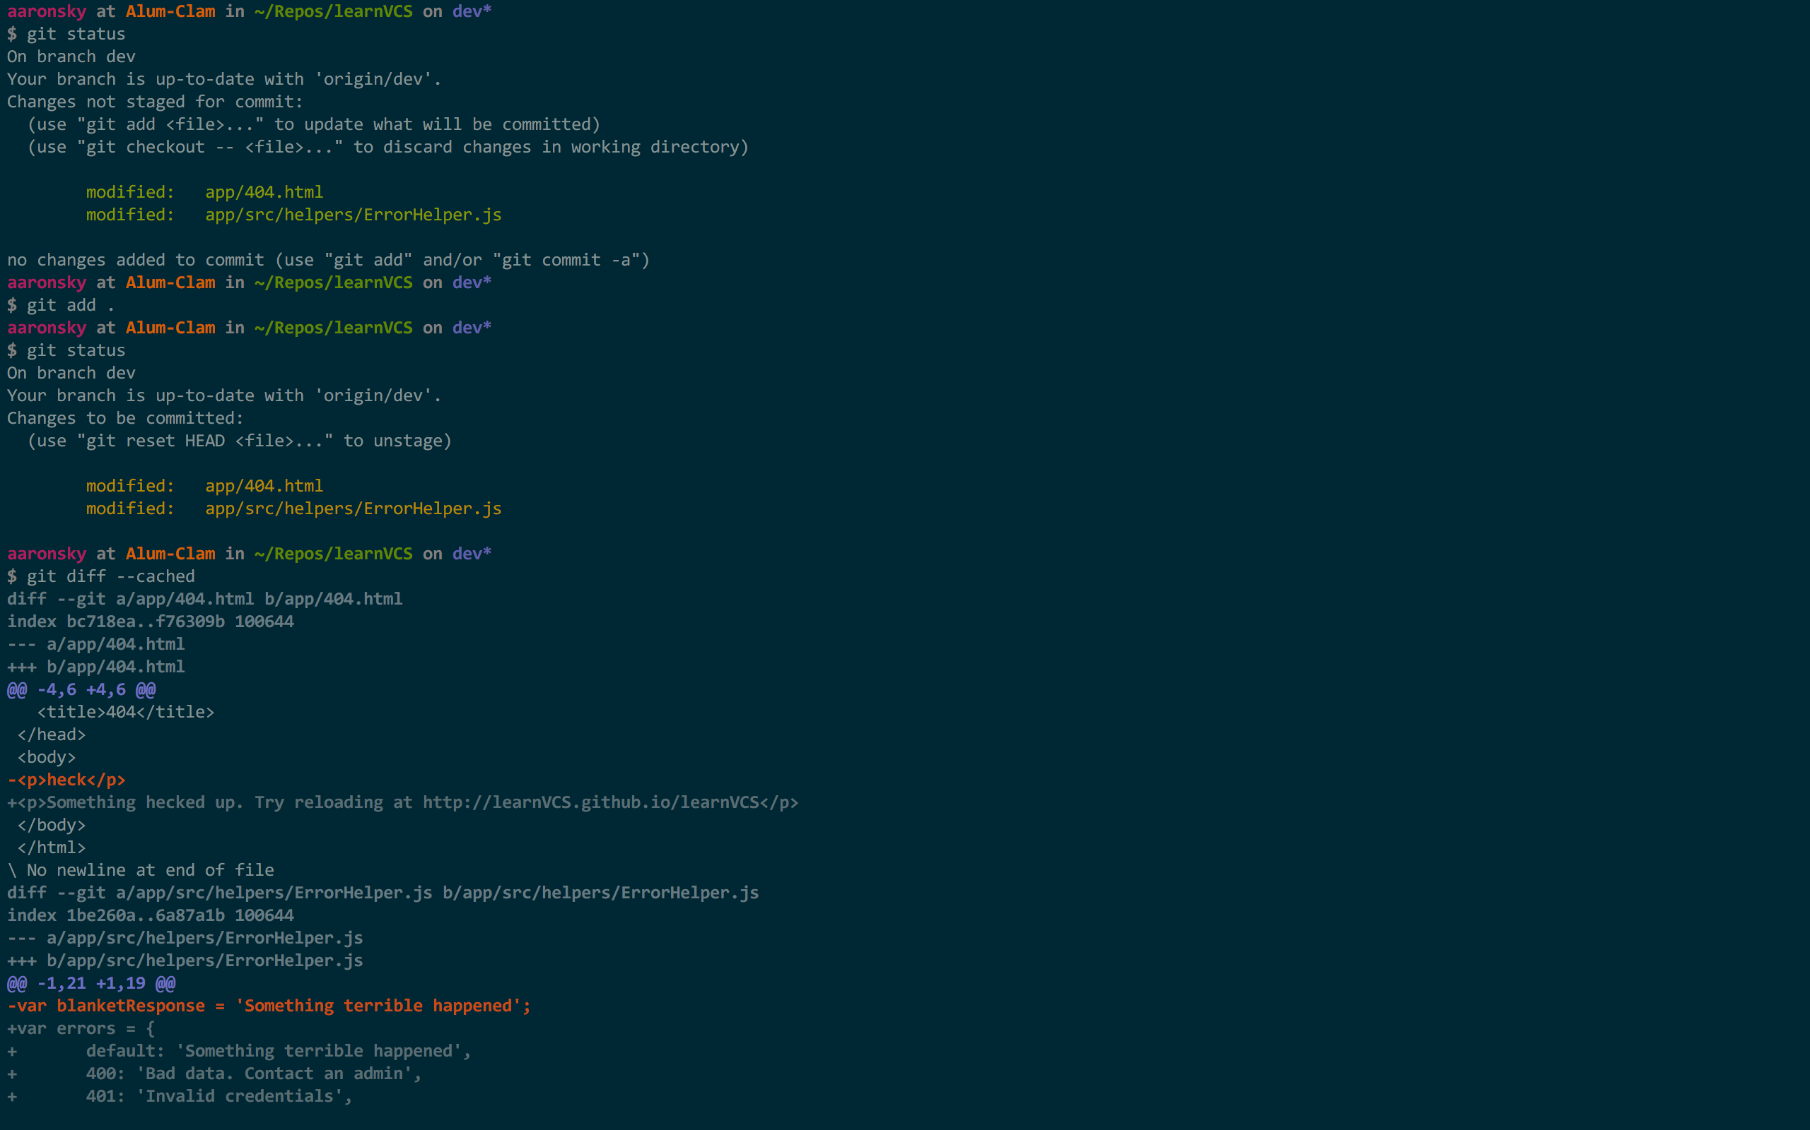
Git - CLI Workflow
(CLI - Command Line Interface)
Git was designed for the command prompt
Basic Commands
git status
git add .
git diff --cached
git commit -m “<message>”
git pull --rebase
git push

Slide 7
Git - CLI Workflow
(CLI - Command Line Interface)
`git status` — Displays the current status of the repo
`git add .` — Stages all changed and untracked files

Slide 8
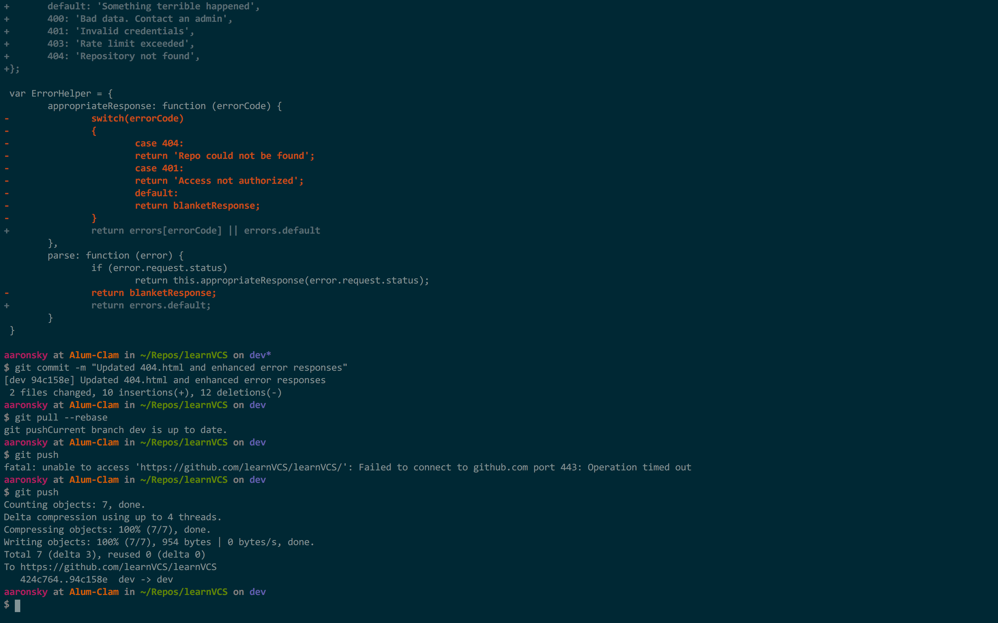
Git - CLI Workflow
(CLI - Command Line Interface)
git diff — Compares all changes to the current HEAD

Slide 9
Git - CLI Workflow
(CLI - Command Line Interface)
git commit -m “<message>”
Common Gotchas
Be as descriptive as possible in your commit messages. Once pushed, this history cannot be changed easily!

Slide 10
Git - CLI Workflow
(CLI - Command Line Interface)
git pull --rebase
git push
Common Gotchas
Always pull before you push!
Rebasing before merging can help reduce merge conflicts

Slide 11


Git - GUI Workflow
Supports Git and Mercurial
Integration with GitHub, Bitbucket and GitLab
Full support for everything you can do in the command line
https://www.sourcetreeapp.com/
Built in support for TFS and Git
Integration with GitHub and Visual Studio Online
Support for common commands

Slide 12


Remote code hosting service
Host your projects publicly for free and privately for a fee
Students get one free private repository
Designed for social coding, many features for collaboration

Slide 13
Instructors can use this to create groups of repositories for an assignment and monitor progress.
https://classroom.github.com/

Slide 14
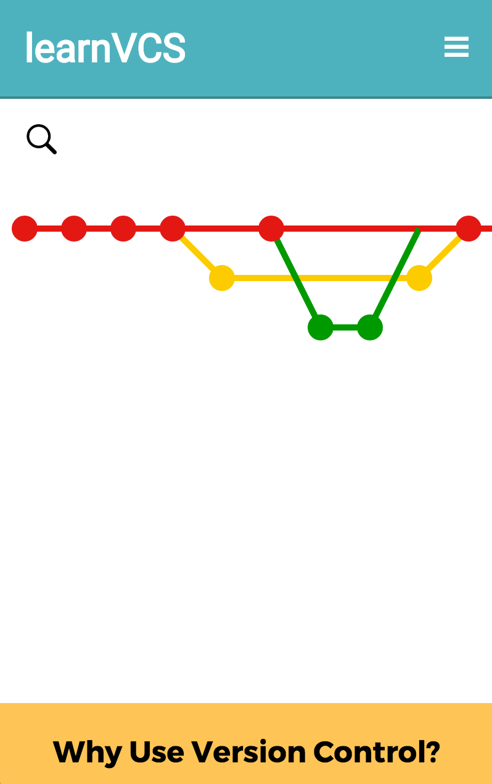
learnVCS
http://learnvcs.github.io/
Created to address gaps in version control education in the IGM curriculum
Interactive visualizations of projects hosted on GitHub
Links to some of the best resources for learning more about version control and how to use tools like Git, Subversion, and more

Slide 15



Slides by the learnVCS team
Aaron Sky
Stephanie Jurgiel
Ben Wilcox

