Slide 1
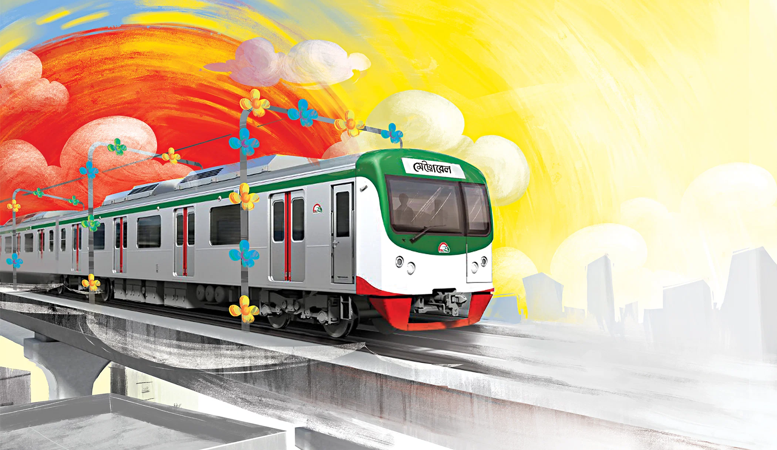
MetroMate
BY
Sajid Ahmed Rahi- 2201005
Suwaybid Ahmed Muaz- 2201020
Abir Kumar Shanto- 2201023

Slide 2

INTRODUCTION
The MetroMate is a simple application designed to make metro travel easier for users, Metro Rail is a mass rapid transit system serving in Dhaka. In light of the expanding Metro Rail system, there is a pressing need for an integrated solution that simplifies ticketing, route planning, and travel information dissemination for commuters.

Slide 3
FEATURES
a) User profile: User will have an user profile by which he/she can use or access to other features. The user login is controlled by appropriate conditions.
b) Effective route suggesting: System can offer user the shortest route based on users current station and destination station.
c) Ticket booking: Ticket can be booked in online, in advance also.
d) Fare calculation: Based on departure and destination station system can calculate and show the estimated price of the ticket.
e) Metro schedule details: Based on user’s location , system can show how much time it could take to come next train/station and how much time it could take to reach the destination.

Slide 4
LIMITATIONS
a) Live tracking won’t be available as tracking system will use saved data instead of GPS to calculate train’s location, there are possibilities that it could be near to accurate or even inaccurate in real life scenario.
b) Different payment systems won’t be so relative with real-life, just the functionality will be shown.

Slide 5
TOOLS AND TECHNOLOGY
Language: C++
Operating system: Windows
IDE: Visual Studio Code
USED DATA STRUCTURE AND ALGORITHMS
Data Structure:
Arrays: Arrays will be used to store the stations names.
Graph and Map Data Structure: To represent the network of Metro rail, Graph will be used.
Queues: Priority Ques will be used in Dijkstra’s algorithm.
Algorithms:
Dijkstra's Algorithm: Utilize Dijkstra's algorithm to find the shortest path between two stations in the metro network. This algorithm efficiently calculates the shortest distance between nodes in a graph, making it suitable for route planning in metro systems

Slide 6
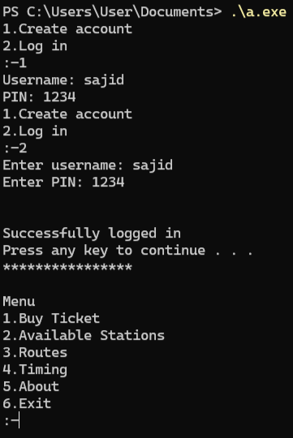
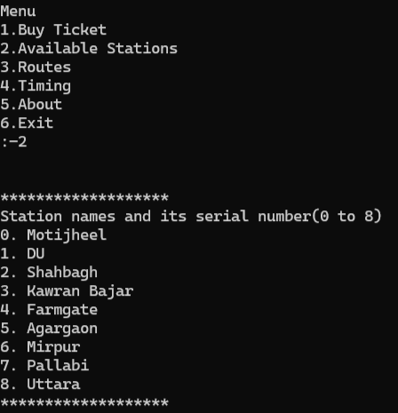
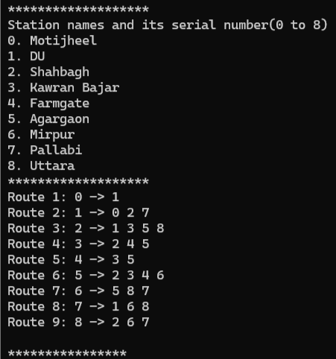
FUNCTIONALITIES

Slide 7
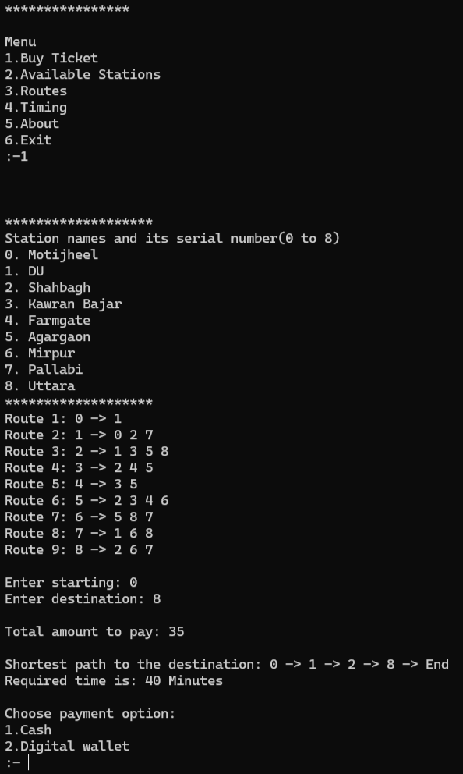
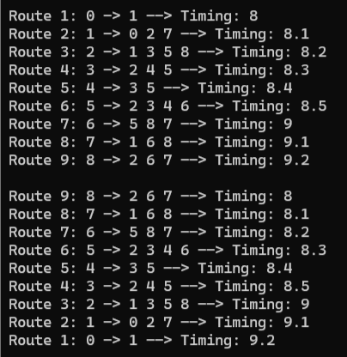

Slide 8
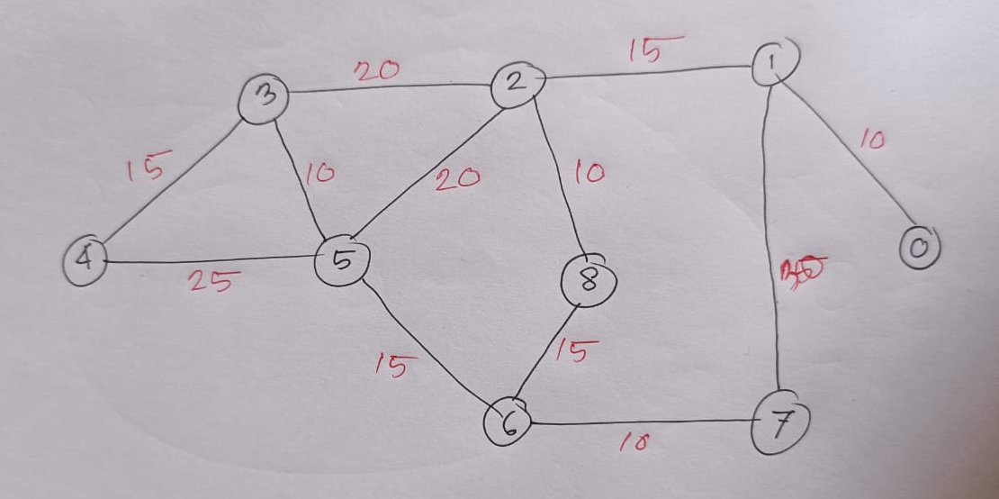
Graph

Slide 9
CONCLUSION
This project is intended to simplify metro travel for commuters by providing a convenient and sustainable but user friendly system for buying ticket and route planning. It will help us to apply knowledge of data structures and algorithms to real world scenario, develop practical problem-solving skills, enhance coding proficiency and algorithmic thinking.

