Slide 1
Label Automator
Exploration of 3 different approaches (scripting, coding, and AI prompting

Slide 2

The Problem to Solve
Easy to forget specific data required by complex labelling regulations.
Errors and slowness of manually importing data.

Slide 3
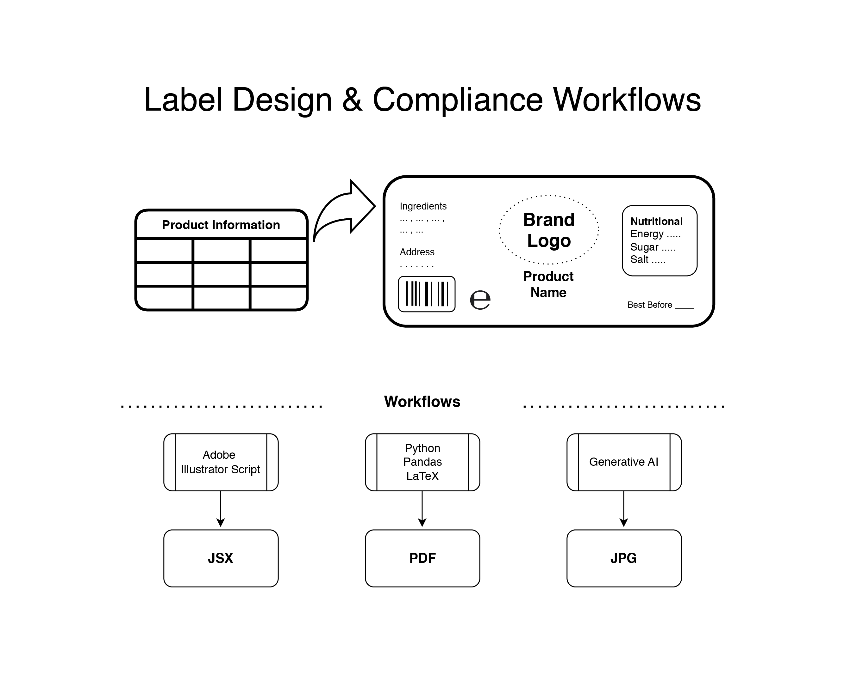

Slide 4
1. Adobe Illustrator Script
Script to import product data into the working document

Slide 5

How it works
From the spreadsheet we manually export the product information to CSV
From Adobe Illustrator then execute a JavaScript file to import coma separated values.
Uses Adobe’s specific functions to insert and format the information.

Slide 6
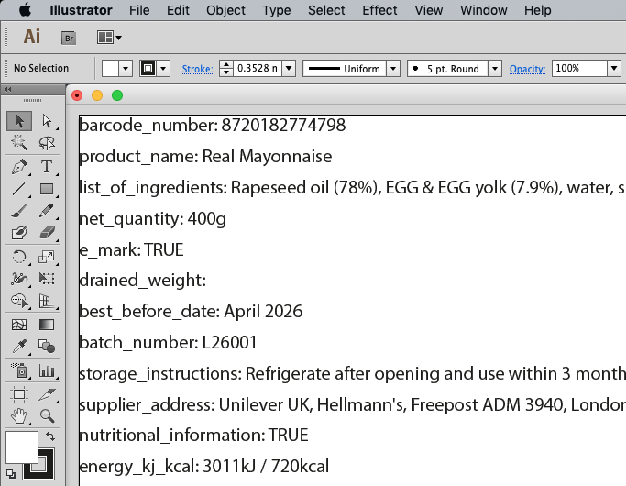
Result

Slide 7

What is it good for?
Time saving; one click import
Avoids copy-paste mistakes
Adapts to table changes

Slide 8


Limitations
Basic functionality
Adobe only

Slide 9
2. Coding
Python code to create the final label in PDF

Slide 10
How it works
Template crafted in LaTeX typesetting.
Uses Python Pandas library to read a CSV file.
Populates a LaTeX (La-Tek) template with the read fields.
Generates a PDF from the template using pdflatex.
Saves label (TeX and PDF) to respective folder.

Slide 11
Result

Slide 12
What is it good for?
Generating many similar labels
No need for Adobe software
LaTeX package supports typesetting in multiple languages

Slide 13




Limitations
Complex to craft a typesetting template
Design adjustments still needed

Slide 14

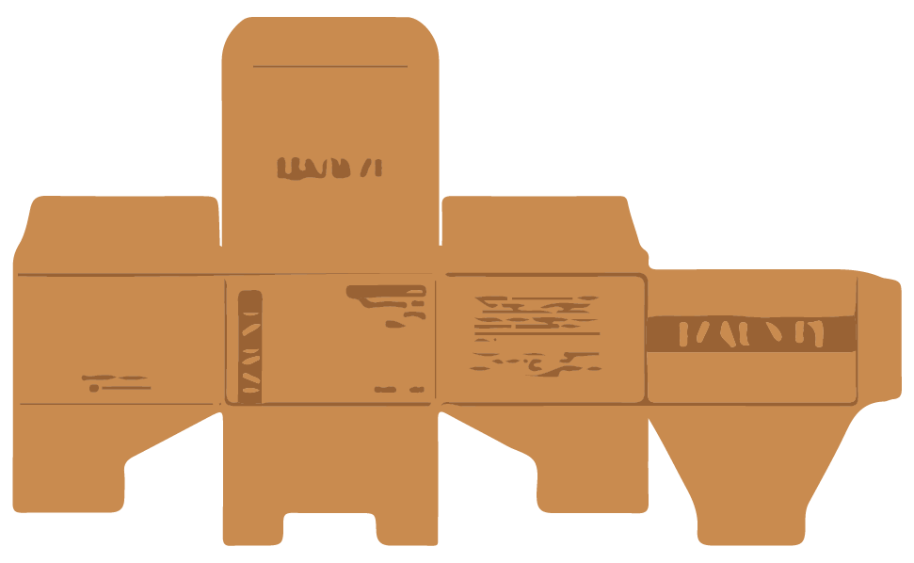
Other Applications
Outer Case Design
White Label
Replace brand logo, business address and barcode

Slide 15
3. AI Prompting
Prompt AI to generate a label

Slide 16



How it works
Upload a Coma Separated Value file into AI chat
Prompt “check for compliance with labelling regulations”
AI

Slide 17
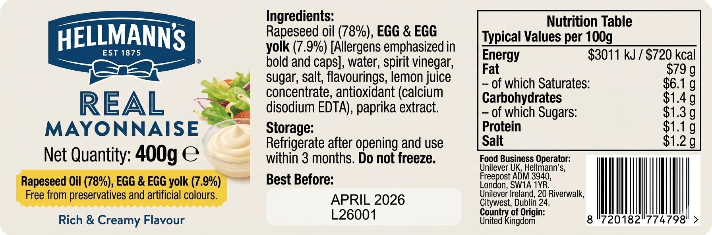
Result (Gemini AI)

Slide 18
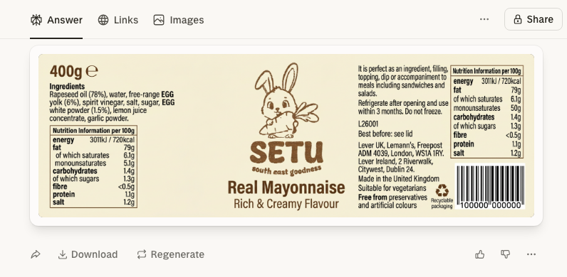
Result (Perplexity AI)

Slide 19
What is it good for?
Compliance check in text mode.
Design brainstorming.
Label preview.

Slide 20




Limitations
Still needs to be reviewed by a human.
Intellectual property
infringement.
Generative AI hallucinations.

Slide 21

Questions?

Slide 22
Thank you

