Slide 1



Deepfake-News Shield: Detecting False Articles and Manipulated Photos
Jaypee University of Information Technology
Department of Computer Science and Engineering and Information Technology
Major Project - I (18B19CI791) | AY 2025-26
Mid-Term Evaluation | Sept 29 – Oct 03, 2025.
Group No.: 17
Team Member (s)
Madhav (221030283)
Soha Khan (221031049)
Harshit Thakur (221031013)
Divyam Saini (221030070)
Supervisor
Name: Dr. Deepak Gupta
Designation: Assistant Professor (SG)

Slide 2
Outline
Introduction
Problem Statement
Objectives
Literature Review
Project Design
Tools, Technologies and Languages
Dataset
Implementation (if any)
Results (if any)
Key Learnings
Work Plan till End-Term Evaluation
Project Plan
Work Contribution and Attendance
Supervisor Interactions
References

Slide 3
Introduction
Modern misinformation is one of the biggest threats in today’s digital world. False content spreads rapidly across social media and online platforms. It shapes public opinion, creates confusion, and can cause serious harm.
Existing tools are limited, as they usually detect only text-based misinformation or only image-based deepfakes and hence they leave significant gaps.
Our solution: Multi-modal detection system for both text and images.
Text analysis: Uses ML and NLP to check article authenticity.
Image analysis: Uses Vision Transformers (ViT) to detect deepfakes.
Deployed as a web app to provide a transparent, user-friendly, and an effective tool to help people recognize and combat misinformation in daily life.
Notes:
This project tackles the growing problem of misinformation by building an AI-powered system to detect both fake news and deepfakes. It uses a combination of machine learning and deep learning techniques, including natural language processing (NLP) for text analysis and computer vision for spotting manipulated media. The system analyzes various factors like linguistic cues, facial landmarks, and contextual information to determine the authenticity of content. By integrating these methods, the project aims to provide a robust tool for identifying and combating the spread of false information online. This automated solution is designed to enhance media literacy and help users critically evaluate the credibility of digital content.
This project focuses on combating misinformation through a 2-pronged approach: fake news and deepfake video detection. It uses machine learning and deep learning techniques to analyze both text-based news articles and video content to identify manipulated or fabricated information. The system is designed with a frontend and a backend. This allows users to input news articles or videos, which are then analyzed to determine their authenticity, helping to minimize the spread of false information.

Slide 4
Problem Statement
The rapid spread of misinformation, containing both fake news articles and deepfake images, presents a significant social threat. Current detection tools are inadequate as they typically focus on either text or images in isolation, failing to address multi-modal content where fabricated text and visuals are combined to create a more convincing false narrative. This leaves a critical gap as there is no such unified, real-world system that can simultaneously both images and text. The core problem is the absence of an integrated, multi-modal platform that can effectively identify and flag complex misinformation, thereby leaving society vulnerable to its harmful influence.
Notes:
High sophistication of fakes: Modern deepfake and fake news generation techniques are highly sophisticated, making it difficult for humans to distinguish between real and fake content.
Multimodal detection challenges: The problem is complex as it requires analyzing and identifying inconsistencies across multiple modalities, including text, images, and videos.
The lack of accessible tools for the average user to verify the authenticity of online content.
Keeping pace with evolving technology.

Slide 5
Objectives
To design and develop a machine learning framework for misinformation detection by combining Natural Language Processing (NLP) for fake news detection and Deep Learning models (Vision Transformer) for deepfake image analysis.
To provide real-time claim verification by integrating the Google FastCheck API and validating news content against trusted fact-checking sources.
To collect, preprocess, and integrates multi-model datasets (textual news articles, claims, and images) to create a unified system capable of handling both text-based and image-based misinformation.
To make all components that are available in interactive web applications using Streamlit and Flask.
Notes:
To design and develop a machine learning framework for misinformation detection by combining Natural Language Processing (NLP) for fake news detection and Deep Learning models (Vision Transformer) for deepfake image analysis.
To provide real-time claim verification by integrating the Google FastCheck API and validating news content against trusted fact-checking sources.
To collect, preprocess, and integrates multi-model datasets (textual news articles, claims, and images) to create a unified system capable of handling both text-based and image-based misinformation.
To make all components that are available in interactive web applications using Streamlit and Flask.

Slide 6
Literature Review
S. No | Author & Paper Title [Citation] | Journal/ Conference (Year) | Tools/ Techniques/ Dataset | Key Findings/ Results | Limitations/ Gaps Identified
1. | Shivam B. Kaliya et al. – “A Comprehensive Survey on Fake News Detection Using ML”[1] | Information Processing & Management, 2021. | Survey of ML/DL, NLP features, LIAR, FakeNewsNet, BuzzFeed. | Summarized approaches & trends; gaps in dataset quality & generalization. | Only survey-based, no implementation; lacks explainability.
2. | Andreas Rössler, et al. — “FaceForensics++: Learning to Detect Manipulated Facial Images” [2] | IEEE/CVF International Conference on Computer Vision (ICCV), 2019 | FaceForensics++ (1.8M imgs), CNN (XceptionNet). | Large-scale dataset; CNN > humans in accuracy. | Limited to facial manipulation; performance drops under compression; resource-heavy.
3. | Mansi Kaur et al. — “Multimodal Fake News Detection: A Survey of Text and Visual Content Integration Methods” [3] | Information Systems Frontiers, 2022. | Review of text+image DL; Weibo, Twitter datasets. | Emphasized that multimodal fusion improves detection accuracy over text-only models. | No new dataset proposed; models are computationally costly; weak generalization across datasets.
4. | Preeti Sharma et al.— “A Robust Ensemble Model for Deepfake Detection of GAN-Generated Images on Social Media” [4] | Discover Computing, 2025. | VOTSTACK (DT, LR, SVM + PCA + RFECV); Real&Fake, DFDC, FF++, Celeb-DF. | ~91.6% accuracy; strong precision/recall; robust across datasets. | High computational cost; scalability for real-time applications remains limited.

Slide 7
Literature Review (cont…)
S. No. | Author & Paper Title [Citation] | Journal/ Conference (Year) | Tools/ Techniques/ Dataset | Key Findings/ Results | Limitations/ Gaps Identified
5. | Qian Jiang et al.— “Robust Manipulated Media Localization and Detection Based on High Frequency and Texture Features” [5] | Discover Computing, 2025. | RMLD-HFTF, MMS, AGAM, Encoder-Decoder; tested on FF++, Celeb-DF, DFDC. | Detected and localized tampered regions; improved cross-dataset robustness by 1–10% over prior work. | Model complexity is high; requires large resources; subtle manipulations may be missed.
6. | B. Ghita et al. — “Deepfake Image Detection using Vision Transformer Models” [6] | IEEE/academic publication, 2023–2024. | ViT, Kaggle dataset, Colab L4 GPU. | 89.91% accuracy; slight bias toward fake detection; needs large datasets. | Limited by compute power; only 40K/190K images used; overfits on small data .
7. | N. N. Prachi et al. —“Detection of Fake News Using Machine Learning and Natural Language Processing Algorithms” [7] | Journal of Advances in Information Technology, vol. 13, no. 6, Dec. 2022. | Kaggle dataset; Regex, TF-IDF, BoW, LR, Naïve Bayes, SVM, LSTM, BERT. | BERT best (98%); preprocessing boosted accuracy; robust context capture. | No multilingual/multimodal; only binary classification; BERT requires heavy computation.
8. | Karthikeyan A. et al. — “Enhancing Deepfake Detection: A Multimodal Approach for Improved Accuracy” [8] | TIJER – International Research Journal, vol. 11, no. 7, July 2024. | Steganalysis network, ResNet, CNN, LSTM, PyTorch; custom video dataset. | Detected deepfake traces (blur, artifacts); CNN+LSTM gave high accuracy with small dataset. | Complex system, requires large datasets, high computational cost. Limited dataset size may lead to overfitting and reduced generalization to large-scale or diverse deepfake videos.

Slide 8
Literature Review (cont…)
S. No. | Author & Paper Title [Citation] | Journal/ Conference (Year) | Tools/ Techniques/ Dataset | Key Findings/ Results | Limitations/ Gaps Identified
9. | C.-M. Rosca et al. — “The New Paradigm of Deepfake Detection at the Text Level” [9] | Appl. Sci., vol. 15, art. 2560, Feb. 27, 2025. | Custom anomaly models (LightGBM, FastTree), 1300 samples (AI vs. human). | 98% accuracy in AI-text & author anomaly detection. | Small dataset; limited topics/languages; may weaken as LLMs evolve.
10. | A. Heidari et al. — “Deepfake detection using deep learning methods: A systematic and comprehensive review” [10] | WIREs Data Mining and Knowledge Discovery, vol. 14, no. 2, Feb. 2024. | CNN (features), LSTM (temporal seq.); FaceForensics++ & custom video dataset. | CNN-LSTM achieves higher accuracy by combining spatial & temporal artifacts. | Limited dataset diversity; performance may drop on unseen or highly sophisticated deepfakes.
11. | N. Shakya and P. Poudyal — "Detection of Fake News Using Deep Neural Networks" [11] | Kathmandu Univ. J. Sci. Eng. Tech., vol. 16, no. 2, 2022. | LSTM, BERT, Hybrid (BERT+LSTM+Attention); SBFN dataset (2010 records). | BERT (content-only: F1=89.5%); Hybrid best with content+source (F1=99.3%). | Only 2,010 entries; text-only (no images/videos); limited scope.
12. | R. Tolosana et al. — "DeepFakes and Beyond: A Survey of Face Manipulation and Fake Detection“ [12] | Information Fusion (Elsevier), 2020. | Review of face manipulation & datasets (FaceForensics++, DeepFakeTIMIT) | Taxonomy of deepfake types (identity swap, expression swap, attribute manipulation) and summary of detection approaches. | Focused on face-based deepfakes; older datasets not matching current quality.

Slide 9
Literature Review (cont…)
S. No. | Author & Paper Title [Citation] | Journal/ Conference (Year) | Tools/ Techniques/ Dataset | Key Findings/ Results | Limitations/ Gaps Identified
13. | Z. He, et al. — "GazeForensics: DeepFake Detection via Gaze-guided Spatial Inconsistency Learning“ [13] | arXiv preprint, 2023. | CNN-based gaze estimation; FaceForensics++, DFDC. | Eye-gaze cues outperform baseline CNNs. | Struggles on low-quality/compressed videos; dataset-specific.
14. | B. Dolhansky et al. — "The DeepFake Detection Challenge (DFDC) Dataset“ [14] | arXiv preprint arXiv:2006.07397, 2020. | Large-scale dataset (Deepfake, GAN, non-learned); model benchmarks. | Largest public dataset for training & benchmarking detectors. | Models show poor generalization; high pub. data accuracy but weak on unseen “black-box”.
15. | B. B. Gupta et al. — "Deep Fake: An Overview“ [15] | Smart and Innovative Trends in Engineering and Technology (SITET-2020), 2021. | Elliptic Curve Cryptography (ECC), DNA-based encryption for secure IoT communication. | Protocol improves IoT security against replay & impersonation attacks. | Poor generalization to new deepfakes; limited datasets (esp. audio/multimodal); weak robustness.
16. | Mika Westerlund — “The Emergence of Deepfake Technology: A Review” [16] | Technology Innovation Management Review (2019). | Literature review of 84 online news articles. | Deepfakes pose a significant threat to society, business & politics. They can be combatted via legislation and detection technology. | The author notes that at the time of publication, scholarly research on the topic was sparse.

Slide 10
Literature Review (cont…)
S. No. | Author & Paper Title [Citation] | Journal/ Conference (Year) | Tools/ Techniques/ Dataset | Key Findings/ Results | Limitations/ Gaps Identified
17. | Shivangi Singhal et al.— SpotFake: “A Multi-modal Framework for Fake News Detection” [17] | IEEE BigMM (2019). | SpotFake: BERT (text) + VGG-19 (images), Twitter dataset. | The model outperforms the state-of-the-art by 3.27% on Twitter. It effectively detects fake news without relying on additional sub-tasks. | Paper highlights that other multi-modal are heavily dependent on sub-tasks, and their performance degrades significantly in their absence.
18. | Ruben Tolosana et al. — “DeepFakes and Beyond: A Survey of Face Manipulation and Fake Detection” [18] | arXiv (2020). | Autoencoders, GANs; datasets: DeepfakeTIMIT, UADFV, FF++, Celeb-DF. | Reviews 4 manipulation types: synthesis, identity swap, attribute, expression swap. | Research still early; lacks public datasets for expression swap.
19. | Fazeela Siddiqui et al.— “Enhanced deepfake detection with DenseNet and Cross-ViT” [19] | Expert Systems With Applications (2025). | DenseNet + CrossViT on DeepForensics 1.0. | The model achieved high performance with a 99.99% AUC on DeepForensics 1.0. | The primary challenge identified is the increasing difficulty of detecting highly realistic facial forgeries.
20. | Rupak Kumar Das — “Fake News Detection After LLM Laundering: Measurement and Explanation” [20] | arXiv (2025) arXiv (2025). | BERTSCORE for semantic similarity; new dataset of paraphrased fakes. | Detectors fail on LLM-paraphrased fakes due to “sentiment shift”. | The paper emphasizes that the field of detecting LLM-generated fake news is still under-explored.

Slide 11
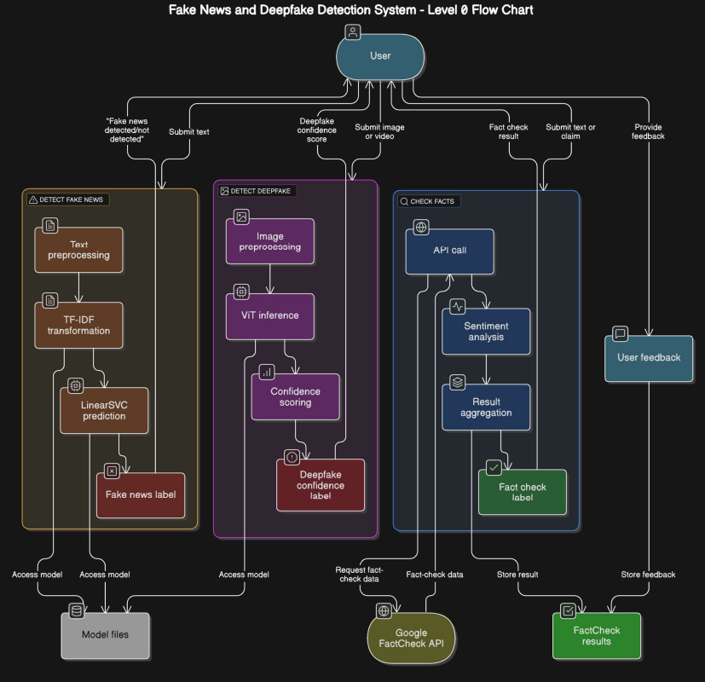
Project Design
Overview
Multi-modal inputs: Supports both text (news articles, claims) and images (deepfakes).
Data integration layer: Centralized processing of text + image data for unified detection.
Key Technologies: NLP (TF-IDF, Transformers), Computer Vision (ViT), Flask & Streamlit.
Design Decision: Unified framework instead of separate systems for text and images, ensuring scalability and consistency.

Slide 12
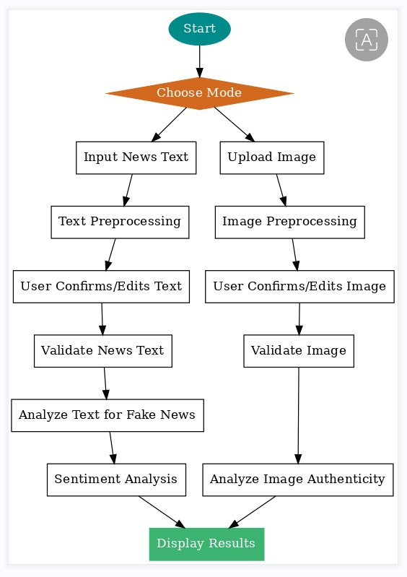
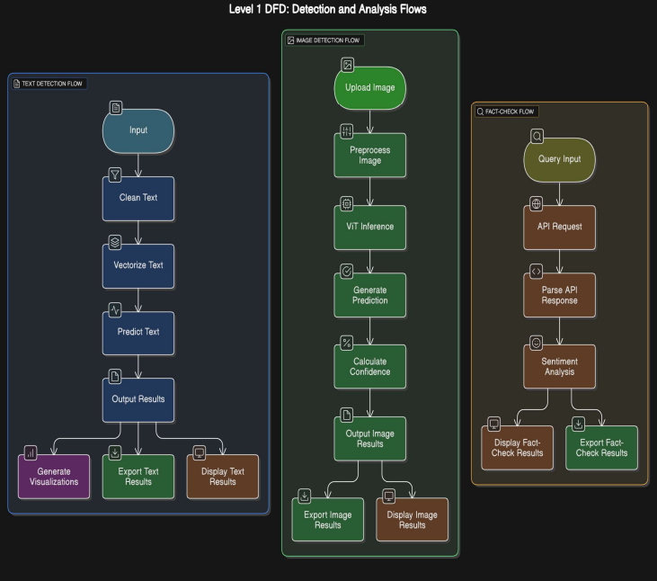
Project Design (cont…)

Slide 13
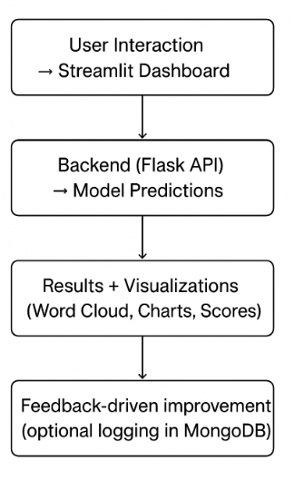
Project Design (cont…)
User Interaction & Deployment
Frontend: Streamlit dashboards for text input, image upload, and visualization.
Backend: Flask APIs serving ML/DL models for real-time predictions.
Visualization: Word clouds, sentiment charts, confidence scores.
Design Decision: Web-based design for accessibility, real-time feedback, and easy deployment.

Slide 14
Tools, Technologies and Languages
Category | Technology | Purpose & Version Information
Programming Languages | Python | Primary language for backend logic, model training, and API handling.
 | HTML, CSS, JavaScript | Used for building the web interface for the deepfake detector.
Backend Frameworks | FastAPI | FastAPI is mentioned for modern, fast API development, while Flask is used specifically for deploying the deepfake classifier API.
Frontend & UI | React.js | Used for creating a fast and interactive user interface.
 | Tailwind CSS | A utility-first CSS framework for styling the web application.
 | Streamlit | Employed to build the interactive dashboards for the fake news and fact-checking components.
Database | MongoDB | Mentioned as the database for the full-stack web application.

Slide 15
Tools, Technologies and Languages (cont…)
Category | Technology / Model | Purpose & Version Information
AI/ML Models | Vision Transformer (ViT) | The core deep learning model used to detect facial manipulations in images and classify them as real or deepfake.
 | LinearSVC (SVM) | The machine learning classifier used with TF-IDF features to detect fake news in text, achieving high accuracy.
 | CNN | Mentioned as established models for fake news and deepfake detection that informed the project's approach.
NLP & Data Libraries | TF-IDF Vectorizer | Used to convert text from news articles into numerical features for the SVM model.
 | VADER / TextBlob | Sentiment analysis tools used to analyze text for emotional manipulation and bias.
External Services | Google Fact-Check API | Integrated to provide real-time claim verification against a database of trusted sources, enhancing the system's reliability

Slide 16
Dataset
1. Fake News Dataset 2. Deepfake Image Dataset
Source: Kaggle – “Fake and Real News Dataset” Source: Kaggle – “Deepfake Detection Challenge Dataset”
Size: ~40,000 news articles Size: ~50,000 labeled images (real vs fake faces)
ATTRIBUTE | DESCRIPTION | EXAMPLE
title | Headline of the news article. | “Donald Trump Sentenced to Prison”
text | Full content of the article | Complete news body text
subject | News category or genre. | “politics”, “technology”
date | Publication date of the article. | “January 10, 2020”
category/label | Binary ground truth for authenticity: 1 = Fake, 0 = Real. | 1 (Fake), 0 (Real)
ATTRIBUTE | DESCRIPTION | EXAMPLE
image_id | Unique identifier for each image. | “img_000245”
image_file | File path or name of the stored image. | “/images/img_000245.jpg”
resolution | Standard image size for model input. | 224 × 224 pixels (Vision Transformer input standard)
channels | Color channel information. | RGB (3 channels)
label | Ground truth for authenticity of image. | “real” or “fake”

Slide 17
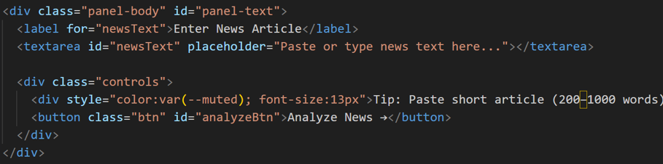
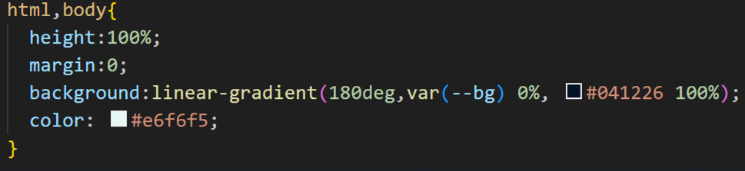
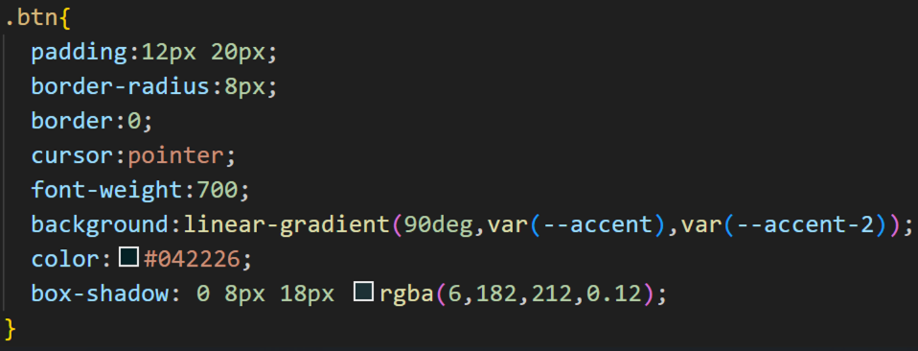
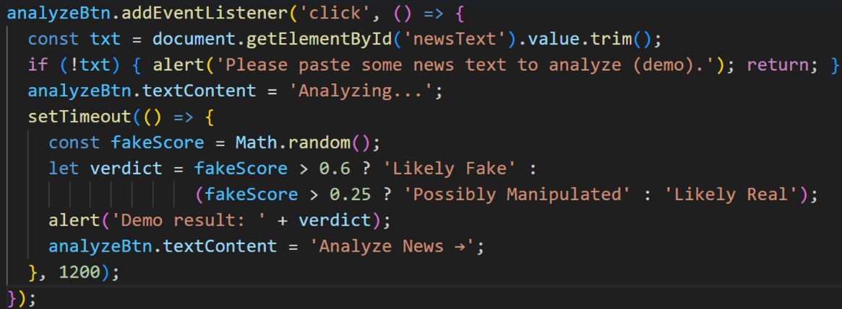
Implementation (if any)
HTML
CSS
JS

Slide 18
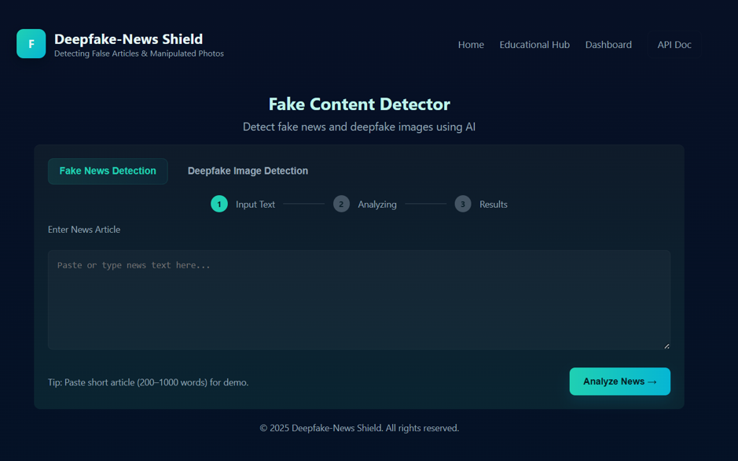
Experimental Results (if any)

Slide 19
Key Learnings
Technical Concepts:
- Multimodal AI: Understood integration of text (fake news) and image (deepfake) detection.
- NLP & ML: Explored TF-IDF, SVM, and transformer-based models for fake news classification.
- Computer Vision: Studied CNNs vs. Vision Transformers (ViT) for deepfake image detection.
Tools and Methods:
- Backend Planning: Python, Flask for API development; Streamlit for dashboards.
- Frontend: Designed initial UI with Streamlit
- Research Workflow: Used Git for version control and structured repository for collaboration.
Outcomes:
- Reviewed 15+ research papers to identify best models, datasets, and tools.
- Developed the frontend interface for user interaction and input handling.
- Gained understanding of ML pipelines, multimodal architectures, and fact-checking integration.
- Established project foundation for backend and model development in next phases.

Slide 20
Work Plan till End-Term Evaluation
October 2025
Complete detailed requirements analysis (functional + non-functional).
Review finalized datasets (fake news + deepfake) and perform initial data exploration.
Verify Git repository setup and establish coding standards & version control workflow.
Finalize backend architecture design (Flask + Streamlit integration plan).
November 2025
Implement preprocessing pipelines:
Text → cleaning, tokenization, TF-IDF.
Image → resizing, normalization, patch preparation for ViT.
Develop Flask APIs to serve model predictions.
Integrate Google FactCheck API for real-time claim verification.
Train baseline Fake News Detection model (TF-IDF + Linear SVC) and evaluate performance.
December 2025
Implement deepfake detection prototype using Vision Transformer (ViT).
Test both text and image models with sample inputs for accuracy and robustness.
Connect backend + frontend to enable text input, image upload, and result display.
Add visualization features (word clouds, sentiment charts, confidence scores).
Prepare documentation, project presentation, and demo for evaluation.

Slide 21
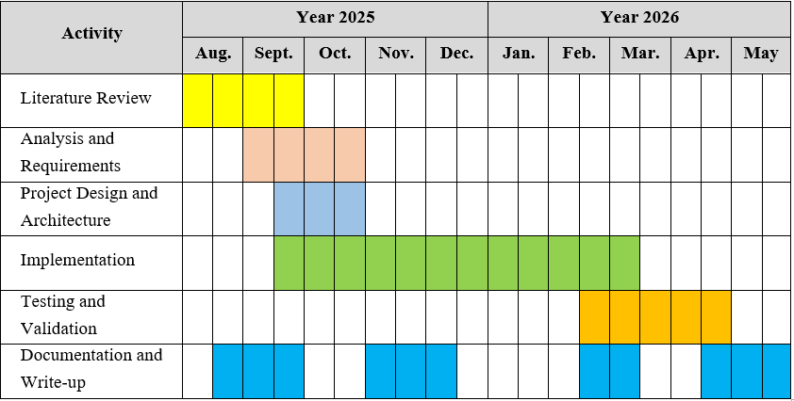
Project Plan

Slide 22
Work Contribution and Attendance
GitHub Repository URL: https://github.com/gitsoha/Deepfake-News-Shield
Team Member | Roll No. | Work Done (provide complete details) | Work Contribution (%) | Lines of Code (if any) | Lab Attendance (%)
1. | 221030283 | Designed Project plan and report, Read five research papers. Worked on frontend. | 25% | 258 | 100%
2. | 221031049 | Managed project documentation. Read five research papers. Created the github repository. | 25% |  | 100%
3. | 221031013 | Sourced and finalized dataset. Read five research papers. Helped in maintaining project report. | 25% |  | 100%
4. | 221030070 | Worked on frontend. Read five research papers. Helped in documentation. | 25% | 61 | 100%

Slide 23
Supervisor Interactions (as mentioned in weekly log)
No. of Meetings with Supervisor:
Week No. | Duration | Remarks (as mentioned in the weekly log) | Incorporated (Yes/No)
1. | 11/09/2025 to 18/09/2025 | Very few research papers. Read more research articles, while papers, books or any other related material | Yes
2. | 18/09/2025 to 22/09/2025 | Work on project report and PPT. | Yes
3. | 22/09/2025 to 25/09/2025 | Work on project report and PPT. | Yes
4. | dd/mm/2025 to dd/mm/2025 | Remark 1 Remark 2 Remark 3
5. | dd/mm/2025 to dd/mm/2025 | Remark 1 Remark 2 Remark 3

Slide 24
Supervisor Interactions (cont…)
Week No. | Duration | Remarks (as mentioned in the weekly log) | Incorporated (Yes/No)
6. | dd/mm/2025 to dd/mm/2025 | Remark 1 Remark 2 Remark 3
7. | dd/mm/2025 to dd/mm/2025 | Remark 1 Remark 2 Remark 3
8. | dd/mm/2025 to dd/mm/2025 | Remark 1 Remark 2 Remark 3
9. | dd/mm/2025 to dd/mm/2025 | Remark 1 Remark 2 Remark 3
10. | dd/mm/2025 to dd/mm/2025 | Remark 1 Remark 2 Remark 3

Slide 25
References
[1] S. Kaliyar, A. Goswami, and P. Narang, “FakeBERT: Fake news detection in social media with a BERT-based deep learning approach,” Multimedia Tools and Applications, vol. 80, no. 8, pp. 11765–11788, 2021.
[2] M. Kaur, S. Kumar, and S. Bawa, “Rumor detection on social media: A data mining perspective,” Information Systems Frontiers, vol. 24, no. 5, pp. 1485–1506, 2022.
[3] A. Rossler, D. Cozzolino, L. Verdoliva, C. Riess, J. Thies, and M. Nießner, “FaceForensics++: Learning to detect manipulated facial images,” in Proceedings of the IEEE/CVF International Conference on Computer Vision (ICCV), 2019, pp. 1–11.
[4] H. Nguyen, J. Yamagishi, and I. Echizen, “Use of a capsule network to detect fake images and videos,” arXiv preprint arXiv:1910.12467, 2019.
[5] M. H. A. Khan and F. Algarni, “Deepfake detection using convolutional neural networks for improved security on social media,” IEEE Access, vol. 9, pp. 143825–143837, 2021.
[6] B. Ghita, I. Kuzminykh, A. Usama, T. Bakhshi, and J. Marchang, “Deepfake Image Detection using Vision Transformer Models,” IEEE/academic publication, 2023–2024
[7] N. N. Prachi, M. Habibullah, M. E. H. Rafi, E. Alam, and R. Khan, “Detection of Fake News Using Machine Learning and Natural Language Processing Algorithms,” Journal of Advances in Information Technology, vol. 13, no. 6, pp. 652–661, Dec. 2022, doi: 10.12720/jait.13.6.652-661.

Slide 26
References (cont…)
References
[8] Karthikeyan A., Monniesh B., Kishorekumar V., and Niveshkumar S., “Enhancing Deepfake Detection: A Multimodal Approach for Improved Accuracy,” TIJER – International Research Journal, vol. 11, no. 7, July 2024, pp. 583–587.
[9] C.-M. Rosca, A. Stancu, and E. M. Iovanovici, “The New Paradigm of Deepfake Detection at the Text Level,” Appl. Sci., vol. 15, art. 2560, Feb. 27, 2025, doi: 10.3390/app15052560.
[10] A. Heidari, N. J. Navimipour, H. Dag, and M. Unal, “Deepfake detection using deep learning methods: A systematic and comprehensive review,” WIREs Data Mining and Knowledge Discovery, vol. 14, no. 2, Feb. 2024, Art. no. e1520.
[11] N. Shakya and P. Poudyal, "Detection of Fake News Using Deep Neural Networks," Kathmandu University Journal of Science, Engineering and Technology, vol. 16, no. 2, pp. 110–119, 2022.
[12] R. Tolosana, R. Vera-Rodriguez, J. Fierrez, A. Morales, and J. Ortega-Garcia, "DeepFakes and Beyond: A Survey of Face Manipulation and Fake Detection," Information Fusion (Elsevier), 2020.
[13] Z. He, et al., "GazeForensics: DeepFake Detection via Gaze-guided Spatial Inconsistency Learning," arXiv preprint, 2023.
[14] B. Dolhansky, J. Bitton, B. Pflaum, J. Lu, R. Howes, M. Wang, and C. C. Ferrer, "The DeepFake Detection Challenge (DFDC) Dataset," arXiv preprint arXiv:2006.07397, 2020.

Slide 27
References (cont…)
[15] 5. B. B. Gupta, S. Kumar, Shubham, and A. Jaiswal, "Deep Fake: An Overview," in (SITET-2020), 2021.
[16] M. Westerlund, "The Emergence of Deepfake Technology: A Review," Technology Innovation Management Review, vol. 9, no. 11, pp. 39–52, Nov. 2019.
[17] S. Singhal, R. R. Shah, T. Chakraborty, P. Kumaraguru, and S. Satoh, "SpotFake: A Multi-modal Framework for Fake News Detection," in Proc. IEEE Int. Conf. Multimedia Big Data (BigMM), 2019.
[18] R. K. Das, "Fake News Detection After LLM Laundering: Measurement and Explanation," arXiv preprint arXiv:2501.18649, 2025.
[19] F. Siddiqui, J. Yang, S. Xiao, and M. Fahad, "Enhanced deepfake detection with DenseNet and Cross-ViT," Expert Systems With Applications, vol. 267, p. 126150, 2025.
[20] R. Tolosana, R. Vera-Rodriguez, J. Fierrez, A. Morales, and J. Ortega-Garcia, "DeepFakes and Beyond: A Survey of Face Manipulation and Fake Detection," arXiv preprint arXiv:2001.00179, 2020.
[21] diagrams.net, "diagrams.net – Free Online Diagram Software," diagrams.net, 2025. [Online].
[22] “DeepFake Detection Using Deep Learning | IEEE Based Project 2024,” YouTube, published last year.
[23] “Deepfake Image Detection | Fake Image Detection | Using Deep Learning,” YouTube, Dec. 21, 2024.
[24] “Detection and Generation of Deep Fakes,” IEEE Signal Processing Society Webinar, Dec. 2023.
[25] P. Agarwal, “Fake News Detection: An Investigation based on ML” ACM / IEEE-style conference, 2022.

Slide 28

Thanks.

