Slide 1



Deepfake-News Shield: Detecting False Articles and Manipulated Photos
Jaypee University of Information Technology
Department of Computer Science and Engineering and Information Technology
Major Project - I (18B19CI791) | AY 2025-26
End-Term Evaluation | December 2025.
Group No.: 17
Team Member (s)
Madhav (221030283)
Soha Khan (221031049)
Harshit Thakur (221031013)
Divyam Saini (221030070)
Supervisor
Name: Dr. Deepak Gupta
Designation: Assistant Professor (SG)

Slide 2
Outline
Introduction
Problem Statement
Objectives
Literature Review
Work Done (after Mid-Term Evaluation)
Project Design
Tools, Technologies and Languages
Dataset
Implementation
Experimental Results and Evaluation
Key Learnings
Work Contribution and Attendance
Supervisor Interactions
Future Work
Project Plan
References

Slide 3
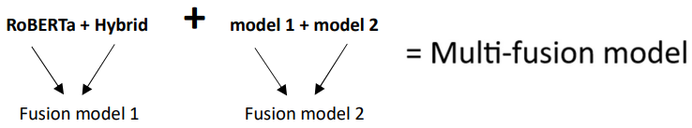
Introduction
Fake news and edited photos spread rapidly across digital platforms.
Most users cannot differentiate real content from manipulated content.
The objective of this project is to build an intelligent system that reads text, analyses images, and flags fake information.
In this semester, the complete text-fusion system is built.
Next semester, the image-fusion system + final multi-fusion model will be completed.
Target:

Slide 4
Problem Statement
Fake articles easily influence people and spread misleading information across the internet. When these false stories are supported with manipulated photos, they look even more real and convincing. Manually checking every piece of content is extremely slow and almost impossible when the volume is huge. Because of this, we need a deep learning–based automated system that can detect both fake text and edited images with reliable accuracy.

Slide 5
Objectives
To preprocess the IFND dataset by removing noise and fixing text inconsistencies for cleaner model input.
To design and train deep learning models for fake-news classification.
To compare model performances and identify the best two for fusion.
To build a feature-level fusion model that combines strengths of both models for improved reliability.
To extend the same fusion approach to images in the next phase of the project.

Slide 6
Literature Review
S. No. | Author & Paper Title [Citation] | Journal/ Conference (Year) | Tools/ Techniques/ Dataset | Key Findings/ Results | Limitations/ Gaps Identified
1. | Shivam B. Kaliya et al. – “A Comprehensive Survey on Fake News Detection Using ML”[1] | Information Processing & Management, 2021. | Survey of ML/DL, NLP features, LIAR, FakeNewsNet, BuzzFeed. | Summarized approaches & trends; gaps in dataset quality & generalization. | Only survey-based, no implementation; lacks explainability.
2. | Andreas Rössler, et al. — “FaceForensics++: Learning to Detect Manipulated Facial Images” [2] | IEEE/CVF International Conference on Computer Vision (ICCV), 2019 | FaceForensics++ (1.8M imgs). | Large-scale dataset; CNN > humans in accuracy. | Limited to facial manipulation; performance drops under compression; resource-heavy.
3. | Mansi Kaur et al. — Survey on Multimodal Fake News Detection” [3] | Information Systems Frontiers, 2022. | Review of text+image DL; Weibo, Twitter datasets. | Emphasized that multimodal fusion improves detection accuracy over text-only models. | No new dataset proposed; models are computationally costly; weak generalization across datasets.
4. | “Preeti Sharma et al. — A Robust Ensemble Model for Deepfake Detection” [4] | Discover Computing, 2025. | Face2Face/Face Tracking (For Preprocessing) | ~91.6% accuracy; strong precision/recall; robust across datasets. | High computational cost; scalability for real-time applications remains limited.

Slide 7
Literature Review (cont…)
S. No. | Author & Paper Title [Citation] | Journal/ Conference (Year) | Tools/ Techniques/ Dataset | Key Findings/ Results | Limitations/ Gaps Identified
5. | “Qian Jiang et al. — Robust Manipulated Media Localization & Detection” [5] is this correct? | Discover Computing, 2025. | RMLD-HFTF, MMS, AGAM, Encoder-Decoder; tested on FF++, Celeb-DF, DFDC. | Detected and localized tampered regions; improved cross-dataset robustness by 1–10% over prior work. | Model complexity is high; requires large resources; subtle manipulations may be missed.
6. | B. Ghita et al. — “Deepfake Image Detection using Vision Transformer Models” [6] | IEEE/academic publication, 2023–2024. | ViT, Kaggle dataset, Colab L4 GPU. | 89.91% accuracy; slight bias toward fake detection; needs large datasets. | Limited by compute power; only 40K/190K images used; overfits on small data .
7. | “N. N. Prachi et al. — Fake News Detection Using ML & NLP” [7] | Journal of Advances in Information Technology — Vol. 13(6), Dec. 2022 | Kaggle dataset; Regex, TF-IDF, BoW, LR, Naïve Bayes, SVM, LSTM, BERT. | BERT best (98%); preprocessing boosted accuracy; robust context capture. | No multilingual or multimodal support; only binary classification; BERT is heavy.
8. | “Karthikeyan A. et al. — Multimodal Deepfake Detection” [8] | TIJER – International Research Journal, vol. 11, no. 7, July 2024. | Steganalysis network, ResNet, CNN, LSTM, PyTorch; custom video dataset. | Detected deepfake traces (blur, artifacts); CNN+LSTM gave high accuracy with small dataset. | Needs large data and high compute; small datasets cause overfitting and weak generalization.

Slide 8
Literature Review (cont…)
S. No. | Author & Paper Title [Citation] | Journal/ Conference (Year) | Tools/ Techniques/ Dataset | Key Findings/ Results | Limitations/ Gaps Identified
9. | C.-M. Rosca et al. — “The New Paradigm of Deepfake Detection at the Text Level” [9] | Appl. Sci., vol. 15, art. 2560, Feb. 27, 2025. | Custom anomaly models (LightGBM, FastTree) on 1300 AI vs human samples. | 98% accuracy in AI-text & author anomaly detection. | Small dataset; limited topics/languages; may weaken as LLMs evolve.
10. | A. Heidari et al. — “Deepfake detection using deep learning review” [10] | WIREs Data Mining and Knowledge Discovery, vol. 14, no. 2, Feb. 2024. | CNN (features), LSTM (temporal seq.); FaceForensics++ & custom video dataset. | CNN-LSTM achieves higher accuracy by combining spatial & temporal artifacts. | Limited dataset diversity; performance may drop on unseen or highly sophisticated deepfakes.
11. | N. Shakya and P. Poudyal — "Detection of Fake News Using Deep Neural Networks" [11] | Kathmandu Univ. J. Sci. Eng. Tech., vol. 16, no. 2, 2022. | LSTM, BERT, Hybrid (BERT+LSTM+Attention); SBFN dataset (2010 records). | BERT (content-only: F1=89.5%); Hybrid best with content+source (F1=99.3%). | Only 2,010 entries; text-only (no images/videos); limited scope.
12. | R. Tolosana et al. — "DeepFakes and Beyond: A Survey of Face Manipulation and Fake Detection“ [12] | Information Fusion (Elsevier), 2020. | Review of face manipulation & datasets (FaceForensics++, DeepFakeTIMIT) | Taxonomy of deepfake types (identity swap, expression swap, attribute manipulation) and summary of detection approaches. | Focused on face-based deepfakes; older datasets not matching current quality.

Slide 9
Literature Review (cont…)
S. No. | Author & Paper Title [Citation] | Journal/ Conference (Year) | Tools/ Techniques/ Dataset | Key Findings/ Results | Limitations/ Gaps Identified
13. | Z. He, et al. — "GazeForensics: DeepFake Detection via Gaze-guided Spatial Inconsistency Learning“ [13] | arXiv preprint, 2023. | CNN-based gaze estimation; FaceForensics++, DFDC. | Eye-gaze cues outperform baseline CNNs. | Struggles on low-quality/compressed videos; dataset-specific.
14. | B. Dolhansky et al. — "The DeepFake Detection Challenge (DFDC) Dataset“ [14] | arXiv preprint arXiv:2006.07397, 2020. | Large-scale dataset (Deepfake, GAN, non-learned); model benchmarks. | Largest public dataset for training & benchmarking detectors. | Models show poor generalization; high pub. data accuracy but weak on unseen “black-box”.
15. | B. B. Gupta et al. — "Deep Fake: An Overview“ [15] | Smart and Innovative Trends in Engineering and Technology (SITET-2020), 2021. | Elliptic Curve Cryptography (ECC), DNA-based encryption for secure IoT communication. | Protocol improves IoT security against replay & impersonation attacks. | Poor generalization to new deepfakes; limited datasets (esp. audio/multimodal); weak robustness.
16. | Mika Westerlund — “The Emergence of Deepfake Technology: A Review” [16] | Technology Innovation Management Review (2019). | Literature review of 84 online news articles. | Deepfakes threaten society, business, and politics, and require laws plus detection tech to counter them. | The author notes that at the time of publication, scholarly research on the topic was sparse.

Slide 10
Literature Review (cont…)
S. No. | Author & Paper Title [Citation] | Journal/ Conference (Year) | Tools/ Techniques/ Dataset | Key Findings/ Results | Limitations/ Gaps Identified
17. | Shivangi Singhal et al.— SpotFake: “A Multi-modal Framework for Fake News Detection” [17] | IEEE BigMM (2019). | SpotFake: BERT (text) + VGG-19 (images), Twitter dataset. | The model outperforms the state-of-the-art by 3.27% on Twitter. It effectively detects fake news without relying on additional sub-tasks. | Paper notes that multimodal models rely heavily on sub-tasks, and their performance drops without them.
18. | Ruben Tolosana et al. — “DeepFakes and Beyond: A Survey of Face Manipulation and Fake Detection” [18] | arXiv (2020). | Autoencoders, GANs; datasets: DeepfakeTIMIT, UADFV, FF++, Celeb-DF. | Reviews 4 manipulation types: synthesis, identity swap, attribute, expression swap. | Research still early; lacks public datasets for expression swap.
19. | Fazeela Siddiqui et al.— “Enhanced deepfake detection with DenseNet and Cross-ViT” [19] | Expert Systems With Applications (2025). | DenseNet + CrossViT on DeepForensics 1.0. | The model achieved high performance with a 99.99% AUC on DeepForensics 1.0. | The primary challenge identified is the increasing difficulty of detecting highly realistic facial forgeries.
20. | Rupak Kumar Das — “Fake News Detection After LLM Laundering: Measurement and Explanation” [20] | arXiv (2025) arXiv (2025). | BERTSCORE for semantic similarity; new dataset of paraphrased fakes. | Detectors fail on LLM-paraphrased fakes due to “sentiment shift”. | The paper emphasizes that the field of detecting LLM-generated fake news is still under-explored.

Slide 11
Work Done (after Mid-Term Evaluation)
Completed full cleaning of the IFND dataset with a 16-stage preprocessing pipeline.
Trained multiple text classification models and selected the top two performers.
Fine-tuned RoBERTa on the cleaned dataset with class-balancing and warmup scheduling.
Built a Hybrid Bi-LSTM + Attention + 1-Layer GRU model for deeper feature learning.
Developed the Fusion Model for text by combining RoBERTa features and Hybrid model features.
Achieved high accuracy and AUC scores across all experiments.

Slide 12
Project Design
The system follows a simple step-by-step pipeline where raw IFND text is cleaned, normalized, and prepared before any deep learning model sees it.
After preprocessing, two different types of models extract features from the same text:
  RoBERTa for deep semantic meaning
  Hybrid Bi-LSTM + Attention + GRU for sequential and contextual patterns
These two representations are combined using feature-level fusion so that both semantic and structural clues are used together during prediction.
Finally, the fused vector goes into a small MLP classifier that produces the Real/Fake output.
This design matches the multi-model idea discussed in recent literature, where combining multiple representations usually improves fake-news detection.

Slide 13
Project Design (cont…)
Overall Flow:
Fig. 1. Conceptual framework of the proposed system.
RAW IFND Dataset
Preprocessing Pipeline
Clean & Normalized Text
RoBERTa
Model
Bi-LSTM
Model
Hybrid
Model
Feature Level Fusion
Feature extraction
from RoBERTa,
Bi-LSTM+attn+gru/
Hybrid models,
followed by fusion
and final fake/real
classification.
Connected Classifier
Final Prediction
(False/True)

Slide 14
Project Design (cont…)
The IFND dataset needed a full cleaning pipeline because the raw text contained encoding issues, noisy characters, duplicates, HTML fragments, and uneven punctuation.
The cleaning process followed around 16 small but important steps, grouped into phases for encoding fixes, structural cleaning, content formatting, and number normalization
These steps ensured that every sample looked consistent and did not confuse the models during training.
Clean data helped the models learn real linguistic patterns instead of noise, which ultimately improved stability and accuracy in testing.
You can also see the complete preprocessing pipeline steps in the visual diagram below.

Slide 15

Project Design (cont…)
Preprocessing
Pipeline:
Raw IFND Dataset
Data Ingestion & Encoding Correction
Unicode &
Control Cleanup
Mojibake Fix
Apostrophe Fixes
Phase1
Symbol &
Punctuation Fix
Stray Ó / Quote
Fix
Deep Encoding
Repair
Structural Cleaning & Deduplication
Phase2
Drop Null/Empty
rows
Remove Exact
Duplicate
Near-Dupe
Removal
The preprocessing
pipeline cleans
the IFND dataset
through 16 essential
steps. After these stages,
the dataset becomes fully
normalized and ready
for model training.
Content Standardization & Formatting
Phase3
WS/Quote
Normalization
Removal HTML
& inline credits
Fix
URL/Email/Htag
Mild Symbol
Cleaning
Robust Number
Normalization
Source-Boilerplate
Mitigation
512 Token Limit &
Min-Length
Phase4
(Cleaned_IFND.csv)
Fig. 2. Sixteen-steps preprocessing pipeline.

Slide 16
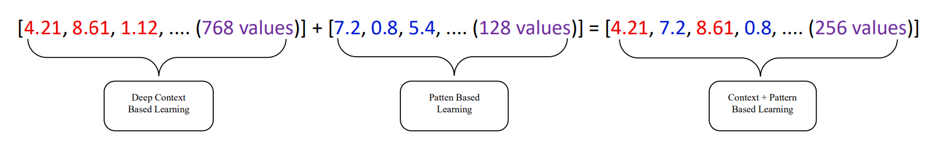
Project Design (cont…)
RoBERTa provides CLS embeddings 768-dim that capture global meaning across the whole sentence.
The Hybrid model provides a 128-dim GRU hidden vector, which highlights local transitions, word importance, and sentence flow.
Both embeddings are fused at the feature-level by concatenating them into a single vector of size 896.
e.g., For Statement 1:
RoBERTa Vector: [4.21, 8.61, 1.12, … (768 values)]
Hybrid Vector: [7.2, 0.8, 5.4, … (128 values)]
Concatenation:
Deep Context
Based Leaning
Pattern
Based Leaning
Context + Pattern
Based Learning

Slide 17
Project Design (cont…)
This fused representation goes into a two-layer MLP with ReLU and Softmax, forming the final classifier.
Fig. 3. Architecture of the feature-level fusion classifier.
Fusion Vector
(896 values)
Dense Layer (896➝256)
ReLU activation + Dropout
Dense Layer (256➝2)
Softmax
FINAL OUTPUT: TRUE/FALSE

Slide 18
Tools, Technologies and Languages
Python 3.12 as the core language for implementing each stage of the pipeline.
NumPy 2.0.2, Pandas 2.2.2 for dataset manipulation, cleaning, and splitting.
PyTorch 2.9.0+cu126 used for building RoBERTa model, Hybrid LSTM-GRU models, and the final fusion classifier.
TensorFlow 2.19.0 used specifically for tokenization and sequence preparation for Hybrid model training.
Matplotlib for ROC curves, evaluation graphs, and accuracy visualizations.
Google Colab GPU (CUDA 12.6) for full training pipeline with mixed precision.
Feature-level Fusion for combining embeddings from RoBERTa and Hybrid models.
Class Weighting to handle dataset imbalance and improve fairness.
MLP classifier + Softmax for final decision layer.

Slide 19
Dataset
The IFND dataset contains short political and factual statements labeled as REAL or FAKE with metadata such as category and date, and in this work only the text portion was used since image fusion will be added in the next phase.
Raw data contained broken characters, HTML leftovers, encoding errors, near-duplicates, and punctuation inconsistencies, which required an extensive cleaning pipeline.
Table 1: Statistics of the cleaned IFND text dataset
Statistic | Count
Total samples | 52,754
Real samples | 36,450
Fake samples | 16,304
Training set (80%) | 42,203
Validation set (10%) | 5,275
Test set (10%) | 5,276

Slide 20
Dataset
After cleaning, the dataset was split into:
  80% Training (42,203 samples)
  10% Validation (5,275 samples)
  10% Testing (5,276 samples)
The cleaned dataset reflects real patterns seen in Indian news content and fits the requirements for deep fake-news analysis.

Slide 21
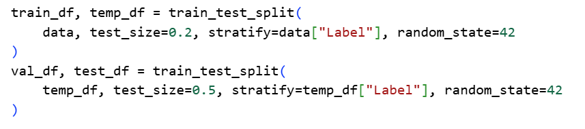
Implementation
Dataset Splitting + RoBERTa Pipeline
  The IFND dataset was split in an 80/10/10 stratified ratio to ensure the TRUE and FALSE labels remained balanced.
  The RoBERTa tokenizer converted the text into input IDs and attention masks, creating a model-ready format.
  The model was trained using AMP, gradient clipping, a warmup scheduler, and early stopping to maintain stable learning.
  Snippet 1: (✔ Dataset Splitting)

Slide 22
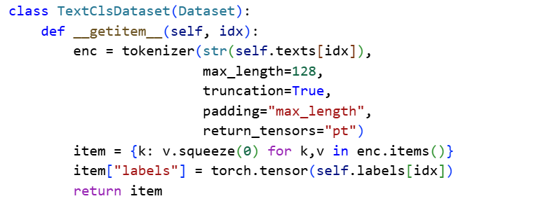
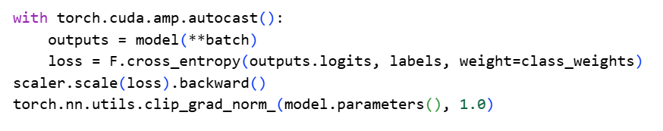
Implementation (cont…)
Snippet 2: (✔ RoBERTa Dataset Loader)
Snippet 3: (✔ Training Core)

Slide 23
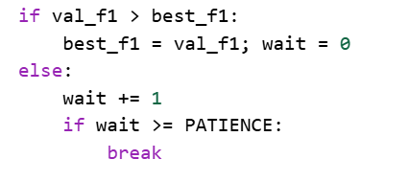
Implementation (cont…)
Snippet 4: (✔ Early Stopping)
Hybrid Model (Bi-LSTM + Attention + GRU)
  The Keras tokenizer converted the text into padded integer sequences with a maximum length of 128.
  The hybrid architecture used Bi-LSTM, an attention mechanism, and GRU layers to extract deep contextual features.
  Training was performed with class-weighted loss, gradient clipping, learning-rate scheduling, and early stopping.

Slide 24

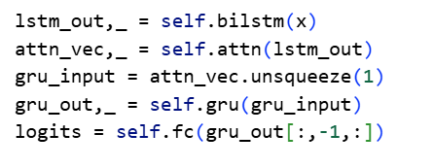
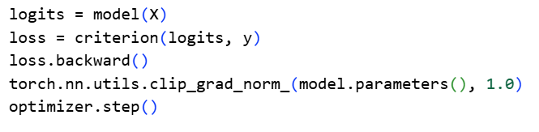
Implementation (cont…)
Snippet 1: (✔ Keras tokenizer to convert text into padded integer sequences)
Snippet 2: (✔ Hybrid Architecture Forward Pass)
Snippet 3: (✔ Training Core)

Slide 25
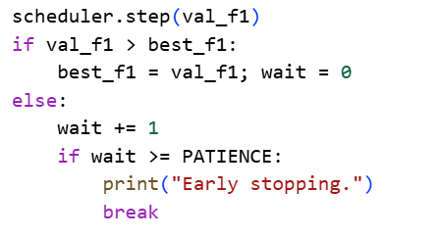
Implementation (cont…)
Snippet 4: (✔ LR Scheduler + Early Stopping)
Feature-Level Fusion (RoBERTa + Hybrid)
  The best RoBERTa and Hybrid models were loaded in frozen feature-extractor mode, meaning only the fusion classifier was trainable.
  RoBERTa’s 768-dim CLS embedding and the Hybrid model’s 128-dim GRU output were extracted and combined into a single fused vector.
  A lightweight MLP classifier was trained on this fused representation, producing the final fake-news predictions.

Slide 26
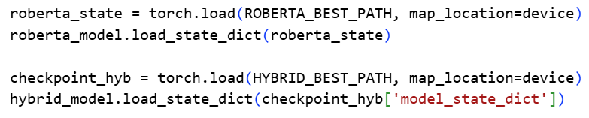

Implementation (cont…)
Snippet 1: (✔ Load Best Saved Models)
Snippet 2: (✔ Freeze Encoders)
Snippet 3: (✔ Extract Feature Embeddings)
Snippet 4: (✔ Concatenate Features)

Slide 27
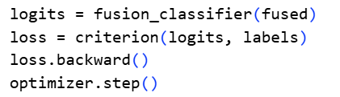
Implementation (cont…)
Snippet 5: (✔ Train Fusion Classifier)

Slide 28
Experimental Results & Evaluation
Initially, multiple deep-learning models were trained and tested on the IFND dataset to compare their performance, stability, and generalization ability.
Table 2: Attention-based models
Table 3: LSTM/ GRU-based models
Model | Accuracy | ROC-AUC | F1-Score
Attention + LSTM | 0.9621 | 0.98335 | 0.9665
Attention + Stacked LSTM | 0.9600 | 0.96000 | 0.9600
Scale Dot-Product MHA+Res. | 0.9622 | 0.98700 | 0.9673
Model | Accuracy | ROC-AUC | F1-Score | Time (min)
LSTM | 0.9544 | 0.9800 | 0.9700 | 1.41
GRU on LSTM no early stopping | 0.9371 | 0.9600 | 0.9500 | 4.55
GRU on LSTM | 0.9546 | 0.9800 | 0.9700 | 1.07
Stacked GRU on LSTM no | 0.9396 | 0.9600 | 0.9600 | 5.51
Stacked GRU on LSTM | 0.9535 | 0.9800 | 0.9700 | 1.43
Bidirectional GRU on LSTM no | 0.9380 | 0.9600 | 0.9700 | 1.51
Credit*: Contributed by Soha Khan
Table 4: Transformer-based models
Model | Accuracy | ROC-AUC
DEBERTA-V3 | 0.9722 | 0.9817
T5 | 0.9678 | 0.9748
Credit*: Contributed by Divyam Saini
Credit*: Contributed by Harshit Thakur

Slide 29
Experimental Results & Evaluation (cont…)
From all the experiments, the two strongest models — RoBERTa and the Hybrid2 (Bi-LSTM + Attention + 1-Layer GRU model) — consistently achieved the highest accuracy, macro-F1, and ROC-AUC scores.
These top models were finally combined using a feature-level fusion approach, and their fused output was evaluated through detailed metrics and visual graphs to validate performance improvement.
You can see the complete comparison of all model results in Table 3, where their test accuracy, AUC scores, and ROC curves are clearly presented.

Slide 30
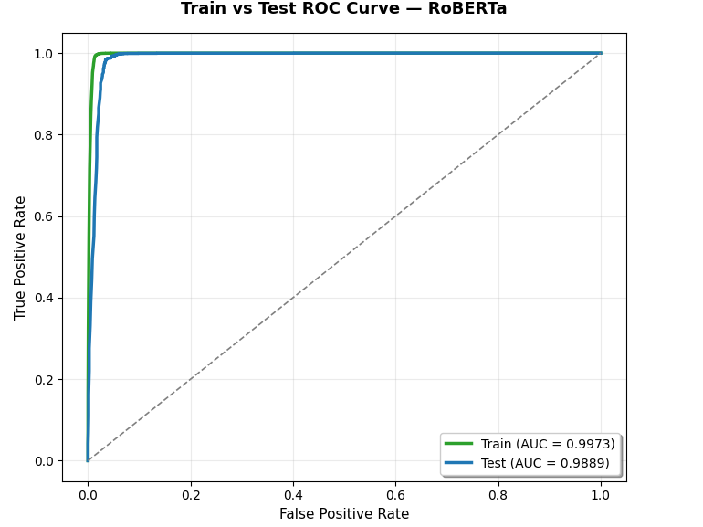
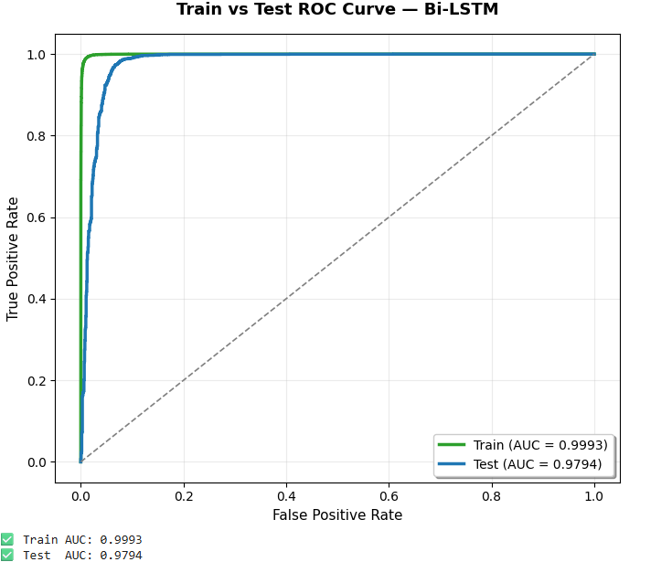
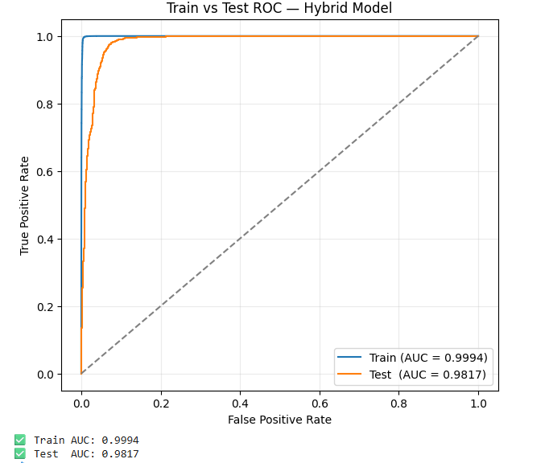
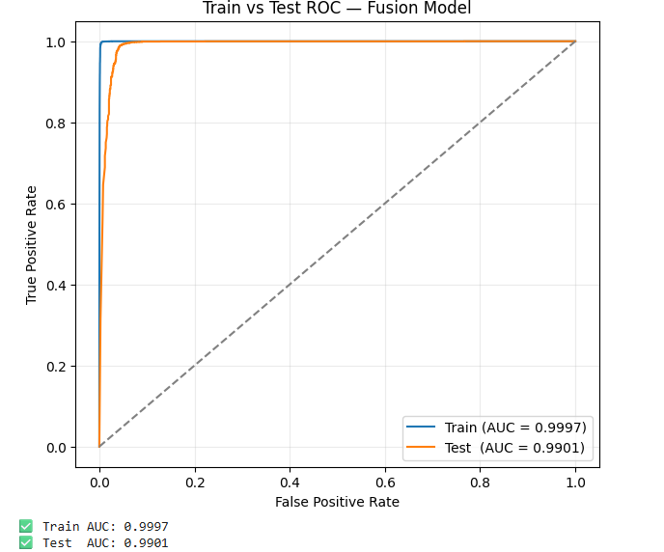
Experimental Results & Evaluation (cont…)
Table 5: Performance comparison of BERT-based, RNN-based and hybrid-models
Model | Test Accuracy | Test AUC | ROC Curve
RoBERTa | 0.9795 | 0.9889
Bi-LSTM | 0.9621 | 0.9794
Hybrid1 (BiLSTM+Attn+2layer/Stacked GRU) | 0.9547 | 0.9791
Hybrid2 (Bi-LSTM+Attn+1layer GRU) | 0.9623 | 0.9817
Fusion (RoBERTa + Hybrid2) | 0.9797 | 0.9901
Credit*: Contributed by Madhav

Slide 31
Key Learnings
Significant learning was gained in cleaning and preprocessing large text datasets, including handling encoding issues, removing noise, and ensuring consistent formatting for model training.
A deeper understanding was developed of how to design, train, and evaluate deep learning architectures such as RoBERTa and Hybrid Bi-LSTM with Attention and GRU.
Practical experience was gained in implementing feature-level fusion, combining two high-performing models into a unified system to improve accuracy and robustness.

Slide 32
Work Contribution and Attendance
GitHub Repository URL: https://github.com/gitsoha/Deepfake-News-Shield
Team Member | Roll No. | Work Done (provide complete details) | Work Contribution (%) | Lines of Code (if any) | Lab Attendance (%)
1. | 221030283 | Designed and finalized the complete ETE PPT. Trained RoBERTa and Hybrid (Bi-LSTM + Attention + GRU) models. Performed feature-level fusion of the top two models and evaluated final results. Created the MTE report. | 25 |  | 100
2. | 221031049 | Implemented and tested LSTM-attn. models. Enhanced bi-lstm with multiple attn. and residual. Created Comparison of all models and updated the report of ETE. Created the MTE PPT. | 25 |  | 100
3. | 221031013 | Worked on DeBERTa model. Added GRU layer over DeBERTa model. Made the hybrid of (DeBERTa+T5). Created the MTE PPT. | 25 |  | 90.86
4. | 221030070 | Trained LSTM and Bi-LSTM models. added 3 types of GRU layers on both the models. added 3 types of Stacked layers on both the models. Created the MTE PPT. | 25 |  | 100

Slide 33
Supervisor Interactions (as mentioned in weekly log)
No. of Meetings with Supervisor: 13
Week No. | Duration | Remarks (as mentioned in the weekly log) | Incorporated (Yes/No)
1. | 11/09/2025 to 18/09/2025 | Very few research papers. Read more research articles, while papers, books or any other related material | Yes
2. | 18/09/2025 to 22/09/2025 | Work on report and ppt | Yes
3. | 22/09/2025 to 25/09/2025 | Work on report and ppt | Yes
4. | 25/09/2025 to 29/09/2025
5. | 20/10/2025 to 27/10/2025 | Build more models | Yes

Slide 34
Supervisor Interactions (cont…)
Week No. | Duration | Remarks (as mentioned in the weekly log) | Incorporated (Yes/No)
6. | 27/10/2025 to 31/10/2025 | Need to work hard! | Yes
7. | 31/10/2025 to 04/11/2025 | Work on dataset details, feature engg., hyperparameter tuning Explore hybrid/fusion models | Yes
8. | 04/11/2025 to 07/11/2025 | Ultimately, we’ll go for multimodal system! | Yes
9. | 07/11/2025 to 10/11/2025 | Soha need to put sincere efforts | Yes
10. | 10/11/2025 to 12/11/2025 | Update google docs regularly! Needs to check the performance on a regular basis! | Yes
11. | 12/11/2025 to 15/11/2025 | Record/write everything(project report, google docs) Note down execution time for every model Neatly draw comparison b/w various models | Yes

Slide 35
Supervisor Interactions (cont…)
Week No. | Duration | Remarks (as mentioned in the weekly log) | Incorporated (Yes/No)
12. | 15/11/2025 to 20/11/2025 | Don’t copy & paste code from Chatgpt without understanding each statement(Soha, Harshit, Divyam) | Yes
13. | 20/11/2025 to 21/11/2025 | PR to be checked on Monday! | Yes
14. | dd/mm/2025 to dd/mm/2025 | Remark 1 Remark 2 Remark 3

Slide 36
Future Work
Adding image-based detection using Vision Transformer (ViT) or EfficientNet models: This can help the system catch fake news that contains edited or misleading images. Models like ViT or EfficientNet B4 can understand visual patterns that the text model cannot see.
Building a multi modal fusion model: A fusion model that mixes text, images, and metadata can provide a more complete view of the content. This usually helps the classifier keep stronger and more accurate.
Deploying the final system using Flask: The model can be turned into a simple web application so users can test it in real time. Deployment also helps check how the system performs on new and unseen data.

Slide 37
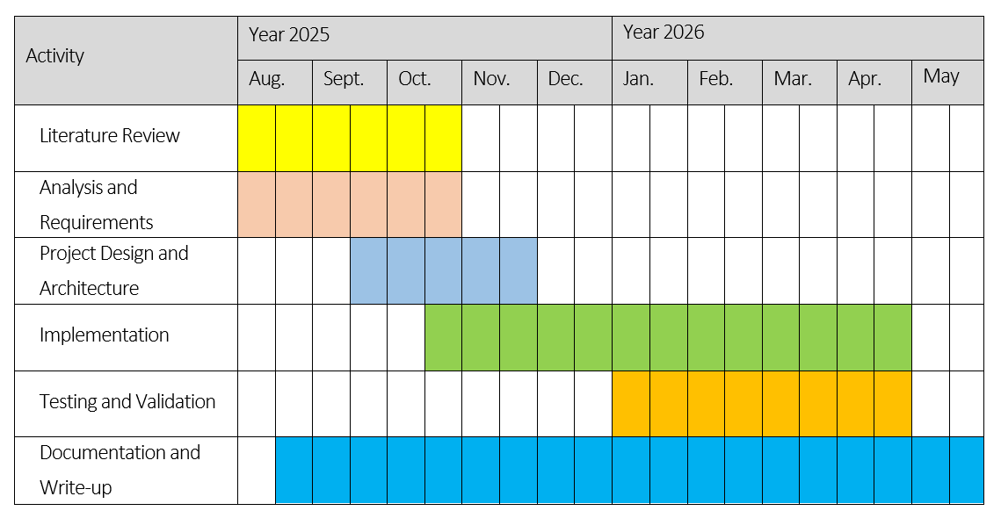
Project Plan

Slide 38
References
[1] D. K. Sharma and S. Garg, “IFND: a benchmark dataset for fake news detection,” Complex & Intelligent Systems, 2023.
[2] W. Y. Wang, “Liar, Liar Pants on Fire: A New Benchmark Dataset for Fake News Detection,” ACL Workshop, 2017.
[3] S. Shah and S. Patel, “A Comprehensive Survey of Fake News Detection Techniques,” Journal of Computer Science, vol. 21, no. 4, pp. 982–990, 2025.
[4] W. Y. Wang, “Liar, Liar Pants on Fire: A New Benchmark Dataset for Fake News Detection,” Proceedings of the 55th Annual Meeting of the Association for Computational Linguistics, pp. 423–428, 2017.
[5] A. Rossler, D. Cozzolino, L. Verdoliva, C. Riess, J. Thies, and M. NieBner, “FaceForensics++: Learning to Detect Manipulated Facial Images,” IEEE/CVF International Conference on Computer Vision (ICCV), pp. 1–11, 2019.
[6] M. Zidan, A. Sleem, A. Nabil, and M. Othman, “Multimodal Fake News Detection: A Survey of Text and Visual Content Integration Methods,” International Journal of Computers and Informatics, vol. 7, pp. 13–25, 2025.
[7] Q. Jiang, S. Liu, S. Miao, H. Yi, X. Jin, Y. Kou, and H. Duan, “RMLD-HFTF: A Hybrid Multimodal Deep Learning Framework for Face Forgery Detection,” Discover Computing, vol. 28, no. 10, pp. 1–14, 2025.

Slide 39
References (cont…)
[8] M. F. Mridha, A. J. Keya, M. A. Hamid, M. M. Monowar, and M. S. Rahman, “A Comprehensive Review on Fake News Detection With Deep Learning,” IEEE Access, vol. 9, pp. 156749–156772, 2021, doi: 10.1109/ACCESS.2021.3129329.
[9] C.-M. Rosca, A. Stancu, and E. M. Iovanovici, “The New Paradigm of Deepfake Detection at the Text Level,” Appl. Sci., vol. 15, art. 2560, Feb. 27, 2025, doi: 10.3390/app15052560.
[10] A. Heidari, N. J. Navimipour, H. Dag, and M. Unal, “Deepfake detection using deep learning methods: A systematic and comprehensive review,” WIREs Data Mining and Knowledge Discovery, vol. 14, no. 2, Feb. 2024, Art. no. e1520.
[11] N. Shakya and P. Poudyal, "Detection of Fake News Using Deep Neural Networks," Kathmandu University Journal of Science, Engineering and Technology, vol. 16, no. 2, pp. 110–119, 2022.
[12] R. Tolosana, R. Vera-Rodriguez, J. Fierrez, A. Morales, and J. Ortega-Garcia, "DeepFakes and Beyond: A Survey of Face Manipulation and Fake Detection," Information Fusion (Elsevier), 2020.
[13] Z. He, et al., "GazeForensics: DeepFake Detection via Gaze-guided Spatial Inconsistency Learning," arXiv preprint, 2023.
[14] B. Dolhansky, J. Bitton, B. Pflaum, J. Lu, R. Howes, M. Wang, and C. C. Ferrer, "The DeepFake Detection Challenge (DFDC) Dataset," arXiv preprint arXiv:2006.07397, 2020.

Slide 40
References (cont…)
[15] 5. B. B. Gupta, S. Kumar, Shubham, and A. Jaiswal, "Deep Fake: An Overview," in (SITET-2020), 2021.
[16] M. Westerlund, "The Emergence of Deepfake Technology: A Review," Technology Innovation Management Review, vol. 9, no. 11, pp. 39–52, Nov. 2019.
[17] S. Singhal, R. R. Shah, T. Chakraborty, P. Kumaraguru, and S. Satoh, "SpotFake: A Multi-modal Framework for Fake News Detection," in Proc. IEEE Int. Conf. Multimedia Big Data (BigMM), 2019.
[18] R. K. Das, "Fake News Detection After LLM Laundering: Measurement and Explanation," arXiv preprint arXiv:2501.18649, 2025.
[19] F. Siddiqui, J. Yang, S. Xiao, and M. Fahad, "Enhanced deepfake detection with DenseNet and Cross-ViT," Expert Systems With Applications, vol. 267, p. 126150, 2025.
[20] R. Tolosana, R. Vera-Rodriguez, J. Fierrez, A. Morales, and J. Ortega-Garcia, "DeepFakes and Beyond: A Survey of Face Manipulation and Fake Detection," arXiv preprint arXiv:2001.00179, 2020.
[21] diagrams.net, "diagrams.net – Free Online Diagram Software," diagrams.net, 2025. [Online].
[22] “DeepFake Detection Using Deep Learning | IEEE Based Project 2024,” YouTube, published last year.
[23] P. Agarwal, “Fake News Detection: An Investigation based on ML” ACM / IEEE-style conference, 2022.
[24] “Deepfake Image Detection | Fake Image Detection | Using Deep Learning,” YouTube, Dec. 21, 2024.

Slide 41

Thanks.

