Slide 1

Software Testing Terminology and Methodology

Slide 2

Objectives
Difference between error, fault and failure.
Life Cycle of a bug.
How does a bug affect economics of software testing?
How does a bug classified?
Testing Principles
Software Testing Life Cycle (STLC) and its models.
Difference between verification and validation.
Development of software testing methodology

Slide 3
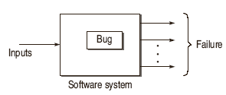
Software Testing Terminology
Failure
The inability of a system or component to perform a required function according to its specification.
Fault / Defect / Bug
Fault is a condition that in actual causes a system to produce failure. It can be said that failures are manifestation of bugs.

Slide 4

Software Testing Terminology
Error
Whenever a member of development team makes any mistake in any phase of SDLC, errors are produced. It might be a typographical error, a misleading of a specification, a misunderstanding of what a subroutine does and so on. Thus, error is a very general term used for human mistakes.

Slide 5
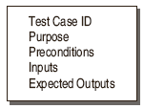
Software Testing Terminology

Slide 6
Software Testing Terminology
Testware
The documents created during the testing activities are known as Testware.
Incident
the symptom(s) associated with a failure that alerts the user to the occurrence of a failure.
Test Oracle
to judge the success or failure of a test,

Slide 7
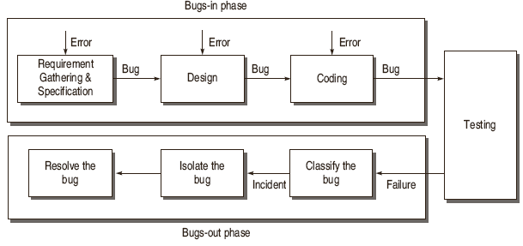
Life Cycle of a Bug

Slide 8
Requirements and Specification Defects
Functional Description Defects
incomplete, ambiguous, incorrect
Feature Defects
Interface Description Defects
→how the target software is to interface with external hardware, software and users

Slide 9
Design Defects
Algorithmic and processing defects
Control, logic and sequence defects
Data defects
Module interface description defects
Functional description defects
Usually detected during design reviews
External interface description defects

Slide 10
Coding Defects
Arithmetic and processing defects
Control, logic and sequence defects
Typographical defects
Initialization defects
Data flow defects
Data structure defects
Module interface defects

Slide 11
Testing Defects
Test Harness Defects
→auxiliary code must be developed during unit and integration levels
Test case design and Test procedure defects

Slide 12
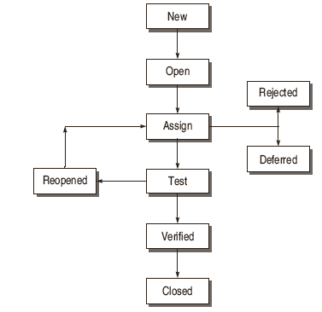
States of a Bug

Slide 13
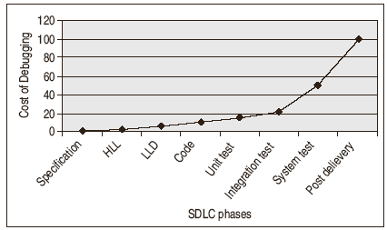
Software Testing Myths
Bug affects Economics of Software Testing

Slide 14
Bug Classification based on Criticality
Critical Bugs
the worst effect on the functioning of software such that it stops or hangs the normal functioning of the software.
Major Bug
This type of bug does not stop the functioning of the software but it causes a functionality to fail to meet its requirements as expected.
Medium Bugs
Medium bugs are less critical in nature as compared to critical and major bugs.
Minor Bugs

Slide 15
Bug Classification based on SDLC
Requirements and Specifications Bugs
Design Bugs
  Control Flow Bugs
  Logic Bugs
Processing Bugs
  Data Flow Bugs
  Error Handling Bugs
  Race Condition Bugs
  Boundary Related Bugs
  User Interface Bugs
Coding Bugs
Interface and Integration Bugs
System Bugs
Testing Bugs

Slide 16
Bug Classification based on SDLC
  Control Flow Bugs
  - unreachable paths, some paths may be missing, etc
  Logic Bugs
  - improper layout of cases
  -missing cases
  -incorrect boolean expressions
Processing Bugs
- computation mistakes ex. Arithmetic error, incorrect conversion of data, ignoring overflow, improper use of logical operators
  Data Flow Bugs
  - un initialized data, or in wrong format
  - data initialized but not used
  -redefined without intermediate use

Slide 17
Bug Classification based on SDLC
  Error Handling Bugs
  - exception handling mechanism
  -checked exception and unchecked exception
  Race Condition Bugs
  - waiting indefinitely to received inputs from each other
  Boundary Related Bugs
  - most of the error occurs on boundaries
  -it happens with arrays
  User Interface Bugs
  - if the user does not feel good about Ui design, it is called as user interface bugs
  -inappropriate error messages,
  -wrong content in the help text

Slide 18
Bug Classification based on SDLC
Coding Bugs
-undeclared data, routines
-dangling code
-typographical erros,
-documentation bugs
Interface and Integration Bugs
-misunderstanding external input and output formats
-wrong subroutine call sequence
-call parameter bugs
-misunderstood entry or exit parameter values
System Bugs
- stress testing (give max load and watch out the performance)
Testing Bugs
-during testing some bugs may exist
-failure to use the most promising test case
-failure to verify fixes
-failure to provide summary report

Slide 19
Testing Principles
Effective Testing not Exhaustive Testing
Testing is not a single phase performed in SDLC
Destructive approach for constructive testing
Early Testing is the best policy.
The probability of the existence of an error in a section of a program is proportional to the number of errors already found in that section.
Testing strategy should start at the smallest module level and expand toward the whole program.

Slide 20
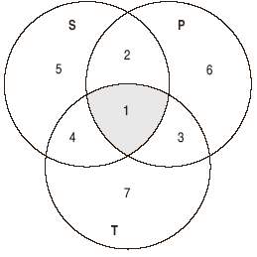
Testing Principles
Testing should also be performed by an independent team.
Everything must be recorded in software testing.
Invalid inputs and unexpected behavior have a high probability of finding an error.
Testers must participate in specification and design reviews.

Slide 21
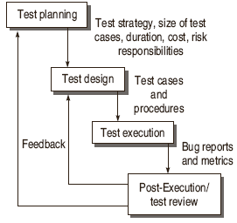
Software Testing Life Cycle (STLC)

Slide 22
Test Planning
Defining the Test Strategy
Estimate of the number of test cases, their duration and cost.
Plan the resources like the manpower to test, tools required, documents required.
Identifying areas of risks.
Defining the test completion criteria.
Identification of methodologies, techniques and tools for various test cases.
Identifying reporting procedures, bug classification, databases for testing, Bug Severity levels, project metrics

Slide 23
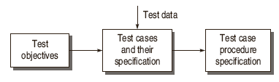
Test Design
Determining the test objectives and their Prioritization
Preparing List of Items to be Tested
Mapping items to test cases
Selection of Test case design techniques
Creating Test Cases and Test Data
Setting up the test environment and supporting tools
Creating Test Procedure Specification

Slide 24
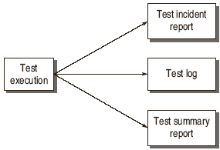
Test Execution

Slide 25
Post-Execution / Test Review
Understanding the Bug
Reproducing the bug
Analyzing the nature and cause of the bug
Reliability analysis
Coverage analysis
Overall defect analysis

Slide 26
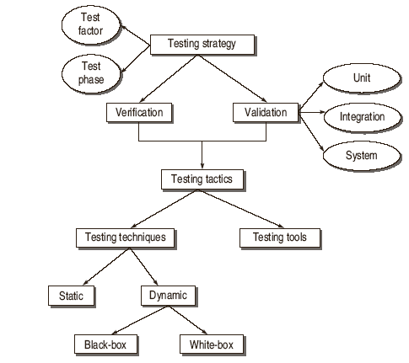
Software Testing Methodology

Slide 27
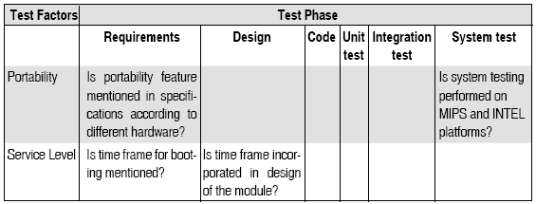
Test Strategy Matrix
Select and Rank Test Factors
Identify the System Development Phases
Identify the Risks associated with System under Development

Slide 28
Development of Test Strategy
Verification: “Are we building the product right?”
Validation: “Are we building the right product?”

Slide 29
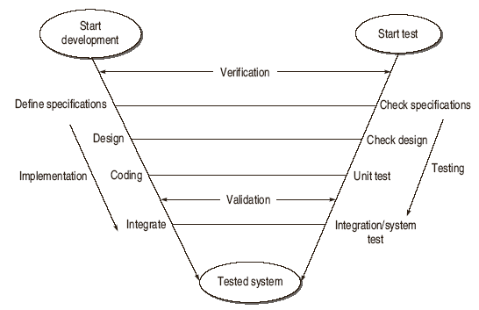
V Testing Life Cycle Model

Slide 30
Validation Activities
Unit Testing
Integration Testing
Function Testing
System Testing
Acceptance Testing

