Slide 1
UACSA105 –Data Structures and Algorithms

Slide 2
Course Objectives 1. Analyze algorithm efficiency using asymptotic notation. 2. Differentiate linear, non-linear data structures and their operations. 3. Design and apply appropriate data structures to solve real-world problems.

Slide 3
Course Outcomes 1. Understand the basic concepts of data structures and time complexity analysis of algorithms 2. Choose appropriate linear data structures and legal operations permitted on them. 3. Articulate non-linear data structure operations for solving a given problem. 4. Discover various tree and graph traversals. 5. Analyze the various searching and sorting algorithm

Slide 4
Module -1 Algorithm Analysis
Importance of algorithms and data structures – Abstract Data Types - Fundamentals of algorithm analysis: space and time complexity of an algorithm, Types of asymptotic notations and rate of growths – Algorithm efficiency – Analysis of non-recursive and recursive algorithms
Text Books
1.Thomas H. Cormen, Charles E. Leiserson, Ronald L. Rivest, and Clifford Stein (2003) Introduction to Algorithms and Java, 2nd edition, McGraw-Hill.
2.Alfred V. Aho, Jeffrey D. Ullman and John E. Hopcroft, Data Structures and Algorithms, 1983, Pearson Education.

Slide 5
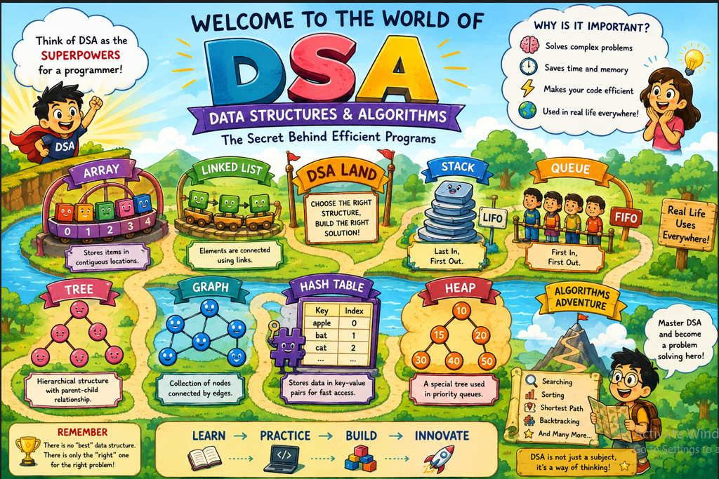

Slide 6
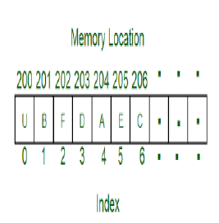
What is a Data Structure? A Data Structure is a method of organizing data in a computer so that it can be stored, retrieved, updated, and processed efficiently. Examples: Array Linked List Stack Queue Tree Graph Hash Table Each data structure has its own advantages and is suitable for solving specific types of problems.

Slide 7
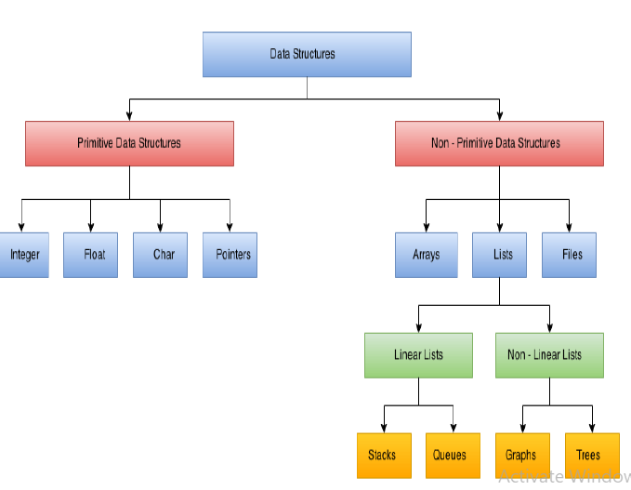

Slide 8
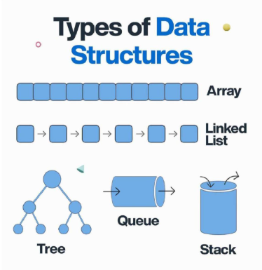

Slide 9
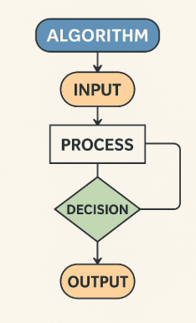
What is an Algorithm? An Algorithm is a finite sequence of well-defined instructions designed to solve a particular problem. Characteristics of an Algorithm Input Output Definiteness (clear steps) Finiteness (must terminate) Effectiveness (steps should be practical) Example Problem: Find the largest number among three numbers. Algorithm: Read A, B, and C. Compare A, B, and C. Display the largest number. Stop.

Slide 10
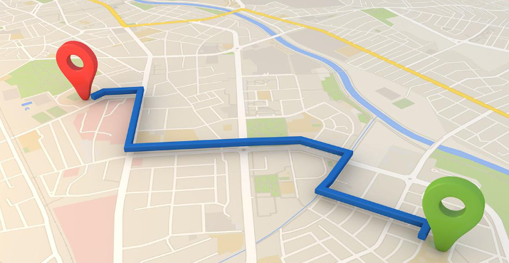
Applications of Data Structures and Algorithms 1. Navigation Systems (Google Maps)
Data Structure: Graph
A graph consists of vertices (locations) and edges (roads connecting locations).
Example:
Vertex → City or Junction
Edge → Road connecting two cities
Algorithm: Shortest Path Algorithm
Algorithms such as Dijkstra's Algorithm and A* find the shortest or fastest path between two locations.

Slide 11
2.Data Structure: Stack
A Stack follows the Last In First Out (LIFO) principle.
Imagine:
You visit:
Google
Wikipedia
YouTube
When you press the Back button,
The browser returns:
YouTube → Wikipedia → Google
This is exactly how a stack works.
Algorithm: Backtracking
The browser stores visited pages in a stack.
Every new webpage is pushed onto the stack.
Pressing Back performs a pop operation.

Slide 12
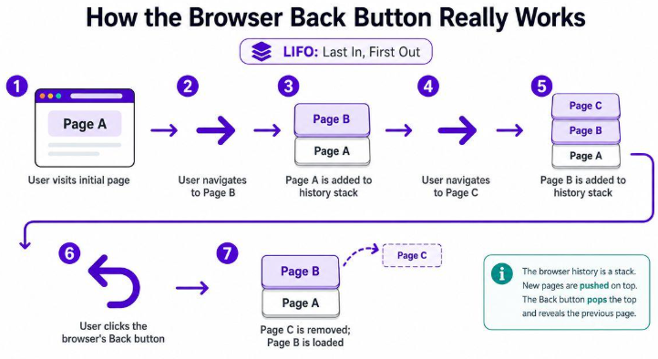

Slide 13
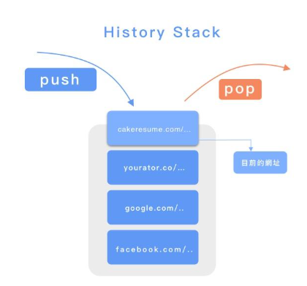

Slide 14
3. Music Playlist
Data Structure: Linked List
Each song is connected to the next song.
Example
Song A → Song B → Song C → Song D
Each song stores:
Song information
Pointer to the next song
Algorithm: Traversal
Traversal means visiting every node one after another.
When you press Next Song,
the player moves to the next node.
Applications
Spotify
Apple Music
VLC Media Player
.

Slide 15
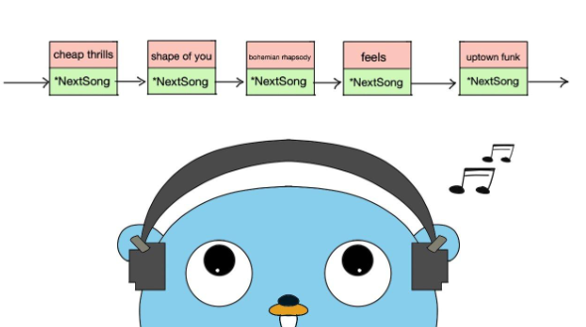
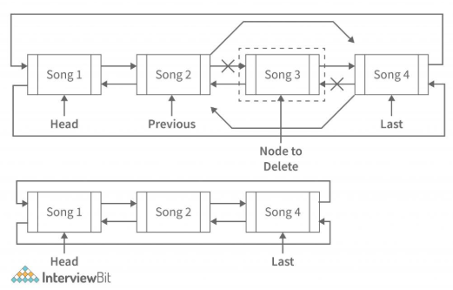

Slide 16
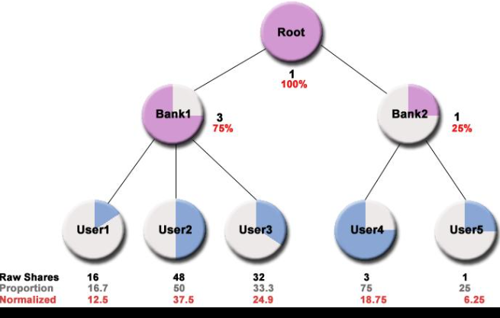
4 Data Structure: Tree
Banks maintain millions of customer records.
Searching every record one by one is inefficient.
Instead, records are stored in Tree structures.
Searching for Account 6000 requires only a few comparisons.
Algorithms
Searching
Sorting
.

Slide 17

5 Data Structure: Graph
Each person is a node.
Friendships are edges.
Recommendation Algorithms
The system recommends:
Friends
Groups
Pages
Videos
based on mutual connections.
Applications
Facebook
Instagram
LinkedIn
.

Slide 18
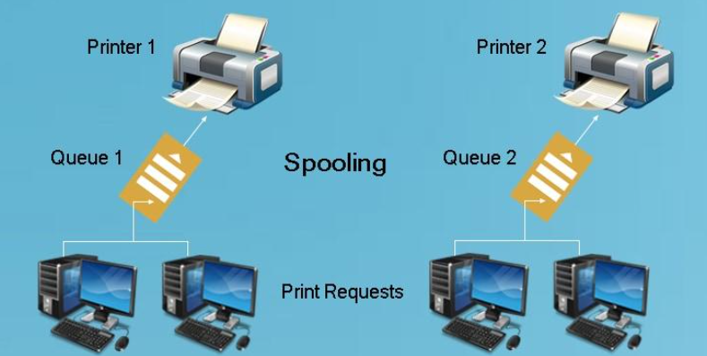
6 Data Structure: Queue
Queue follows First In First Out (FIFO).
Each person is a node.
Friendships are edges.
CPU Scheduling
Processes waiting for CPU execution are stored in queues.
The operating system schedules them one after another according to the scheduling policy.
Applications
CPU scheduling
Printer queue
Keyboard buffer
Task scheduling
.

Slide 19
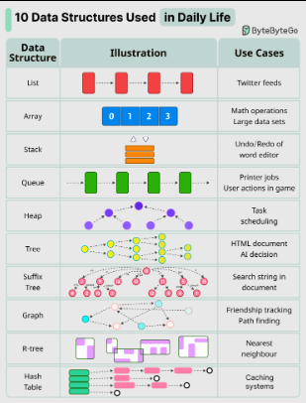
.

Slide 20
.
Importance of algorithms and data structures?

Slide 21
.
1. Organize Data Efficiently
A well-organized data structure makes information easy to find and update.
Example: A library arranges books by category and author. Finding a book takes only a few minutes.
2. Save Time
Efficient data structures reduce the time required to perform operations.
Example: Searching for a student's roll number in:
An unsorted list of 100 students may require checking many entries.
A sorted list can be searched much faster.

Slide 22
3. Save Memory
Good data structures use computer memory efficiently.
Example: Instead of storing unnecessary duplicate data, we store only what is needed.
4. Handle Large Data
Modern applications process millions or even billions of records.
Examples:
Instagram stores billions of photos.
Google indexes billions of webpages.
Amazon manages millions of products.
Without proper data structures, these applications would become very slow.
.

Slide 23
Abstract Data Type (ADT)
ADT is a logical description of a data structure that specifies what operations can be performed on the data, without explaining how those operations are implemented.
An ADT defines:
What operations can be performed on the data.
It does not specify how the data is stored.
A data structure defines:
How the data is actually stored and organized in memory.
.

Slide 24
Operations
Stack ADT
Operations:
Push()
Pop()
Peek()
IsEmpty()
Queue
Operations:
Enqueue()
Dequeue()
Front()
Rear()
.
List ADT.
Add an element
Delete an element
Search for an element
Update an element
 | Trees Insert, Delete, Search, Traverse, Height, Depth
 | Graphs Add Vertex, Add Edge, Delete Vertex, Delete Edge, BFS, DFS

Slide 25
.
Fundamentals of Algorithm analysis
It is the process of evaluating an algorithm to determine how efficient it is in terms of time and memory.
Instead of asking "Does the algorithm work?",
algorithm analysis asks:
How fast does it work?
How much memory does it use?
Will it still perform well when the input becomes very large?

Slide 26
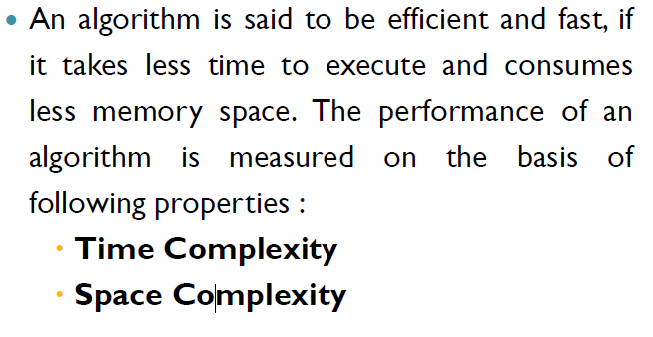
.
Fundamentals of Algorithm analysis

Slide 27
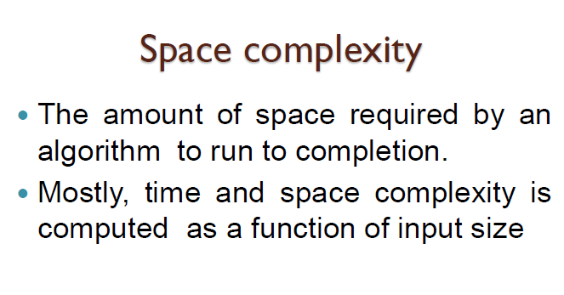
.
Fundamentals of Algorithm analysis

Slide 28
Space Complexity
Space complexity is the amount of memory an algorithm requires to execute as the input size (n) increases.
.
Example 1: Constant Space – O(1)
Void main()
{
int a , b , c;
c=a+b;
Print c;
}
Memory Used
Variable | Memory
a b c | 3 integer -- a b c will use only 3 integer even if the value of a and b increases

Slide 29
Space Complexity
Example 2
int a[3],i;
for(int i = 0; i < 3; i++)
{
get (a[i]);
Print (a[i]);
}
.
n=5
arr 10 20 30 40 50
n=10
a[i]=1 2 3 4 5 6 7 8 9 10
Memory space depends on n..
If n increases then space also increases..
Space Complexity = O(n)
Memory Used
Variable | Memory
a[i] | 3 integer
i | 1 integer

Slide 30
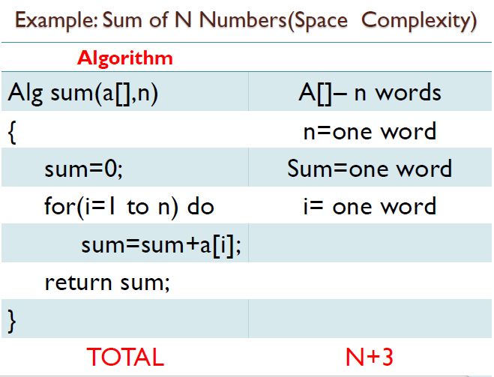
.

Slide 31
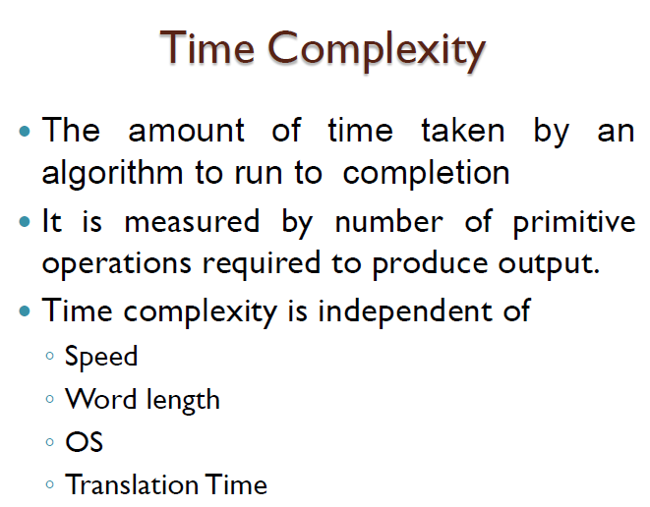
.
Fundamentals of Algorithm analysis
We do not measure time in seconds or milliseconds.
We count the number of basic operations

Slide 32
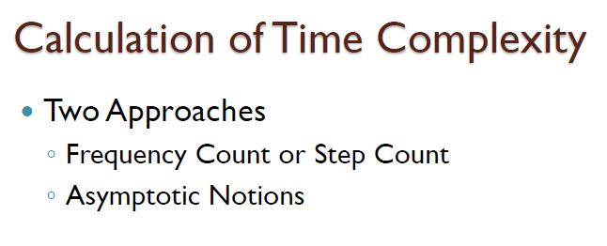
.
Fundamentals of Algorithm analysis

Slide 33
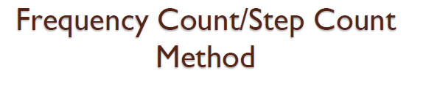
.
Fundamentals of Algorithm analysis
Example 1: Print One Number
printf("Hello");
printf("Hello") → 1 operation
Time Complexity = O(1)

Slide 34
Example 2: Single Loop
for(i = 0; i < n; i++) {
printf("%d", i);
}
Step-by-Step Analysis
Suppose
n = 5
Loop execution:
i=0 Print
i=1 Print
i=2 Print
i=3 Print
i=4 Print
The loop runs 5 times.
If n = 100
It runs 100 times.
If n = 1000 It runs 1000 times.
.

Slide 35
.
Therefore, Number of operations T(n) = n
Time Complexity O(n)

Slide 36
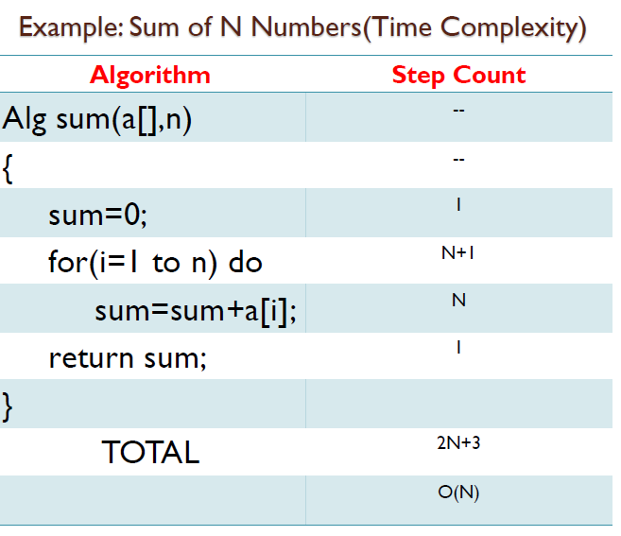
.

Slide 37
.
2. Asymptotic Notations
Asymptotic notations are mathematical notations used to describe the growth rate of an algorithm's time or space complexity as the input size (n) becomes very large.
There are three main notations:
Big-O (O) – Worst Case
Big-Omega (Ω) – Best Case
Big-Theta (Θ) – Average case

Slide 38
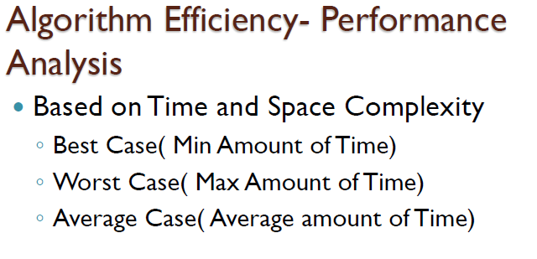
.
Fundamentals of Algorithm analysis

Slide 39
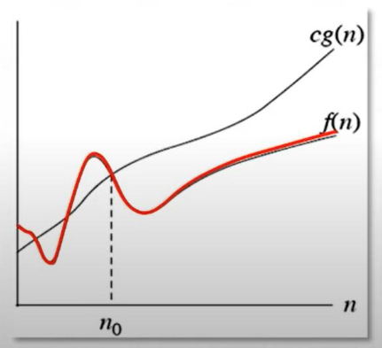
1. Big-O Notation (O)
Big-O represents the upper bound or worst-case performance of an algorithm.
Max amount required for execution is calculated( i e ..,Worst Case)
Example: Linear Search
10 20 30 40 50
Search for 50.
Comparisons:
10 ✗ 20 ✗ 30 ✗ 40 ✗ 50 ✓
Number of comparisons = 5
If there are n elements,
Maximum comparisons = n
Therefore, Worst Case = O(n)

Slide 40
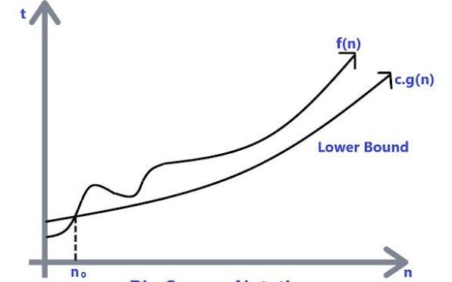
2. Big-Omega (Ω)
Big-Omega represents the lower bound or best-case performance of an algorithm.
Min amount required for execution is calculated( i e ..,Best Case)
Example: Linear Search
10 20 30 40 50
Search for 10
10 ✓
Only one comparison.
Therefore,
Best Case = Ω(1)

Slide 41
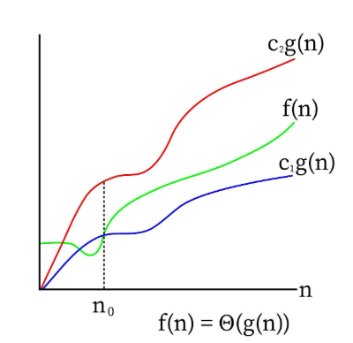
3. Big-Theta (Θ)
Big-Theta represents the tight bound, describing the typical or average growth of an algorithm when both upper and lower bounds are the same order.
Average amount required for execution is calculated( i e ..,Average Case)
Example
Linear Search
10 20 30 40 50
Search for 30.
Average comparisons
(n+1)/2
Therefore,
Average Case = Θ(n)

Slide 42
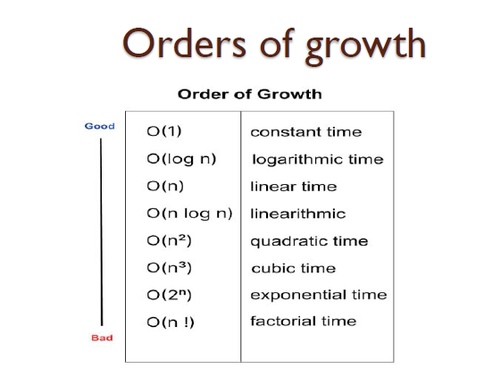
.

Slide 43
.
Analysis of non-recursive and recursive algorithms
Non-recursive algorithms use loops, whereas recursive algorithms solve a problem by calling themselves repeatedly until a base condition is reached.

Slide 44
.
Analysis of Non-Recursive Algorithms
A non-recursive algorithm is an algorithm that does not call itself. It uses loops (for, while, do-while) to solve a problem.
(calculate Time and space complexity )
Example 1: Sum of n Numbers
#include<stdio.h>
int main() {
int i, n, sum = 0;
printf("Enter n: ");
scanf("%d", &n);
for(i = 1; i <= n; i++)
{
sum = sum + i;
}
printf("Sum = %d", sum); return 0; }

Slide 45
.
Analysis of Non-Recursive Algorithms
Example 1: Sum of n Numbers
Time complexity =?
Space complexity =?

Slide 46
.
Analysis of Non-Recursive Algorithms
Example 1: Sum of n Numbers
Time complexity =O(n)
Space complexity =O(1)

Slide 47
.
Analysis of Non-Recursive Algorithms
Example 2:
for(i=0;i<n;i++) // Outer loop runs n times
{
for(j=0;j<n;j++) // Inner loop runs n times
{
printf("*");
}
}
Outer loop runs n times
Inner loop runs n times
Time complexity = ?
Space complexity =?

Slide 48
.
Analysis of Non-Recursive Algorithms
Example 2:
for(i=0;i<n;i++) // Outer loop runs n times
{
for(j=0;j<n;j++) // Inner loop runs n times
{
printf("*");
}
}
Outer loop runs n times
Inner loop runs n times
Time complexity = (n * n)= O(n²)
Space complexity =O(1)

Slide 49
.
Analysis of Recursive Algorithms
A recursive algorithm is an algorithm that solves a problem by calling itself until a base condition is reached.
Example:1 Factorial of a given number
#include<stdio.h>
int fact(int n)
{
if(n==1)
return 1;
return n * fact(n-1);
}
int main()
{
printf("%d",fact(5));
}
Time complexity= ? Space complexity=?
How it is executed
fact(5)
↓
5 × fact(4)
↓
5 × 4 × fact(3)
↓
5 × 4 × 3 × fact(2)
↓
5 × 4 × 3 × 2 × fact(1)
↓
120

Slide 50
.
Analysis of Recursive Algorithms
If n increases then time also will increase...
So...Time complexity= O(n)
Space complexity= O(n)
Each recursive call occupies memory in the call stack.
fact(5) 120
fact(4) 24
fact(3) 6
fact(2) 2
fact(1) 1

Slide 51
.
Analysis of Recursive Algorithms
Example 2 Fibonacci Series
The Fibonacci sequence is
0 1 1 2 3 5 8 13 21 ...

Slide 52
.
Analysis of Recursive Algorithms
Example 2 Fibonacci Series
#include <stdio.h>
int fibonacci(int n)
{
if(n == 0)
return 0;
if(n == 1)
return 1;
return fibonacci(n-1) + fibonacci(n-2);
}
int main()
{
int n;
printf("Enter n: ");
scanf("%d",&n);
printf("Fibonacci = %d", fibonacci(n));
return 0; }

Slide 53
.
Analysis of Recursive Algorithms
Example 2 Fibonacci Series
Algorithm Fibonacci(n)
Step 1: If n = 0
Return 0
Step 2: If n = 1
Return 1
Step 3: Return Fibonacci(n-1) + Fibonacci(n-2)
Step 4: End
Time complexity= T(n)=T(n−1)+T(n−2)+1 = O(2ⁿ)
Space complexity= O(n)
(stack stores every previous value...so if n increases then space also will increase)

