Slide 1


Slide 2

Rebus Puzzle

Slide 3

Once in blue moon

Slide 4

For instance

Slide 5

Nothing good on television

Slide 6

Green with envy

Slide 7
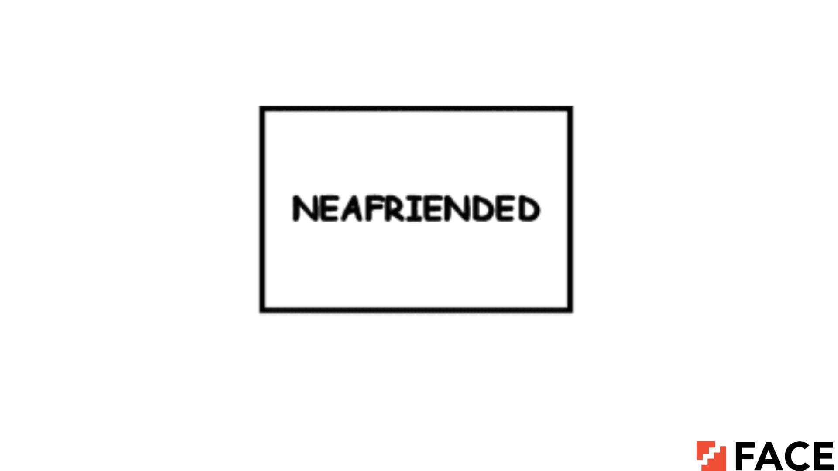
A friend in need

Slide 8
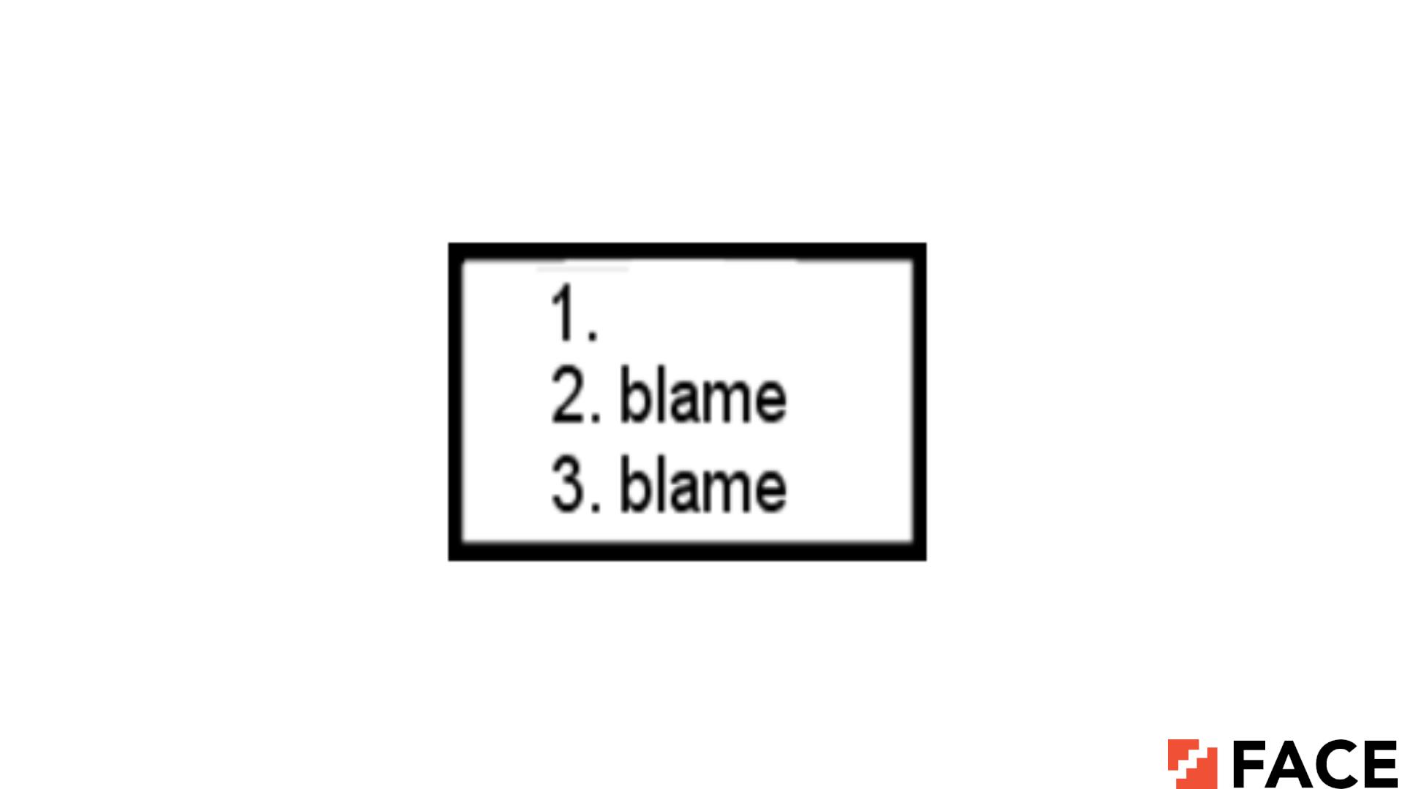
No one to blame

Slide 9

ABCDEFGHIJKLMNOPQRSTUVWYZ
QQQQQQQQQQQQQQQQQQQQQ
Missing X + Q’s = No excuse

Slide 10
TEN BADTION
Bad intention

Slide 11
BIG BIG
IGNORE IGNORE
To big to ignore

Slide 12
COME TABLE TABLE TABLE
TABLE
Comfortable

Slide 13
ESTIMATE
----------------- UR NME
NEVER
Never underestimate your enemy

Slide 14
CHAWHOWHORGE
Who is in charge?

Slide 15
J K
A2345678910Q
High + Jack + King = Hijacking

Slide 16
ESIW KCOLC
Anti clockwise

Slide 17
BRIDGE
_____________________
HIJKLMNO
Water under the bridge

Slide 18
YOU CONTOL R
You are out of control

Slide 19

Square root

Slide 20

Summary

Slide 21
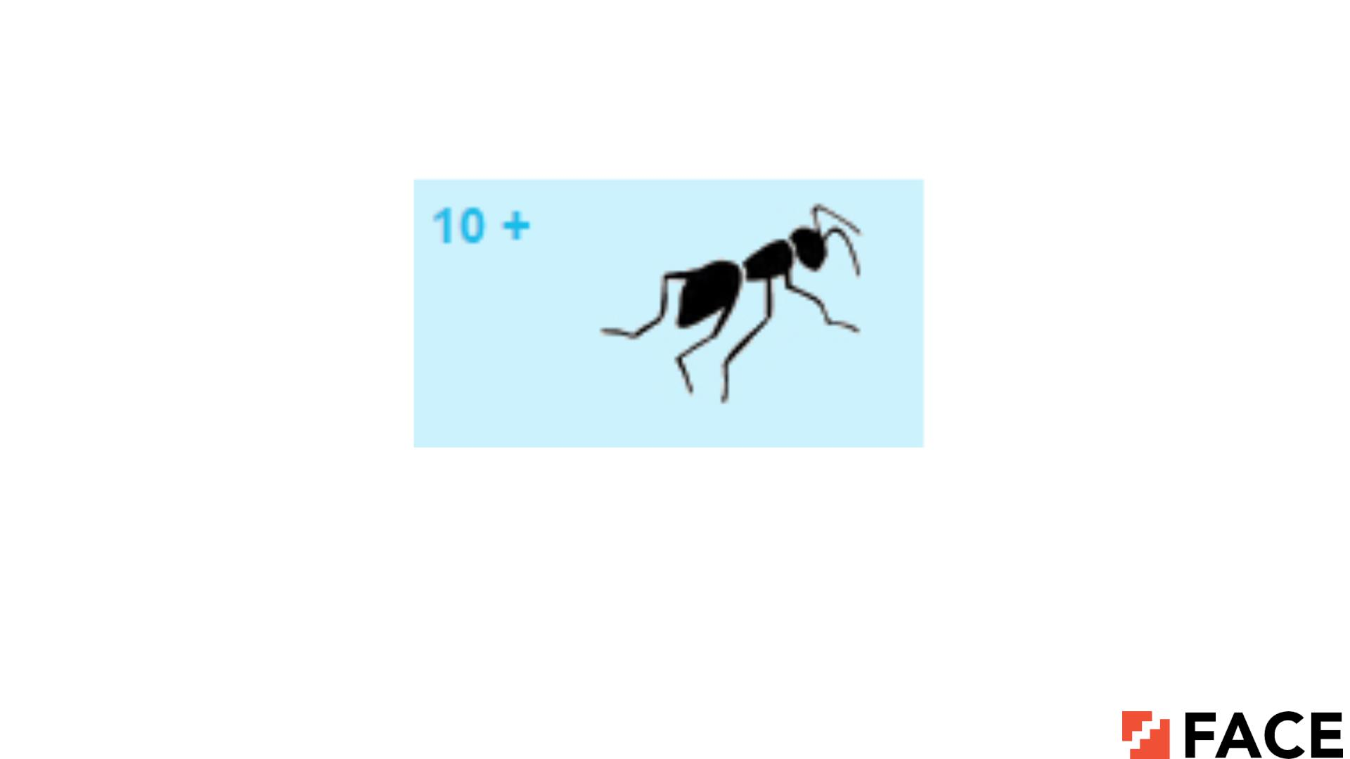
Tenants

Slide 22
/r/e/a/d/i/n/g/
Reading between the lines

Slide 23
ADNST
STAND in alphabetical order

Slide 24

Arctic circle

Slide 25
T
R WORLD P
I
Trip around the world

Slide 26
O_ER_T_O_
PAIN less operation

Slide 27

Ready for anything

Slide 28
ITIT,NCENTCENT
Its common sense (its comma n cents)

Slide 29

Note book

Slide 30
MEREPEAT
Repeat after me

Slide 31
GRAVITY
Center of gravity

Slide 32

Diamond ring

Slide 33
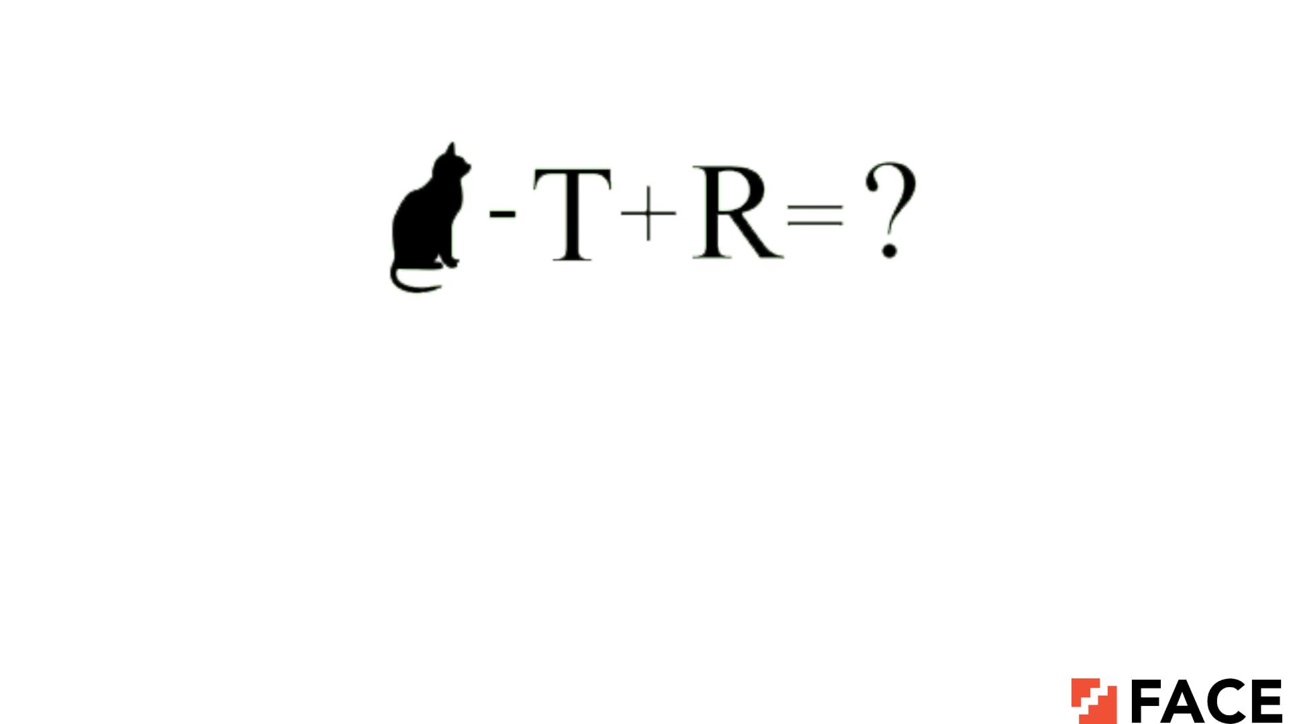
CAR

Slide 34
THINKBBBBULEAP
Think before you leap

Slide 35
POT OOOOOOOO
Potatoes (Pot + 8 O’s)

Slide 36
1,2,3……38,39,40 LIFE
Life begins at 40 or Life after 40

Slide 37
IMPORTANT = IMPORTANT
Equal importance

Slide 38
abcdefghijklmnopqrstvwxyz
Missing you

Slide 39
BLOOD WATER
Blood is thicker than water

Slide 40
ME111ONEONE11
Someone is following me

Slide 41
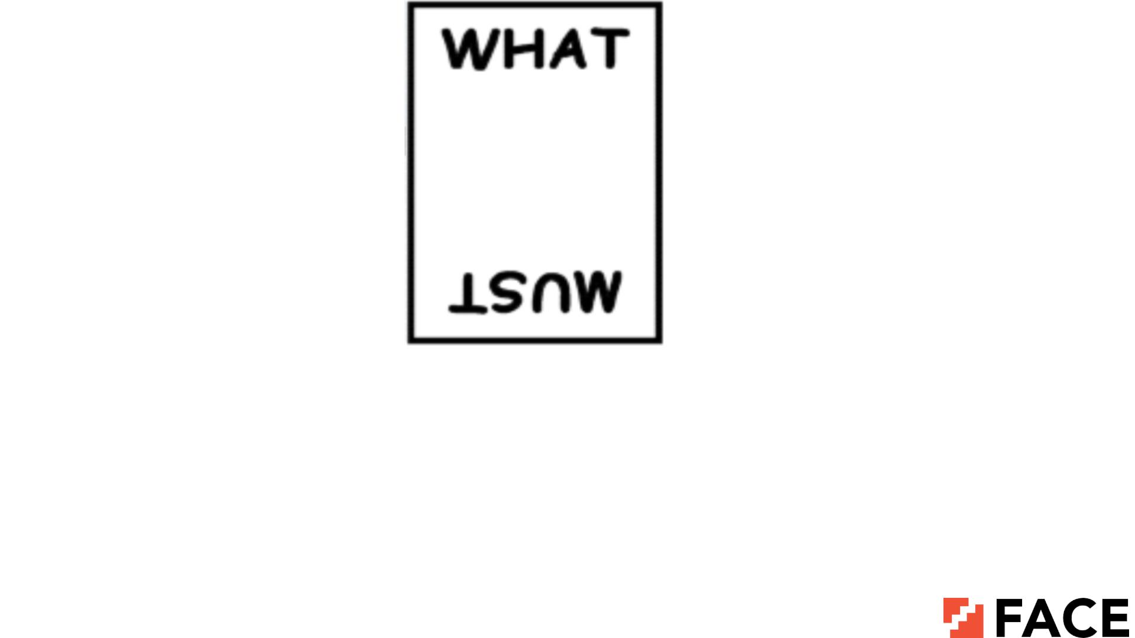
What goes up must come down

Slide 42
EILN PU
Line up in alphabetical order

Slide 43
OVER OVER
Over and over again

Slide 44

Love at 1st sight

Slide 45

3d movies

Slide 46
2222 DAY
Tuesday

Slide 47

Mixed emotions

Slide 48

No excuse for it

Slide 49
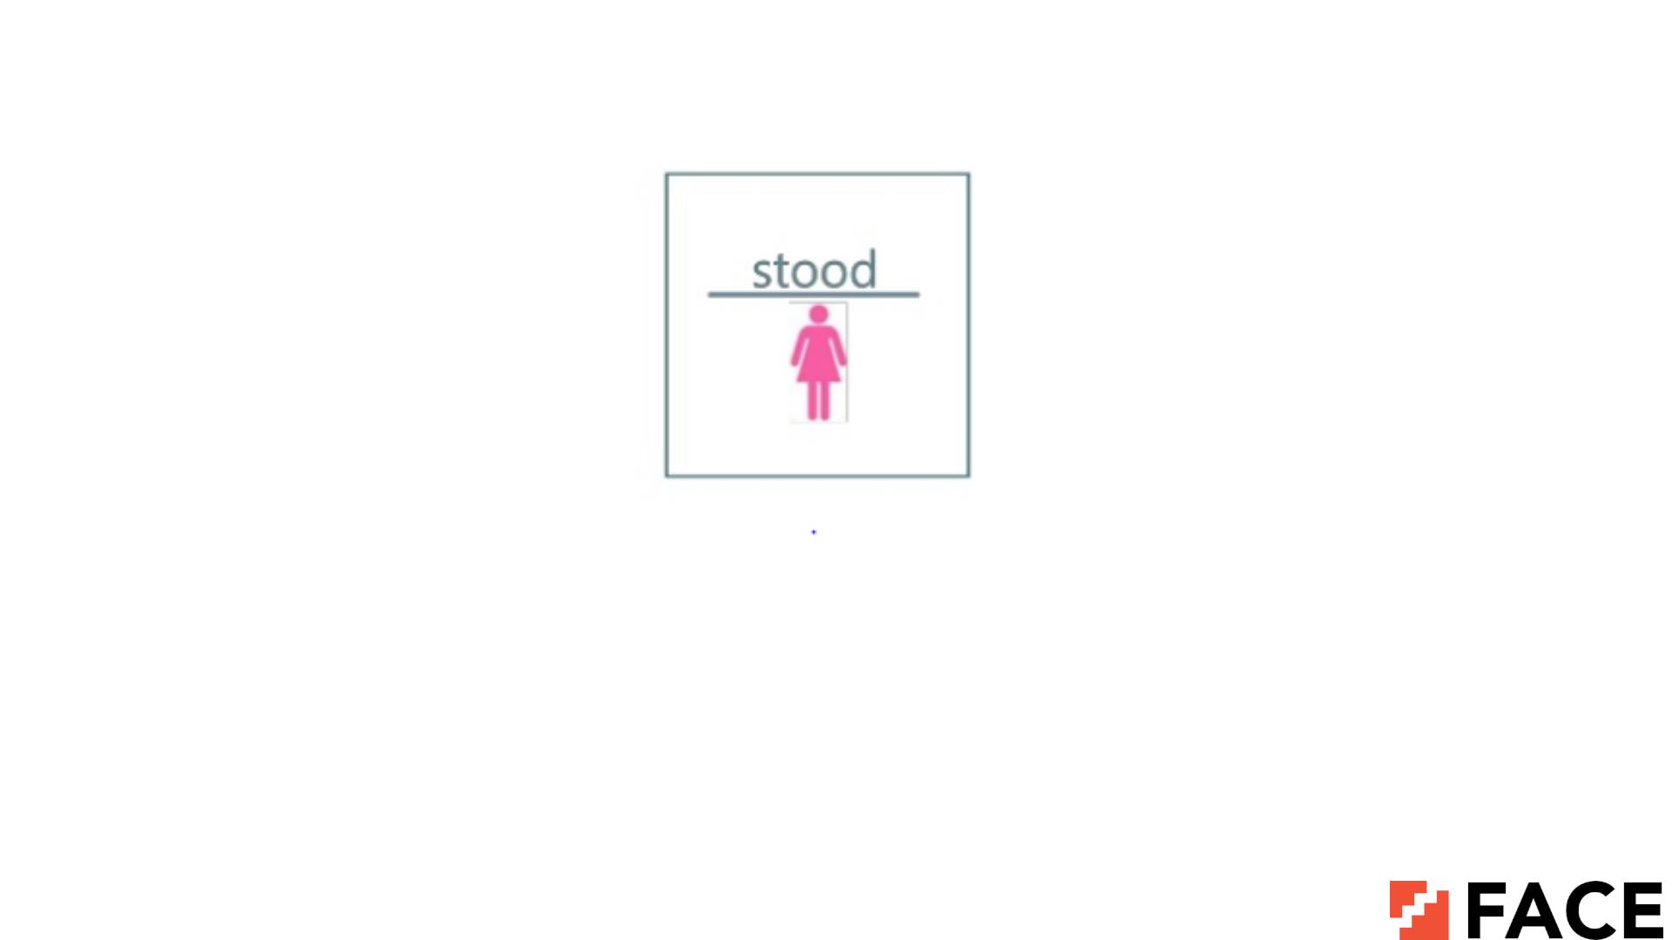
Miss understood

Slide 50

You will get over it

Slide 51
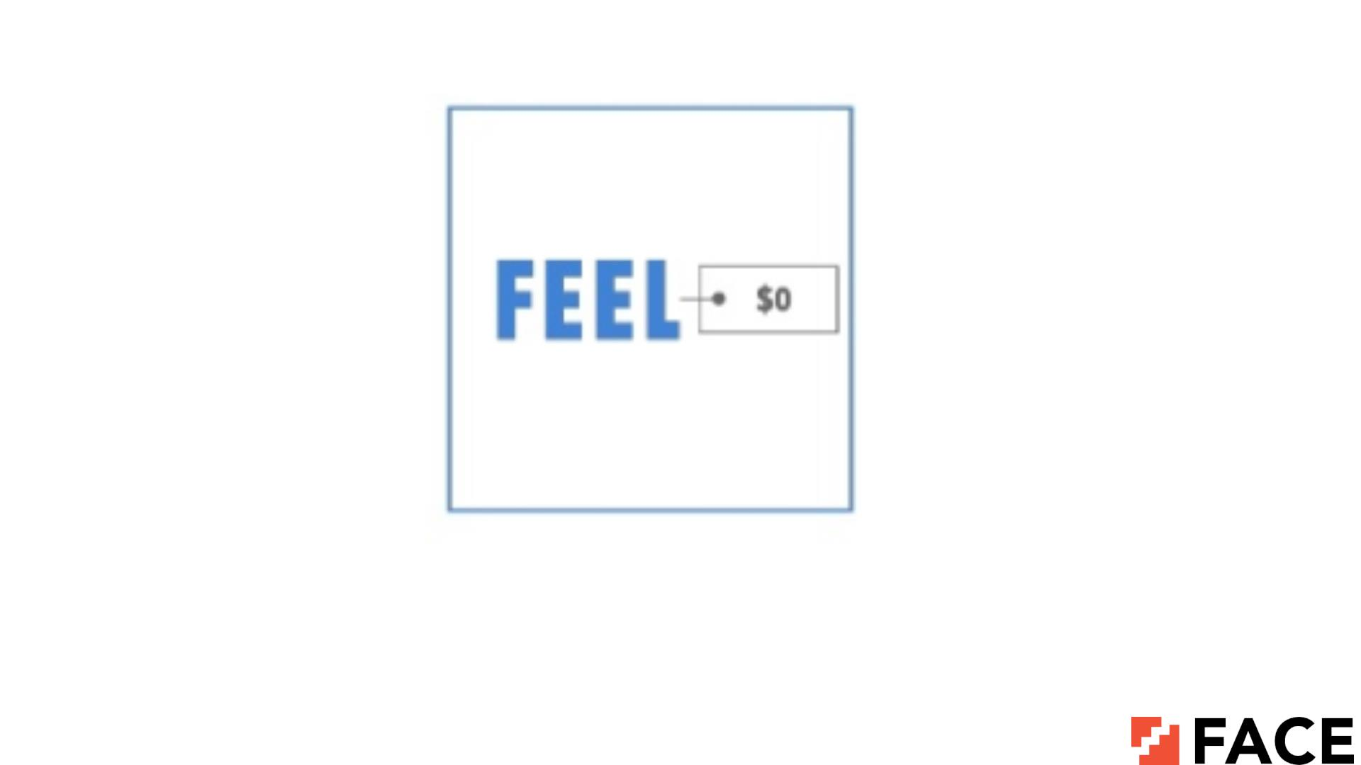
Feel Free

Slide 52
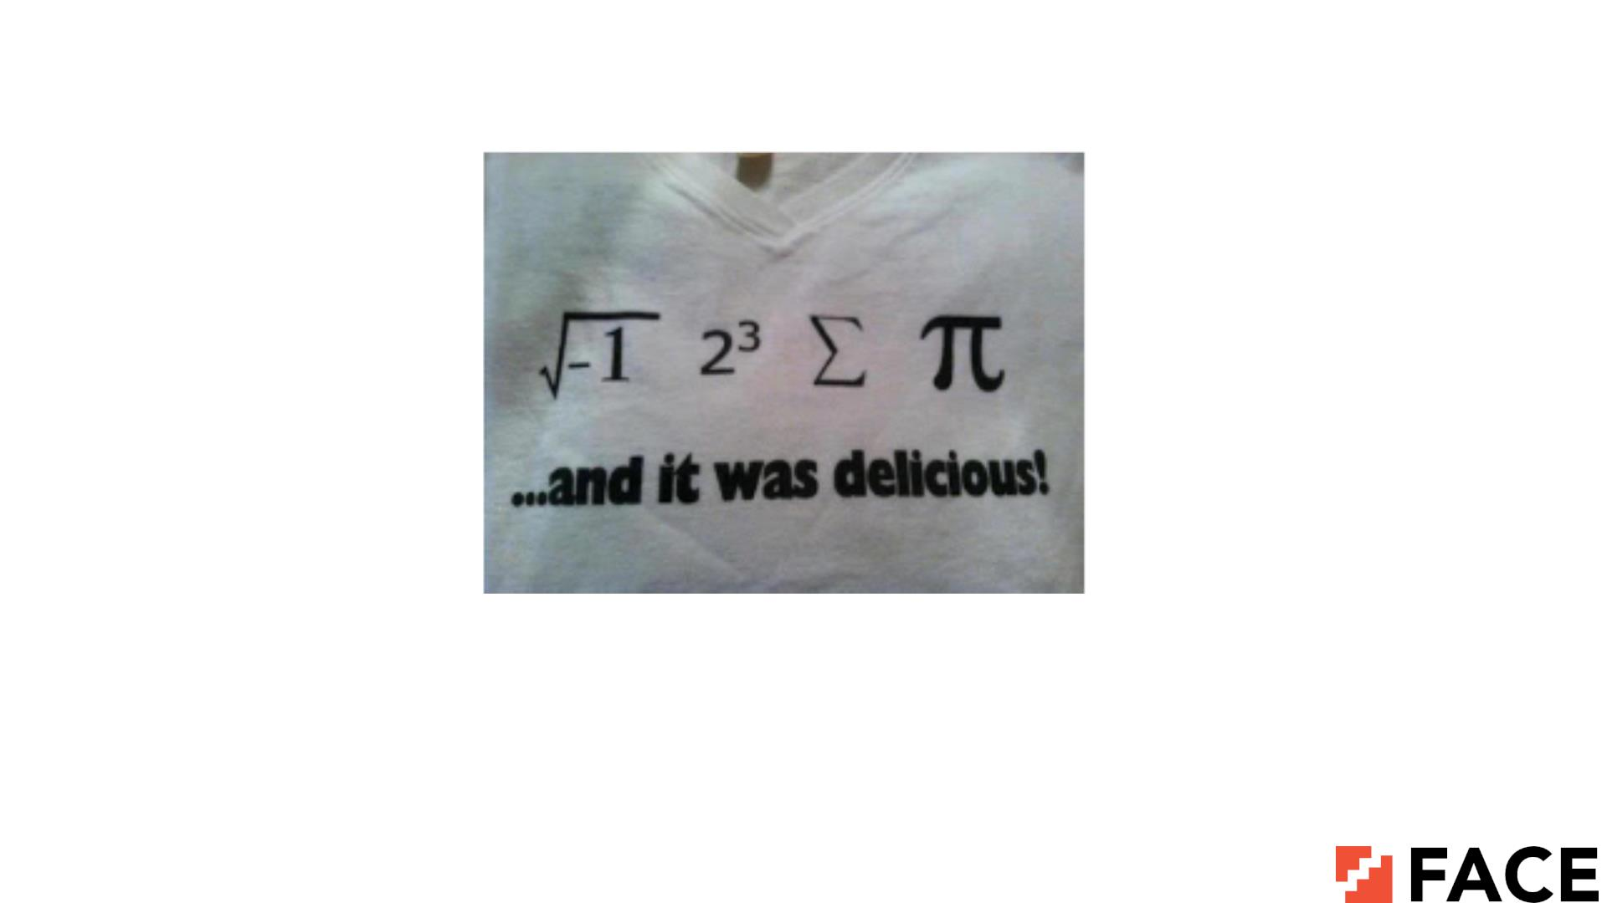
I ate some pie

Slide 53
ISSUES ISSUES
ISSUES ISSUES
ISSUES ISSUES
ISSUES ISSUES
ISSUES ISSUES
Tennis shoes

Slide 54
STANDS
0__23456789
No one under stands

Slide 55
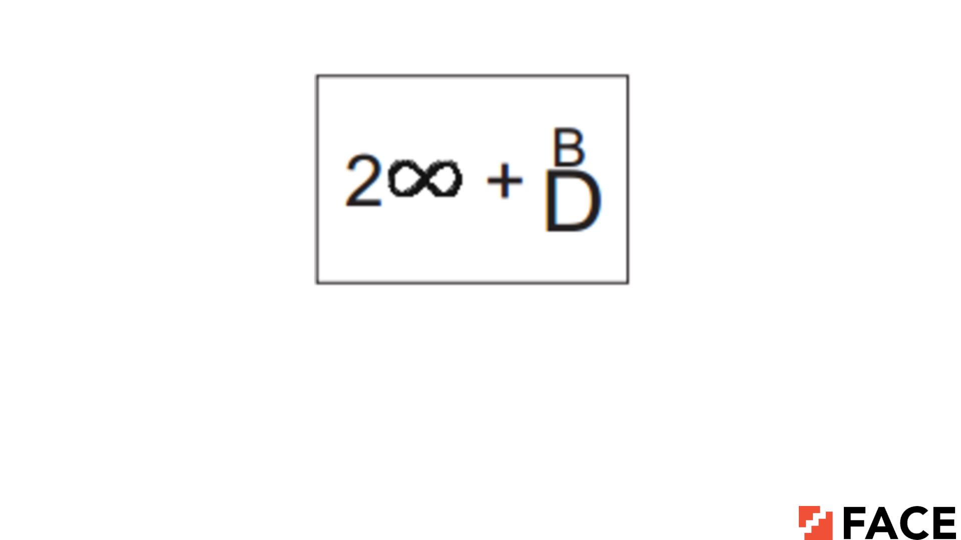
To infinity and Beyond

Slide 56
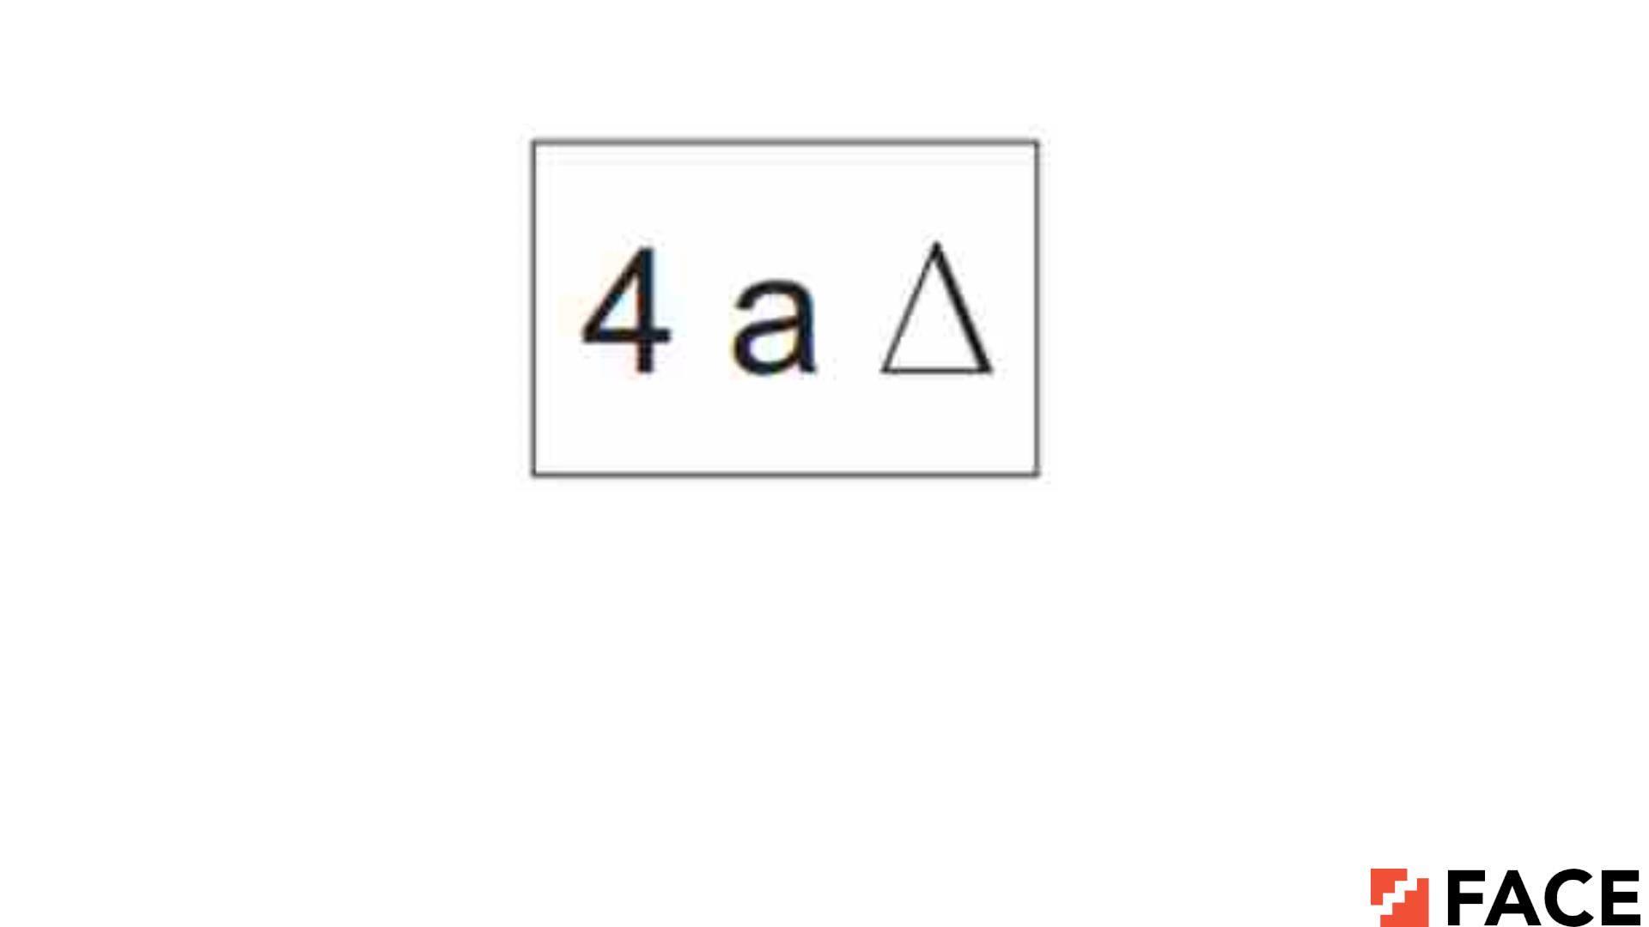
For a change

Slide 57
O
N
C
E
TIME
Once upon a time

Slide 58
R + R Nacl
Somersault

Slide 59
SOIUDTE
Inside out

Slide 60
SURIV
Anti virus

Slide 61

THANK YOU

