Slide 1
Des Moines Docker Users Group
May 23, 2018

Slide 2




Slide 3
Let’s Get Started

Slide 4
Dockerfile Deep Dive
Surendra Bajracharya, Wells Fargo

Slide 5
Agenda
Why docker file is needed and how to create one
Briefly go through basic docker commands and terms
Go through sample examples
Dockerize existing java and nodejs app
Demo by pushing to docker hub and pull and run it (Build, Ship and RUN)
https://github.com/gitsuren/dsm-docker-meetup

Slide 6
Next Meeting

Slide 7

Don’t miss the container industry event of the year!
Register now: https://2018.dockercon.com/
Special 10% Discount Code: BIRTHDAY10
*good for full conference passes only
Check out the Docker blog for an early preview of the agenda: https://blog.docker.com

Slide 8
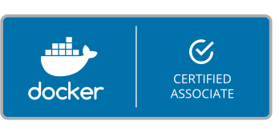
Get Docker Certified!
Continue your learning journey and set yourself apart
Go to http://success.docker.com/certification

