Slide 1


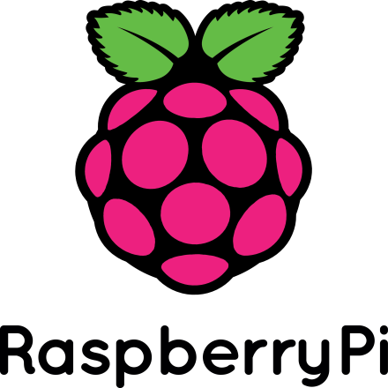



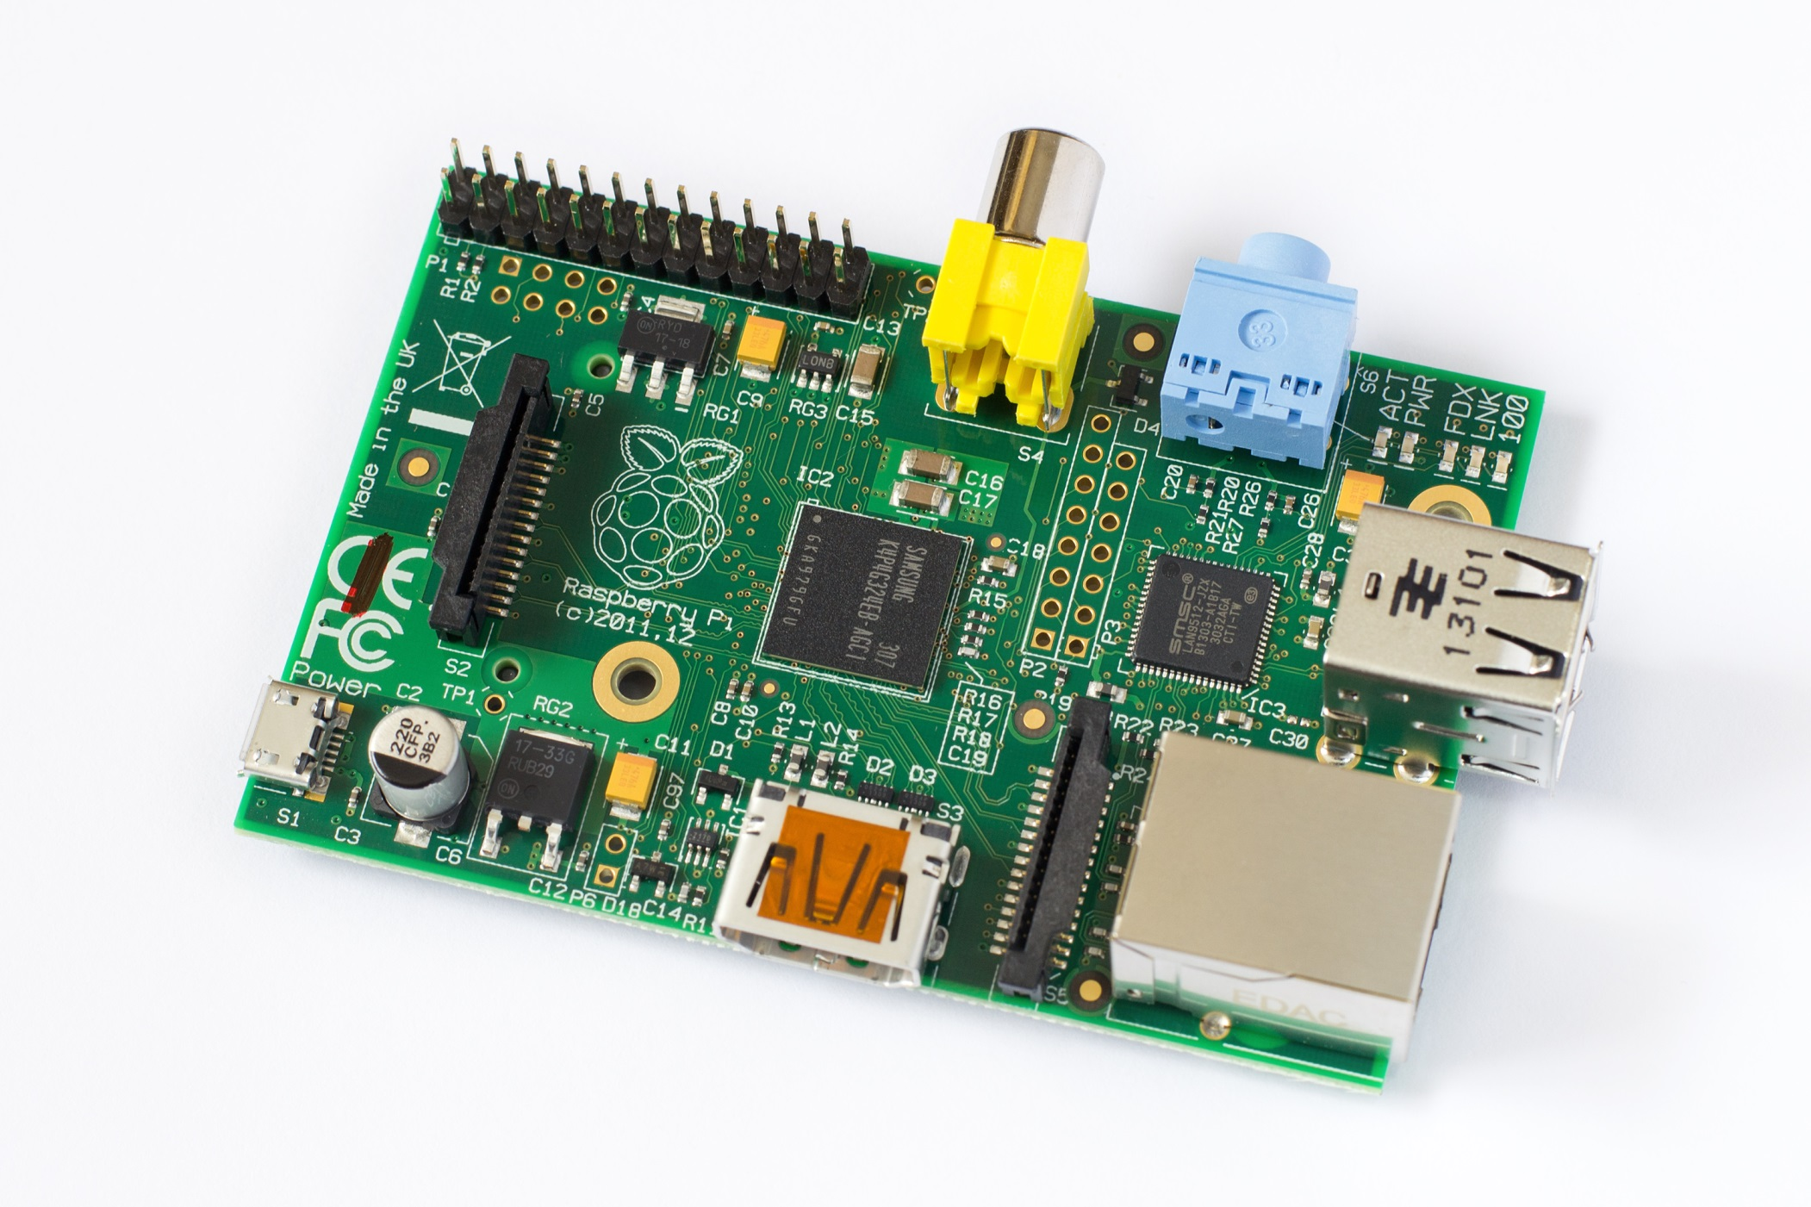
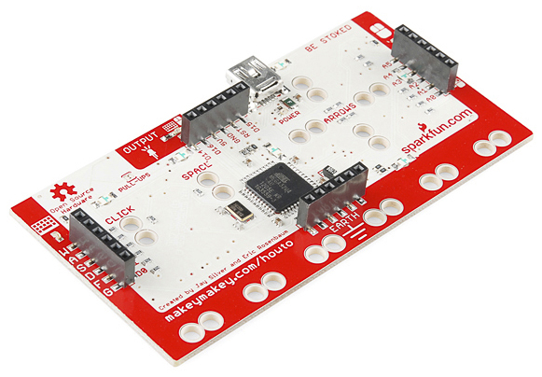


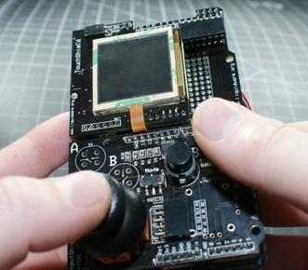
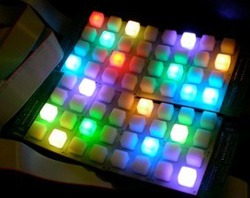
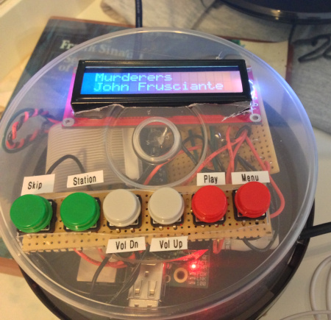
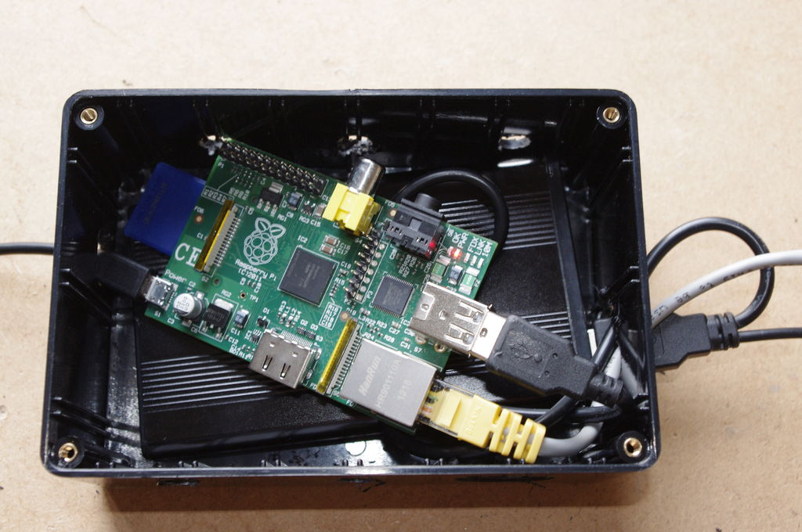
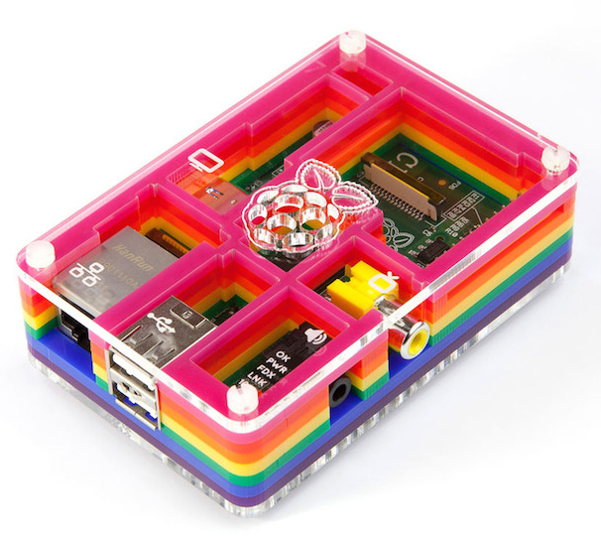
How Does this Work?
What is a Raspberry Pi?
The Raspberry Pi is a credit-card-sized computer developed in the UK by the Raspberry Pi Foundation to promote learning basic computer science. It is cheap, robust, and portable. It’s a perfect machine for making custom projects and products around school, home, or work.
How does the hardware work?
The MaKey MaKey is a printed circuit board that uses an ATmega32u4 microcontroller running Arduino Leonardo firmware. The MaKey MaKey provides convenient ways to hook up inputs, and the microcontroller handles how to react to them.
By completing a simple circuit, the Arduino can recognize which input was triggered. Then, it can send key presses, mouse clicks, or mouse movements. We use high-resistance switching so you can close a circuit even though materials like oranges, coins, and pencil lead. For this project, we simply send key presses like ‘r’, ‘d’, ‘f’, and ‘g’ to our Raspberry Pi whenever you complete a circuit.
How does the software work?
We run Raspian, a optimized version of Linux, on our Raspberry Pi. This way, the Raspberry Pi is in charge of the software-side of things. We’ve compiled this Bomberman game using C++, a common programming language you’ll learn here at BYU! Then, we’ve configured Bomberman to recognize the keyboard letters sent here by the Arduino so you can compete in Bomberman with play-doh, coins, or anything else conductive!
Debouncing:
Pushing a button isn’t as smooth as you’d think! In reality, the signal “bounces” up and down before it finally makes a good connection.
The Arduino on the MaKey MaKey has been programmed to wait for the input signals to fully settle before registering a new button press.
How powerful is it?
The GPU is capable of 1Gpixel/s, 1.5Gtexel/s or 24 GFLOPs of general purpose compute and features a bunch of texture filtering and DMA infrastructure. This means that graphics capabilities are roughly equivalent to the original Xbox’s level of performance. Real world performance is like a 300MHz Pentium 2, only with much, much swankier graphics.
What else can Arduino do?
Arduino is an open-source prototyping platform intended for anyone interested in creating interactive objects or environments. The MaKey MaKey is just one of the projects based on Arduino. Arduino can receive input from a variety of sensors and can send signals, control lights, motors, and other actuators. Some other cool projects include:
What else can a Raspberry Pi do?
Basically, a Raspberry Pi is a powerful, compact, $30 computer! Because it can run Linux, you can use it for nearly any software projects like the three (of hundreds) shown below!
Arduino Laser Harps
Open Source GameBoy
Color Combo Door Lock
Pandora Jukebox
Mountable Web Server
Home Media Center

