Slide 1
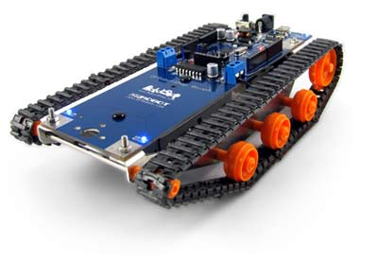
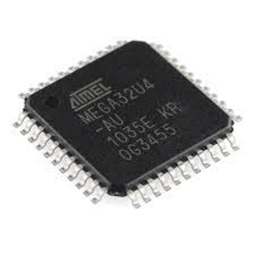
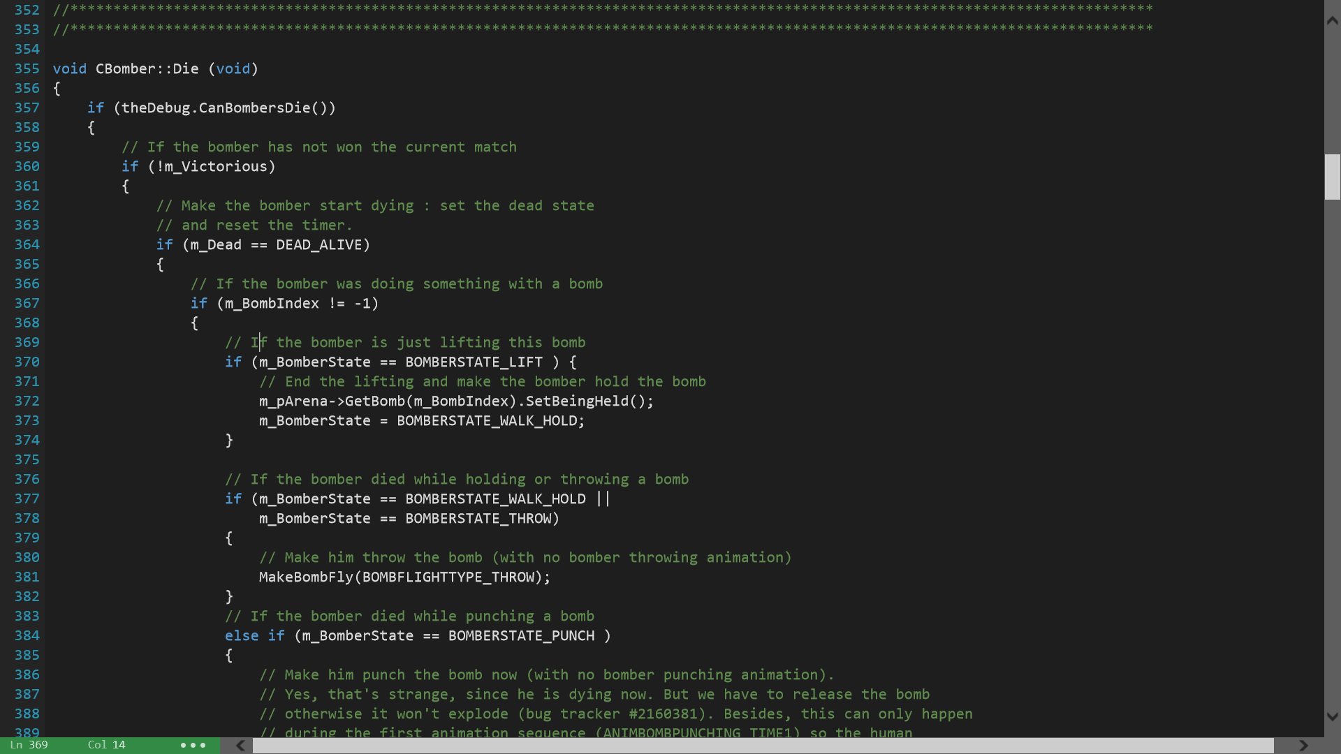
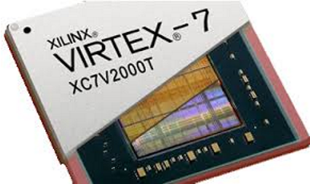
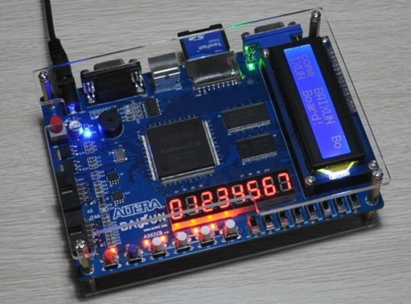
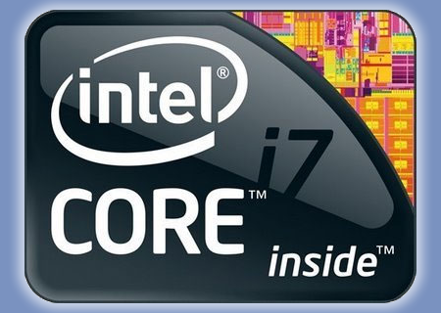
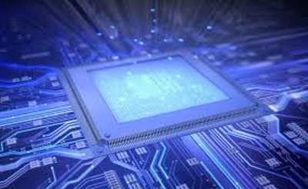






What is Computer Engineering?
Hardware
Software
Computer Engineering is all about interfacing two key components, the first of which is hardware. Believe it or not, hardware is more than just what is found within computers! Here at BYU you will learn about several hardware components that are fundamental to computing in a variety of different applications.
The second key component to Computer Engineering is software. Although hardware is where the rubber meets the road, it would not be very useful if there was no software for it to run. Computer Engineers get to learn a variety of different programming languages that run on hardware at different levels of abstraction. They also understand how programs go from code to execution. In other words, you get to develop some really sweet stuff!
Microcontrollers:
Microcontrollers are designed for use in embedded systems. Generally, they are lower power and more cost-efficient than typical microprocessors, making them ideal for applications such as robotics, automobile control systems, and medical devices. They are usually programmed in assembly or C. A great example of this is the MaKey MaKey which using an ATMega32u4 microcontroller.
Levels of Abstraction
Source Code
The Bomberman game you’re playing is thousands of lines of C++ code. Here is a snippet of the code that tells our computer what to do when a Bomberman gets burned.
In Computer Engineering, you’ll learn how to develop software using object oriented design, write clean code, and optimize programs for performance!
Preprocessing
Compilation
FPGAs:
A Field-Programmable Gate Array is another type of integrated circuit that is most often used to perform complex digital computations very quickly. They are programmed with the use of Hardware Description Languages (like VHDL or Verilog) which are capable of describing a digital circuit. Ask us about the cool Space and CERN projects involving FPGAs going on at BYU right now!
Java/C#
Assembly Code
Assembler
C++
Machine Code
Linking
Microprocessors:
All modern CPUs are microprocessors. These are devices that accept digital data as input, processes it according to the instructions stored in its memory, and provides results as output. Here at BYU you will learn how processors operate, design your own LC-3, and see how techniques like hyper-threading, caching, and pipelining improve performance.
C
Executable Code
Assembly
Compiling Process
You’ll also learn about ASICs, DSPs, GPUs, and create your own powerful systems within Computer Engineering!
Why be a Computer Engineer?
Being a Computer Engineer is the best! You’ll be set apart from the competition because of your understanding of both hardware and software in computing systems. Not only do you get to create innovative technology, you get to work on some of BYU’s own award-winning projects such as:
Robot Soccer Competition
Light Suits
Robotic/Machine Vision
Not to mention, there is an expected 21% employment growth ending in 2018. In 2013, the graduating class of Computer Engineers experienced an average starting salary of $70,900!
If you want to be in high demand, make a good living, guide technology forward, and love your job…
Apply Now!
Visit http://ee.byu.edu

