Slide 1
Group Projects
Software Engineering Course
2015-2016

Slide 2
Technologies
Server: Rails + slim language, Stamplay/Firebase for Web API, node.js
Web Client: AngularJS (Google), ReactJS (Facebook), Web components, vue.js,
Mobile: Ionic
UI: Material Design, Bootstrap 4/Semantic-UI/Foundation
Deployment: Heroku, Jenkins-ci
Testing: Unit Test, Selenium HQ, BDD, Karma or Jasmine
AND SIMILAR ONES …

Slide 3
Projects Ideas
Quiz App
Base on https://polymer-topeka.appspot.com, rebuild it
One team build a server using Rails + slim, expose REST API.
One team build a web client using AngularJS
One team build a mobile client using Ionic
Then add more functionalities
Login using Facebook, Google, Microsoft accounts
Add/Edit/Delete questions in the question banks
Add properties to questions: difficulty levels, answer hints,
Allow rating and commenting for each question
Store user’s results
Create user progress reports

Slide 4
Projects Ideas
Online Learning Platform
Base on olm.vn, rebuild it
One team build a server using Rails + slim, expose REST API.
One team build a web client using AngularJS
One team build a mobile client using Ionic
More teams can join

Slide 5
Other ideas
Clone some other website
Good candidates: based on Flash, not responsive (not mobile friendly)
=> Clone it with HTML5/JavaScript and responsive design
Why cloning? Because we have a pretty good and clear requirements

Slide 6
Plan
Online:
https://gitter.im/
Offline
2nd week: discussion
5th week: demo the first few functions
8th week: demo + code review
11th week: demo + automated testing
14th week: final presentation + documentation

Slide 7
What are the important points in projects?
PRODUCT
QUALITY, QUALITY, QUALITY
Internal ones: code quality, design quality
External ones: UI, UX
Tips: Just use the standard, built-in ones
PROCESS
We can only observe it, so make evidences about yours

Slide 8
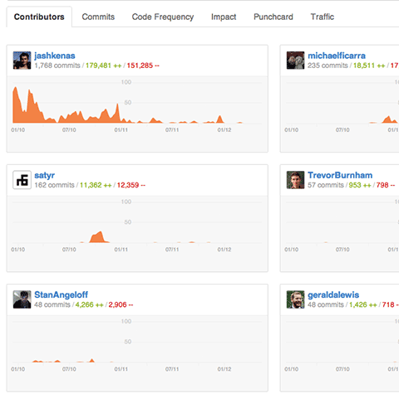
Tracking
Github activities

