Slide 1
Swift Day 7
Storyboard-Viewcontroller-UIView-UIGestureRecognizer-UIKit Dynamic

Slide 2
Sumary
Friendly Xcode
iOS app architecture
Working with Storyboard
Working with XIB
ViewController-UIView
UIGestureRecognizer
UIKit Dynamic

Slide 3
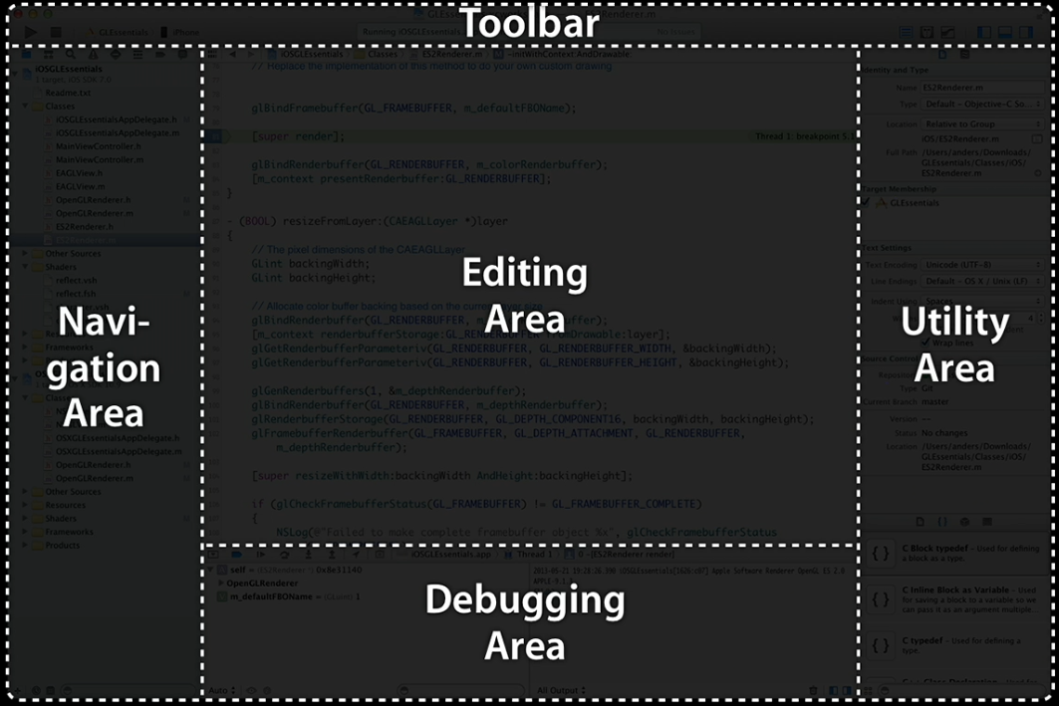
Xcode
The Toolbar: Where you choose your scheme and destination, run your app, and switch between common interface layouts.
The Navigation Area: Where you navigate through your project, symbols, errors, etc.
The Editing Area: Where all the magic happens. Includes the Jump bar at the top of this view.
The Utility Area: Includes the Inspectors and the Libraries.
The Debugging Area: Includes the Console and the Variable Inspector.

Slide 4
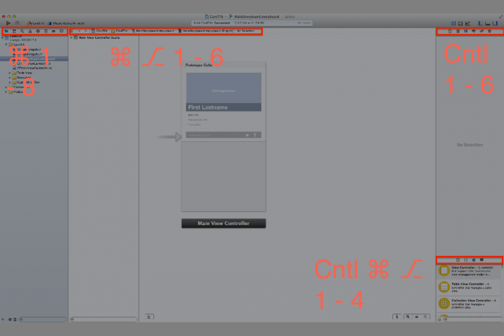
Hotkey
Command (⌘), Alt (⎇), Control
Command 1~8 to jump through the Navigators, Command 0 to close the navigation area.
Command Alt 1~6 to jump through the Inspectors, Command Alt 0 to close the utility area.
Control Command Alt 1~4 to jump through the Libraries.
Control 1~6 to bring down tabs in the Jump Bar.

Slide 5
About iOS App Architecture
Expected App Behaviors: Providing the Required Resources, The App Bundle, The Information Property List File, Declaring the Required Device Capabilities, App Icons, App Launch (Default) Images…
The App Life Cycle
Background Execution
Ref: https://developer.apple.com/library/prerelease/ios/documentation/iPhone/Conceptual/iPhoneOSProgrammingGuide/Introduction/Introduction.html

Slide 6
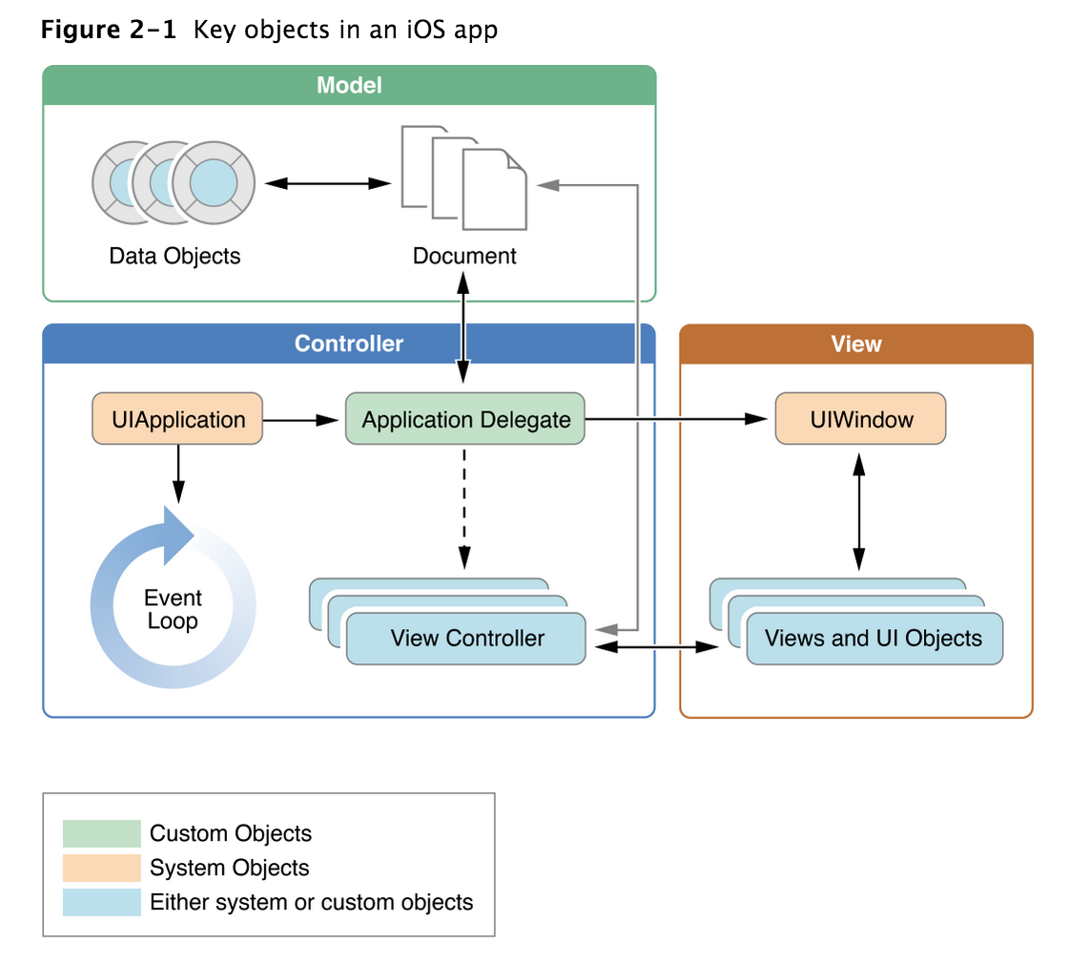
The App Life Cycle
The Structure of an App
Notes:
During startup, the UIApplicationMain function sets up several key objects and starts the app running. At the heart of every iOS app is the UIApplication object, whose job is to facilitate the interactions between the system and other objects in the app. Figure 2-1 shows the objects commonly found in most apps, while Table 2-1 lists the roles each of those objects plays. The first thing to notice is that iOS apps use amodel-view-controller architecture. This pattern separates the app’s data and business logic from the visual presentation of that data. This architecture is crucial to creating apps that can run on different devices with different screen sizes.

Slide 7
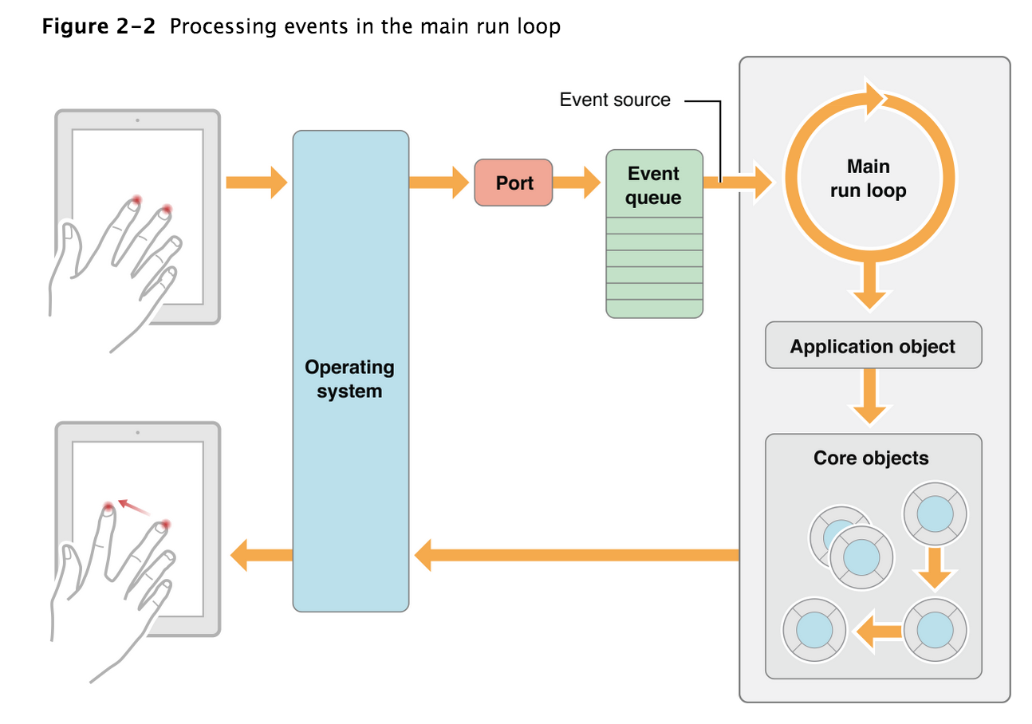
The App Life Cycle
The Main Run Loop
Notes:
An app’s main run loop processes all user-related events. The UIApplication object sets up the main run loop at launch time and uses it to process events and handle updates to view-based interfaces. As the name suggests, the main run loop executes on the app’s main thread. This behavior ensures that user-related events are processed serially in the order in which they were received.
Figure 2-2 shows the architecture of the main run loop and how user events result in actions taken by your app. As the user interacts with a device, events related to those interactions are generated by the system and delivered to the app via a special port set up by UIKit. Events are queued internally by the app and dispatched one-by-one to the main run loop for execution. The UIApplication object is the first object to receive the event and make the decision about what needs to be done. A touch event is usually dispatched to the main window object, which in turn dispatches it to the view in which the touch occurred. Other events might take slightly different paths through various app objects.

Slide 8
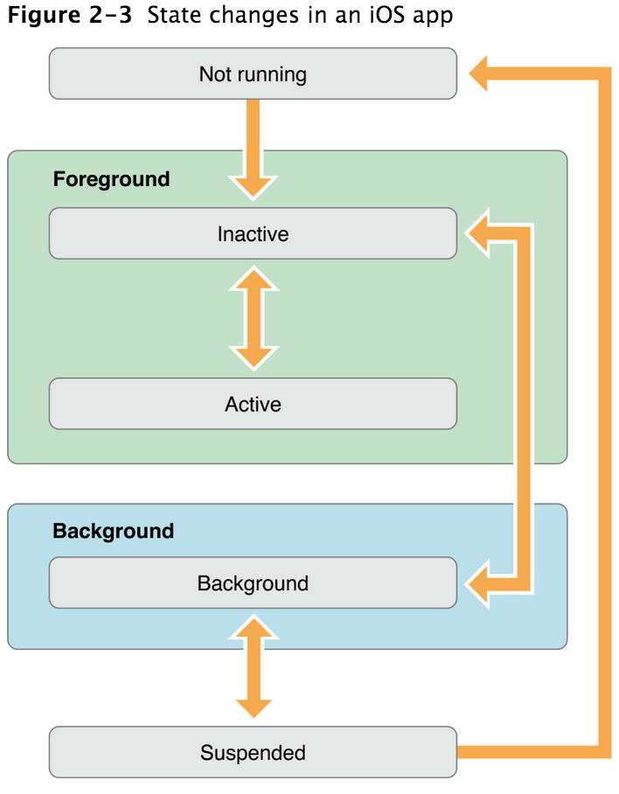
The App Life Cycle
Execution States for Apps
application:willFinishLaunchingWithOptions:
application:didFinishLaunchingWithOptions:
applicationDidBecomeActive:
applicationWillResignActive:
applicationDidEnterBackground:
applicationWillEnterForeground:
applicationWillTerminate:
Notes:
Not running: The app has not been launched or was running but was terminated by the system.
Inactive: The app is running in the foreground but is currently not receiving events. (It may be executing other code though.) An app usually stays in this state only briefly as it transitions to a different state.
Active: The app is running in the foreground and is receiving events. This is the normal mode for foreground apps.
Background: The app is in the background and executing code. Most apps enter this state briefly on their way to being suspended. However, an app that requests extra execution time may remain in this state for a period of time. In addition, an app being launched directly into the background enters this state instead of the inactive state. For information about how to execute code while in the background, seeBackground Execution.
Suspended: The app is in the background but is not executing code. The system moves apps to this state automatically and does not notify them before doing so. While suspended, an app remains in memory but does not execute any code.
When a low-memory condition occurs, the system may purge suspended apps without notice to make more space for the foreground app.

Slide 9
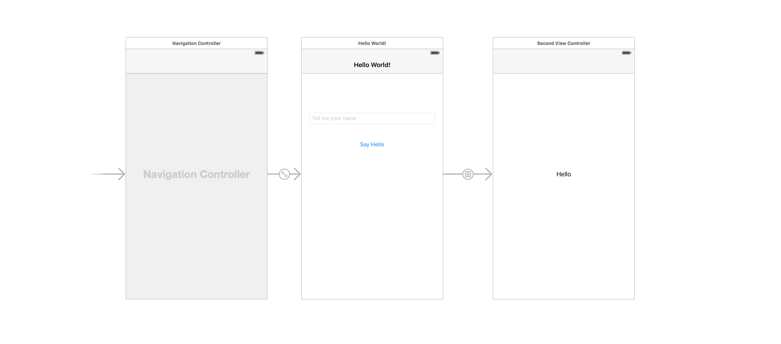
Storyboard
Storyboarding is an exciting new feature in iOS 5 that will save you a lot of time building user interfaces for your apps.

Slide 10
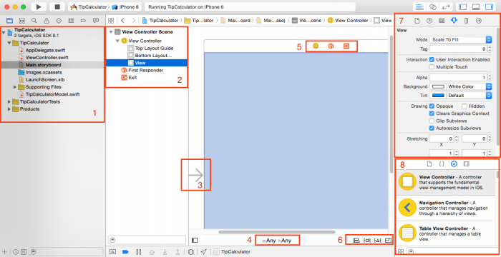
Interface builder
Notes:
There’s a lot of stuff to cover here, so let’s go over each section of the screen one at a time.
On the far left is your Project Navigator, where your can see the files in your project.
On the left of Interface Builder is your Document Outline, where you can see at a glance the views inside each “screen” of your app (view controllers). Be sure to click the “down” arrows next to each item to fully expand the document outline. Right now your app only has one view controller, with only one empty white view. You’ll be adding things into this soon.
There’s an arrow to the left of your view controller. This indicates that this is the initial view controller, or the view controller that is first displayed when the app starts up. You can change this by dragging the arrow to a different view controller, or by clicking the “Is Initial View Controller” property on a different view controller in the Attributes Inspector (more on Inspectors later).
On the bottom of the Interface Builder you’ll see something that says “w Any”, “h Any”. This means that you are editing the layout for your app in a way that should work on any sized user interface. You can do this through the power of something called Auto Layout. By clicking this area, you can switch to editing the layout for devices of specific size classes. You’ll learn about Adaptive UI and Auto Layout in a future tutorial.
On the top of your view controller (if you don’t see these, click the view controller to reveal them) you’ll see three small icons, which represent the view controller itself and two other items: First Responder, and Exit. If you’ve been developing in Xcode for a while, you’ll notice that these have moved (they used to be below the view controller). You won’t be using these in this tutorial, so don’t worry about them for now.
On the bottom right of Interface Builder are four icons related to Auto Layout. Again, you’ll learn more about these in a future tutorial.
On the upper right of Interface Builder are the Inspectors for whatever you have selected in the Document Outline. If you do not see the inspectors, go to View\Utilities\Show Utilities. Note there are several tabs of inspectors. You’ll be using these a lot in this tutorial to configure the views you add to this project.
On the bottom right of Interface Builder are the Libraries. This is a list of different types of views or view controllers you can add to your app. Soon you will be dragging items from your library into your view controller to lay out your app.

Slide 11
XIB
Demo

Slide 12
Storyboard vs XIB
In simple words Storyboard is one single file for all the views or screens that in yours apps.
It minimizes (reduces) the number of files in your apps.
Storyboard can put the XIB files.
Storyboard is universal; that means your apps can run both iPhone and iPad.
Storyboard is good for seeing how the controllers connect to each other.
XIB is Mac OS x interface builder.
It allows Cocoa Touch and Carbon Touch.
In XIB the result is stored as a NIB file.
It is the part of X code.
In XIB modularity is done in a very nice way.
In XIB it gives you more flexibility, and simplicity in terms of code.
In Storyboard if you have too many views then Storyboard can be confusing.
It is less flexible.
In XIB there is no flow of control and transition between the view and controller.
In XIB if there is any bug in making a connection then it is to hard too debug.

Slide 13
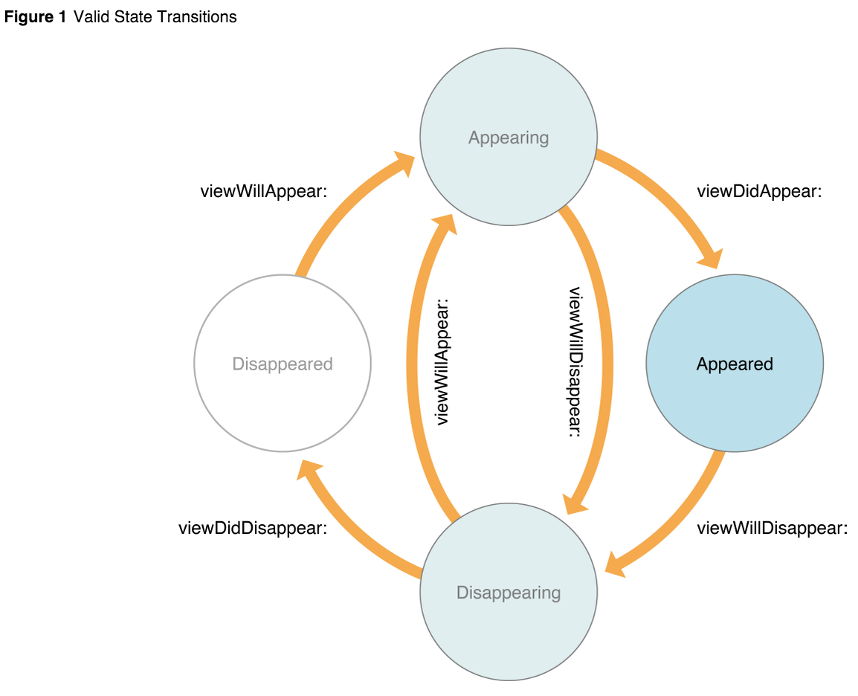
ViewController
func viewDidLoad()
func viewDidUnload()
Ref: https://developer.apple.com/library/ios/documentation/UIKit/Reference/UIViewController_Class/

Slide 14
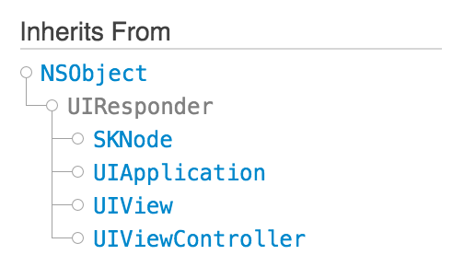
UIView
Rectangular area on screen
Handles events
Subclass of UIResponder (event handling class)
Views arranged hierarchically
every view has one superview
every view has zero or more subviews

Slide 15
View Hierarchy - UIWindow
Views live inside of a window
UIWindow is actually just a view
adds some additional functionality specific to top level view
One UIWindow for an iPhone app
Contains the entire view hierarchy
Set up by default in Xcode template project

Slide 16
View Hierarchy - UIWindow
Add/remove views in IB or using UIView methods
public func addSubview(view: UIView)
public func removeFromSuperview()
Manipulate the view hierarchy manually:
public func insertSubview(view: UIView, atIndex index: Int)
public func insertSubview(view: UIView, belowSubview siblingSubview: UIView)
public func insertSubview(view: UIView, aboveSubview siblingSubview: UIView)
public func exchangeSubviewAtIndex(index1: Int, withSubviewAtIndex index2: Int)

Slide 17
View Hierarchy - Ownership
Superviews retain their subviews
Not uncommon for views to only be retained by superview
Be careful when removing!
Retain subview before removing if you want to reuse it
Views can be temporarily hidden
myView.hidden = true;

Slide 18
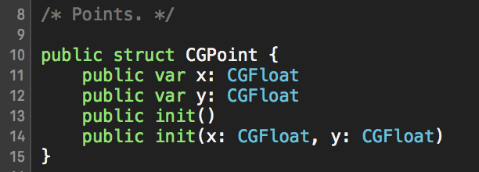
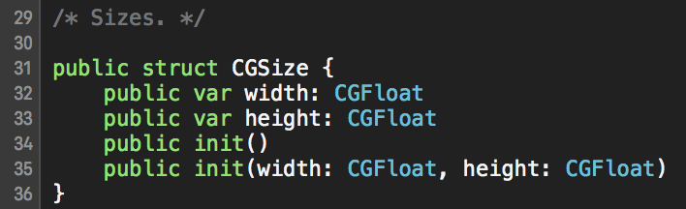
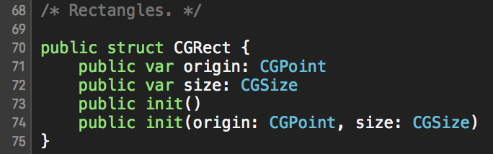
View-related Structures
CGPoint
location in space: { x , y }
CGSize dimensions: { width , height }
CGRect location and dimension: { origin , size }
Notes:
0ppp

Slide 19
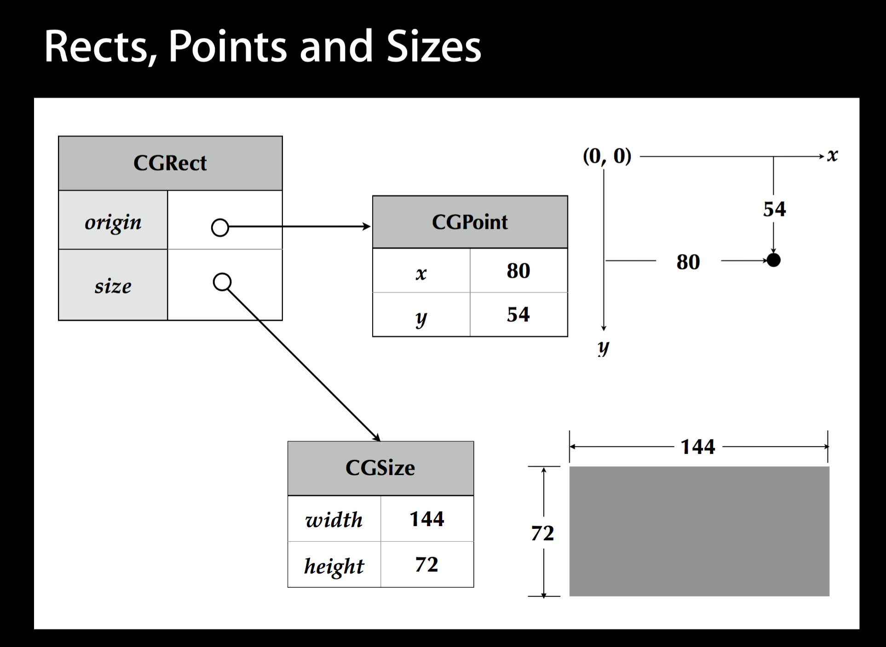
Notes:
0ppp

Slide 20
Location and Size
View’s location and size expressed in two ways
Frame is in superview’s coordinate system
Bounds is in local coordinate system
center - this is the property you will likely focus on for sprite based games and animations where movement or scaling may occur. By default animation and rotation will be based on the center of the UIView. It rarely makes sense to try and manage such objects by the frame property.
Ref: http://stackoverflow.com/questions/1210047/cocoa-whats-the-difference-between-the-frame-and-the-bounds

Slide 21
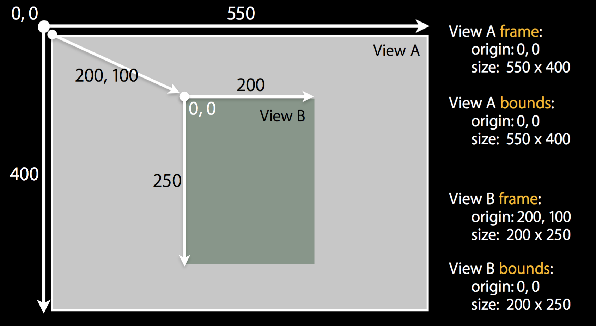
Location and Size

Slide 22
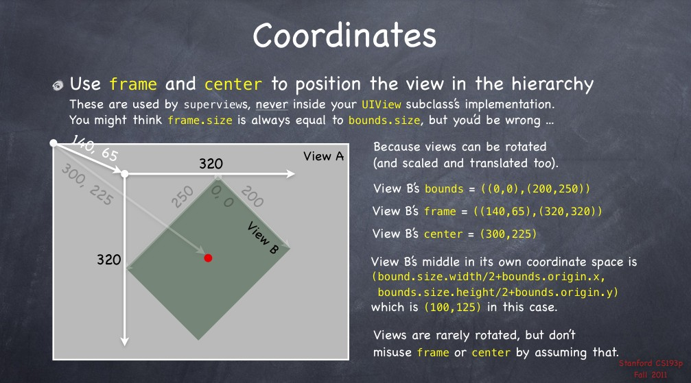

Slide 23
UIGestureRecognizer
UITapGestureRecognizer
UIPinchGestureRecognizer
UIRotationGestureRecognizer
UISwipeGestureRecognizer
UIPanGestureRecognizer
UIScreenEdgePanGestureRecognizer
UILongPressGestureRecognizer
Notes:
Demo

Slide 24
UIKit Dynamic
UIKit Dynamics is a full physics engine integrated into UIKit. It allows you to create interfaces that feel real by adding behaviors such as gravity, attachments (springs) and forces. You define the physical traits that you would like your interface elements to adopt, and the dynamics engine takes care of the rest.
Motion Effects allows you to create cool parallax effects like you see when you tilt the iOS 7 home screen. Basically you can harness the data supplied by the phone’s accelerometer in order to create interfaces that react to changes in phone orientation.

