Slide 1

Swift programming language
3Si – 09/15/15

Slide 2
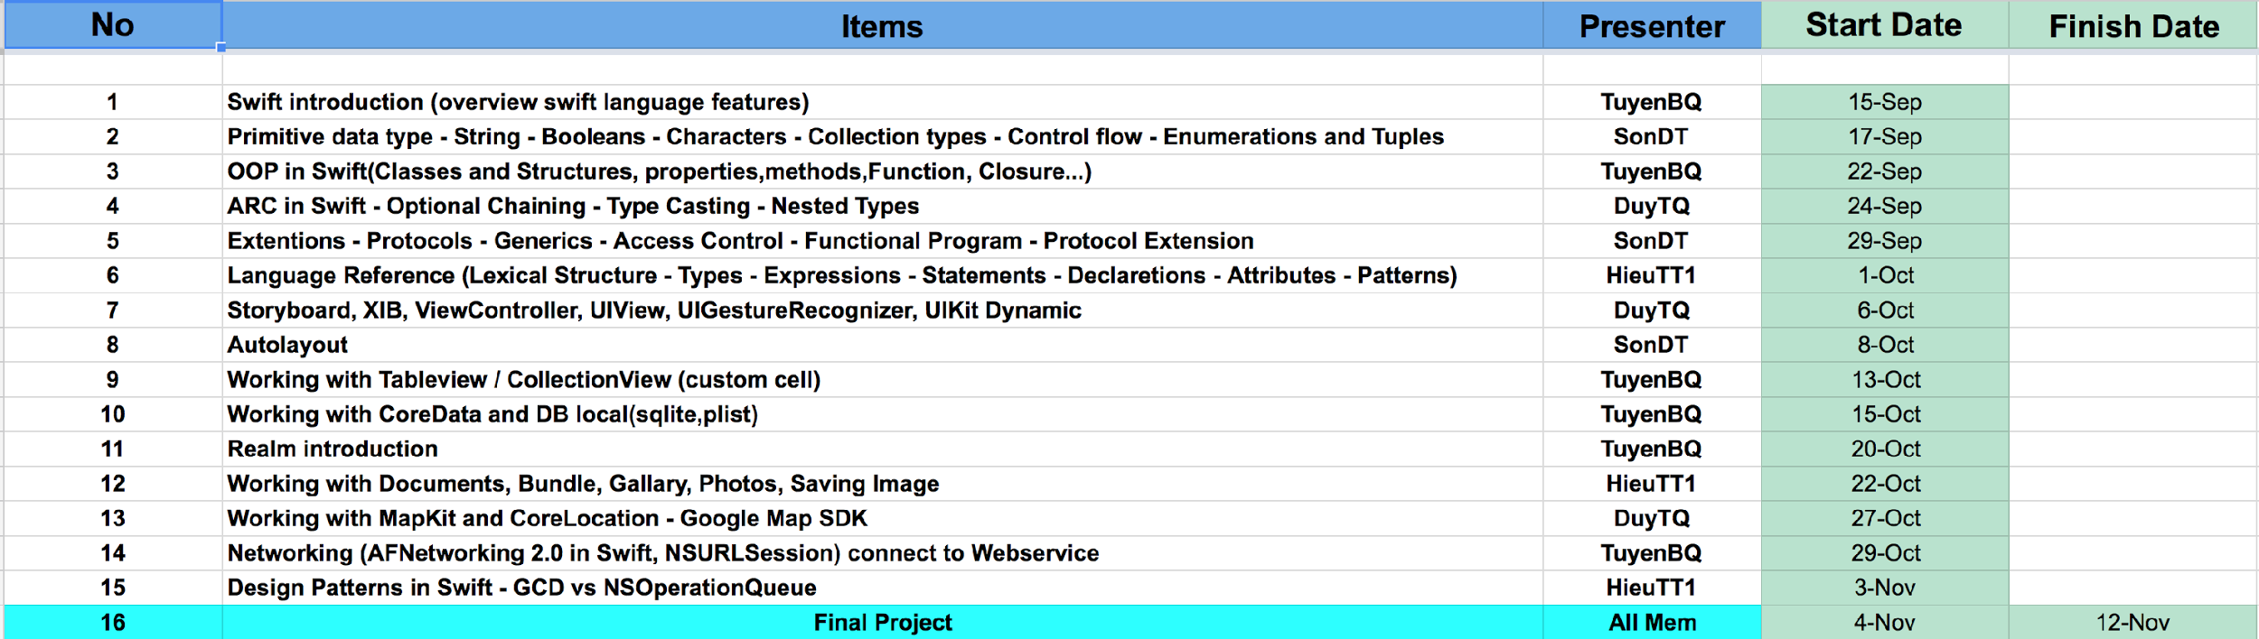

Slide 3
What’s Swift ?
At WWDC 2014, Apple introduced the shiny, new Swift language. Swift brings concise syntax, type safety and modern programming language features to Mac and iOS developers. The Apple developer community has responded with great excitement and adoption is growing rapidly.

Slide 4
Why we should choose Swift ?
Swift is easier to read
Swift is easier to maintain
Swift is safer
Swift is unified with memory management
Swift requires less code
Swift is faster
Swift Playgrounds encourages interactive coding
Swift is a future you can influence

Slide 5
Swift is easier to read
Objective-C suffers all the warts you’d expect from a language built on C. To differentiate keywords and types from C types, Objective-C introduced new keywords using the @ symbol. Because Swift isn’t built on C, it can unify all the keywords and remove the numerous @ symbols in front of every Objective-C type or object-related keyword.
Swift drops legacy conventions. Another large change is that method calls do not nest inside each other resulting in bracket hell
Ex: var imageView : UIImageView
imageView = UIImageView(frame:CGRectMake(10, 50, 100, 300));
==========================================================
UIImageView *imageView = [[[ UIImageView] alloc] initWithFrame(…) ]
Swift code more closely resembles natural English, in addition to other modern popular programming languages. This readability makes it easier for existing programmers from JavaScript, Java, Python, C#, and C++ to adopt Swift into their tool chain -- unlike the ugly duckling that was Objective-C.

Slide 6
Swift is easier to maintain
Swift drops the two-file requirement. Xcode and the LLVM compiler can figure out dependencies and perform incremental builds automatically in Swift 1.2. As a result, the repetitive task of separating the table of contents (header file) from the body (implementation file) is a thing of the past. Swift combines the Objective-C header (.h) and implementation files (.m) into a single code file (.swift).
Xcode and the LLVM compiler can do work behind the scenes to reduce the workload on the programmer. With Swift, programmers do less bookkeeping and can spend more time creating app logic. Swift cuts out boilerplate work and improves the quality of code, comments, and features that are supported.

Slide 7
Swift is safer
One interesting aspect of Objective-C is the way in which pointers -- particularly nil (null) pointers -- are handled. In Objective-C, nothing happens if you try to call a method with a pointer variable that is nil (uninitialized). The expression or line of code becomes a no-operation (no-op), and while it might seem beneficial that it doesn’t crash, it has been a huge source of bugs. A no-op leads to unpredictable behavior, which is the enemy of programmers trying to find and fix a random crash or stop erratic behavior.
Optional types make the possibility of a nil optional value very clear in Swift code, which means it can generate a compiler error as you write bad code. This creates a short feedback loop and allows programmers to code with intention. Problems can be fixed as code is written, which greatly reduces the amount of time and money that you will spend on fixing bugs related to pointer logic from Objective-C.

Slide 8
Swift is unified with memory management
Swift unifies the language in a way that Objective-C never has. The support for Automatic Reference Counting (ARC) is complete across the procedural and object-oriented code paths. In Objective-C, ARC is supported within the Cocoa APIs and object-oriented code; it isn’t available, however, for procedural C code and APIs like Core Graphics. This means it becomes the programmer’s responsibility to handle memory management when working with the Core Graphics APIs and other low-level APIs available on iOS. The huge memory leaks that a programmer can have in Objective-C are impossible in Swift.
A programmer should not have to think about memory for every digital object he or she creates. Because ARC handles all memory management at compile time, the brainpower that would have gone toward memory management can instead be focused on core app logic and new features. Because ARC in Swift works across both procedural and object-oriented code, it requires no more mental context switches for programmers, even as they write code that touches lower-level APIs -- a problem with the current version of Objective-C.

Slide 9
Swift requires less code
Swift reduces the amount of code that is required for repetitive statements and string manipulation. In Objective-C, working with text strings is very verbose and requires many steps to combine two pieces of information. Swift adopts modern programming language features like adding two strings together with a “+” operator, which is missing in Objective-C. Support for combining characters and strings like this is fundamental for any programming language that displays text to a user on a screen.

Slide 10
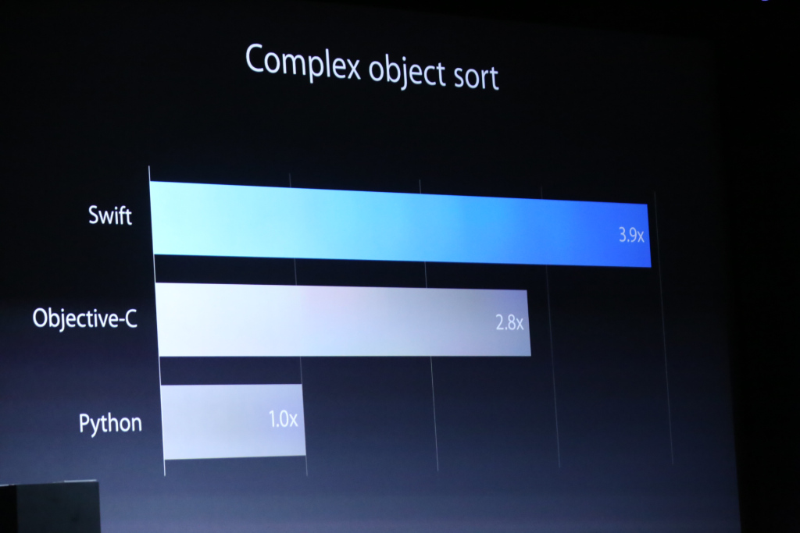
Swift is faster

Slide 11

Swift Playgrounds encourages interactive coding

Slide 12
Swift is a future you can influence
Apple Watch
Apple TV
New OSX and New iOS

Slide 13


What you need
OSX environment(10.9 or later)
XCode 6 or later
iOS 7 or later

Slide 14
Something about Swift’s features
type inference
let vs var
Semicolons
“?” and “!” symbol
playground

Slide 15
Swift vs Swift 2.0
Error Handling
No More println()
Protocol Extensions
Availability Checking
do-while is now repeat-while
Binding
Open source

