Slide 1
Swift Day 05

Slide 2
OOP VS POP

Slide 3
Access Control
Public
Internal (Default)
Private

Slide 4
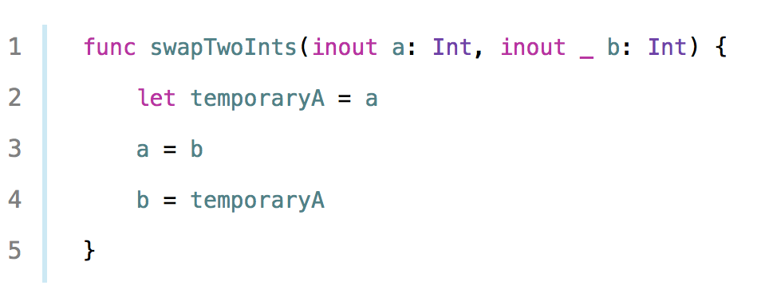
Generic
Swap 2 Int:

Slide 5
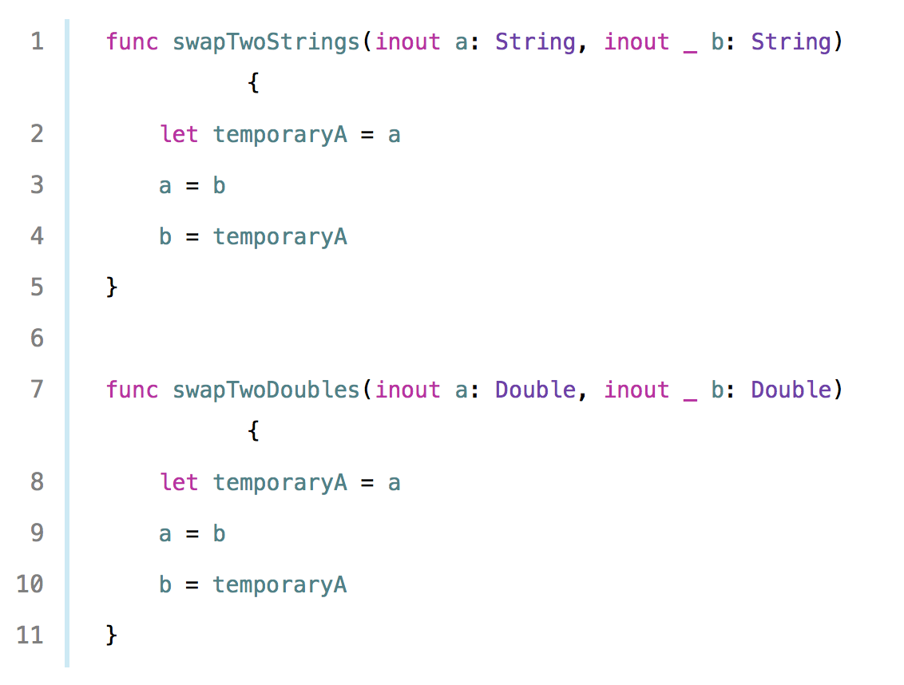
Generic
Swap 2 Strings:
Swap 2 Doubles:

Slide 6

Generic
Swap 2 values(Float, Array, Struct….)???

Slide 7
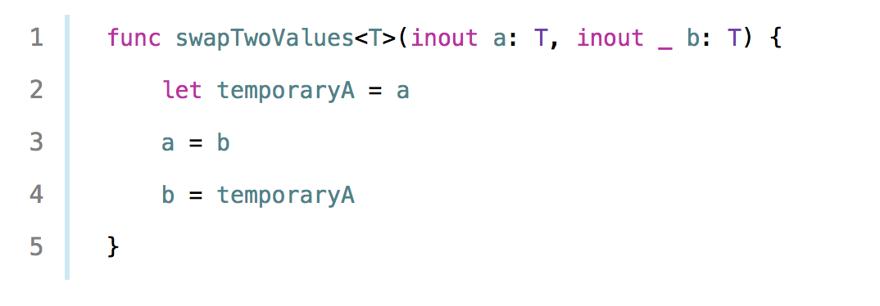
Generic
Generic Solution:

Slide 8
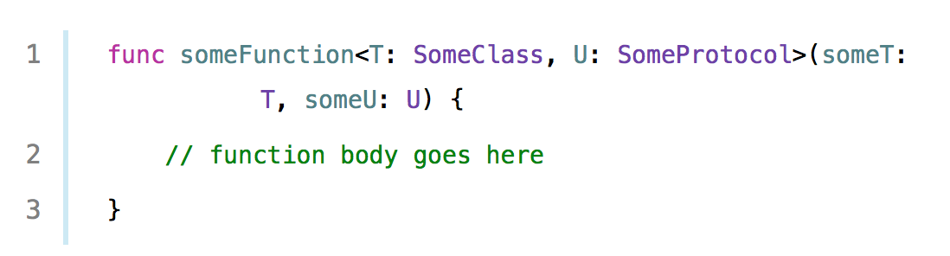
Generic
Type constraints:

Slide 9
Extension
How to add new functionality to existing Type???
Subclass? => Another Type!!!
Have access source code to modify?

Slide 10
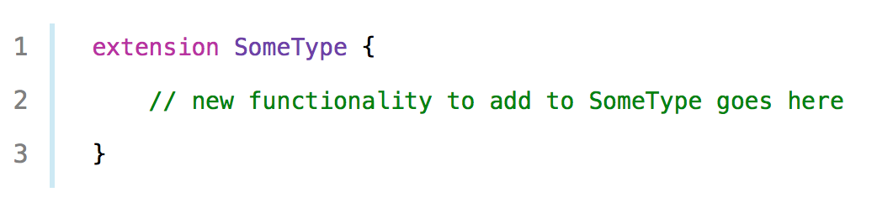
Extension

Slide 11
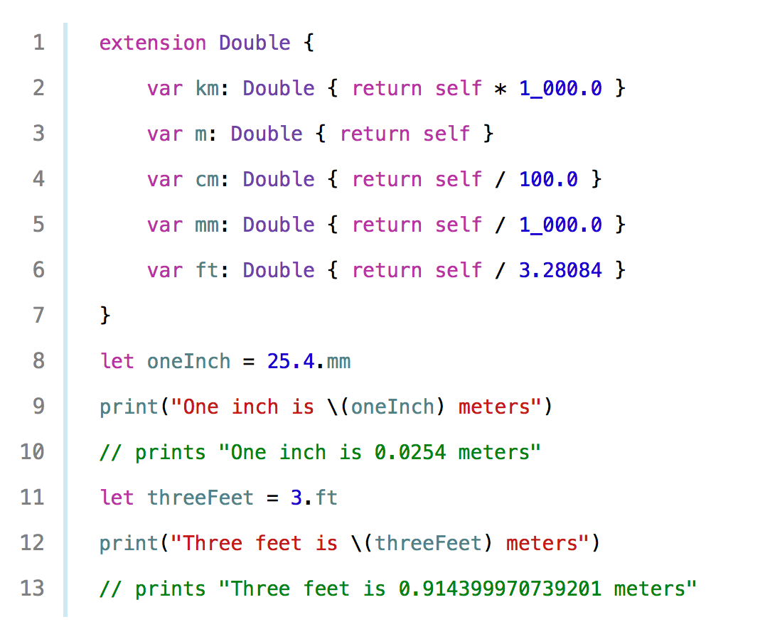
Extension

Slide 12
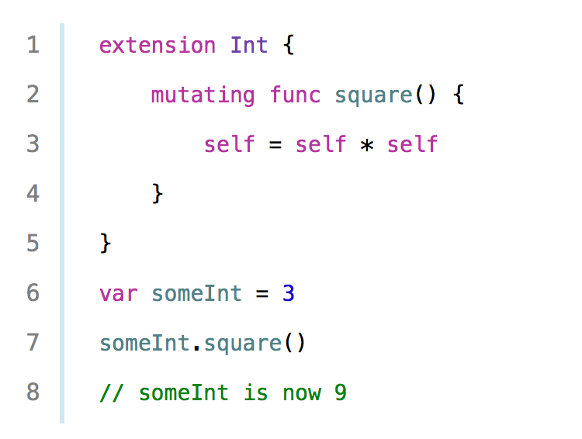
Extension

Slide 13
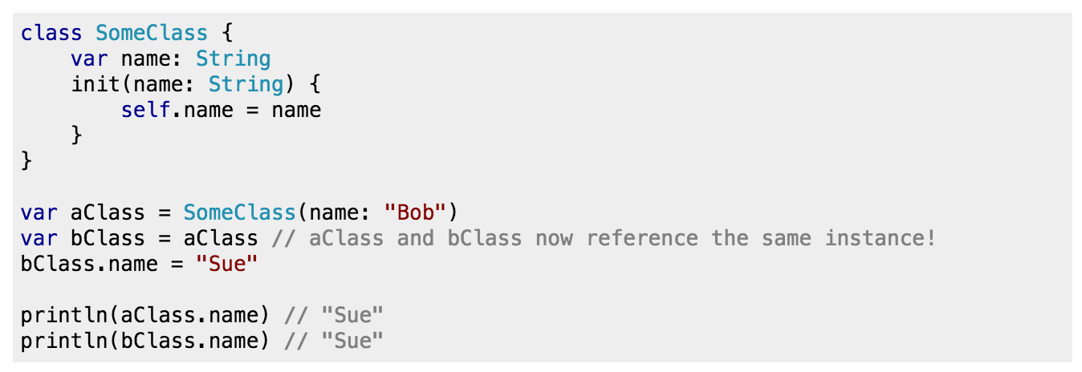
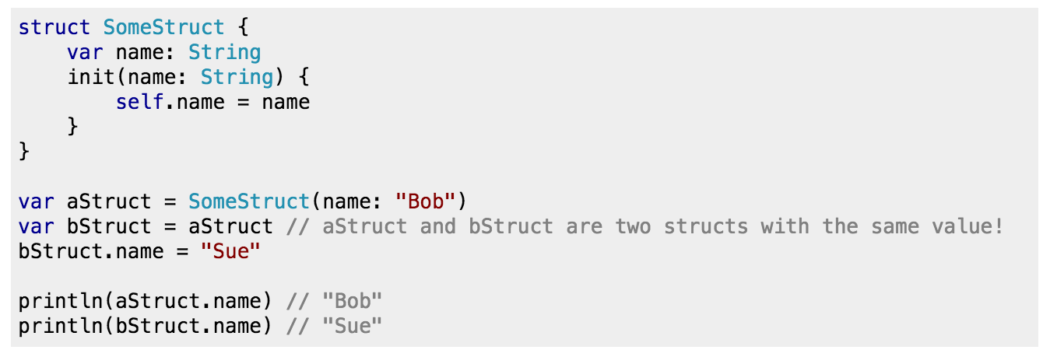
Class VS Struct

Slide 14
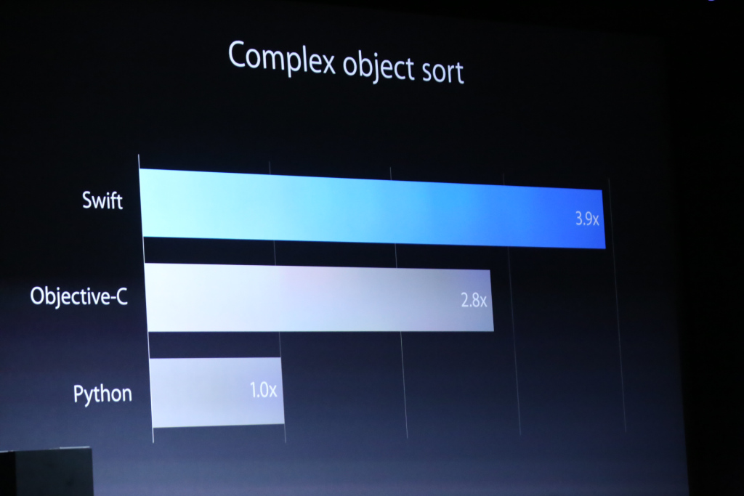
Class VS Struct
Swift is faster than Objective-C. But Why?

Slide 15
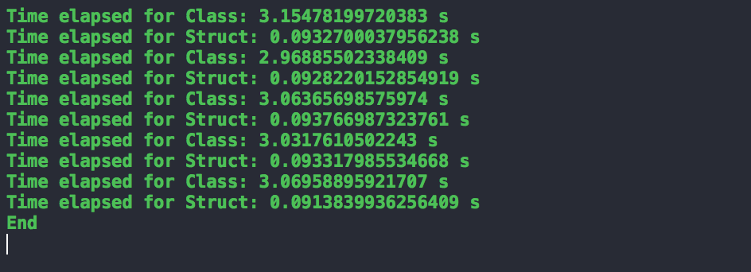
Struct
Struct is faster than Class in small data:
Ref: Wikipedia - Value Types

Slide 16
Struct
Struct is the same as Class in common:
Define properties to store values.
Define methods to provide functionality.
Define subscripts to provide access to their values using subscript syntax.
Define initializers to set up their initial state.
Be extended to expand their functionality beyond a default implementation.
Conform to protocols to provide standard functionality of a.

Slide 17
Struct
Use Struct when available:
Automatically threadsafe due to not being shareable.
Uses less memory due to no isa and refcount (and in fact is stack allocated generally).
Methods are always statically dispatched, so can be inlined (though @final can do this for classes).
Easier to reason about (no need to "defensively copy" as is typical with NSArray, NSString, etc...) for the same reason as thread safety.
Ref: Building Better Apps with Value Types in Swift
A Warm Welcome to Structs and Value Types

Slide 18
OOP Problem
Implicit sharing: such that if two objects refer a third object, then both can modify it without the other knowing about it. This leads to workrounds such as duplicating the referred object to avoid sharing, which in turn leads to inefficiencies; alternatively, sharing may require using locks to avoid race conditions and this can cause more inefficiency and even lead to deadlocks. What this entails is more complexity, which means more bugs.
Inheritance issues: in many OOP language, there can be one just superclass, and it has to be chosen at the very start. Changing it later can be extremely hard. A superclass, furthermore, forces any stored property on derived classes and this can make it complex to handle initialization and not to break any invariants that the superclass require. Finally, there are usually limitations to what can be overridden, and how, or when it should not be, and those constraints are usually left to the docs.
Lost type relationship: which ensues from the conflation of interface and implementation. This usually manifests itself through some base class’ methods where no implementation is possible and thus the necessity to downcast to the concrete derived class in that method’s implementation. This last point is illustrated in the following code snippet:

Slide 19

OOP Problem

Slide 20
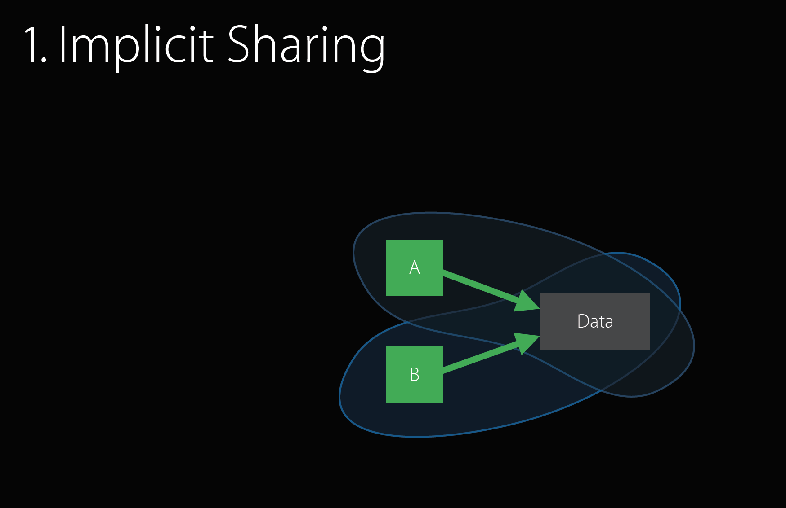
OOP

Slide 21
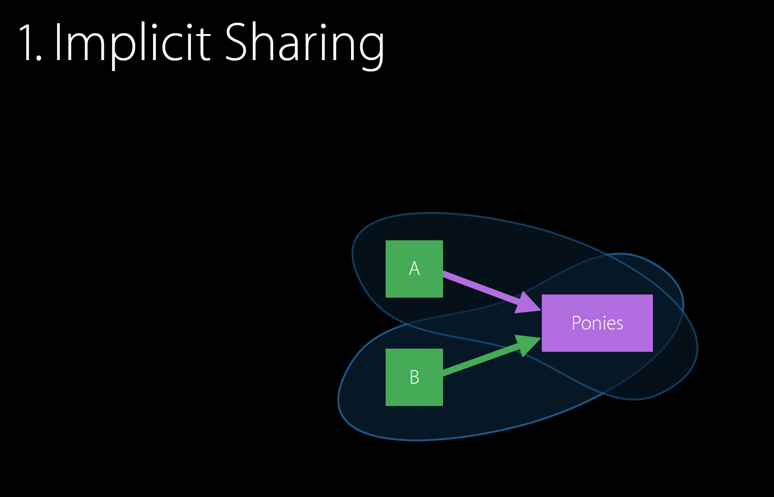

OOP

Slide 22
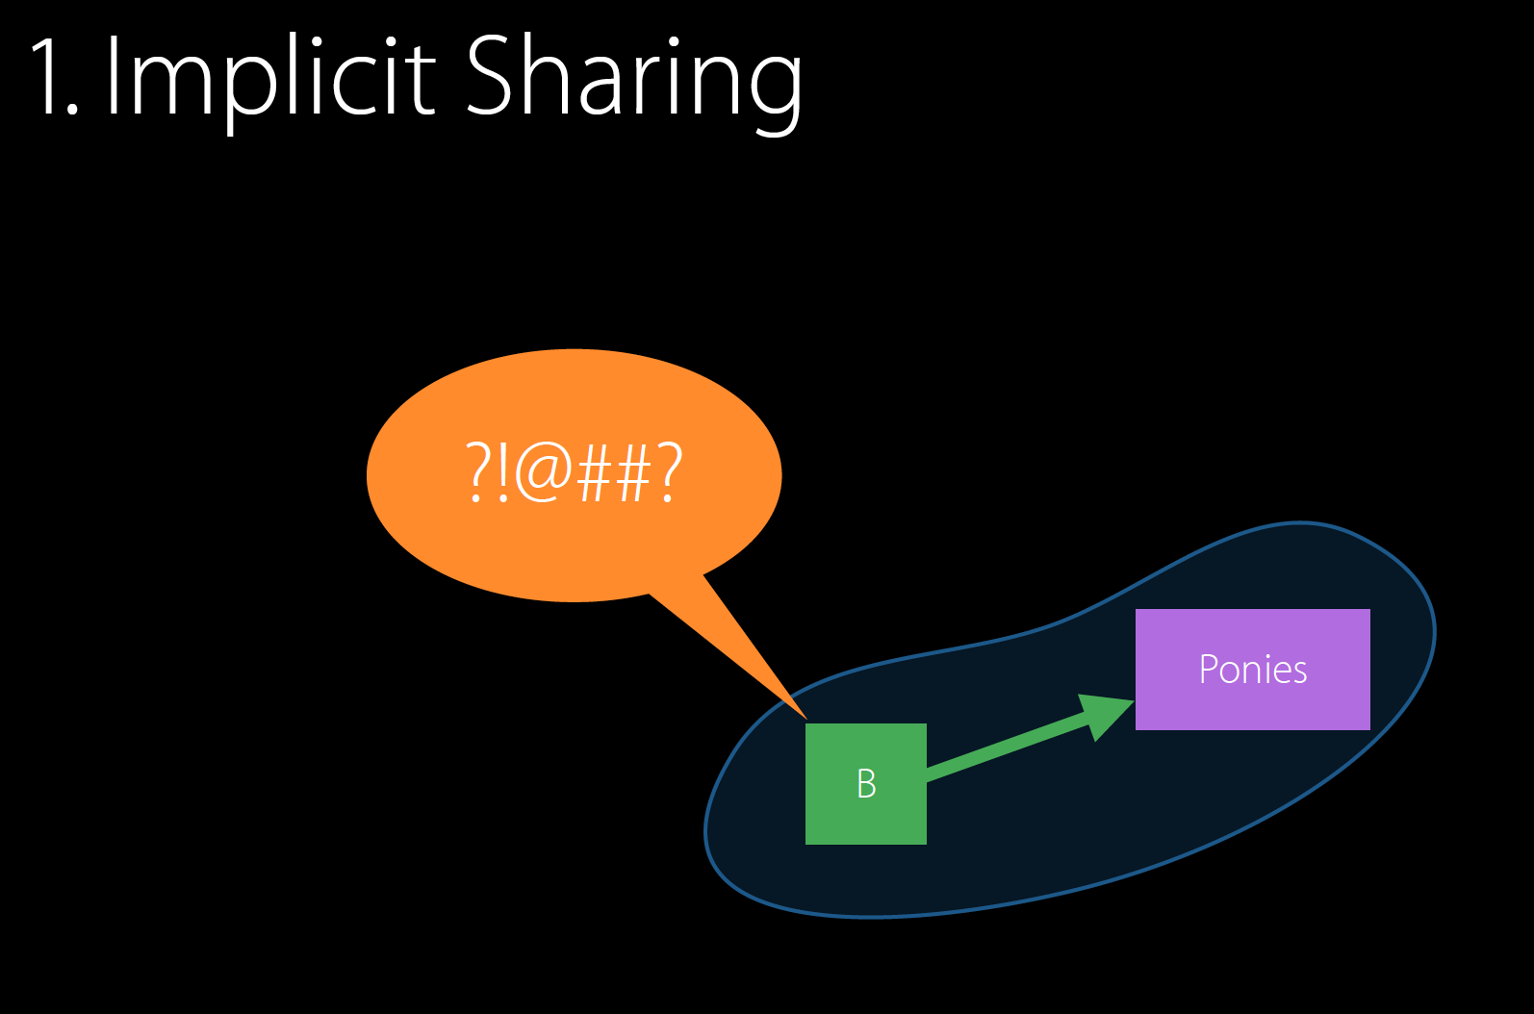
OOP

Slide 23
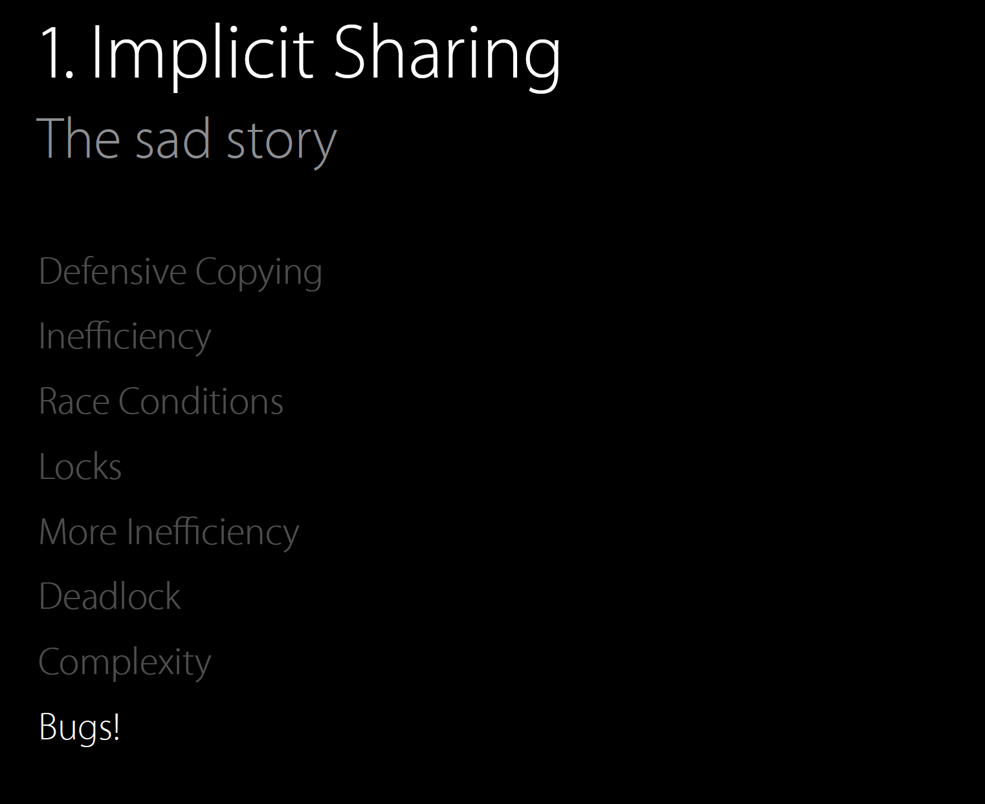
OOP

Slide 24
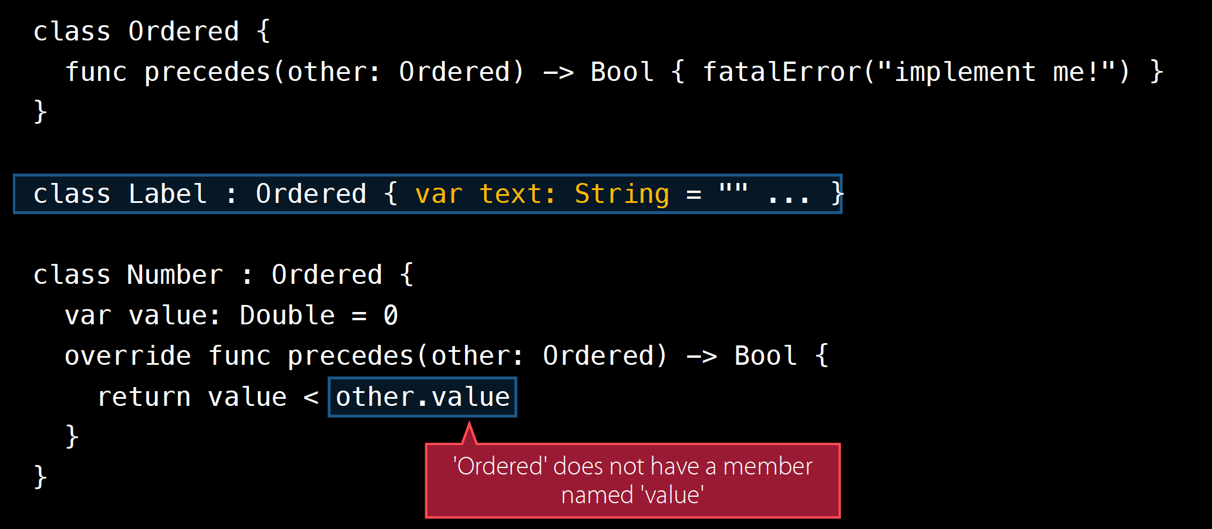
OOP

Slide 25
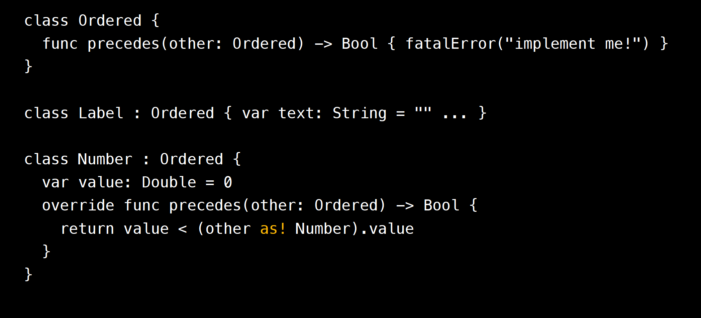
OOP

Slide 26
POP is awesome
Protocol-Oriented Programming(POP) is ♥ of Swift.

Slide 27
POP is awesome
Protocol-Oriented Programming is a better abstraction mechanism:
Value types (besides classes)
Static type relationships (besides dynamic dispatch)
Retroactive modeling
No forcing of data on models
No initialization burden
Clarity as to what shall be implemented.

Slide 28
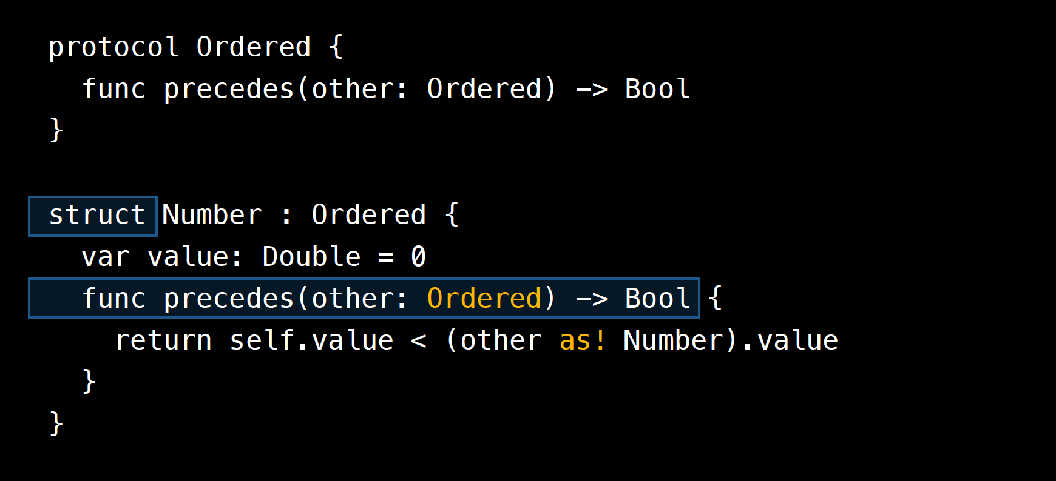
POP

Slide 29
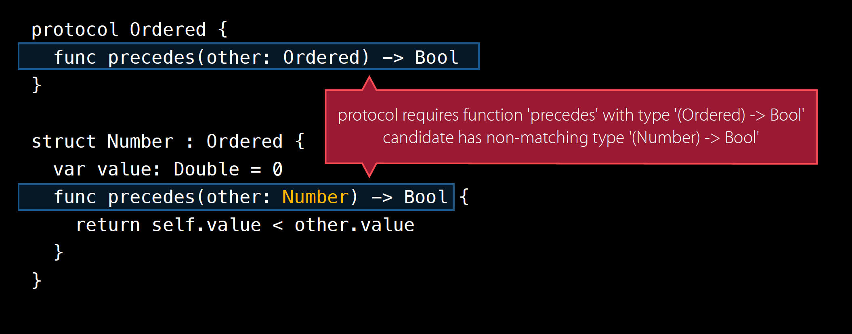
POP

Slide 30
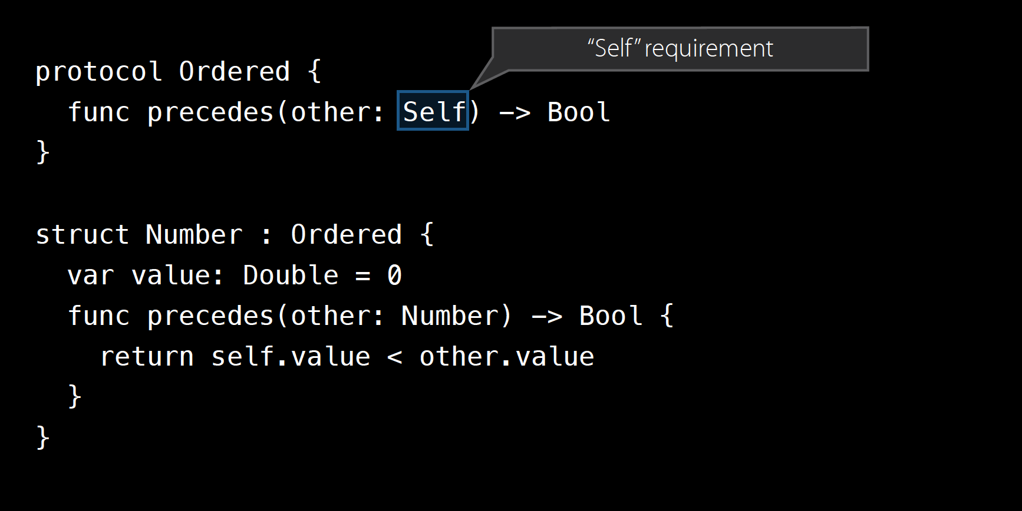
POP

Slide 31
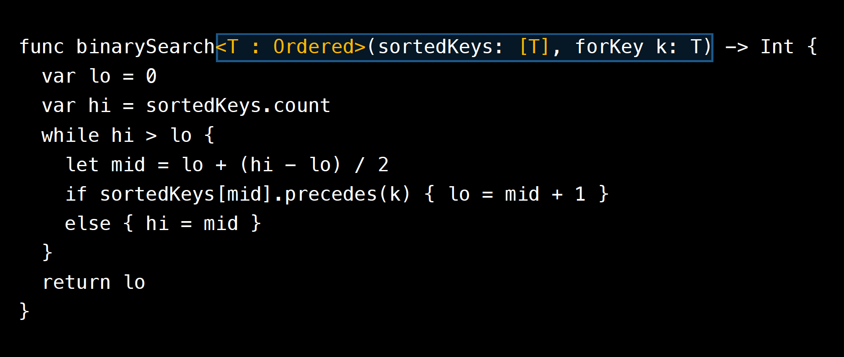
POP

Slide 32
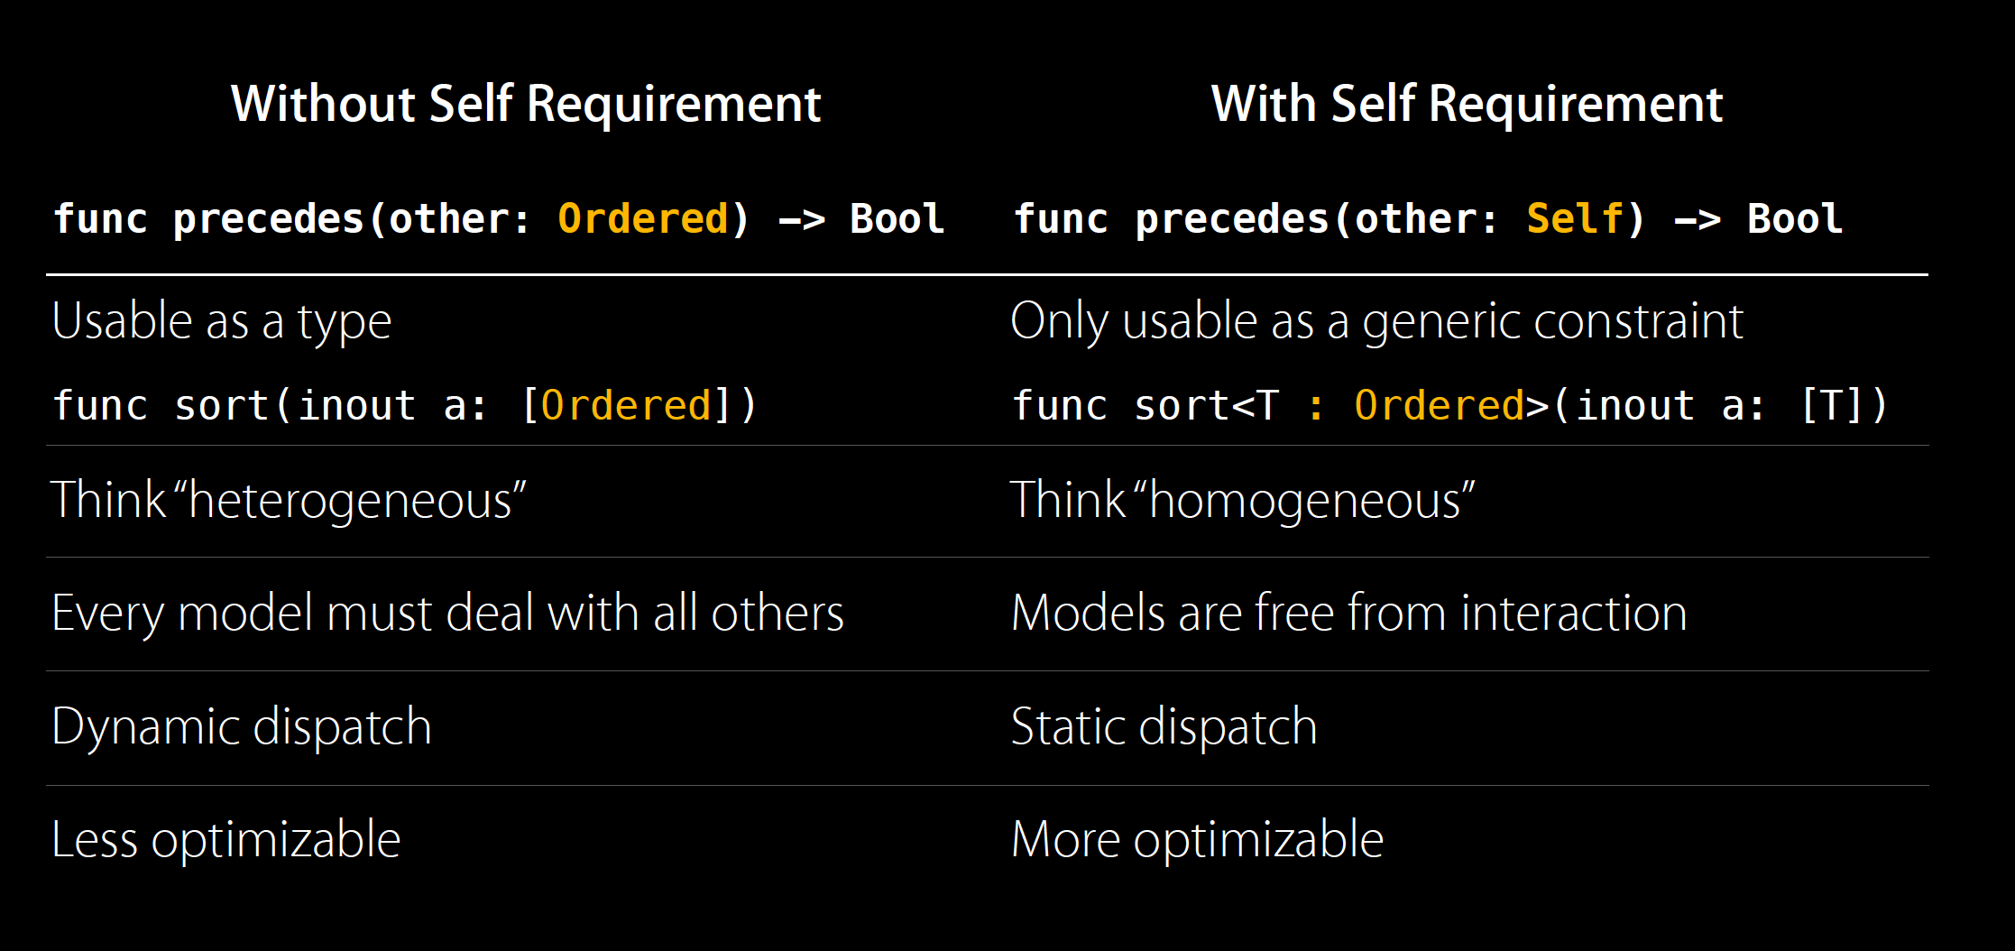
POP

Slide 33
OOP VS POP
Problem 1: Struct cannot Inherit from other types (Class)

Slide 34
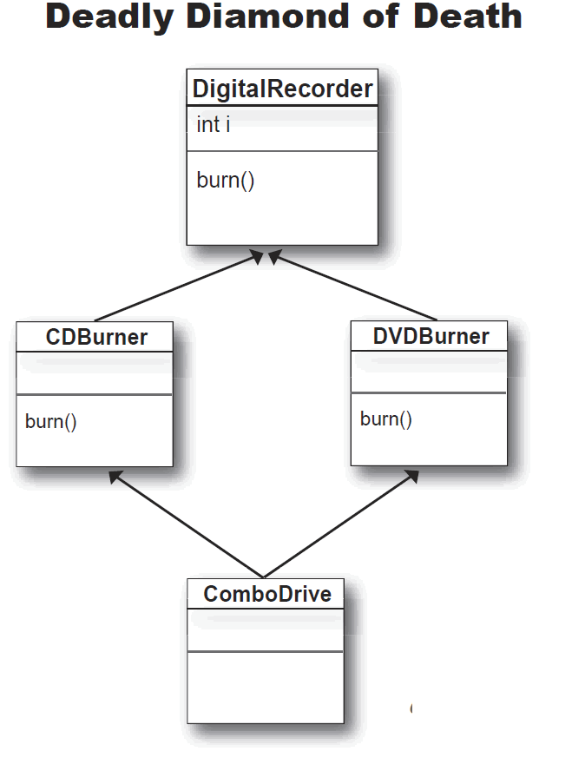
OOP VS POP
Problem 2: Multiple inheritance
See Animal example.

Slide 35
OOP VS POP
Problem 3: Protocol Extension is perfect match.
In Swift 2.0: Swift standard library is re-written using Protocol Extension.

Slide 36
OOP VS POP
When to use Classes?

Slide 37
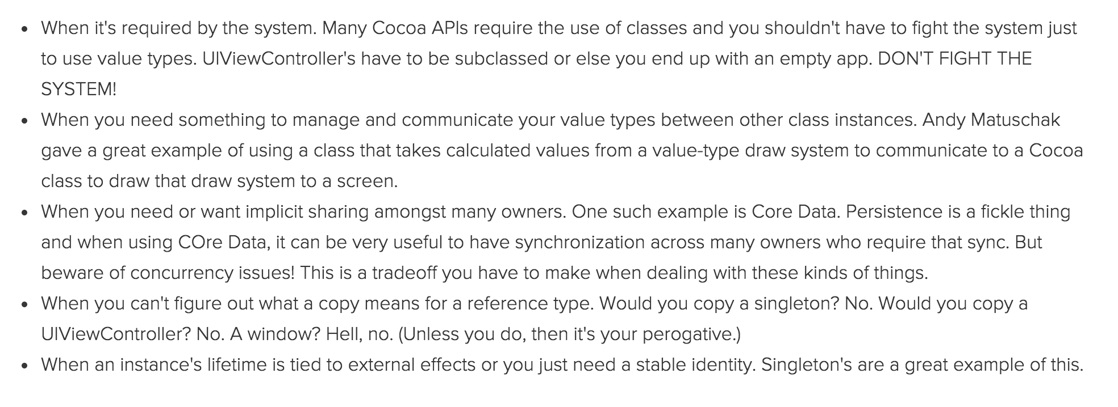
OOP VS POP

