Slide 1
Swift Day 12

Slide 2
Documents Bundle Gallary, Photos, Saving Image

Slide 3
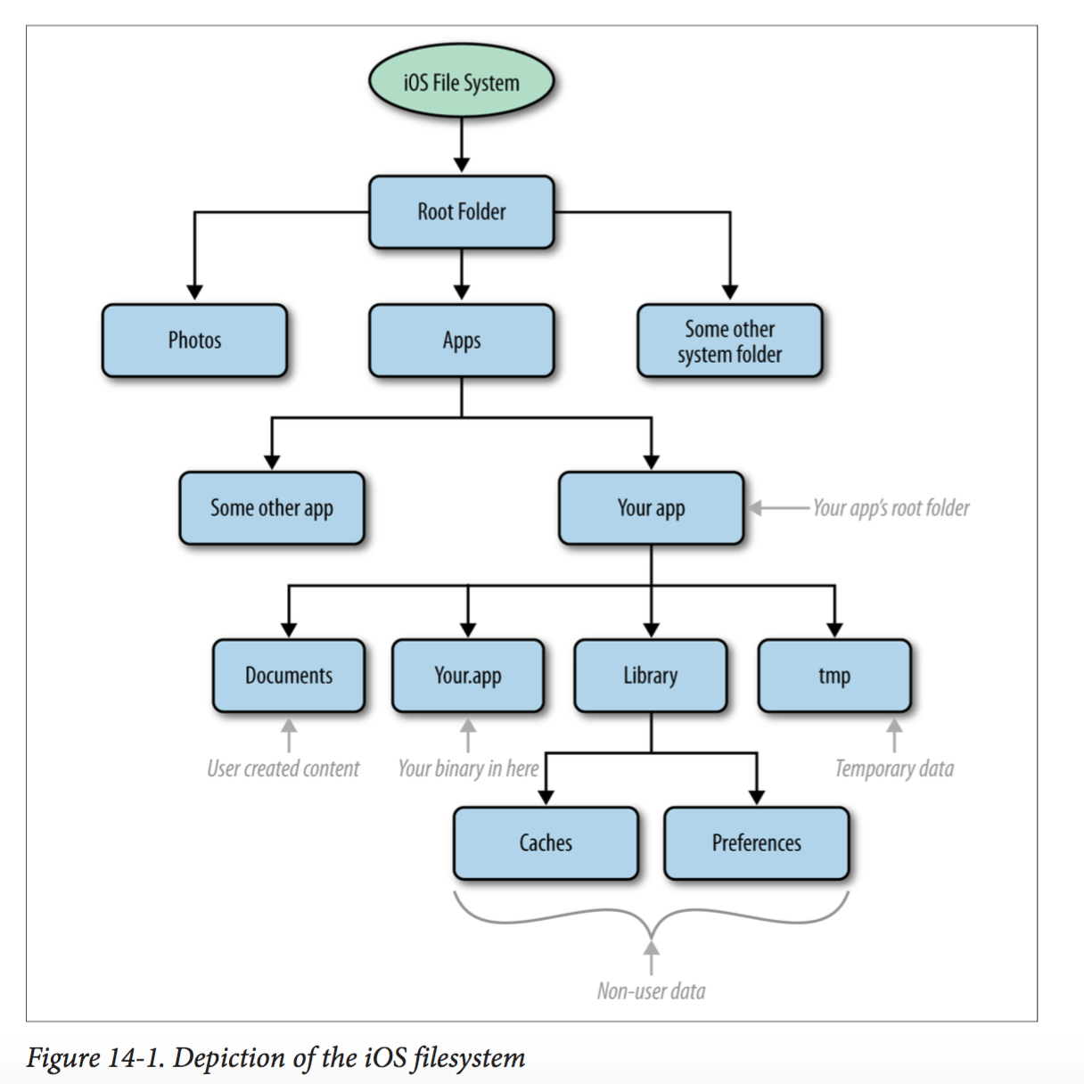
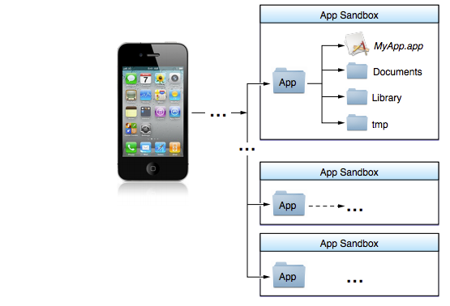
Documents
Notes:
1/ When an iOS app is installed on the device, the folder structure shown in Figure 14-1 will be created for that app by the system. Name.app Despite the odd name with the .app extension, this is a folder. The contents of your main bundle all go in here. For instance, all your app icons, your app binary, your different branding images, fonts, sounds, etc., are placed in this folder automatically when iOS installs your app on a device. The name is the product name that you set for your app. So if your app is called MyApp, the .app folder will be called MyApp.app.
Documents/
This folder is the destination for all user-created content. Content that your app has populated, downloaded, or created should not be stored in this folder.
Library/
You use this directory to store cached files, user preferences, and so on. Usually, this folder on its own does not contain files. It contains other folders that contain files.

Slide 4
NSFileManager NSFileHandle NSData
Notes:
The Foundation Framework provides three classes that are indispensable when it comes to working with files and directories:
NSFileManager - The NSFileManager class can be used to perform basic file and directory operations such as creating, moving, reading and writing files and reading and setting file attributes. In addition, this class provides methods for, amongst other tasks, identifying the current working directory, changing to a new directory, creating directories and listing the contents of a directory.
NSFileHandle - The NSFileHandle class is provided for performing lower level operations on files, such as seeking to a specific position in a file and reading and writing a file's contents by a specified number of byte chunks and appending data to an existing file. This class will be used extensively in the chapter entitled Working with Files in Swift on iOS 8.
NSData - The NSData class provides a useful storage buffer into which the contents of a file may be read, or from which dynamically stored data may be written to a file.

Slide 5
NSFileManager +defaultManager() -> singleton instance
Notes:
The URLsForDirectory:inDomains: instance method of the NSFileManager class al‐ lows you to search for specific directories on the iOS filesystem, mostly in your app’s sandbox. There are two parameters to this method:
URLsForDirectory: This is the directory that you want to search for. Pass a value of type NSSearchPath Directory enumeration to this parameter. I will talk more about this soon.
inDomains
This is where you look for the given directory. The value to this parameter must be of type NSSearchPathDomainMask enumeration.
Ref: http://www.techotopia.com/index.php/Working_with_Files_in_Swift_on_iOS_8

Slide 6
NSFileHandle
Notes:
The URLsForDirectory:inDomains: instance method of the NSFileManager class al‐ lows you to search for specific directories on the iOS filesystem, mostly in your app’s sandbox. There are two parameters to this method:
URLsForDirectory: This is the directory that you want to search for. Pass a value of type NSSearchPath Directory enumeration to this parameter. I will talk more about this soon.
inDomains
This is where you look for the given directory. The value to this parameter must be of type NSSearchPathDomainMask enumeration.

Slide 7
NSData
Notes:
NSData and its mutable subclass NSMutableData provide data objects, object-oriented wrappers for byte buffers. Data objects let simple allocated buffers (that is, data with no embedded pointers) take on the behavior of Foundation objects.
NSData creates static data objects, and NSMutableData creates dynamic data objects. NSData and NSMutableData are typically used for data storage and are also useful in Distributed Objects applications, where data contained in data objects can be copied or moved between applications.
+ data binary: of String, image, file….

