Slide 1
SWIFT DAY 10

Slide 2
SUMMARY
Realm
UICollectionView

Slide 3

REALM
About Realm
Inside Realm

Slide 4

Realm is a cross-platform mobile database just released to the public in July of 2014. It’s a data persistence solution designed specifically for mobile applications.
Realm is a mobile database: a replacement for SQLite & Core Data

Slide 5

Realm is a mobile database
hundreds of millions of people rely on

Slide 6
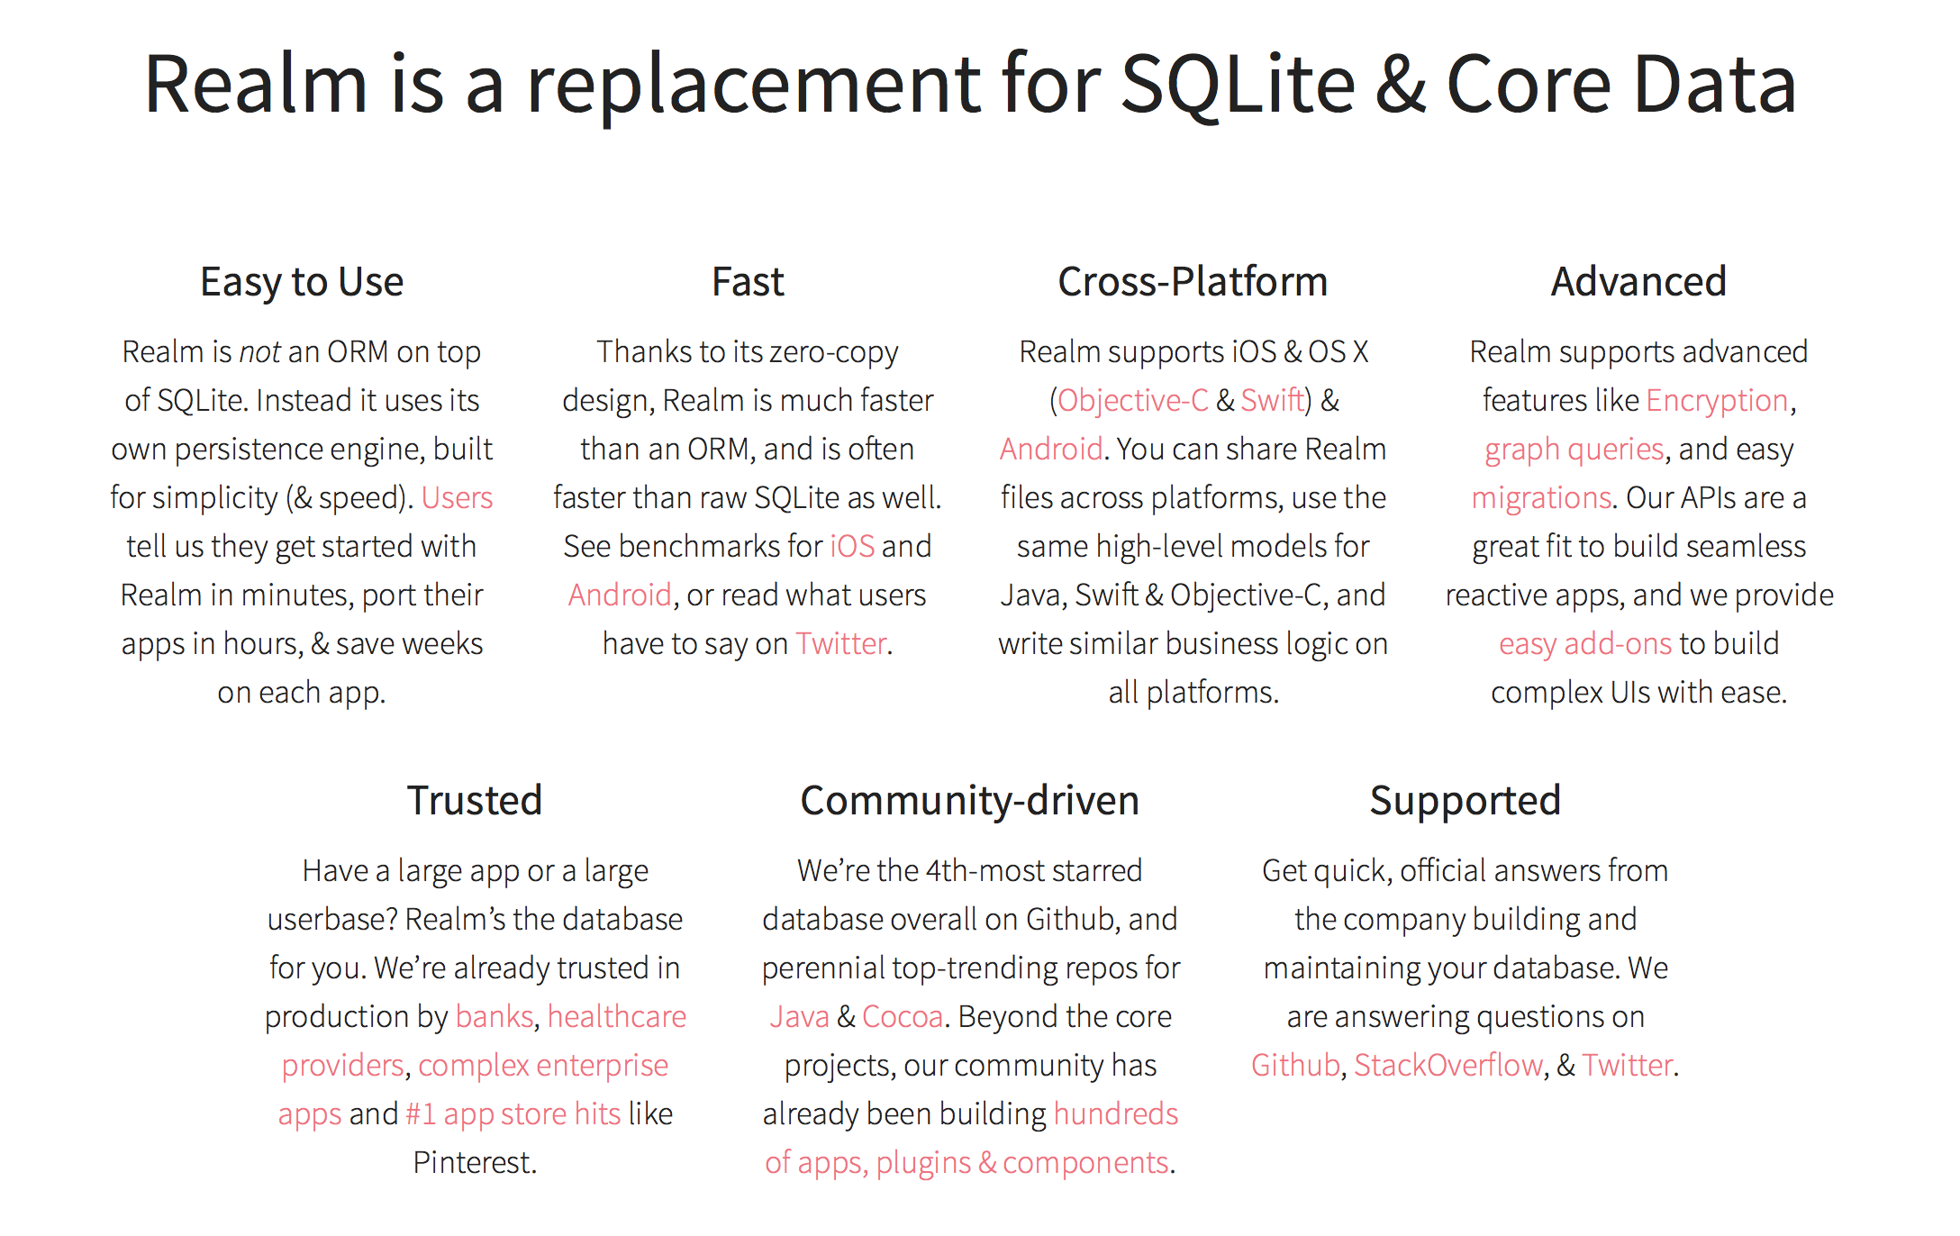

Slide 7
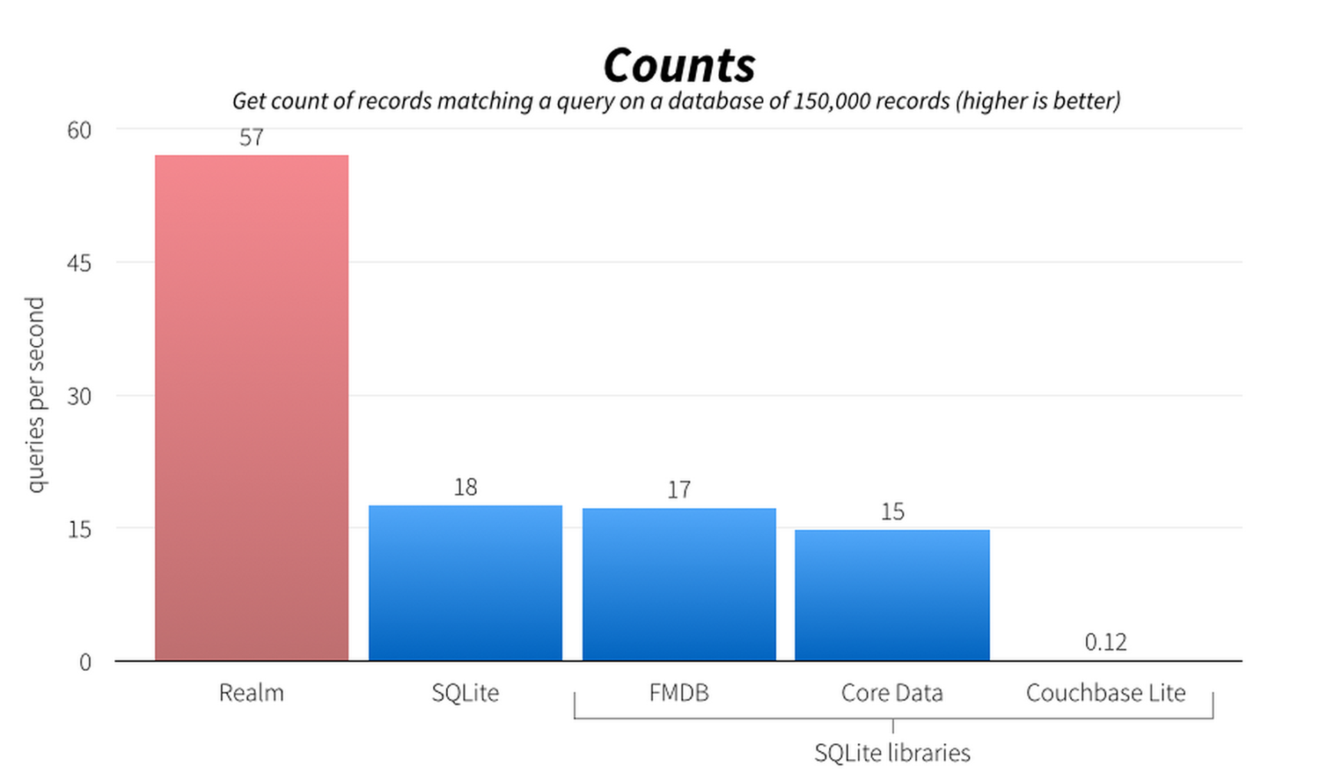
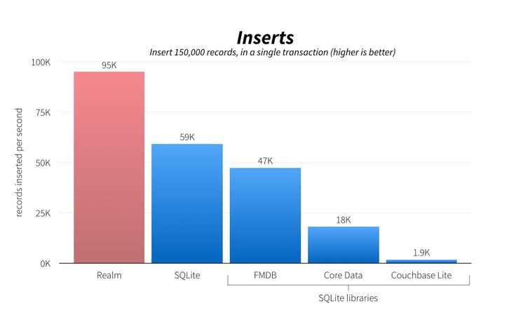

Slide 8
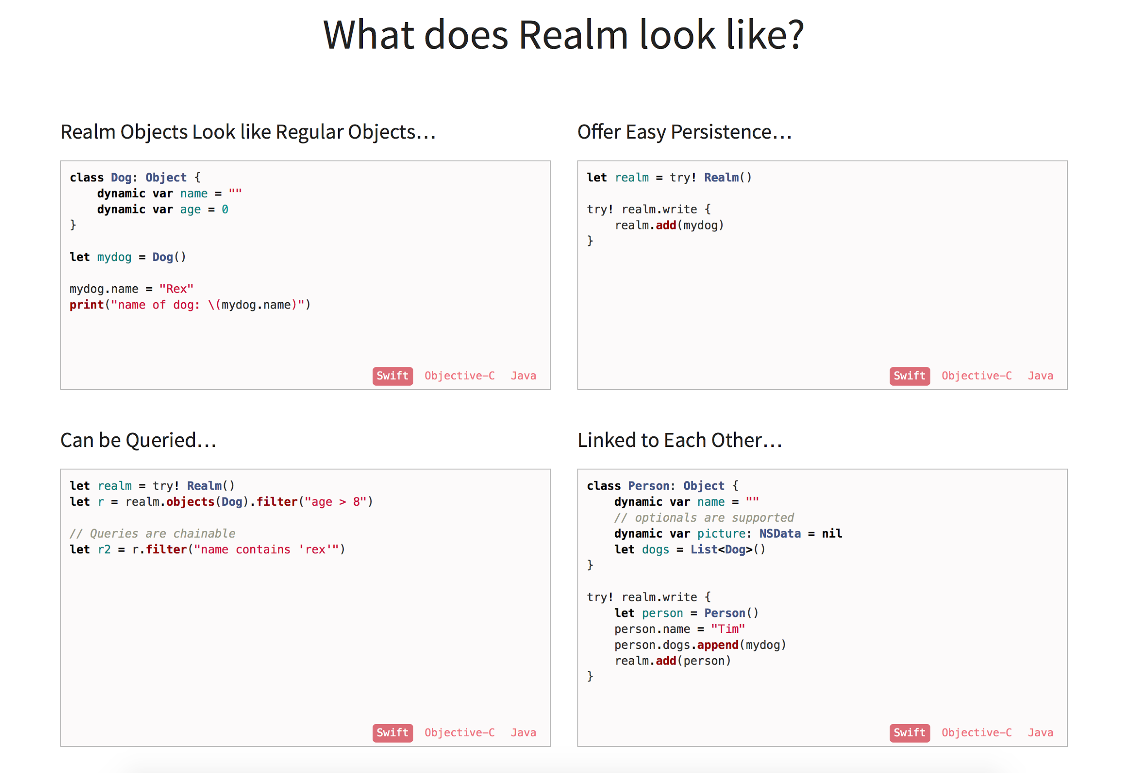


Slide 9
CONCEPTS AND MAJOR CLASSES
RLMRealm: RLMRealm is the heart of the framework; it’s your access point to the underlying database, similar to a Core Data managed object context. For your coding convenience, there’s a singleton defaultRealm which you’ll use in this tutorial. There’s also an in-memory realm instance that you can use when you don’t need to persist the results to disk, and you can create other realms as needed to support concurrent operations.
RLMObject: This is your realm model. The act of creating a model defines the schema of the database; to create a model you simply subclass RLMObject and define the fields you want to persist as properties.
Relationships: You create one-to-many relationships between objects by simply declaring a property of the type of the RLMObject you want to refer to. You can create many-to-one and many-to-many relationships via a property of type RLMArray, which leads you to…

Slide 10
CONCEPTS AND MAJOR CLASSES (CONT…)
RLMArray: This class has an API similar to that of NSArray; you can use it to store multiple RLMObjectinstances and define relationships. Its has other hidden powers, too; it can sort RLMObject instances, query the database, and can perform aggregate queries.
Write Transactions: Any operations in the database such as creating, editing, or deleting objects must be performed within transactions which are delineated by the beginWriteTransaction() andcommitWriteTransaction() operations.
Queries: To retrieve objects from the database you’ll need to use queries. The simplest form of a query is calling allObjects() on an RLMObject. If your data retrieval needs are more complex you can make use of predicates, chain your queries, and order your results as well.

Slide 11
LINK REFER:
https://realm.io/docs/swift/latest/
http://www.sebastiandobrincu.com/blog/5-reasons-why-you-should-choose-realm-over-coredata

Slide 12

UICOLLECTIONVIEW

