Slide 1
Swift Day 03

Slide 2

Summary
Object oriented programming overview
OOP in Swift
Classes and Structures
Design Pattern overview
Closures
Demo

Slide 3

Object oriented programming overview
What is OOP.? OOD?
Features of OOP.?

Slide 4
There are 3 key aspects of object oriented programming:
Encapsulation means that objects keep their state information private. Rather than directly manipulating an object’s data, other objects send requests to the object, in the form of messages, some of which the object may respond to by altering its internal state. Tính đóng gói +
Polymorphism means that objects of different classes can be used interchangeably. This is especially important, as it allows you to hook up classes at a later date in ways you didn’t necessarily foresee when those classes were first designed. + Ví dụ: hình vuông, hình tròn có cùng phương thức tính chu vi
Inheritance means that objects of one class can derive part of their behavior from another (base or parent) class. Some object-oriented languages (C++, for example, but not Swift) allow multiple inheritance, where objects of one class can derive part or all of their behavior from multiple independent base classes. Swift ko có đa kế thừa.

Slide 5
There are 3 key aspects of object oriented programming:
OverWrite: Kế thừa từ cha, OverLoad: đinh nghĩa thêm behavior

Slide 6
OOP in swift
Classes and Objects
Properties
Methods
Inheritance
Overriding
Base class
Protocols
Polymorphism

Slide 7
Classes and Objects
In object-oriented programming, a class is an extensible program-code-template for creating objects, providing initial values for state (member variables) and implementations of behavior (member functions, methods). In other words, a class is like a blueprint, it defines the data and behavior of a type.
The definition above creates an empty class named Viva. The only thing it can do is create new Viva objects:
class Viva {
}
var vivaObj = Viva()
In the example above vivaObj is an instance of the Viva class.

Slide 8
Properties
Classes and instances can have associated values named properties.
class Square {
var length: Int = 1
}
The Square class has a length property that has a default value of 1.
In order to create squares with a different length than 1 we need to write a custom initializer.

Slide 9
class Square {
var length: Int = 1
init(length: Int) {
self.length = length
}
}
var firstSquare = Square(length: 3)
println(firstSquare.length)
var secondSquare = Square(length: 10)
println(secondSquare.length)
if firstSquare.length < secondSquare.length {
println("the small square has the length \(firstSquare.length)")
} else {
println("the small square has the length \(secondSquare.length)")
}

Slide 10
Properties in swift
Lazy Stored Properties: A lazy stored property is a property whose initial value is not calculated until the first time it is used. You indicate a lazy stored property by writing the lazy modifier before its declaration.
Computed Properties: In addition to stored properties, classes, structures, and enumerations can define computed properties, which do not actually store a value. Instead, they provide a getter and an optional setter to retrieve and set other properties and values indirectly.
Read-Only Computed Properties: A computed property with a getter but no setter is known as a read-only computed property. A read-only computed property always returns a value, and can be accessed through dot syntax, but cannot be set to a different value
Property Observers: observe and respond to changes in a property’s value. Property observers are called every time a property’s value is set, even if the new value is the same as the property’s current value.

Slide 11
class DataImporter {
var fileName = "data.txt”
}
class DataManager {
lazy var importer = DataImporter()
var data = [String]()
}
let manager = DataManager()
manager.data.append("Some data")
manager.data.append("Some more data")
print(manager.importer.fileName)
// the DataImporter instance for the importer property has now been created
// prints "data.txt"

Slide 12
struct Point {
var x = 0.0, y = 0.0
}
struct Size {
var width = 0.0, height = 0.0
}
struct Rect {
var origin = Point()
var size = Size()
var center: Point {
get {
let centerX = origin.x + (size.width / 2)
let centerY = origin.y + (size.height / 2)
return Point(x: centerX, y: centerY)
}
set(newCenter) {
origin.x = newCenter.x - (size.width / 2)
origin.y = newCenter.y - (size.height / 2)
}
}
}
var square = Rect(origin: Point(x: 0.0, y: 0.0),
size: Size(width: 10.0, height: 10.0))
let initialSquareCenter = square.center
square.center = Point(x: 15.0, y: 15.0)
print("square.origin is now at (\(square.origin.x), \(square.origin.y))")
// prints "square.origin is now at (10.0, 10.0)"

Slide 13

Property Observers
You have the option to define either or both of these observers on a property:
willSet is called just before the value is stored.
didSet is called immediately after the new value is stored.

Slide 14
class StepCounter {
var totalSteps: a href="" Int /a = 0 {
willSet(newTotalSteps) {
print("About to set totalSteps to \(newTotalSteps)")
}
didSet {
if totalSteps > oldValue {
print("Added \(totalSteps - oldValue) steps")
}
}
}
}
let stepCounter = StepCounter()
stepCounter.totalSteps = 200
// About to set totalSteps to 200
// Added 200 steps
stepCounter.totalSteps = 360
// About to set totalSteps to 360
// Added 160 steps
stepCounter.totalSteps = 896
// About to set totalSteps to 896
// Added 536 steps

Slide 15
Methods
Syntax:
func functionName(){
}
func functionName(argument1: Type, argument2: Type) -> Type{
}

Slide 16
Inheritance - Overriding
A class can inherit methods, properties, and other characteristics from another class. When one class inherits from another, the inheriting class is known as a subclass, and the class it inherits from is known as its superclass. Inheritance is a fundamental behavior that differentiates classes from other types in Swift.
You can override methods in order to provide custom behavior. To override a method write the override keyword before the method declaration

Slide 17
class AClass {
func doSomething() {
println("Hello from AClass")
}
}
class Subclass: AClass {
override func doSomething() {
println("Hello from Subclass")
}
}
let base_object = AClass()
base_object.doSomething()
//> Hello from AClass
let enhanced_object = Subclass()
enhanced_object.doSomething()
//> Hello from Subclass

Slide 18
Base class
Any class that does not inherit from another class is known as a base class.
Swift classes do not inherit from a universal base class. Classes you define without specifying a superclass automatically become base classes for you to build upon.
class Vehicle {
var currentSpeed = 0.0
var description: String {
return "traveling at \(currentSpeed) miles per hour"
}
func makeNoise() {
// do nothing - an arbitrary vehicle doesn't necessarily make a noise
}
}

Slide 19
Protocols
Protocols are declared in a similar way to classes.
protocol MyFirstProtocol {
// I do nothing
}
class AnotherSwiftClass: MyFirstProtocol, AnotherProtocol {
...
}

Slide 20
Polymorphism
Polymorphism means “having multiple forms”. Objects of different classes can be used interchangeably if they have a common superclass.

Slide 21
Classes and Structures
Classes and structures in Swift have many things in common. Both can:
Define properties to store values
Define methods to provide functionality
Define subscripts to provide access to their values using subscript syntax
Define initializers to set up their initial state
Be extended to expand their functionality beyond a default implementation
Conform to protocols to provide standard functionality of a certain kind

Slide 22
Classes and Structures
Classes have additional capabilities that structures do not:
Inheritance enables one class to inherit the characteristics of another.
Type casting enables you to check and interpret the type of a class instance at runtime.
Deinitializers enable an instance of a class to free up any resources it has assigned.
Reference counting allows more than one reference to a class instance.

Slide 23
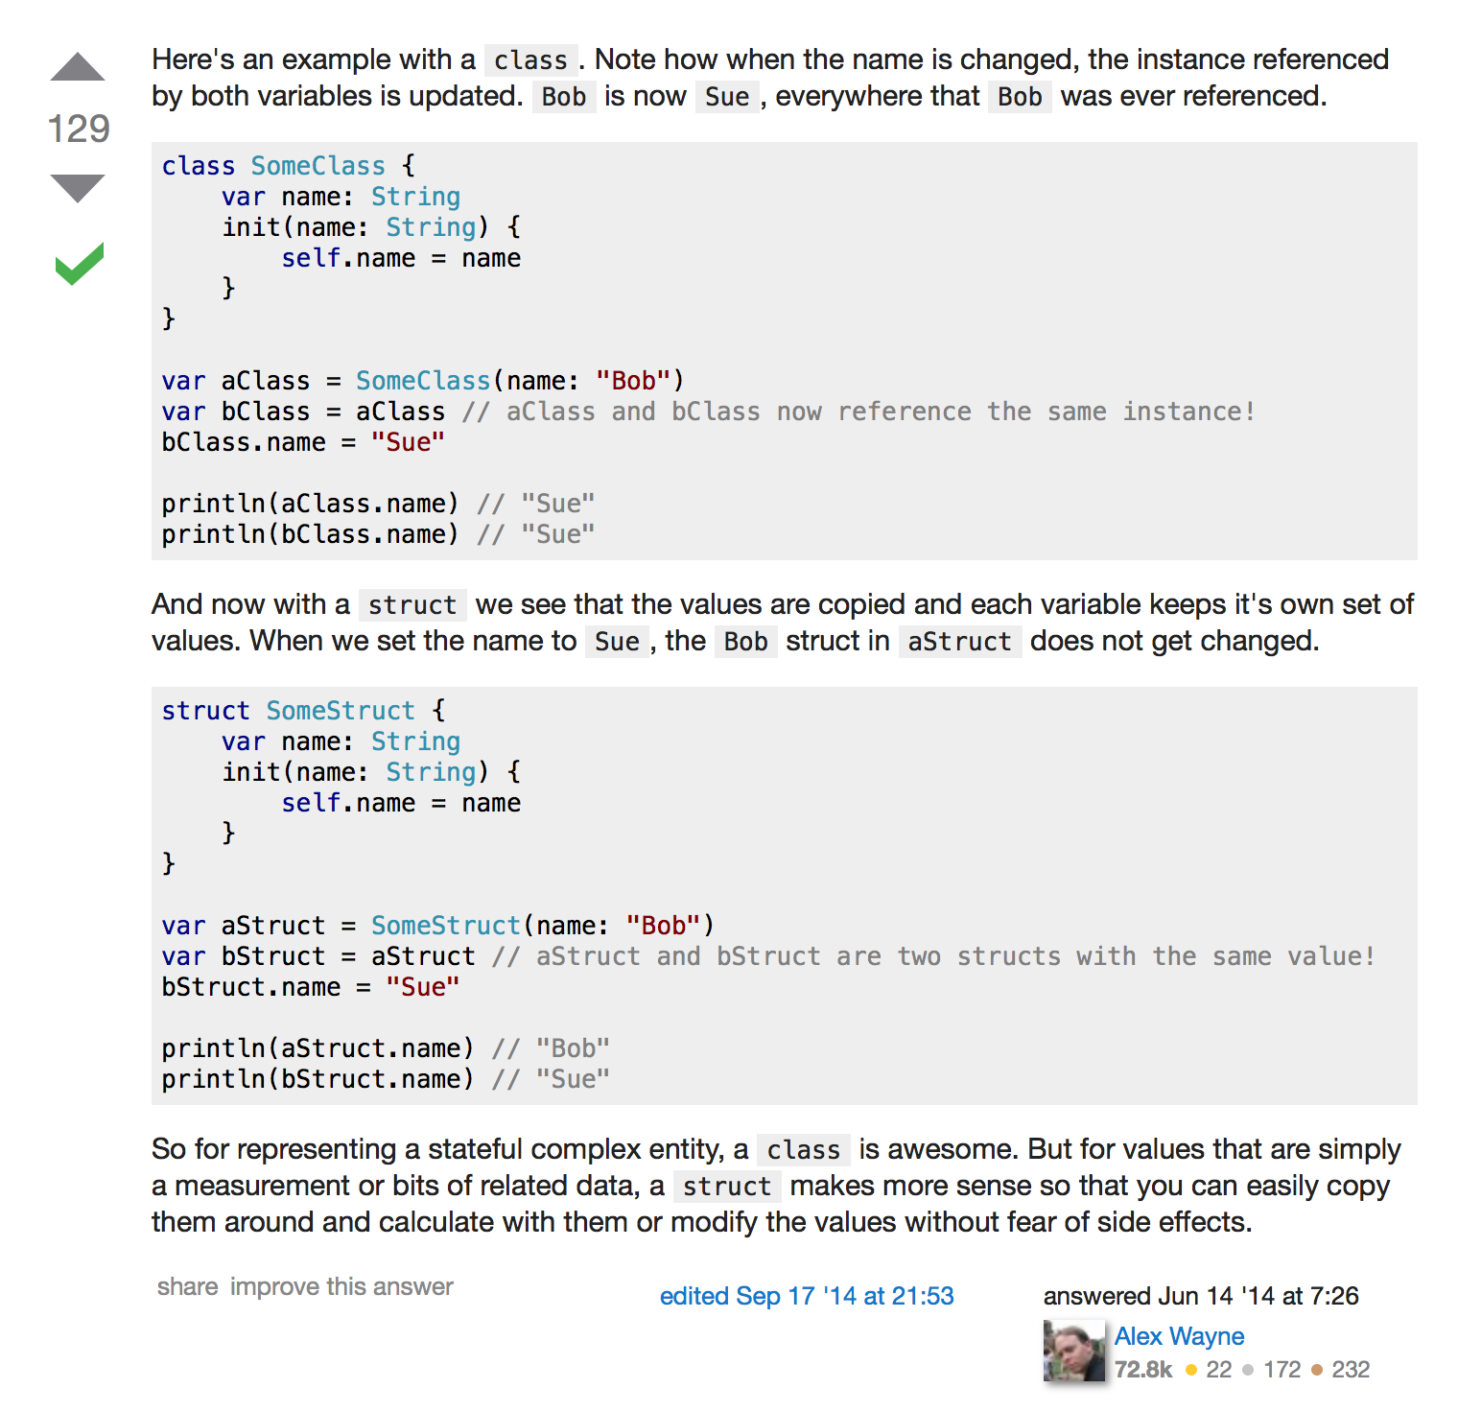

Slide 24

Design Pattern overview
What is the design pattern?
How many?
In Swift?

Slide 25
Design Pattern overview
MVC
The Singleton Pattern
Delegation
The Adapter Pattern (Protocols)

Slide 26
Closures
https://www.weheartswift.com/closures/
https://developer.apple.com/library/ios/documentation/Swift/Conceptual/Swift_Programming_Language/Closures.html#//apple_ref/doc/uid/TP40014097-CH11-ID94

Slide 27

Demo
class Square {
var length: Int = 1
init(length: Int) {
self.length = length
}
}
var firstSquare = Square(length: 3)
println(firstSquare.length)
var secondSquare = Square(length: 10)
println(secondSquare.length)
if firstSquare.length < secondSquare.length {
println("the small square has the length \(firstSquare.length)")
} else {
println("the small square has the length \(secondSquare.length)")
}

