Slide 1
Swift Day 4
ARC in Swift - Optional Chaining - Type Casting - Nested Types

Slide 2
Summary
Automatic Reference Counting
Strong Reference – Weak Reference – Unowned Reference
Optional Chaining
Type Casting
Nested Types

Slide 3
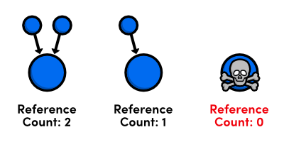
Automatic Reference Counting (ARC)
What?
Swift using ARC to track and manage app's memory usage. ARC automatically free up the memory used by class instances when those instance are no longer needed.
How ARC work?
NOTE
Reference counting only applies to instances of classes. Structures and enumerations are value types, not reference types, and are not stored and passed by reference.
Notes:
ARC: Automatic reference counting
What: Swift using ARC to track and manage app's memory usage. ARC automatically free up the memory used by class instances when those instance are no longer needed.
(only applies to instances of classes. structures and enumerations are value type, not reference type)
How ARC work: every time you create a new instance of a class, ARC allocates a chunk of memory to store information about that instance (information about type of the instance, together with the value of any stored properties associated with that instance)
When an instance is no longer needed, ARC free up the memory used by that instance so that the memory can be used for other purpose instead.
If you try to access the instance were to deallocate, your app would most like crash.

Slide 4
Compare ARC in Swift and ObjC
Swift support for Automatic Reference Counting (ARC) is complete across the procedural and object-oriented code paths.
In Objective-C, ARC is supported within the Cocoa APIs and object-oriented code; it isn’t available, however, for procedural C code and APIs like Core Graphics.
The huge memory leaks that a programmer can have in Objective-C are impossible in Swift.

Slide 5
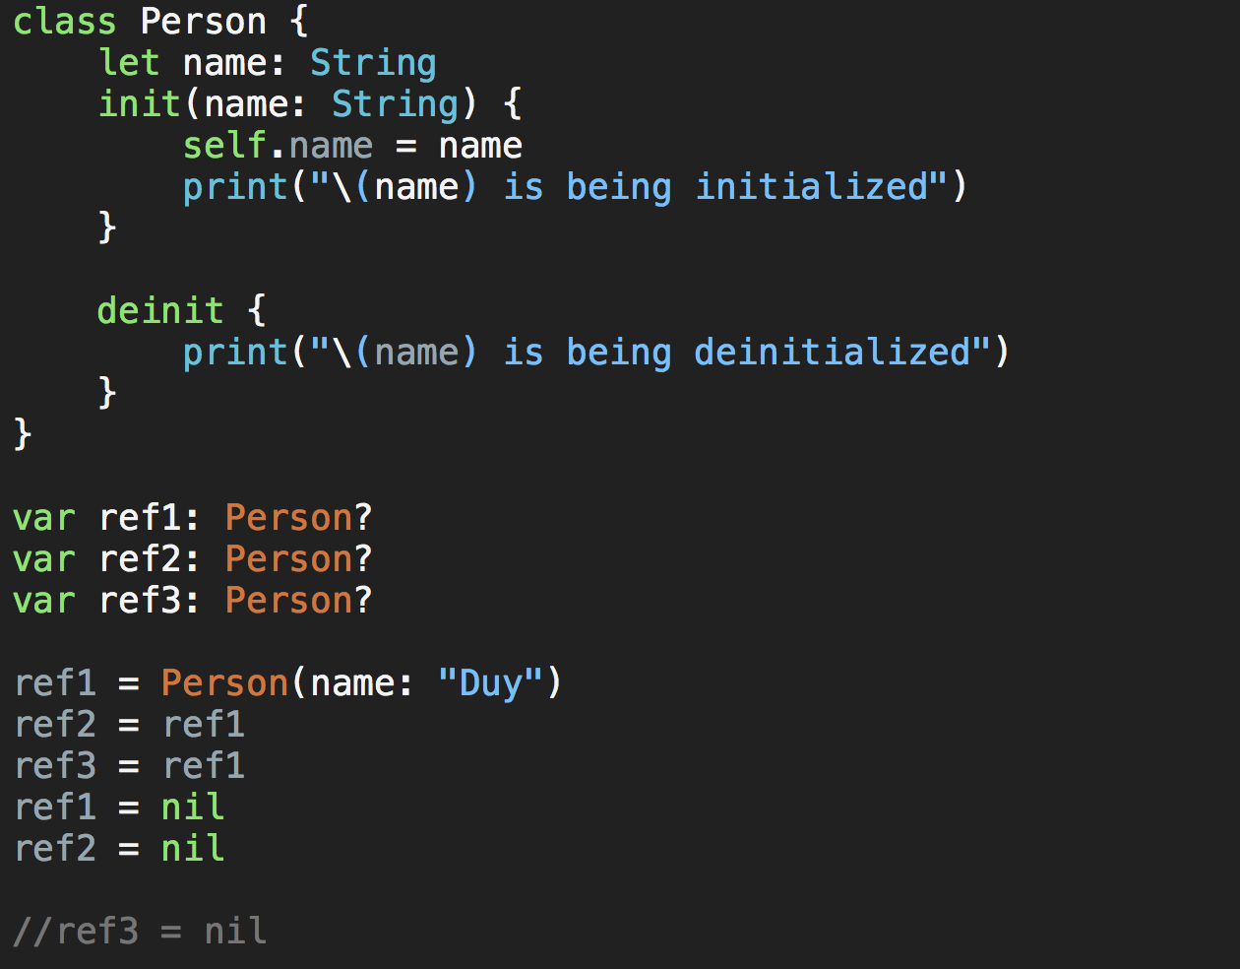
Strong reference
When deinit was call?
Why deinit was call?

Slide 6
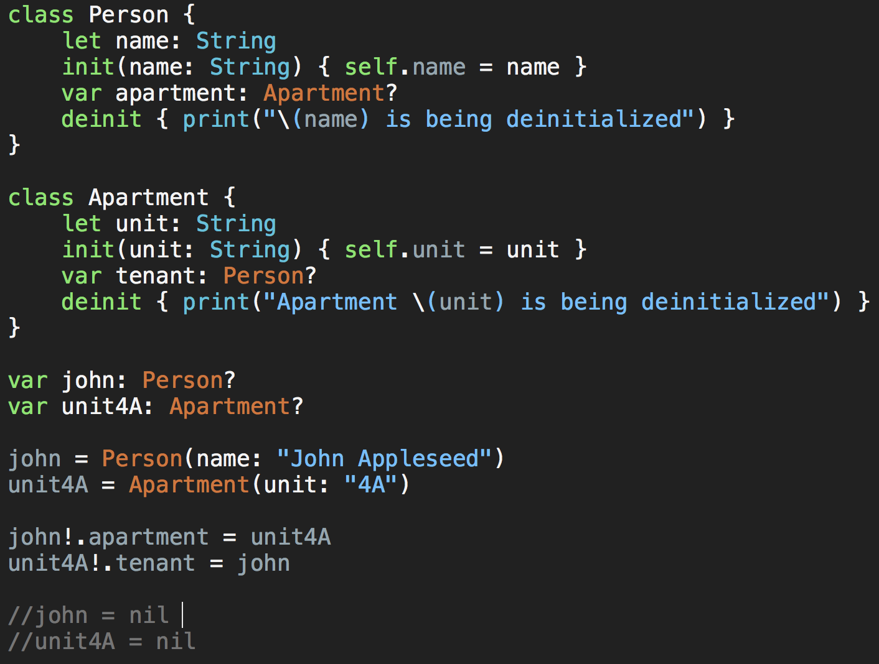
Strong reference Cycle
What happen when uncomment 2 last line?
Notes:
This can happen if two class instances hold a strong reference to each other, such that each instance keeps the other alive. This is known as a strong reference cycle.
Demo code
You resolve strong reference cycles by defining some of the relationships between classes as weak or unowned references instead of as strong references.

Slide 7
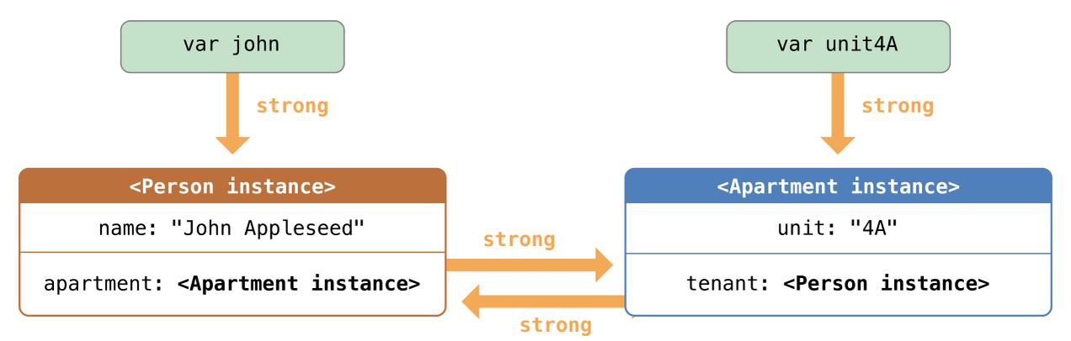
Strong reference Cycle

Slide 8
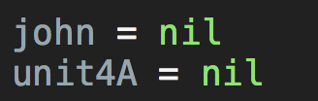
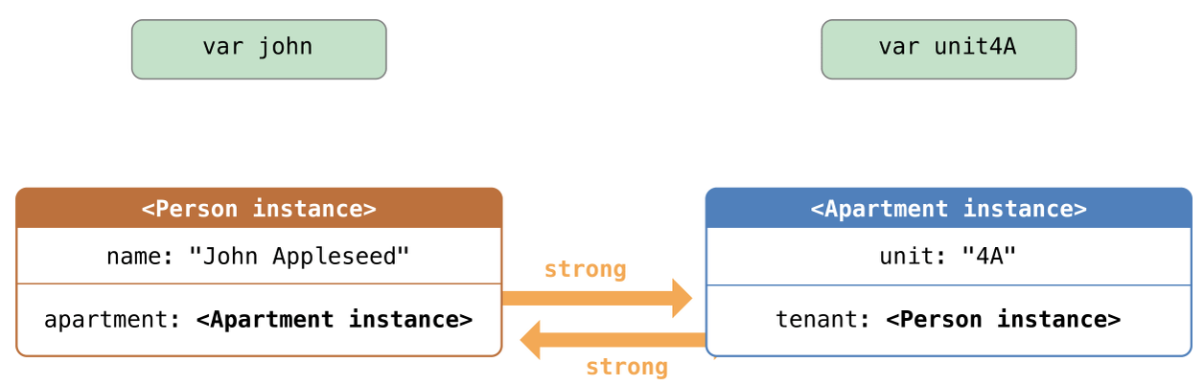
Strong reference Cycle

Slide 9
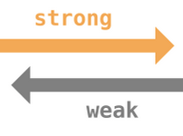
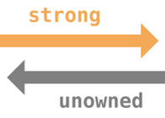
Strong reference Cycle
You resolve strong reference cycles by defining some of the relationships between classes as weak or unowned references instead of as strong references.

Slide 10

Weak reference
A weak reference is a reference that does not keep a strong hold on the instance it refers to, and so does not stop ARC from disposing of the referenced instance.
NOTE
Weak references must be declared as variables, to indicate that their value can change at runtime. A weak reference cannot be declared as a constant.
Weak references are allowed to have “no value”, you must declare every weak reference as having an optional type.
Notes:
A weak reference is a reference that does not keep a strong hold on the instance it refers to, and so does not stop ARC from disposing of the referenced instance.
****
NOTE
Weak references must be declared as variables, to indicate that their value can change at runtime. A weak reference cannot be declared as a constant.
****
Use a weak reference to avoid reference cycles whenever it is possible for that reference to have “no value” at some point in its life.
Because weak references are allowed to have “no value”, you must declare every weak reference as having an optional type. Optional types are the preferred way to represent the possibility for “no value” in Swift.
- demo code

Slide 11
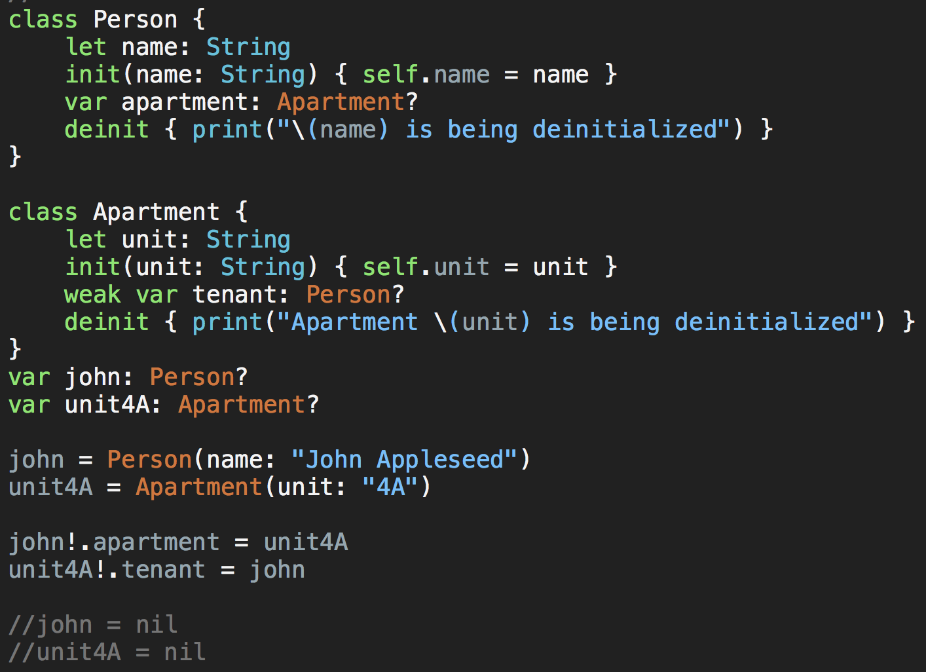

Slide 12
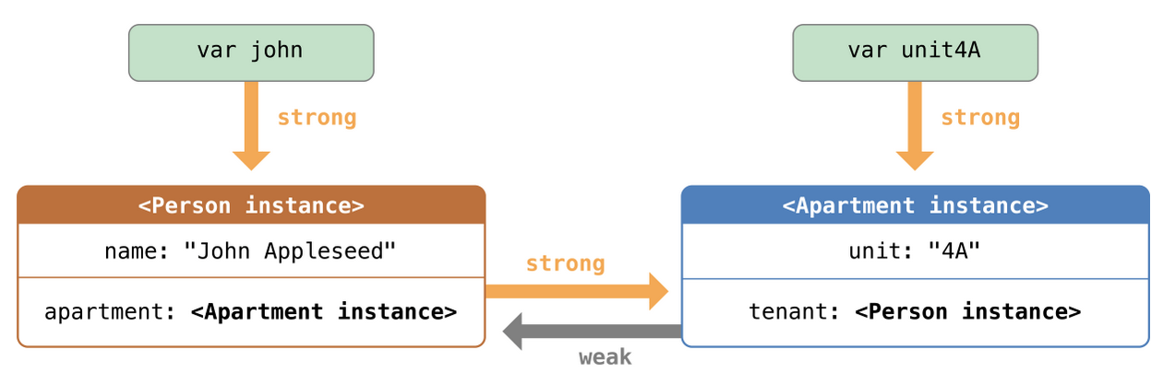

Slide 13
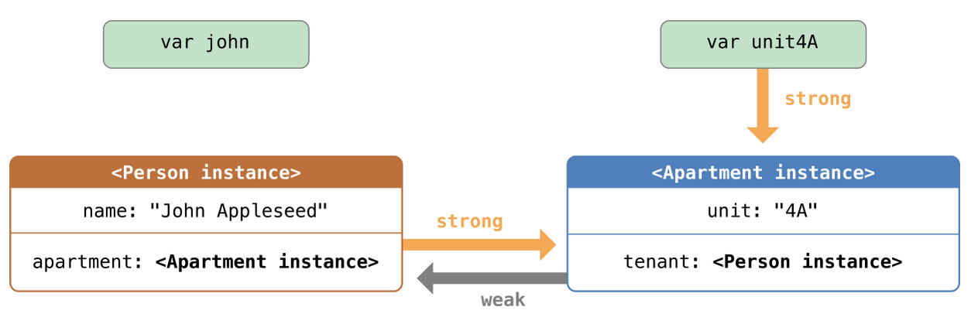

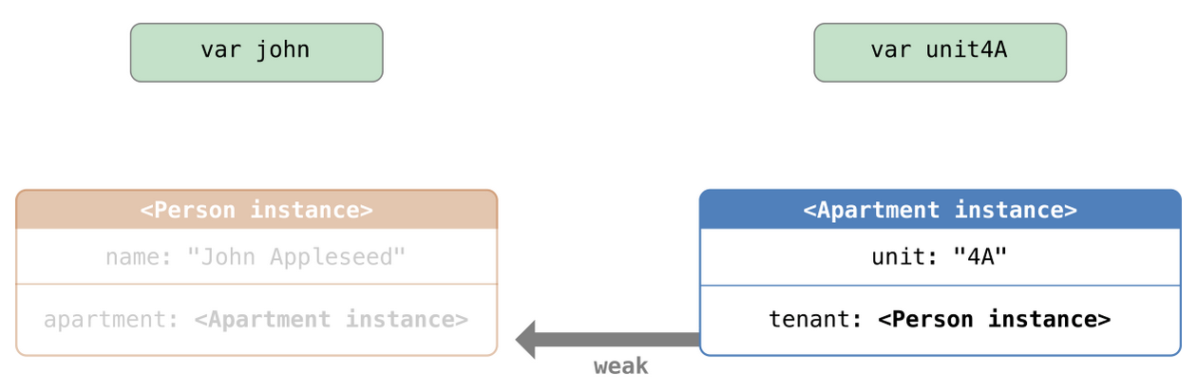


Slide 14

Unowned reference
Like weak references, an unowned reference does not keep a strong hold on the instance it refers to.
Unlike a weak reference, however, an unowned reference is assumed to always have a value.
Unowned reference is always defined as a nonoptional type.
NOTE
If you try to access an unowned reference after the instance that it references is deallocated, you will trigger a runtime error.
Notes:
Unowned reference
Like weak references, an unowned reference does not keep a strong hold on the instance it refers to. Unlike a weak reference, however, an unowned reference is assumed to always have a value. Because of this, an unowned reference is always defined as a nonoptional type.
Because an unowned reference is nonoptional, you don’t need to unwrap the unowned reference each time it is used. An unowned reference can always be accessed directly. However, ARC cannot set the reference to nil when the instance it refers to is deallocated, because variables of a nonoptional type cannot be set to nil.
****
NOTE
If you try to access an unowned reference after the instance that it references is deallocated, you will trigger a runtime error. Use unowned references only when you are sure that the reference will always refer to an instance.
Note also that Swift guarantees your app will crash if you try to access an unowned reference after the instance it references is deallocated. You will never encounter unexpected behavior in this situation. Your app will always crash reliably, although you should, of course, prevent it from doing so.
****
- demo code

Slide 15
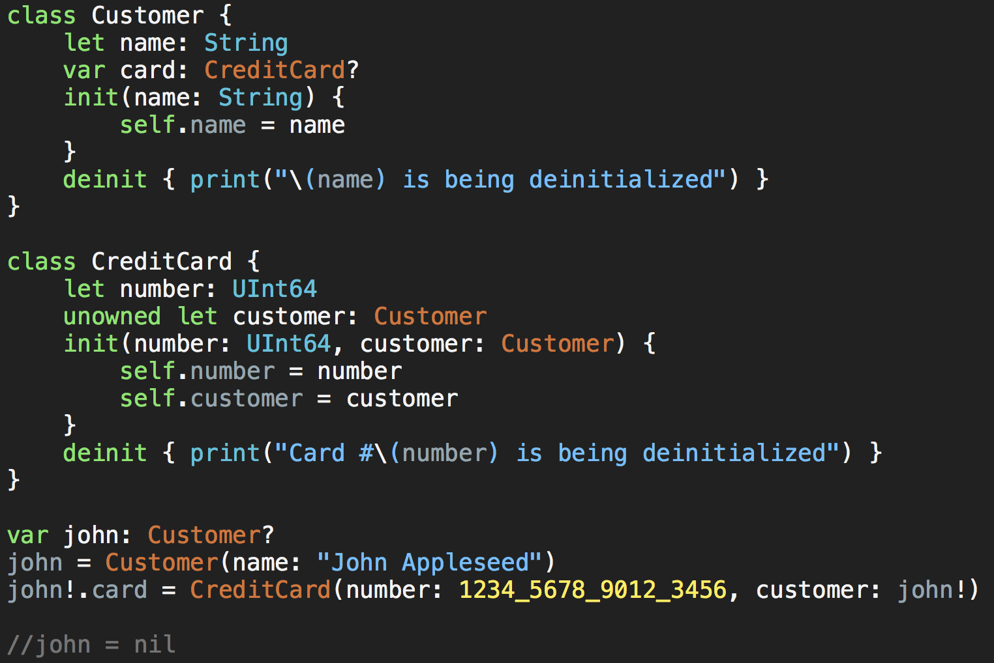

Slide 16
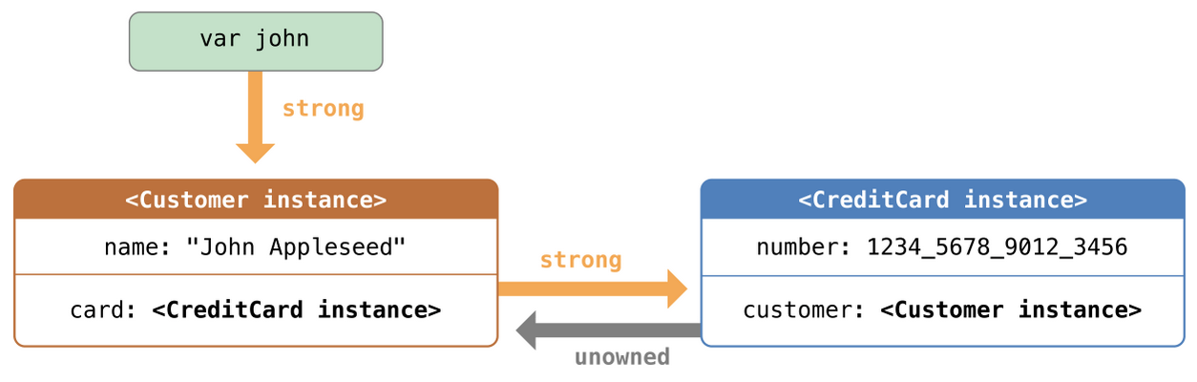

Slide 17
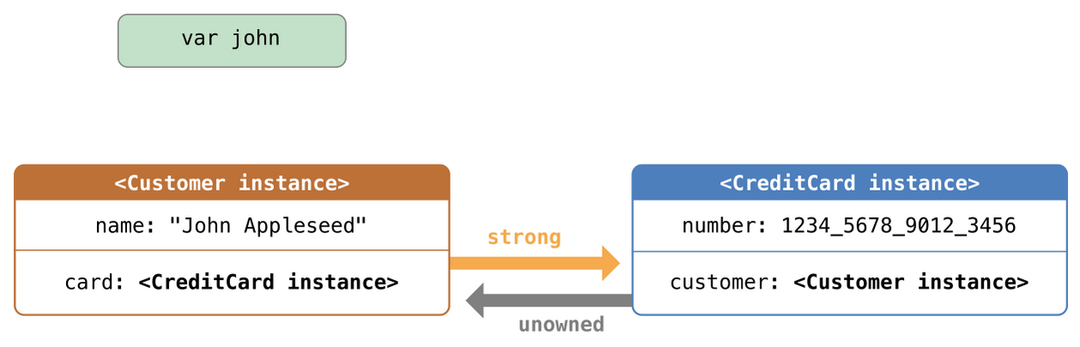


Slide 18
Unowned References and Implicitly Unwrapped Optional Properties
Strong Reference Cycles for Closures
Refer: https://developer.apple.com/library/ios/documentation/Swift/Conceptual/Swift_Programming_Language/AutomaticReferenceCounting.html#//apple_ref/doc/uid/TP40014097-CH20-ID48
HOMEWORK: Research 2 problem and write a report or sample code about it.

Slide 19
Optional Chaining
Optional Chaining as an Alternative to Forced Unwrapping
Optional Chaining is a process for querying and calling properties, methods, and subscripts on an optional that might currently be nil.
NOTE
Optional chaining in Swift is similar to messaging nil in Objective-C, but in a way that works for any type, and that can be checked for success or failure.
Notes:
Optional Chaining as an Alternative to Forced Unwrapping: là một giải pháp thay thế Force Unwrapping
Optional chaining is a process for querying and calling properties, methods, and subscripts on an optional that might currently be nil. If the optional contains a value, the property, method, or subscript call succeeds; if the optional is nil, the property, method, or subscript call returns nil. Multiple queries can be chained together, and the entire chain fails gracefully if any link in the chain is nil.

Slide 20
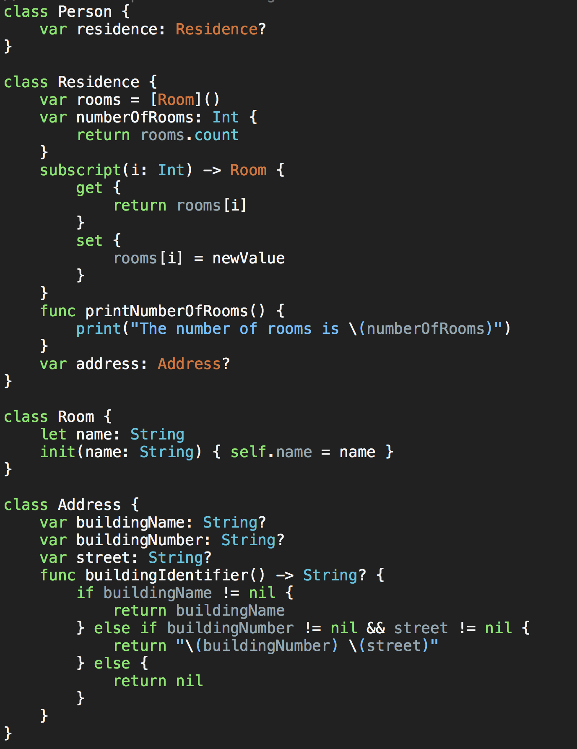

Slide 21
Optional Chaining
Accessing Properties Through Optional Chaining
Calling Methods Through Optional Chaining
Accessing Subscripts Through Optional Chaining
Linking Multiple Levels of Chaining
Chaining on Methods with Optional Return Values
Accessing Subscripts of Optional Type

Slide 22
Type Casting
Type casting is a way to check the type of an instance, and/or to treat that instance as if it is a different superclass or subclass from somewhere else in its own class hierarchy.
Type casting in Swift is implemented with the is and as operators. These two operators provide a simple and expressive way to check the type of a value or cast a value to a different type.

Slide 23
Type Casting
Checking Type
Downcast
Type Casting for Any and AnyObject
Swift provides two special type aliases for working with non-specific types:
AnyObject can represent an instance of any class type.
Any can represent an instance of any type at all, including function types.
Notes:
-Checking Type
Use the type check operator (is) to check whether an instance is of a certain subclass type. The type check operator returns true if the instance is of that subclass type and false if it is not.
demo code
-Downcast
A constant or variable of a certain class type may actually refer to an instance of a subclass behind the scenes. Where you believe this is the case, you can try to downcast to the subclass type with a type cast operator (as? or as!).
****
NOTE
Casting does not actually modify the instance or change its values. The underlying instance remains the same; it is simply treated and accessed as an instance of the type to which it has been cast.
****
-Type Casting for Any and AnyObject
Swift provides two special type aliases for working with non-specific types:
+ AnyObject can represent an instance of any class type.
+ Any can represent an instance of any type at all, including function types.

Slide 24
Nested Types
Enumerations are often created to support a specific class or structure’s functionality. Similarly, it can be convenient to define utility classes and structures purely for use within the context of a more complex type. To accomplish this, Swift enables you to define nested types, whereby you nest supporting enumerations, classes, and structures within the definition of the type they support.
Notes:
Enumerations are often created to support a specific class or structure’s functionality. Similarly, it can be convenient to define utility classes and structures purely for use within the context of a more complex type. To accomplish this, Swift enables you to define nested types, whereby you nest supporting enumerations, classes, and structures within the definition of the type they support.
(Kiểu Enumerations thường được tạo ra để hỗ trợ một lớp học cụ thể hoặc chức năng cấu trúc của. Tương tự như vậy, nó có thể được thuận tiện để định nghĩa các lớp tiện ích và các cấu trúc hoàn toàn để sử dụng trong bối cảnh của một loại phức tạp hơn. Để thực hiện điều này, Swift cho phép bạn xác định các loại lồng nhau, nhờ đó mà bạn tổ hỗ trợ kiểu liệt kê, các lớp và cấu trúc bên trong định nghĩa của các loại họ hỗ trợ.)

