Slide 1
Swift Day 06

Slide 2
Languae Reference
Lexical Structure
Types
Expressions:
Statements
Declaretions
Atributes:
Patterns:
Notes:
Quy tắc sử dụng ngôn ngữ, cú pháp trong swift

Slide 3
Lexical Structure
Comments
Whitespace
Identifiers
Keywords
Literals
Operators

Slide 4
Lexical Structure
Keywords
Notes:
Keywords used in declarations: class, deinit, enum, extension, func, import, init, inout, internal, let, operator, private, protocol, public, static, struct, subscript, typealias, and var.
Keywords used in statements: break, case, continue, default, defer, do, else, fallthrough, for, guard, if, in, repeat, return, switch, where, and while. Keywords used in expressions and types: as, catch, dynamicType, false, is, nil, rethrows, super, self, Self, throw, throws, true, try, __COLUMN__, __FILE__, __FUNCTION__, and __LINE “Keywords reserved in particular contexts: associativity, convenience, dynamic, didSet, final, get, infix, indirect, lazy, left, mutating, none, nonmutating, optional, override, postfix, precedence, prefix, Protocol, required, right, set, Type, unowned, weak, and willSet

Slide 5
Lexical Structure
Literals
Integer literals
decimal, binary, octal and hexadecimal forms
Floating point literals
decimal numbers, exponential numbers both decimal and hexadecimal floating point numbers
Notes:
Literals :

Slide 6
Lexical Structure
Literals
String literals

Slide 7
Lexical Structure
Operators
Prefix
++: Increment
--: Decrement
+: Unary plus
-: Unary minus
!: Logical NOT
~: Bitwise NOT

Slide 8
Lexical Structure
Operators
Infix
<< : Bitwise left shift
>> : Bitwise right shift
* : Multiply
/ : Divide
%!: Remainder
&* : Multiply, ignoring overflow
&/ : Divide, ignoring overflow
&% : Remainder, ignoring overflow
& Bitwise AND
+ , - :
&+ : Add with overflow
&-: Subtract with overflow
| : Bitwise OR
^ : Bitwise XOR
Range
..<: Half-open range
... : Closed range

Slide 9
Lexical Structure
Operators
Infix
Cast
is: Type check
as: Type cast
Comparative:
< :Less than
Ref: http://nshipster.com/swift-operators/
Notes:
http://swift.freevnn.com/?p=244

Slide 10
Lexical Structure
Operators
Member Functions In addition to the aforementioned standard operators, there are some de facto operators defined by the language:
. : Member Access
? : Optional
! : Forced-Value
[] : Subscript
[]= : Subscript Assignment

Slide 11
Lexical Structure
Operators
Overloading
Notes:
Swift has the ability to overload operators such that existing operators, like +, can be made to work with additional types.
To overload an operator, simply define a new function for the operator symbol, taking the appropriate number and type of arguments.

Slide 12
Lexical Structure
Operators
Custom Operators
Notes:
“You can declare and implement your own custom operators in addition to the standard operators provided by Swift. For a list of characters that can be used to define custom operators, see Operators.New operators are declared at a global level using the operator keyword, and are marked with the prefix, infix or postfix modifiers

Slide 13
Lexical Structure
Operators
Custom Operators with Protocol and Method
Notes:
Function definitions for the operators themselves should be extremely simple—a single LOC, really. For anything more complex, some additional setup is warranted.
Take, for example, a custom operator, =~, which returns whether the left hand side matches a regular expression on the right hand side
First, a RegularExpressionMatchable protocol is declared, with a single method for matching regular expressions.
Next, an extension adding conformance to this protocol to String is declared, with a provided implementation of match, using NSRegularExpression.
Finally, the =~ operator is declared and implemented on a generic type conforming to RegularExpressionMatchable.

Slide 14
Lexical Structure
Operators
Use of Mathematical Symbols
Ref: https://github.com/mattt/Euler
Notes:
https://github.com/mattt/Euler

Slide 15
Statements 1. simple statements 2. compiler control statements 3. control flow statements.

Slide 16
Statements 1. simple statements
Loop Statements
While Statement/ Repeat while

Slide 17
Statements 1. simple statements
If statement
Guard Statement
Ref: http://ericcerney.com/swift-guard-statement/

Slide 18
Statements
Switch statement

Slide 19
Statements
Defer Statement

Slide 20
Declarations
Notes:
“A declaration introduces a new name or construct into your program”

Slide 21
Declarations
Notes:
“A declaration introduces a new name or construct into your program”

Slide 22
Attributes
Notes:
“Attributes provide more information about a declaration or type”Excerpt From: Apple Inc. “The Swift Programming Language (Swift 2).” iBooks. https://itun.es/us/jEUH0.l

Slide 23
Types
Named types: classes, structures, enumerations, and protocols
Compound types
Ex: tuple type (Int, (Int, Int))
Type Annotation:
Notes:
In Swift, there are two kinds of types: named types and compound types. A named type is a type that can be given a particular name when it is defined.
Named types include classes, structures, enumerations, and protocols.
“A compound type is a type without a name, defined in the Swift language itself. There are two compound types: function types and tuple types. A compound type may contain named types and other compound types. For instance, the tuple type (Int, (Int, Int)) contains two elements: The first is the named type Int, and the second is another compound type (Int, Int).

Slide 24
Types
Type Identifier Int Dictionary<String, Int>

Slide 25
Types
Tuple Type Function Type
Notes:
A tuple type is a comma-separated list of zero or more types, enclosed in parentheses. You can use a tuple type as the return type of a function to enable the function to return a single tuple containing multiple values.

Slide 26
Types
Array Type Tuple Type Dictionary Type
Notes:
A tuple type is a comma-separated list of zero or more types, enclosed in parentheses. You can use a tuple type as the return type of a function to enable the function to return a single tuple containing multiple values.

Slide 27
Types
Array Type Optional Type Implicitly Unwrapped Optional Type
Notes:
A tuple type is a comma-separated list of zero or more types, enclosed in parentheses. You can use a tuple type as the return type of a function to enable the function to return a single tuple containing multiple values.

Slide 28
Types Protocol Composition Type protocol<Protocol 1, Protocol 2>

Slide 29
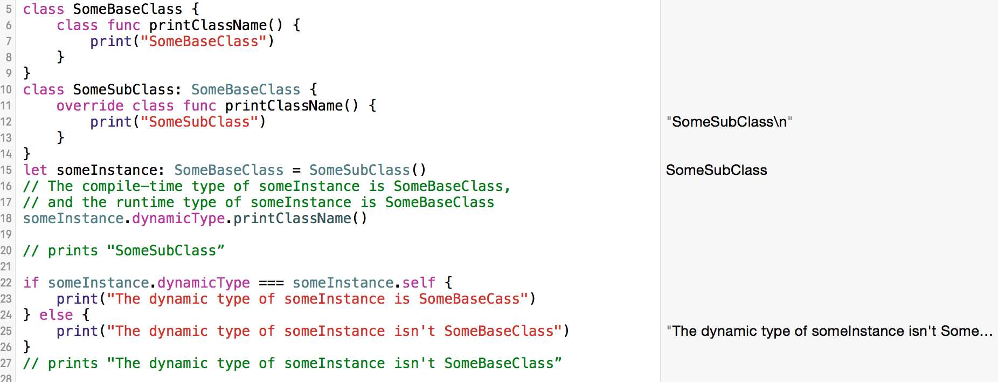
Types
Metatype Type “A metatype type refers to the type of any type, including class types, structure types, enumeration types, and protocol types.The metatype of a class, structure, or enumeration type is the name of that type followed by .Protocol “
Notes:
“A metatype type refers to the type of any type, including class types, structure types, enumeration types, and protocol types.The metatype of a class, structure, or enumeration type is the name of that type followed by . “The metatype of a class, structure, or enumeration type is the name of that type followed by .Type. The metatype of a protocol type—not the concrete type that conforms to the protocol at runtime—is the name of that protocol followed by .Protocol. For example, the metatype of the class type SomeClass is SomeClass.Type and the metatype of the protocol SomeProtocol is SomeProtocol.Protocol.

Slide 30
Type
Type Inheritance Clause [NO DEMO]
Notes:
“A type inheritance clause is used to specify which class a named type inherits from and which protocols a named type conforms to. A type inheritance clause is also used to specify a class requirement on a protocol. A type inheritance clause begins with a colon (:), followed by either a class requirement, a list of type identifiers, or both.”Excerpt From: Apple Inc. “The Swift Programming Language (Swift 2).” iBooks. https://itun.es/us/jEUH0.l

Slide 31
Type
Type Inference [NO DEMO]
Notes:
“Swift uses type inference extensively, allowing you to omit the type or part of the type of many variables and expressions in your code. ”Excerpt From: Apple Inc. “The Swift Programming Language (Swift 2).” iBooks. https://itun.es/us/jEUH0.l

Slide 32
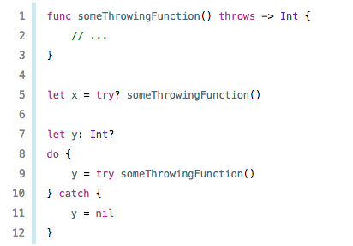
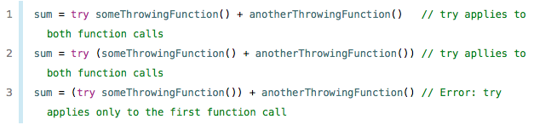
TRY OPERATOR
Try expression
A “try expression” consists of the try operator followed by an expression that can throw an error
Try? Expression
An optional-try expression consists of the try?
operator followed by an expression that can throw an error
* Return is an optional containing
the value of the expression , Otherwise,
the value of the optional-try expression is nil.
Try! Expression
A forced-try expression consists of the try! operator followed by
an expression that can throw an error * not safe
* you can use parentheses to be explicit
about the scope of the operator’s application.
Notes:
“

Slide 33


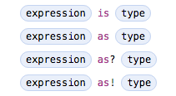
Binary Expressions
Assignment Operator
The assignment operator sets a new value for a given expression
* If the expression is a tuple, the value must be a tuple with the same number of elements. (Nested tuples are allowed.)
Ternary Conditional Operator
Type-Casting Operators
There are four type-casting operators
IS :
AS : When a conversion can be guaranteed to succeed and
therefore not be the cause of an app crash
AS? : Cast to Optional
Notes:
“

Slide 34
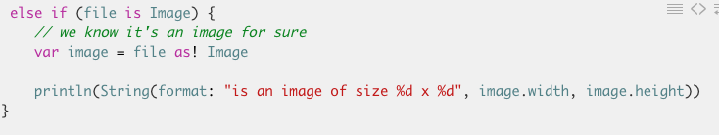
AS! : Forced Conversion
* Not safe , throw runtime error
Link : https://www.murage.ca/downcasting-in-swift-1-2-with-as-exclamation/
Notes:
“

Slide 35
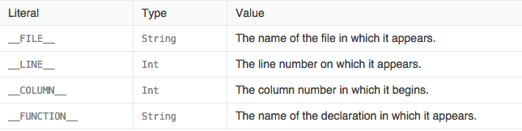
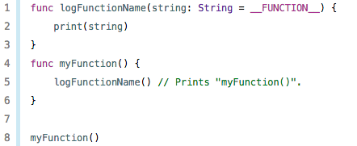
Primay Expression
Primary expressions are the most basic kind of expression
Literal Expression
A literal expression consists of either an ordinary literal (such as a string or a number), an array or dictionary literal, or one of the following special literal
Inside a function, the value of __FUNCTION__ is the name of that function, inside a method it is the name of that method, inside a property getter or setter it is the name of that property, inside special members like init or subscript it is the name of that keyword, and at the top level of a file it is the name of the current module.
Notes:
“

Slide 36
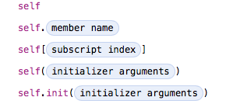
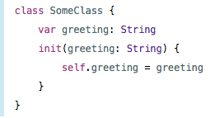
Array literal
Dictionary literal
Self Expression
The self expression is an explicit reference to the current type or instance of the type in which it occurs
The self expression is used to specify scope when accessing members, providing disambiguation when
there is another variable of the same name in scope, such as a function parameter
Notes:
“

Slide 37
Patterns “A pattern represents the structure of a single value or a composite value”
Notes:
“A pattern represents the structure of a single value or a composite value”
“The first kind of pattern is used for destructuring values in simple variable, constant, and optional bindings”: “wildcard patterns, identifier patterns, and any value binding or tuple patterns containing them”

Slide 38
Patterns Wildcard Pattern: “A wildcard pattern matches and ignores any value and consists of an underscore (_).
Use a wildcard pattern when you don’t care about the values being matched against
Notes:
“A wildcard pattern matches and ignores any value and consists of an underscore (_).
Use a wildcard pattern when you don’t care about the values being matched against

Slide 39
Patterns Identifier Pattern
Notes:
“An identifier pattern matches any value and binds the matched value to a variable or constant name”Excerpt From: Apple Inc. “The Swift Programming Language (Swift 2).” iBooks. https://itun.es/us/jEUH0.l

Slide 40
Patterns Value-Binding Pattern
Notes:
“A value-binding pattern binds matched values to variable or constant names”Excerpt From: Apple Inc. “The Swift Programming Language (Swift 2).” iBooks. https://itun.es/us/jEUH0.l

Slide 41
Patterns Tuple Pattern “A tuple pattern is a comma-separated list of zero or more patterns, enclosed in parentheses”
Notes:
“A tuple pattern is a comma-separated list of zero or more patterns, enclosed in parentheses. Tuple patterns match values of corresponding tuple types.”Excerpt From: Apple Inc. “The Swift Programming Language (Swift 2).” iBooks. https://itun.es/us/jEUH0.l

Slide 42
Patterns Enumeration Case Pattern
Notes:
“A tuple pattern is a comma-separated list of zero or more patterns, enclosed in parentheses. Tuple patterns match values of corresponding tuple types.”Excerpt From: Apple Inc. “The Swift Programming Language (Swift 2).” iBooks. https://itun.es/us/jEUH0.l REF: http://austinzheng.com/2014/12/16/swift-pattern-matching-switch/

Slide 43
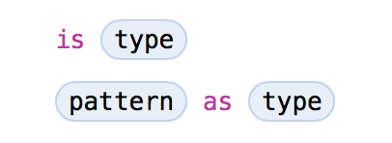
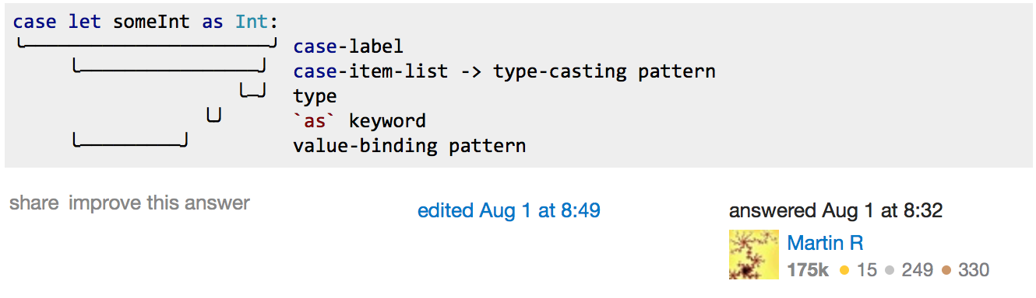
Patterns Type-Casting Patterns
Notes:
Ref: http://appventure.me/2015/08/20/swift-pattern-matching-in-detail/ http://austinzheng.com/2014/12/17/custom-pattern-matching/ is type: Matches the runtime type (or a subclass of it) against the right hand side. This performs a type cast but disregards the returned type. So your case block won't know about the matched type. pattern as type: Performs the same match as the is pattern but for a successful match casts the type into the pattern specified on the left hand side

Slide 44
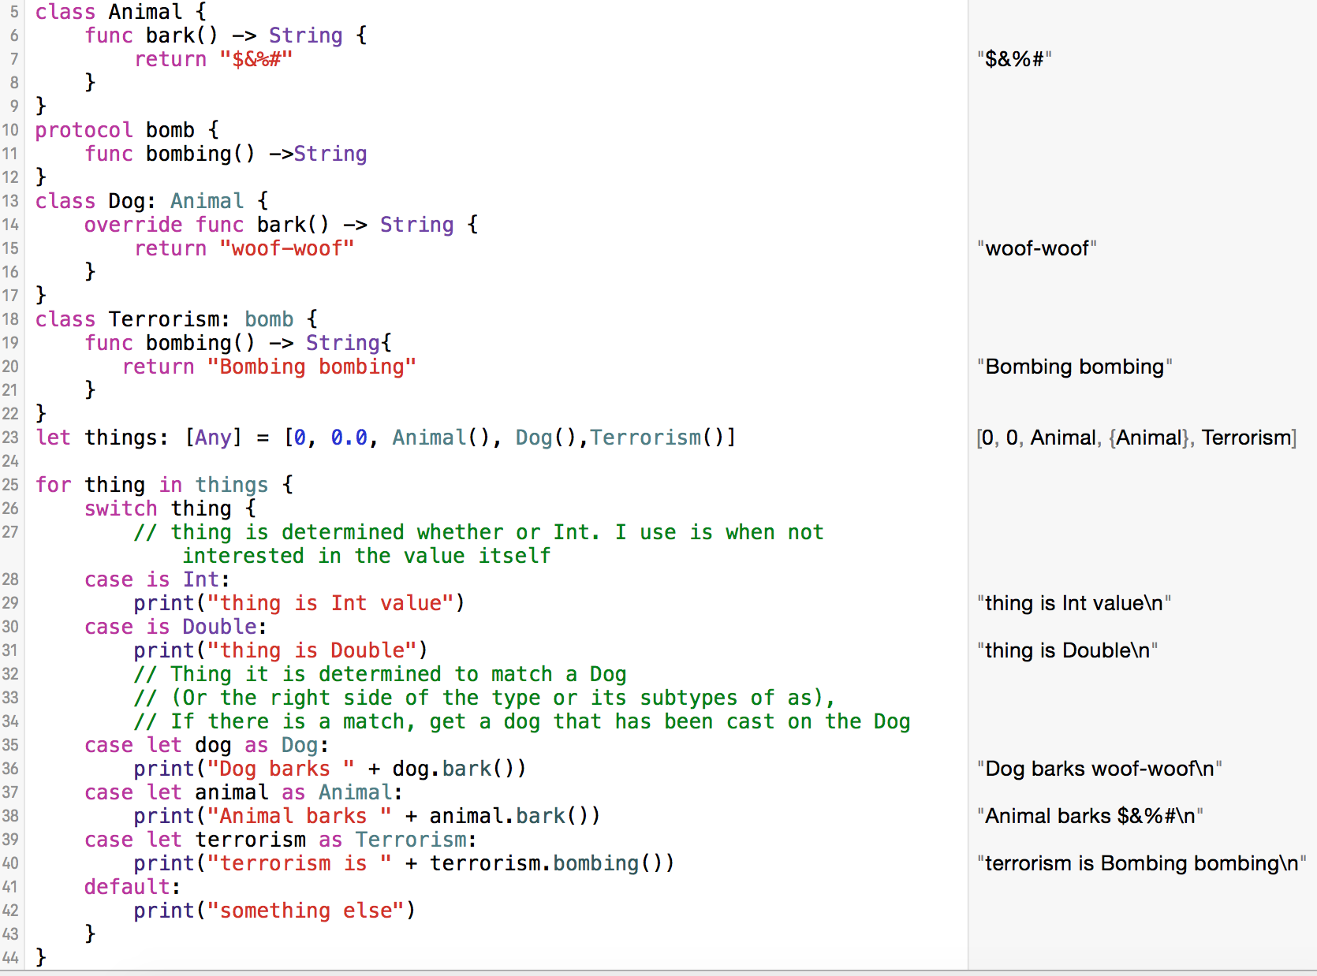
Patterns Type-Casting Patterns
Notes:
Ref: http://appventure.me/2015/08/20/swift-pattern-matching-in-detail/ http://austinzheng.com/2014/12/17/custom-pattern-matching/ is type: Matches the runtime type (or a subclass of it) against the right hand side. This performs a type cast but disregards the returned type. So your case block won't know about the matched type. pattern as type: Performs the same match as the is pattern but for a successful match casts the type into the pattern specified on the left hand side

Slide 45
Patterns Expression Pattern
Notes:
“An expression pattern represents the value of an expression. Expression patterns appear only in switch statement case labels.”

