Slide 1
Broadcast Receivers
Broadcast Receivers are one of four components of an App (other three are Activity, Services and Content Providers).
Respond to system wide announcements. Announcements can be generated by the Android system or other apps.
Examples of system generated announcements: Screen turned off, battery is low, picture captured etc.
Apps can also generate custom broadcasts by calling Context.sendBroadcast() method and passing an intent as a parameter.
To listen to broadcasts we need to register a receiver. This can be done:
statically by declaring in the manifest file.
dynamically using method Context.registerReceiver() and passing an instance of class extending BroadcastReceiver class.
BroadcastReceiver.onReceive() method is invoked whenever a broadcast with intent matches our receiver’s filter.

Slide 2
The app instantiates a class which extends BroadcastReciever class
private final BroadcastReceiver broadcastReceiver = new BroadcastReceiver() {
@Override
public void onReceive(Context context, Intent intent) {
//Code to execute when broadcast is received.
}
};
Register receiver in onResume() callback method.
IntentFilter intentFilterWiFi = new IntentFilter(); // Instantiate new IntentFilter Class
intentFilterWiFi.addAction(WifiManager.WIFI_STATE_CHANGED_ACTION); // Specify the type of broadcast to listen
registerReceiver(broadcastReceiverWiFi, intentFilterWiFi); // Register the receiver.
Unregister the receiver in onPause() callback method to conserve resources.
unregisterReceiver(broadcastReceiverWiFi);
Send custom broadcast in our app.
Intent intent = new Intent(); //Instantiate Intent Class
intent.setAction(getPackageName() + ".uniqueIntentCustom"); //Specify the intent action that other apps
//should use to receive this broadcast
sendBroadcast(intent); //Broadcast using sendBroadcast() method

Slide 3
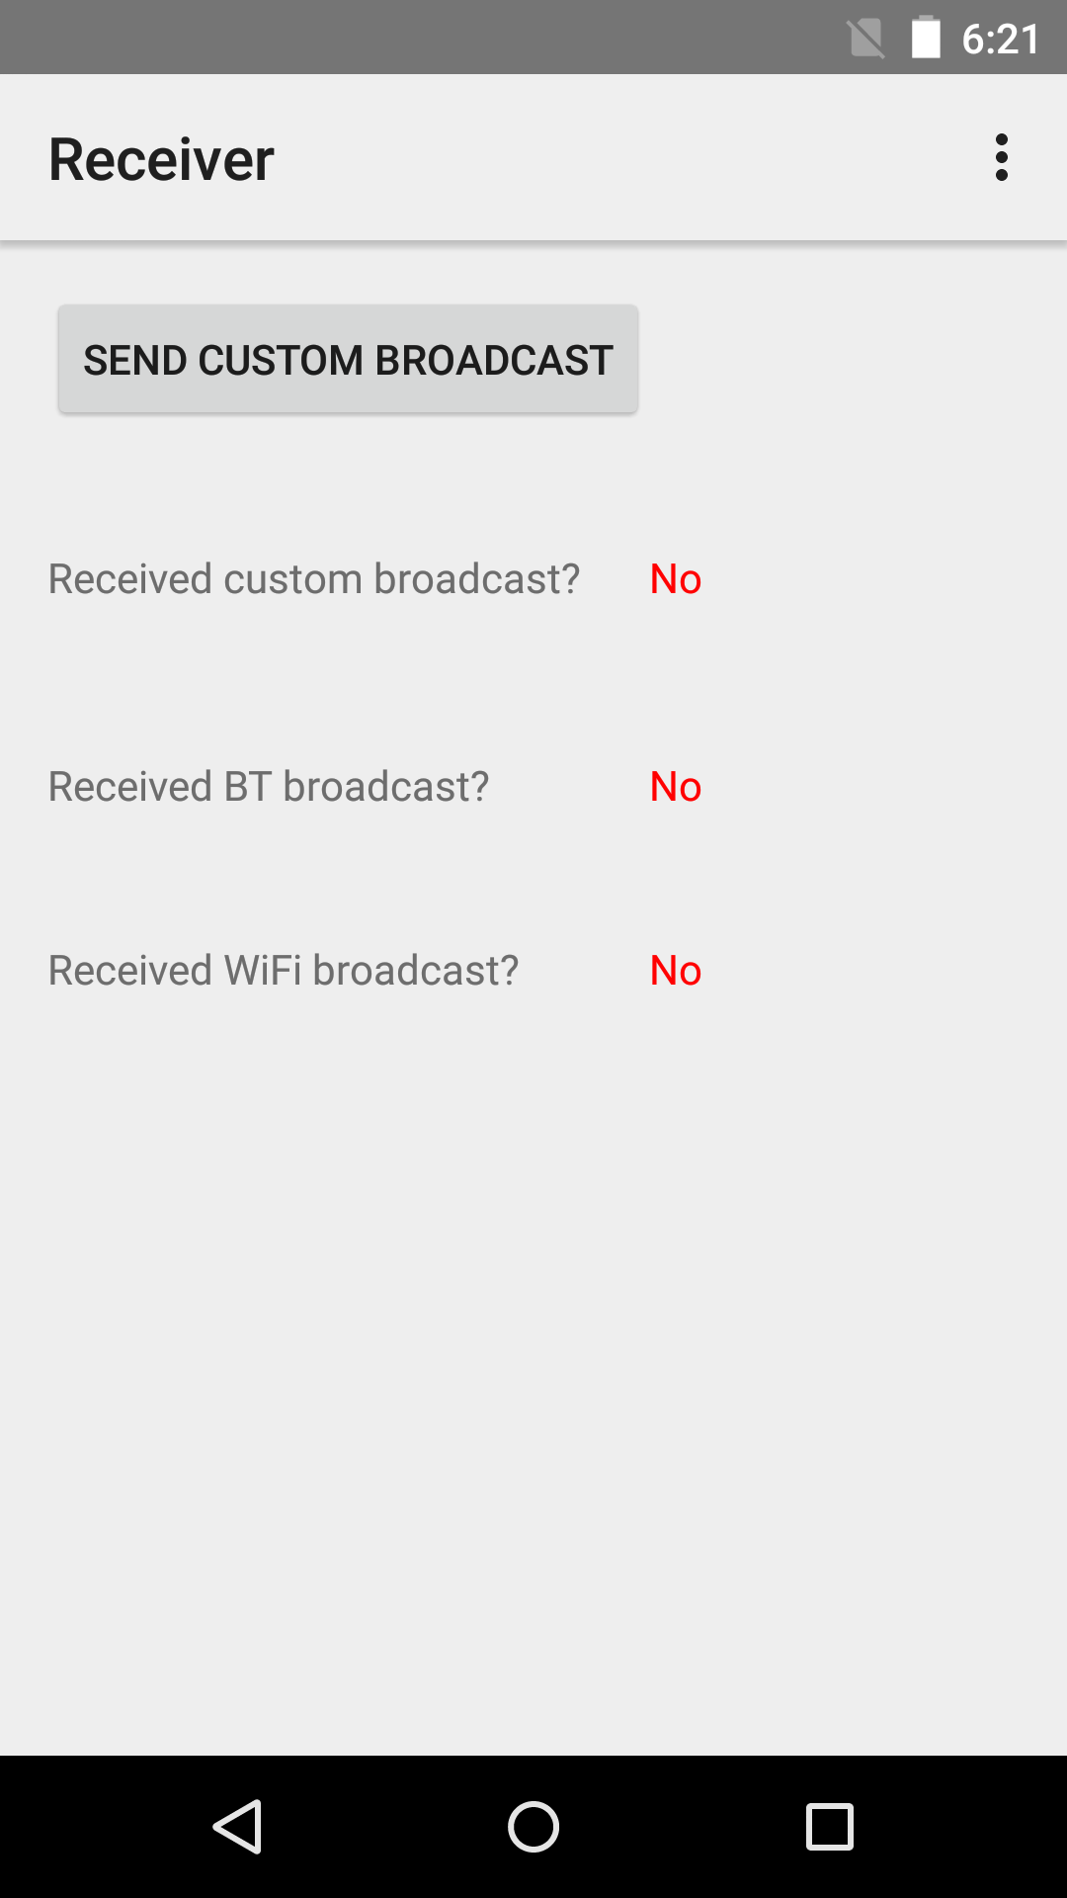
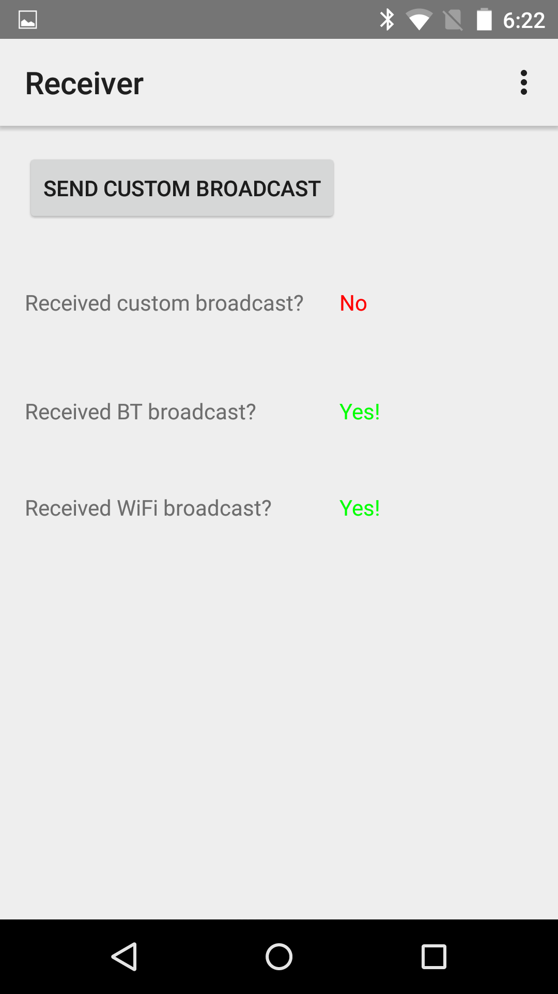
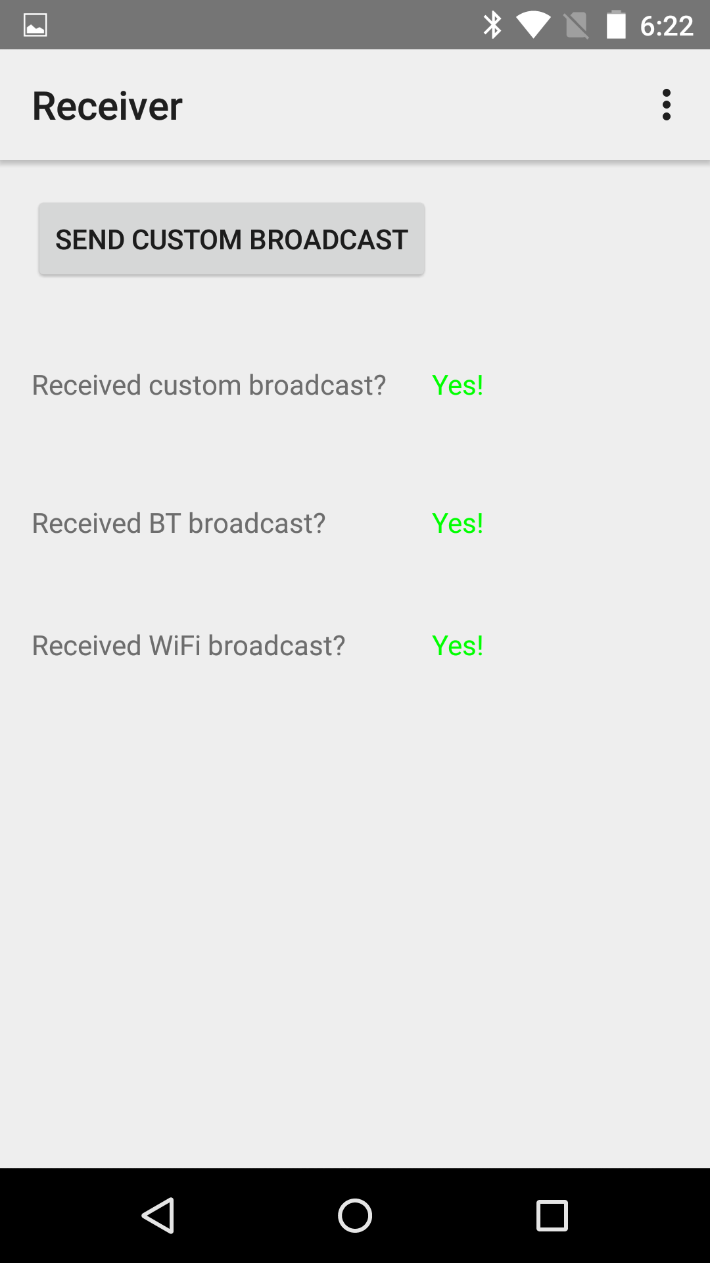
The app sends and receives one custom broadcast (click button) and receives two system broadcasts(BT and Wi-Fi).
After turning on Bluetooth and Wi-Fi
After sending custom broadcast
App start screen

Slide 4
Two major classes of broadcasts.
Normal Broadcasts: use Context.sendBroadcast() method.
Asynchronous.
All the receivers of this broadcast are executed in undefined order.
Receivers cannot use result or abort the broadcast.
Advantages: Efficient, simple to use.
Ordered Broadcasts: use Context.sendOrderedBroadcast() method.
Broadcast are delivered one at a time based on priority.
Each receiver can propagate result to next receiver.
Receivers can abort the broadcast and prevent next receiver from receiving.
LocalBroadcastManager - Used to send intents to local objects within the app process.
We know the data we are sending within our app.
Other apps cannot broadcast to our app.
More efficient and secure compared to system wide broadcast.

Slide 5
References
BroadcastReceivers
Intents and Intent-Filters
LocalBroadcastManager

Slide 6
Exercise:
Nothing to do!

