Slide 1
Introduction to AMITEX_FFTP http://www.maisondelasimulation.fr/projects/amitex/html/index.html Application to the behavior of concretes submitted to thermo-hydro-mechanical loadings
L.Gélébart, F.Bernachy
CEA Saclay - DEN
Journée « utilisateurs MFRONT » / 20 Mai 2016 / EDF Saclay

Slide 2
OUTLINE
Introduction FFT
AMITEX_FFTP code – main features and specificities
Application to concretes
ECCOMAS Congress 2016
5 - 10 JUNE 2016 Crete Island, Greece
European Congress on Computational Methods in Applied Sciences and Engineering
Minisymposium FFT : 17 presentations

Slide 3
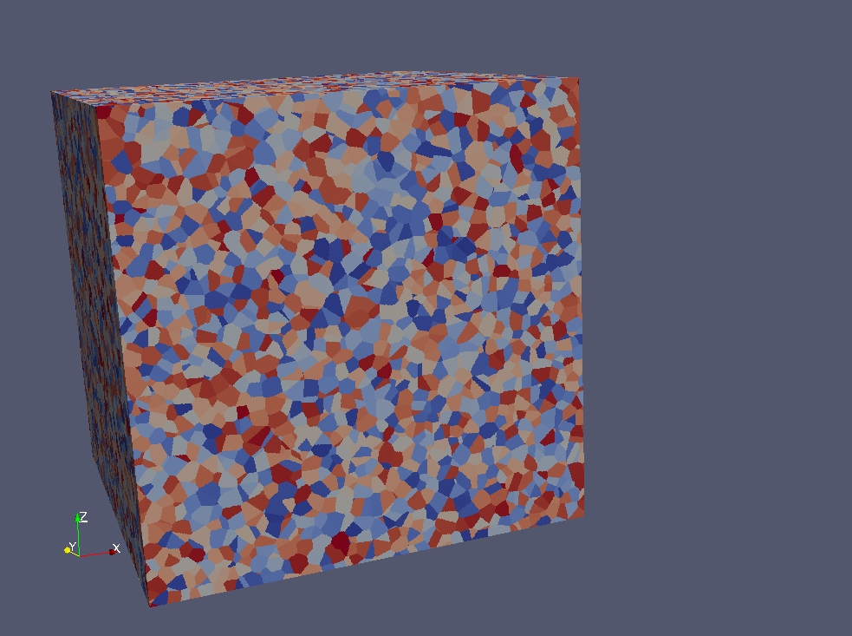
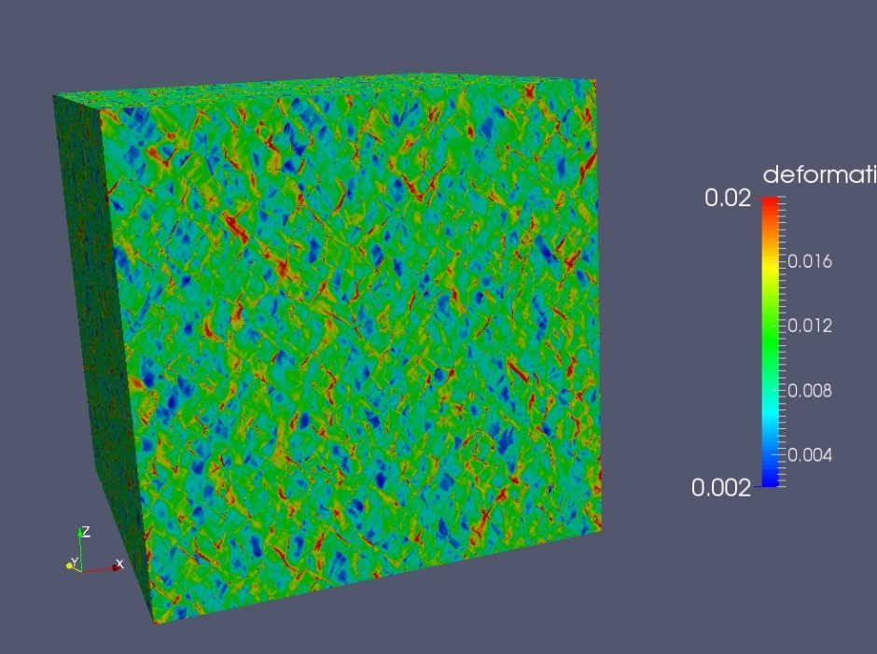
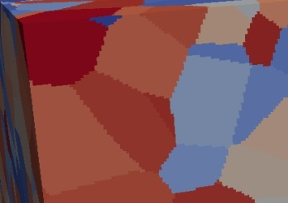
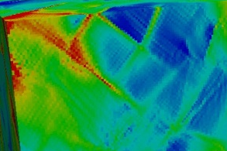
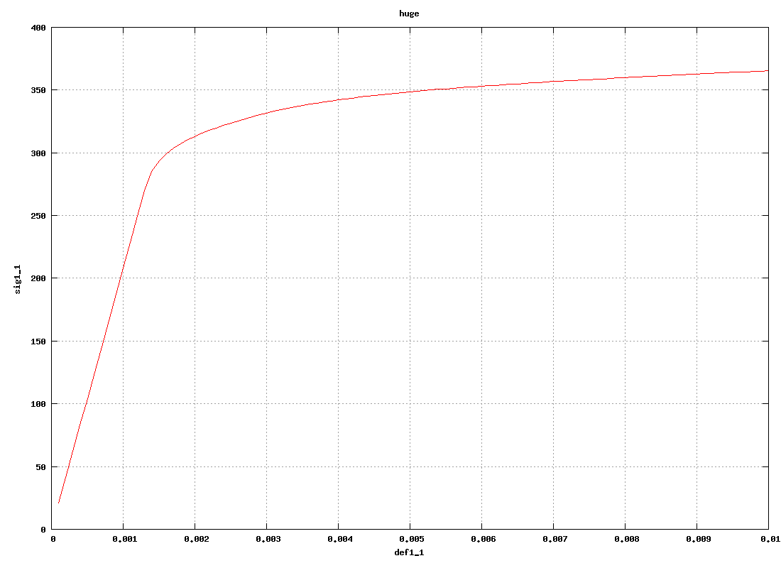


Introduction
« FFT-based » methods (or « Lippman-Schwinger-based » methods)
3D Image
(regular grid)
Stress, strain fields…
FFT-based method
Periodic BC
AMITEX_FFTP
AMITEX_FFTP
+ Local behavior
+ Average loading
ADVANTAGES (vs standard FE code)
No mesh, Efficiency, Well-suited for parallelism

Slide 4
Introduction
« FFT-based » methods (or « Lippman-Schwinger-based » methods)
Problem to solve
Auxiliary problem
Solution for the Auxiliary Problem
Re-written problem
Application of the Green operator:
Simple product in Fourier space
Mura 1997
Moulinec-Suquet,1994

Slide 5
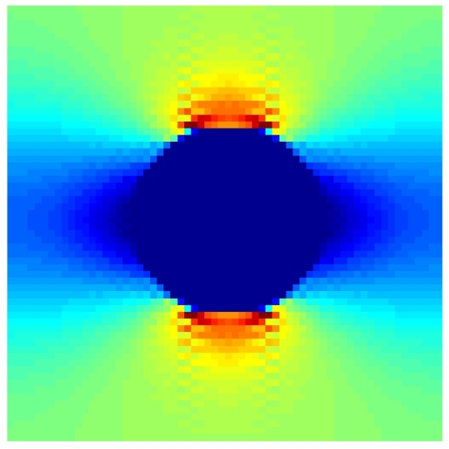
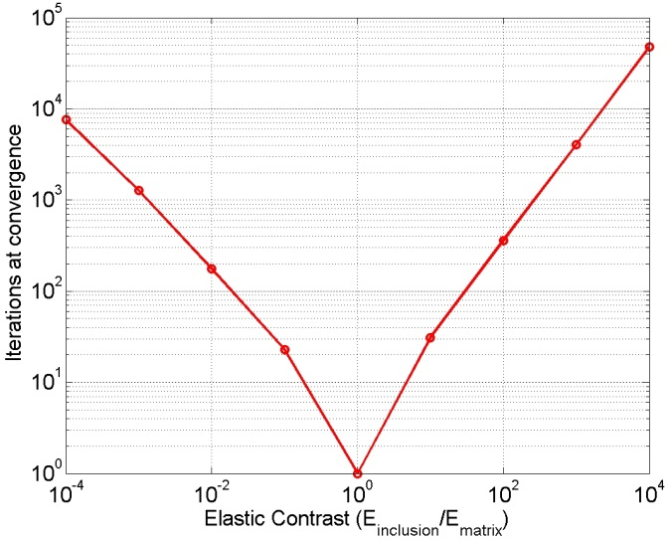
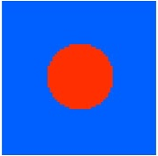
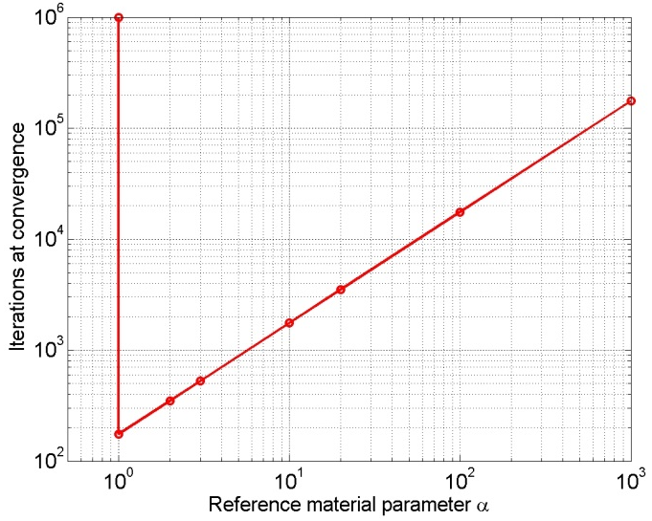
INTRODUCTION
Drawbacks of the « Basic Scheme » (MS1994)
Sensitivity to
élastic contrast
Spurious oscillations
Uniaxial Strain
Sensitivity to
Reference Medium

Slide 6
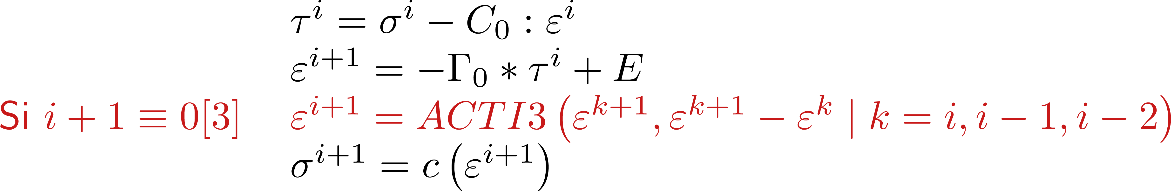
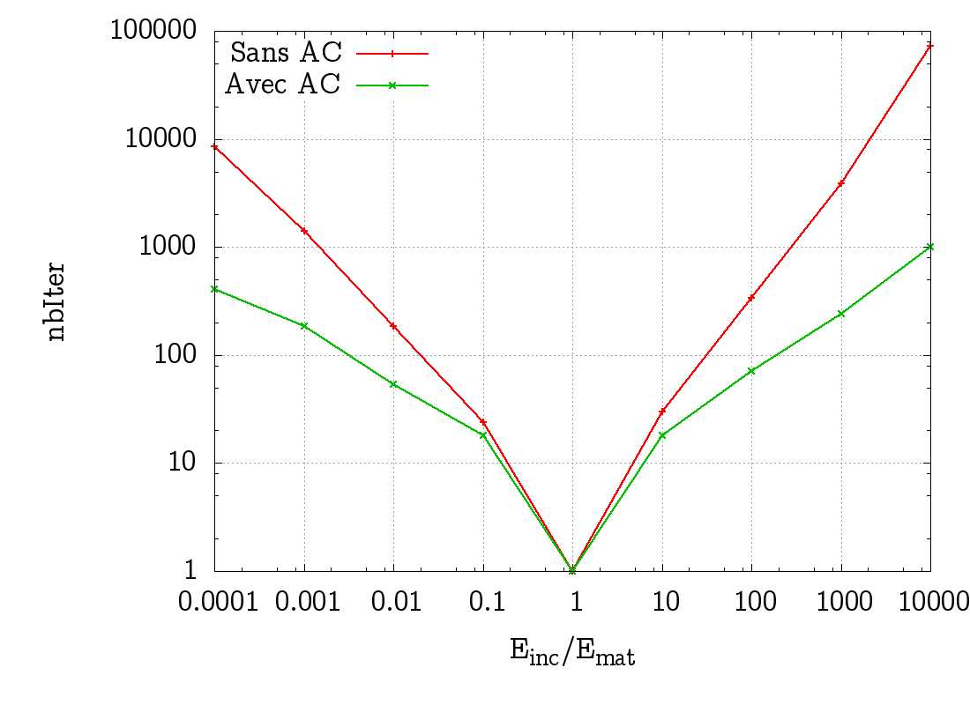
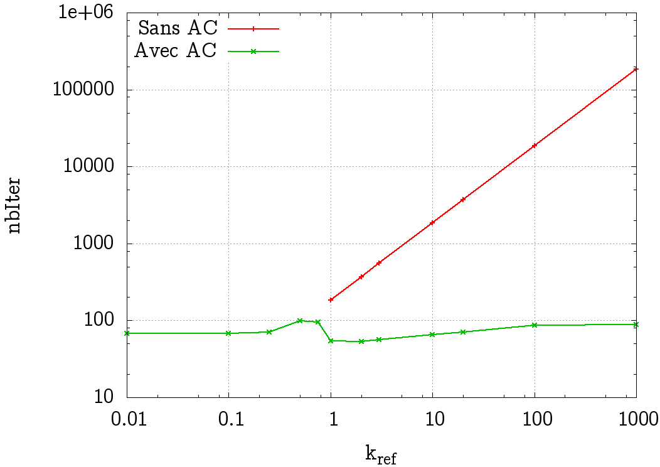


New features IN AMITEX_FFTP
Post-doc Franck Ouaki, 2014-2015
Convergence Acceleration technique (~Krylov-based method)
Used in FE-code CAST3M (Newton-Raphson)
Do not require the tangent behavior
Simple implementation
Elastic contrast Sentitivity
Reference Material Sensitivity

Slide 7
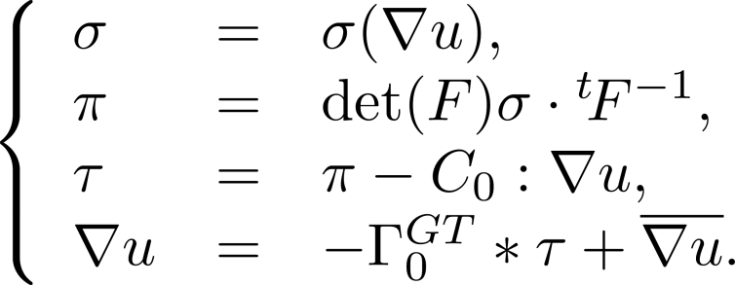
New features IN AMITEX_FFTP
Post-doc Franck Ouaki, 2014-2015
Finite Strain extension
Basic Scheme
+ Convergence
Acceleration
Technique
(see also Lahellec, Eisenlhor…)

Slide 8
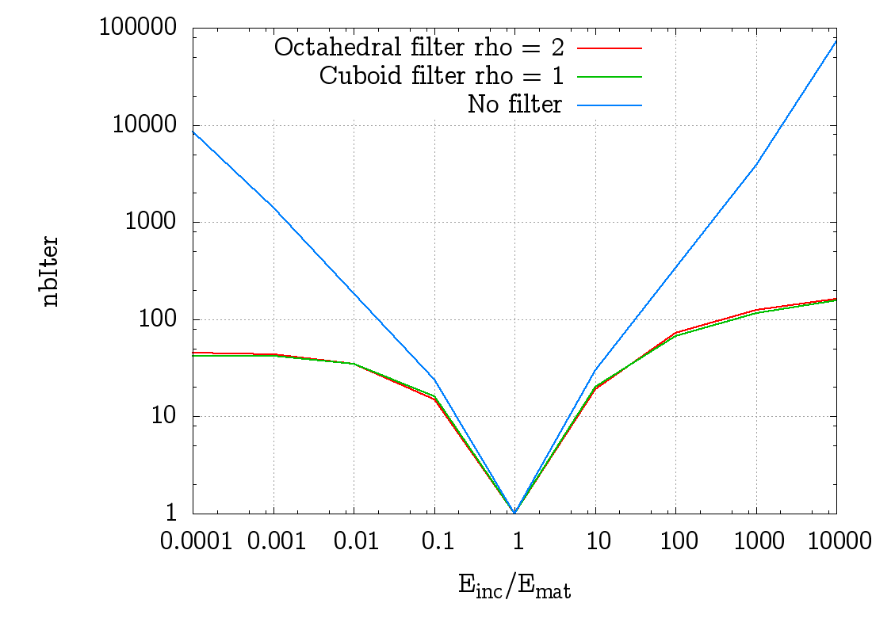
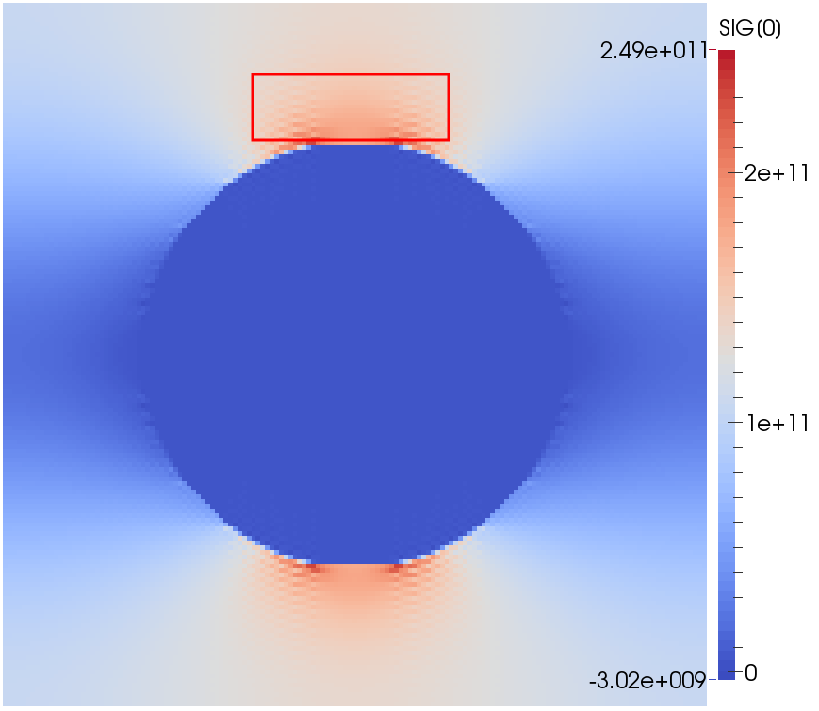
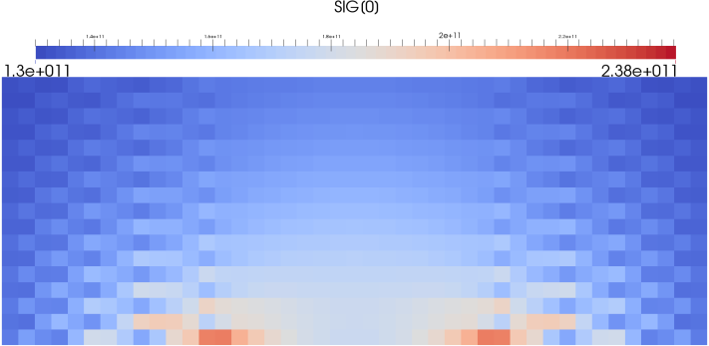
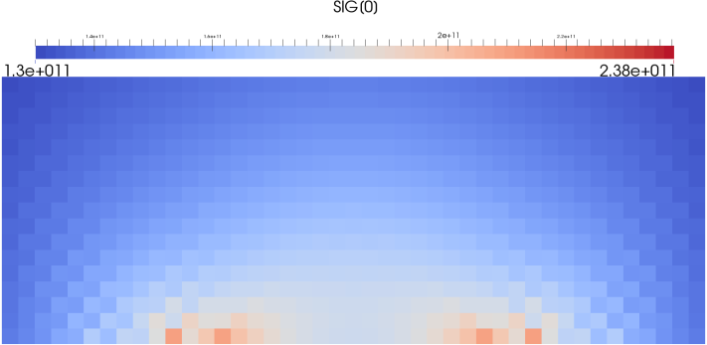
New features IN AMITEX_FFTP
Post-doc Franck Ouaki, 2014-2015
Modified Discrete Green operator
Sensitivity to
elastic contrast
Classical Green Operator
=> Continuous derivation
Modified Green Operator
=> Discrete derivation (average/voxel)
(see also Willot, Brisard, Kabel…)
Classical Green Operator
Modified Green operator

Slide 9
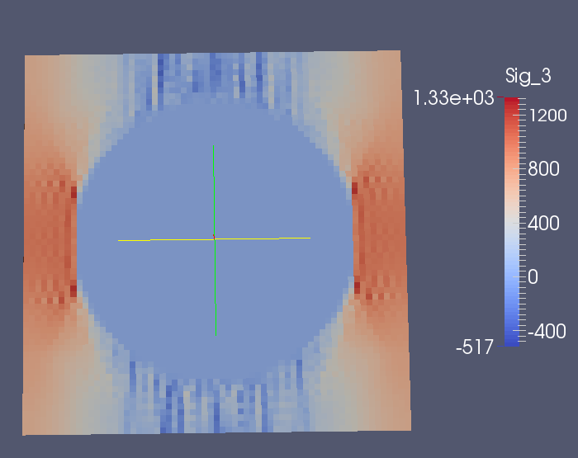
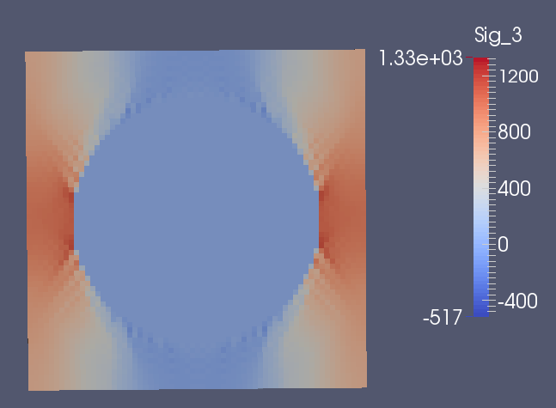
New features IN AMITEX_FFTP
Modified Discrete Green operator
Recent application in progress (PhD P.O Barrioz at CEA/DEN/DMN/SEMI) :
Uniaxial tensile test (10%), at RT (298K)
Finite strain, 1000 steps
Dislocation-based CP for FCC austenitic steels (316 stainless steel)
Spheric Porosity within a Single Crystal
Classical Green Operator
Modified Green operator

Slide 10
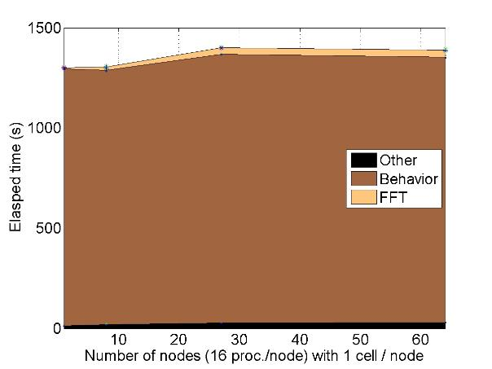
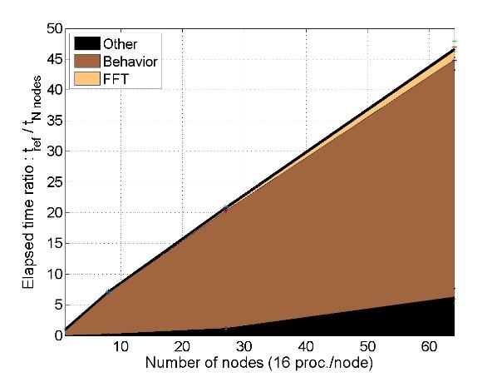
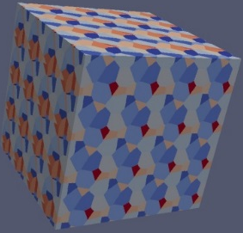

New features IN AMITEX_FFTP
Distributed parallel MPI implementation
Polycrystal (voronoï), dislocation-based Crystal Plasticity, small perturbations
Cluster poincare (Maison de la Simulation)
Weak scalability
Strong scalability
Number of nodes = N, Problem size = NxK0
Elasped time on 1 node : t_{ref}
Elapsed time on N nodes : t_{N}
Number of nodes = N, Problem size = K0
Elasped time on 1 node : t_{ref}
Elapsed time on N nodes : t_{N}
IDEALLY : t_{N} = t_{ref}
IDEALLY : t_{ref} / t_{N} = N
1 node
16 cores
64 nodes
1024 cores
1 node
16 cores
64 nodes
1024 cores
Notes:
Pourquoi prédire? Comment prédire?
Réponse macroscopique => modèle pour reproduire (pas simple) => un modèle pour prédire
Toute une école qui s’est développée autour de l’idée que pour pouvoir « mieux » prédire il fallait comprendre comment il se déformait
Microstructure et mécanismes : fondement de l’approche multi-échelles
Remonter ces informations vers la modélisation
La simulation numérique peut être une étape intermédiaire
Matériaux polycristallins, alliges de Zr ou les aciers, SiC/SiC, bétons

Slide 11
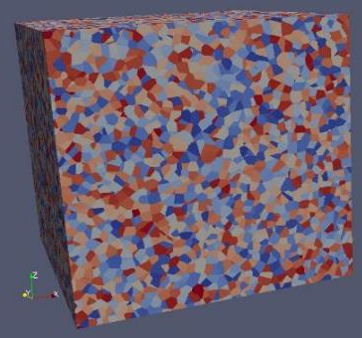
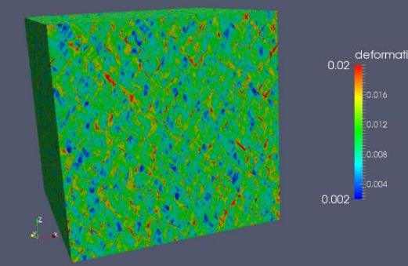

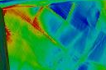
APPLICATION TO CRYSTAL PLASTICITY
EXEMPLE OF A MASSIVELY PARALLEL SIMULATION
Uniaxial tensile test (1%)
Small Perturbations, 100 steps
Dislocation-based CP (54 internal variables)
1024 cores
Strain distribution
42875 grains
1024³ resolution

Slide 12
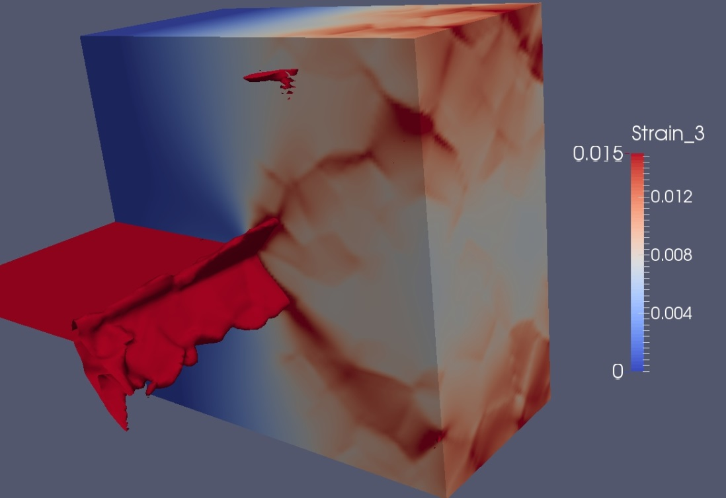
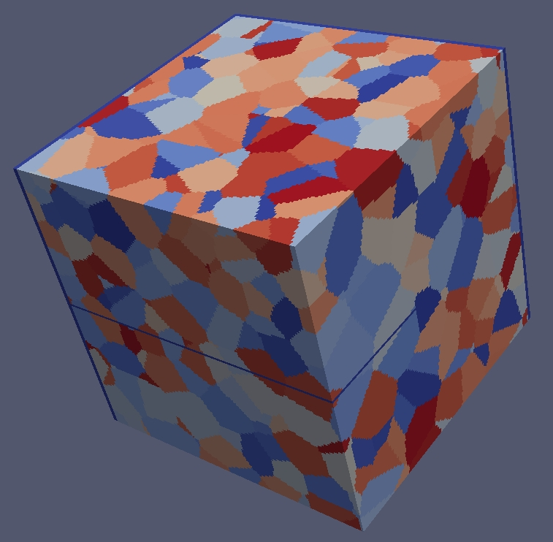
EXEMPLES D’APPLICATION
FISSURE DANS UN POLYCRISTAL

Slide 13
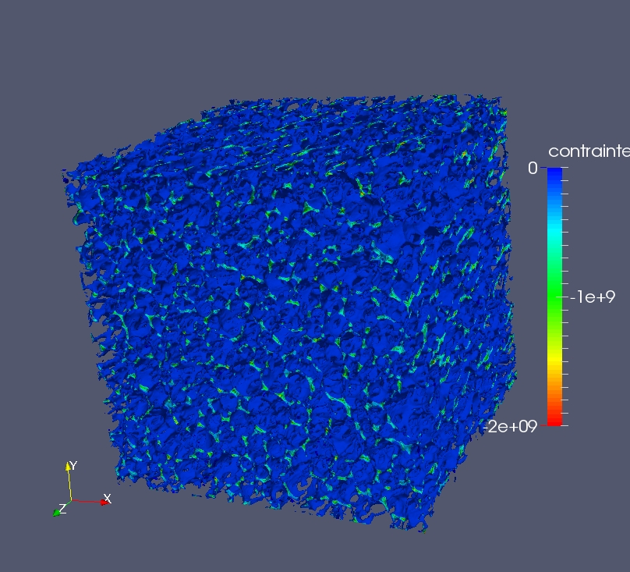
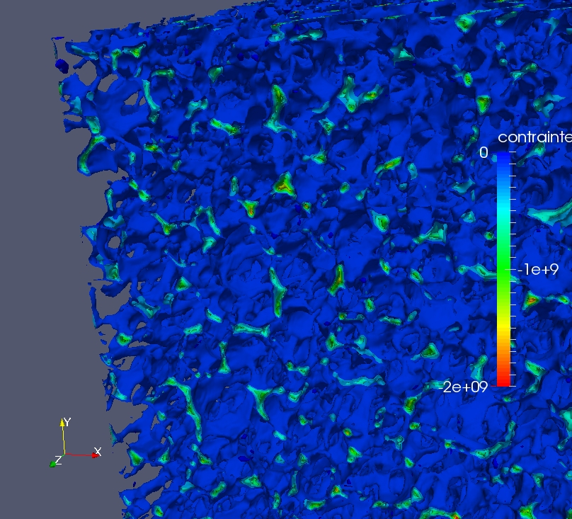
EXEMPLES D’APPLICATION
MOUSSE (coll. CEA – Le Ripault)

Slide 14
New features vs « Basic scheme »
AMITEX_FFTP
http://www.maisondelasimulation.fr/projects/amitex/html/index.html
Efficient MPI implementation
Modified Green Operator
Basic Scheme + Convergence Acceleration
Small perturbations and Finite Strain
Mfront (http://tfel.sourceforge.net/)
code generator compatibility
Inputs :
one .xml file for
algorithm parameters
material coefficients
loading and output
vtk file(s) for the 3D image
Outputs :
Average response
Per phase av. and std dev
Fields (vtk files)
A quite ROBUST and EFFICIENT code (VERY efficient compared to FE!)
Usage : from STANDALONE PC to HPC
Research & Education licence : OK
Available online : OK

