Slide 1
NASA Space Apps Challenge
Team MRP

Slide 2
Challenge: Seismic Detection Across the Solar System
Algorithm developed which combined the Short Term Average/Long Term Average method with the Root Mean Square method to determine seismic data.
Signal filtering was done on seismic data to reduce noise

Slide 3
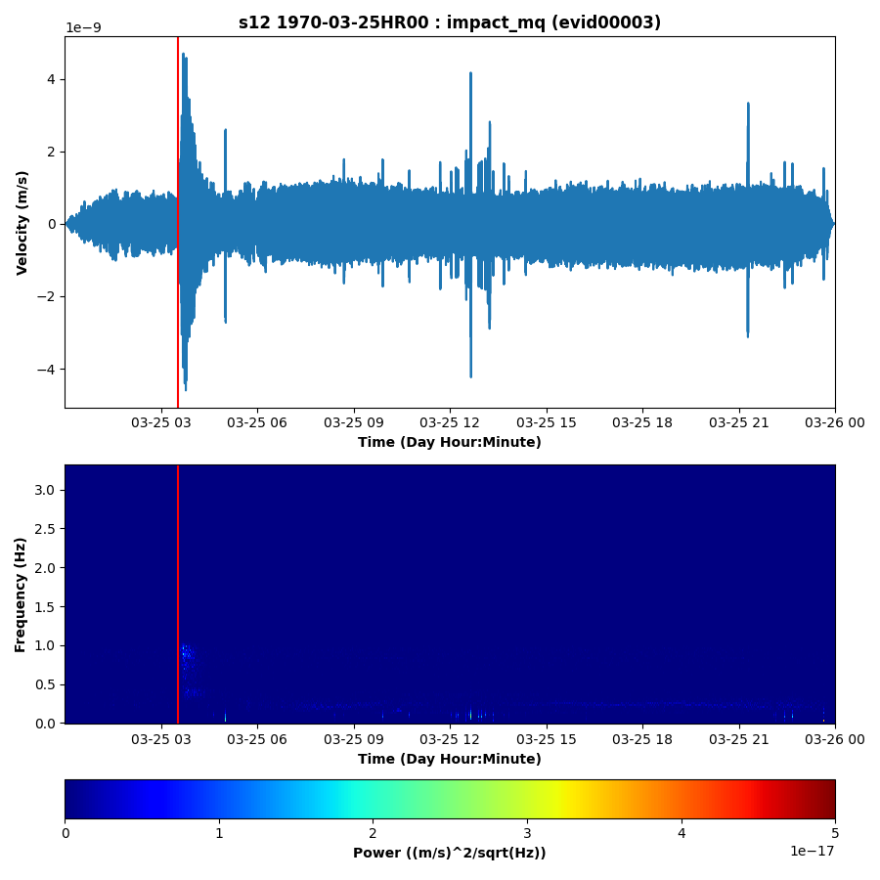
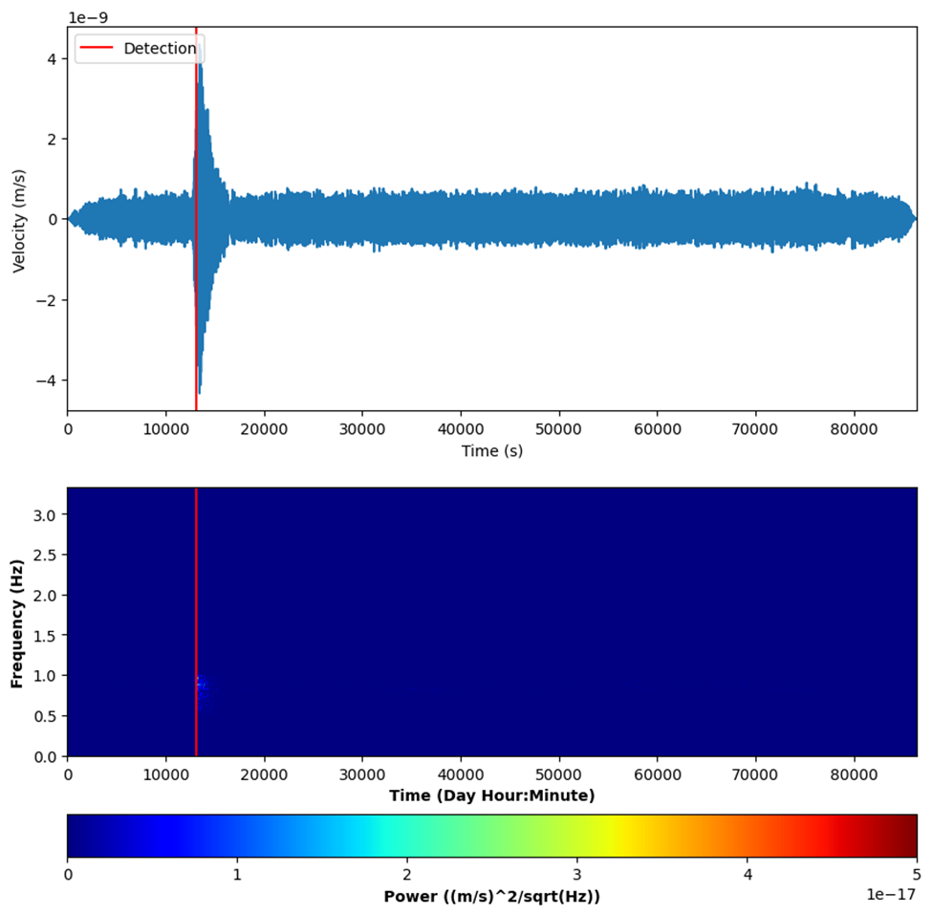
Lunar Training case
Sample output
Actual output (Filtered)

Slide 4
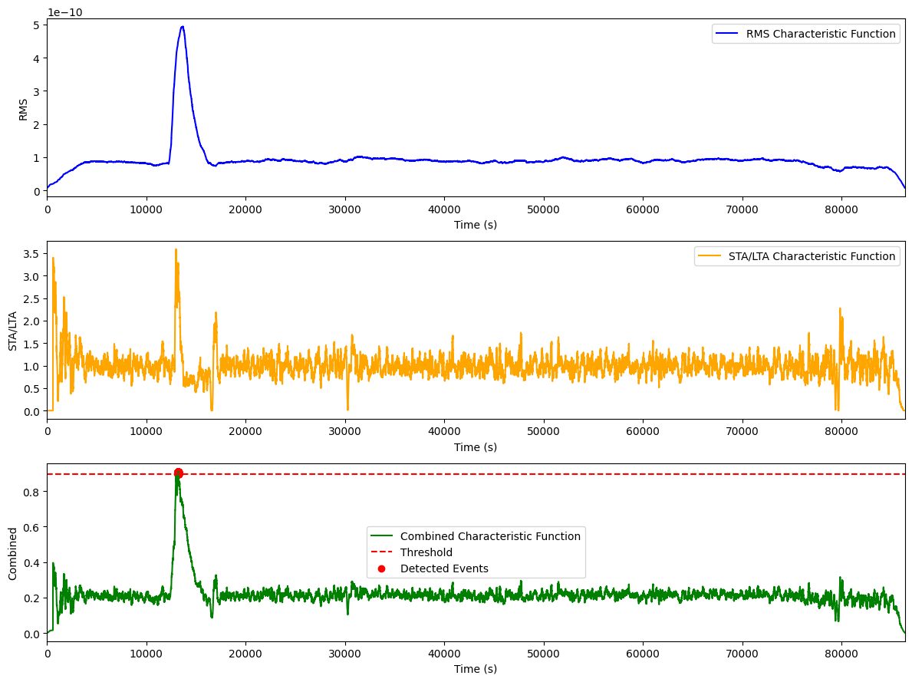
Creation of Combined Characteristic Function

Slide 5
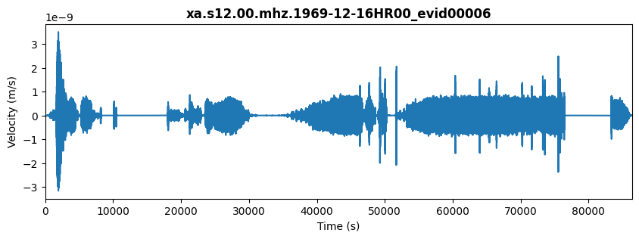
Lunar Test case

Slide 6
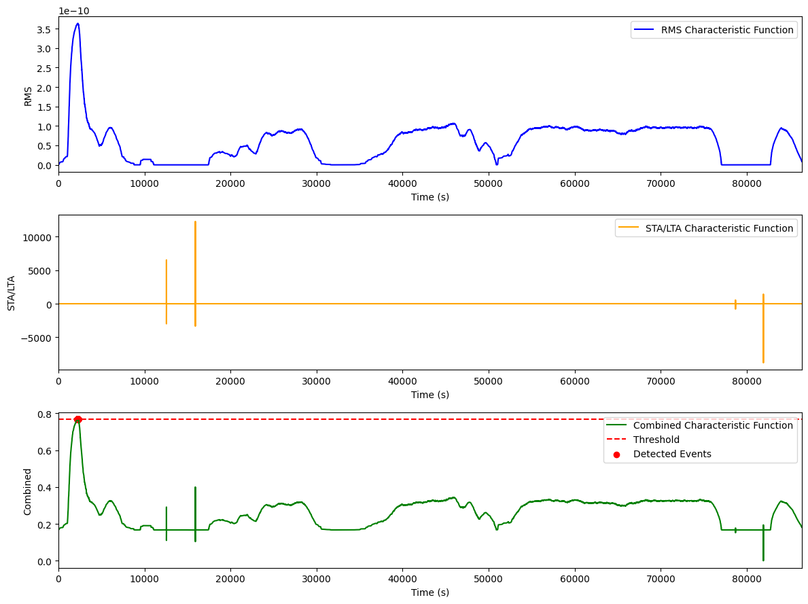
Combined Characteristic Function

Slide 7
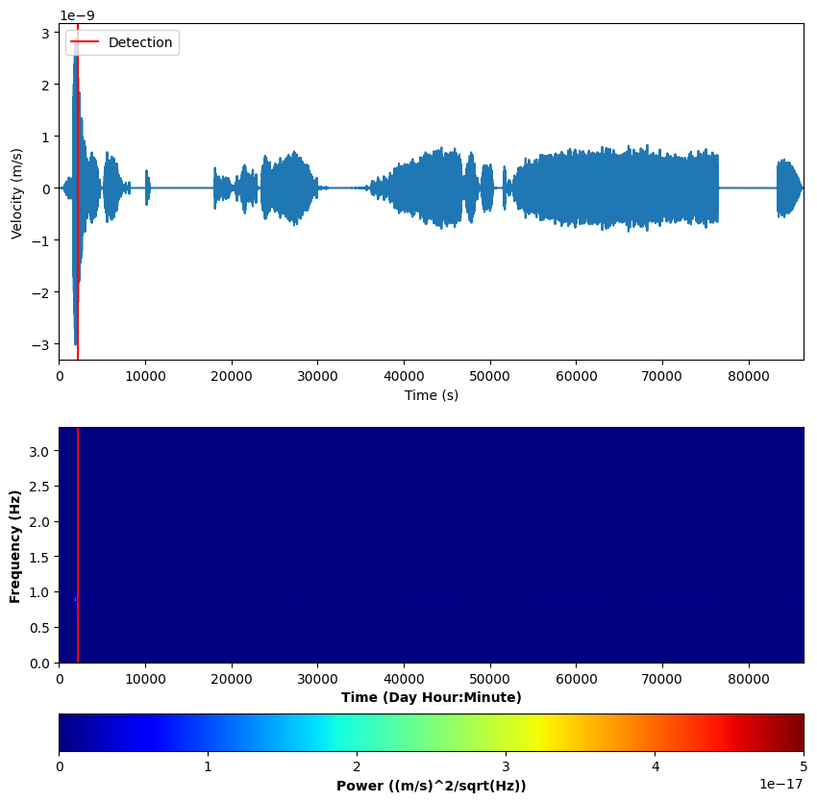
Output:
Detected event times (in seconds): 2229.2830188679245
The data was filtered and a seismic event was detected at the start, correlated by the spectrogram.

