Slide 1
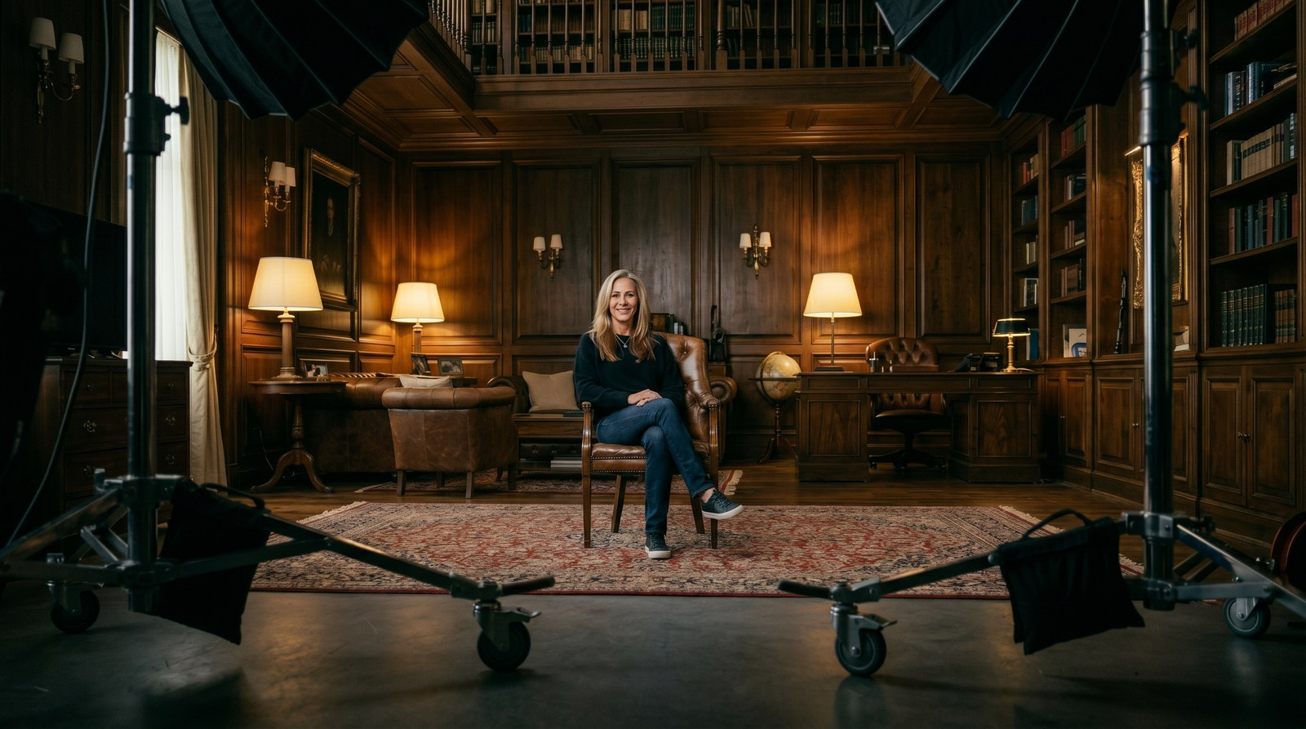
THE SHOOT
Julie, on set.
The film that introduces the world's #2-ranked bio-optimizer as the face of Longevity Life Academy.
1 / 10

Slide 2
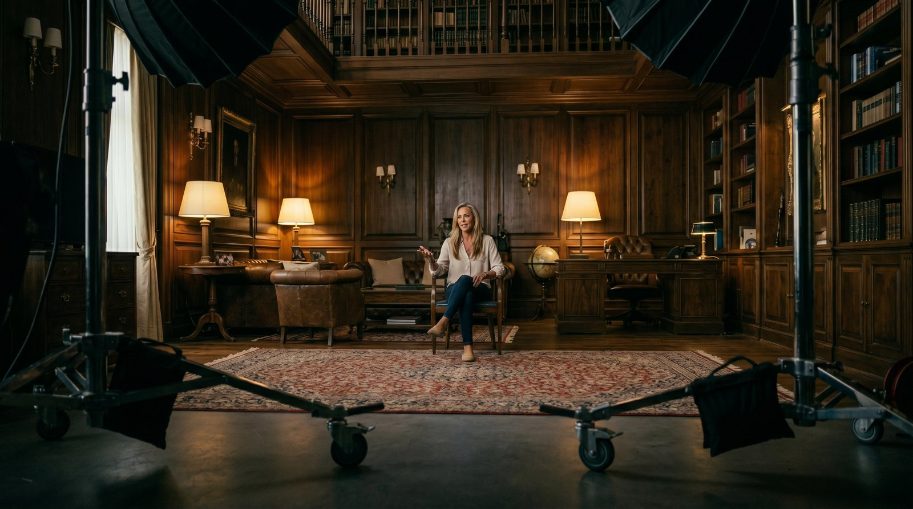

THE SET
A room built for authority.
Warm wood, a wall of books, layered lamplight. Cinema lighting, one subject, no distractions — the visual language of trust.
2 / 10

Slide 3
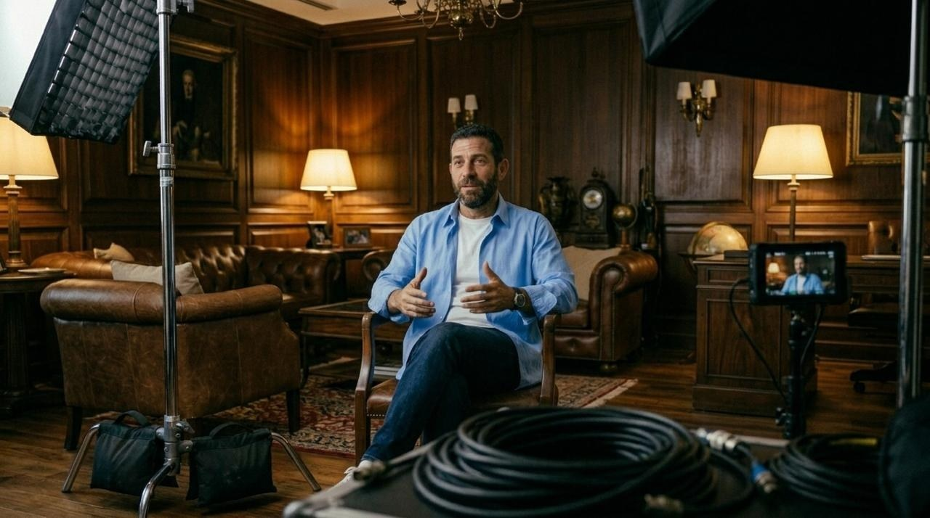

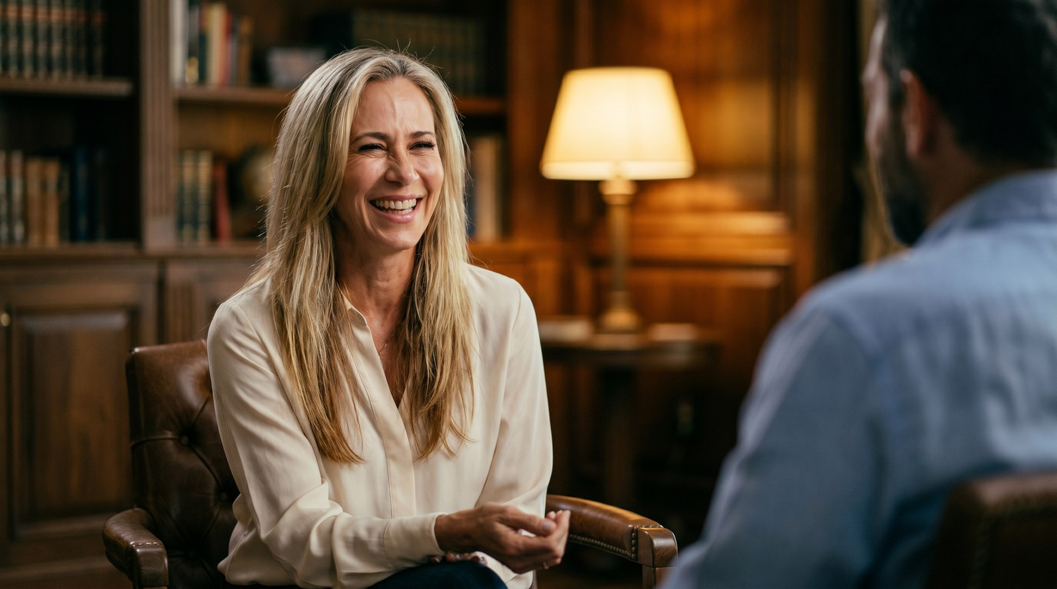
THE CASTING
Same set. The right person in the chair.
BEFORE
AFTER
A placeholder stand-in.
Julie Gibson Clark — the real voice.
3 / 10

Slide 4
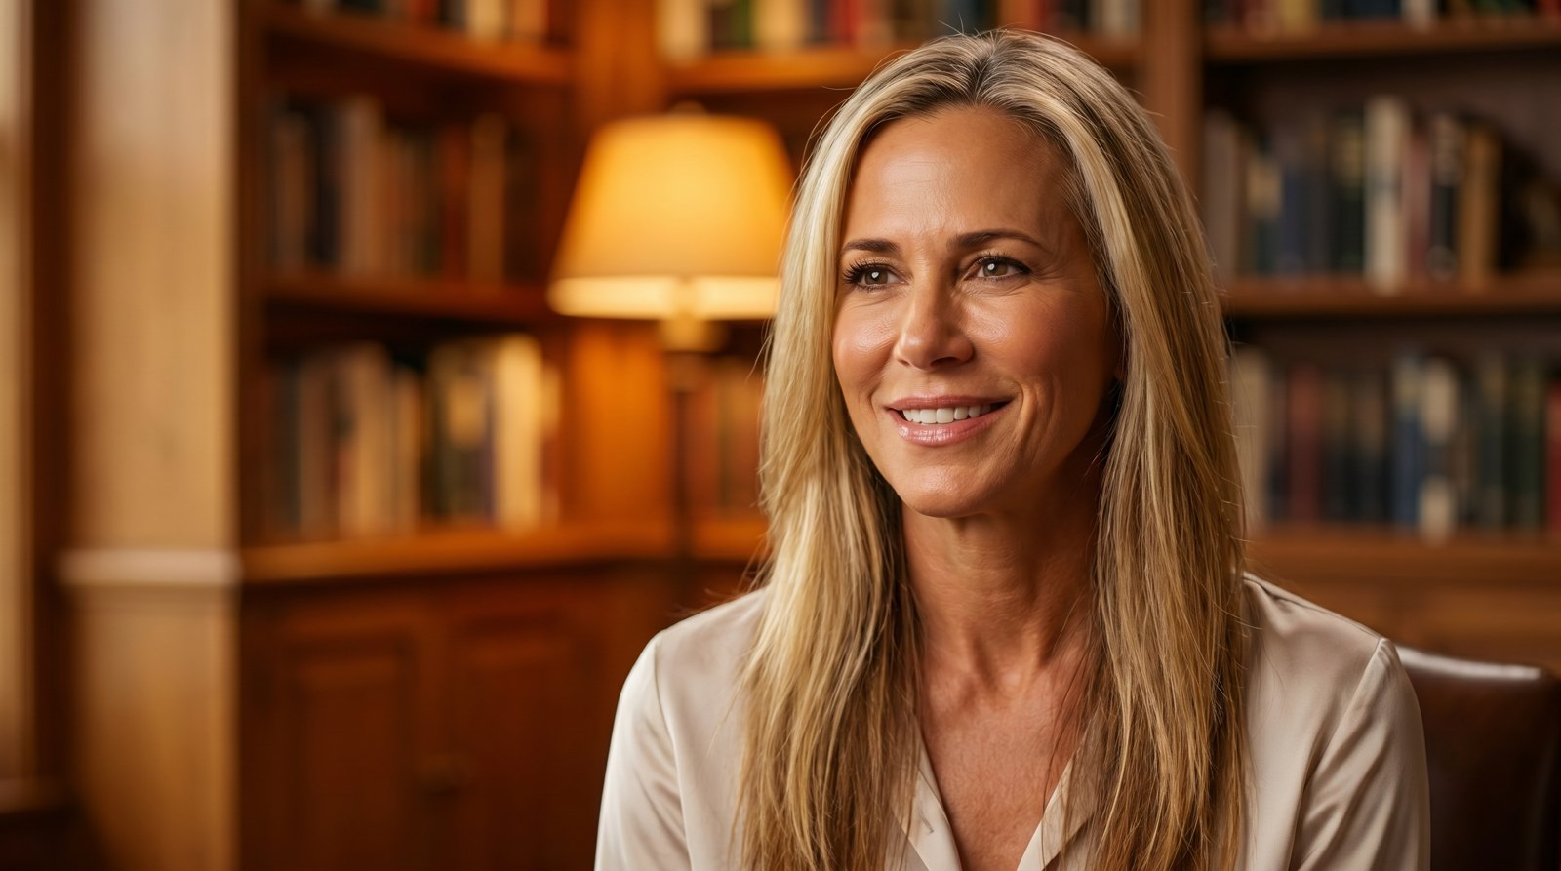

“It has to be like
brushing your
teeth.”
The whole message in one line — longevity as a daily habit anyone can keep.
JULIE GIBSON CLARK · ON SET
4 / 10

Slide 5
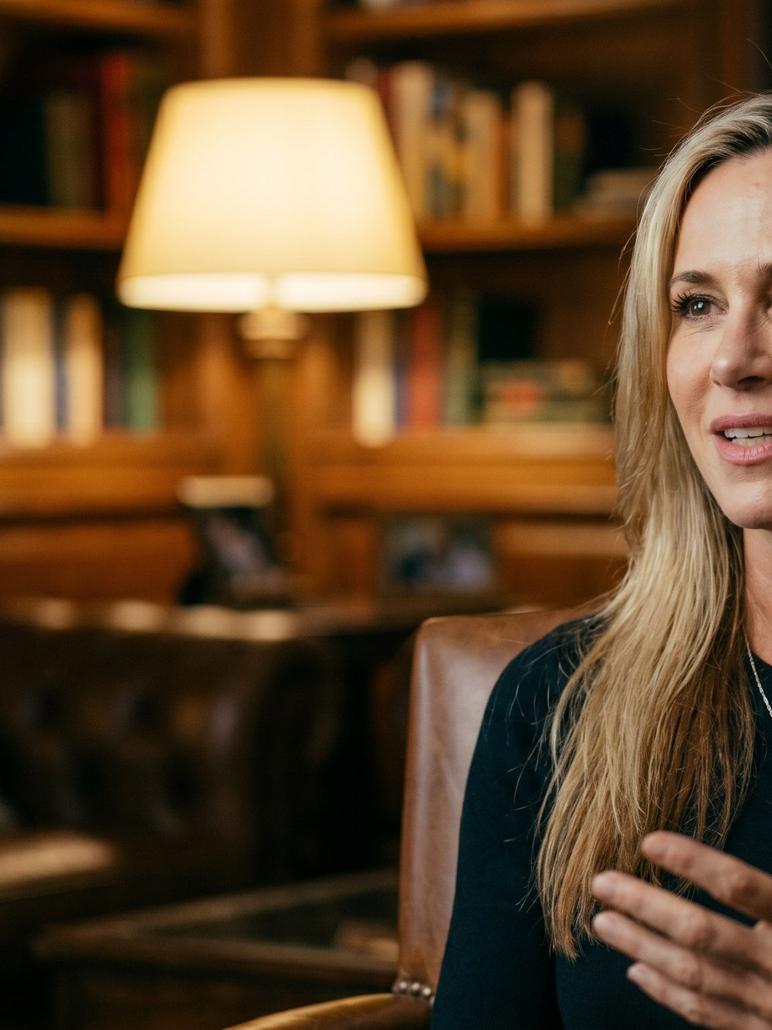
WHY THIS WORKS
Real person.
Real set.
Real authority.
No stock, no stand-in
The actual World #2 bio-optimizer — not a model reading lines.
A set that signals trust
The library backdrop frames her as the credible expert she is.
Cinematic, not corporate
Warm lamplight and shallow depth feel premium and human.
One shoot, many cuts
The film, reels, thumbnails and ad frames — all from one day.
5 / 10

Slide 6

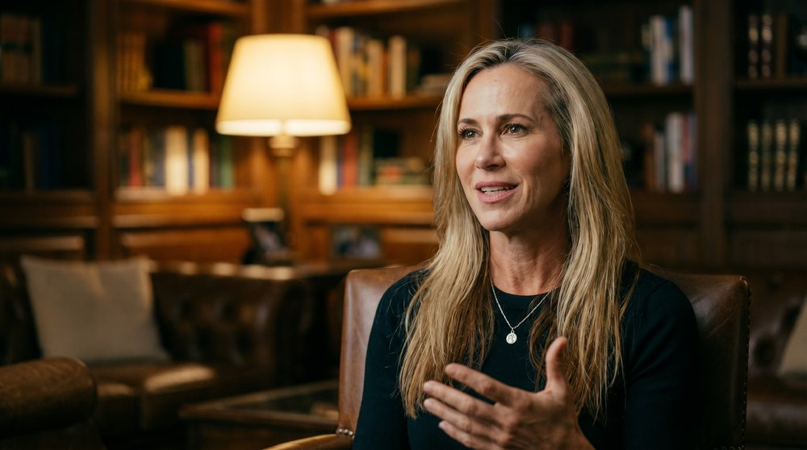
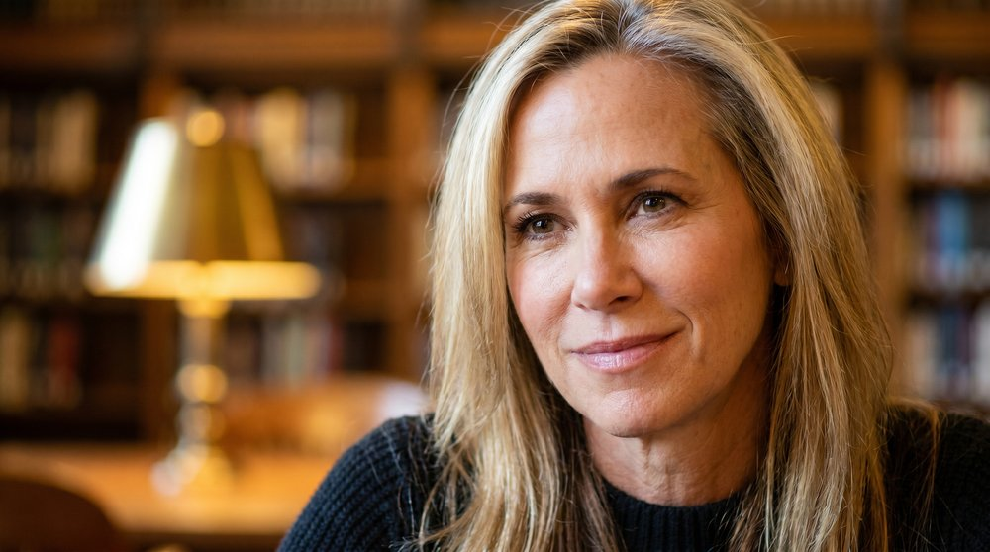
COVERAGE
Three frames from one set-up.
WIDE
MEDIUM
CLOSE
Establishes the room — sets tone and scale.
The interview frame — hero of the film and reels.
Emotion and eye contact — the quote moments.
6 / 10

Slide 7

THE LOOK
Cinematic treatment.
Lighting
Warm practicals + soft key. Golden, never clinical.
Camera
Shallow depth. Subject sharp, room soft behind.
Palette
Wood browns, amber lamplight, deep shadows.
Pace
Unhurried. Let her speak. Room in every cut.
Sound
Intimate room tone, soft score. Her voice leads.
7 / 10

Slide 8
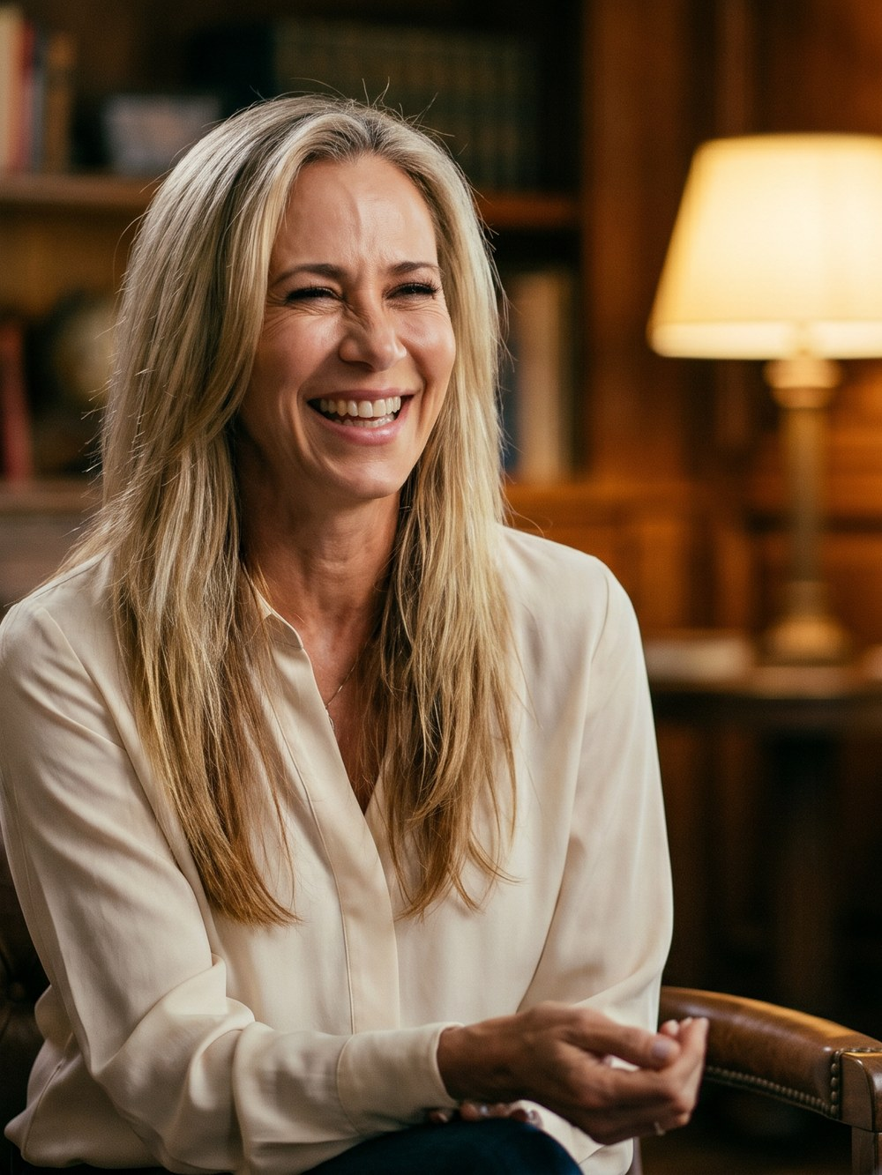
ON-CAMERA LINES
What she says in the chair.
“You cannot biohack your way out of a good night's sleep.”
THE EQUALIZER
“My why is my son. I want to be there for him as long as possible.”
THE HEART
“We don't need millions of dollars to live long, vibrant lives.”
THE MISSION
8 / 10

Slide 9

DELIVERABLES
One shoot, everywhere.
The film
Social reels
Paid ads
Stills
90-sec brand film for the site & launch.
6–8 vertical cut-downs for IG & TikTok.
Meta / YouTube frames from the close-ups.
Thumbnails, press kit & article headers.
9 / 10

Slide 10

Ready to roll.
The set is built, the story is written, and the right person is in the chair. Let's shoot it.
LONGEVITY LIFE ACADEMY × JULIE GIBSON CLARK
10 / 10

