Slide 1
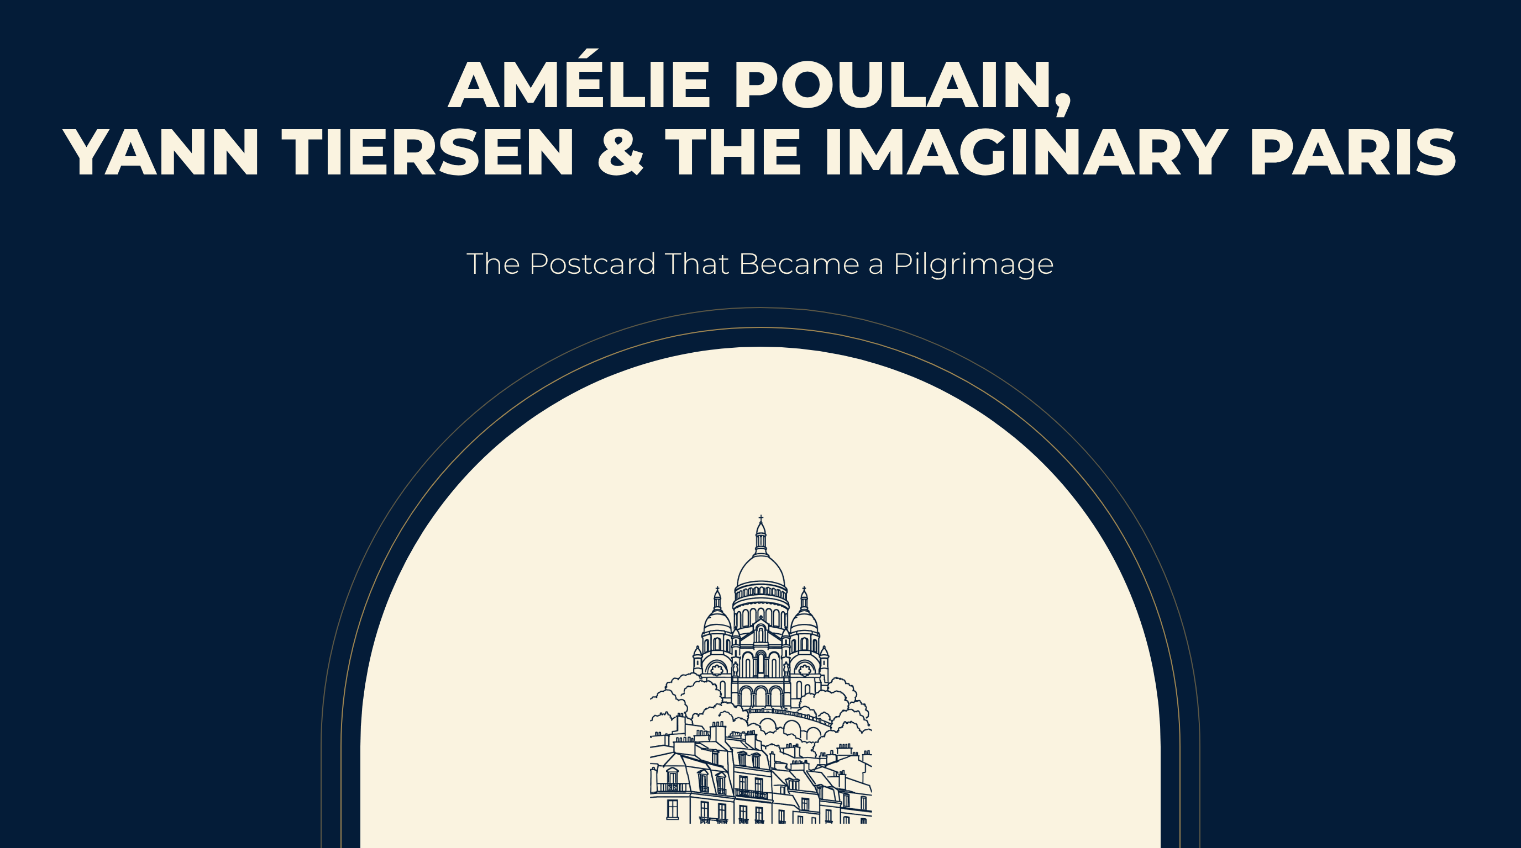
Notes:
AMÉLIE POULAIN,
YANN TIERSEN & THE IMAGINARY PARIS
The Postcard That Became a Pilgrimage

Slide 2
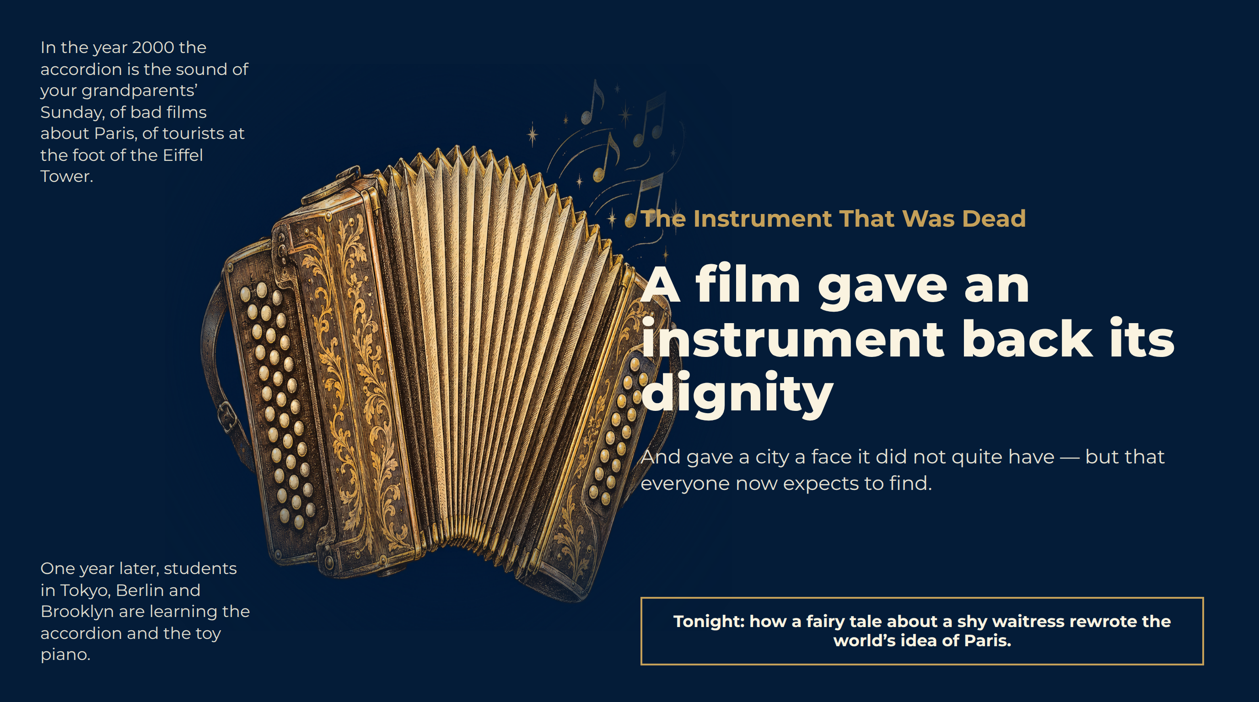
Notes:
The Instrument That Was Dead
In the year 2000 the accordion is the sound of your grandparents’ Sunday, of bad films about Paris, of tourists at the foot of the Eiffel Tower.
One year later, students in Tokyo, Berlin and Brooklyn are learning the accordion and the toy piano.
A film gave an instrument back its dignity
And gave a city a face it did not quite have — but that everyone now expects to find.
Tonight: how a fairy tale about a shy waitress rewrote the world’s idea of Paris.

Slide 3
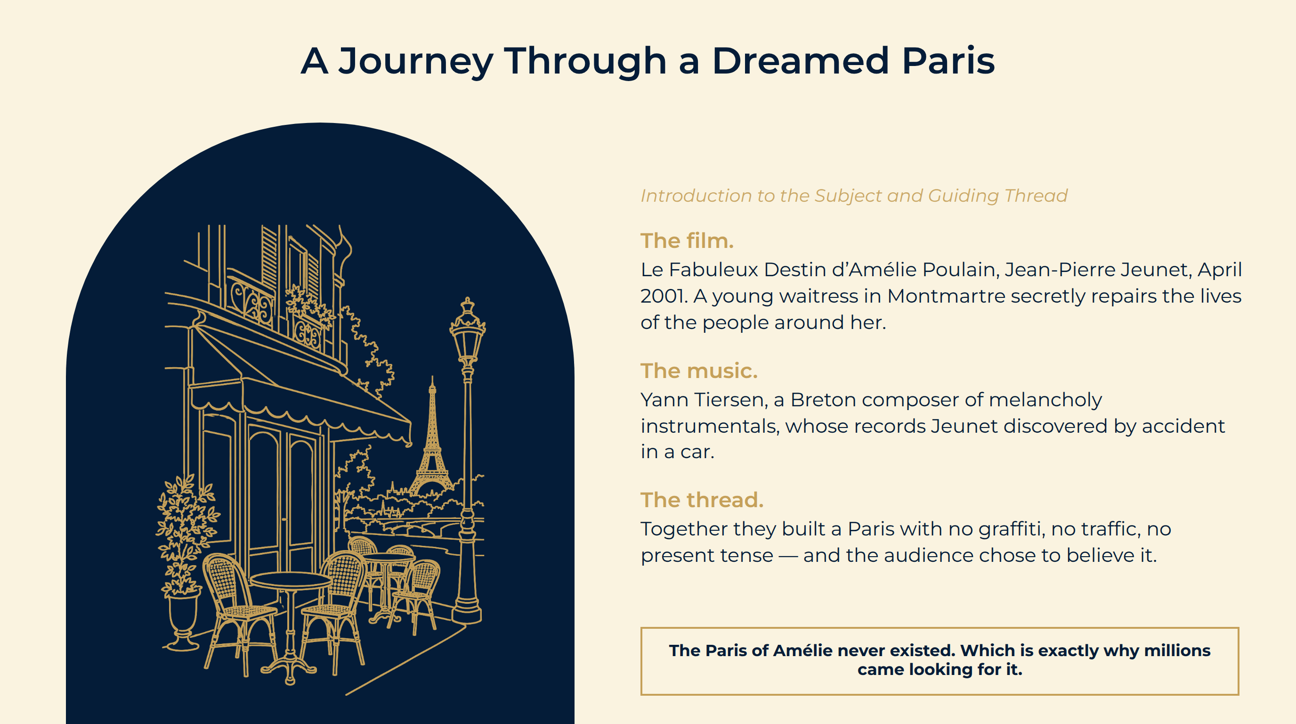
Notes:
A Journey Through a Dreamed Paris
The film. Le Fabuleux Destin d’Amélie Poulain, Jean-Pierre Jeunet, April 2001. A young waitress in Montmartre secretly repairs the lives of the people around her.
The music. Yann Tiersen, a Breton composer of melancholy instrumentals, whose records Jeunet discovered by accident in a car.
The thread. Together they built a Paris with no graffiti, no traffic, no present tense — and the audience chose to believe it.
The Paris of Amélie never existed. Which is exactly why millions came looking for it.

Slide 4
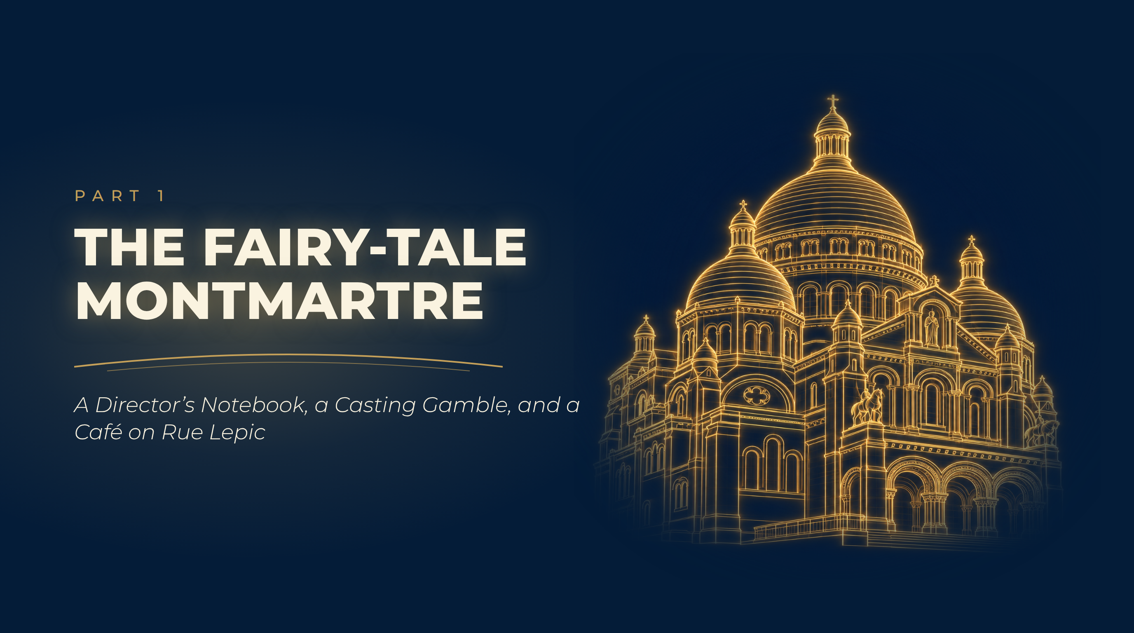
Notes:
The Fairy-Tale Montmartre
A Director’s Notebook, a Casting Gamble, and a Café on Rue Lepic

Slide 5
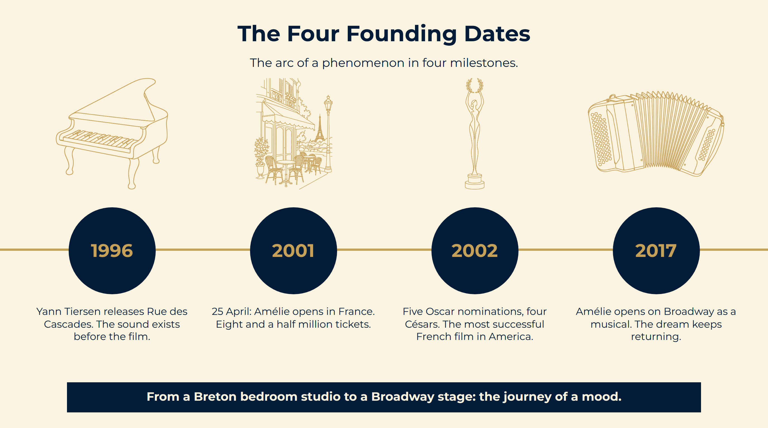
Notes:
The Four Founding Dates
From a Breton bedroom studio to a Broadway stage: the journey of a mood.
The arc of a phenomenon in four milestones.

Slide 6
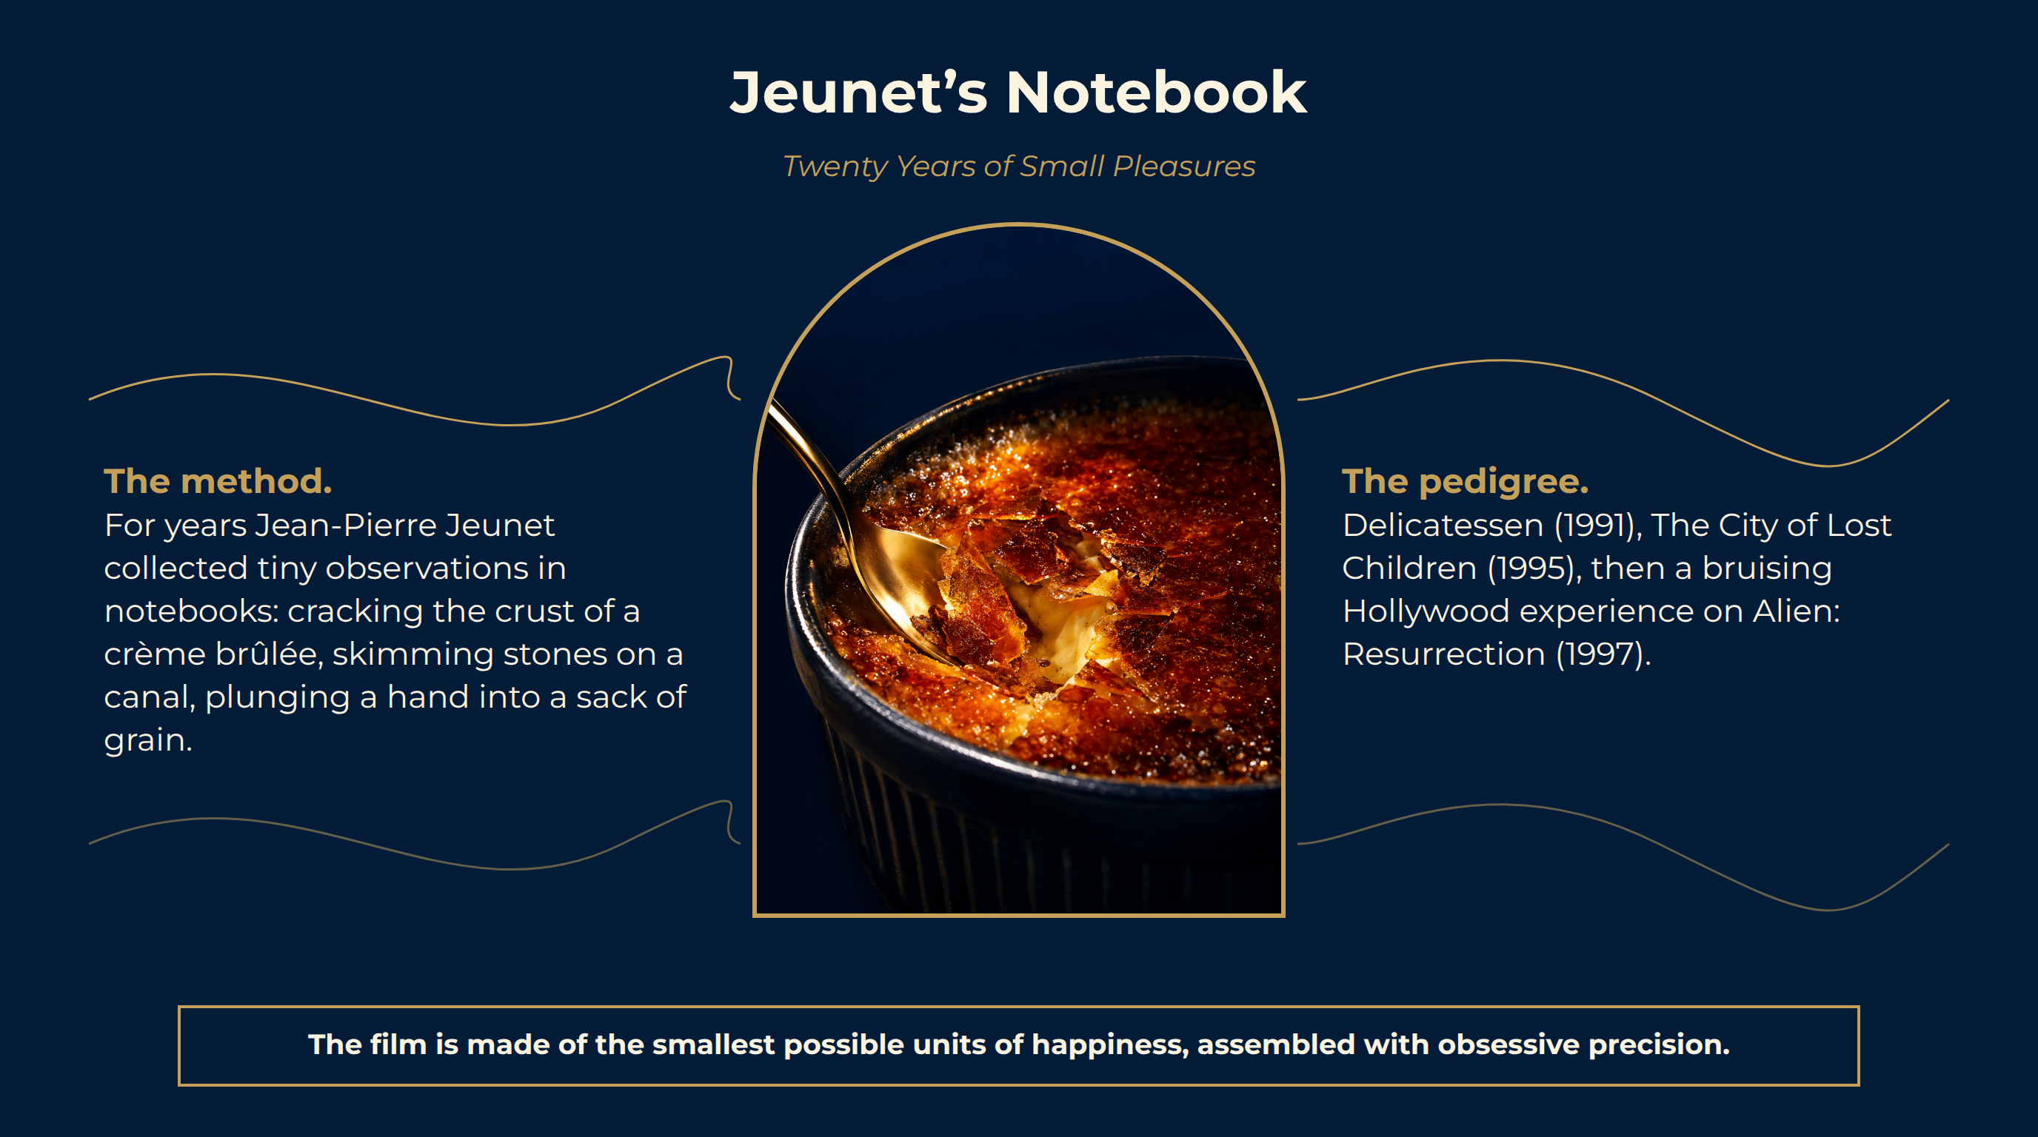
Notes:
Jeunet’s Notebook
The method. For years Jean-Pierre Jeunet collected tiny observations in notebooks: cracking the crust of a crème brûlée, skimming stones on a canal, plunging a hand into a sack of grain.
The pedigree. Delicatessen (1991), The City of Lost Children (1995), then a bruising Hollywood experience on Alien: Resurrection (1997).
The structure. A heroine who intervenes in strangers’ lives; a gallery of neighbours; a love story conducted through riddles.
The film is made of the smallest possible units of happiness, assembled with obsessive precision.

Slide 7
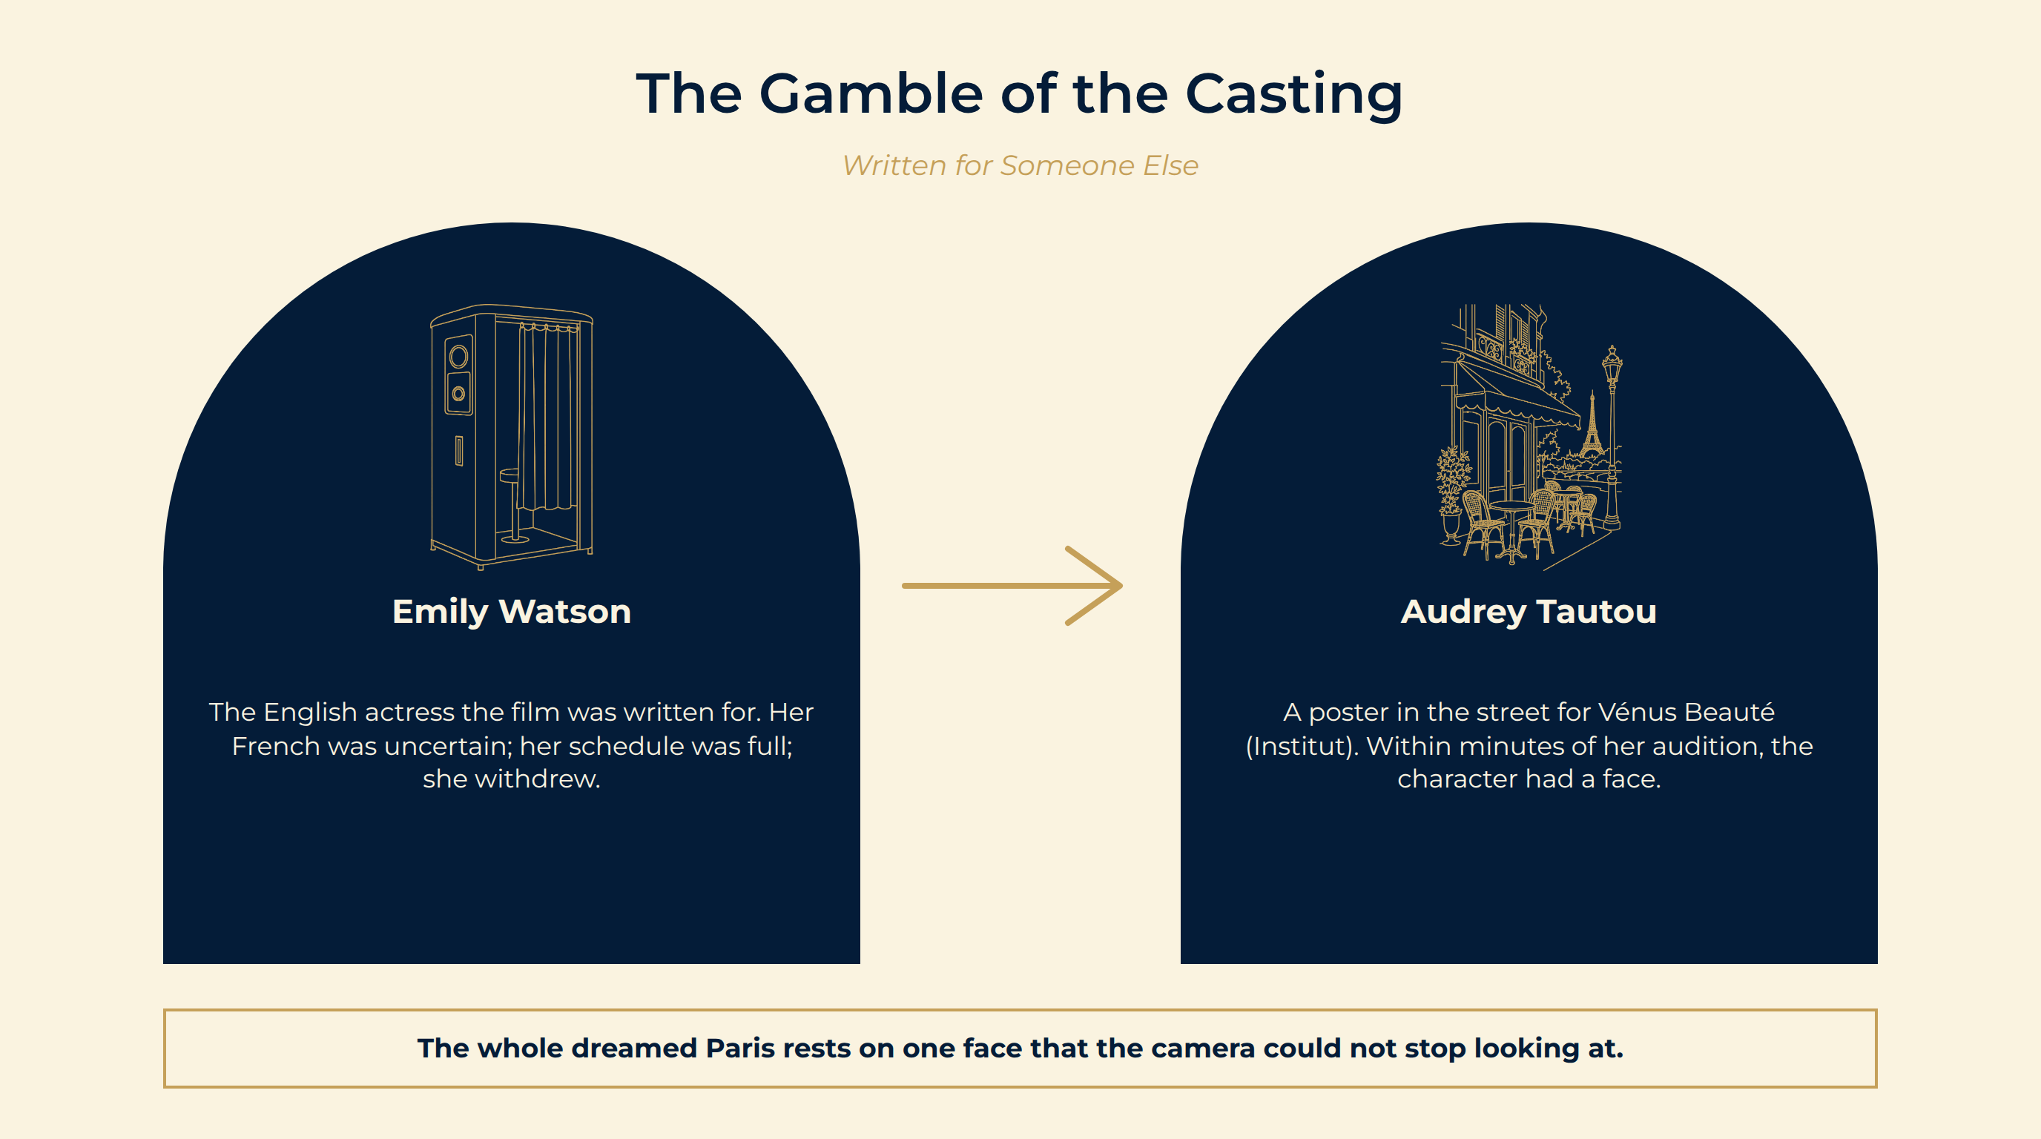
Notes:
The Gamble of the Casting
Written for someone else. Jeunet wrote Amélie for the English actress Emily Watson. Her French was uncertain and her schedule was full; she withdrew.
A poster in the street. Jeunet notices Audrey Tautou on the poster of Vénus Beauté (Institut). Within minutes of her audition he knows.
What she brought. A silent-film face — enormous eyes, a bob, a gaze straight into the lens. The character becomes an icon before she speaks.
Emily Watson The English actress the film was written for. Her French was uncertain; her schedule was full; she withdrew.
Audrey Tautou A poster in the street for Vénus Beauté (Institut). Within minutes of her audition, the character had a face.
The whole dreamed Paris rests on one face that the camera could not stop looking at.

Slide 8
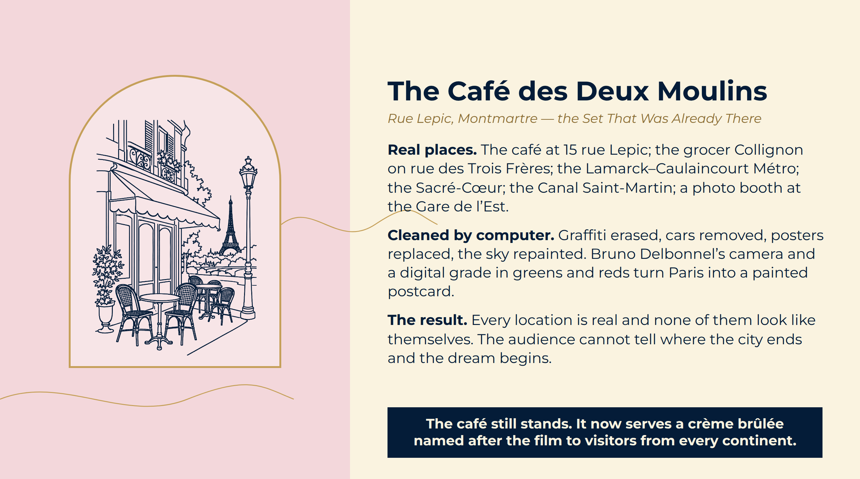
Notes:
The Café des Deux Moulins
Real places. The café at 15 rue Lepic; the grocer Collignon on rue des Trois Frères; the Lamarck–Caulaincourt Métro; the Sacré-Cœur; the Canal Saint-Martin; a photo booth at the Gare de l’Est.
Cleaned by computer. Graffiti erased, cars removed, posters replaced, the sky repainted. Bruno Delbonnel’s camera and a digital grade in greens and reds turn Paris into a painted postcard.
The result. Every location is real and none of them look like themselves. The audience cannot tell where the city ends and the dream begins.
The café still stands. It now serves a crème brûlée named after the film to visitors from every continent.

Slide 9
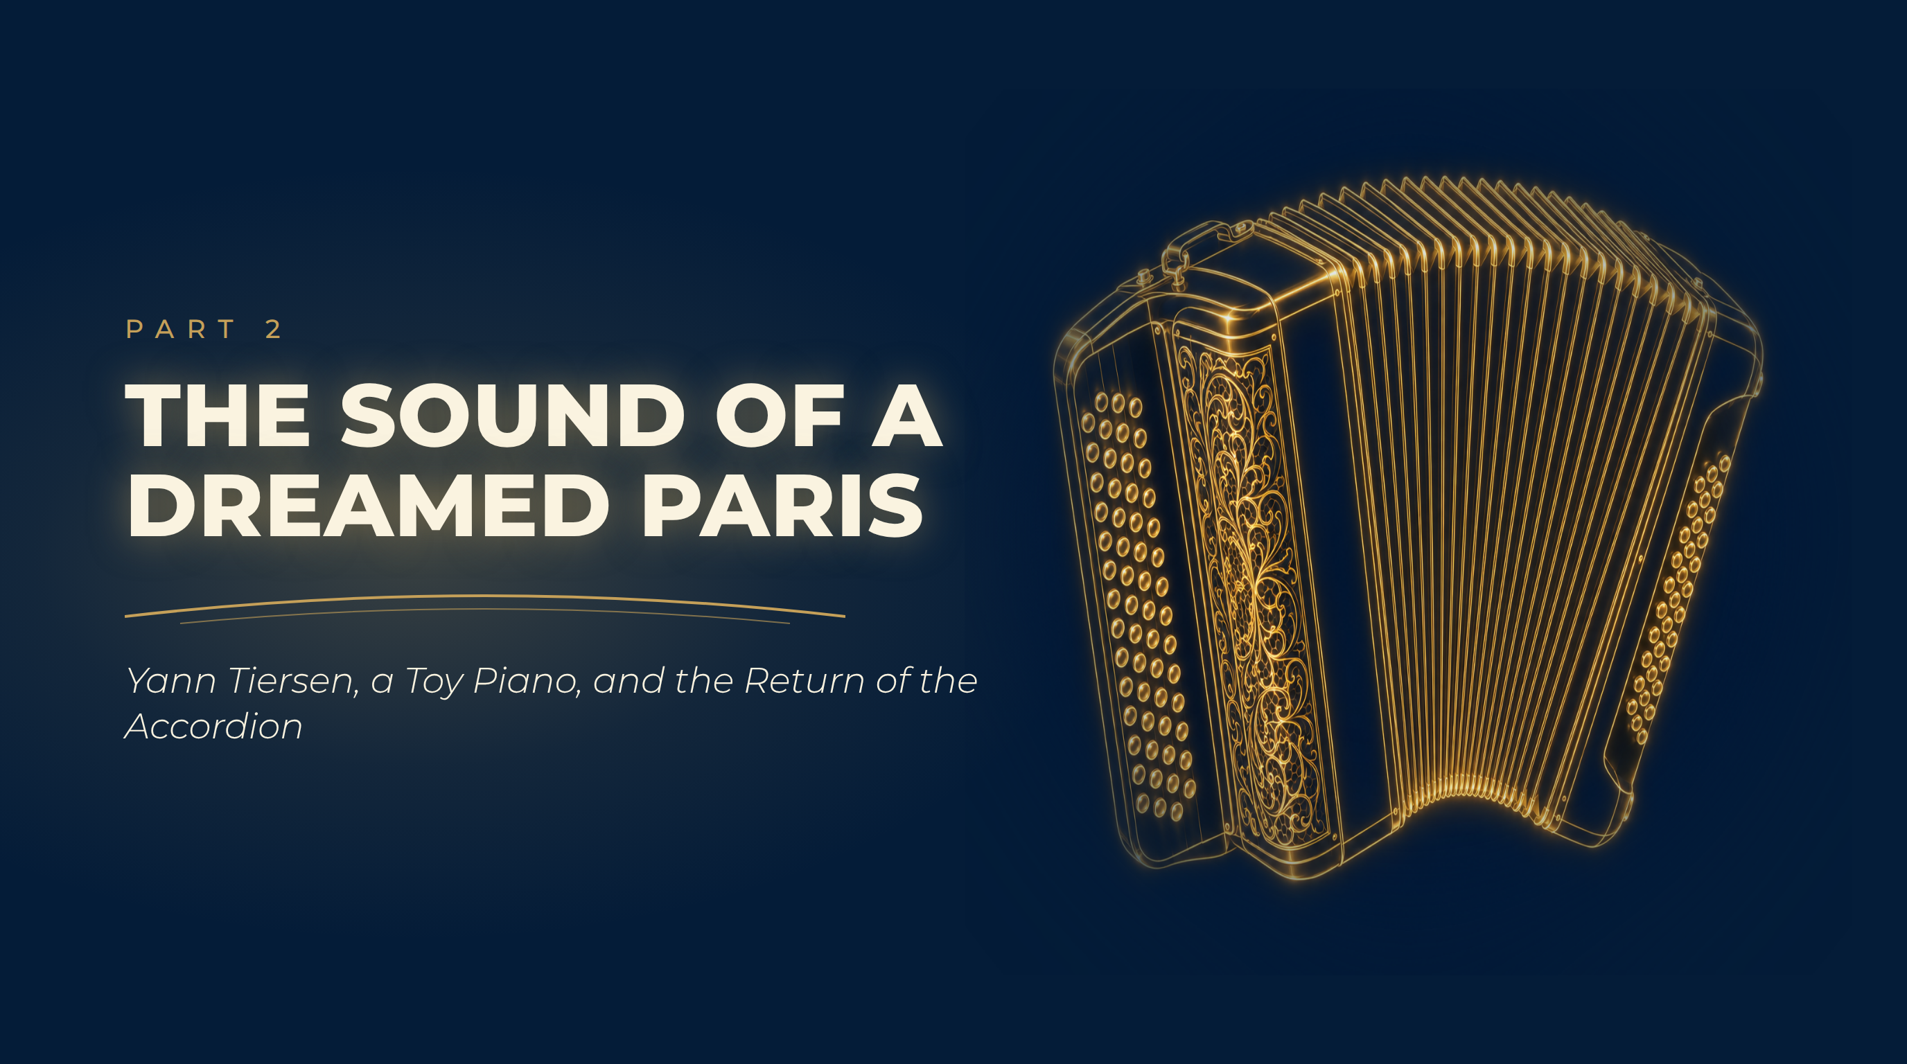
Notes:
The Sound of a Dreamed Paris
Yann Tiersen, a Toy Piano, and the Return of the Accordion

Slide 10
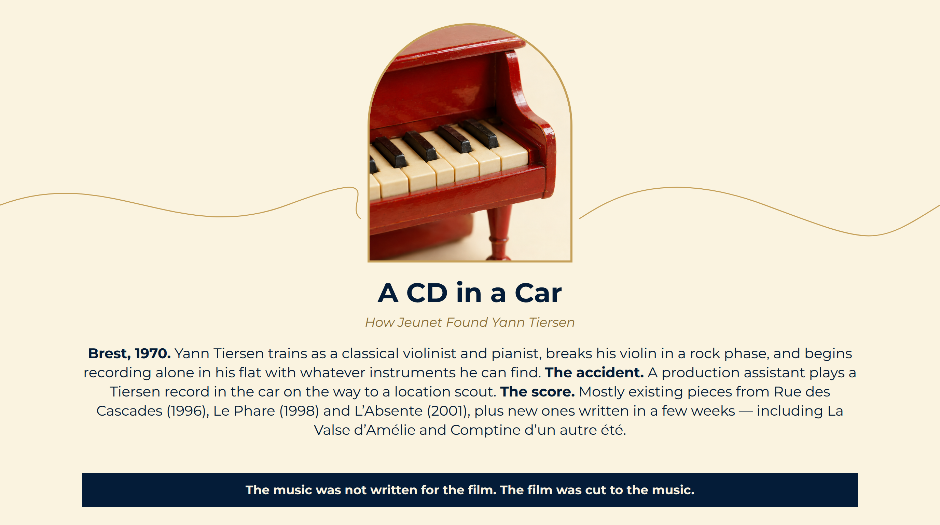
Notes:
A CD in a Car
Brest, 1970. Yann Tiersen trains as a classical violinist and pianist, breaks his violin in a rock phase, and begins recording alone in his flat with whatever instruments he can find.
The accident. A production assistant plays a Tiersen record in the car on the way to a location scout.
The score. Mostly existing pieces from Rue des Cascades (1996), Le Phare (1998) and L’Absente (2001), plus new ones written in a few weeks — including La Valse d’Amélie and Comptine d’un autre été.
The music was not written for the film. The film was cut to the music.

Slide 11
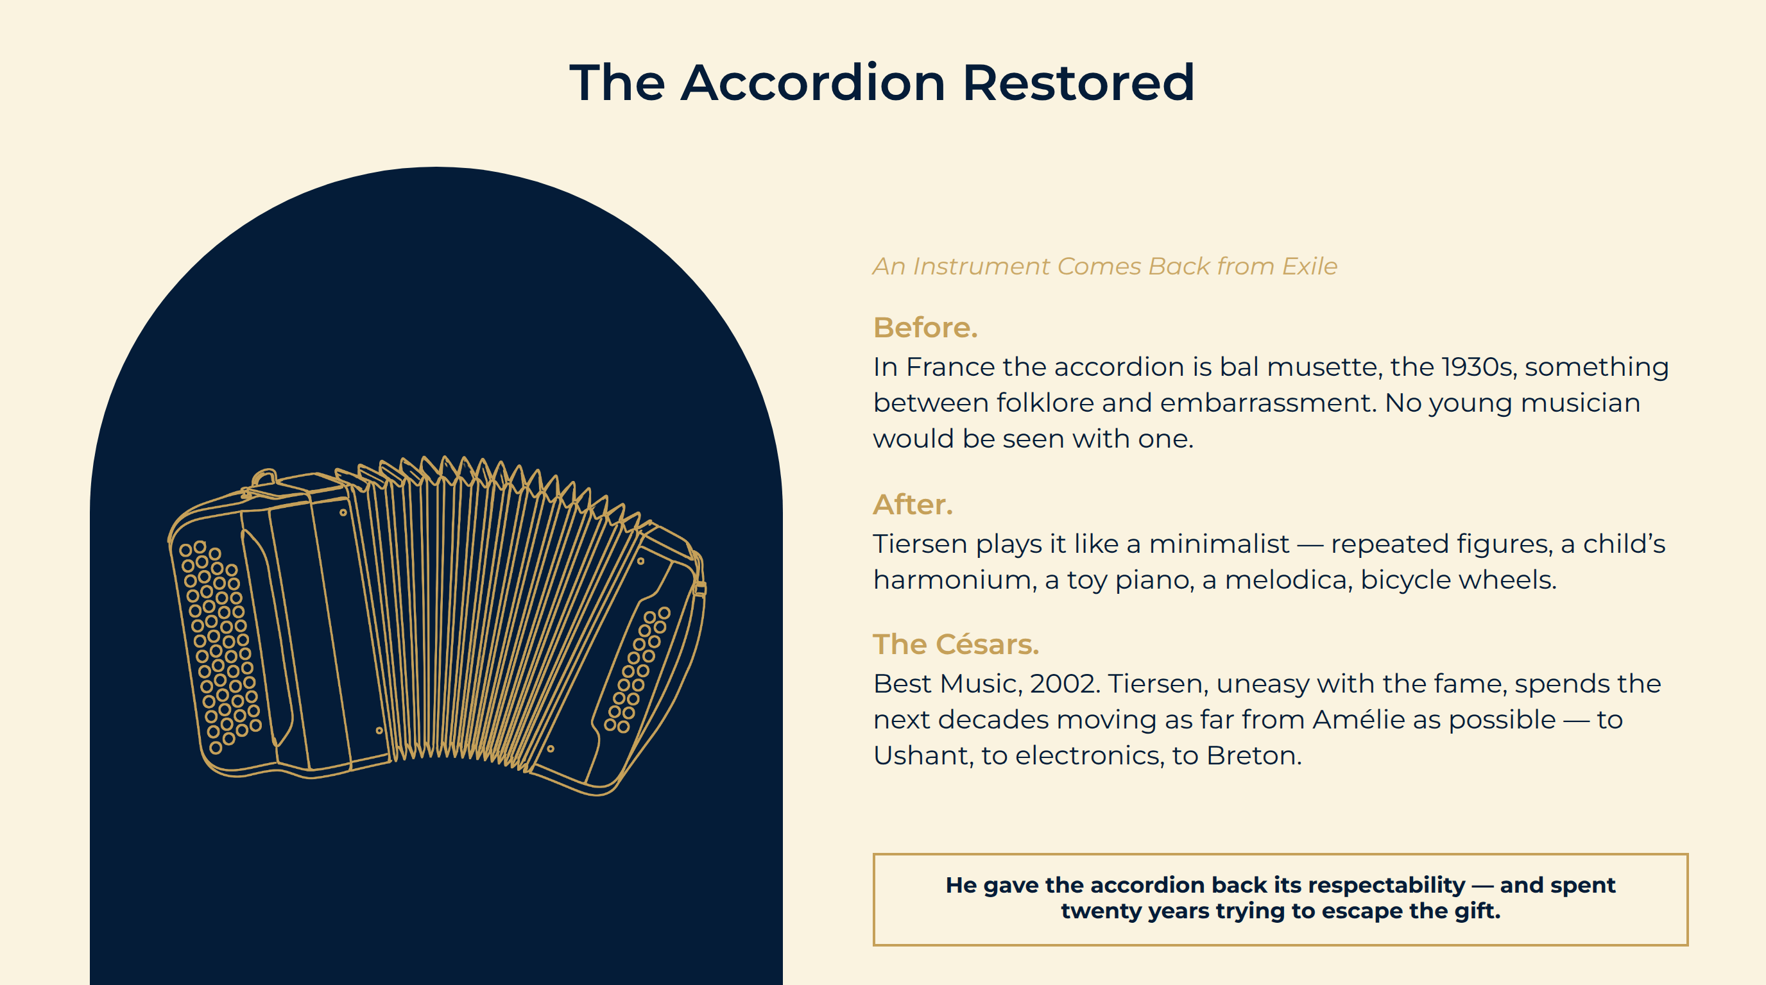
Notes:
The Accordion Restored
Before. In France the accordion is bal musette, the 1930s, something between folklore and embarrassment. No young musician would be seen with one.
After. Tiersen plays it like a minimalist — repeated figures, a child’s harmonium, a toy piano, a melodica, bicycle wheels.
The Césars. Best Music, 2002. Tiersen, uneasy with the fame, spends the next decades moving as far from Amélie as possible — to Ushant, to electronics, to Breton.
He gave the accordion back its respectability — and spent twenty years trying to escape the gift.

Slide 12
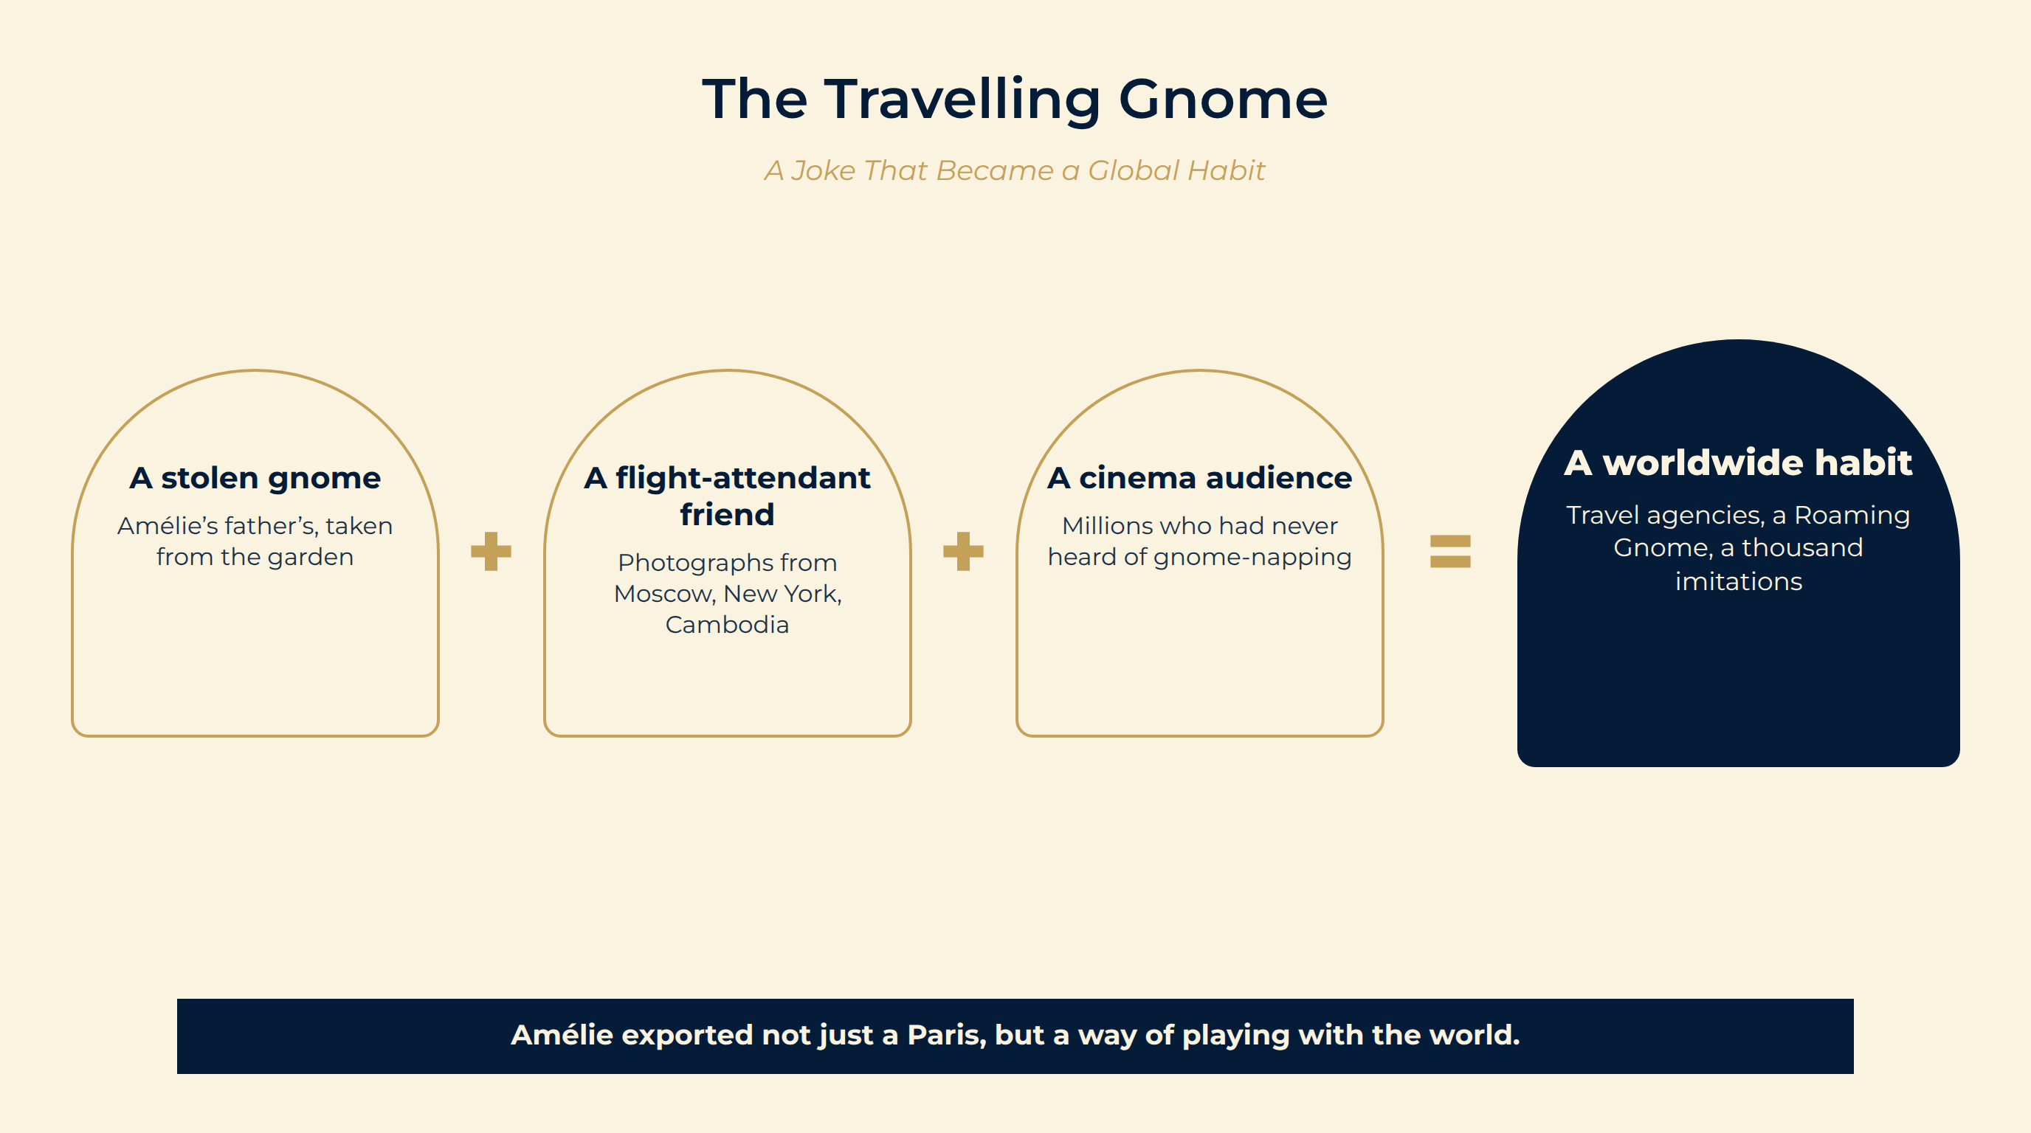
Notes:
The Travelling Gnome
In the film. Amélie steals her widowed father’s garden gnome and has a flight-attendant friend photograph it in front of monuments around the world, to persuade him to travel.
Outside the film. Gnome-napping pranks had existed since the 1980s. The film turned them into a worldwide ritual — and an American travel company adopted a Roaming Gnome as its mascot.
What it tells us. The film’s small ideas were so portable that they left the cinema and became behaviour.
A stolen gnome Amélie’s father’s, taken from the garden
A flight-attendant friend Photographs from Moscow, New York, Cambodia
A cinema audience Millions who had never heard of gnome-napping
A worldwide habit Travel agencies, a Roaming Gnome, a thousand imitations
Amélie exported not just a Paris, but a way of playing with the world.

Slide 13
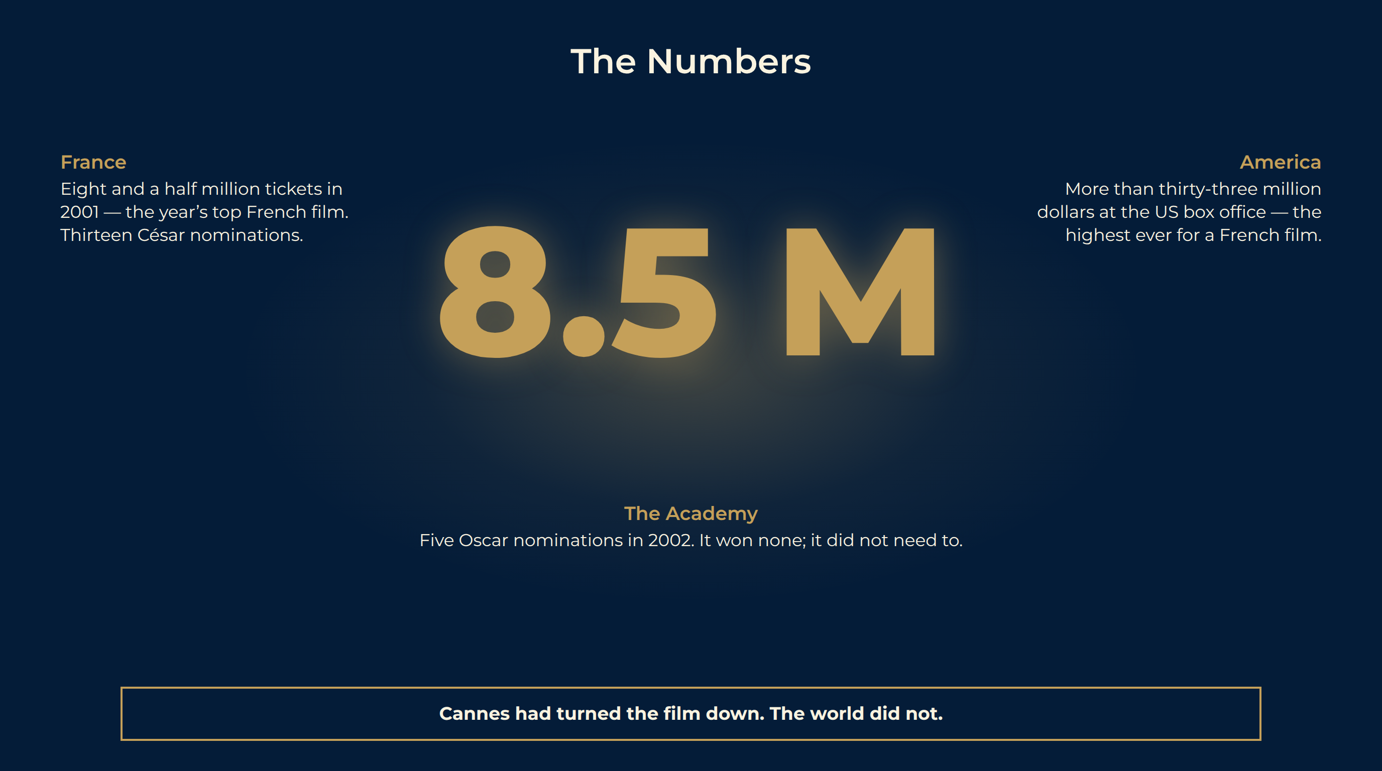
Notes:
The Numbers
France. Eight and a half million tickets in 2001 — the top French film of the year.
America. More than thirty-three million dollars at the US box office — then the highest ever for a French film — and roughly 174 million worldwide.
The Academy. Five Oscar nominations in 2002: Foreign Language Film, Original Screenplay, Cinematography, Art Direction, Sound. It won none; it did not need to.
France Eight and a half million tickets in 2001 — the year’s top French film. Thirteen César nominations.
America More than thirty-three million dollars at the US box office — the highest ever for a French film.
The Academy Five Oscar nominations in 2002. It won none; it did not need to.
Cannes had turned the film down. The world did not.

Slide 14
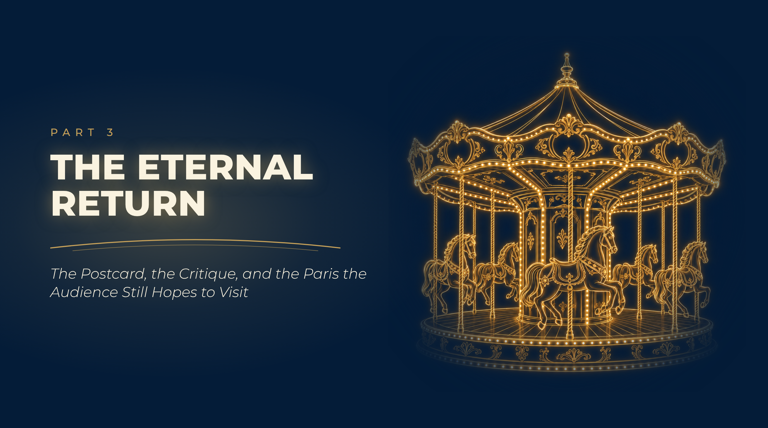
Notes:
The Eternal Return
The Postcard, the Critique, and the Paris the Audience Still Hopes to Visit

Slide 15
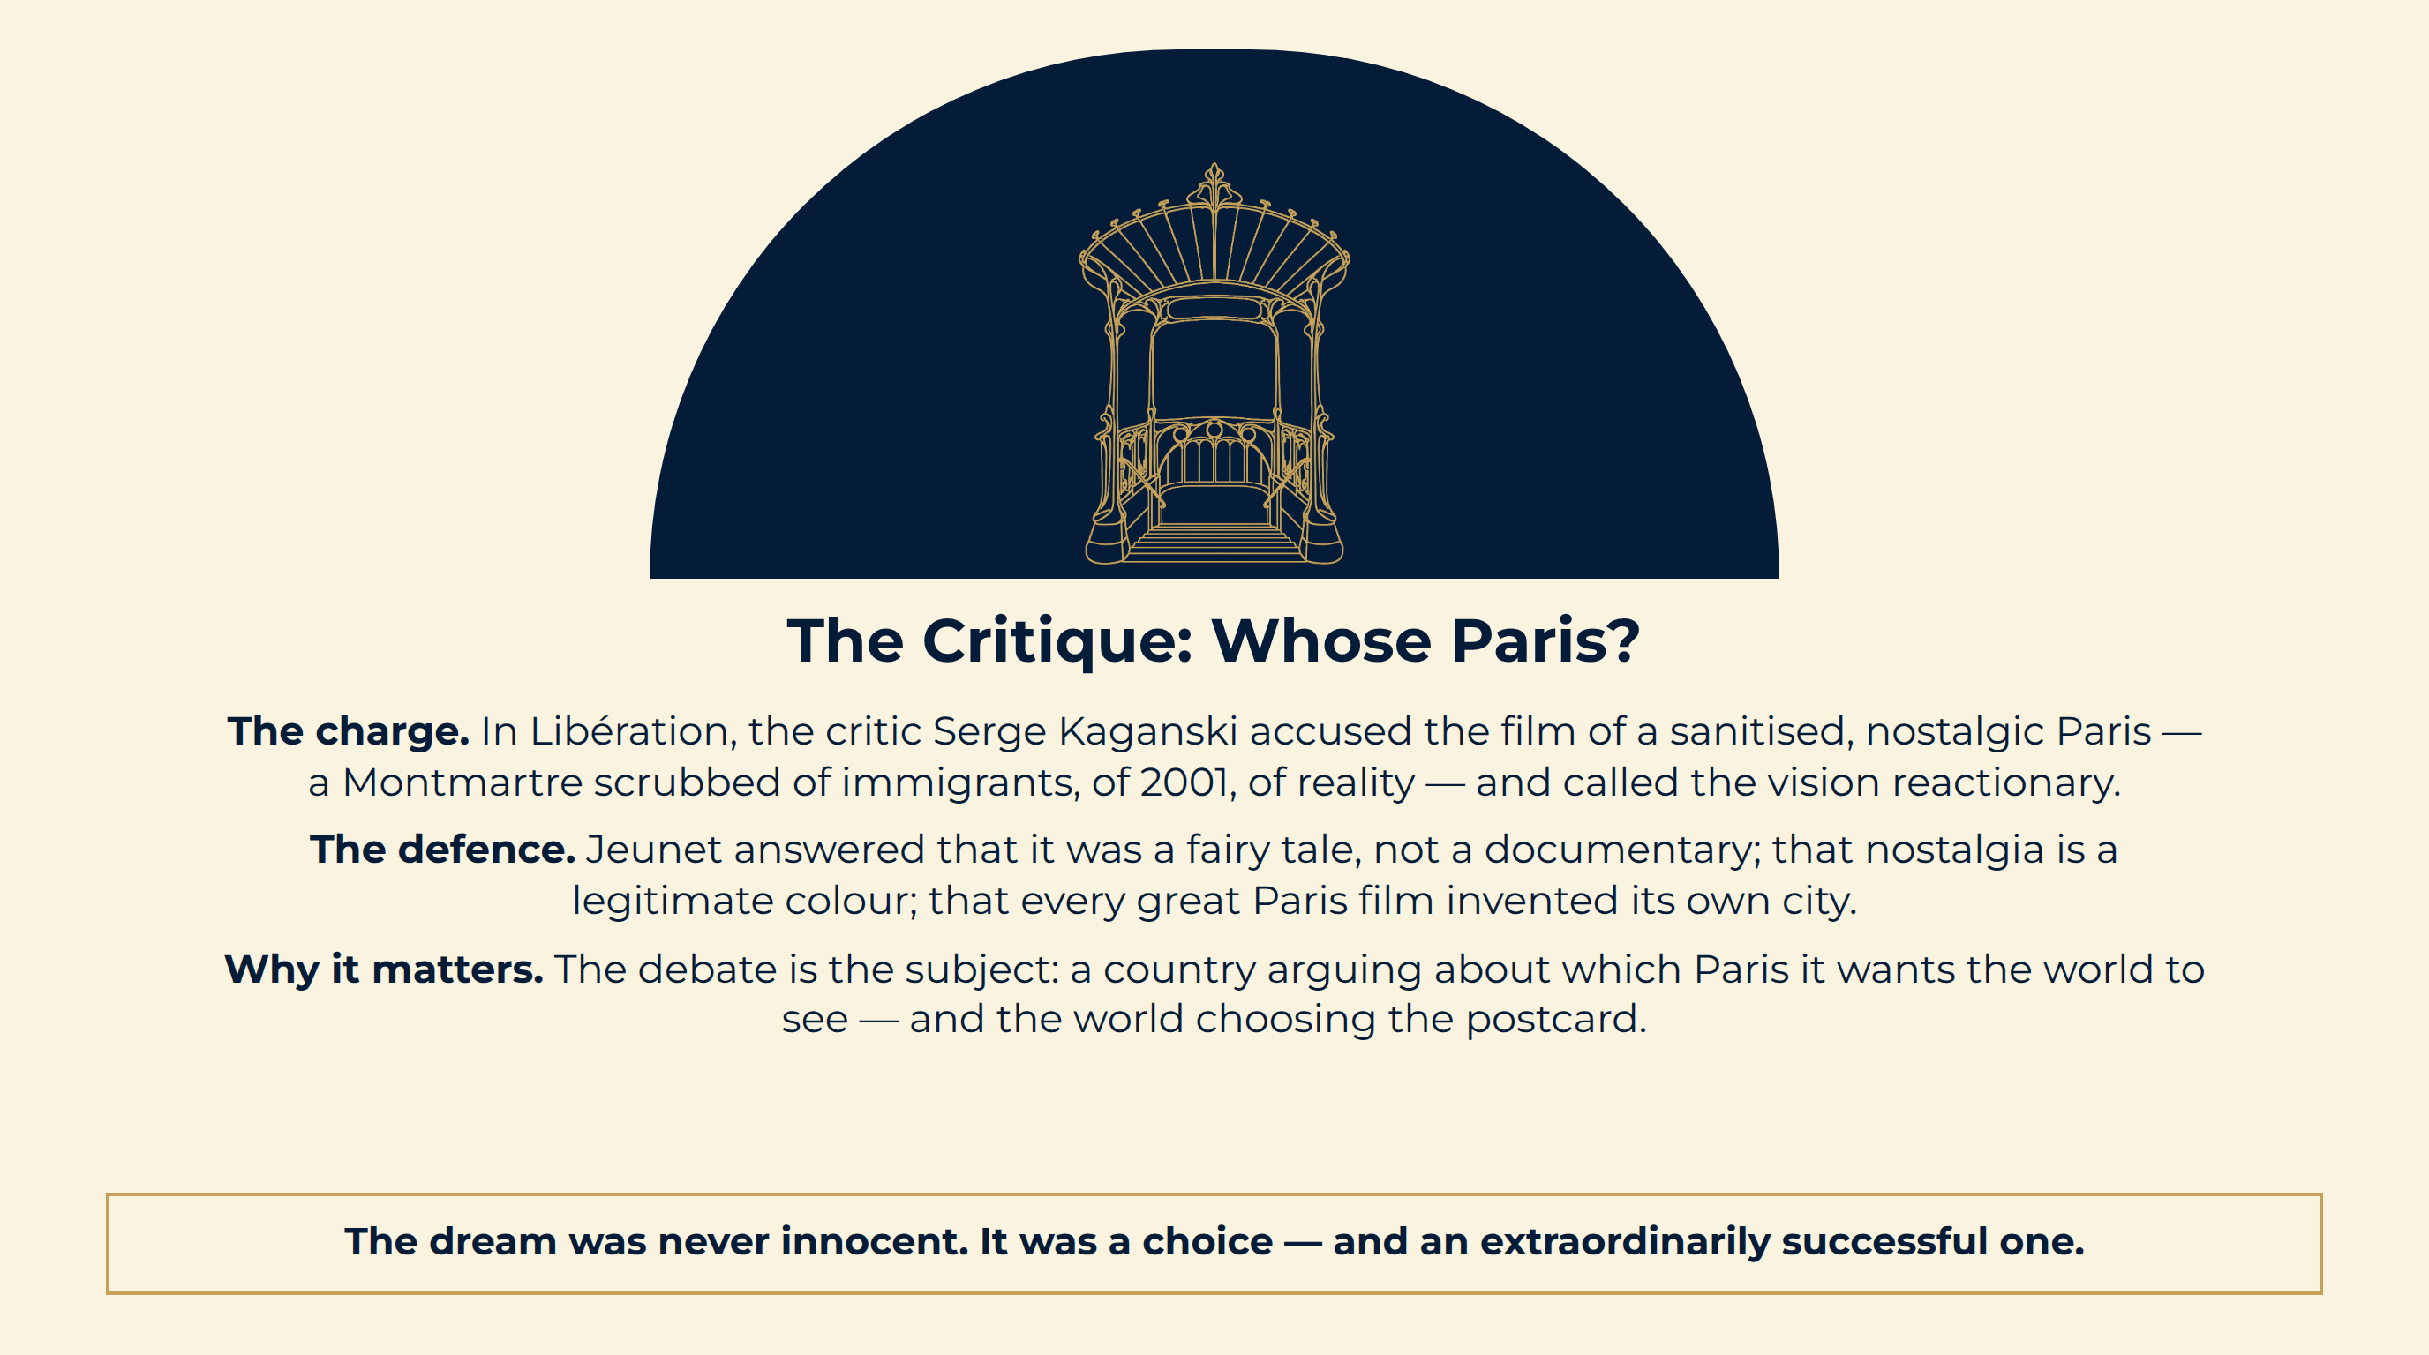
Notes:
The Critique: Whose Paris?
The charge. In Libération, the critic Serge Kaganski accused the film of a sanitised, nostalgic Paris — a Montmartre scrubbed of immigrants, of 2001, of reality — and called the vision reactionary.
The defence. Jeunet answered that it was a fairy tale, not a documentary; that nostalgia is a legitimate colour; that every great Paris film invented its own city.
Why it matters. The debate is the subject: a country arguing about which Paris it wants the world to see — and the world choosing the postcard.
The dream was never innocent. It was a choice — and an extraordinarily successful one.

Slide 16
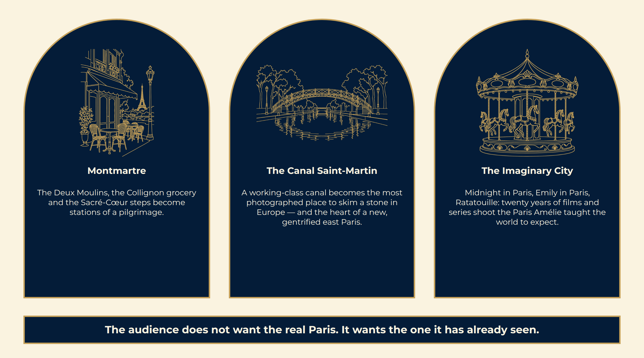
Notes:
The Postcard Industry
The audience does not want the real Paris. It wants the one it has already seen.

Slide 17
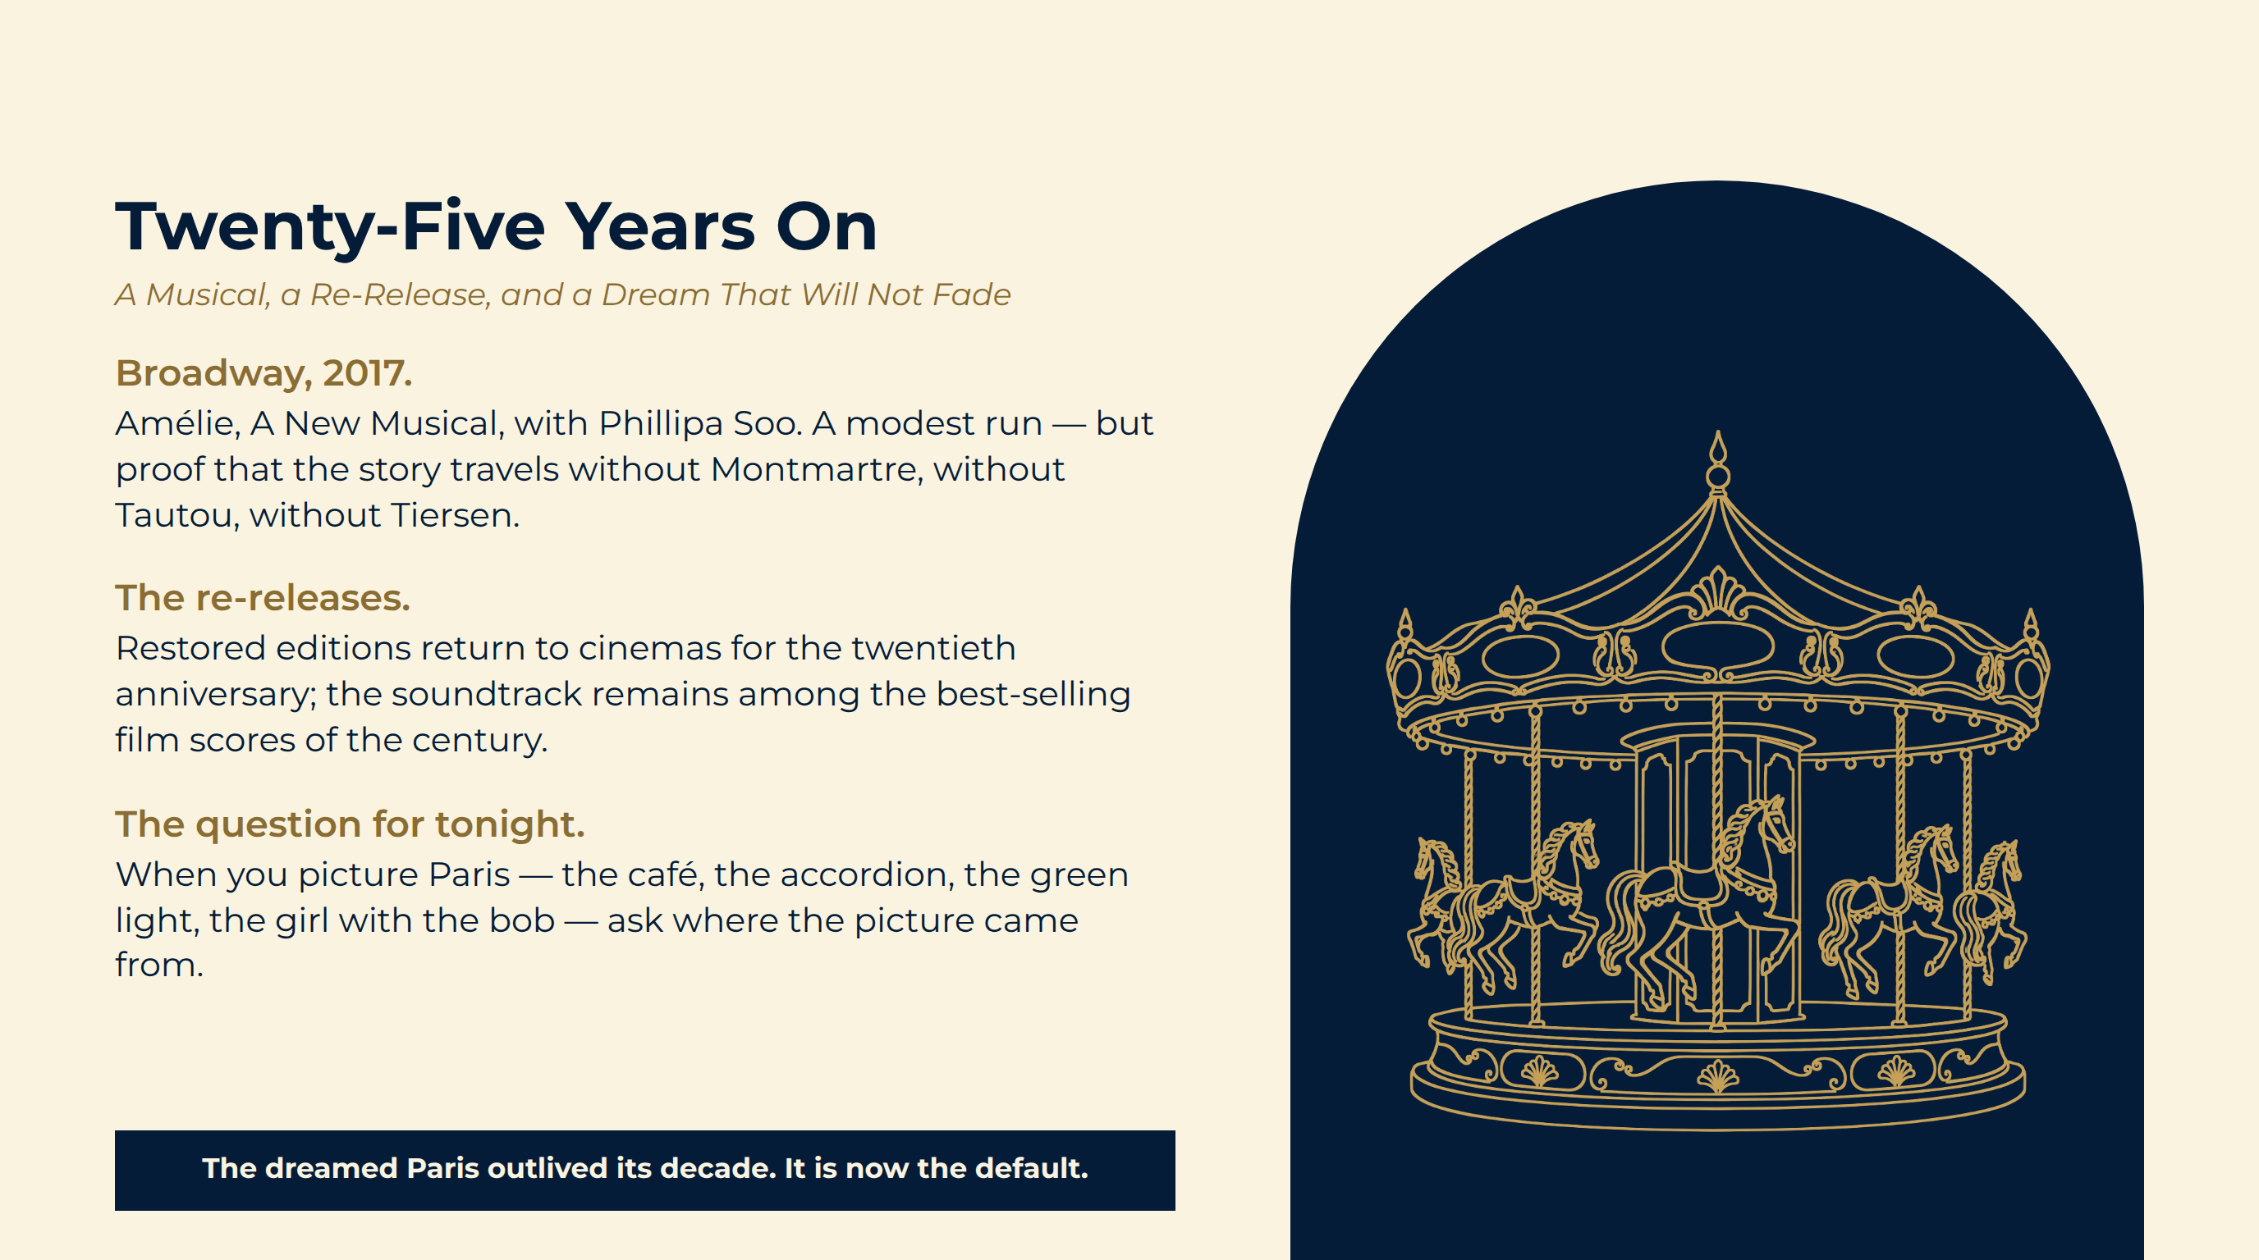
Notes:
Twenty-Five Years On
Broadway, 2017. Amélie, A New Musical, with Phillipa Soo. A modest run — but proof that the story travels without Montmartre, without Tautou, without Tiersen.
The re-releases. Restored editions return to cinemas for the twentieth anniversary; the soundtrack remains among the best-selling film scores of the century.
The question for tonight. When you picture Paris — the café, the accordion, the green light, the girl with the bob — ask where the picture came from.
The dreamed Paris outlived its decade. It is now the default.

Slide 18
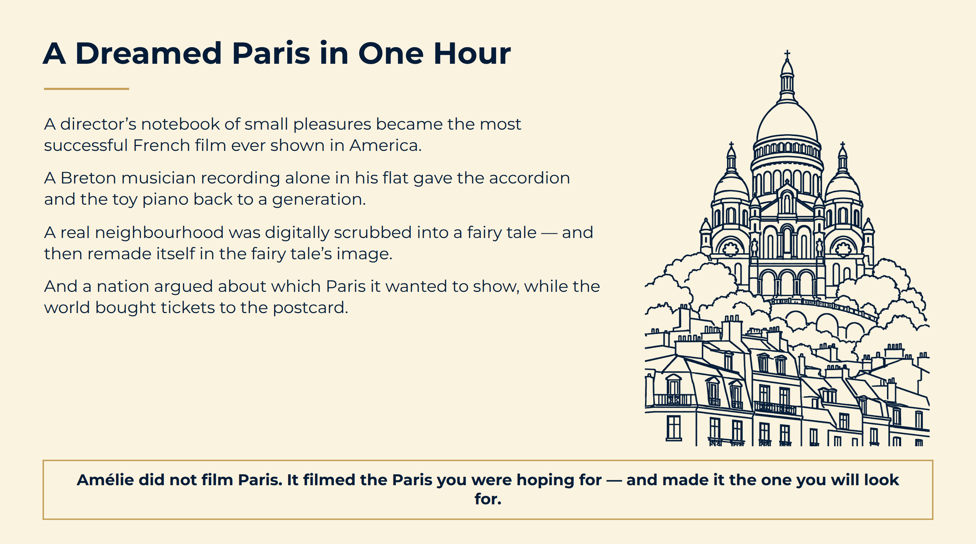
Notes:
A Dreamed Paris in One Hour
Amélie did not film Paris. It filmed the Paris you were hoping for — and made it the one you will look for.

Slide 19
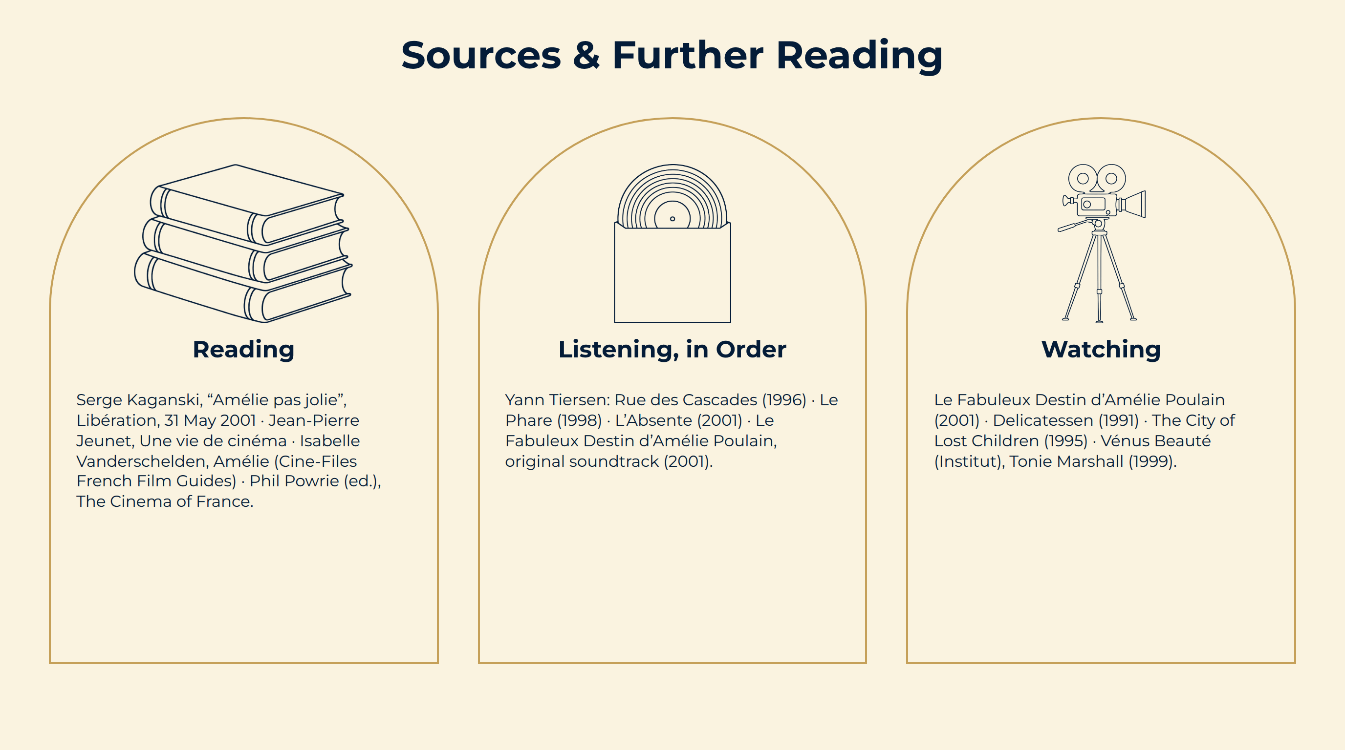
Notes:
Sources & Further Reading

