Slide 1
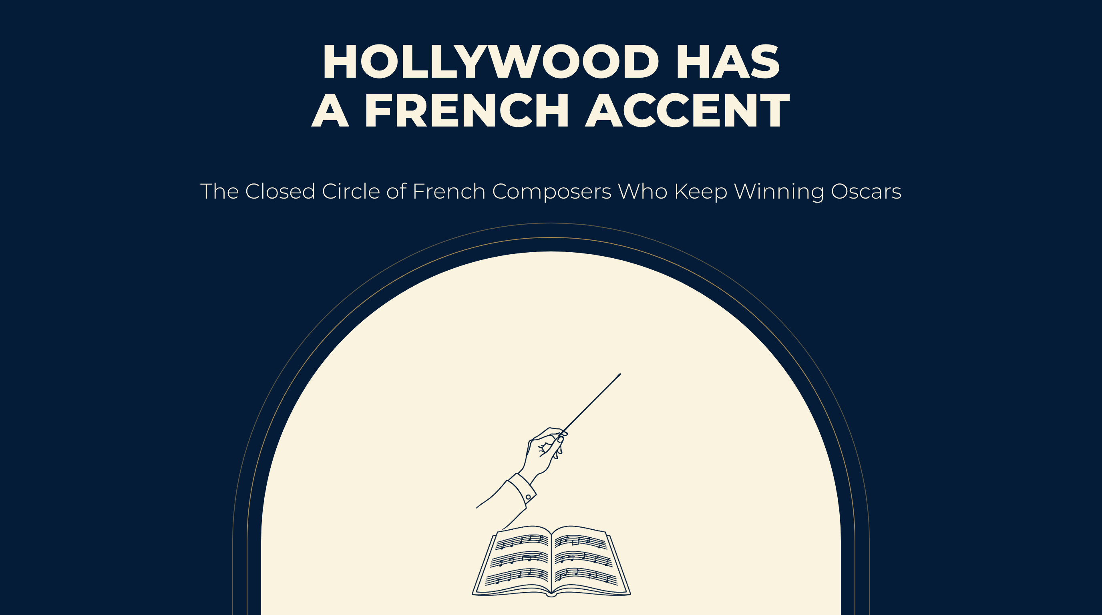
Notes:
HOLLYWOOD HAS
A FRENCH ACCENT
The Closed Circle of French Composers Who Keep Winning Oscars

Slide 2
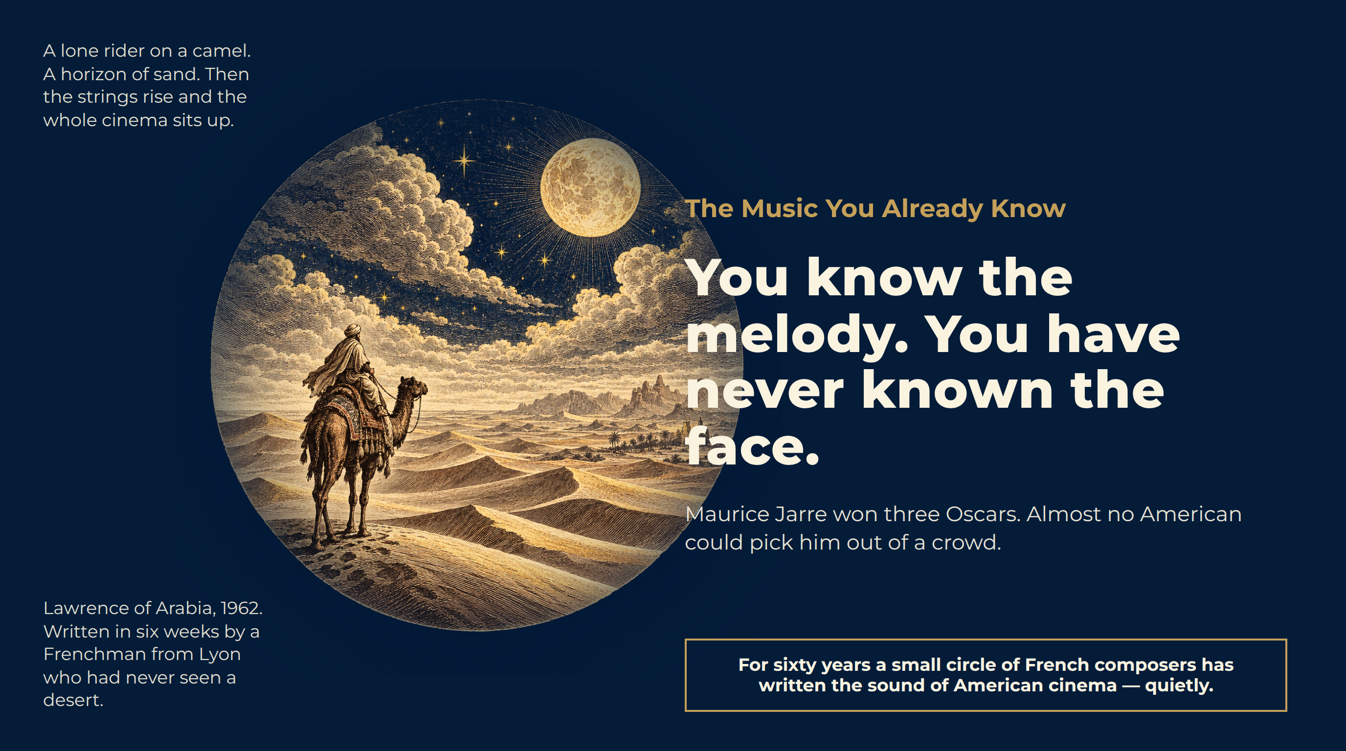
Notes:
The Music You Already Know
A lone rider on a camel. A horizon of sand. Then the strings rise and the whole cinema sits up.
Lawrence of Arabia, 1962. Written in six weeks by a Frenchman from Lyon who had never seen a desert.
You know the melody. You have never known the face.
Maurice Jarre won three Oscars. Almost no American could pick him out of a crowd.
For sixty years a small circle of French composers has written the sound of American cinema — quietly.

Slide 3
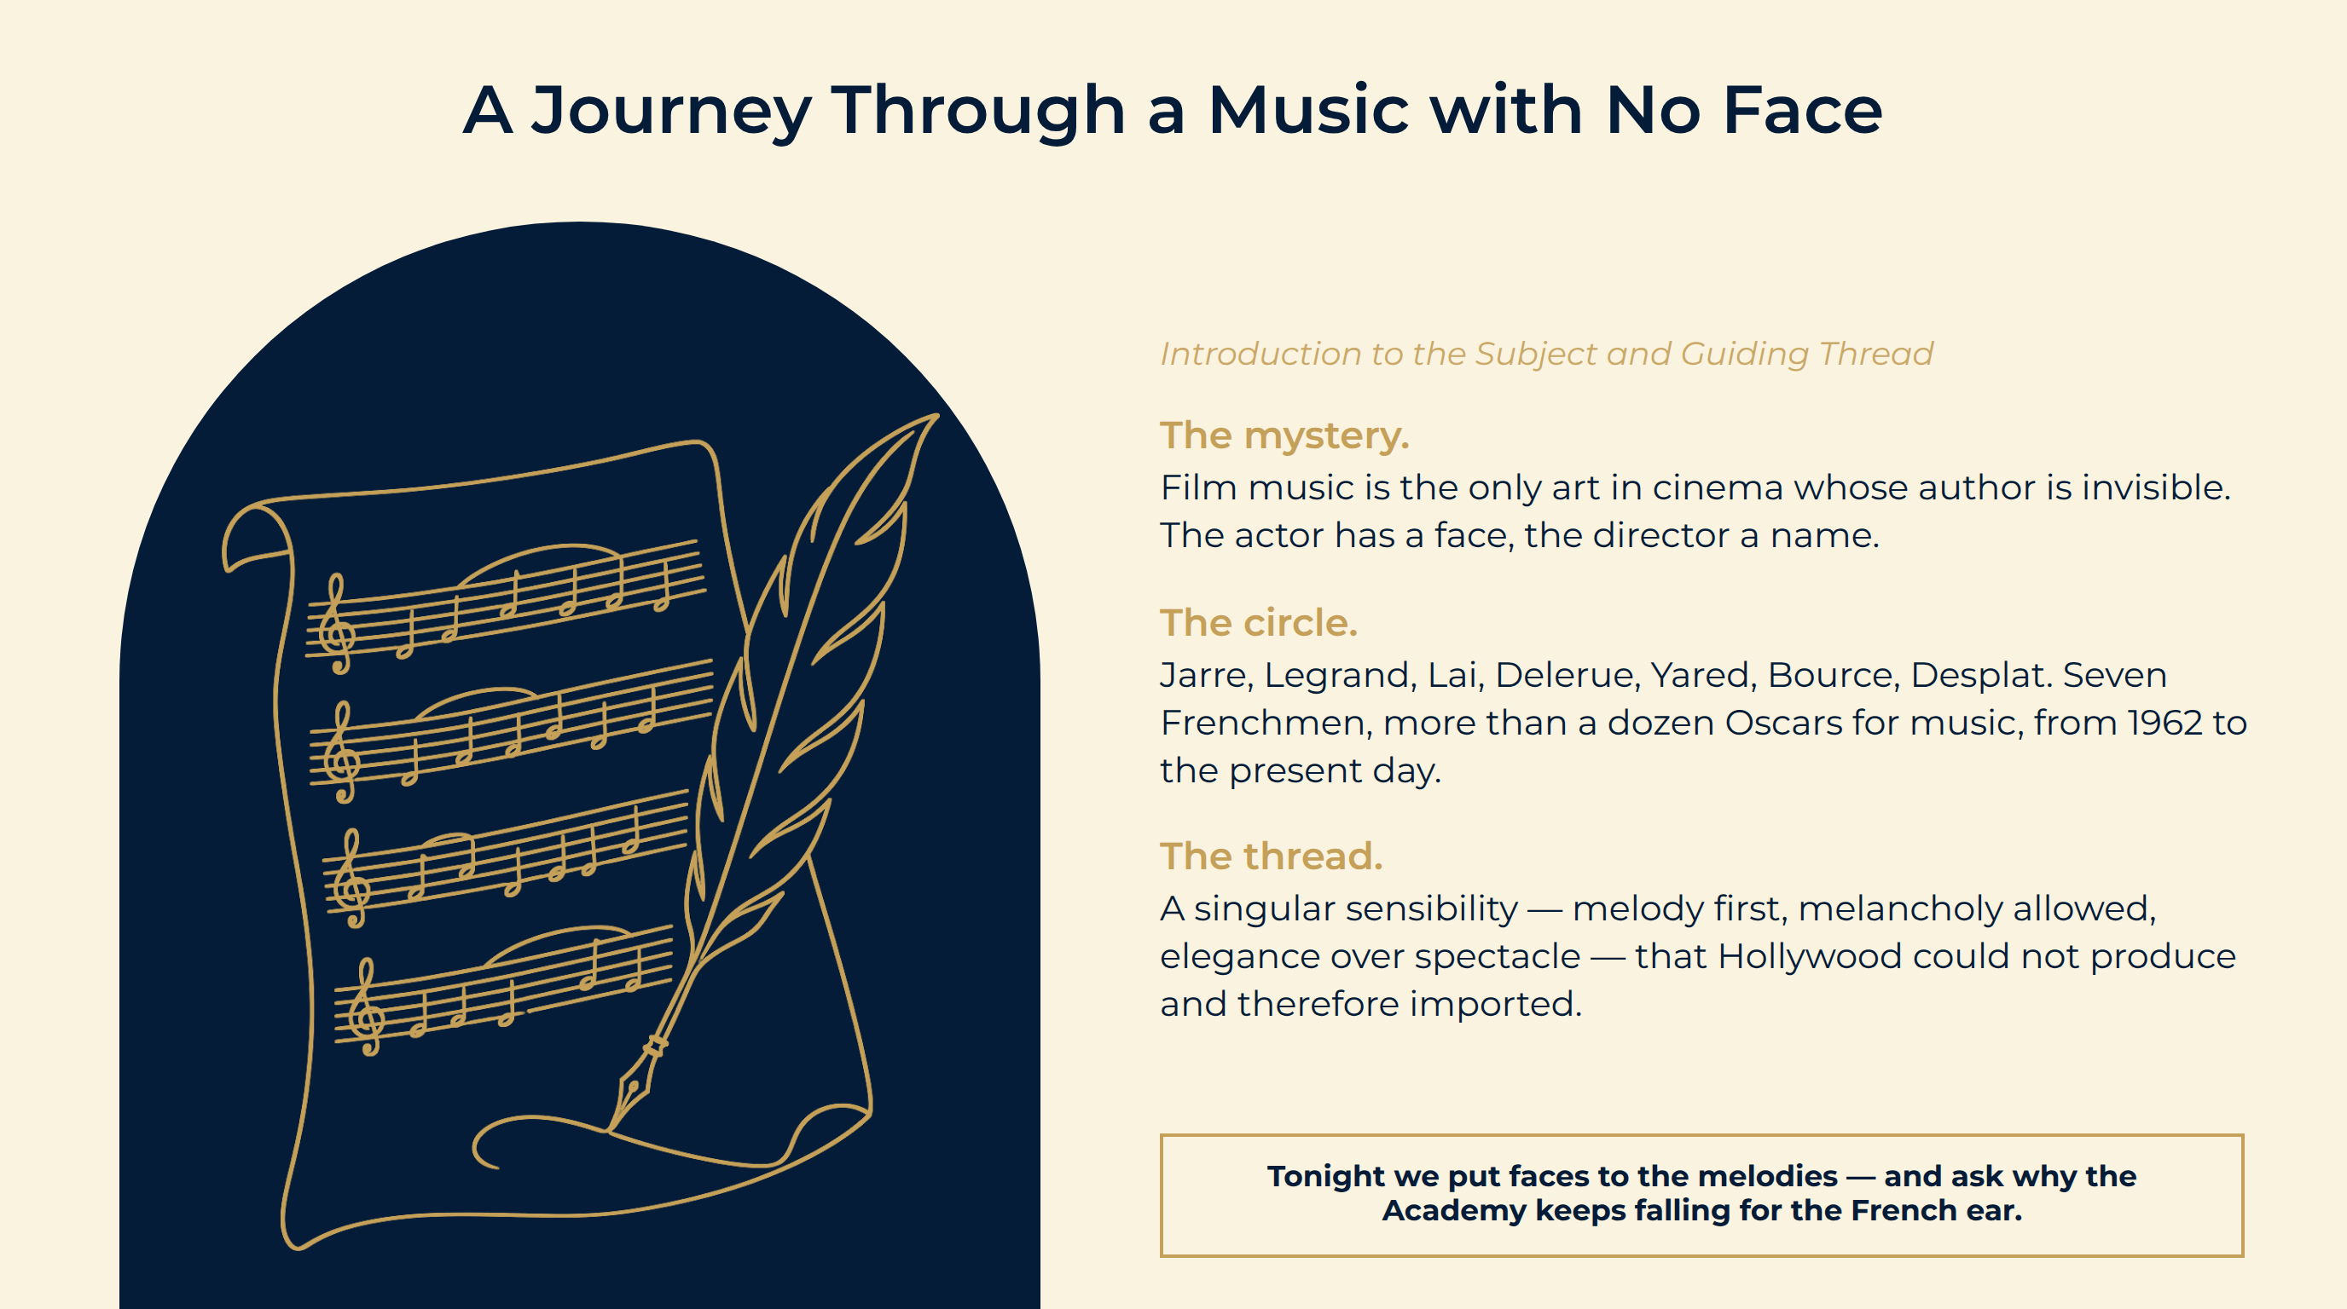
Notes:
A Journey Through a Music with No Face
The mystery. Film music is the only art in cinema whose author is invisible. The actor has a face, the director a name.
The circle. Jarre, Legrand, Lai, Delerue, Yared, Bource, Desplat. Seven Frenchmen, more than a dozen Oscars for music, from 1962 to the present day.
The thread. A singular sensibility — melody first, melancholy allowed, elegance over spectacle — that Hollywood could not produce and therefore imported.
Tonight we put faces to the melodies — and ask why the Academy keeps falling for the French ear.

Slide 4
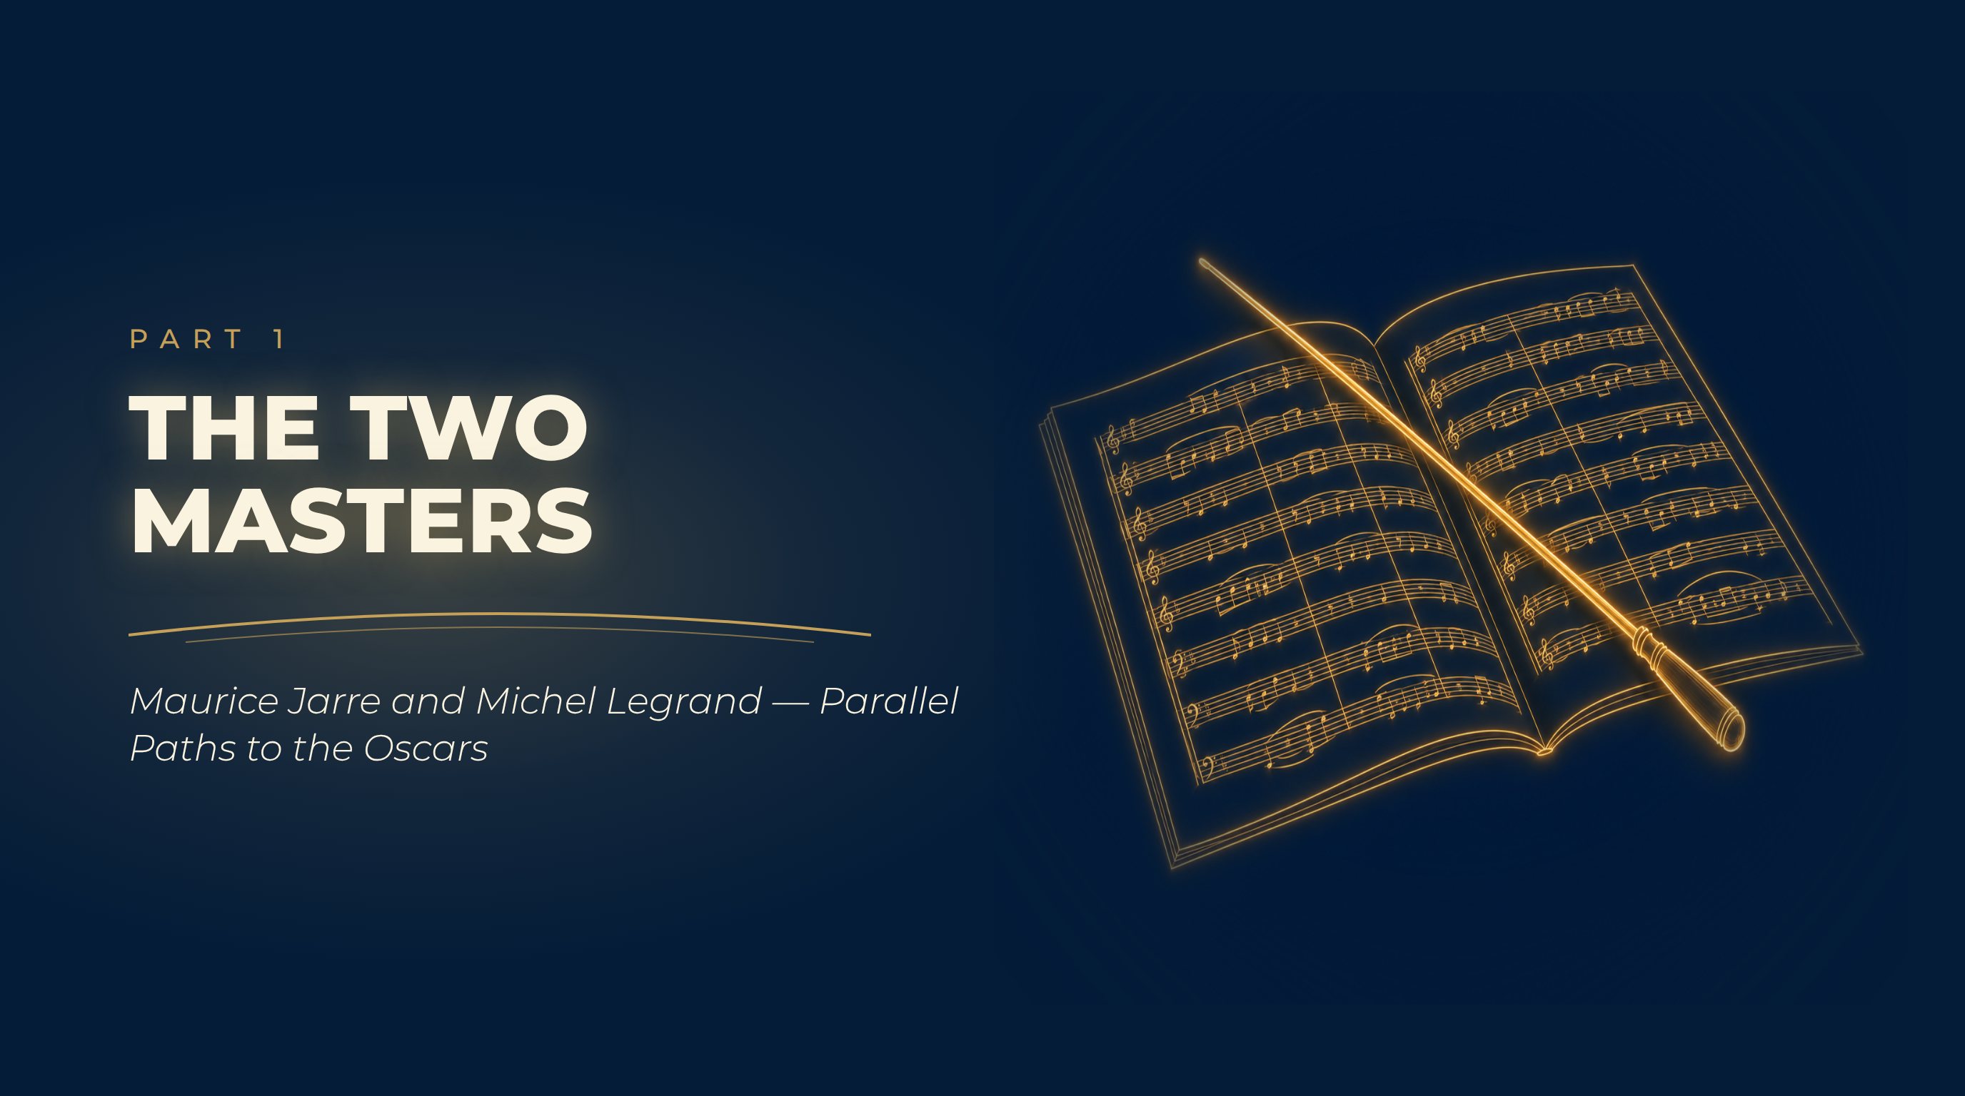
Notes:
The Two Masters
Maurice Jarre and Michel Legrand — Parallel Paths to the Oscars

Slide 5
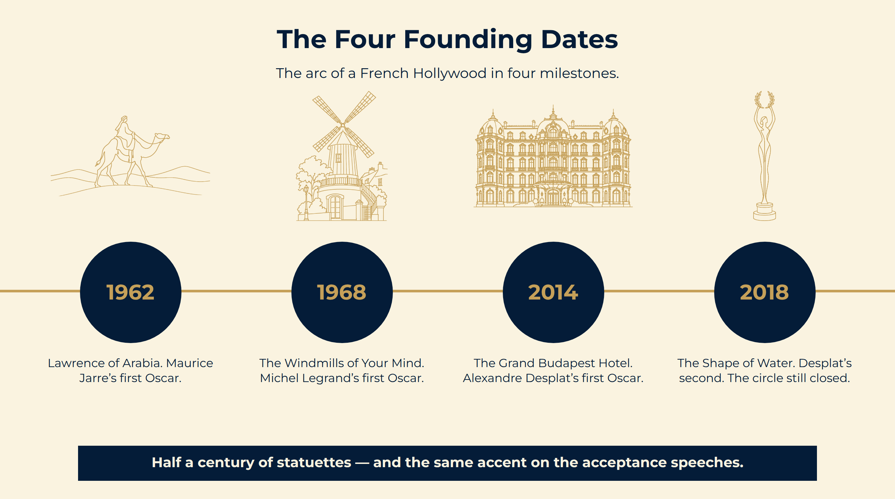
Notes:
The Four Founding Dates
Half a century of statuettes — and the same accent on the acceptance speeches.
The arc of a French Hollywood in four milestones.

Slide 6
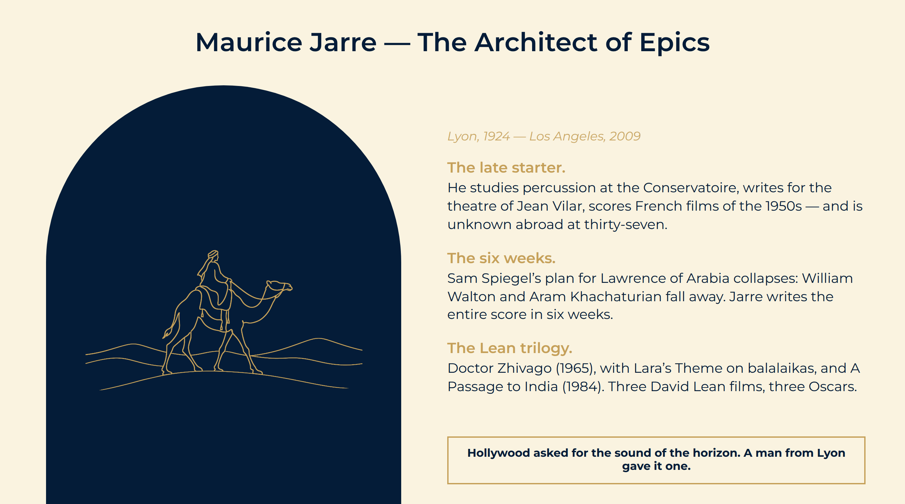
Notes:
Maurice Jarre — The Architect of Epics
The late starter. He studies percussion at the Conservatoire, writes for the theatre of Jean Vilar, scores French films of the 1950s — and is unknown abroad at thirty-seven.
The six weeks. Sam Spiegel’s plan for Lawrence of Arabia collapses: William Walton and Aram Khachaturian fall away. Jarre writes the entire score in six weeks.
The Lean trilogy. Doctor Zhivago (1965), with Lara’s Theme on balalaikas, and A Passage to India (1984). Three David Lean films, three Oscars.
Hollywood asked for the sound of the horizon. A man from Lyon gave it one.

Slide 7
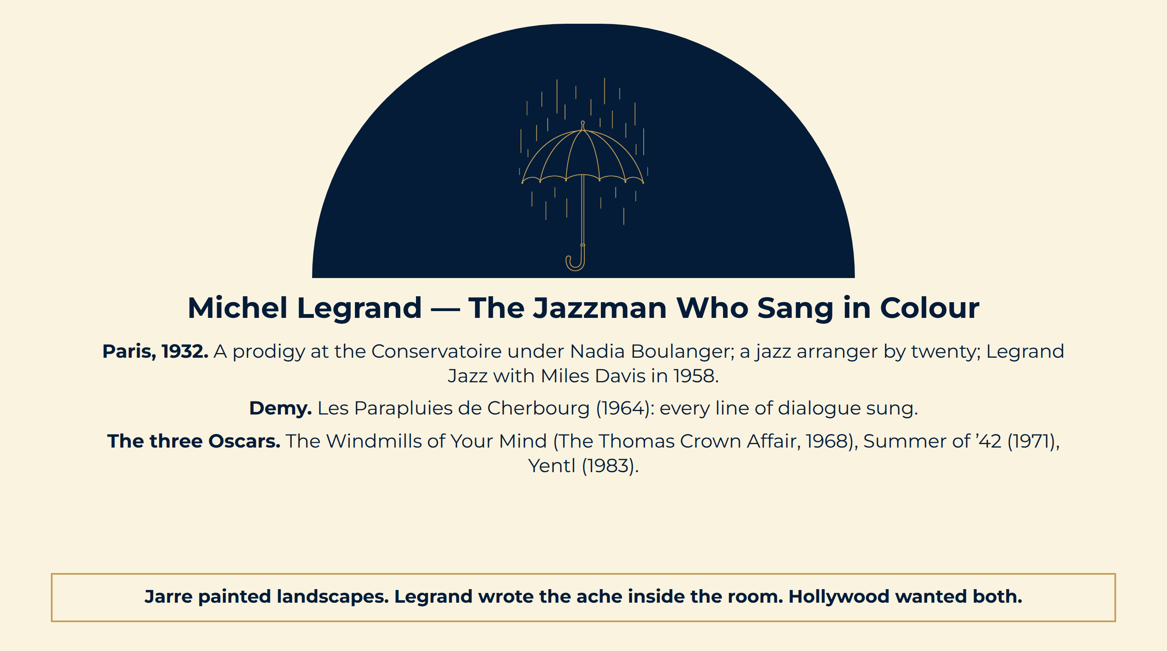
Notes:
Michel Legrand — The Jazzman Who Sang in Colour
Paris, 1932. A prodigy at the Conservatoire under Nadia Boulanger; a jazz arranger by twenty; Legrand Jazz with Miles Davis in 1958.
Demy. Les Parapluies de Cherbourg (1964): every line of dialogue sung.
The three Oscars. The Windmills of Your Mind (The Thomas Crown Affair, 1968), Summer of ’42 (1971), Yentl (1983).
Jarre painted landscapes. Legrand wrote the ache inside the room. Hollywood wanted both.

Slide 8
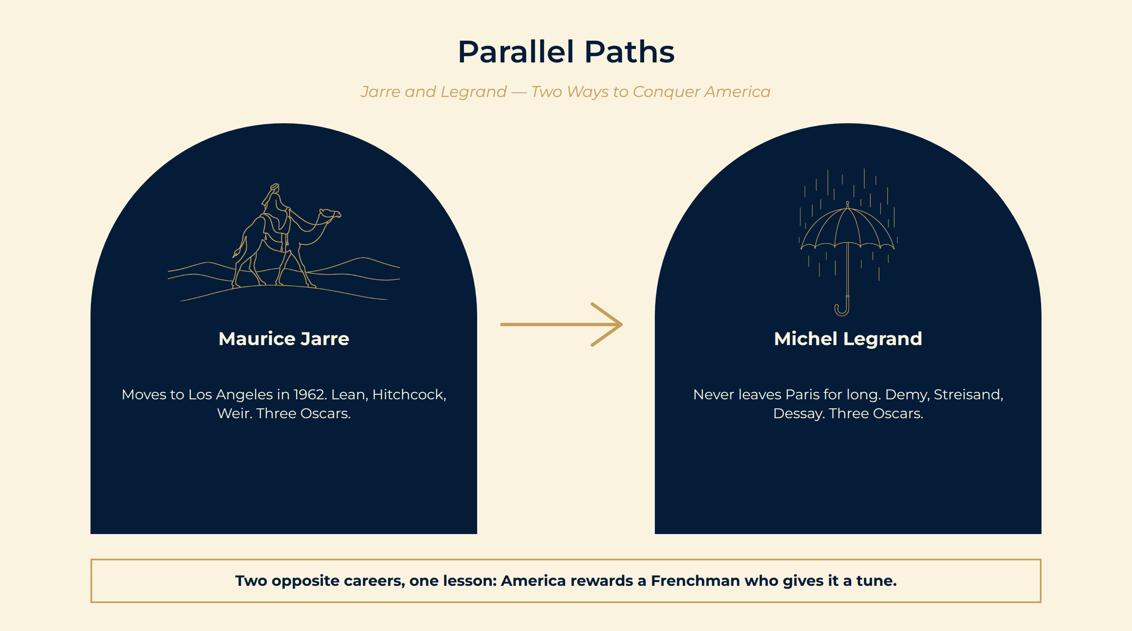
Notes:
Parallel Paths
Jarre moves in. He settles in Los Angeles, works with Lean, Hitchcock, Weir, and in 1985 reinvents himself with electronics for Witness.
Legrand commutes. He never leaves Paris for long: films, jazz albums, Barbra Streisand, Nana Mouskouri, Natalie Dessay. Hollywood comes to him.
What they share. A melody you can hum after one hearing, written by a classically trained musician who treats a film score as a composition, not a service.
Maurice Jarre Moves to Los Angeles in 1962. Lean, Hitchcock, Weir. Three Oscars.
Michel Legrand Never leaves Paris for long. Demy, Streisand, Dessay. Three Oscars.
Two opposite careers, one lesson: America rewards a Frenchman who gives it a tune.

Slide 9
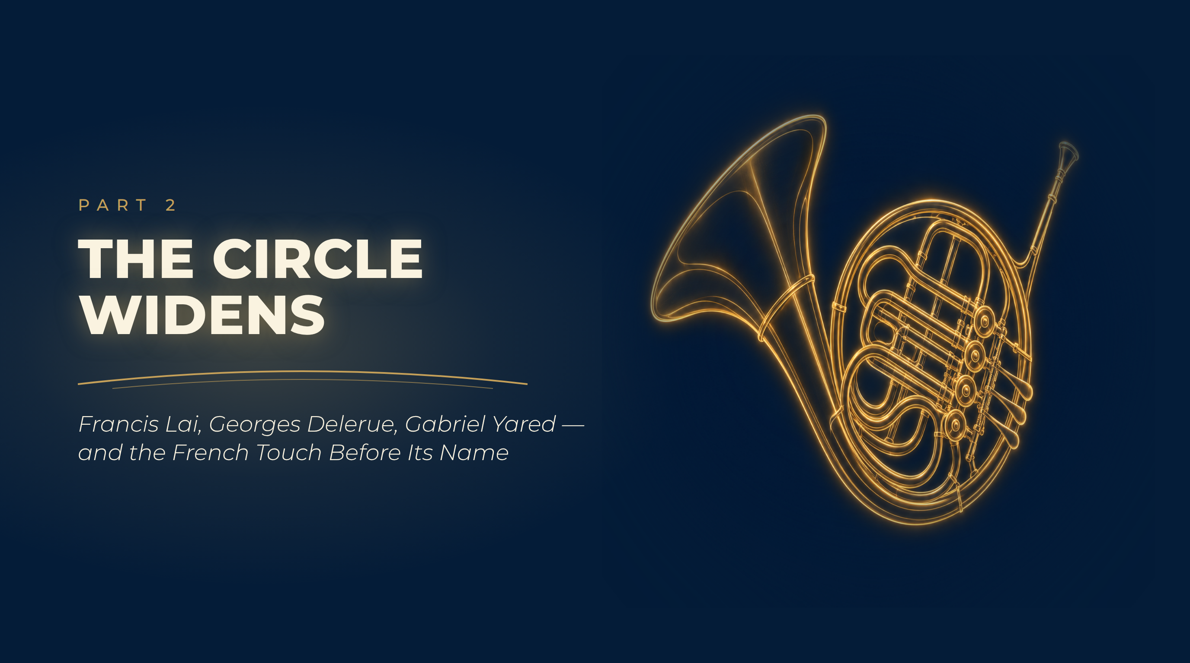
Notes:
The Circle Widens
Francis Lai, Georges Delerue, Gabriel Yared — and the French Touch Before Its Name

Slide 10
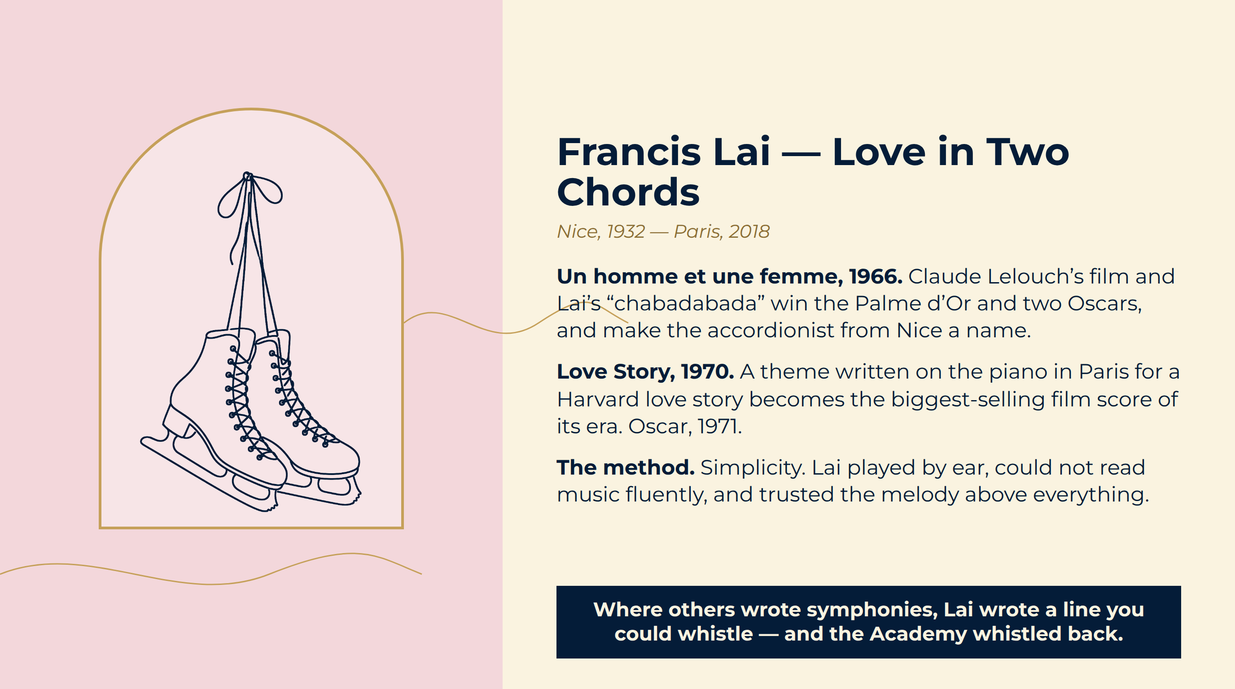
Notes:
Francis Lai — Love in Two Chords
Un homme et une femme, 1966. Claude Lelouch’s film and Lai’s “chabadabada” win the Palme d’Or and two Oscars, and make the accordionist from Nice a name.
Love Story, 1970. A theme written on the piano in Paris for a Harvard love story becomes the biggest-selling film score of its era. Oscar, 1971.
The method. Simplicity. Lai played by ear, could not read music fluently, and trusted the melody above everything.
Where others wrote symphonies, Lai wrote a line you could whistle — and the Academy whistled back.

Slide 11
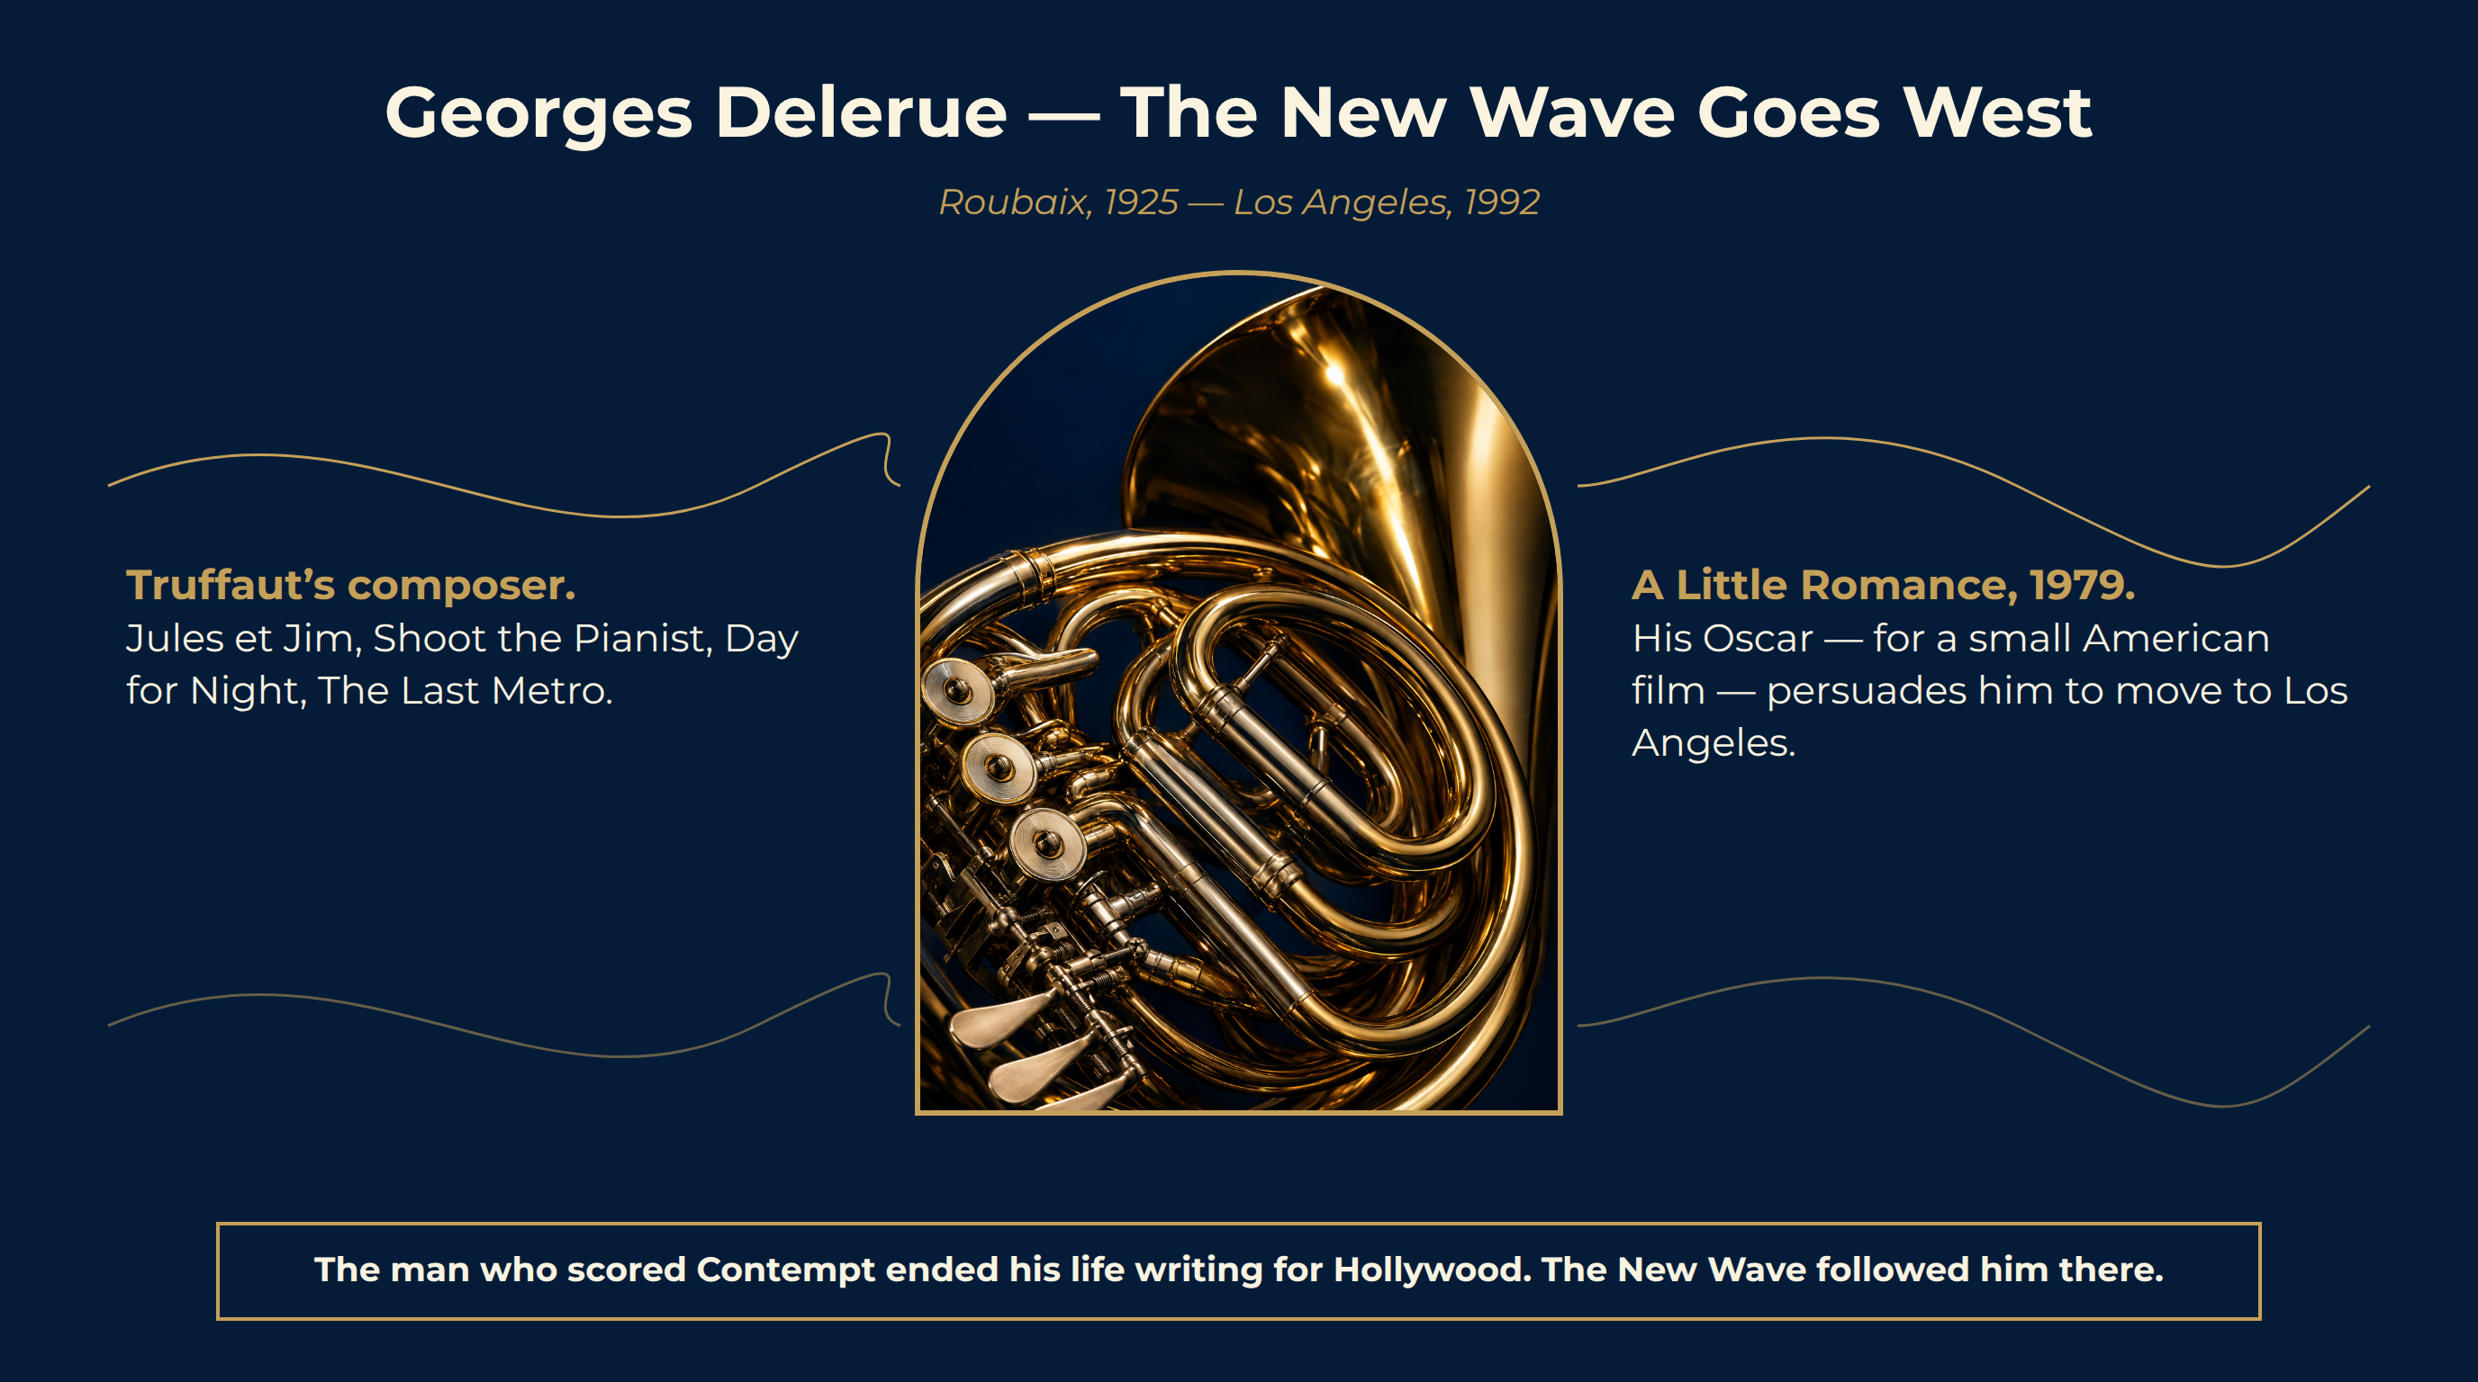
Notes:
Georges Delerue — The New Wave Goes West
Truffaut’s composer. Jules et Jim, Shoot the Pianist, Day for Night, The Last Metro.
A Little Romance, 1979. His Oscar — for a small American film — persuades him to move to Los Angeles.
The legacy. Oliver Stone built Platoon on Barber’s Adagio but asked Delerue for its heart.
The man who scored Contempt ended his life writing for Hollywood. The New Wave followed him there.

Slide 12
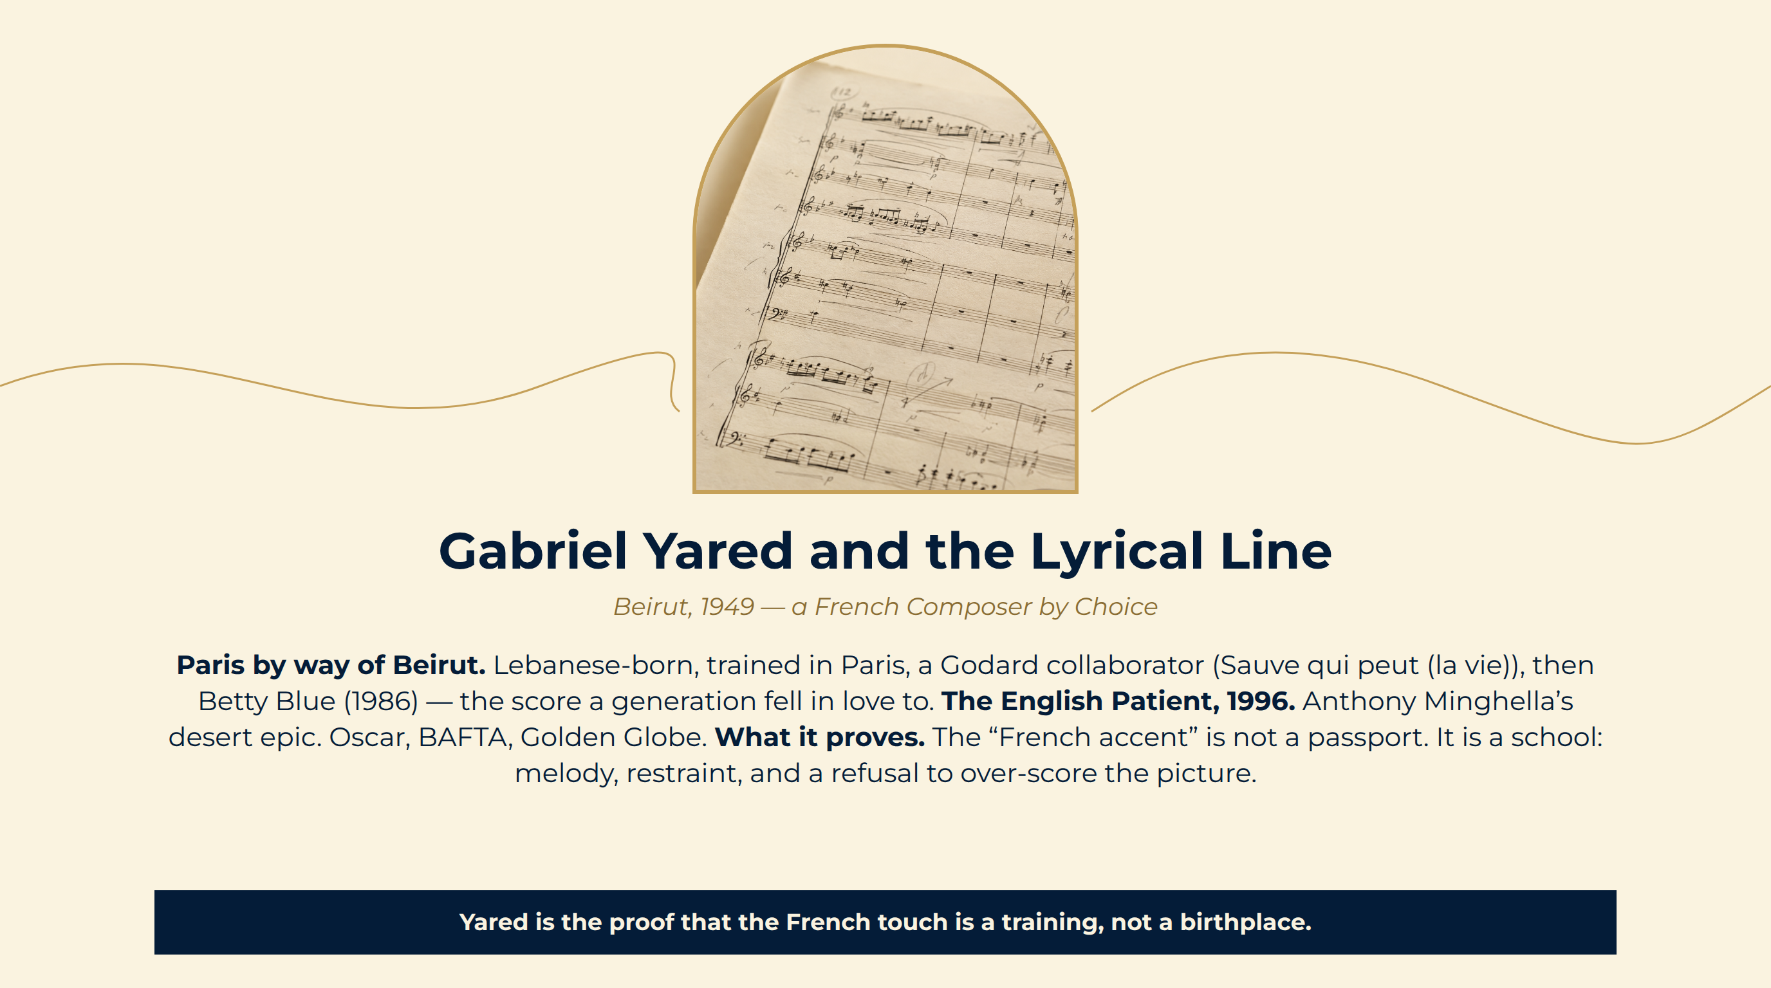
Notes:
Gabriel Yared and the Lyrical Line
Paris by way of Beirut. Lebanese-born, trained in Paris, a Godard collaborator (Sauve qui peut (la vie)), then Betty Blue (1986) — the score a generation fell in love to.
The English Patient, 1996. Anthony Minghella’s desert epic. Oscar, BAFTA, Golden Globe.
What it proves. The “French accent” is not a passport. It is a school: melody, restraint, and a refusal to over-score the picture.
Yared is the proof that the French touch is a training, not a birthplace.

Slide 13
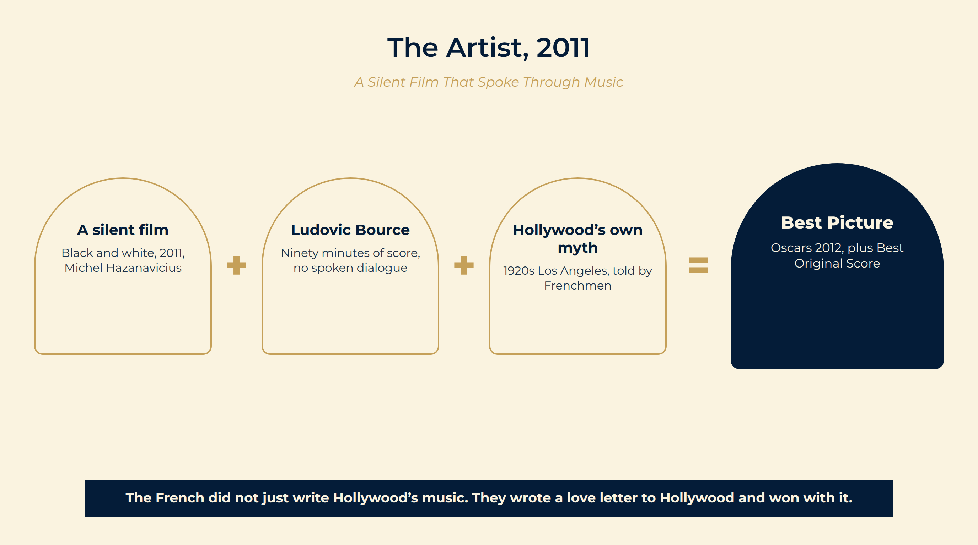
Notes:
The Artist, 2011
A French film about Hollywood. Michel Hazanavicius’s black-and-white, silent homage to 1920s Hollywood, with Jean Dujardin — Best Picture at the Oscars.
A score that is the dialogue. With no spoken words, Ludovic Bource’s music carries every scene. Oscar for Best Original Score, 2012.
The loop closes. A French composer wins Hollywood’s highest prize for imitating the Hollywood of a century before. The accent had become the original.
A silent film Black and white, 2011, Michel Hazanavicius
Ludovic Bource Ninety minutes of score, no spoken dialogue
Hollywood’s own myth 1920s Los Angeles, told by Frenchmen
Best Picture Oscars 2012, plus Best Original Score
The French did not just write Hollywood’s music. They wrote a love letter to Hollywood and won with it.

Slide 14
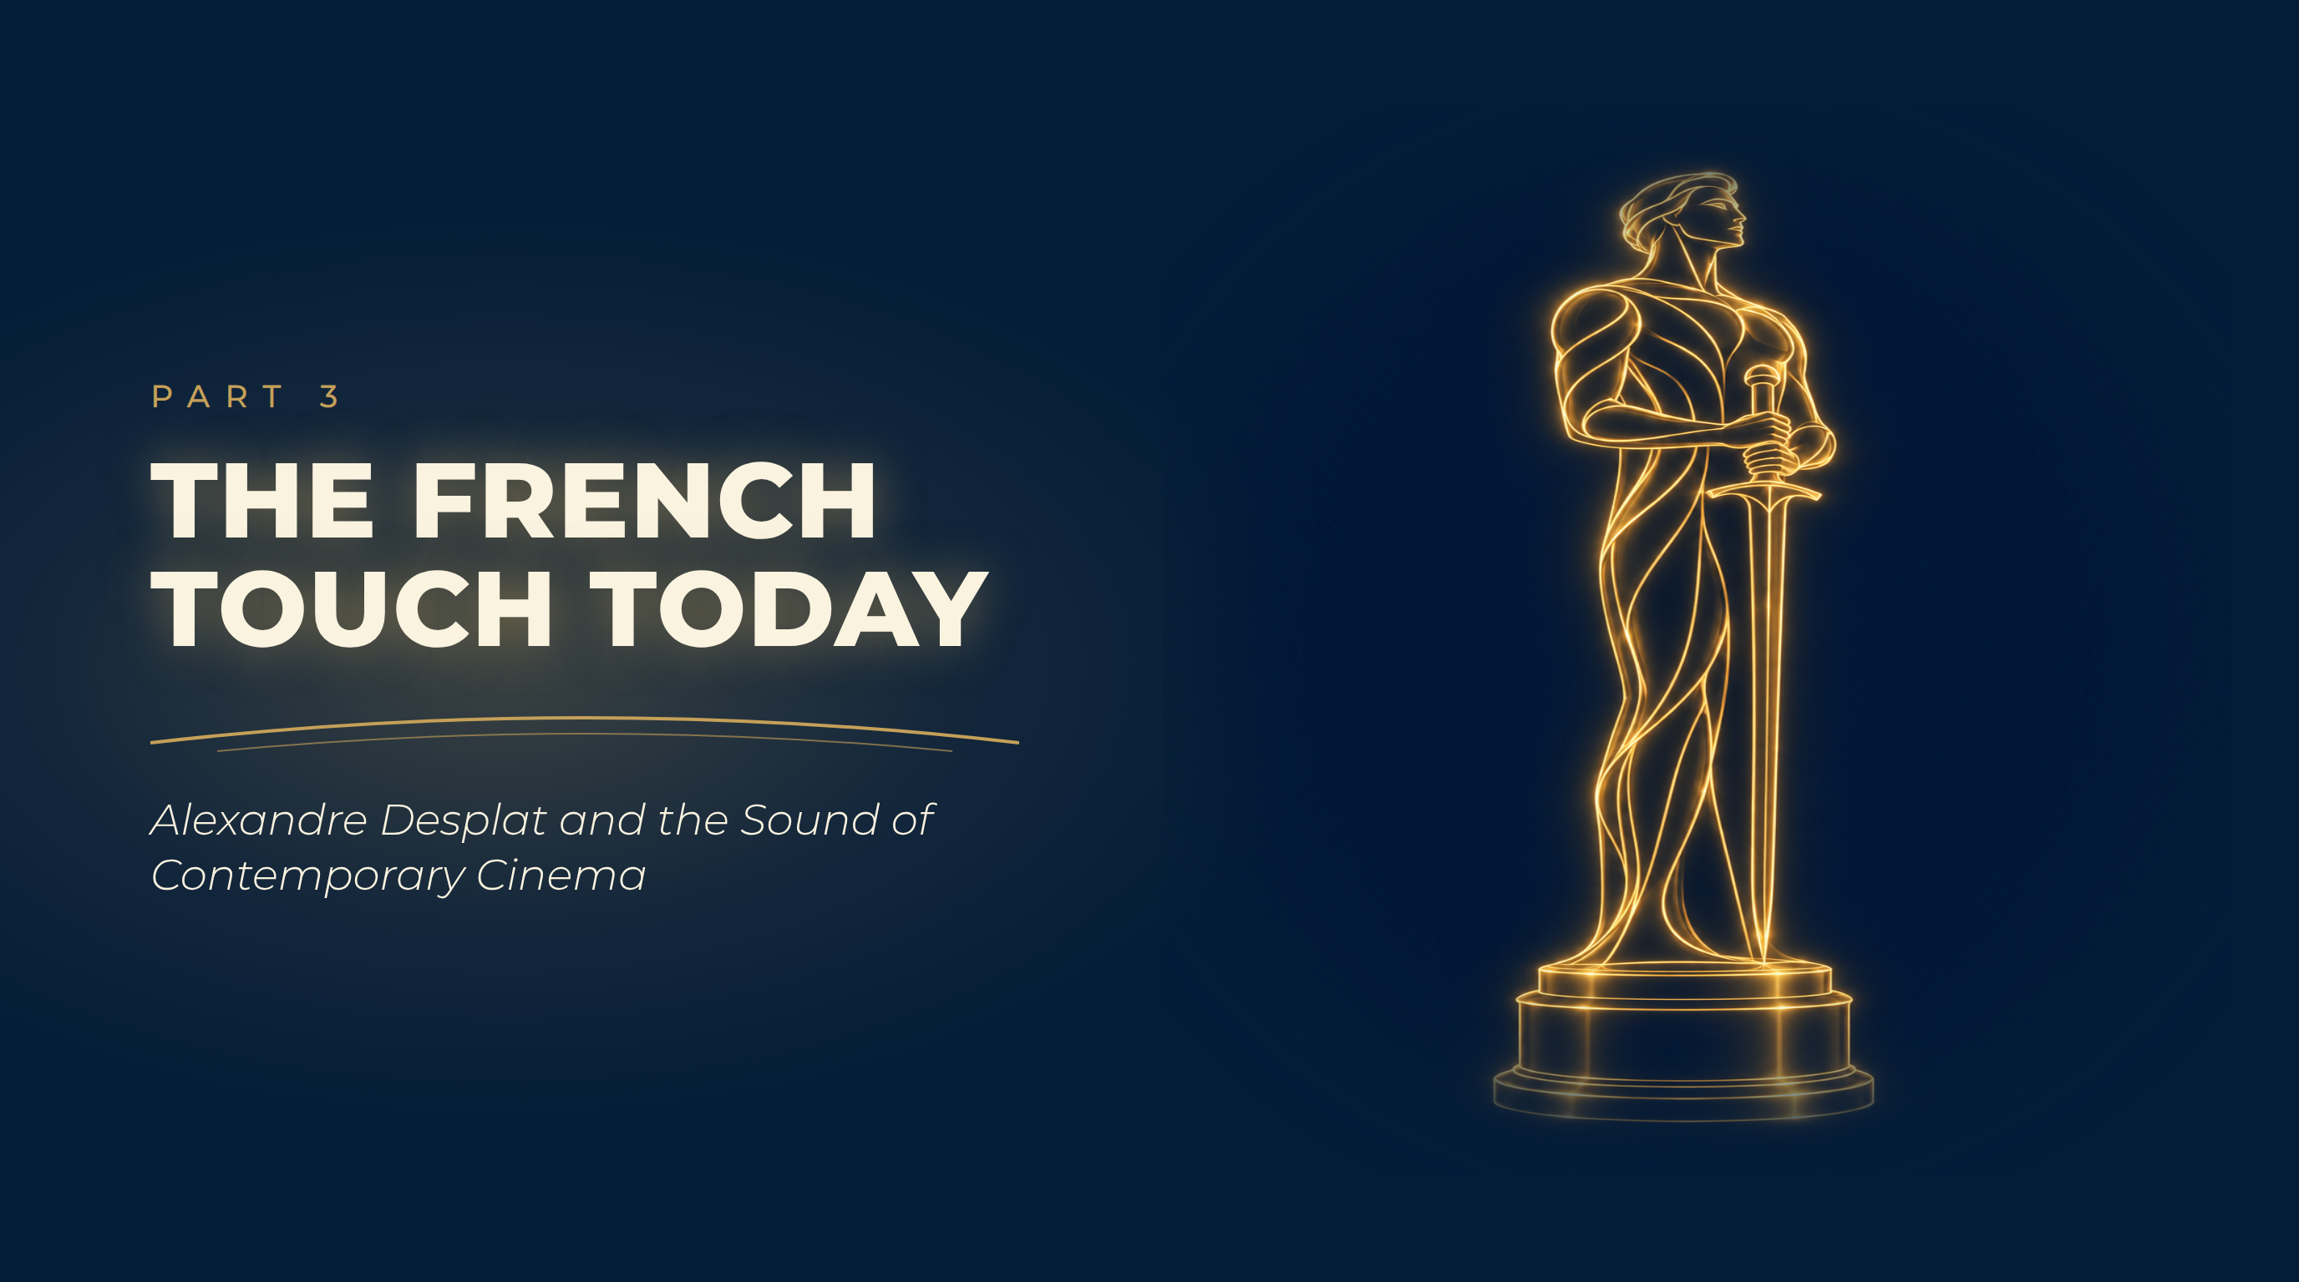
Notes:
The French Touch Today
Alexandre Desplat and the Sound of Contemporary Cinema

Slide 15
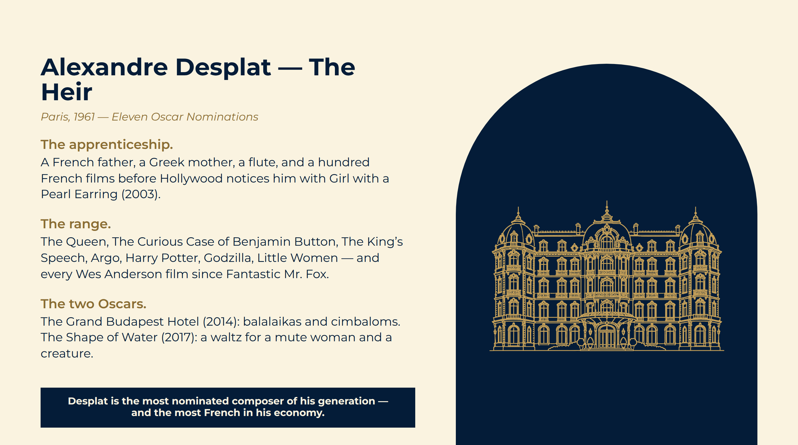
Notes:
Alexandre Desplat — The Heir
The apprenticeship. A French father, a Greek mother, a flute, and a hundred French films before Hollywood notices him with Girl with a Pearl Earring (2003).
The range. The Queen, The Curious Case of Benjamin Button, The King’s Speech, Argo, Harry Potter, Godzilla, Little Women — and every Wes Anderson film since Fantastic Mr. Fox.
The two Oscars. The Grand Budapest Hotel (2014): balalaikas and cimbaloms. The Shape of Water (2017): a waltz for a mute woman and a creature.
Desplat is the most nominated composer of his generation — and the most French in his economy.

Slide 16
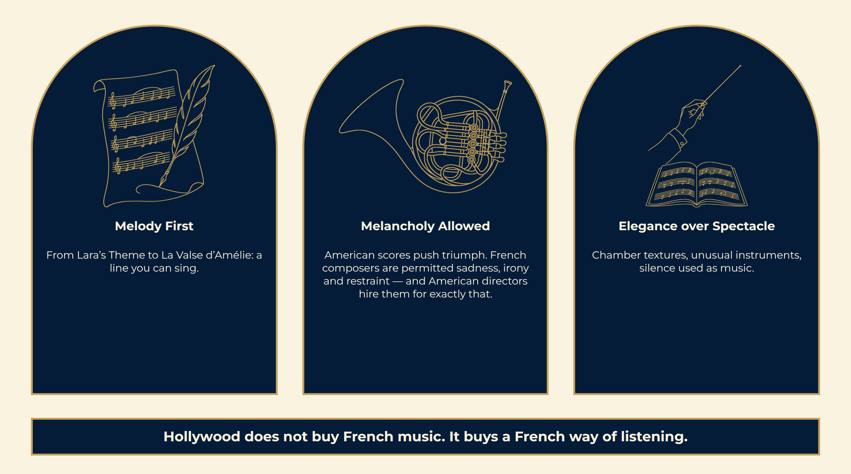
Notes:
What Makes the French Ear
Hollywood does not buy French music. It buys a French way of listening.

Slide 17
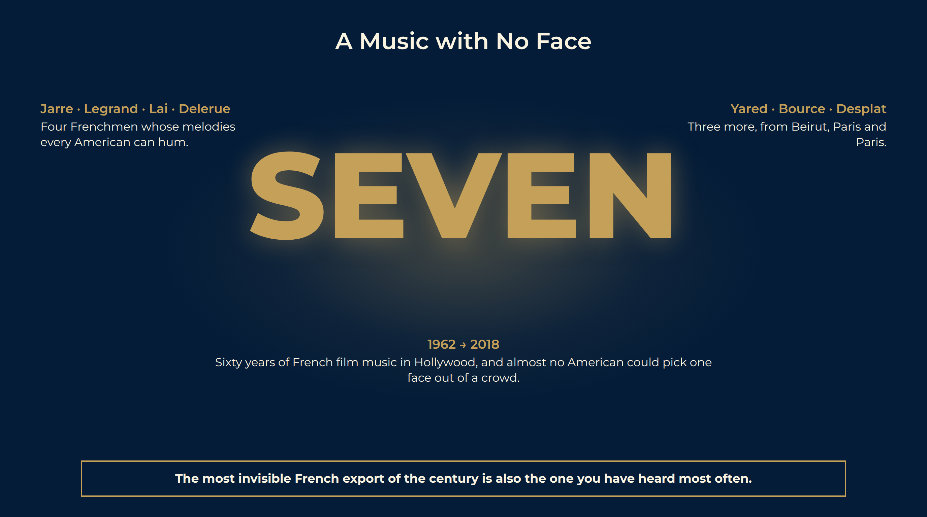
Notes:
A Music with No Face
The paradox. Jarre, Legrand, Lai, Delerue, Yared, Bource, Desplat: more Oscars for music than any other foreign nation’s composers — and almost no public recognition in America.
The reason. A film composer is heard, not seen. Their fame belongs to the images they serve.
The question for tonight. Next time the strings rise in an American cinema, listen for the accent. The chances are it is French.
Jarre · Legrand · Lai · Delerue Four Frenchmen whose melodies every American can hum.
Yared · Bource · Desplat Three more, from Beirut, Paris and Paris.
1962 → 2018 Sixty years of French film music in Hollywood, and almost no American could pick one face out of a crowd.
The most invisible French export of the century is also the one you have heard most often.

Slide 18
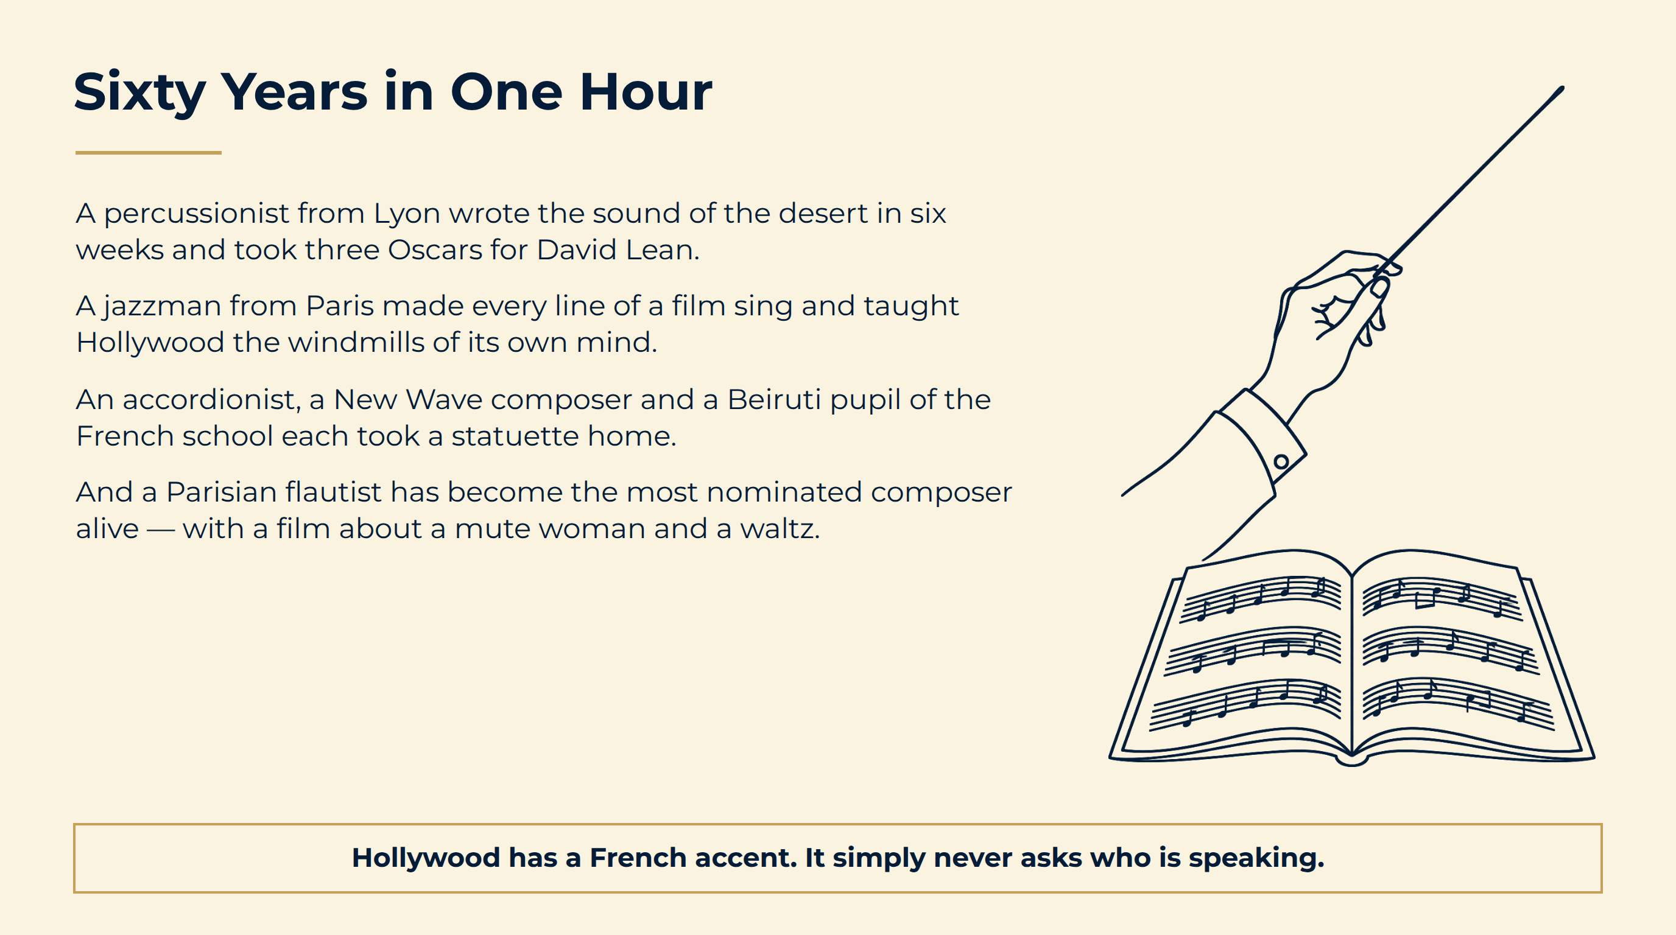
Notes:
Sixty Years in One Hour
Hollywood has a French accent. It simply never asks who is speaking.

Slide 19
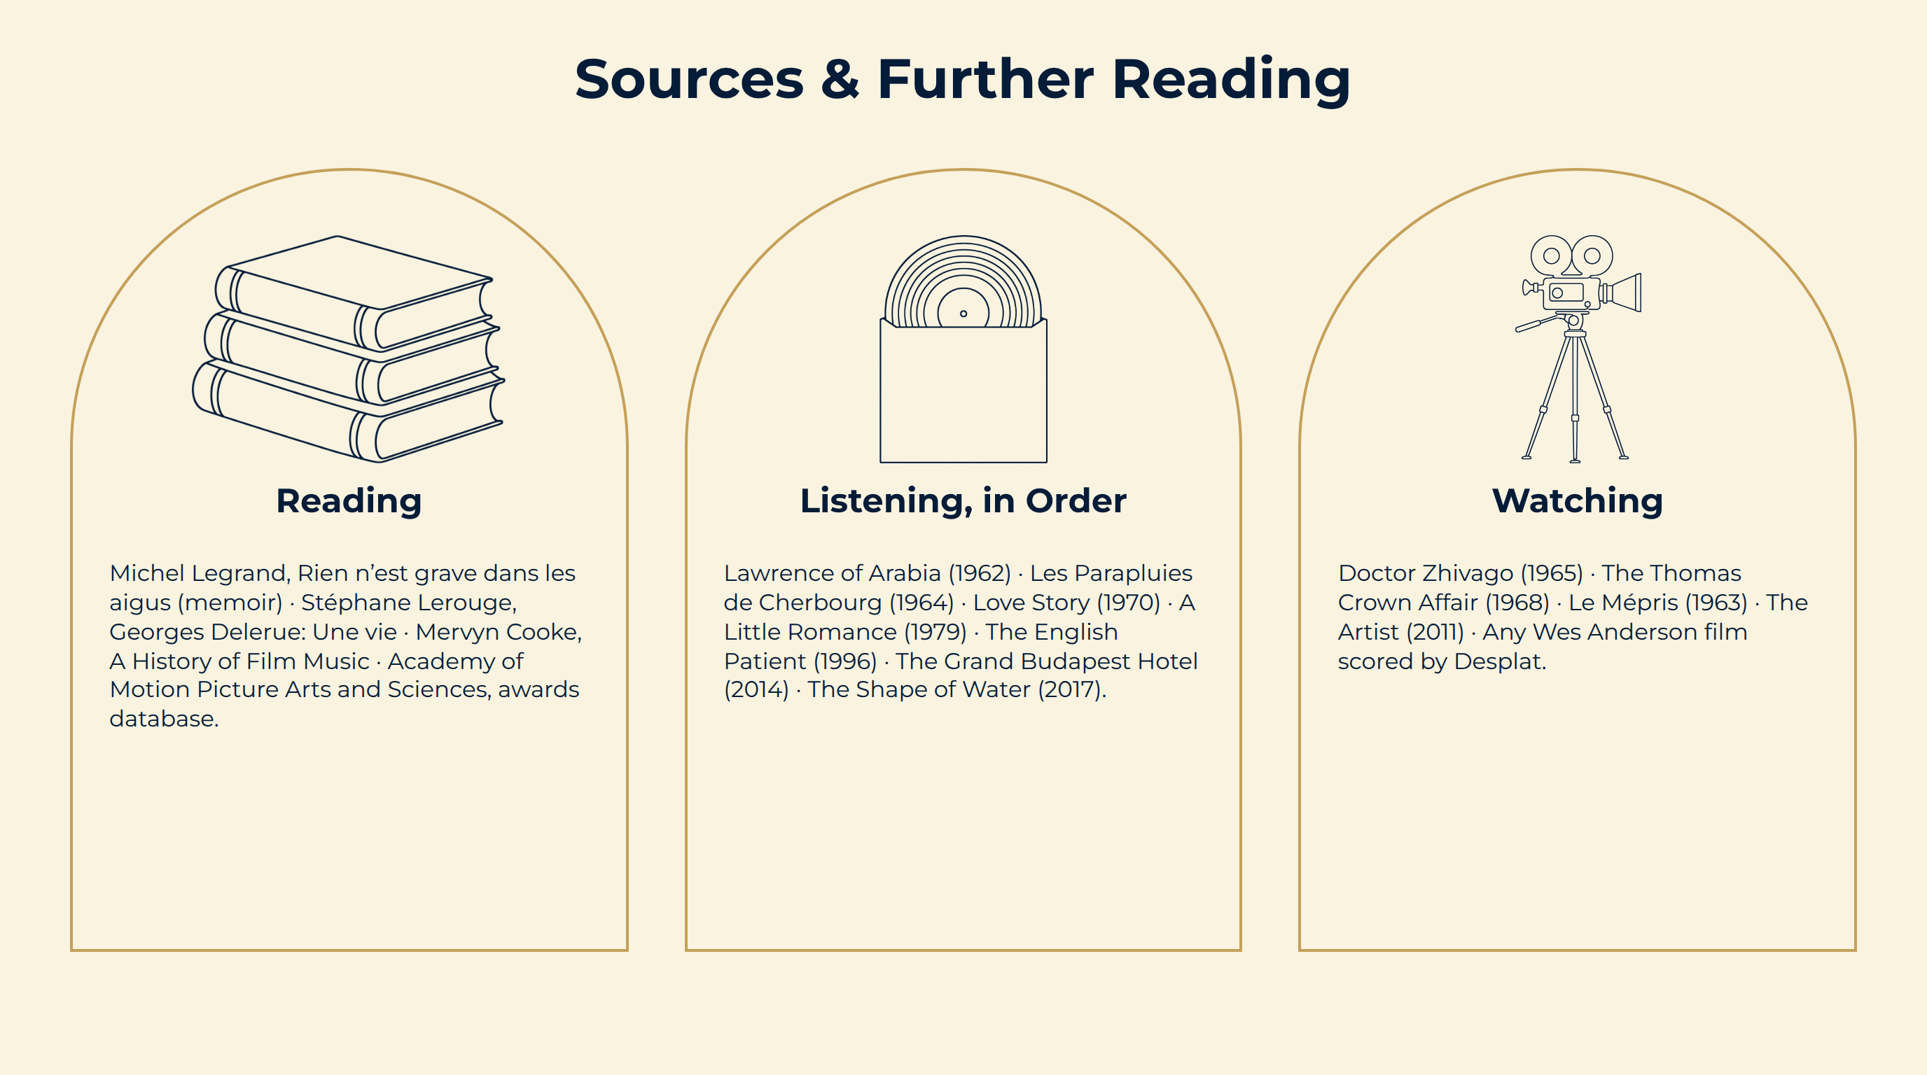
Notes:
Sources & Further Reading

