Slide 1
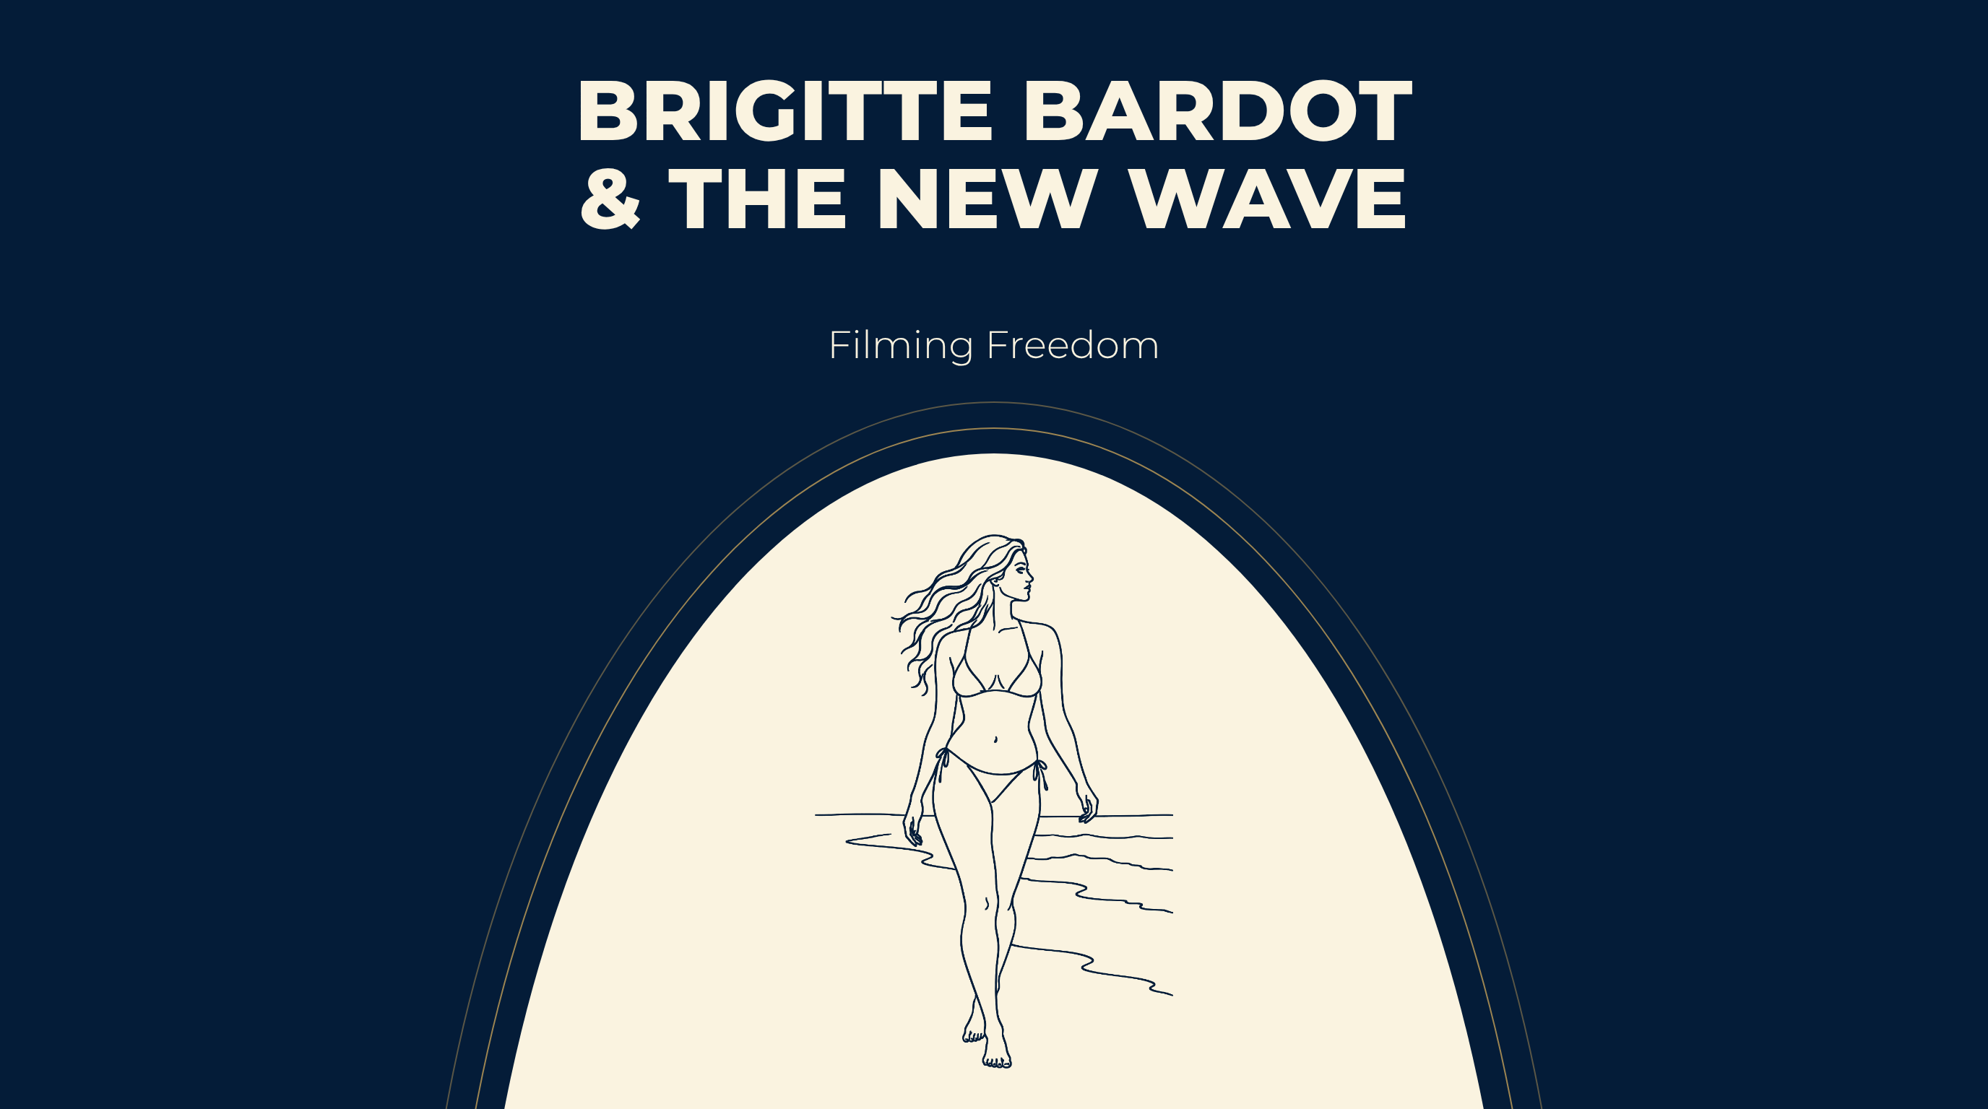
Notes:
BRIGITTE BARDOT
& THE NEW WAVE
Filming Freedom

Slide 2

Notes:
What Is on Your Feet
1956. A former ballet student asks Rose Repetto for a shoe as soft as a slipper, strong enough for the street.
Repetto calls the model Cendrillon — Cinderella. It has since sold in the millions.
The ballet flat was invented for one woman
Because she could not walk on the cobblestones of a fishing village called Saint-Tropez.
Two revolutions, three years apart. One of the body. One of the camera. Tonight they collide.

Slide 3
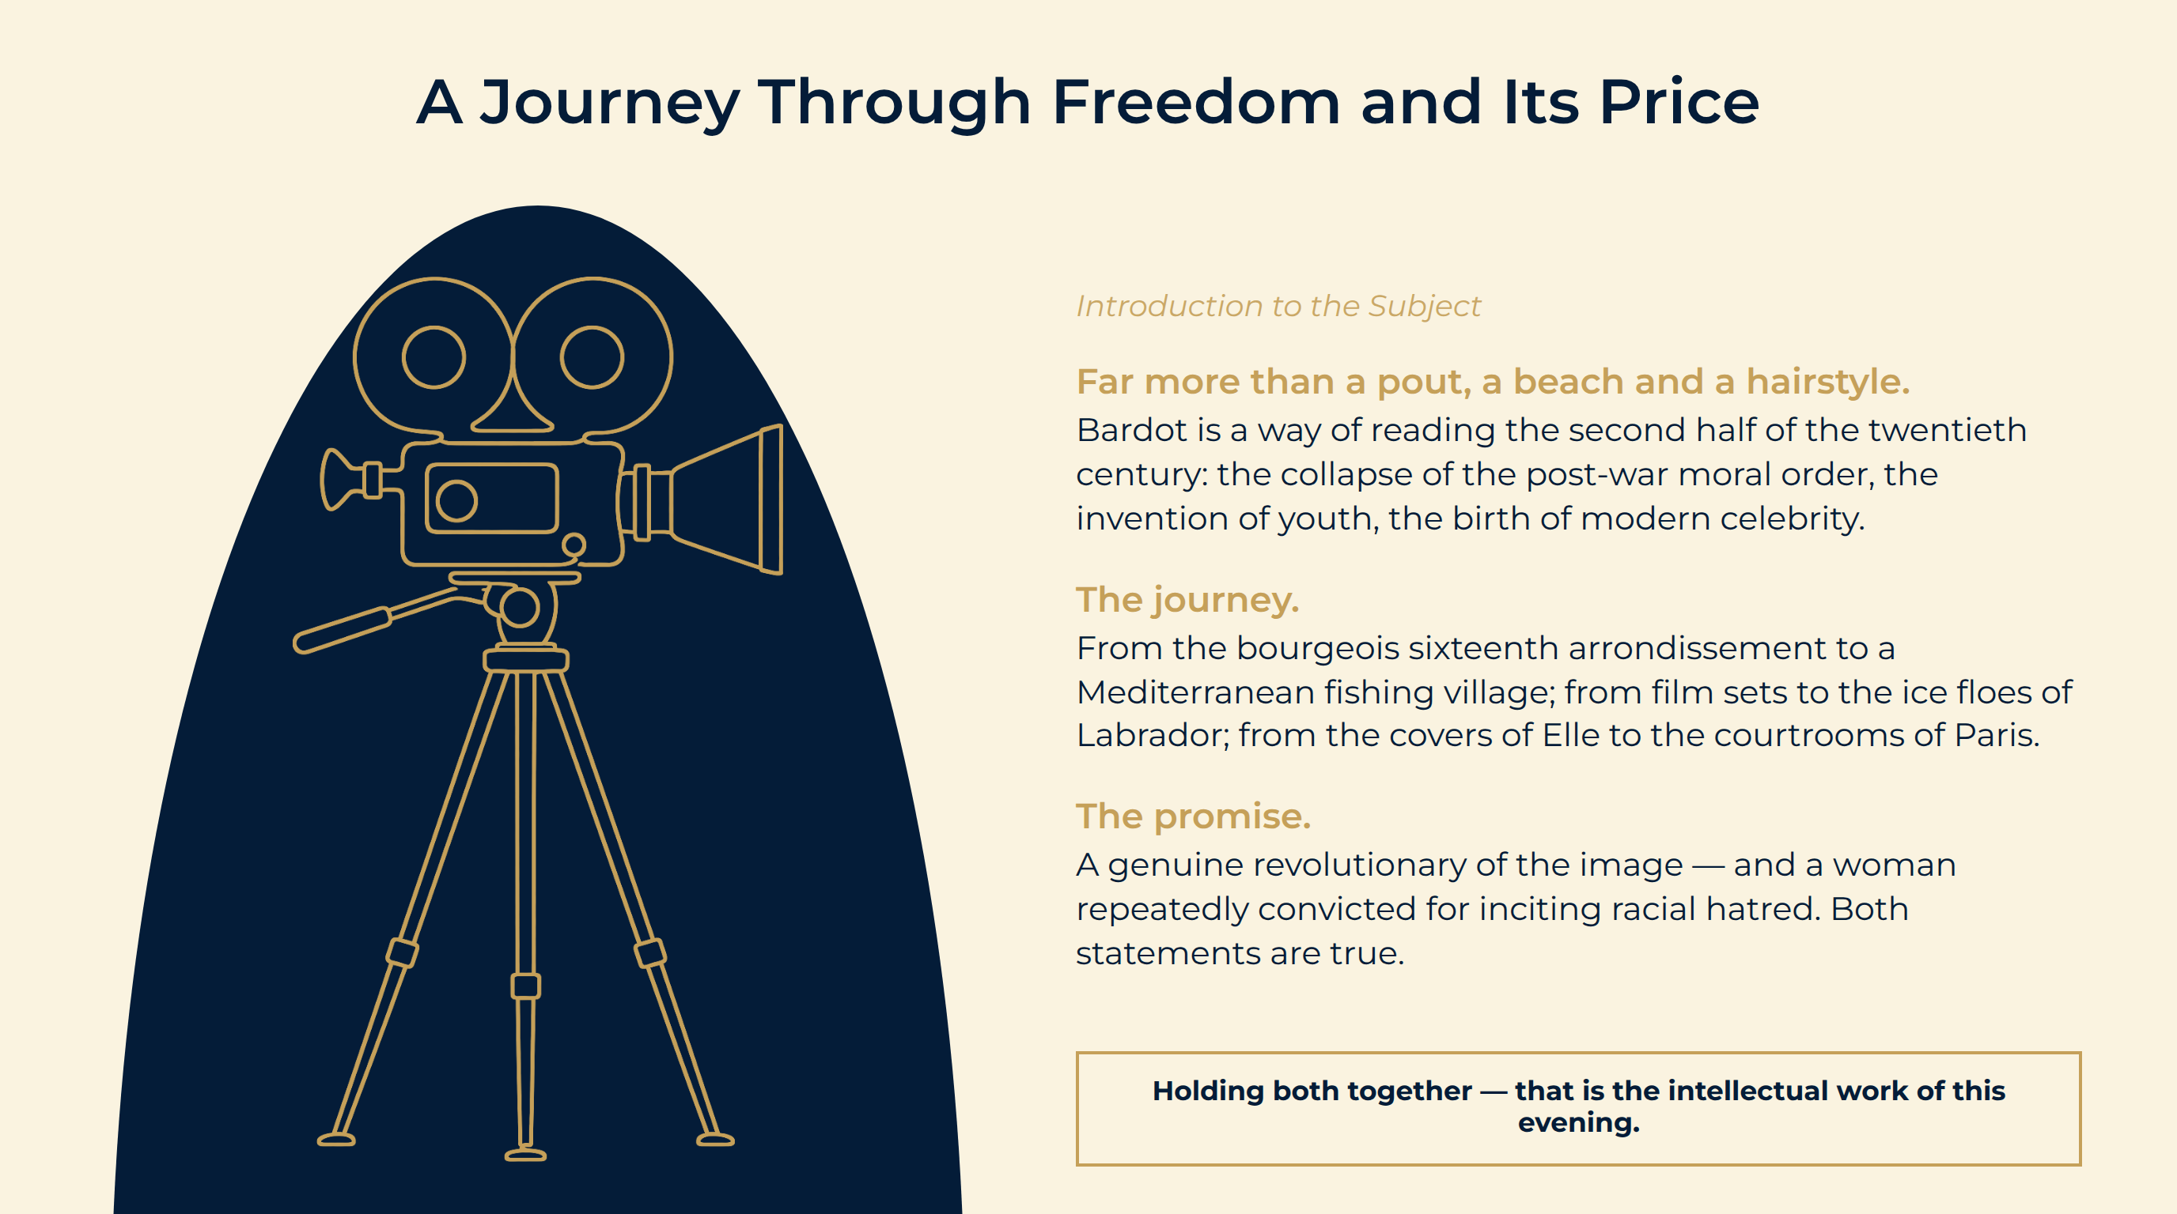
Notes:
A Journey Through Freedom and Its Price
Far more than a pout, a beach and a hairstyle. Bardot is a way of reading the second half of the twentieth century: the collapse of the post-war moral order, the invention of youth, the birth of modern celebrity.
The journey. From the bourgeois sixteenth arrondissement to a Mediterranean fishing village; from film sets to the ice floes of Labrador; from the covers of Elle to the courtrooms of Paris.
The promise. A genuine revolutionary of the image — and a woman repeatedly convicted for inciting racial hatred. Both statements are true.
Holding both together — that is the intellectual work of this evening.

Slide 4

Notes:
The Manufacture of an Icon
How “BB” Was Built — and Who Held the Tools.

Slide 5
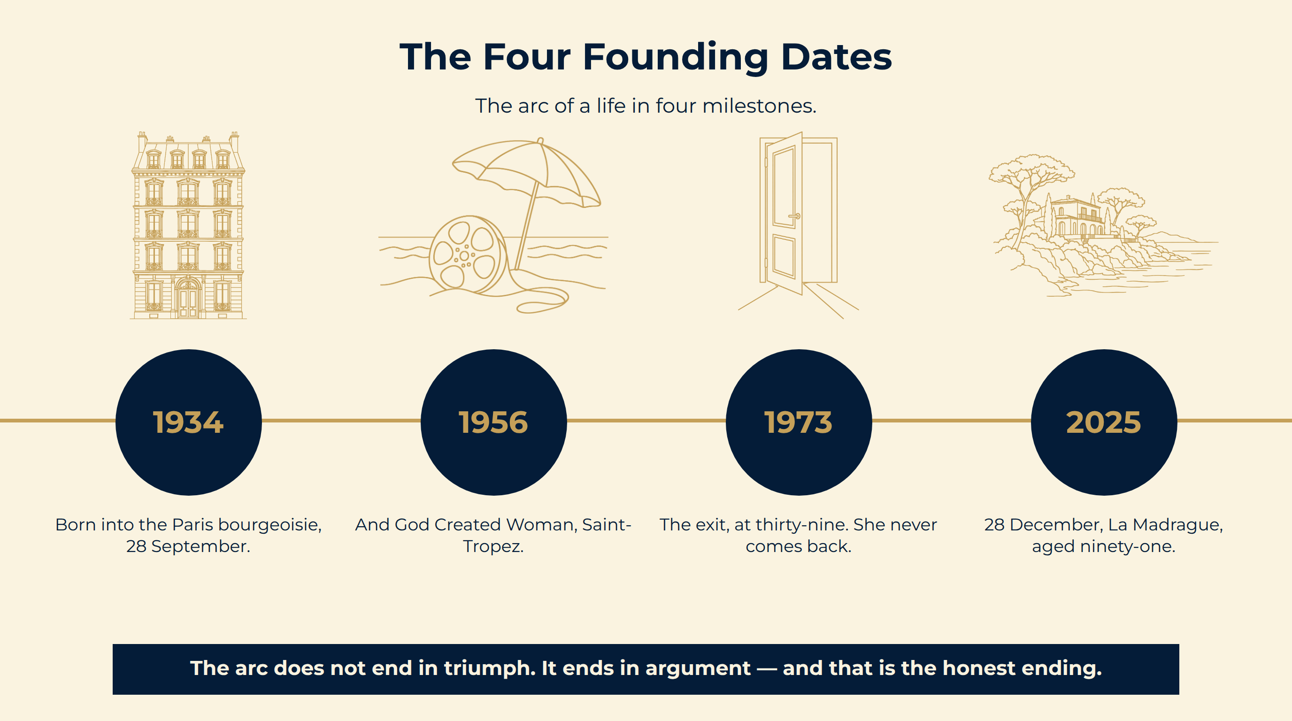
Notes:
The Four Founding Dates
The arc does not end in triumph. It ends in argument — and that is the honest ending.
The arc of a life in four milestones.

Slide 6
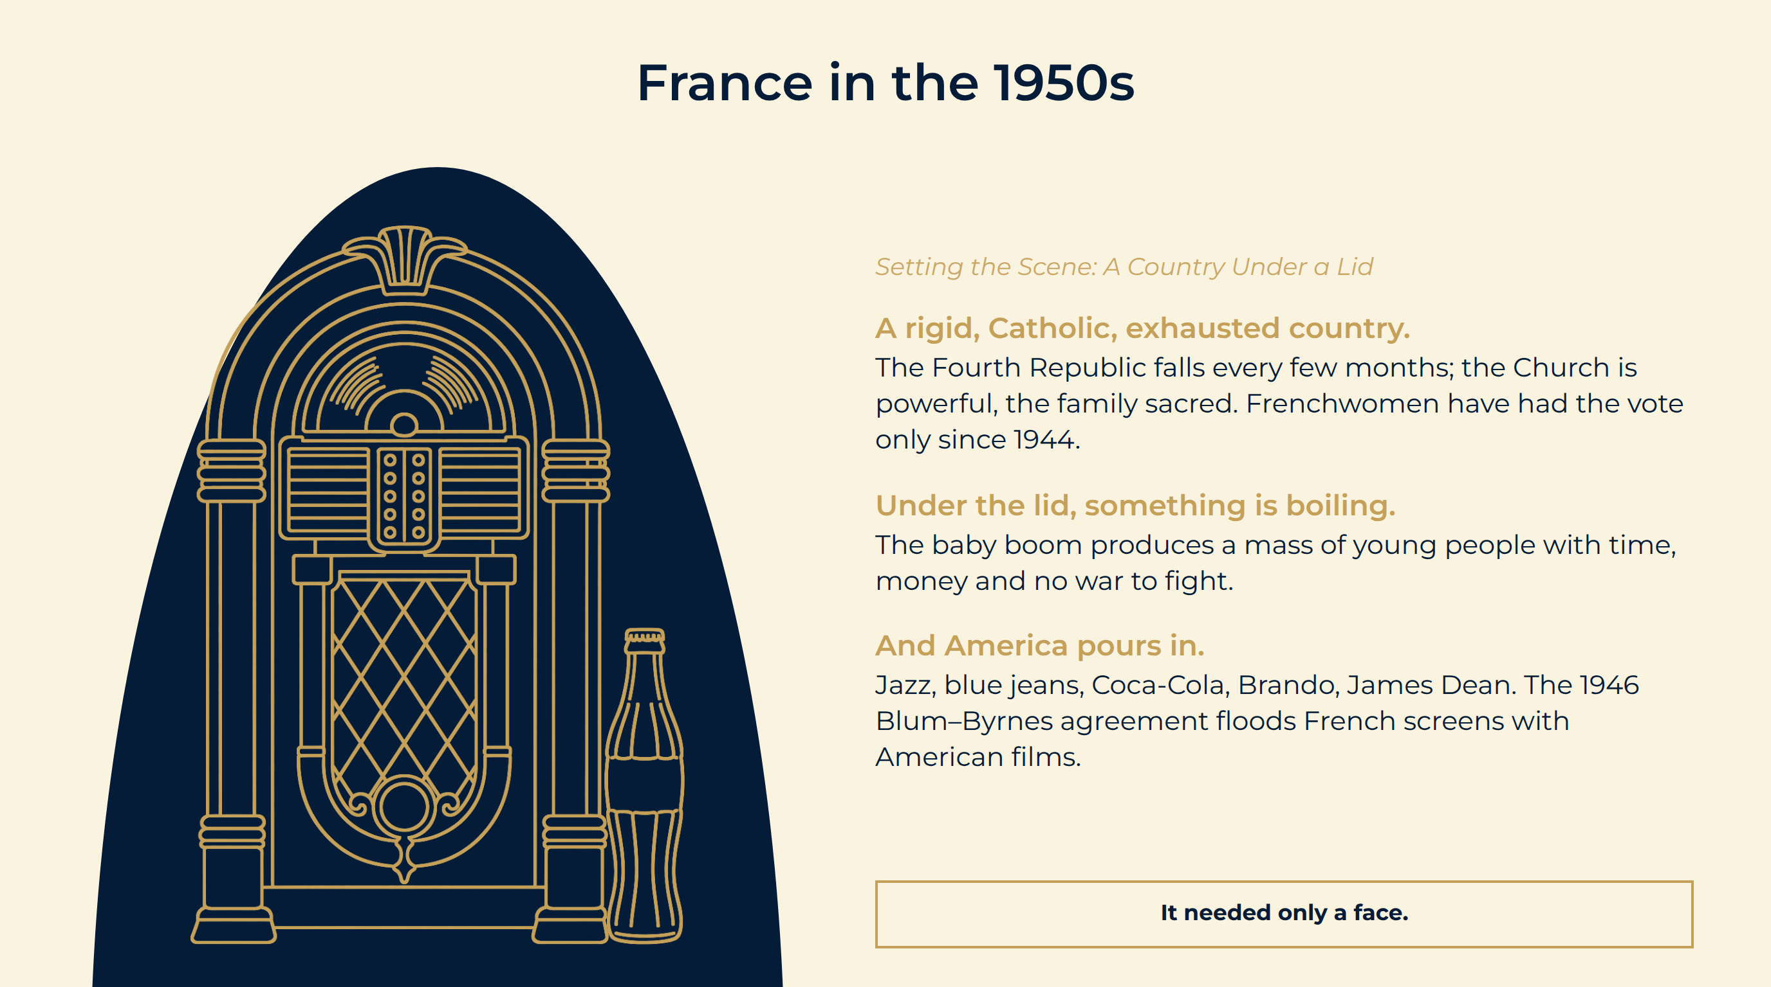
Notes:
France in the 1950s
A rigid, Catholic, exhausted country. The Fourth Republic falls every few months; the Church is powerful, the family sacred. Frenchwomen have had the vote only since 1944.
Under the lid, something is boiling. The baby boom produces a mass of young people with time, money and no war to fight.
And America pours in. Jazz, blue jeans, Coca-Cola, Brando, James Dean. The 1946 Blum–Byrnes agreement floods French screens with American films.
It needed only a face.

Slide 7
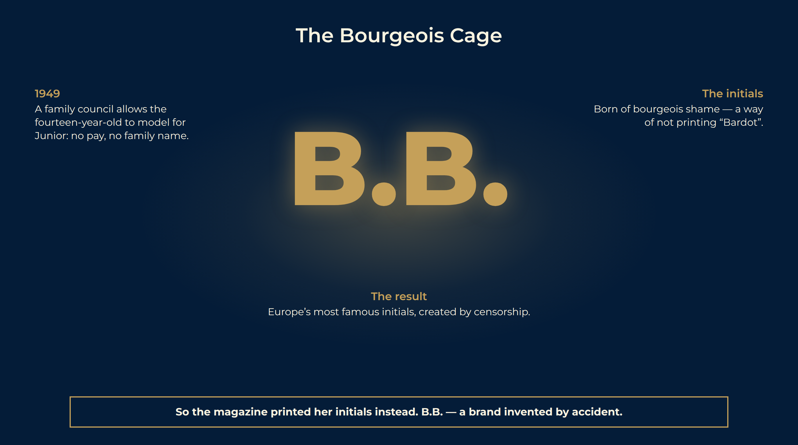
Notes:
The Bourgeois Cage
Rue de la Pompe. A father who ran factories, a mother who had dreamed of dancing — and redirected that dream, with some force, onto her daughter.
Six years of training. The Paris Conservatoire dance classes at thirteen. The carriage, the turned-out feet, the physical ease on screen: not natural.
Early 1949: a family council. May a fourteen-year-old be photographed? Yes — on two conditions: she must not be paid, and the family name must not appear.
1949 A family council allows the fourteen-year-old to model for Junior: no pay, no family name.
The initials Born of bourgeois shame — a way of not printing “Bardot”.
The result Europe’s most famous initials, created by censorship.
So the magazine printed her initials instead. B.B. — a brand invented by accident.

Slide 8
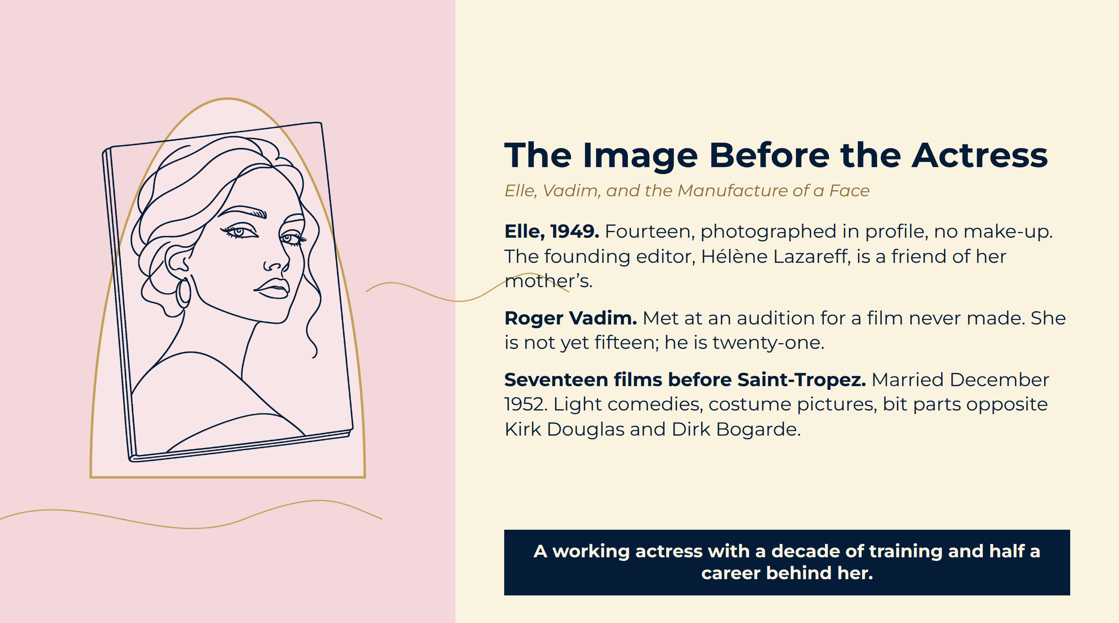
Notes:
The Image Before the Actress
Elle, 1949. Fourteen, photographed in profile, no make-up. The founding editor, Hélène Lazareff, is a friend of her mother’s.
Roger Vadim. Met at an audition for a film never made. She is not yet fifteen; he is twenty-one.
Seventeen films before Saint-Tropez. Married December 1952. Light comedies, costume pictures, bit parts opposite Kirk Douglas and Dirk Bogarde.
A working actress with a decade of training and half a career behind her.

Slide 9
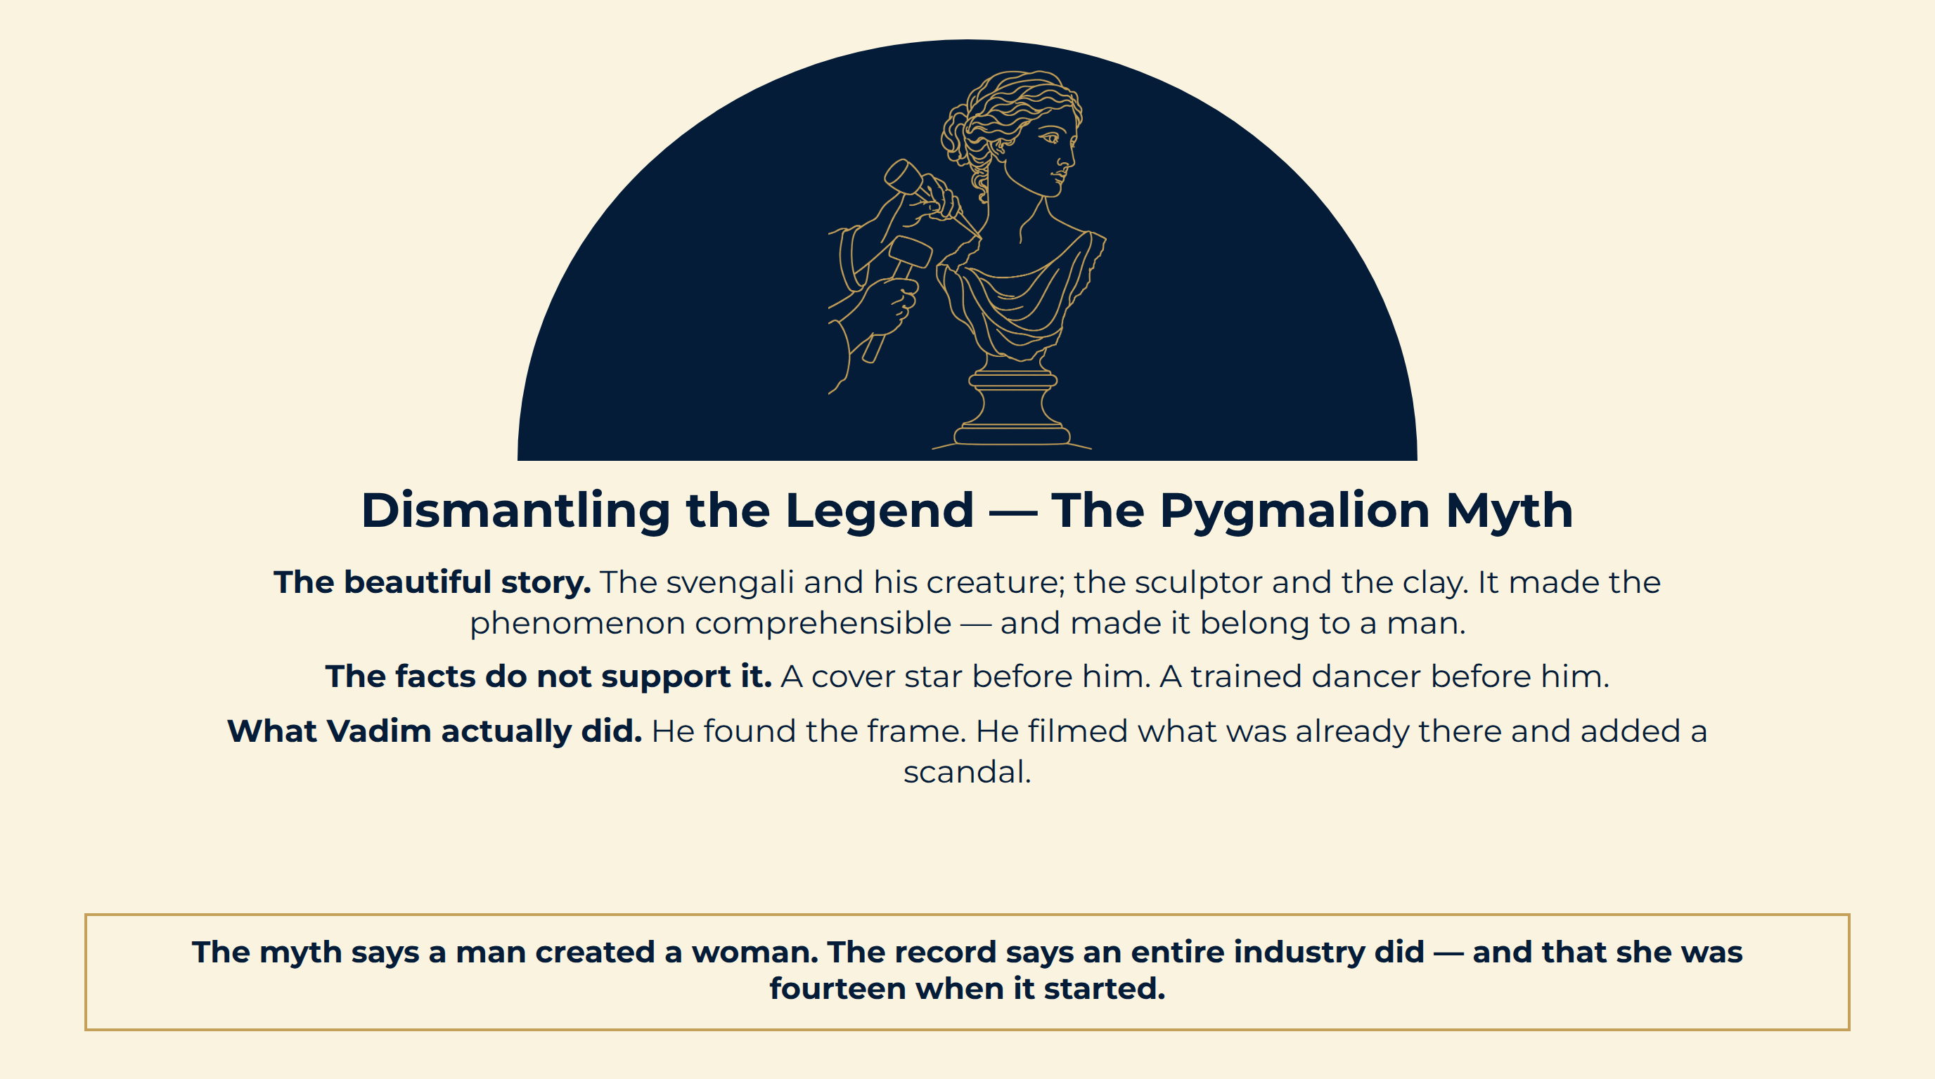
Notes:
Dismantling the Legend — The Pygmalion Myth
The beautiful story. The svengali and his creature; the sculptor and the clay. It made the phenomenon comprehensible — and made it belong to a man.
The facts do not support it. A cover star before him. A trained dancer before him.
What Vadim actually did. He found the frame. He filmed what was already there and added a scandal.
The myth says a man created a woman. The record says an entire industry did — and that she was fourteen when it started.

Slide 10
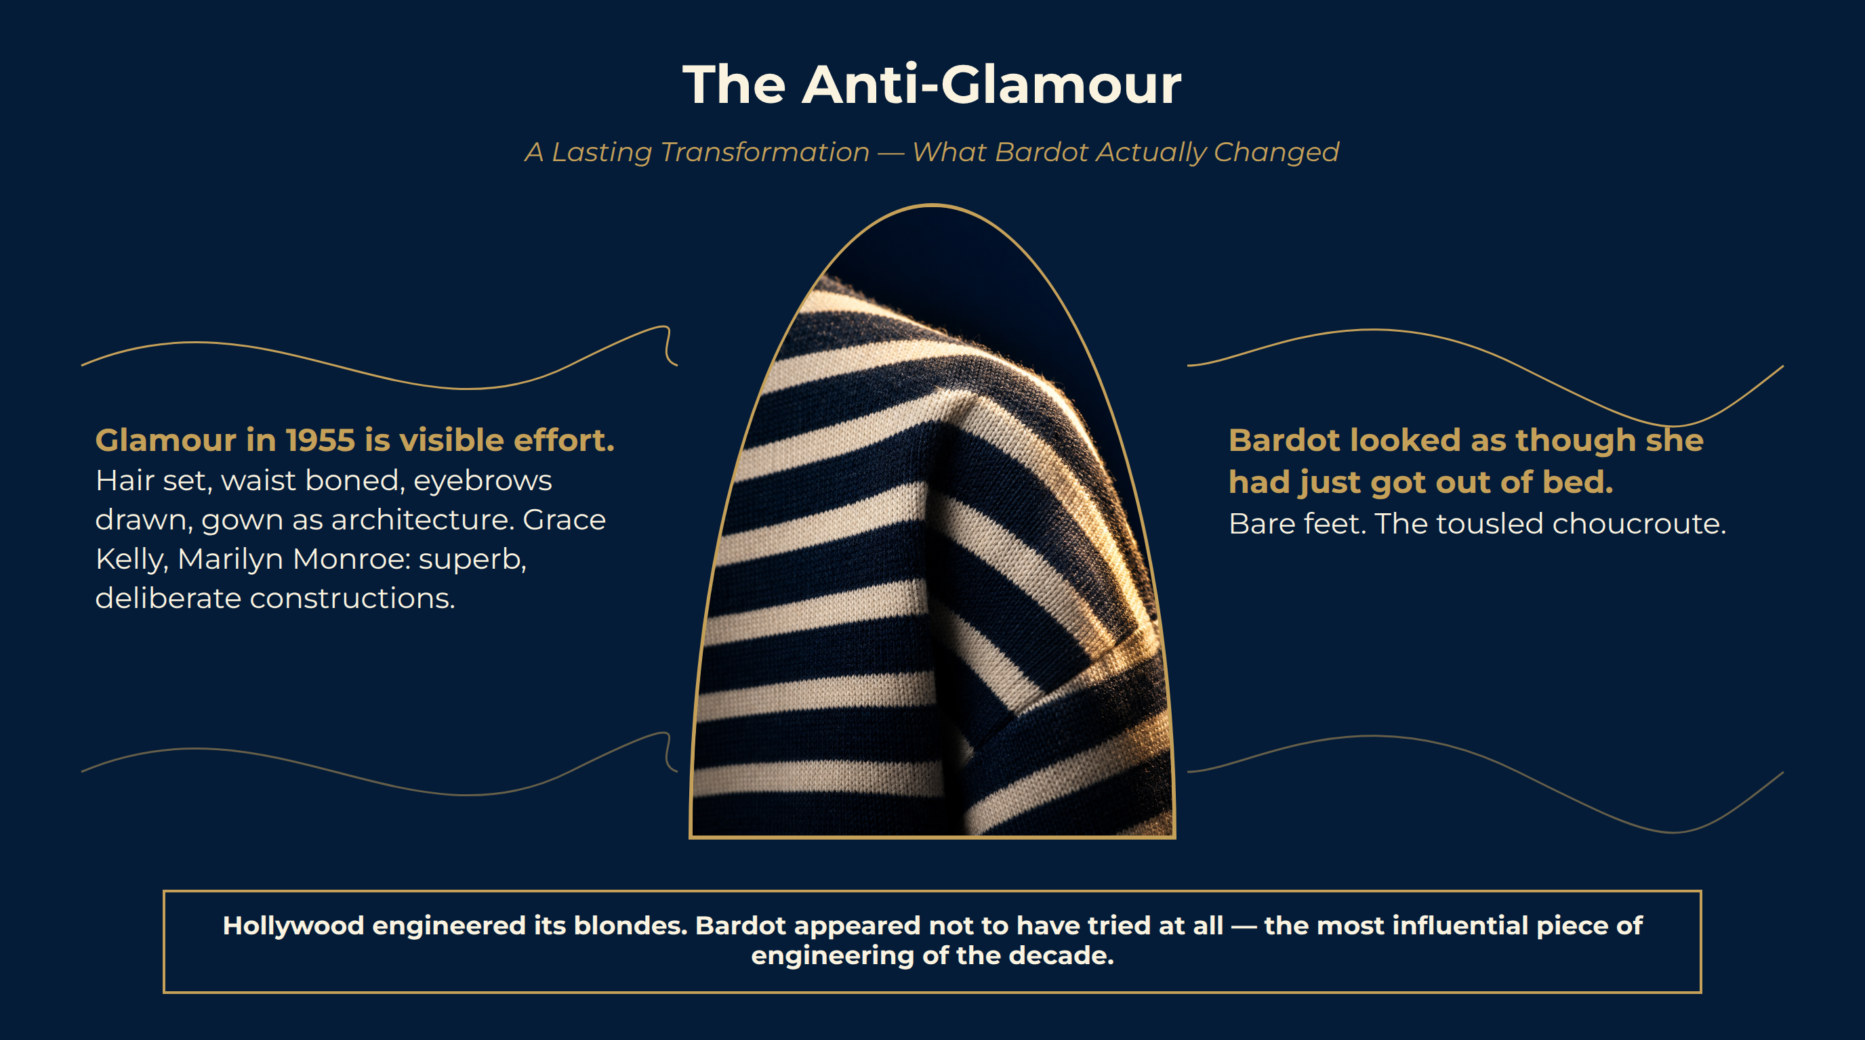
Notes:
The Anti-Glamour
Glamour in 1955 is visible effort. Hair set, waist boned, eyebrows drawn, gown as architecture. Grace Kelly, Marilyn Monroe: superb, deliberate constructions.
Bardot looked as though she had just got out of bed. Bare feet. The tousled choucroute.
Glamour-as-effort replaced by glamour-as-ease. Chanel took the male wardrobe and gave it to women. Bardot took the working wardrobe and made it the uniform of freedom.
Hollywood engineered its blondes. Bardot appeared not to have tried at all — the most influential piece of engineering of the decade.

Slide 11
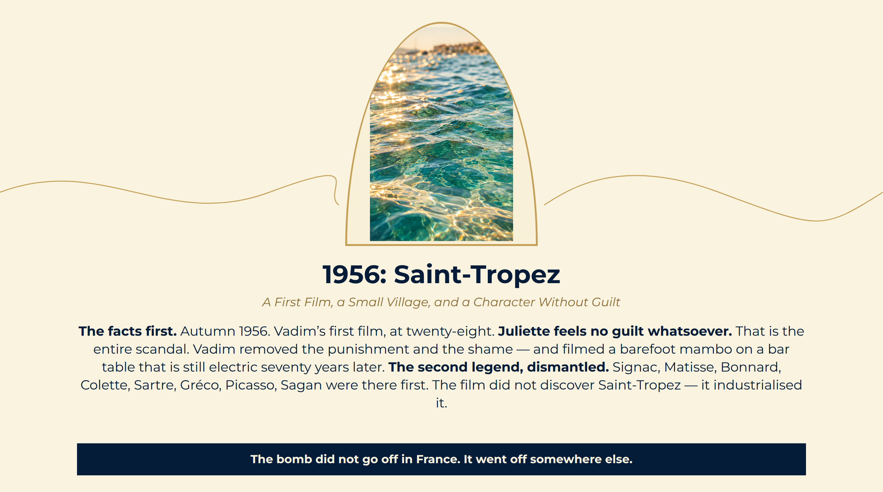
Notes:
1956: Saint-Tropez
The facts first. Autumn 1956. Vadim’s first film, at twenty-eight.
Juliette feels no guilt whatsoever. That is the entire scandal. Vadim removed the punishment and the shame — and filmed a barefoot mambo on a bar table that is still electric seventy years later.
The second legend, dismantled. Signac, Matisse, Bonnard, Colette, Sartre, Gréco, Picasso, Sagan were there first. The film did not discover Saint-Tropez — it industrialised it.
The bomb did not go off in France. It went off somewhere else.

Slide 12
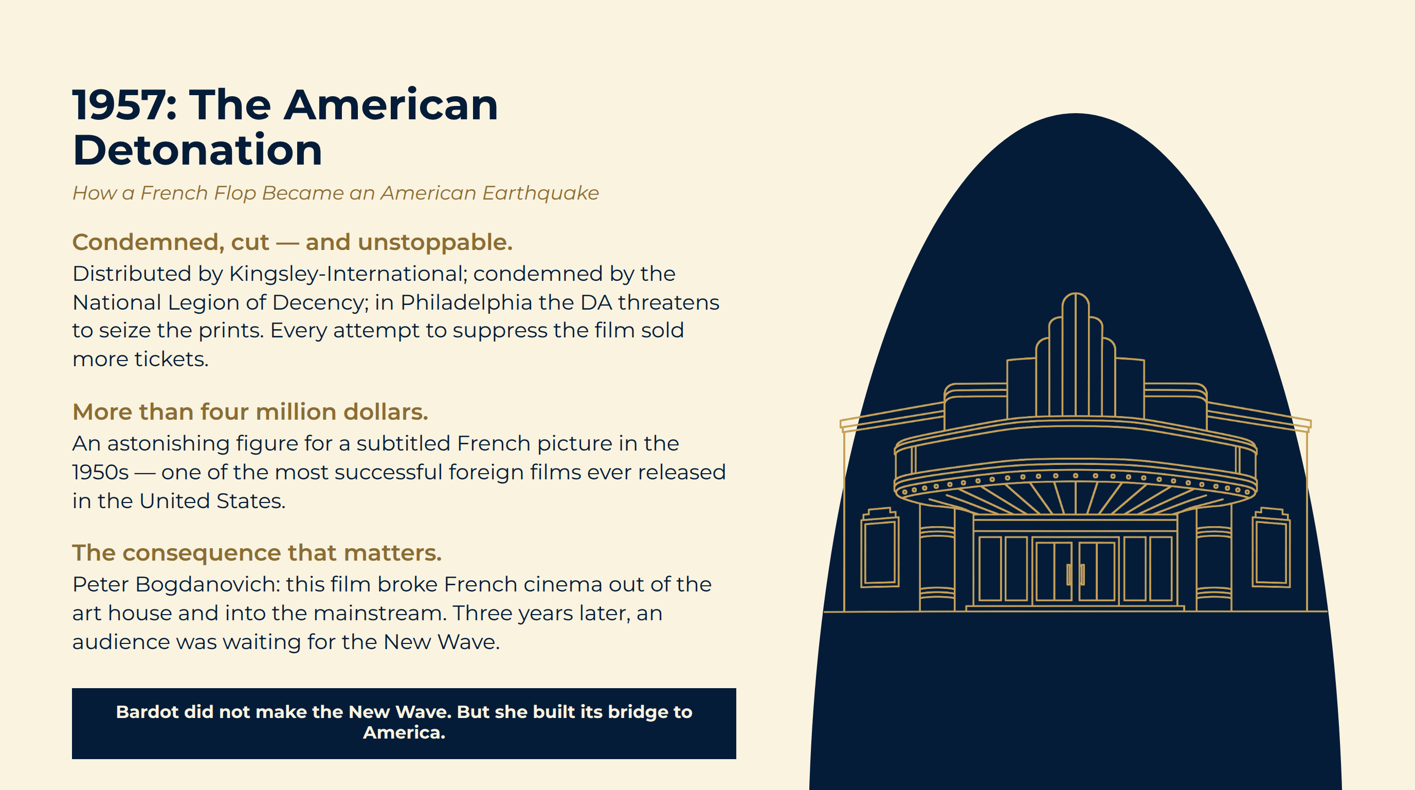
Notes:
1957: The American Detonation
Condemned, cut — and unstoppable. Distributed by Kingsley-International; condemned by the National Legion of Decency; in Philadelphia the DA threatens to seize the prints. Every attempt to suppress the film sold more tickets.
More than four million dollars. An astonishing figure for a subtitled French picture in the 1950s — one of the most successful foreign films ever released in the United States.
The consequence that matters. Peter Bogdanovich: this film broke French cinema out of the art house and into the mainstream. Three years later, an audience was waiting for the New Wave.
Bardot did not make the New Wave. But she built its bridge to America.

Slide 13

Notes:
The New Wave
A Revolution in the Grammar of Cinema — and the Voice That Sang Beside It.

Slide 14
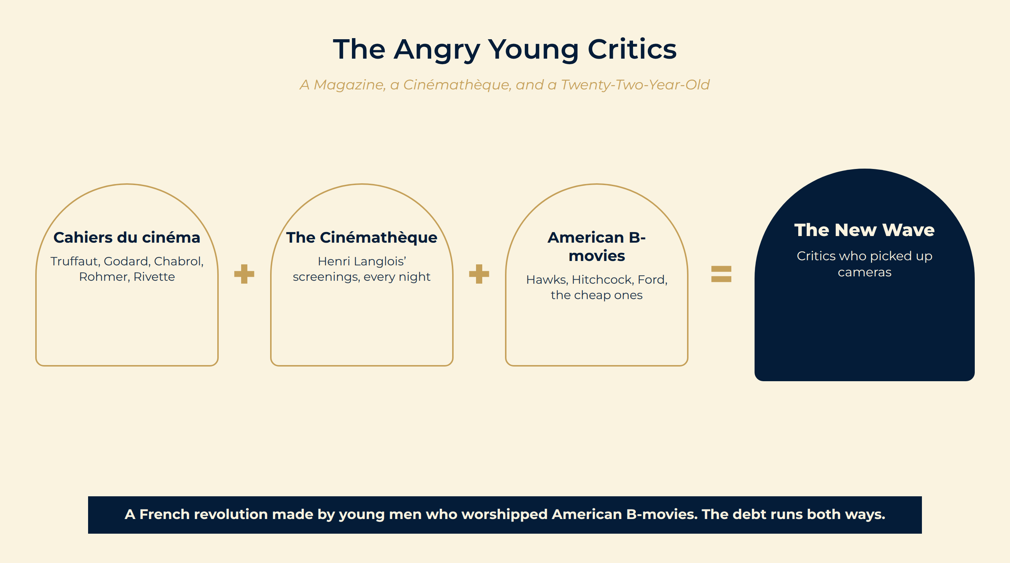
Notes:
The Angry Young Critics
All day, every day, in the dark. Truffaut, Godard, Chabrol, Rohmer, Rivette — at Henri Langlois’s Cinémathèque, writing for a yellow-covered magazine called Cahiers du cinéma. No money, no equipment, no permission.
The auteur theory. French cinema has become a beautifully upholstered corpse. A film should belong to one person: the director is the author.
The paradox. What did these young Frenchmen love? Hollywood — the cheap ones.
Cahiers du cinéma Truffaut, Godard, Chabrol, Rohmer, Rivette
The Cinémathèque Henri Langlois’ screenings, every night
American B-movies Hawks, Hitchcock, Ford, the cheap ones
The New Wave Critics who picked up cameras
A French revolution made by young men who worshipped American B-movies. The debt runs both ways.

Slide 15
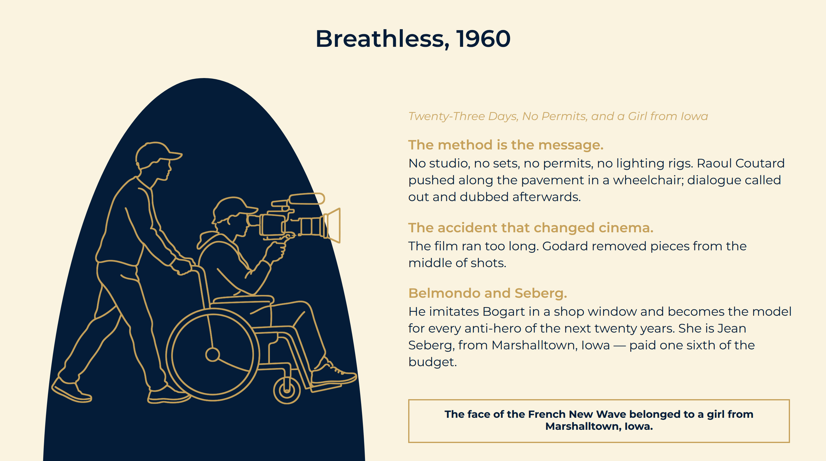
Notes:
Breathless, 1960
The method is the message. No studio, no sets, no permits, no lighting rigs. Raoul Coutard pushed along the pavement in a wheelchair; dialogue called out and dubbed afterwards.
The accident that changed cinema. The film ran too long. Godard removed pieces from the middle of shots.
Belmondo and Seberg. He imitates Bogart in a shop window and becomes the model for every anti-hero of the next twenty years. She is Jean Seberg, from Marshalltown, Iowa — paid one sixth of the budget.
The face of the French New Wave belonged to a girl from Marshalltown, Iowa.

Slide 16
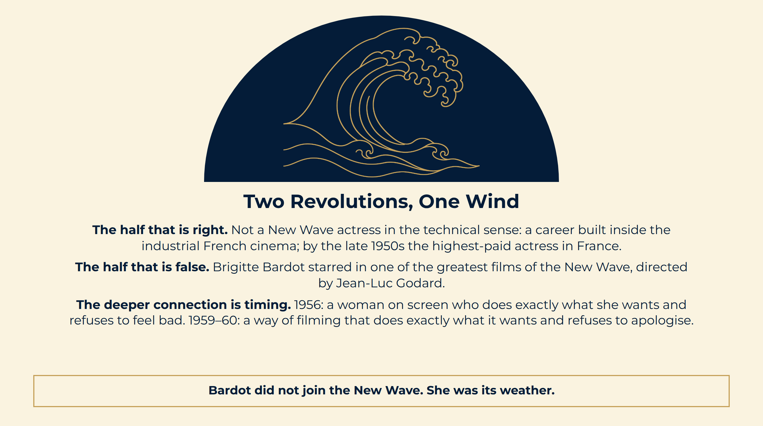
Notes:
Two Revolutions, One Wind
The half that is right. Not a New Wave actress in the technical sense: a career built inside the industrial French cinema; by the late 1950s the highest-paid actress in France.
The half that is false. Brigitte Bardot starred in one of the greatest films of the New Wave, directed by Jean-Luc Godard.
The deeper connection is timing. 1956: a woman on screen who does exactly what she wants and refuses to feel bad. 1959–60: a way of filming that does exactly what it wants and refuses to apologise.
Bardot did not join the New Wave. She was its weather.

Slide 17
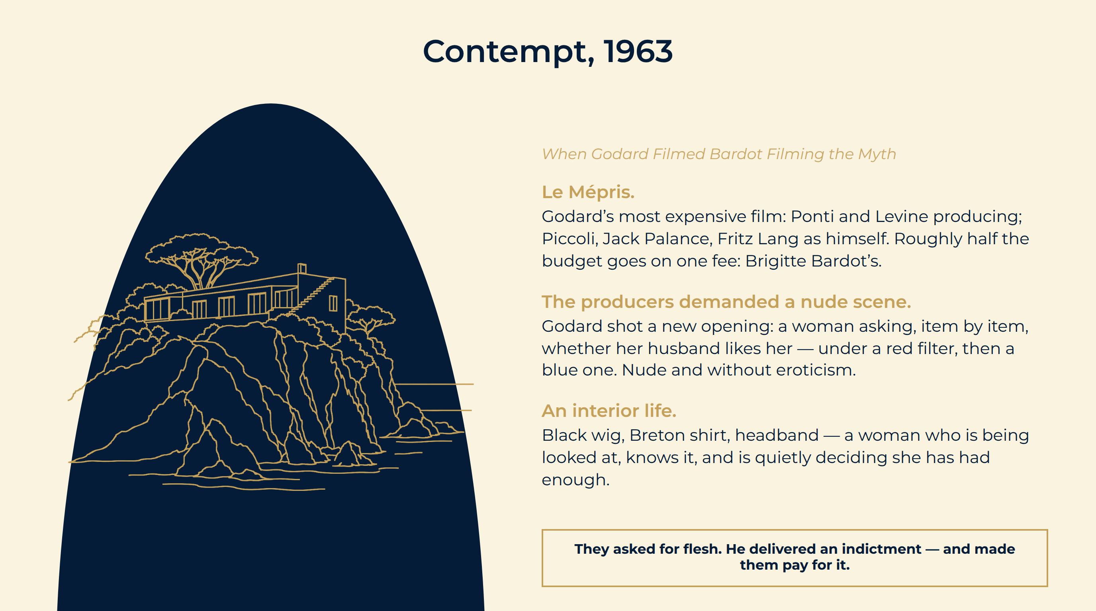
Notes:
Contempt, 1963
Le Mépris. Godard’s most expensive film: Ponti and Levine producing; Piccoli, Jack Palance, Fritz Lang as himself. Roughly half the budget goes on one fee: Brigitte Bardot’s.
The producers demanded a nude scene. Godard shot a new opening: a woman asking, item by item, whether her husband likes her — under a red filter, then a blue one. Nude and without eroticism.
An interior life. Black wig, Breton shirt, headband — a woman who is being looked at, knows it, and is quietly deciding she has had enough.
They asked for flesh. He delivered an indictment — and made them pay for it.

Slide 18
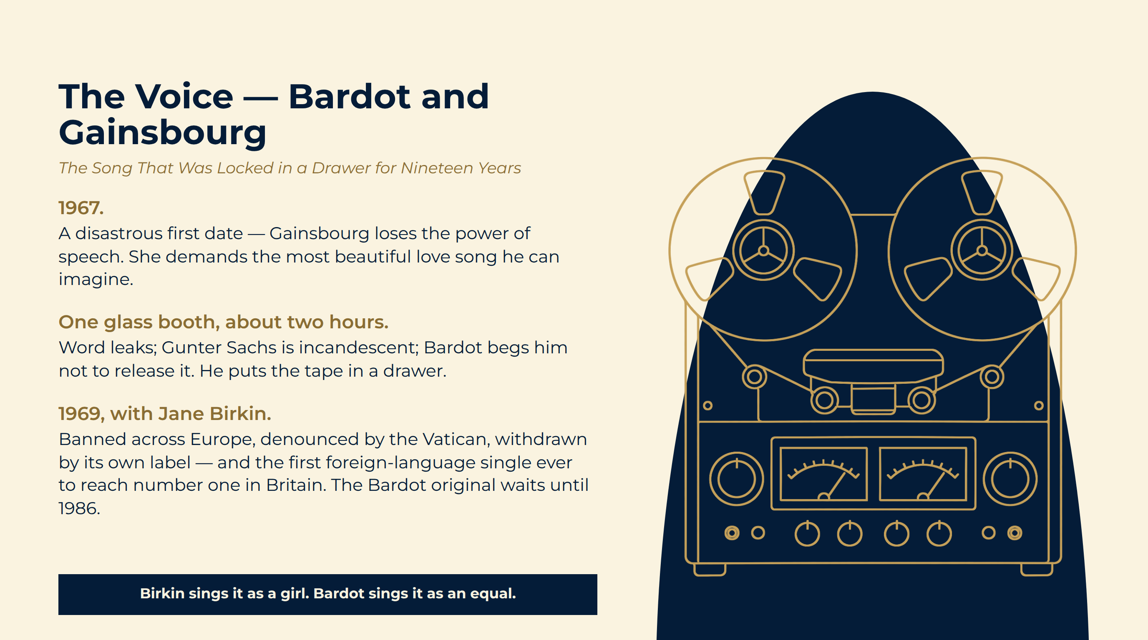
Notes:
The Voice — Bardot and Gainsbourg
1967. A disastrous first date — Gainsbourg loses the power of speech. She demands the most beautiful love song he can imagine.
One glass booth, about two hours. Word leaks; Gunter Sachs is incandescent; Bardot begs him not to release it. He puts the tape in a drawer.
1969, with Jane Birkin. Banned across Europe, denounced by the Vatican, withdrawn by its own label — and the first foreign-language single ever to reach number one in Britain. The Bardot original waits until 1986.
Birkin sings it as a girl. Bardot sings it as an equal.

Slide 19
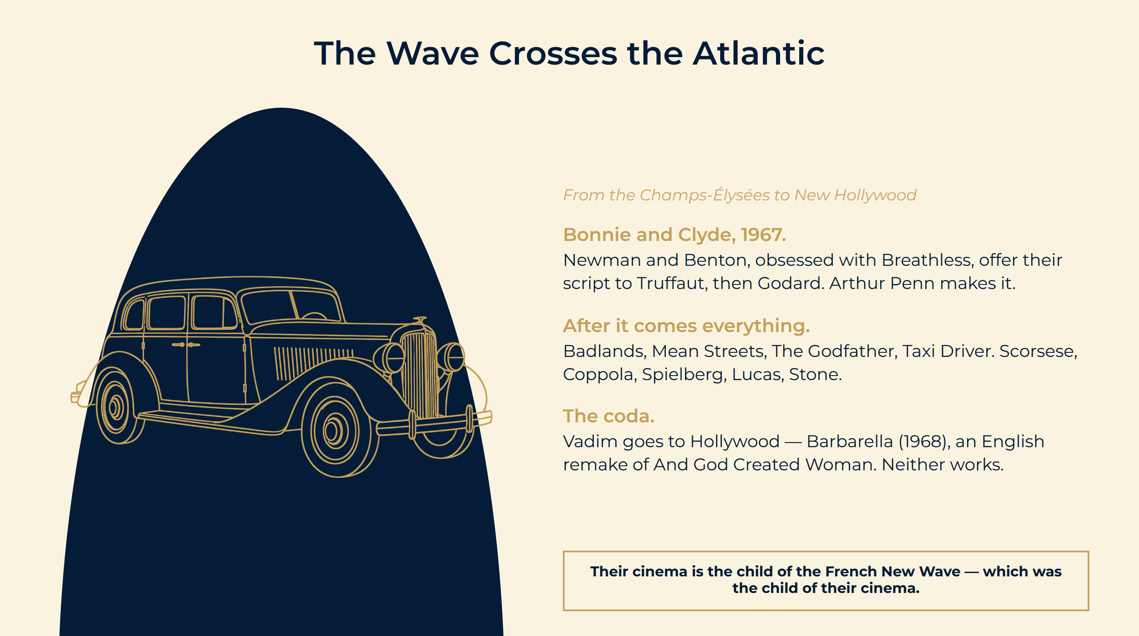
Notes:
The Wave Crosses the Atlantic
Bonnie and Clyde, 1967. Newman and Benton, obsessed with Breathless, offer their script to Truffaut, then Godard. Arthur Penn makes it.
After it comes everything. Badlands, Mean Streets, The Godfather, Taxi Driver. Scorsese, Coppola, Spielberg, Lucas, Stone.
The coda. Vadim goes to Hollywood — Barbarella (1968), an English remake of And God Created Woman. Neither works.
Their cinema is the child of the French New Wave — which was the child of their cinema.

Slide 20

Notes:
The Myth and the Shadow
The Price of the Image, and an Honest Reckoning.

Slide 21
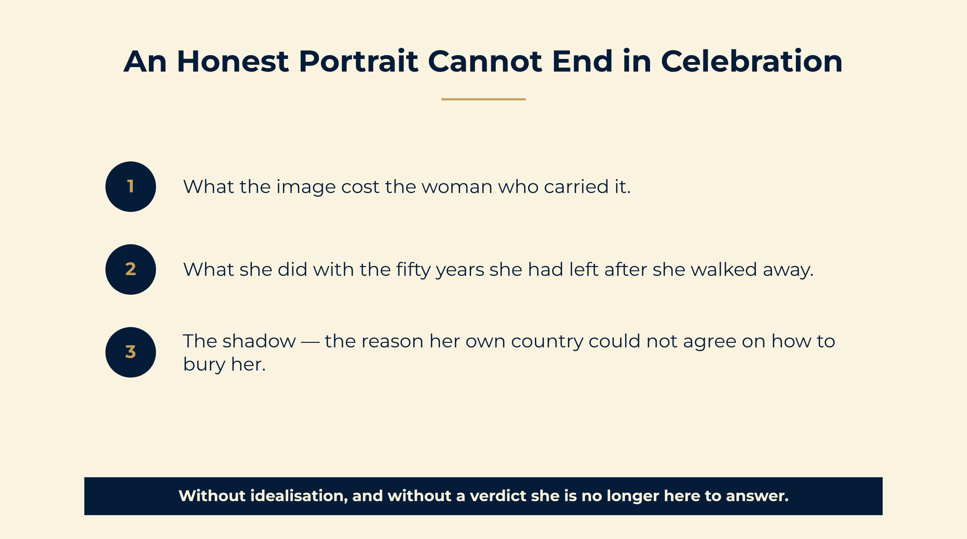
Notes:
An Honest Portrait Cannot End in Celebration
Without idealisation, and without a verdict she is no longer here to answer.

Slide 22
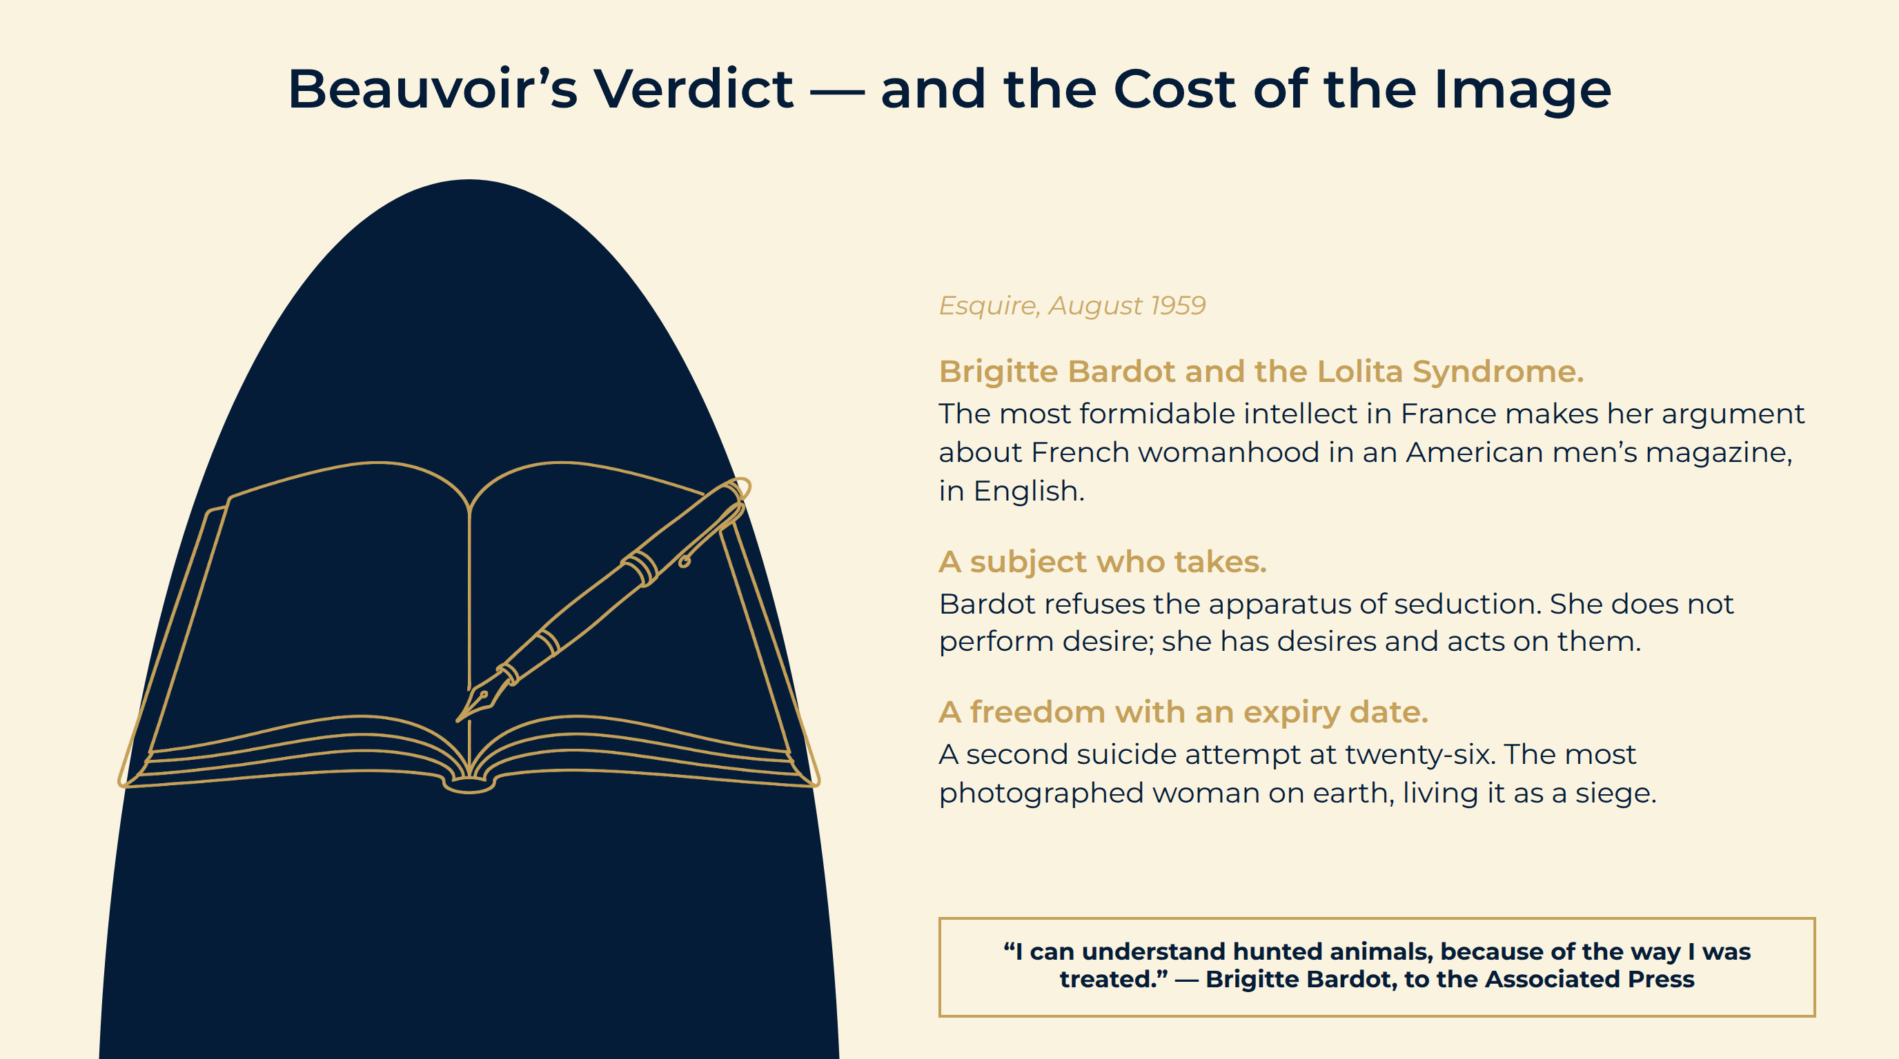
Notes:
Beauvoir’s Verdict — and the Cost of the Image
Brigitte Bardot and the Lolita Syndrome. The most formidable intellect in France makes her argument about French womanhood in an American men’s magazine, in English.
A subject who takes. Bardot refuses the apparatus of seduction. She does not perform desire; she has desires and acts on them.
A freedom with an expiry date. A second suicide attempt at twenty-six. The most photographed woman on earth, living it as a siege.
“I can understand hunted animals, because of the way I was treated.” — Brigitte Bardot, to the Associated Press
“I can understand hunted animals, because of the way I was treated.” — Brigitte Bardot, to the Associated Press

Slide 23
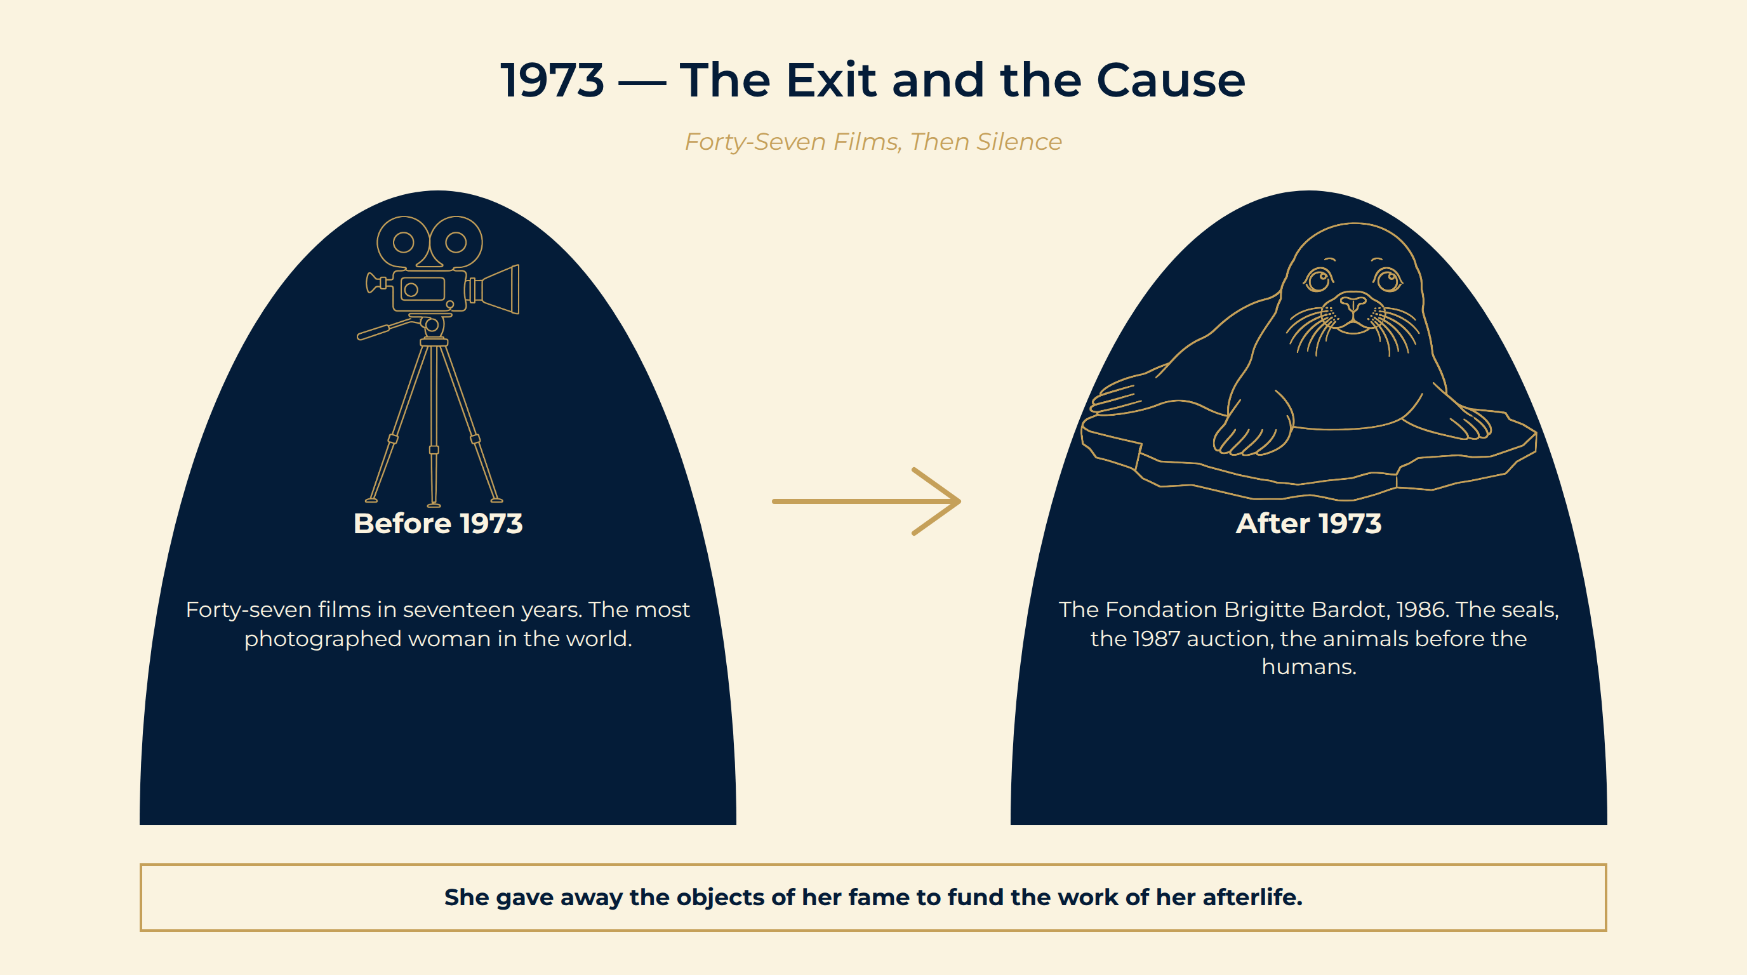
Notes:
1973 — The Exit and the Cause
She simply stops. One of the most bankable actresses alive. No retrospective, no comeback role, no memoir tour.
March 1977, the ice floes off Labrador. Photographed beside a white-coated harp seal pup — one of the most effective images in the history of political campaigning. Canada bans the whitecoat hunt in 1987.
1986: the Fondation Brigitte Bardot. She auctions her jewellery and possessions to found it. Recognised by the French state as a public-interest institution six years later.
Before 1973 Forty-seven films in seventeen years. The most photographed woman in the world.
After 1973 The Fondation Brigitte Bardot, 1986. The seals, the 1987 auction, the animals before the humans.
She gave away the objects of her fame to fund the work of her afterlife.

Slide 24
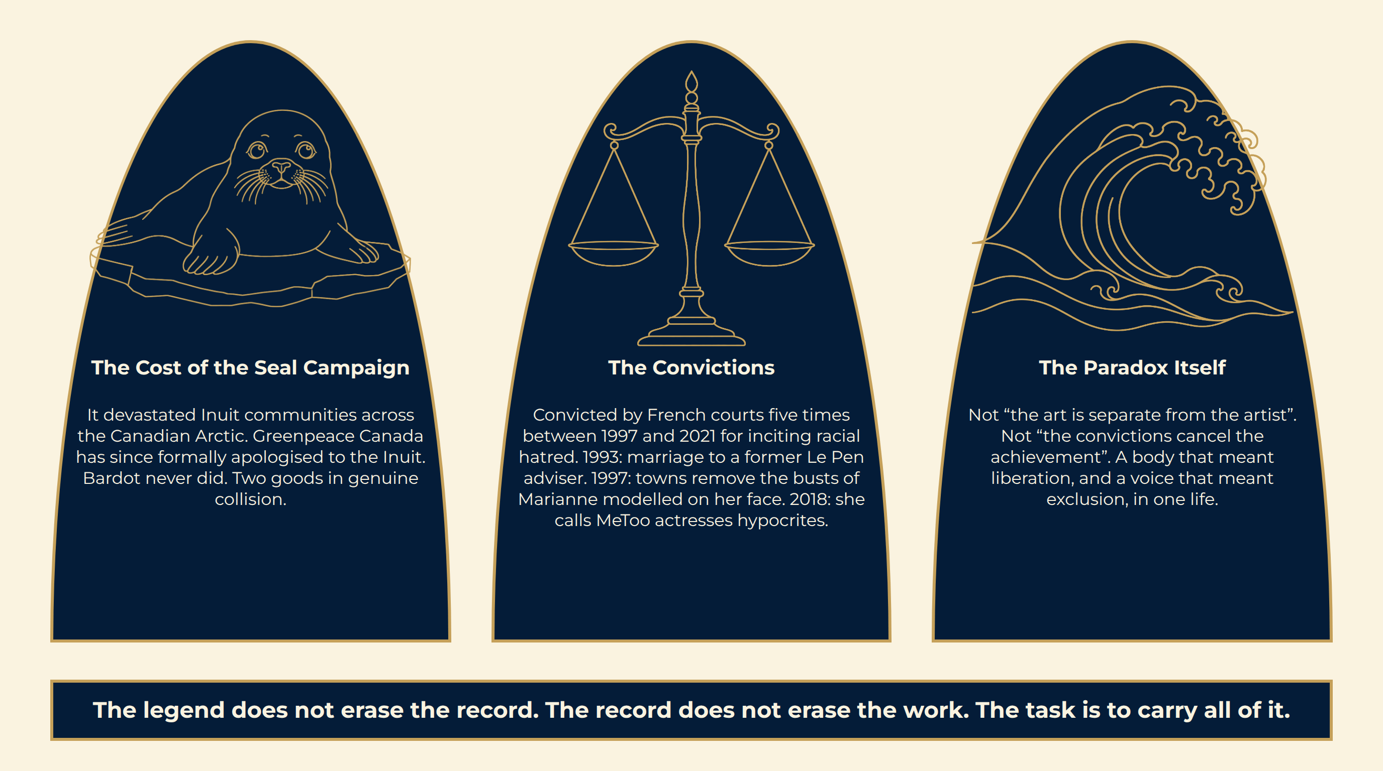
Notes:
The Shadow
The legend does not erase the record. The record does not erase the work. The task is to carry all of it.

Slide 25
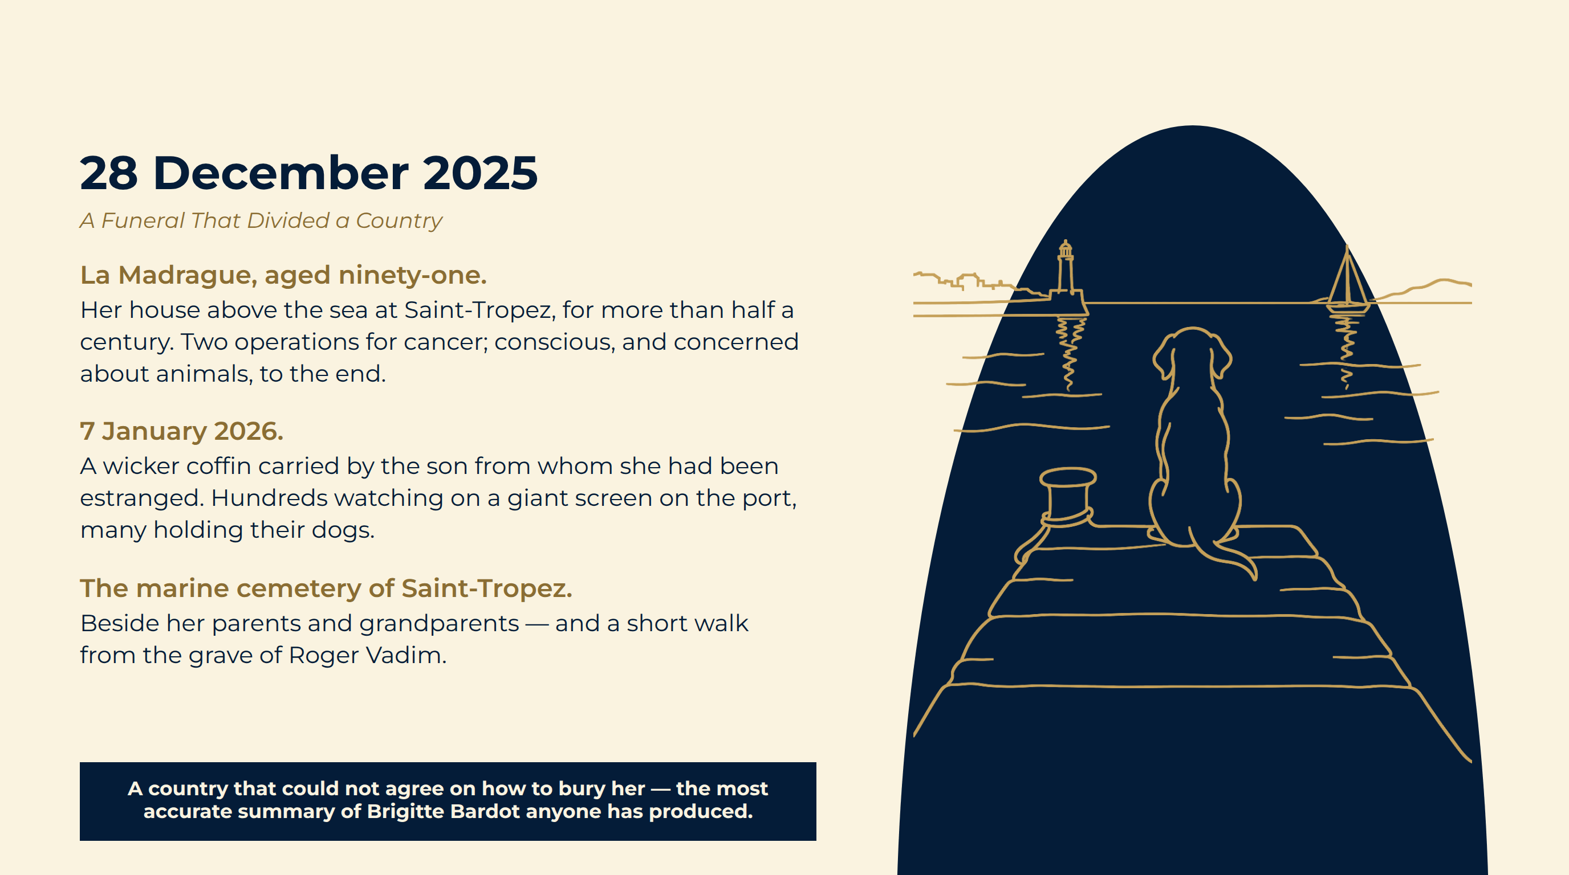
Notes:
28 December 2025
La Madrague, aged ninety-one. Her house above the sea at Saint-Tropez, for more than half a century. Two operations for cancer; conscious, and concerned about animals, to the end.
7 January 2026. A wicker coffin carried by the son from whom she had been estranged. Hundreds watching on a giant screen on the port, many holding their dogs.
The marine cemetery of Saint-Tropez. Beside her parents and grandparents — and a short walk from the grave of Roger Vadim.
A country that could not agree on how to bury her — the most accurate summary of Brigitte Bardot anyone has produced.

Slide 26
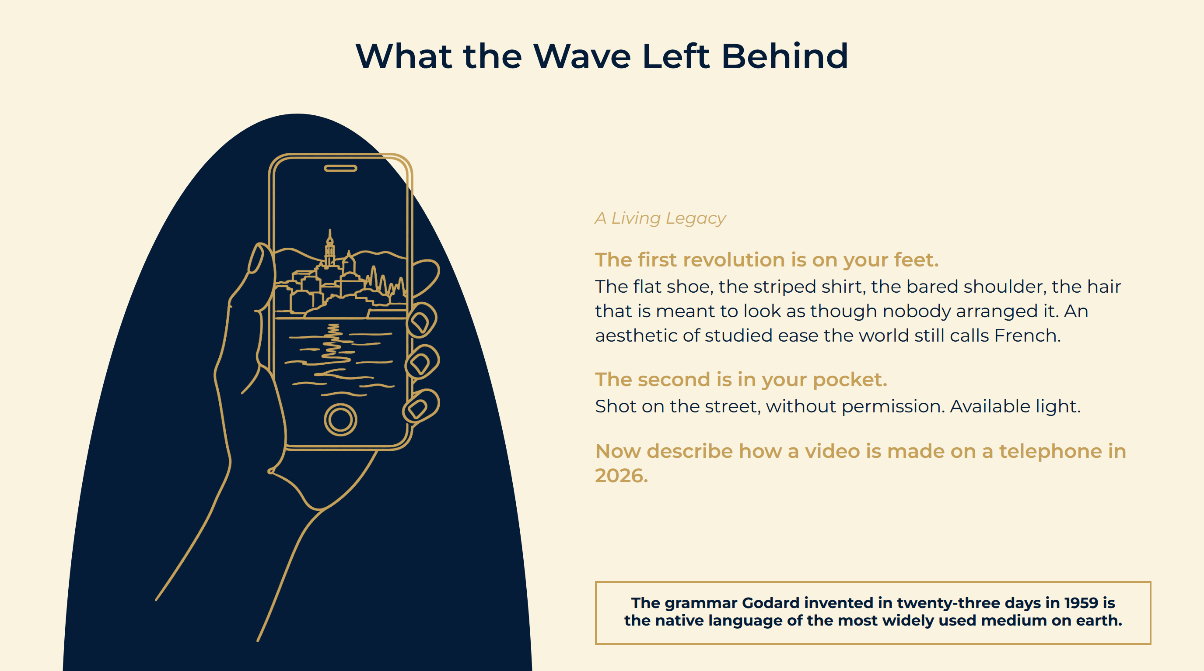
Notes:
What the Wave Left Behind
The first revolution is on your feet. The flat shoe, the striped shirt, the bared shoulder, the hair that is meant to look as though nobody arranged it. An aesthetic of studied ease the world still calls French.
The second is in your pocket. Shot on the street, without permission. Available light.
Now describe how a video is made on a telephone in 2026.
The grammar Godard invented in twenty-three days in 1959 is the native language of the most widely used medium on earth.

Slide 27
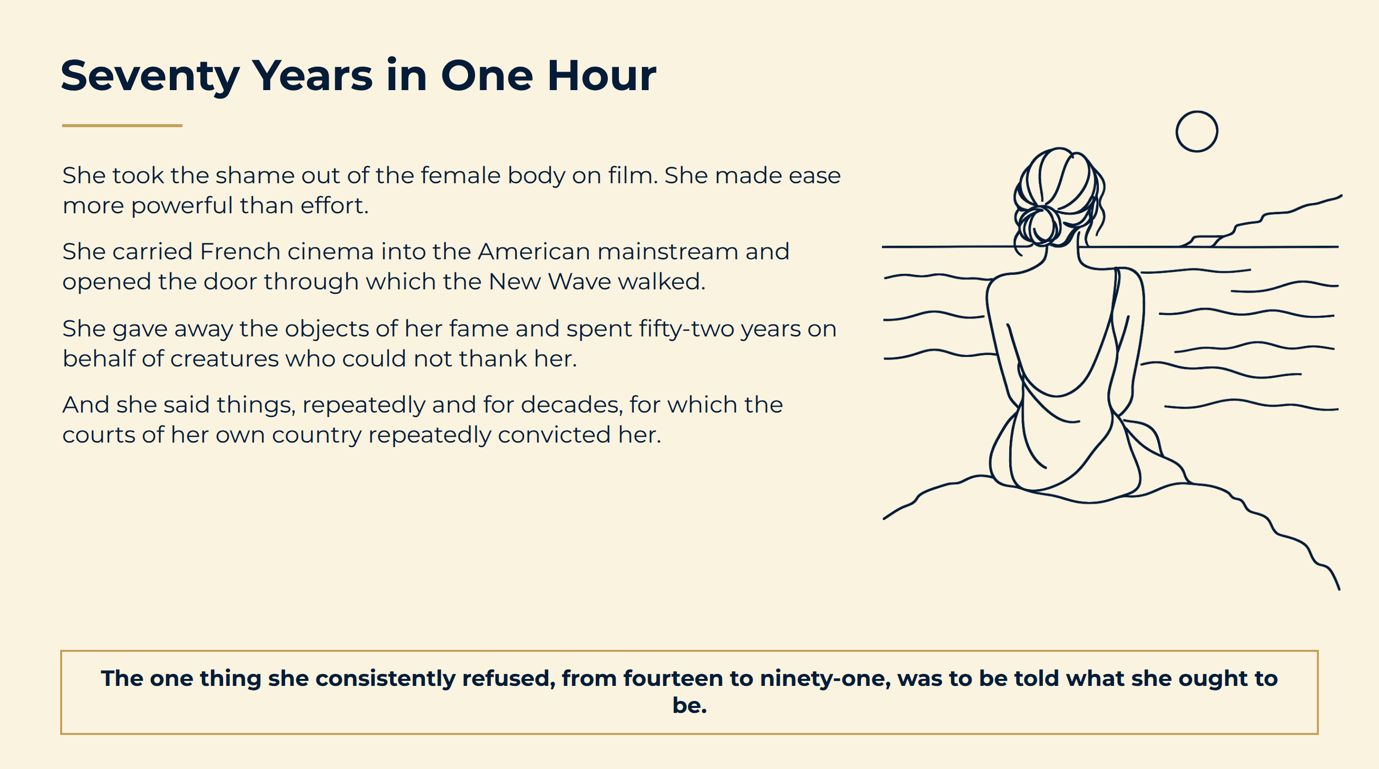
Notes:
Seventy Years in One Hour
The one thing she consistently refused, from fourteen to ninety-one, was to be told what she ought to be.

Slide 28
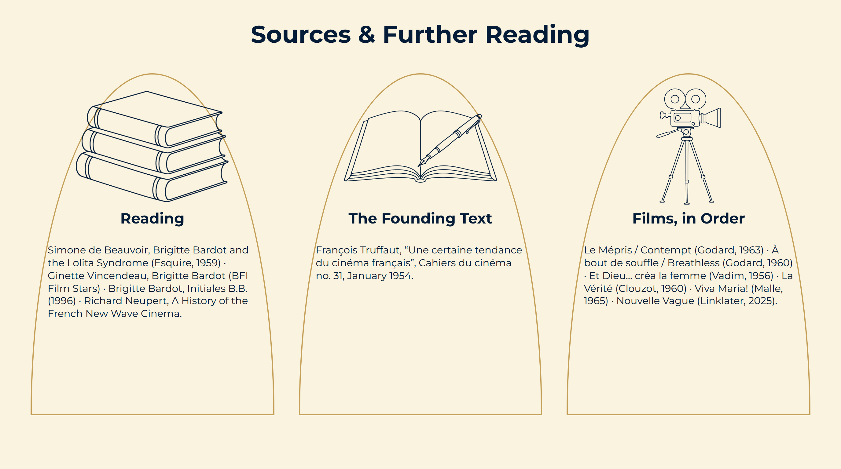
Notes:
Sources & Further Reading

