Slide 1
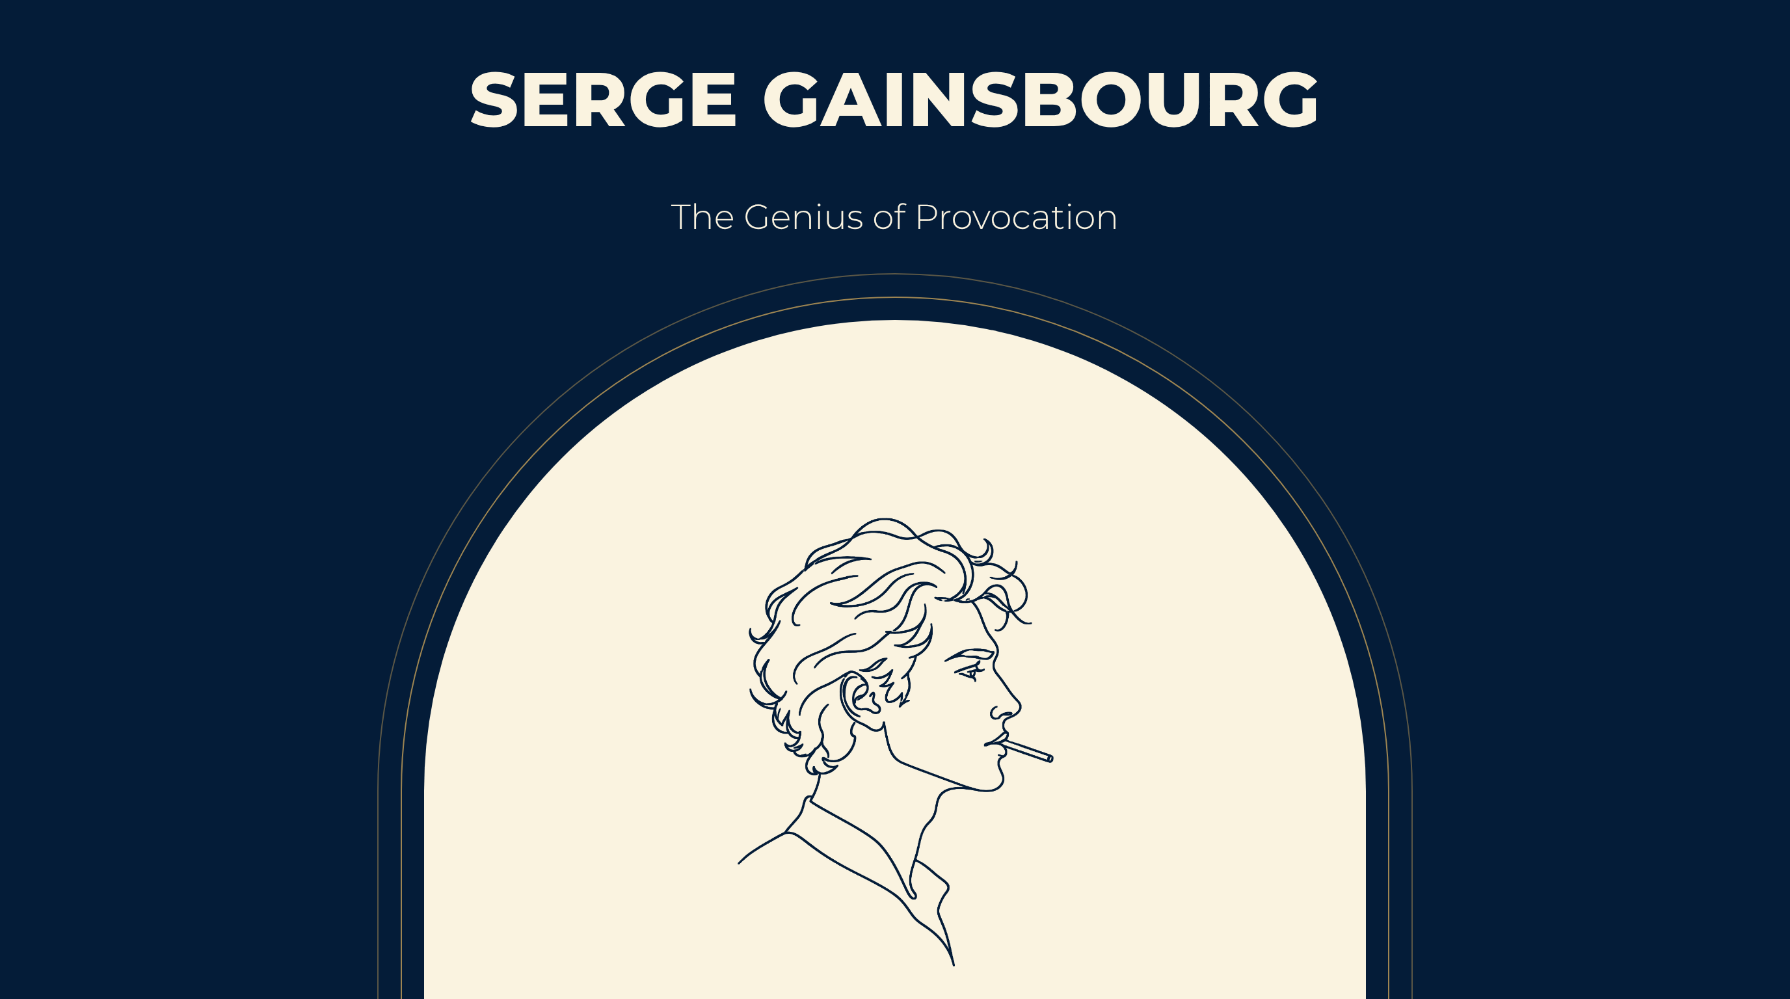
Notes:
SERGE GAINSBOURG
The Genius of Provocation

Slide 2
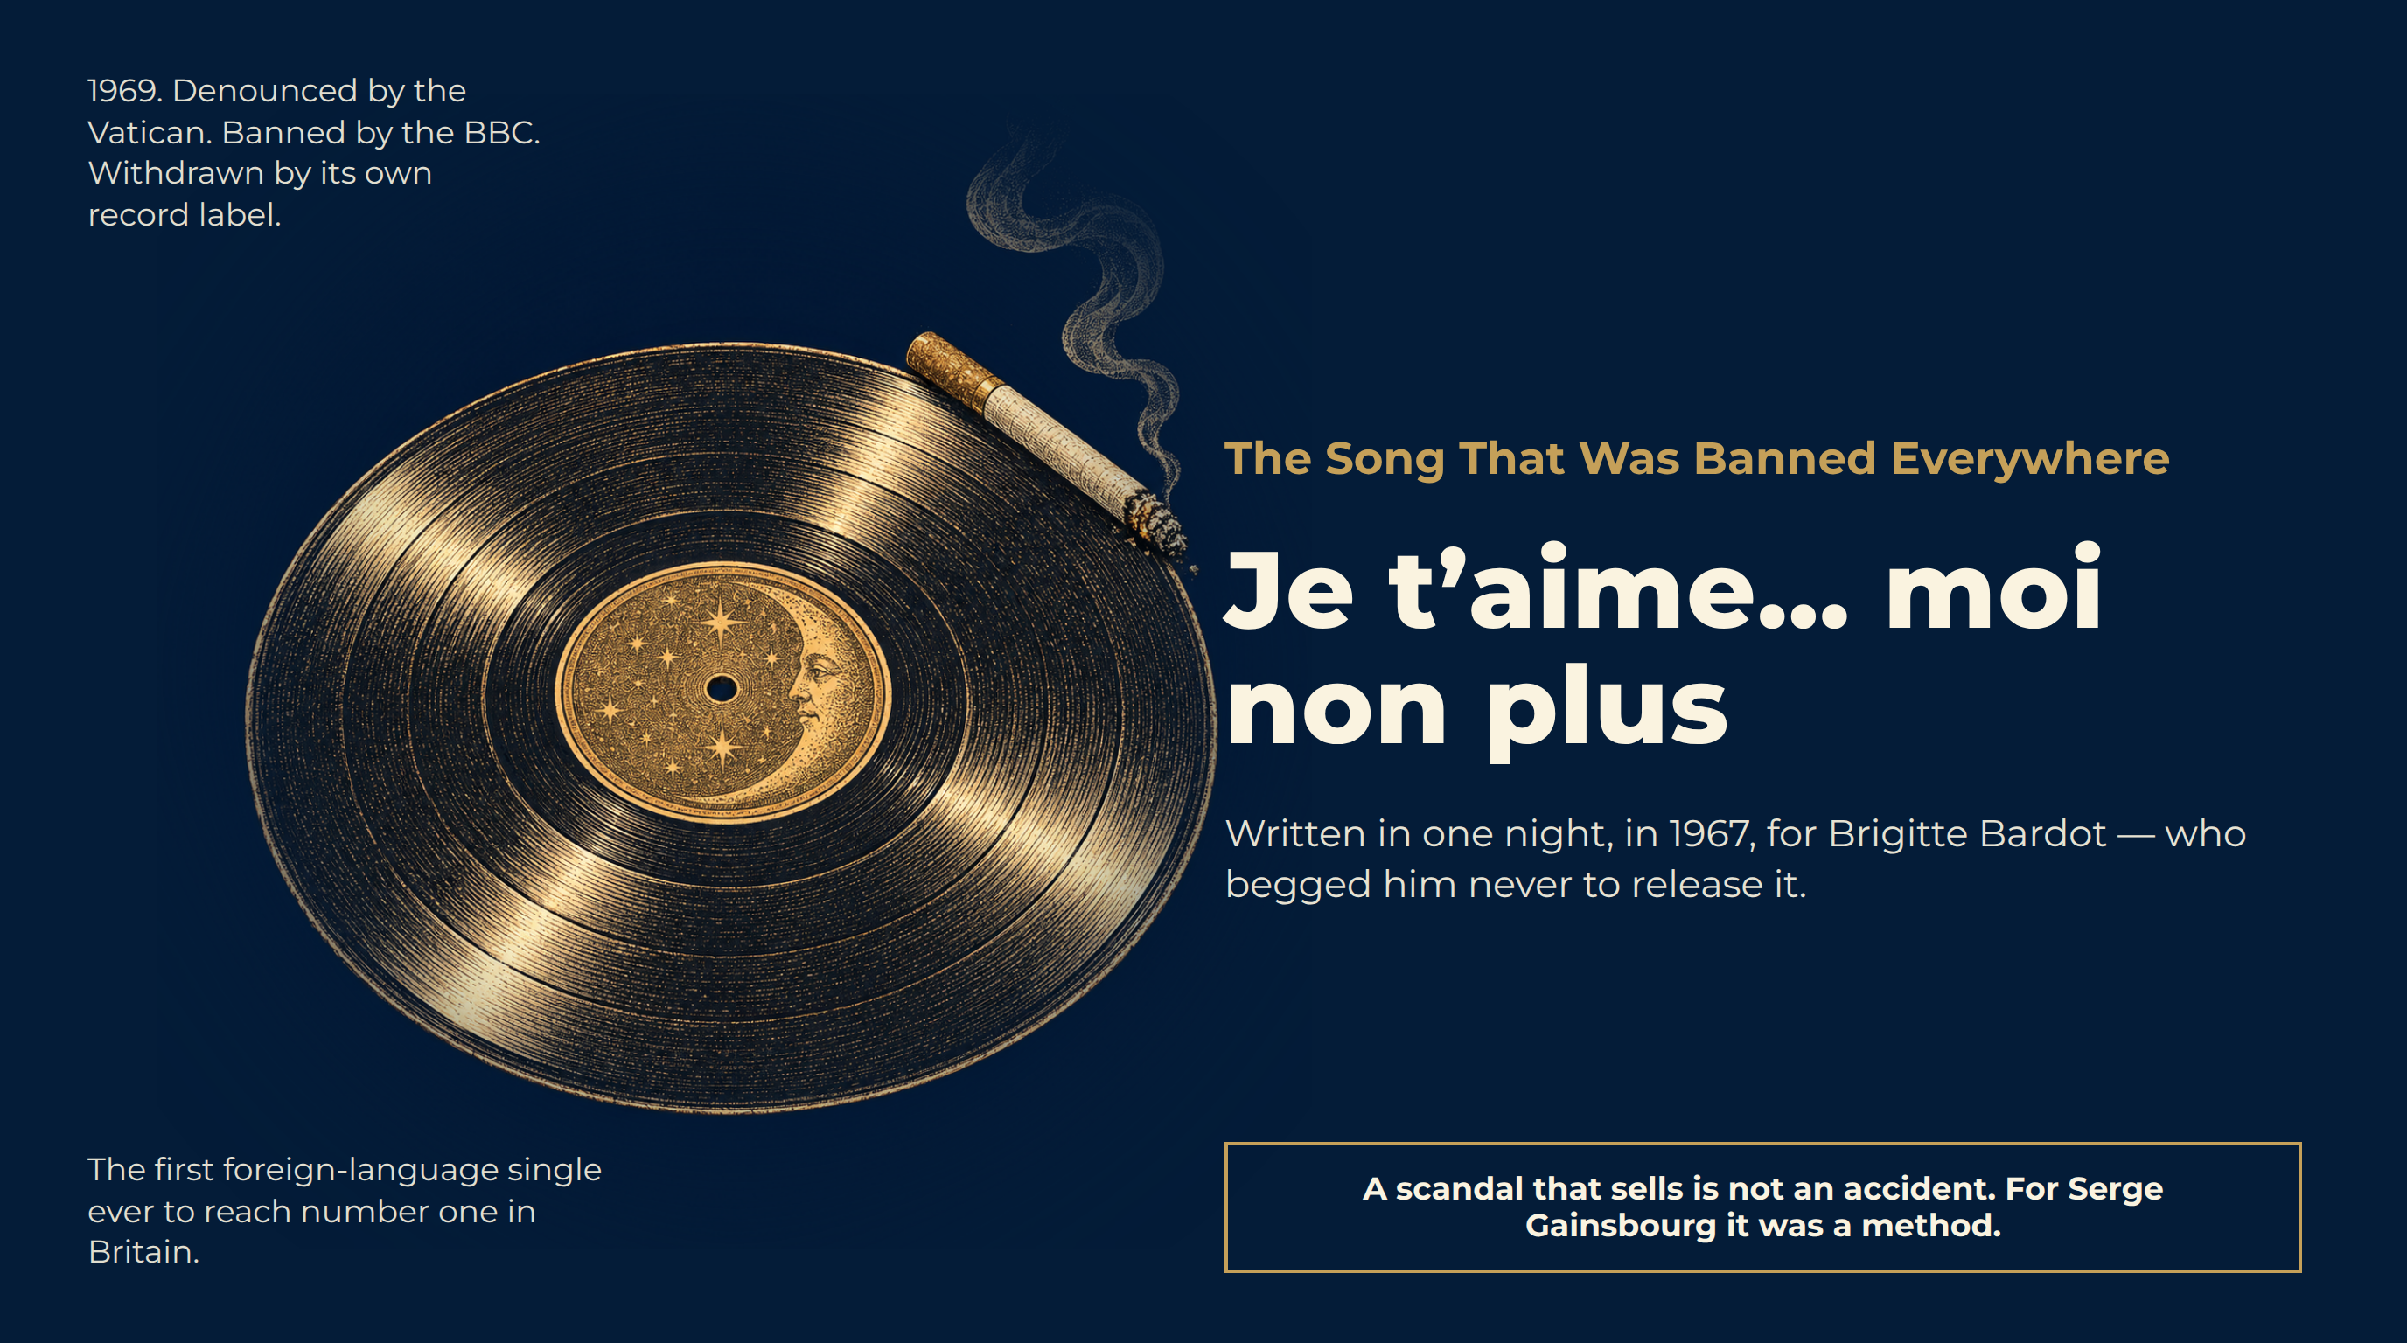
Notes:
The Song That Was Banned Everywhere
1969. Denounced by the Vatican. Banned by the BBC. Withdrawn by its own record label.
The first foreign-language single ever to reach number one in Britain.
Je t’aime… moi non plus
Written in one night, in 1967, for Brigitte Bardot — who begged him never to release it.
A scandal that sells is not an accident. For Serge Gainsbourg it was a method.

Slide 3
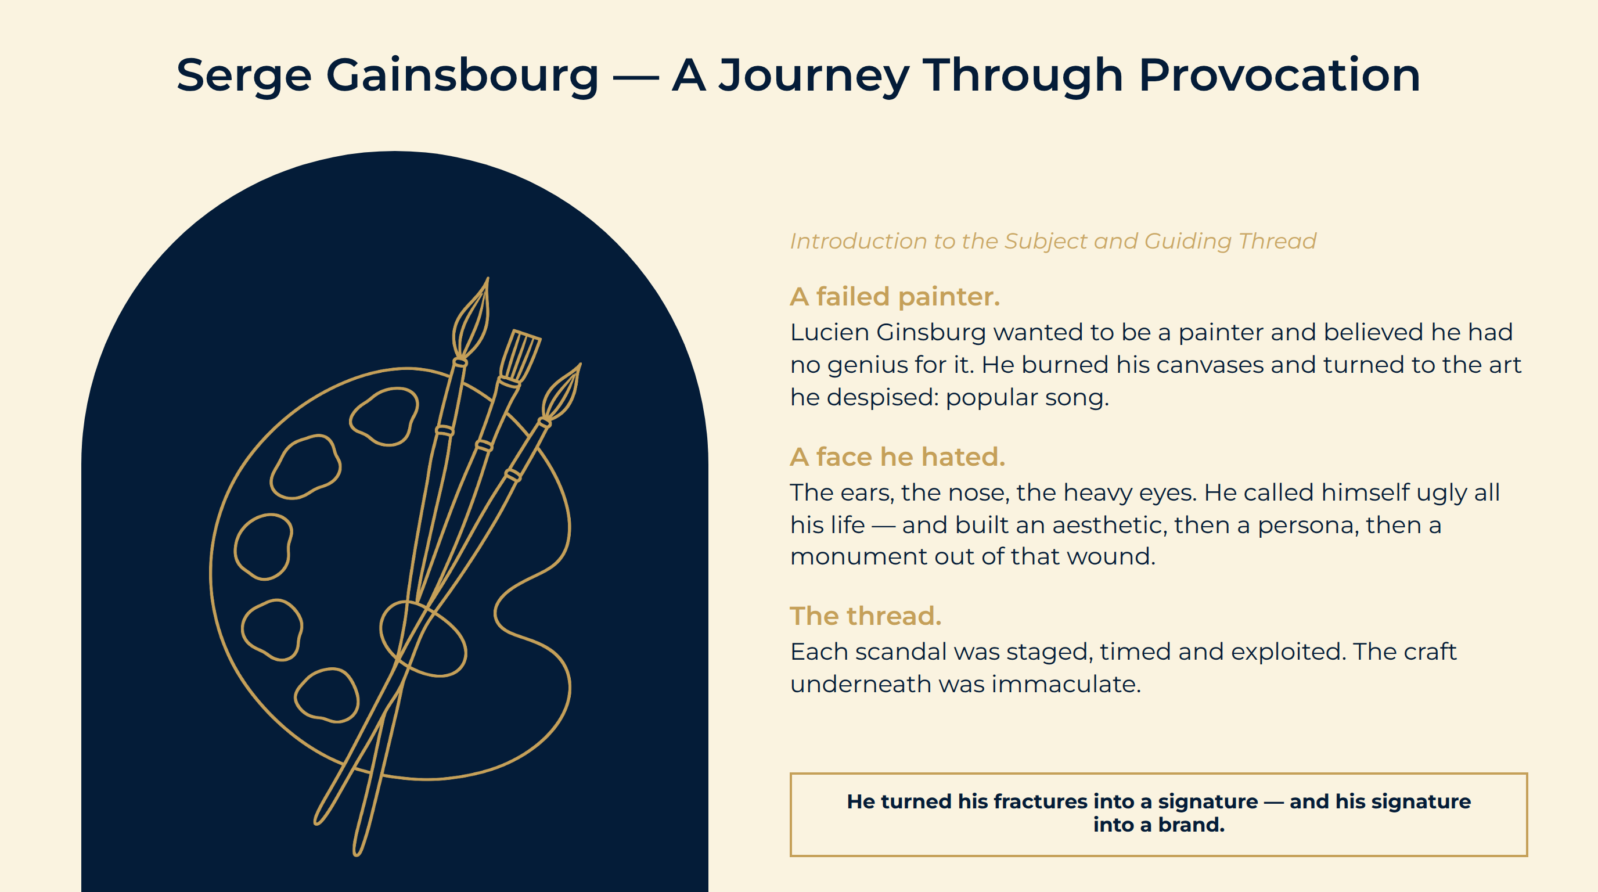
Notes:
Serge Gainsbourg — A Journey Through Provocation
A failed painter. Lucien Ginsburg wanted to be a painter and believed he had no genius for it. He burned his canvases and turned to the art he despised: popular song.
A face he hated. The ears, the nose, the heavy eyes. He called himself ugly all his life — and built an aesthetic, then a persona, then a monument out of that wound.
The thread. Each scandal was staged, timed and exploited. The craft underneath was immaculate.
He turned his fractures into a signature — and his signature into a brand.

Slide 4
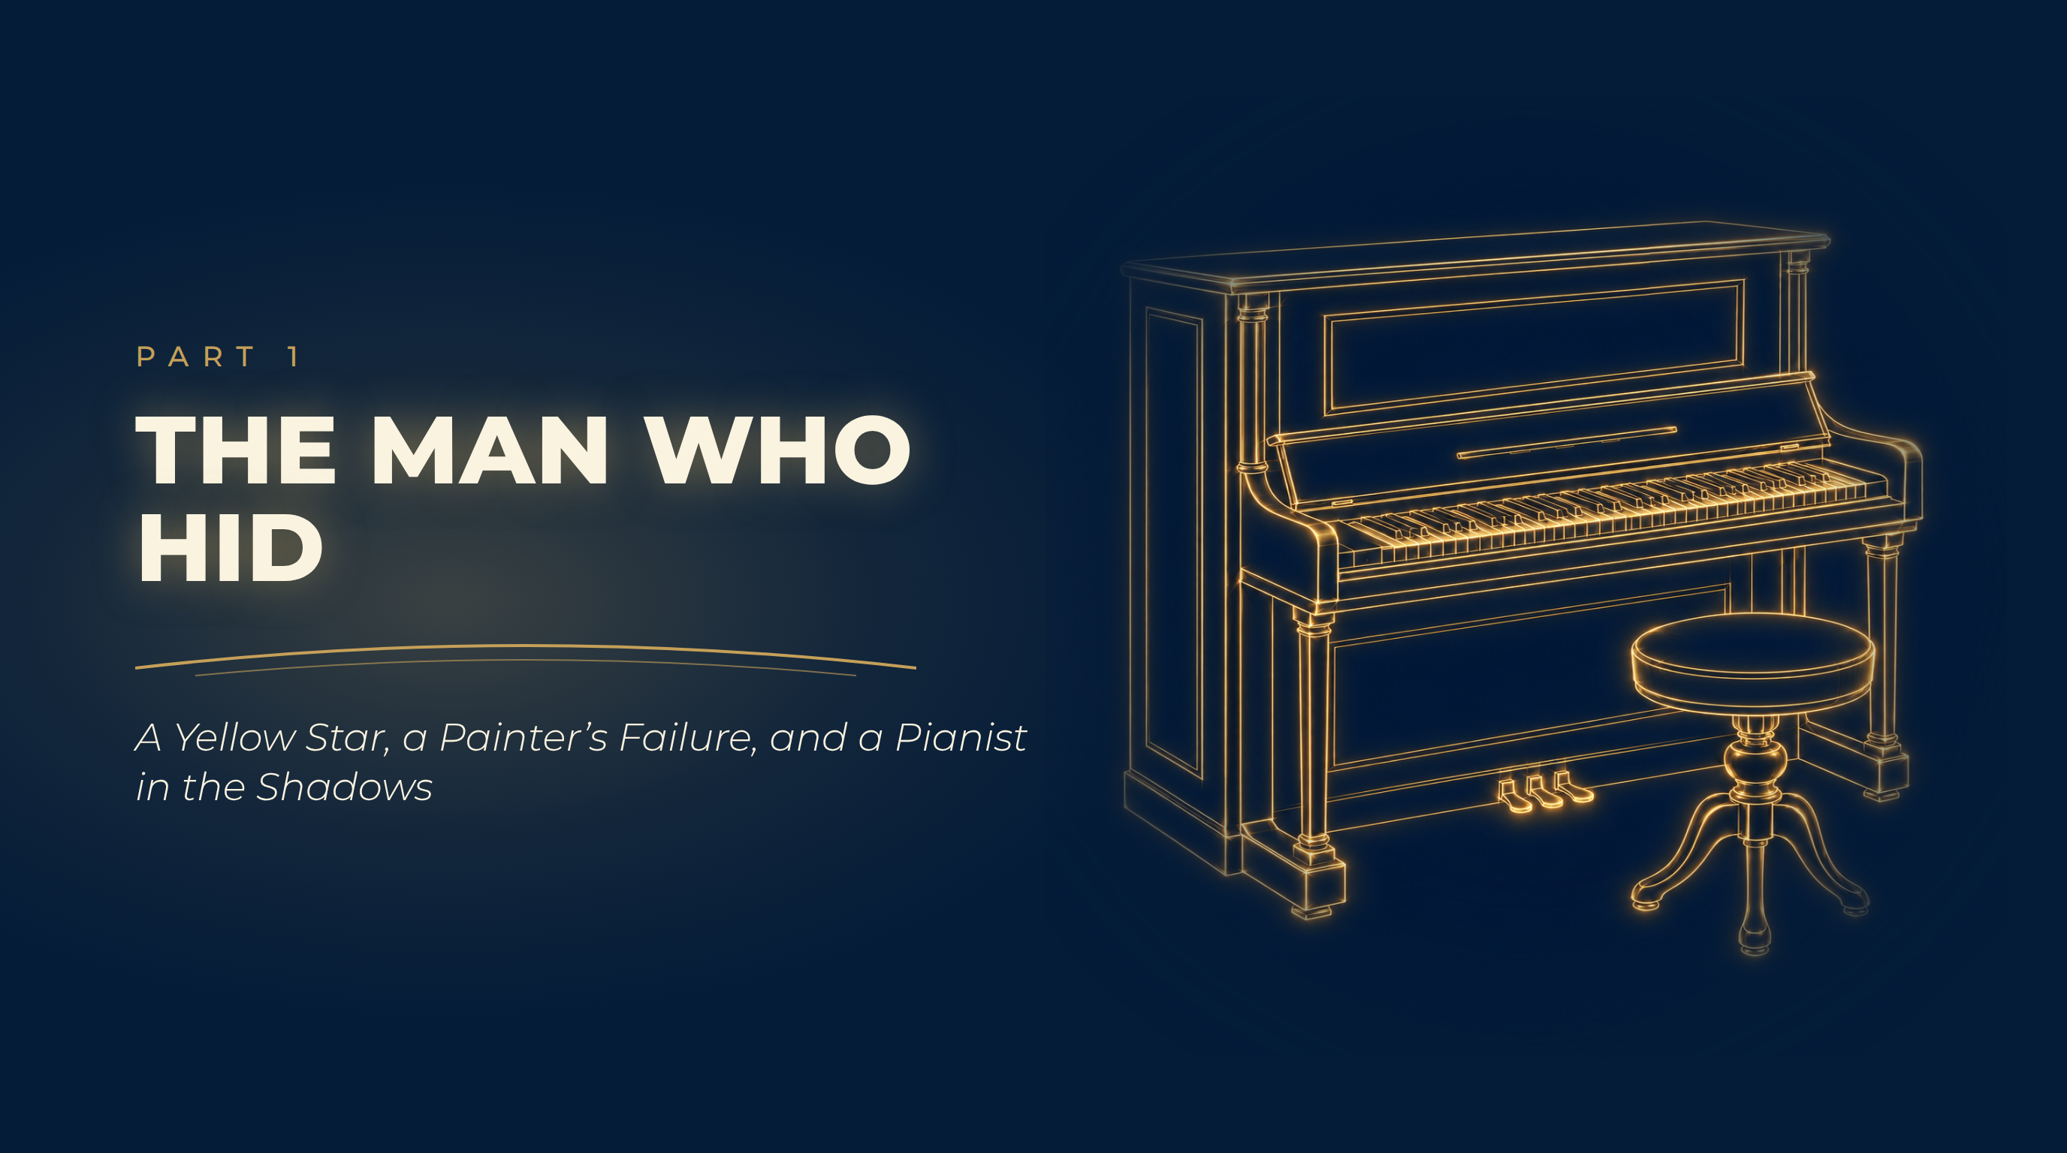
Notes:
The Man Who Hid
A Yellow Star, a Painter’s Failure, and a Pianist in the Shadows

Slide 5
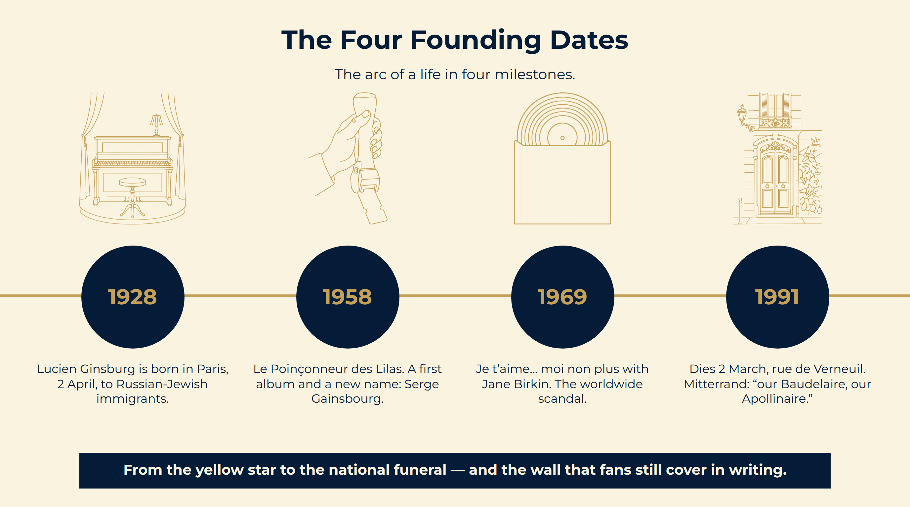
Notes:
The Four Founding Dates
From the yellow star to the national funeral — and the wall that fans still cover in writing.
The arc of a life in four milestones.

Slide 6
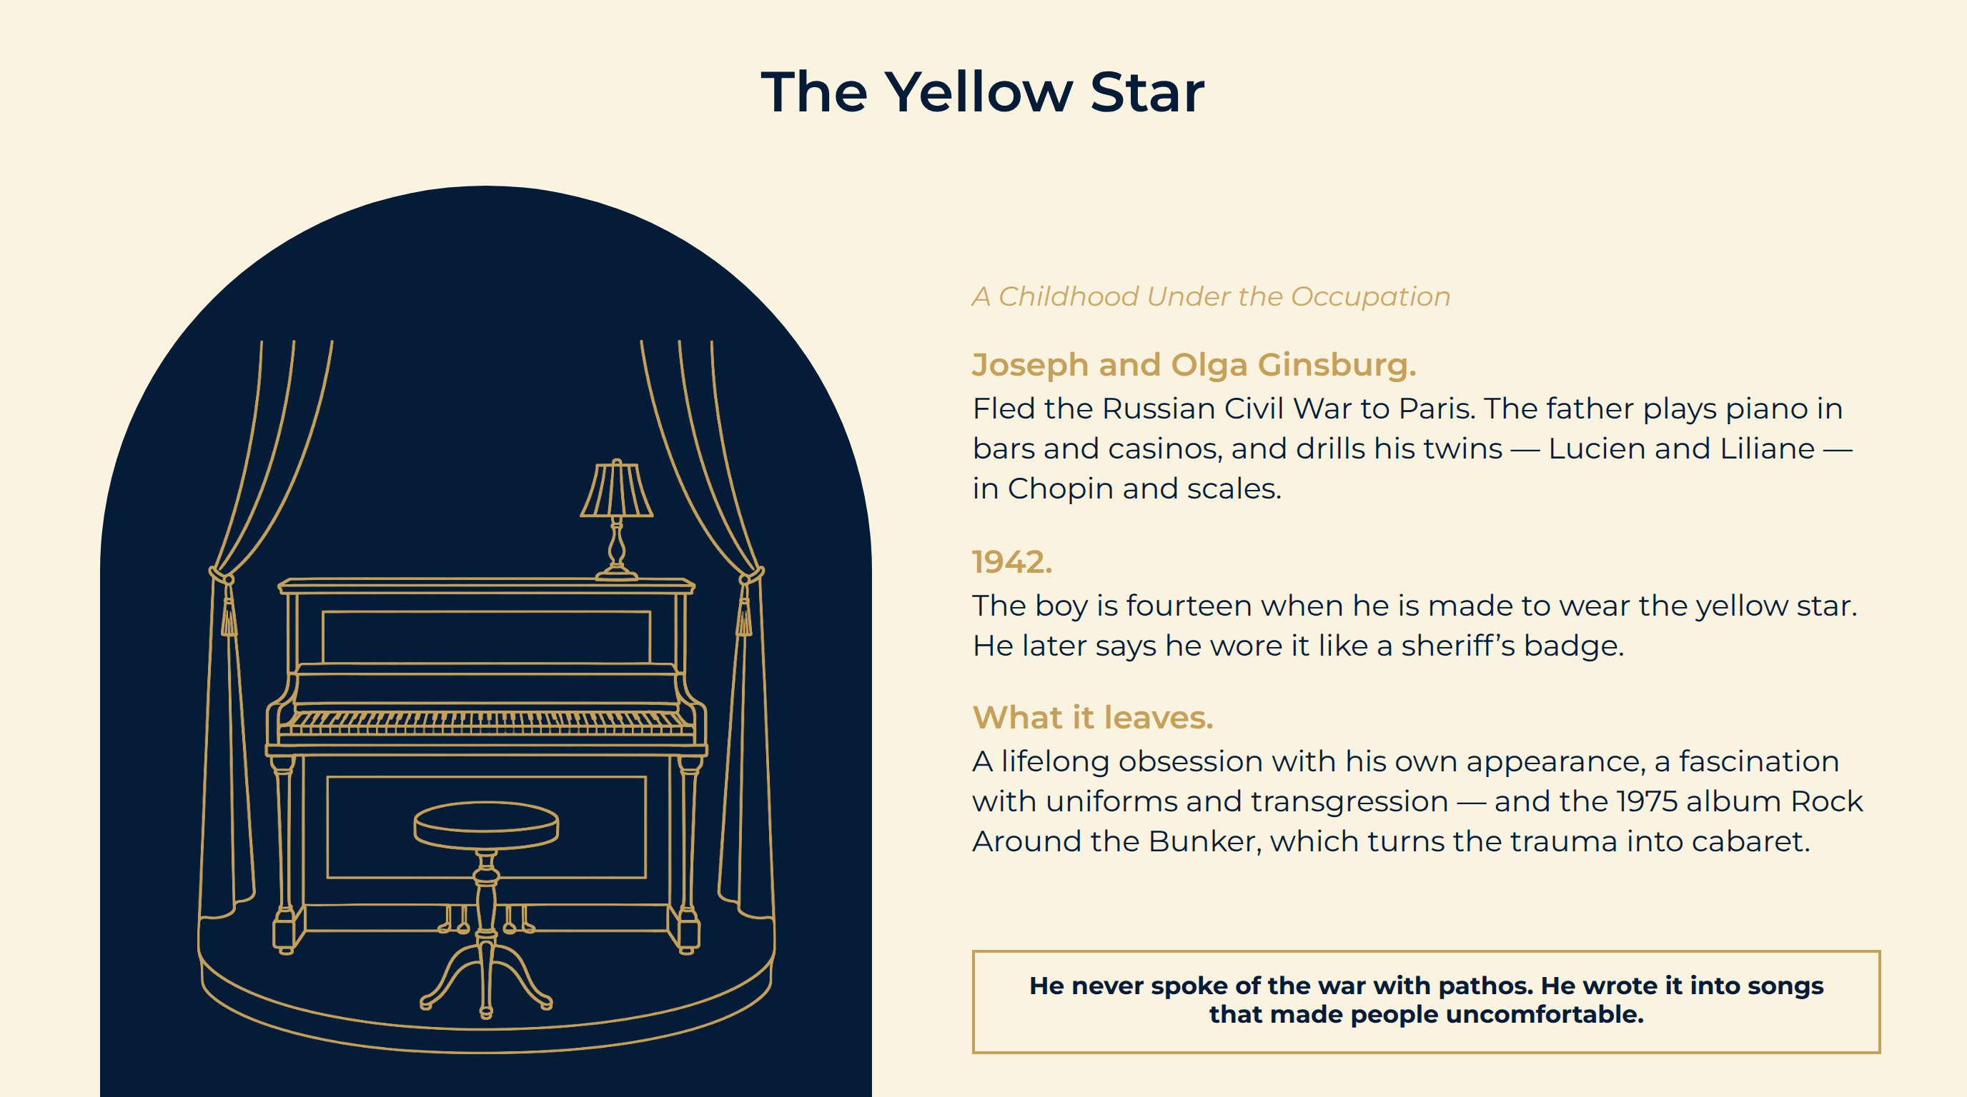
Notes:
The Yellow Star
Joseph and Olga Ginsburg. Fled the Russian Civil War to Paris. The father plays piano in bars and casinos, and drills his twins — Lucien and Liliane — in Chopin and scales.
1942. The boy is fourteen when he is made to wear the yellow star. He later says he wore it like a sheriff’s badge.
What it leaves. A lifelong obsession with his own appearance, a fascination with uniforms and transgression — and the 1975 album Rock Around the Bunker, which turns the trauma into cabaret.
He never spoke of the war with pathos. He wrote it into songs that made people uncomfortable.

Slide 7
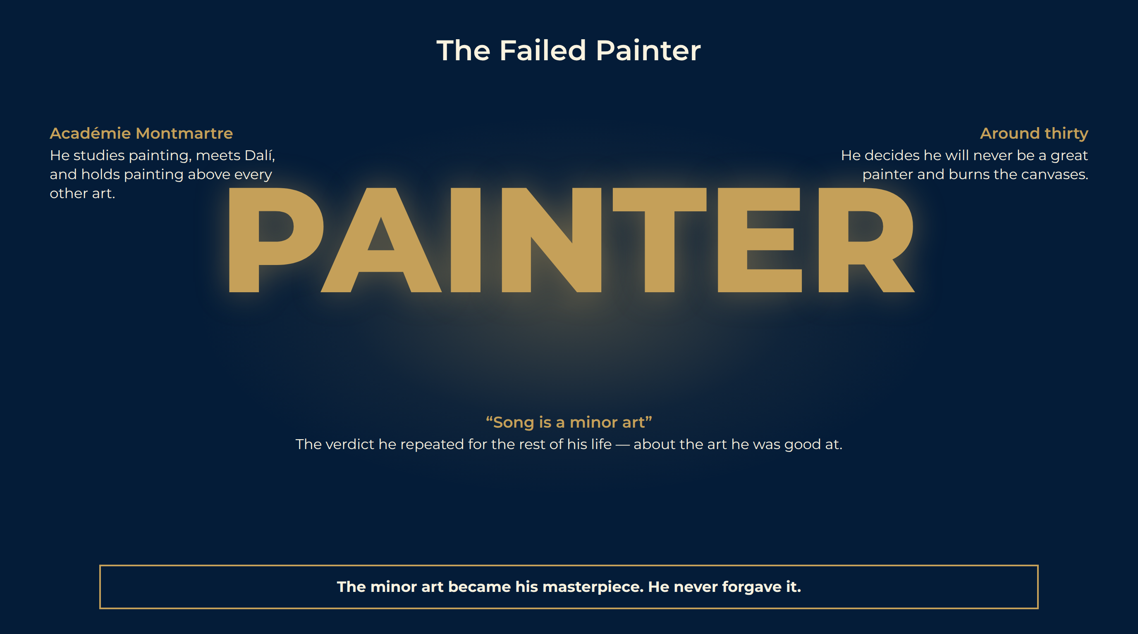
Notes:
The Failed Painter
The Académie Montmartre. He studies painting, meets Dalí, and holds painting above every other art. Song, to him, is a minor art — “an art for minors.”
The verdict. Around thirty, he decides he will never be a great painter and destroys most of his work.
The pianist in the shadows. To live, he plays piano in bars and the cabaret Milord l’Arsouille, behind Boris Vian. Vian’s cruel, elegant songs show him the way in.
Académie Montmartre He studies painting, meets Dalí, and holds painting above every other art.
Around thirty He decides he will never be a great painter and burns the canvases.
“Song is a minor art” The verdict he repeated for the rest of his life — about the art he was good at.
The minor art became his masterpiece. He never forgave it.

Slide 8
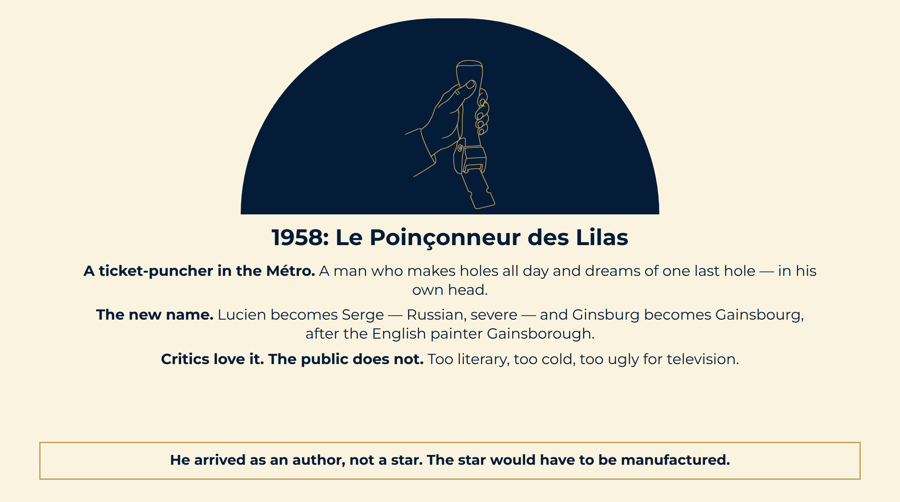
Notes:
1958: Le Poinçonneur des Lilas
A ticket-puncher in the Métro. A man who makes holes all day and dreams of one last hole — in his own head.
The new name. Lucien becomes Serge — Russian, severe — and Ginsburg becomes Gainsbourg, after the English painter Gainsborough.
Critics love it. The public does not. Too literary, too cold, too ugly for television.
He arrived as an author, not a star. The star would have to be manufactured.

Slide 9
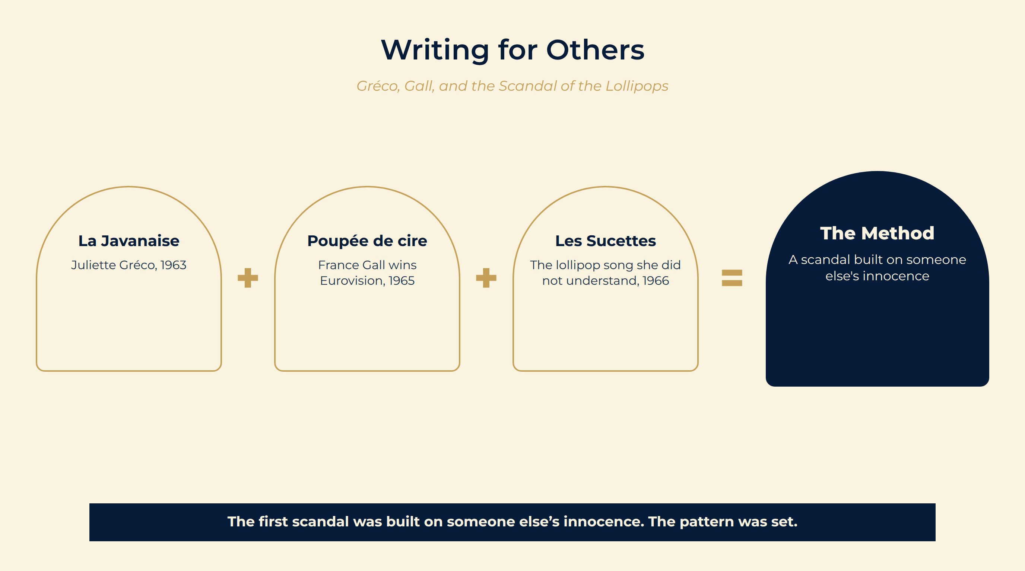
Notes:
Writing for Others
La Javanaise, 1963. Written overnight for Juliette Gréco after an evening of champagne. A waltz built on a play of syllables — the craft already perfect.
Eurovision, 1965. Poupée de cire, poupée de son for seventeen-year-old France Gall wins for Luxembourg. Pop, yé-yé, and a lyric about a doll who sings what she is told.
Les Sucettes, 1966. A song about a girl who loves aniseed lollipops. Gall sings it innocently; the double meaning is obvious to everyone else.
La Javanaise Juliette Gréco, 1963
Poupée de cire France Gall wins Eurovision, 1965
Les Sucettes The lollipop song she did not understand, 1966
The Method A scandal built on someone else's innocence
The first scandal was built on someone else’s innocence. The pattern was set.

Slide 10
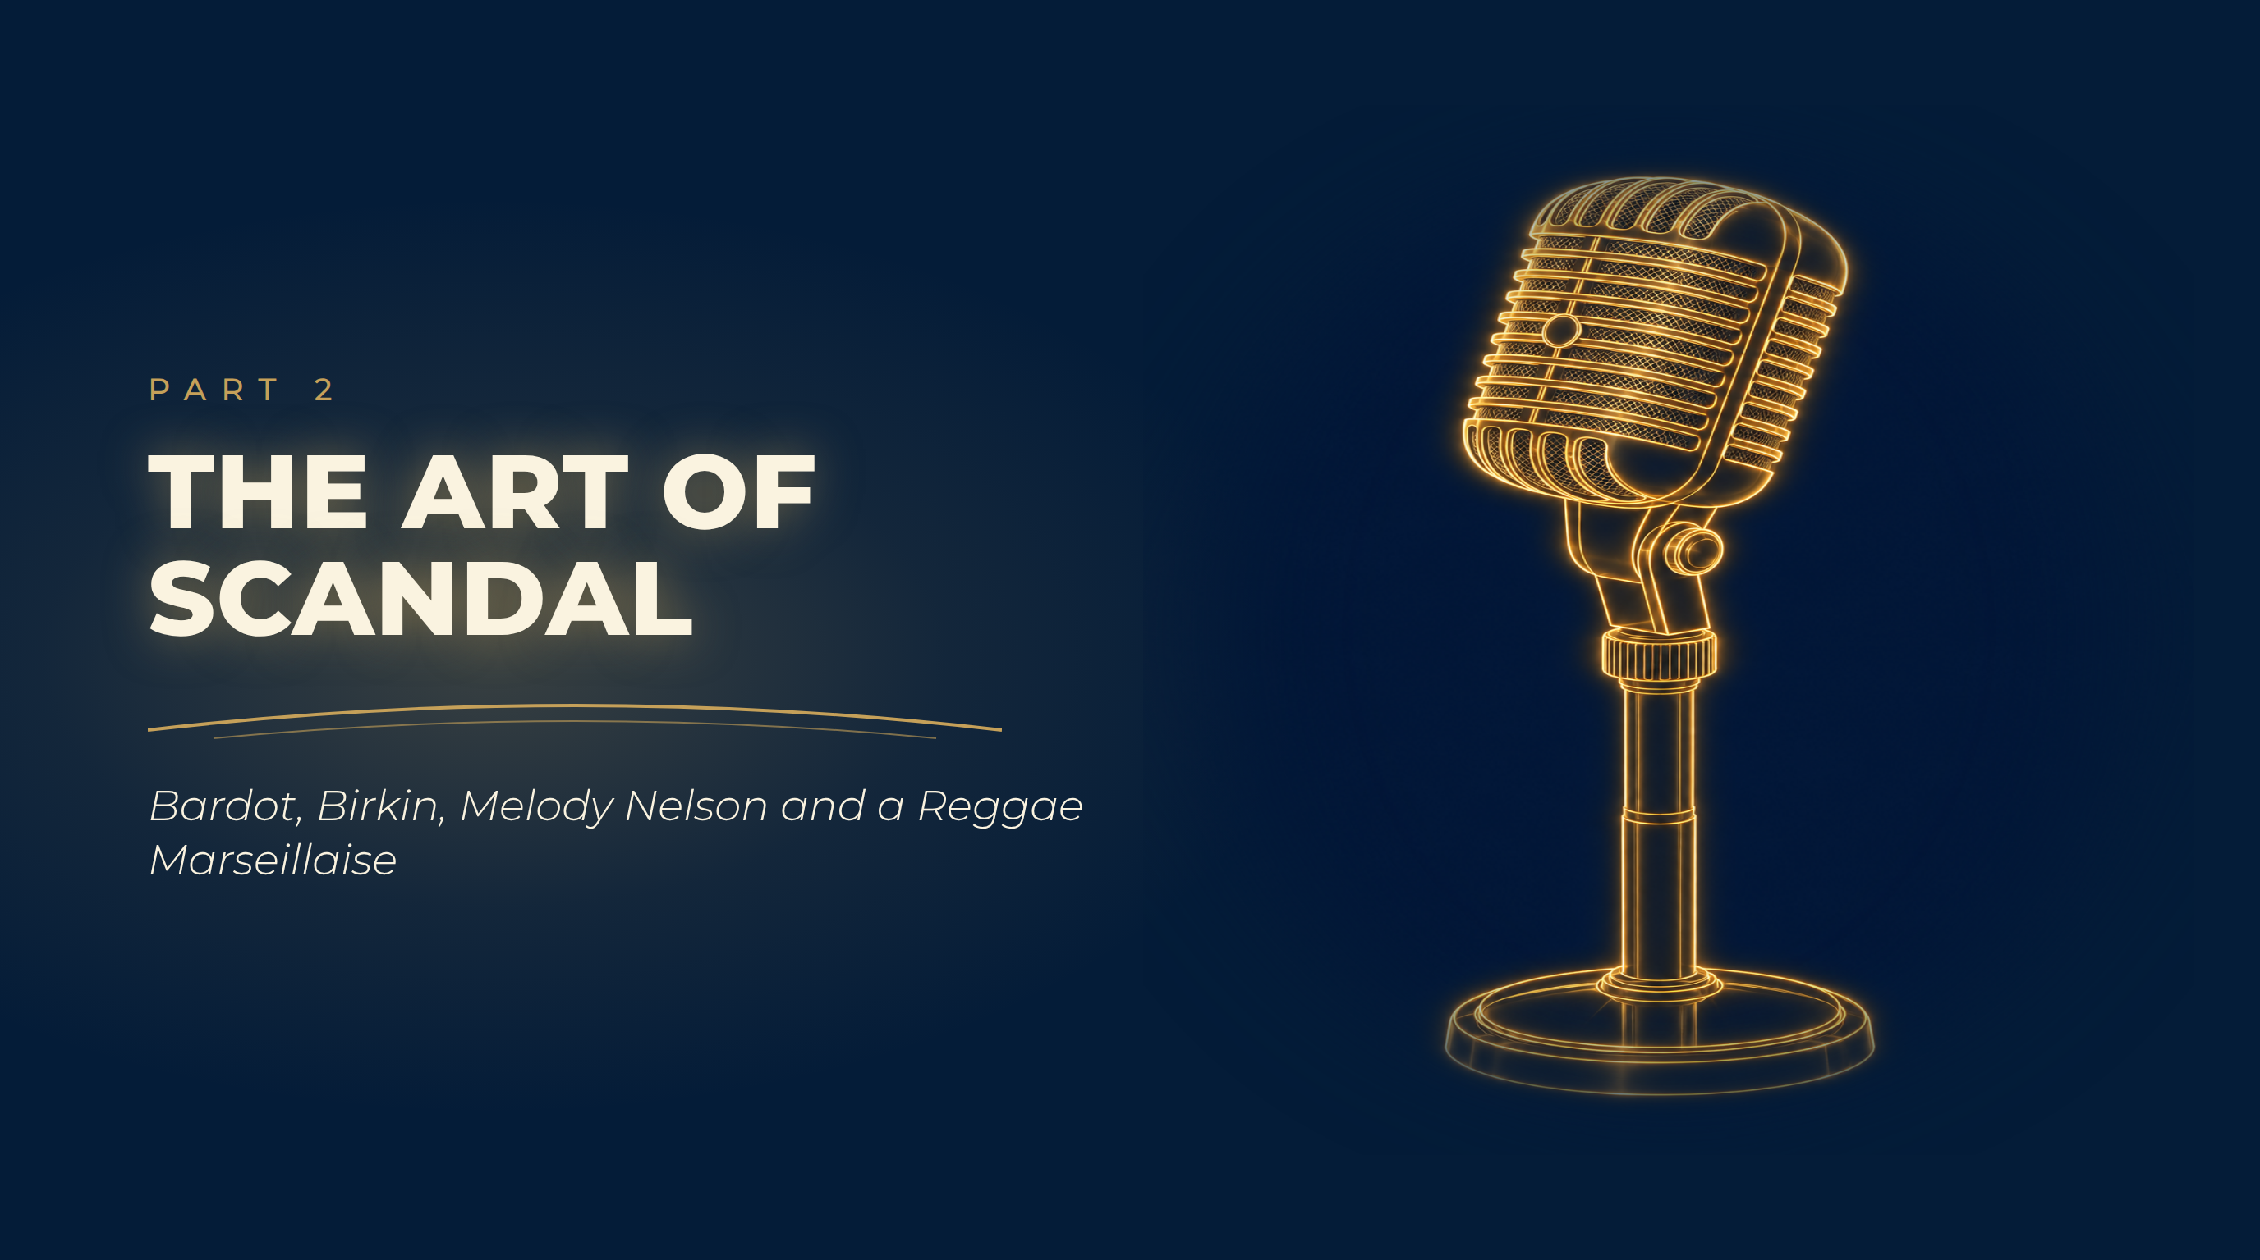
Notes:
The Art of Scandal
Bardot, Birkin, Melody Nelson and a Reggae Marseillaise

Slide 11
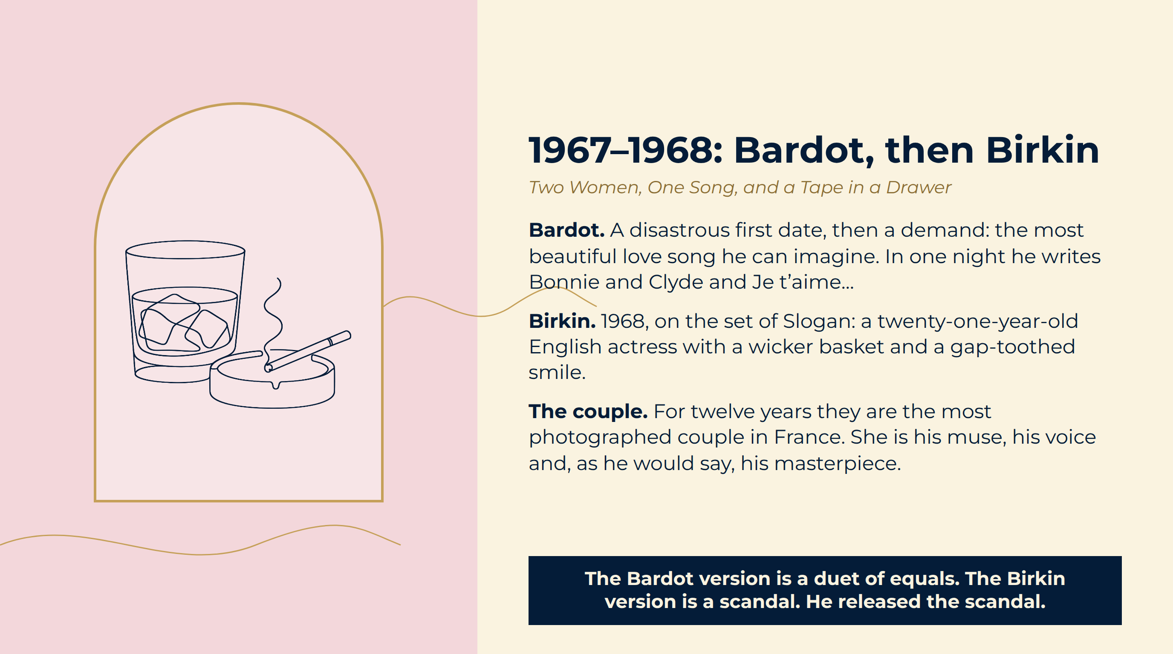
Notes:
1967–1968: Bardot, then Birkin
Bardot. A disastrous first date, then a demand: the most beautiful love song he can imagine. In one night he writes Bonnie and Clyde and Je t’aime…
Birkin. 1968, on the set of Slogan: a twenty-one-year-old English actress with a wicker basket and a gap-toothed smile.
The couple. For twelve years they are the most photographed couple in France. She is his muse, his voice and, as he would say, his masterpiece.
The Bardot version is a duet of equals. The Birkin version is a scandal. He released the scandal.

Slide 12
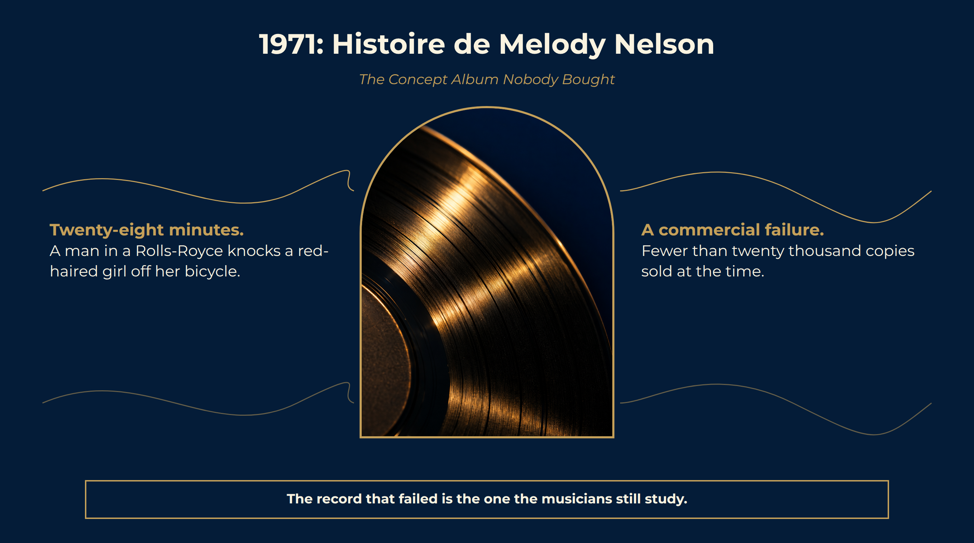
Notes:
1971: Histoire de Melody Nelson
Twenty-eight minutes. A man in a Rolls-Royce knocks a red-haired girl off her bicycle.
A commercial failure. Fewer than twenty thousand copies sold at the time.
Why it matters. It is the proof, for anyone who doubted it, that the provocateur was first a composer and arranger of the highest rank.
The record that failed is the one the musicians still study.

Slide 13
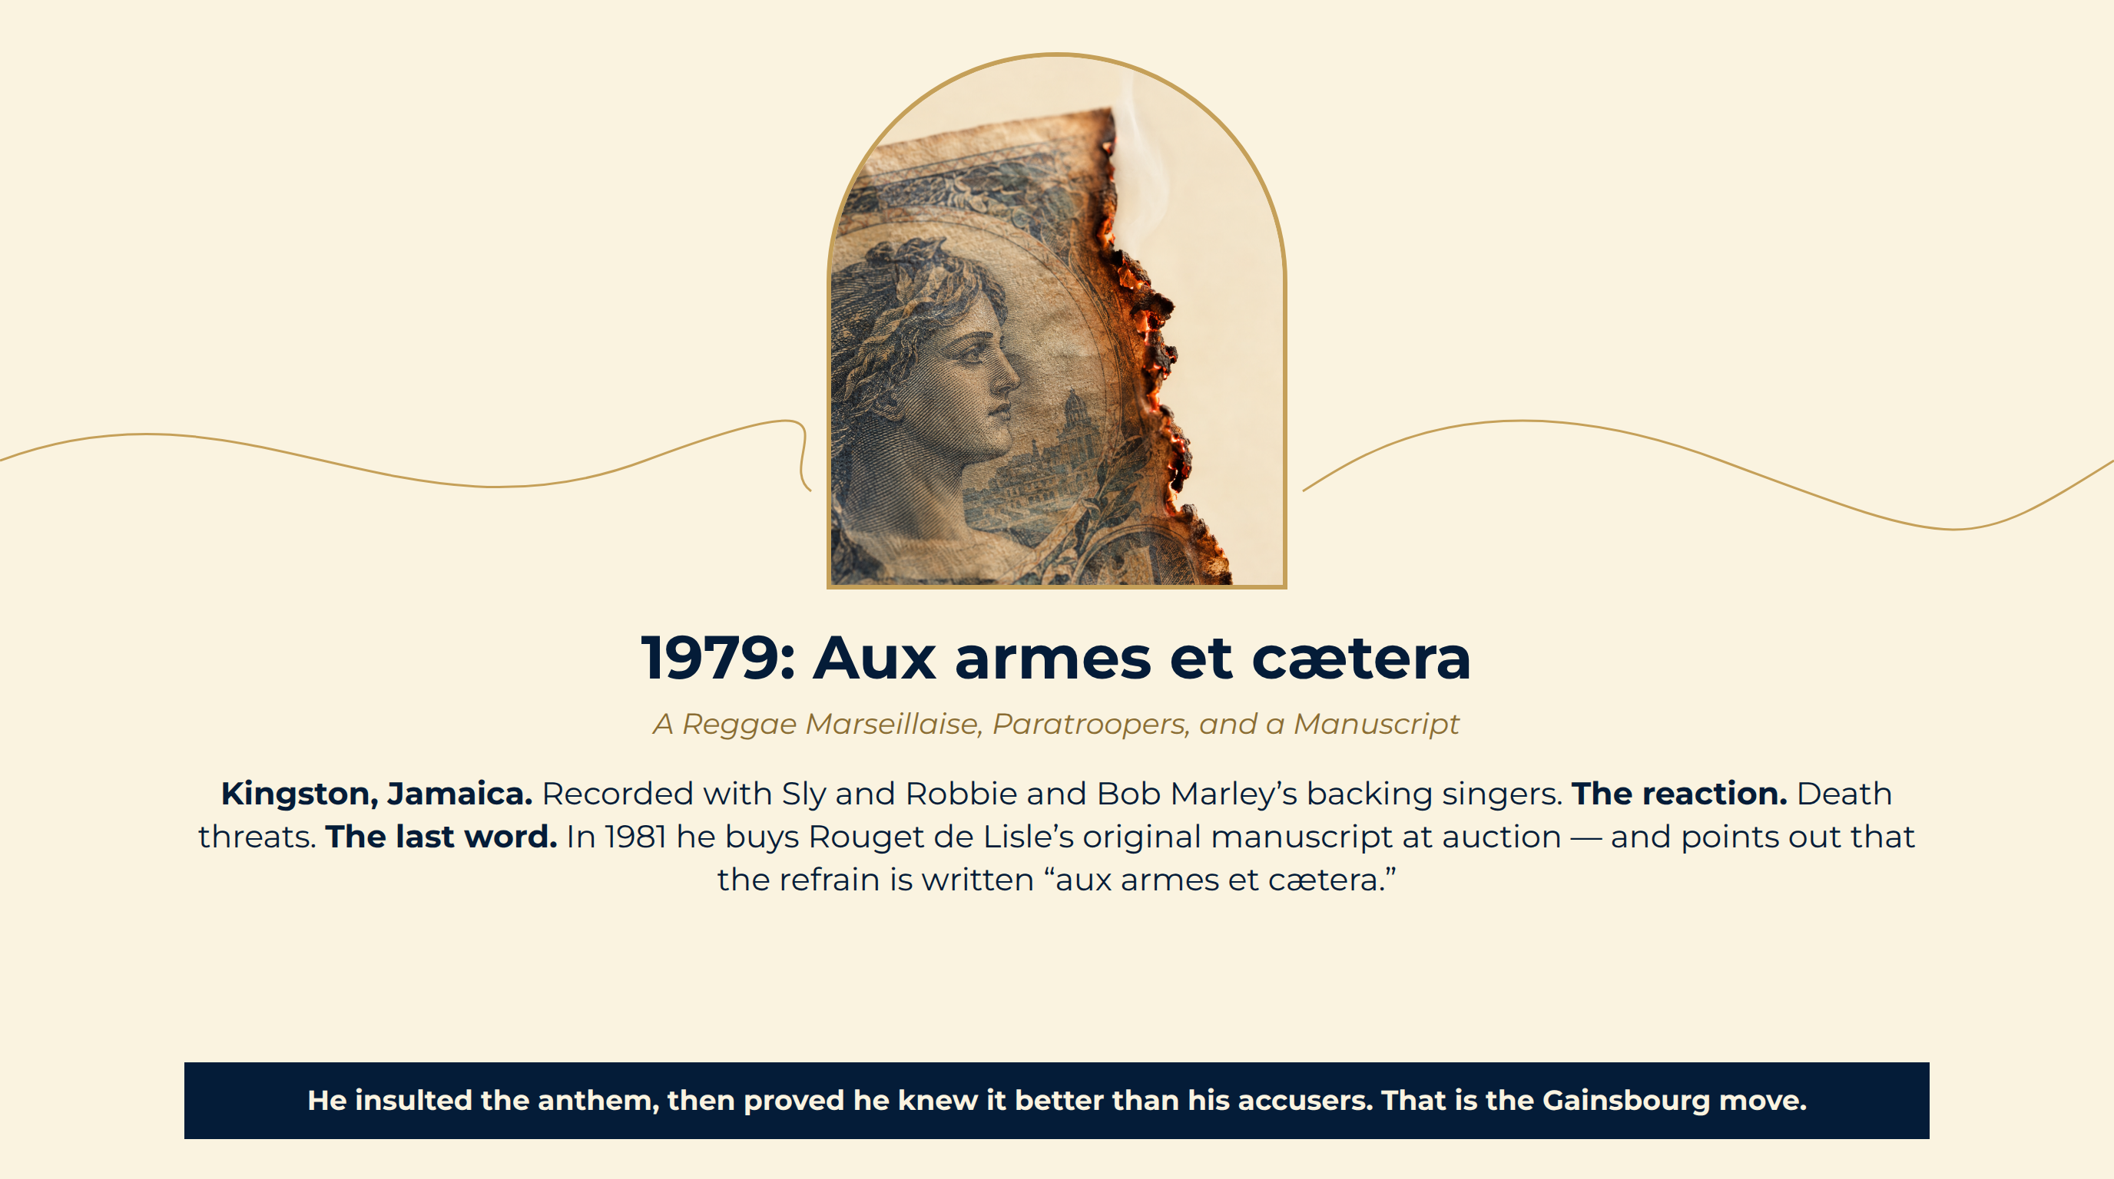
Notes:
1979: Aux armes et cætera
Kingston, Jamaica. Recorded with Sly and Robbie and Bob Marley’s backing singers.
The reaction. Death threats.
The last word. In 1981 he buys Rouget de Lisle’s original manuscript at auction — and points out that the refrain is written “aux armes et cætera.”
He insulted the anthem, then proved he knew it better than his accusers. That is the Gainsbourg move.

Slide 14
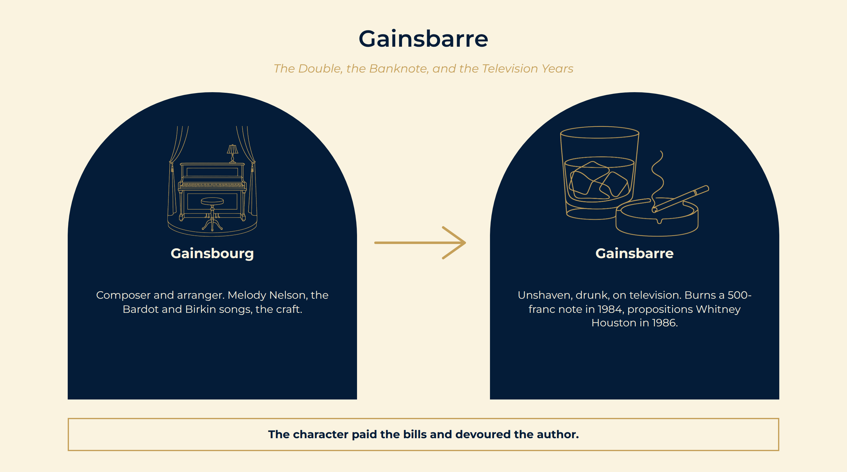
Notes:
Gainsbarre
The alter ego. After Birkin leaves in 1980 he invents “Gainsbarre”: unshaven, drunk, in a denim jacket, saying the unsayable on live television.
11 March 1984. On a Sunday-evening programme he sets fire to a 500-franc note to protest taxation. Burning money is a crime.
1986. Live on air, he tells Whitney Houston, in English, exactly what he would like to do to her.
Gainsbourg Composer and arranger. Melody Nelson, the Bardot and Birkin songs, the craft.
Gainsbarre Unshaven, drunk, on television. Burns a 500-franc note in 1984, propositions Whitney Houston in 1986.
The character paid the bills and devoured the author.

Slide 15
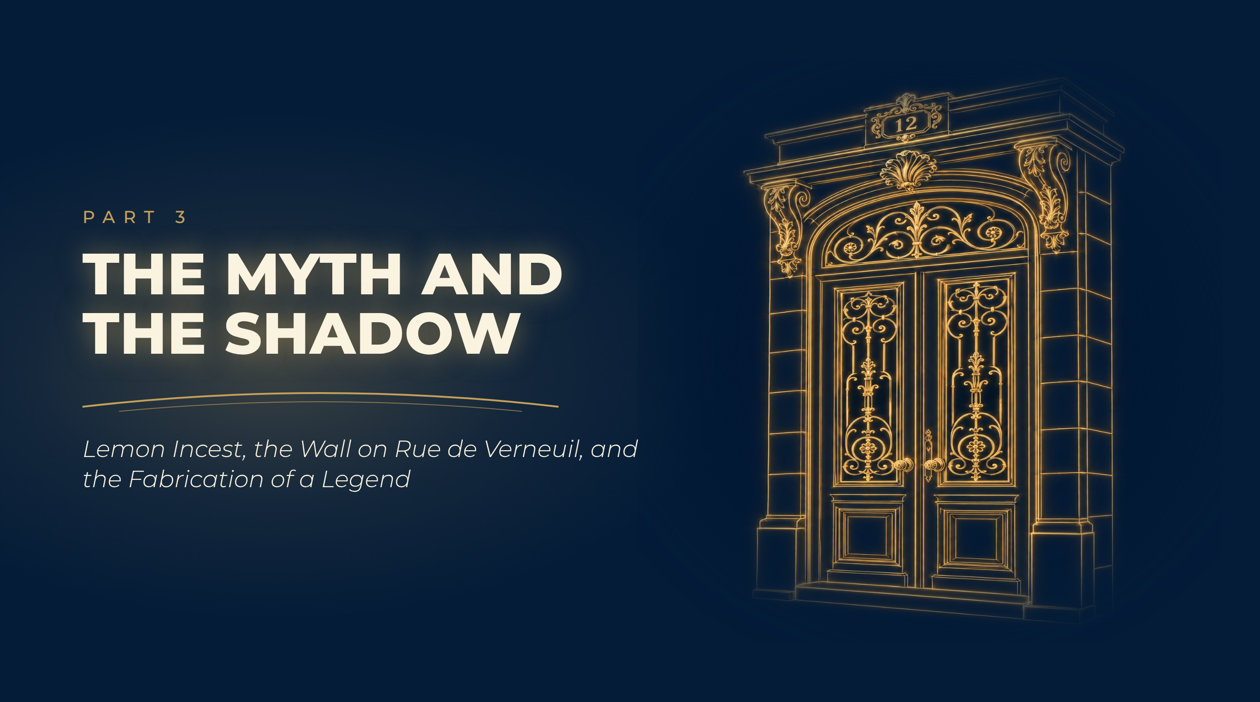
Notes:
The Myth and the Shadow
Lemon Incest, the Wall on Rue de Verneuil, and the Fabrication of a Legend

Slide 16
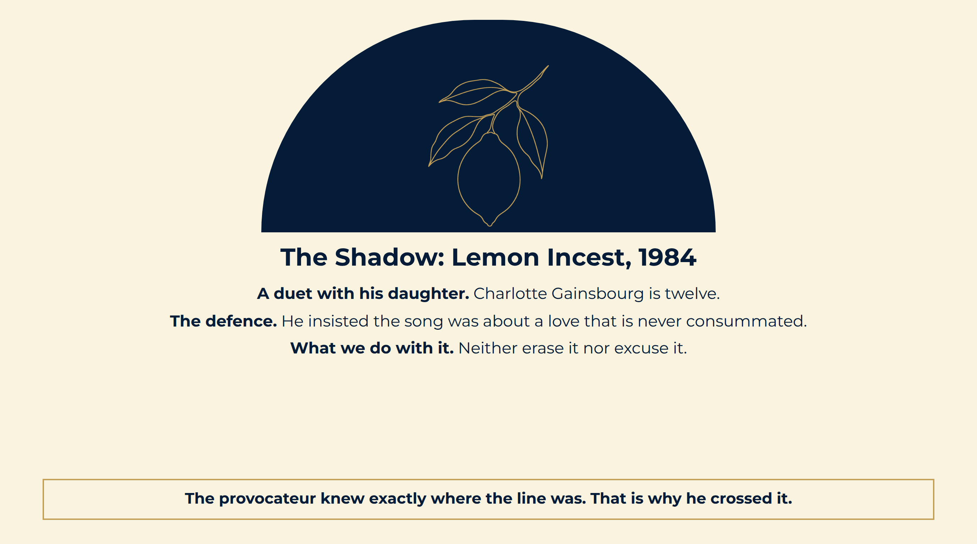
Notes:
The Shadow: Lemon Incest, 1984
A duet with his daughter. Charlotte Gainsbourg is twelve.
The defence. He insisted the song was about a love that is never consummated.
What we do with it. Neither erase it nor excuse it.
The provocateur knew exactly where the line was. That is why he crossed it.

Slide 17
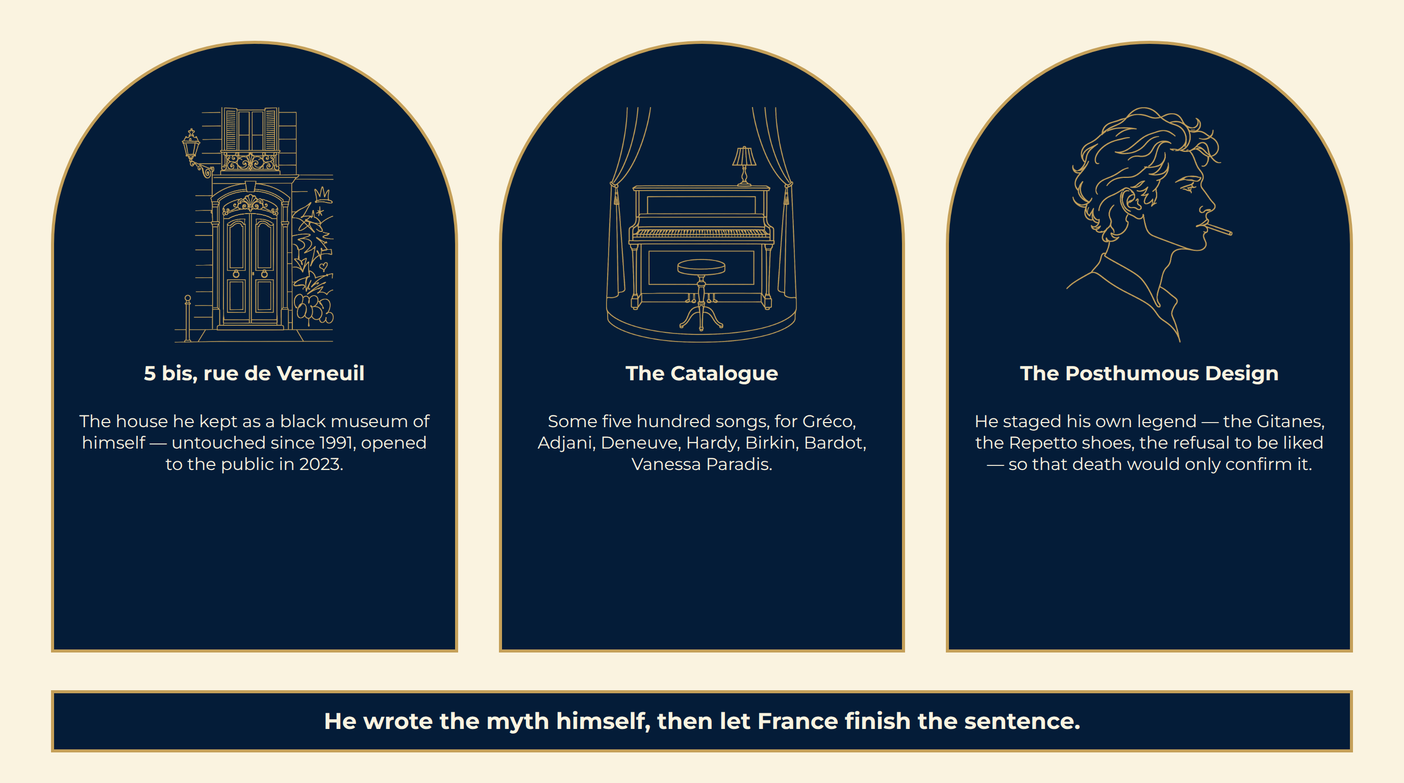
Notes:
The Fabrication of a Myth
He wrote the myth himself, then let France finish the sentence.

Slide 18
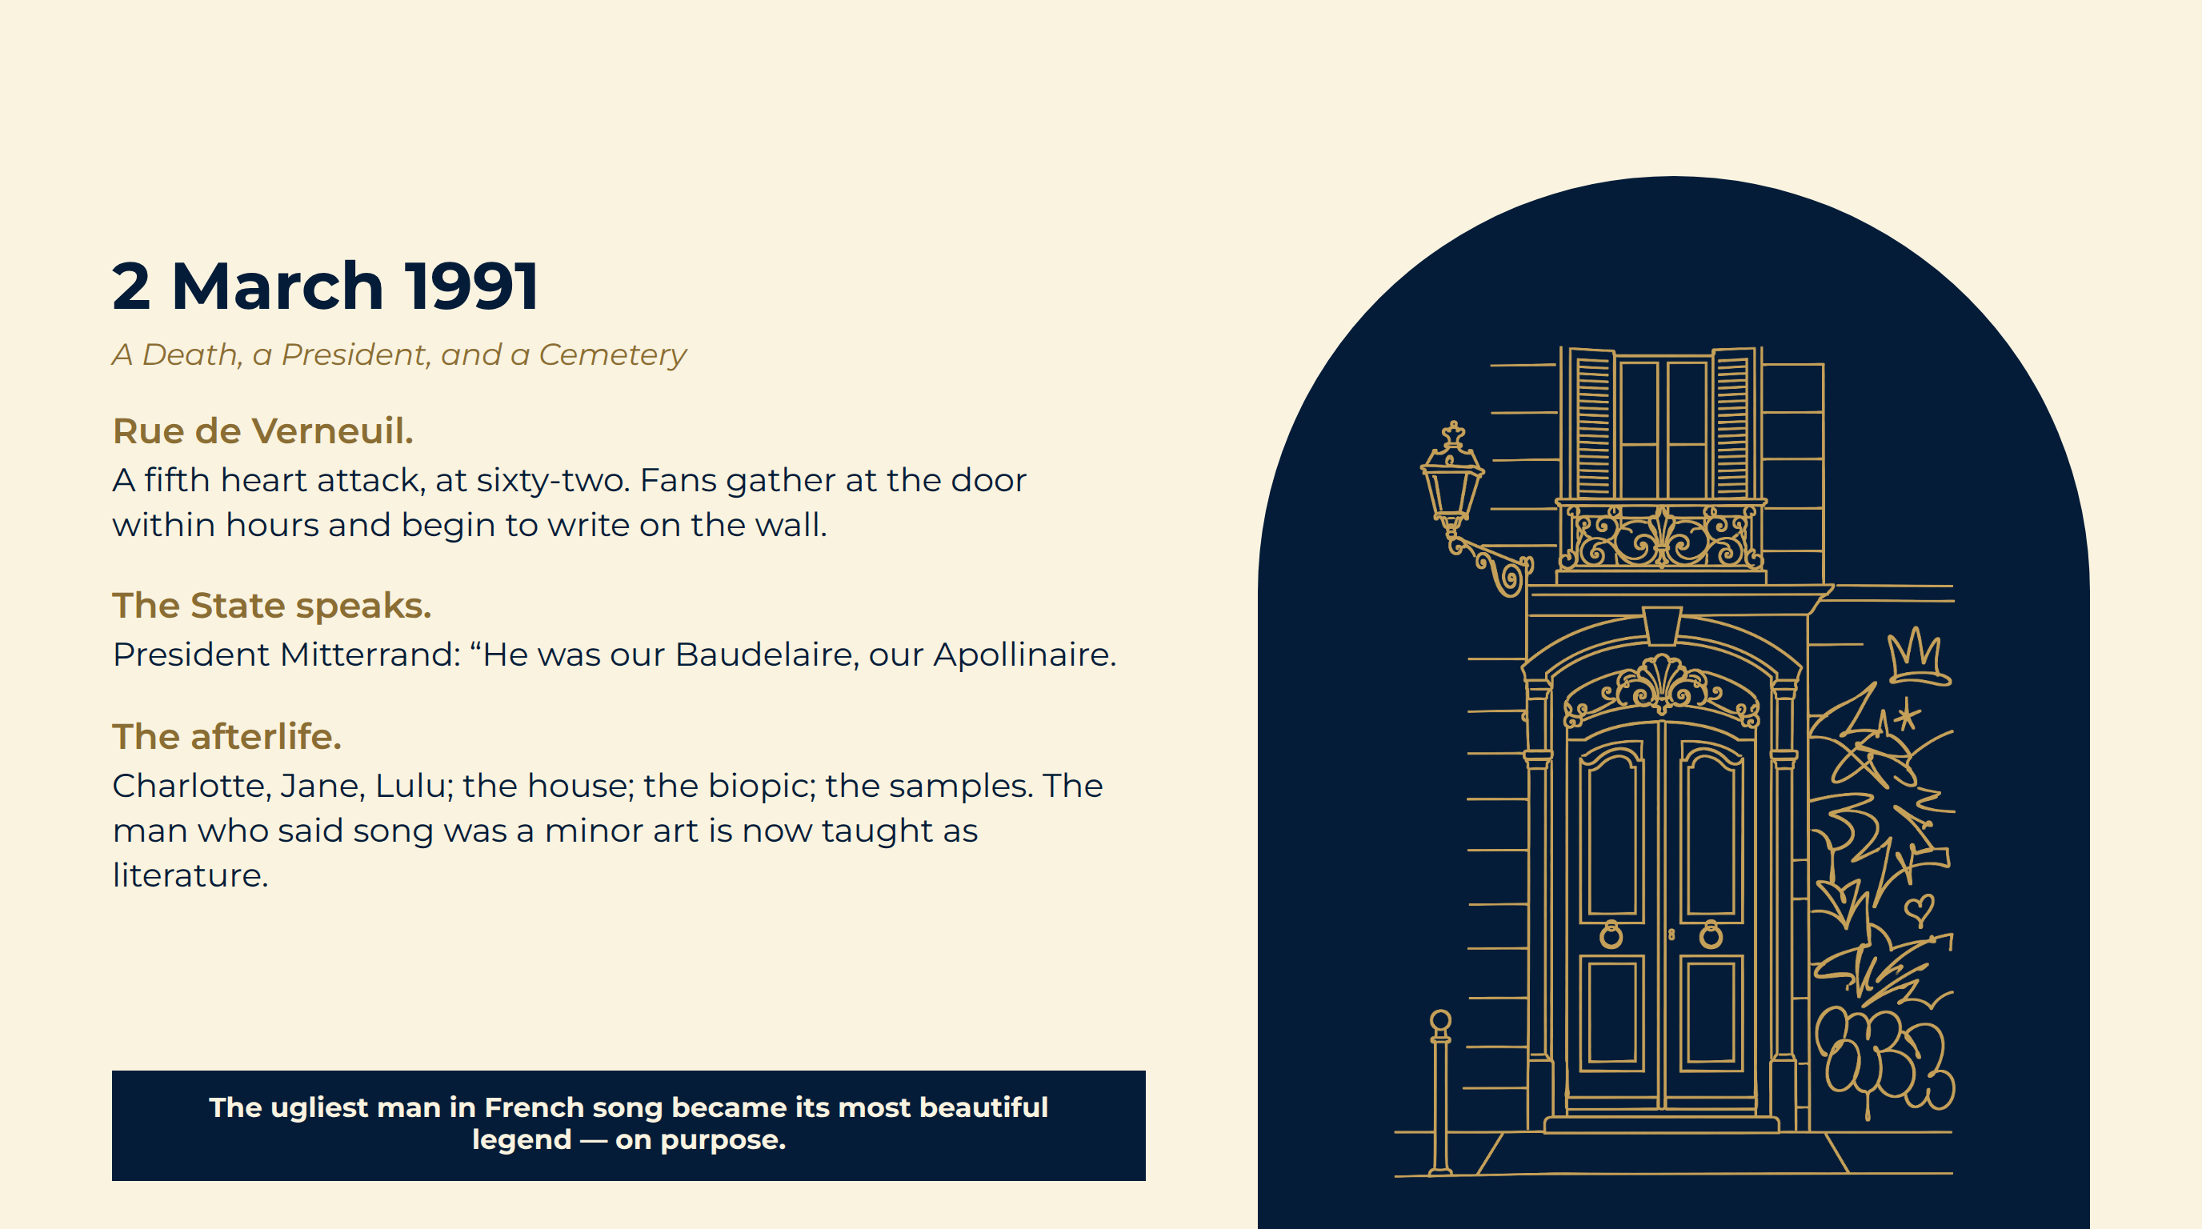
Notes:
2 March 1991
Rue de Verneuil. A fifth heart attack, at sixty-two. Fans gather at the door within hours and begin to write on the wall.
The State speaks. President Mitterrand: “He was our Baudelaire, our Apollinaire.
The afterlife. Charlotte, Jane, Lulu; the house; the biopic; the samples. The man who said song was a minor art is now taught as literature.
The ugliest man in French song became its most beautiful legend — on purpose.

Slide 19
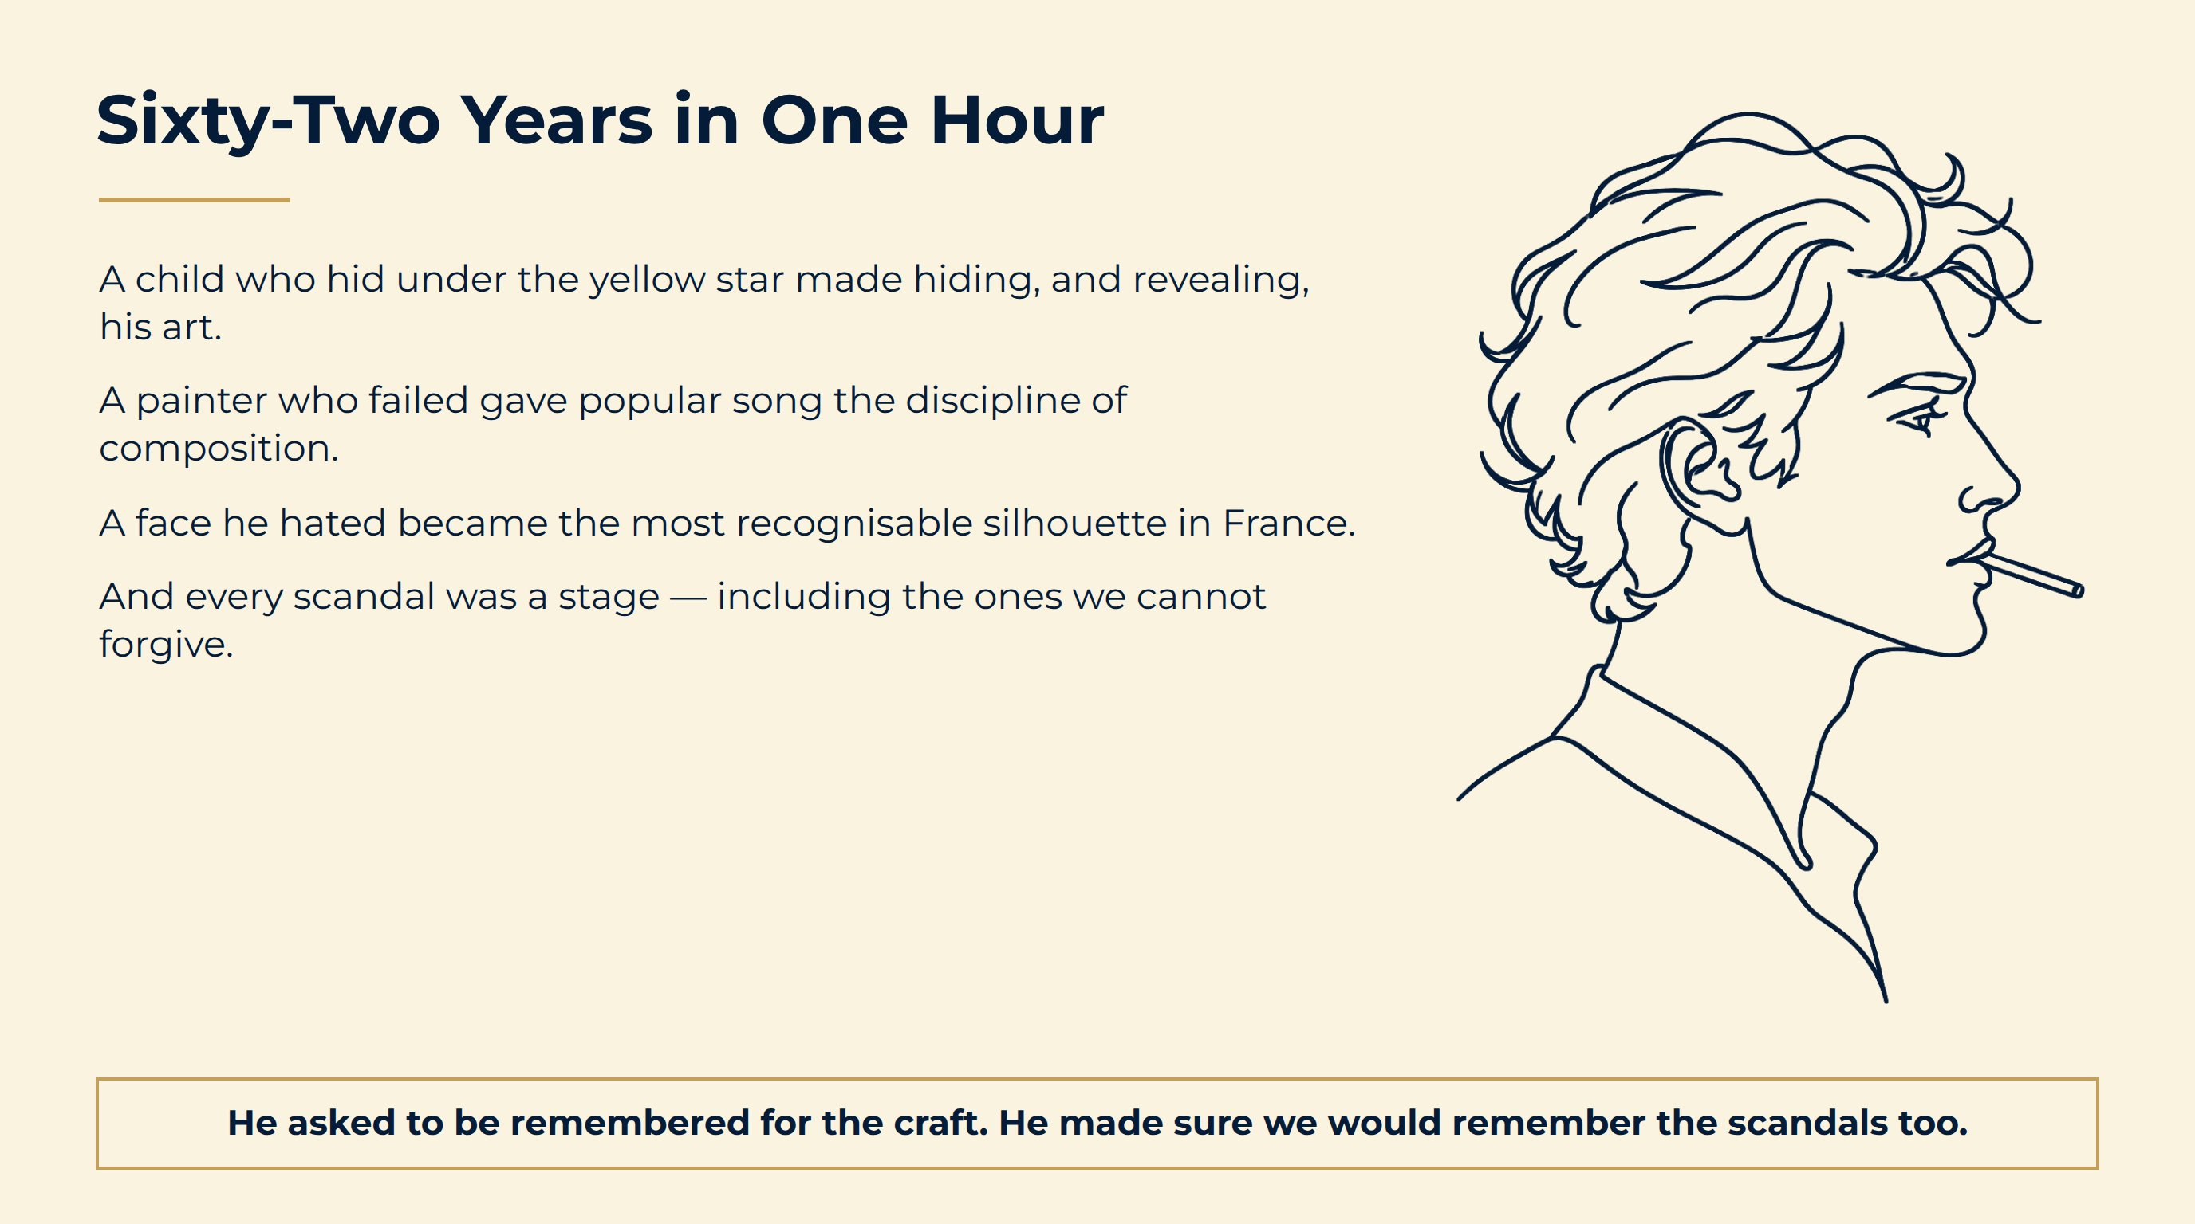
Notes:
Sixty-Two Years in One Hour
He asked to be remembered for the craft. He made sure we would remember the scandals too.

Slide 20
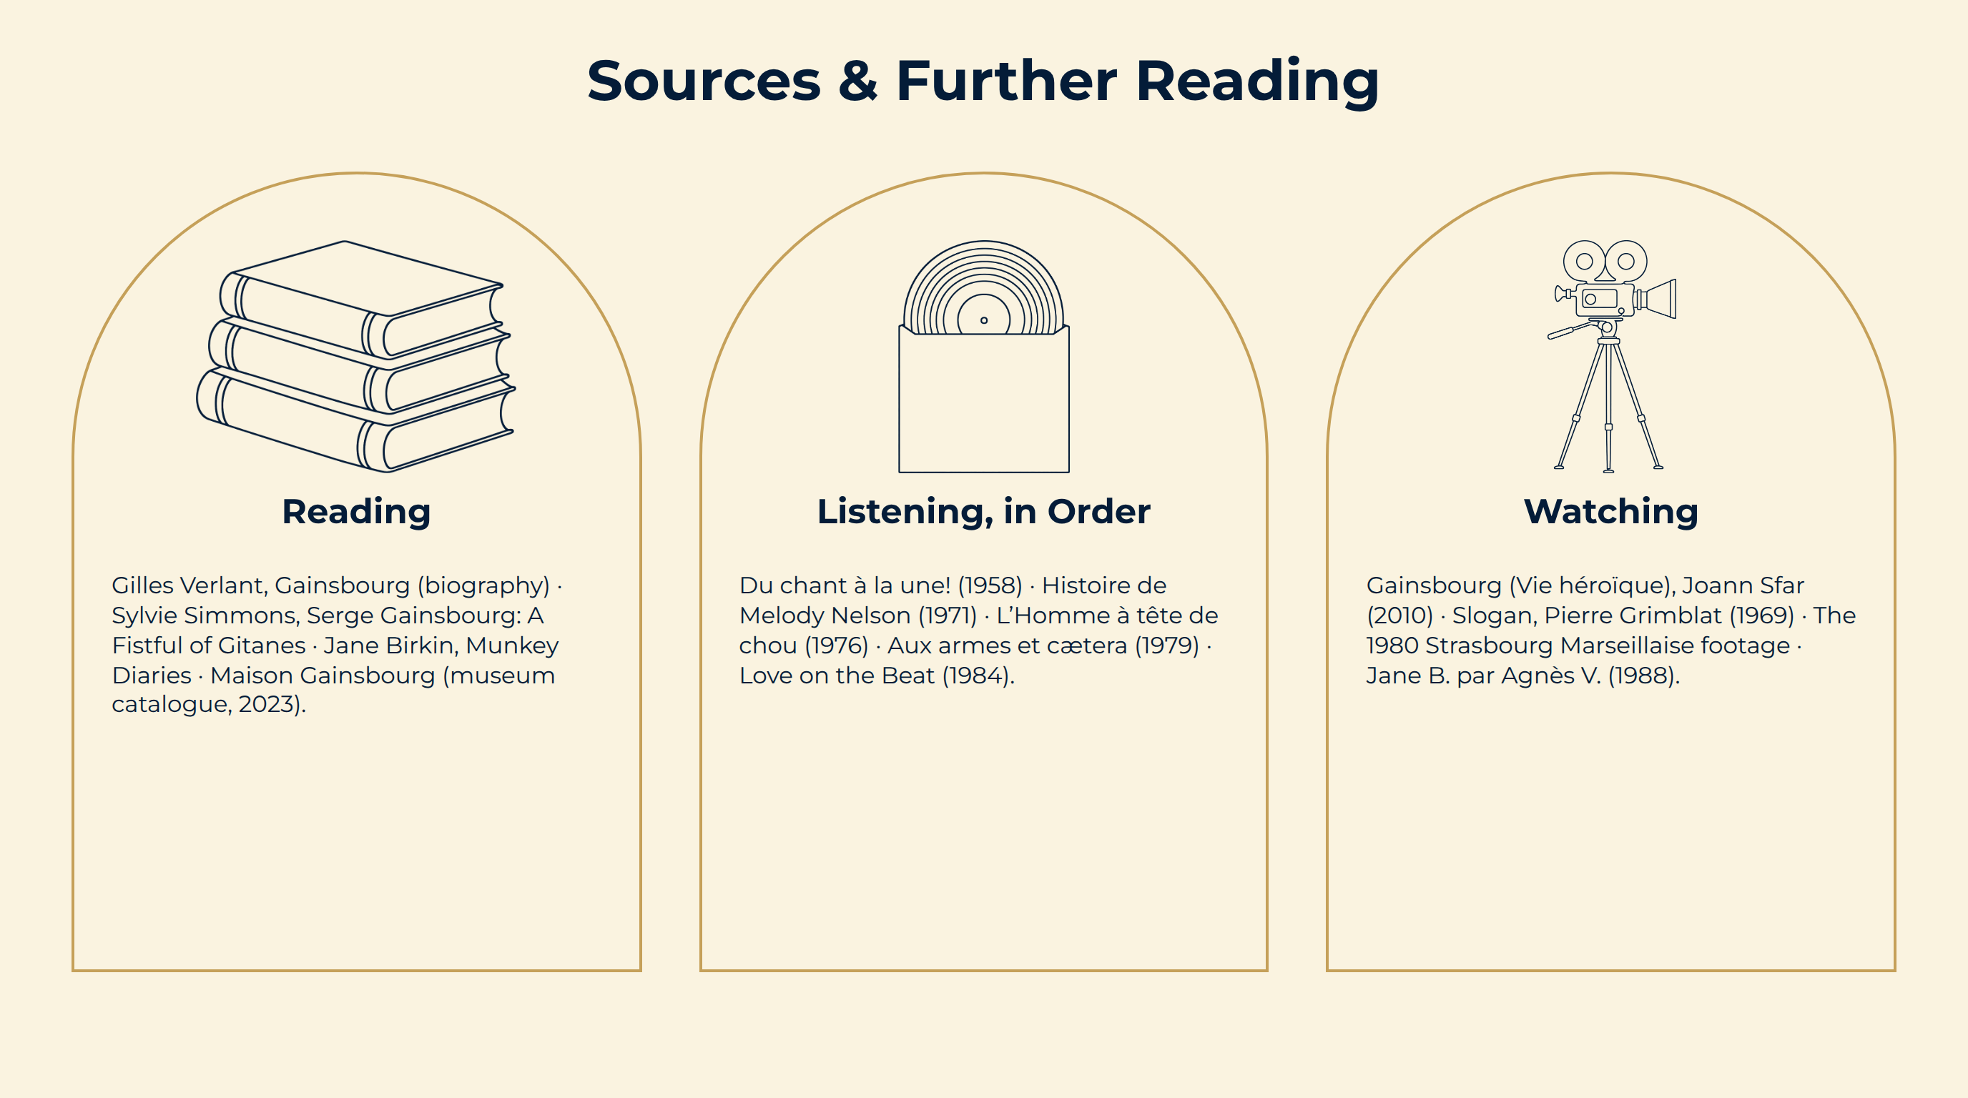
Notes:
Sources & Further Reading

