Slide 1
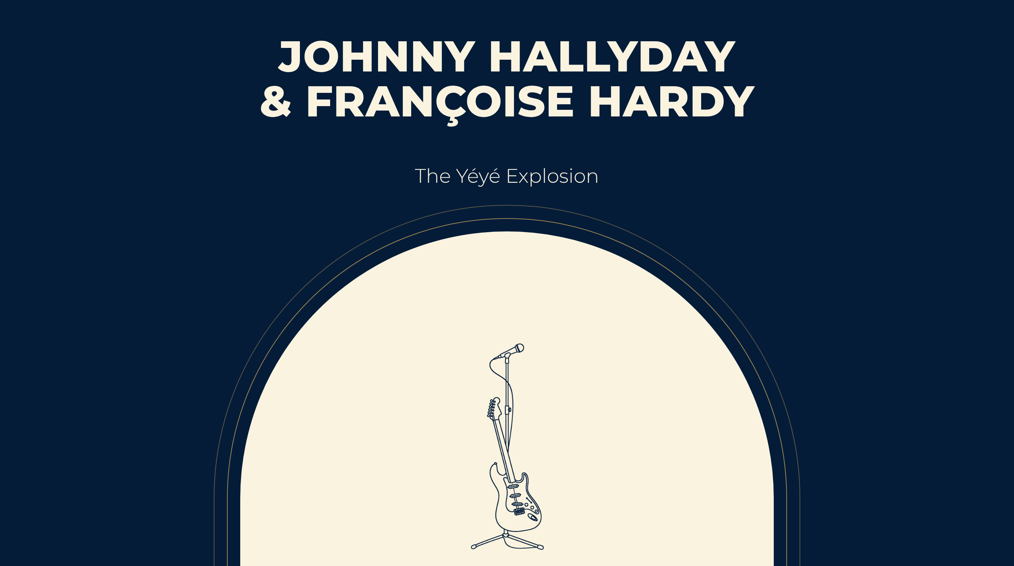
Notes:
JOHNNY HALLYDAY
& FRANÇOISE HARDY
The Yéyé Explosion

Slide 2
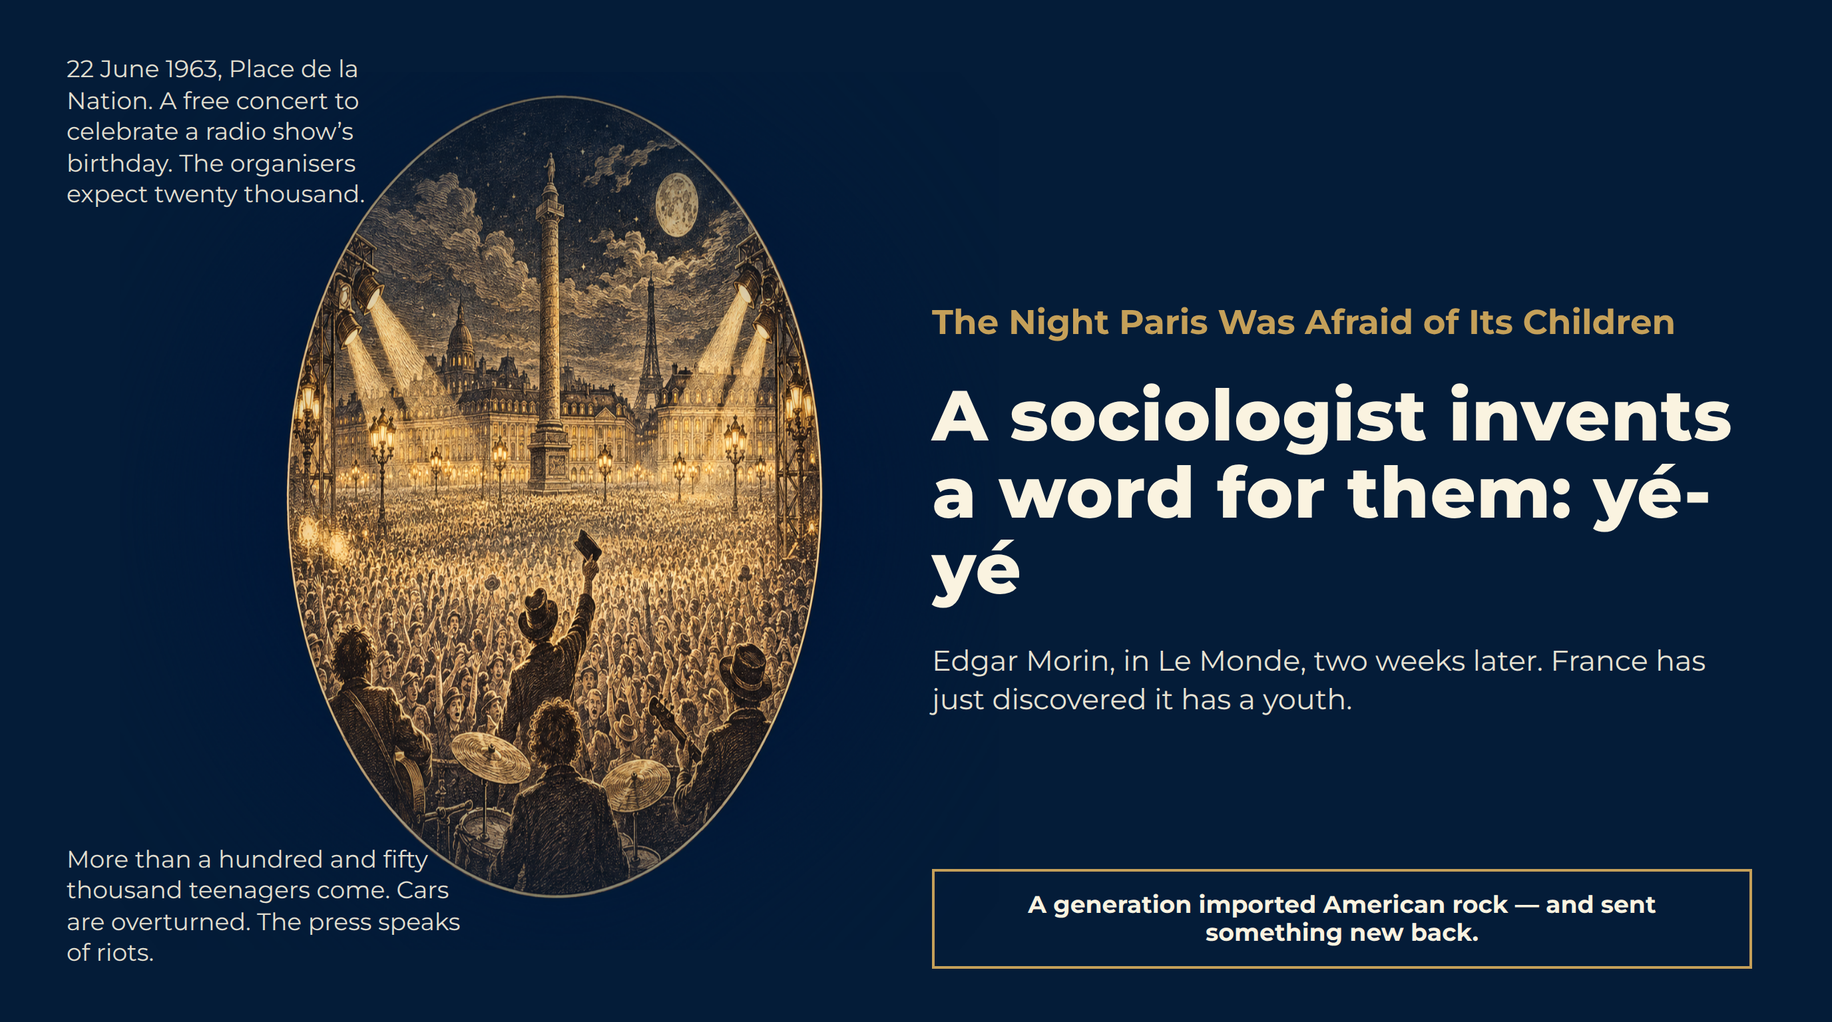
Notes:
The Night Paris Was Afraid of Its Children
22 June 1963, Place de la Nation. A free concert to celebrate a radio show’s birthday. The organisers expect twenty thousand.
More than a hundred and fifty thousand teenagers come. Cars are overturned. The press speaks of riots.
A sociologist invents a word for them: yé-yé
Edgar Morin, in Le Monde, two weeks later. France has just discovered it has a youth.
A generation imported American rock — and sent something new back.

Slide 3
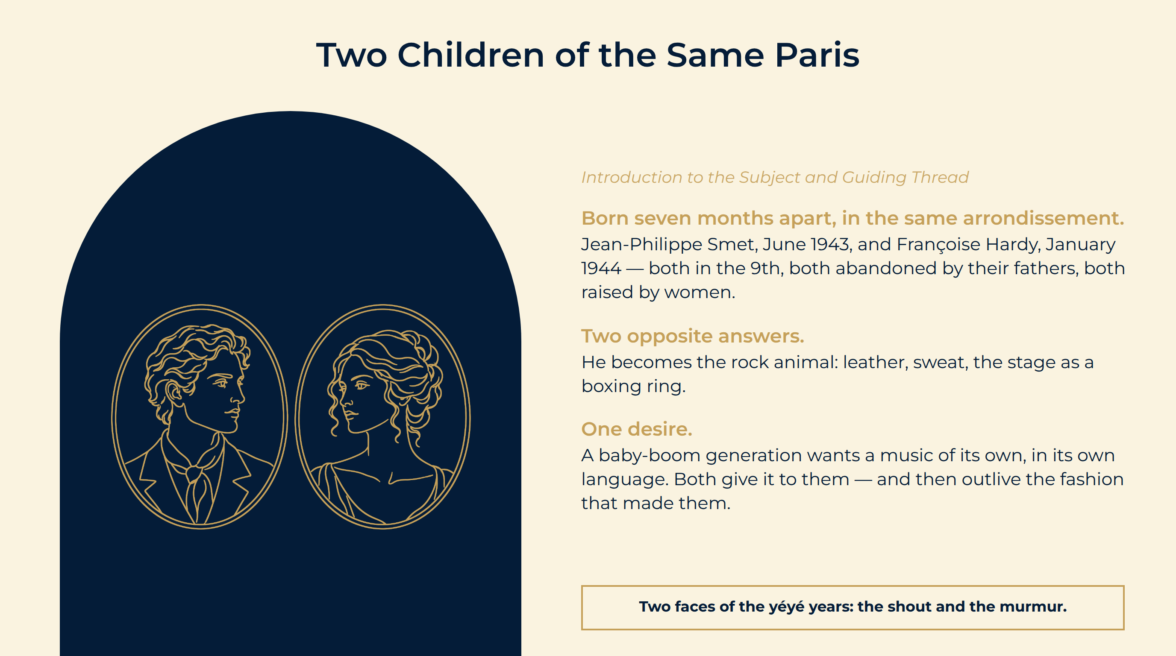
Notes:
Two Children of the Same Paris
Born seven months apart, in the same arrondissement. Jean-Philippe Smet, June 1943, and Françoise Hardy, January 1944 — both in the 9th, both abandoned by their fathers, both raised by women.
Two opposite answers. He becomes the rock animal: leather, sweat, the stage as a boxing ring.
One desire. A baby-boom generation wants a music of its own, in its own language. Both give it to them — and then outlive the fashion that made them.
Two faces of the yéyé years: the shout and the murmur.

Slide 4
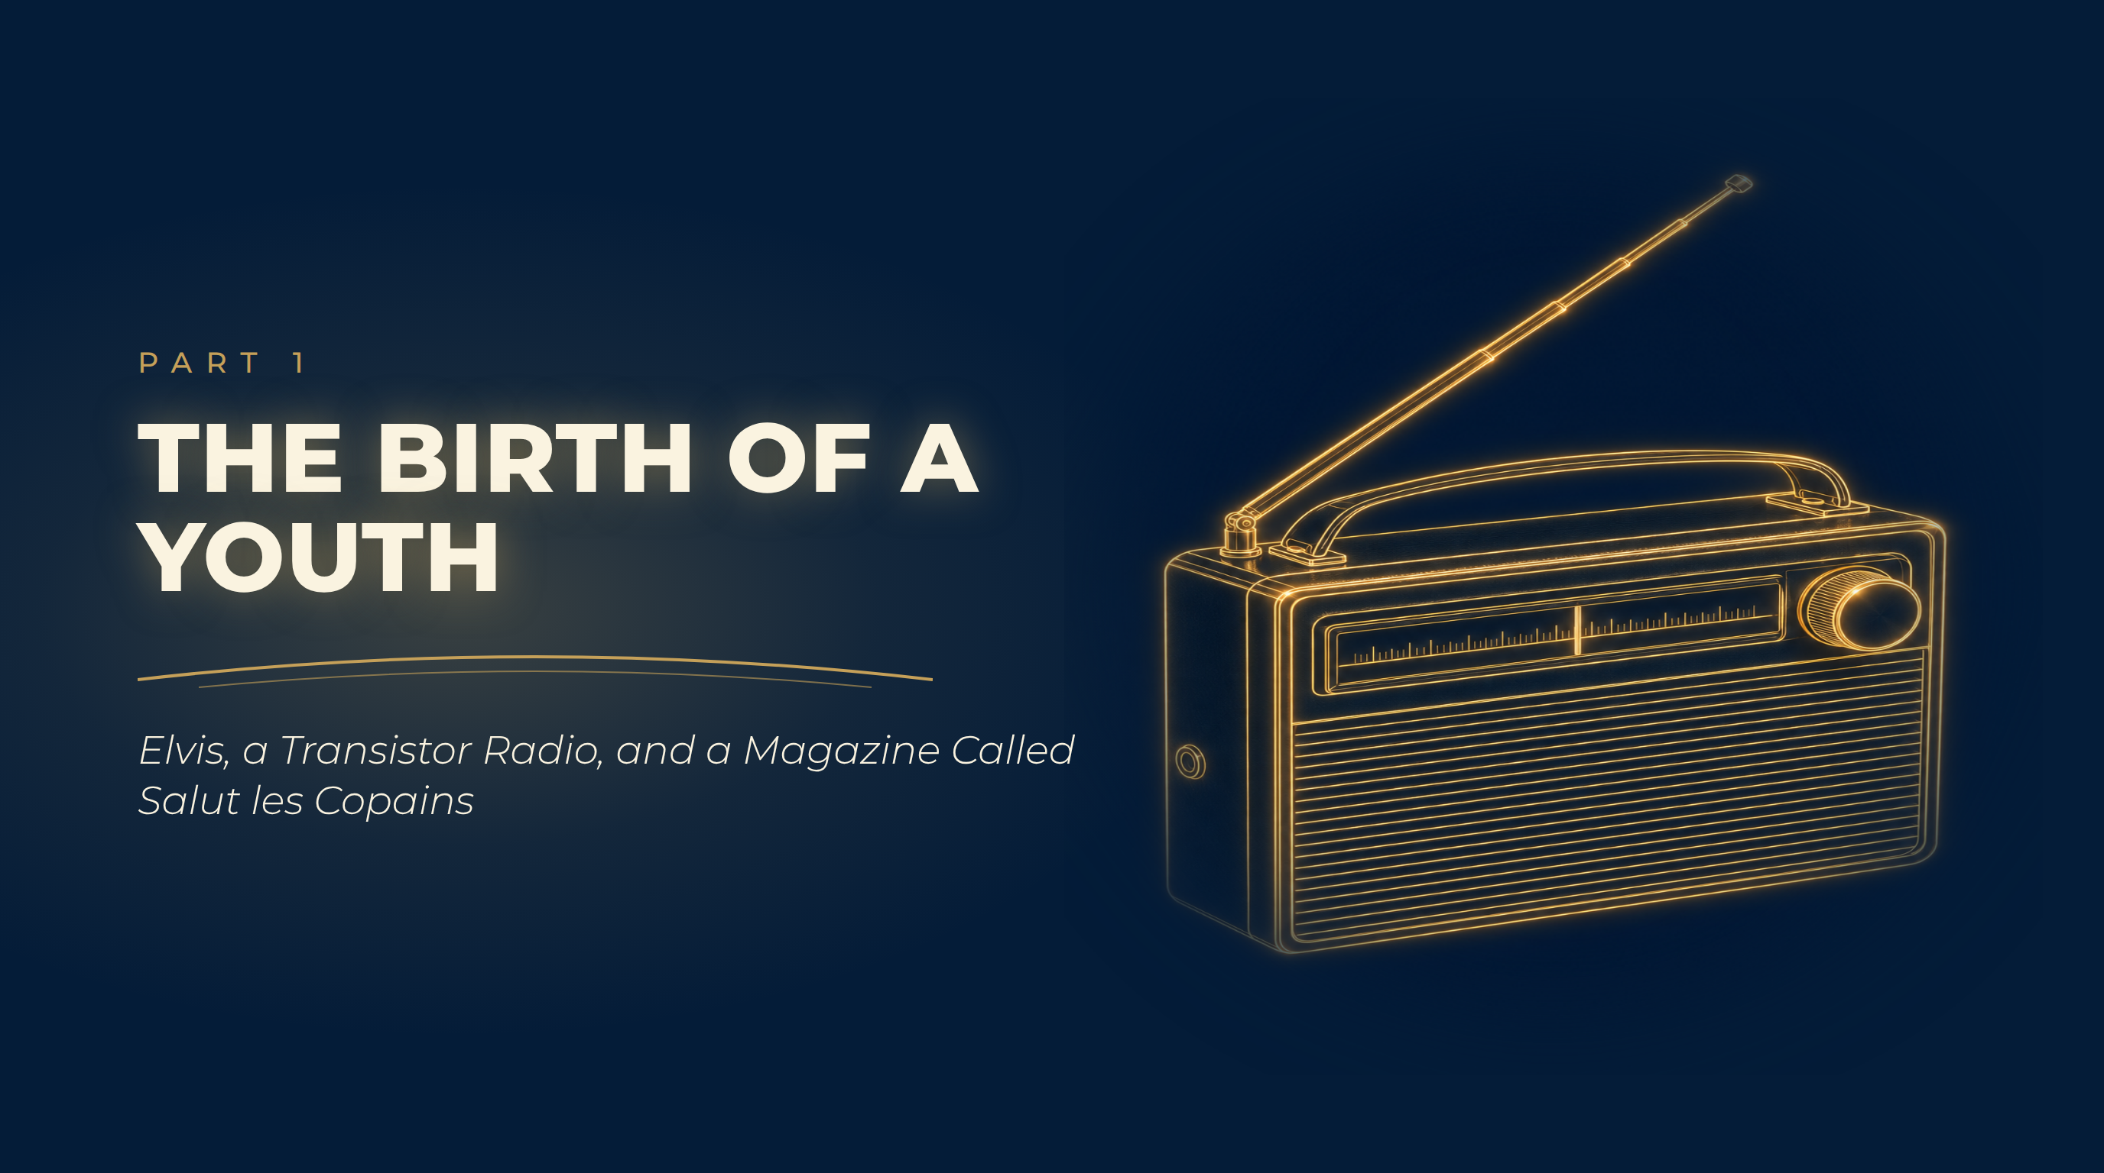
Notes:
The Birth of a Youth
Elvis, a Transistor Radio, and a Magazine Called Salut les Copains

Slide 5
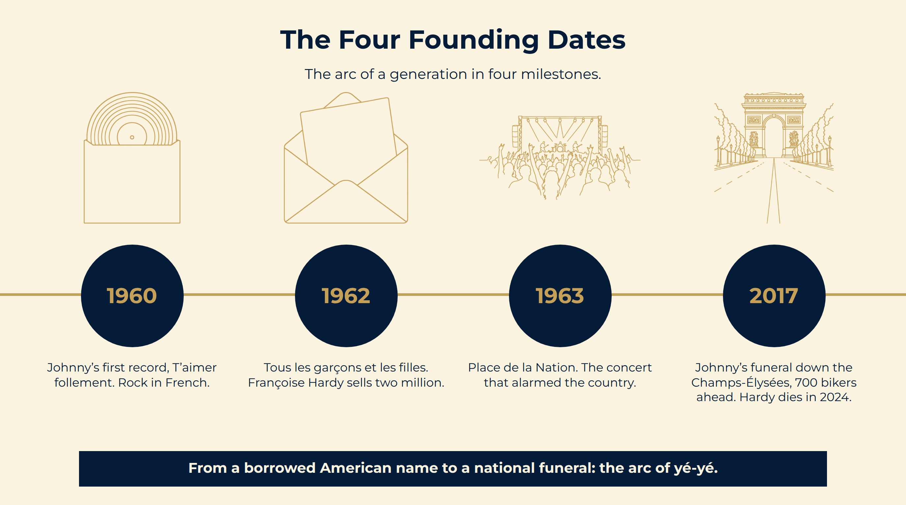
Notes:
The Four Founding Dates
From a borrowed American name to a national funeral: the arc of yé-yé.
The arc of a generation in four milestones.

Slide 6
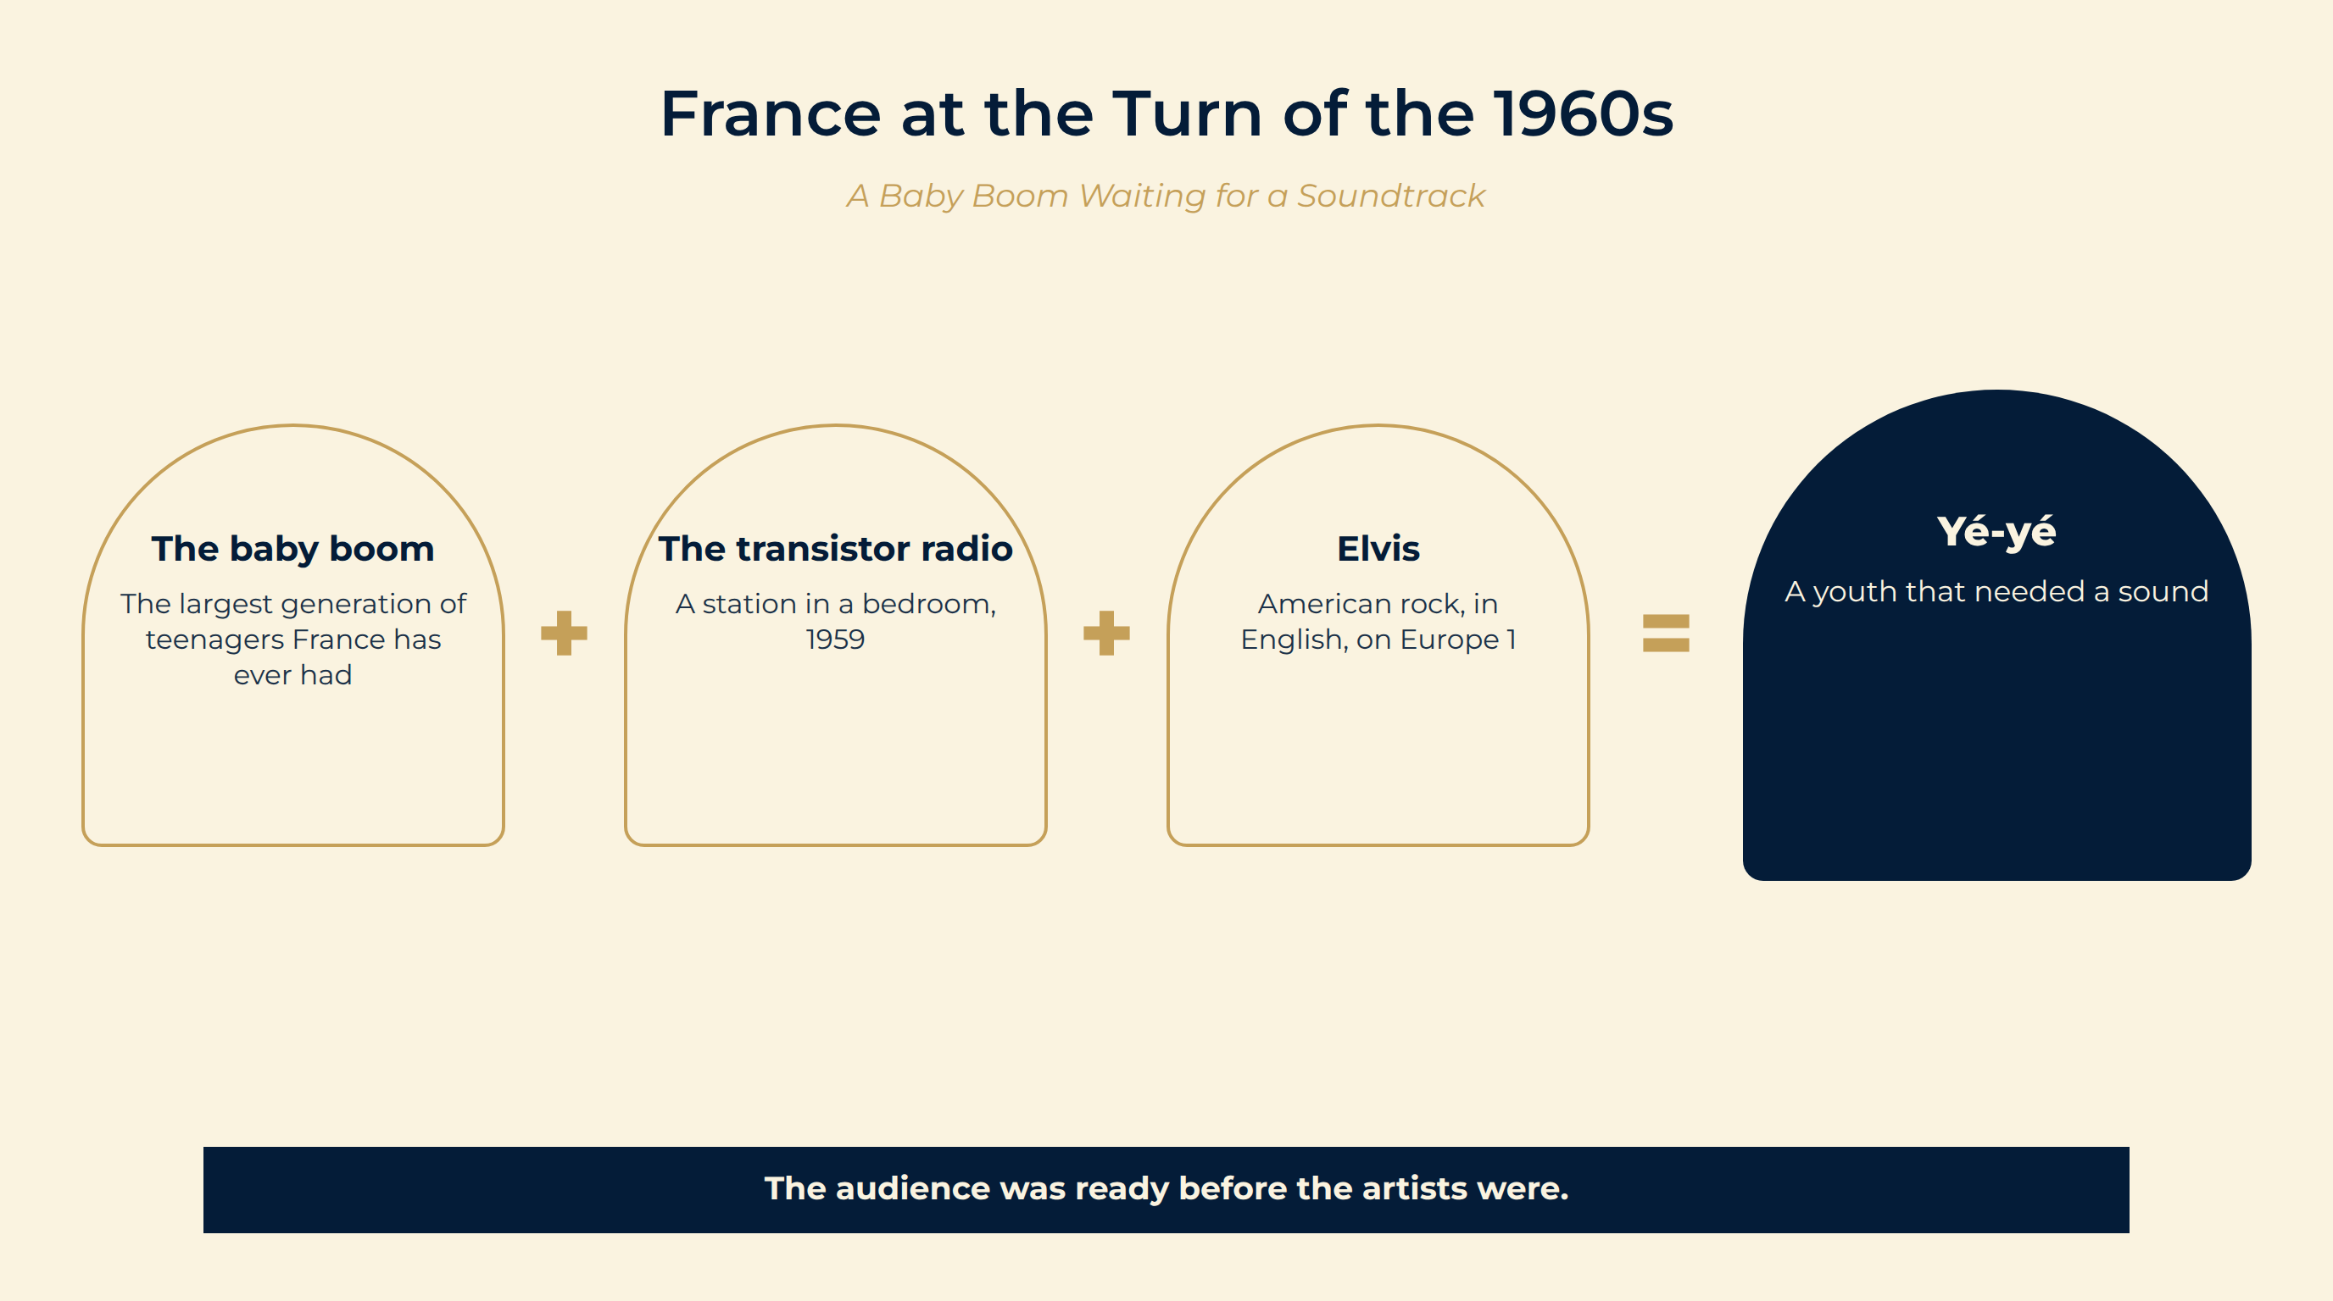
Notes:
France at the Turn of the 1960s
The numbers. The post-war boom produces the largest generation of teenagers France has ever had — with pocket money, school until sixteen, and no war in sight.
The device. The transistor radio. For the first time a young person can listen alone, in a bedroom, to a station chosen by them.
The gap. French song belongs to adults: Brassens, Brel, Piaf, Aznavour. American rock exists only in English.
The baby boom The largest generation of teenagers France has ever had
The transistor radio A station in a bedroom, 1959
Elvis American rock, in English, on Europe 1
Yé-yé A youth that needed a sound
The audience was ready before the artists were.

Slide 7
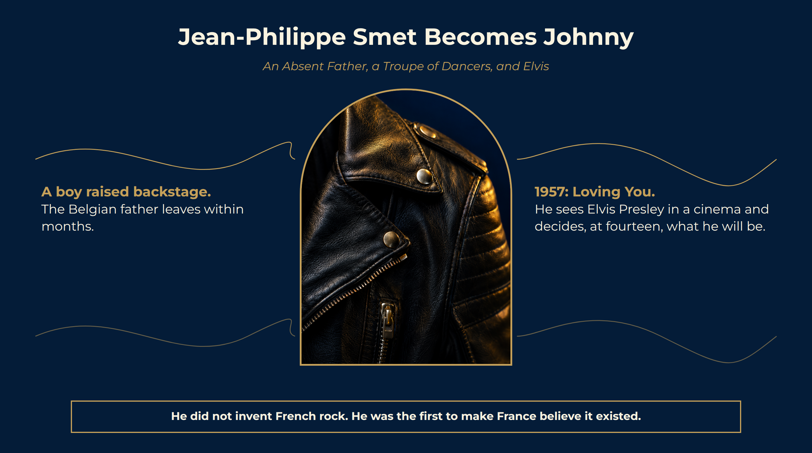
Notes:
Jean-Philippe Smet Becomes Johnny
A boy raised backstage. The Belgian father leaves within months.
1957: Loving You. He sees Elvis Presley in a cinema and decides, at fourteen, what he will be.
1960–61. A first record, a first TV appearance, and concerts where seats are torn out.
He did not invent French rock. He was the first to make France believe it existed.

Slide 8
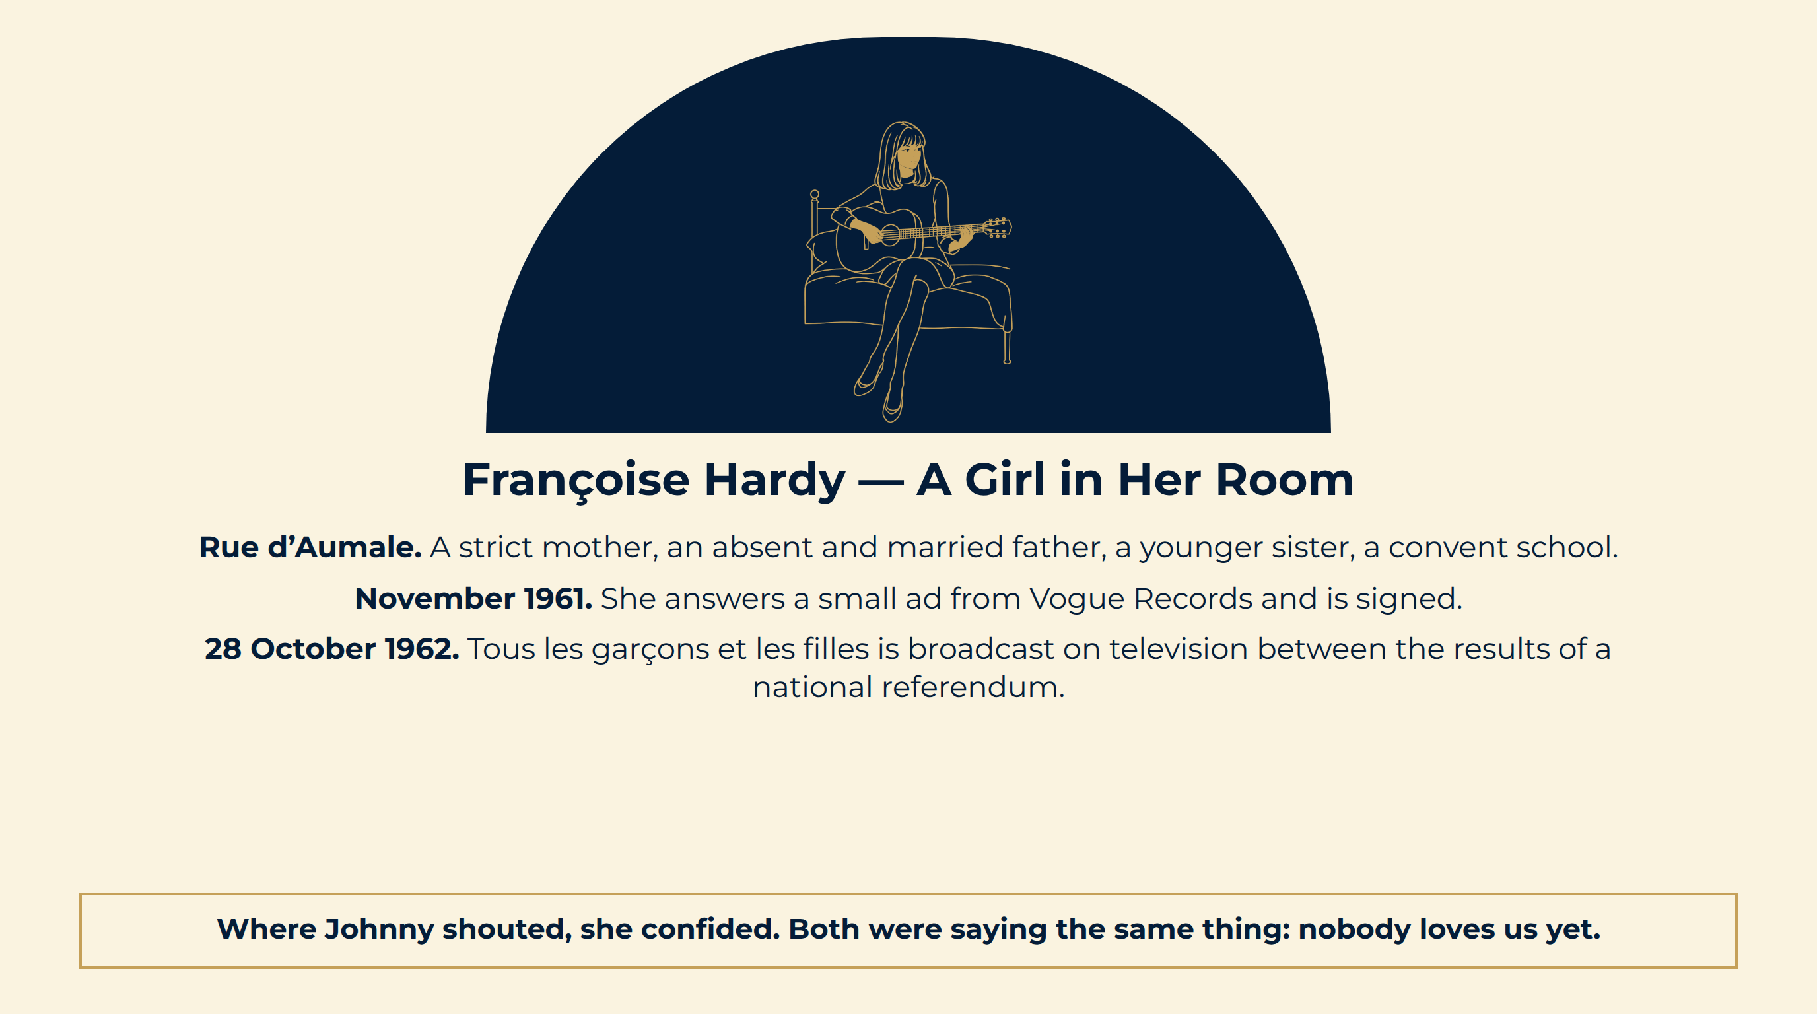
Notes:
Françoise Hardy — A Girl in Her Room
Rue d’Aumale. A strict mother, an absent and married father, a younger sister, a convent school.
November 1961. She answers a small ad from Vogue Records and is signed.
28 October 1962. Tous les garçons et les filles is broadcast on television between the results of a national referendum.
Where Johnny shouted, she confided. Both were saying the same thing: nobody loves us yet.

Slide 9
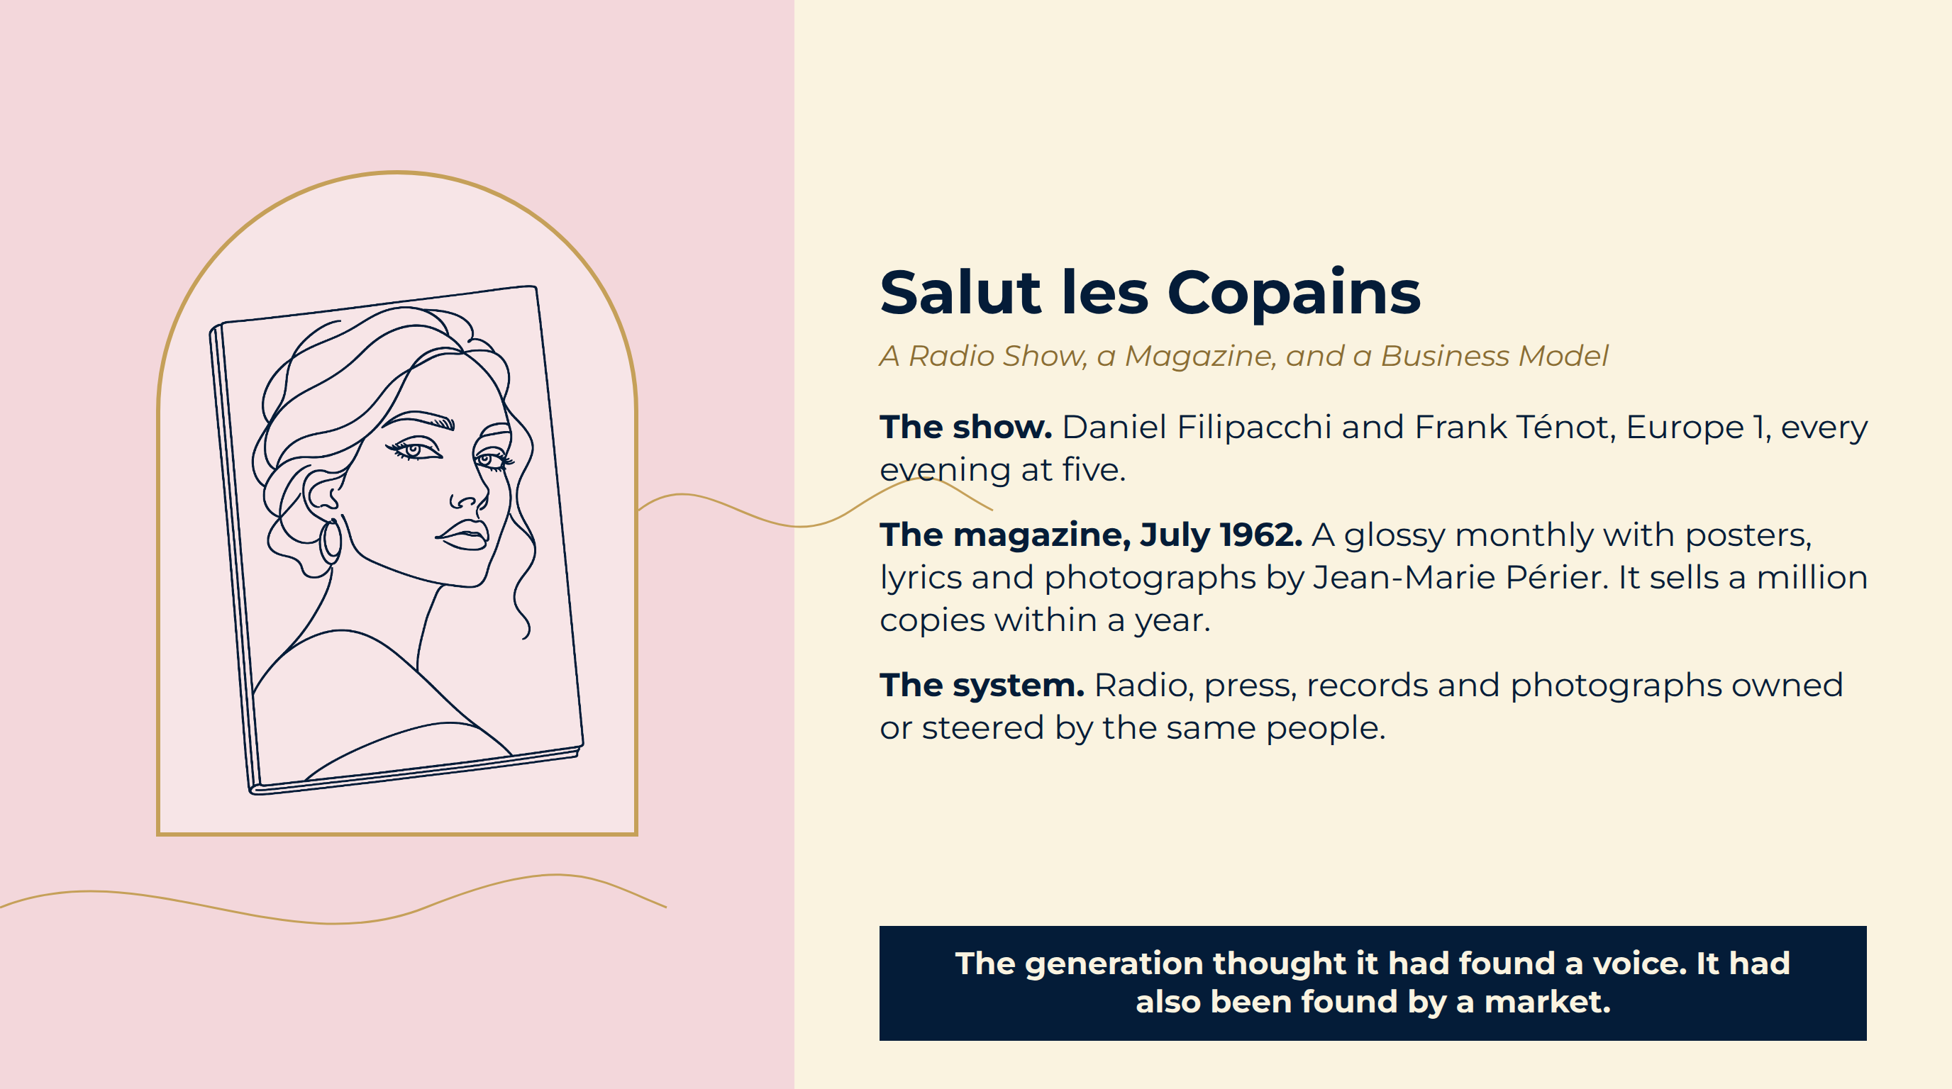
Notes:
Salut les Copains
The show. Daniel Filipacchi and Frank Ténot, Europe 1, every evening at five.
The magazine, July 1962. A glossy monthly with posters, lyrics and photographs by Jean-Marie Périer. It sells a million copies within a year.
The system. Radio, press, records and photographs owned or steered by the same people.
The generation thought it had found a voice. It had also been found by a market.

Slide 10
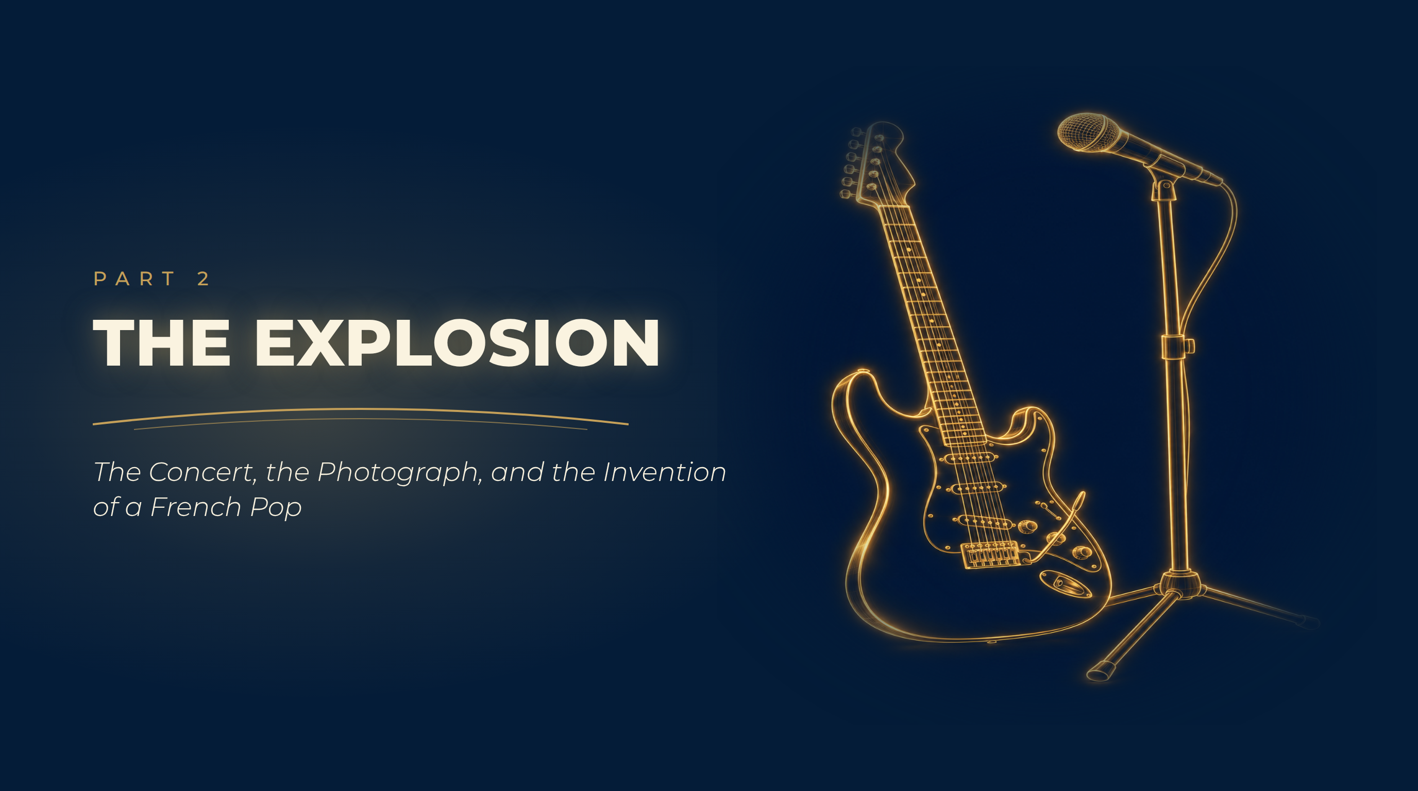
Notes:
The Explosion
The Concert, the Photograph, and the Invention of a French Pop

Slide 11
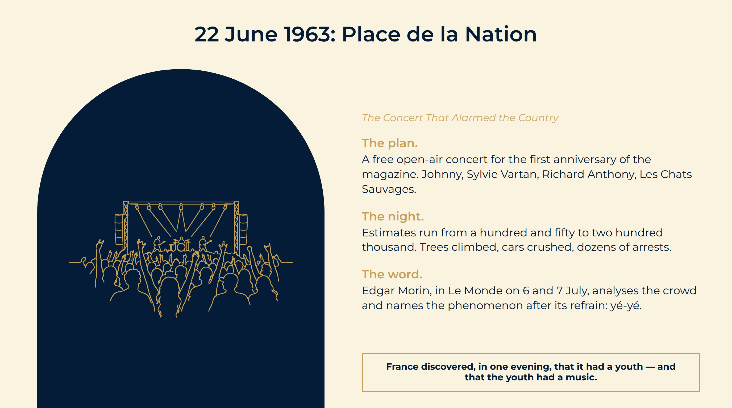
Notes:
22 June 1963: Place de la Nation
The plan. A free open-air concert for the first anniversary of the magazine. Johnny, Sylvie Vartan, Richard Anthony, Les Chats Sauvages.
The night. Estimates run from a hundred and fifty to two hundred thousand. Trees climbed, cars crushed, dozens of arrests.
The word. Edgar Morin, in Le Monde on 6 and 7 July, analyses the crowd and names the phenomenon after its refrain: yé-yé.
France discovered, in one evening, that it had a youth — and that the youth had a music.

Slide 12
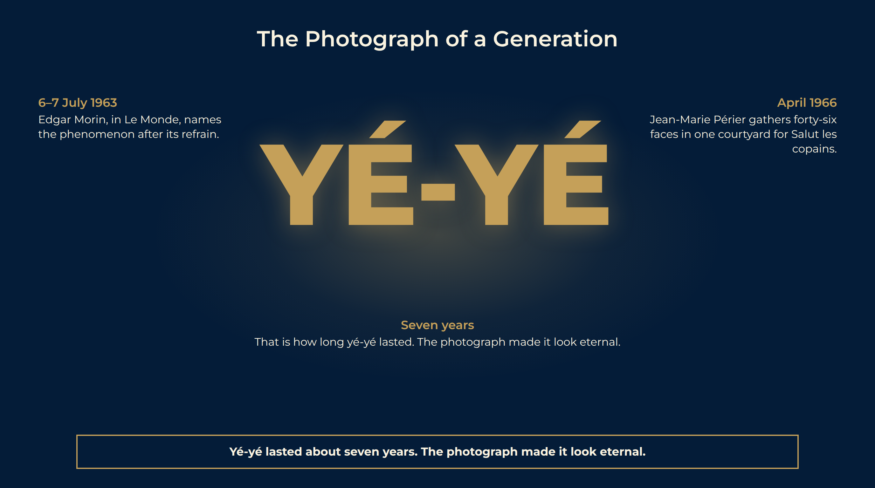
Notes:
The Photograph of a Generation
Forty-six faces. Johnny, Sylvie, Françoise, Dutronc, Gall, Sheila, Eddy Mitchell, Claude François — photographed together for Salut les copains in a single frame.
What it fixes. A moment when the whole of French pop could stand in one courtyard. Many are not yet twenty-five.
What it hides. The quarrels, the rivalries, the business behind the smiles — and the fact that within three years the fashion will have passed.
6–7 July 1963 Edgar Morin, in Le Monde, names the phenomenon after its refrain.
April 1966 Jean-Marie Périer gathers forty-six faces in one courtyard for Salut les copains.
Seven years That is how long yé-yé lasted. The photograph made it look eternal.
Yé-yé lasted about seven years. The photograph made it look eternal.

Slide 13
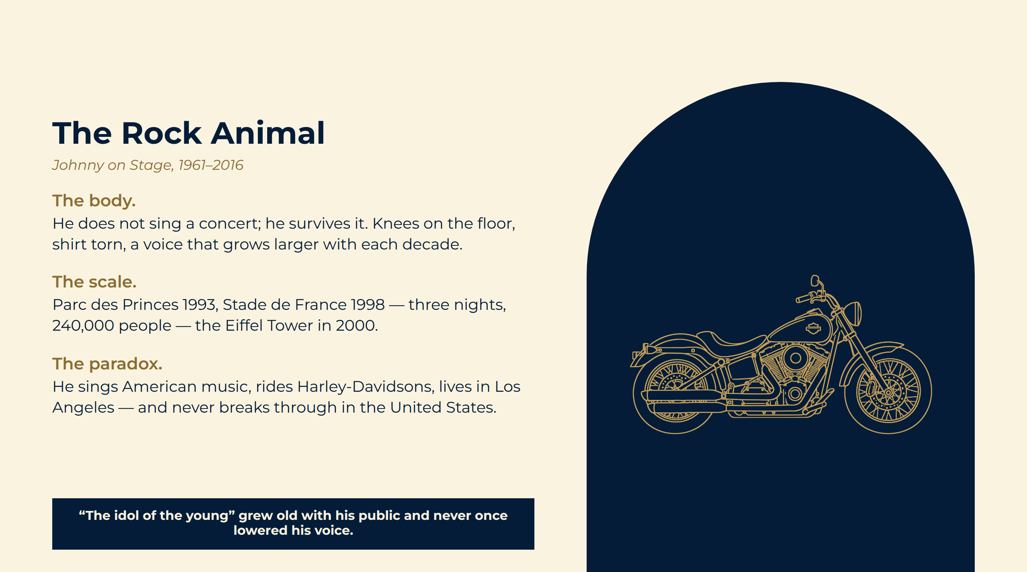
Notes:
The Rock Animal
The body. He does not sing a concert; he survives it. Knees on the floor, shirt torn, a voice that grows larger with each decade.
The scale. Parc des Princes 1993, Stade de France 1998 — three nights, 240,000 people — the Eiffel Tower in 2000.
The paradox. He sings American music, rides Harley-Davidsons, lives in Los Angeles — and never breaks through in the United States.
“The idol of the young” grew old with his public and never once lowered his voice.

Slide 14
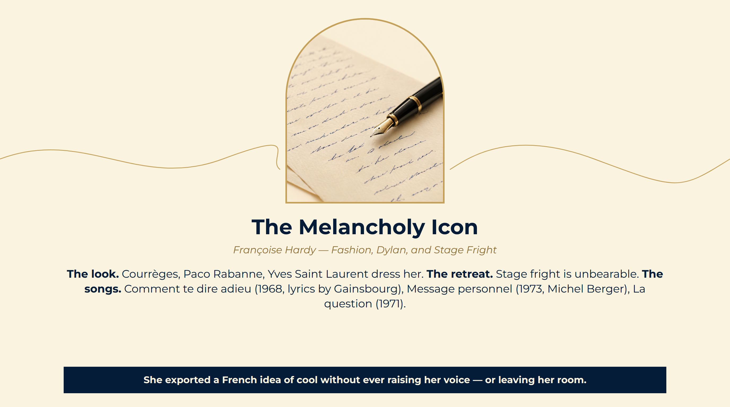
Notes:
The Melancholy Icon
The look. Courrèges, Paco Rabanne, Yves Saint Laurent dress her.
The retreat. Stage fright is unbearable.
The songs. Comment te dire adieu (1968, lyrics by Gainsbourg), Message personnel (1973, Michel Berger), La question (1971).
She exported a French idea of cool without ever raising her voice — or leaving her room.

Slide 15
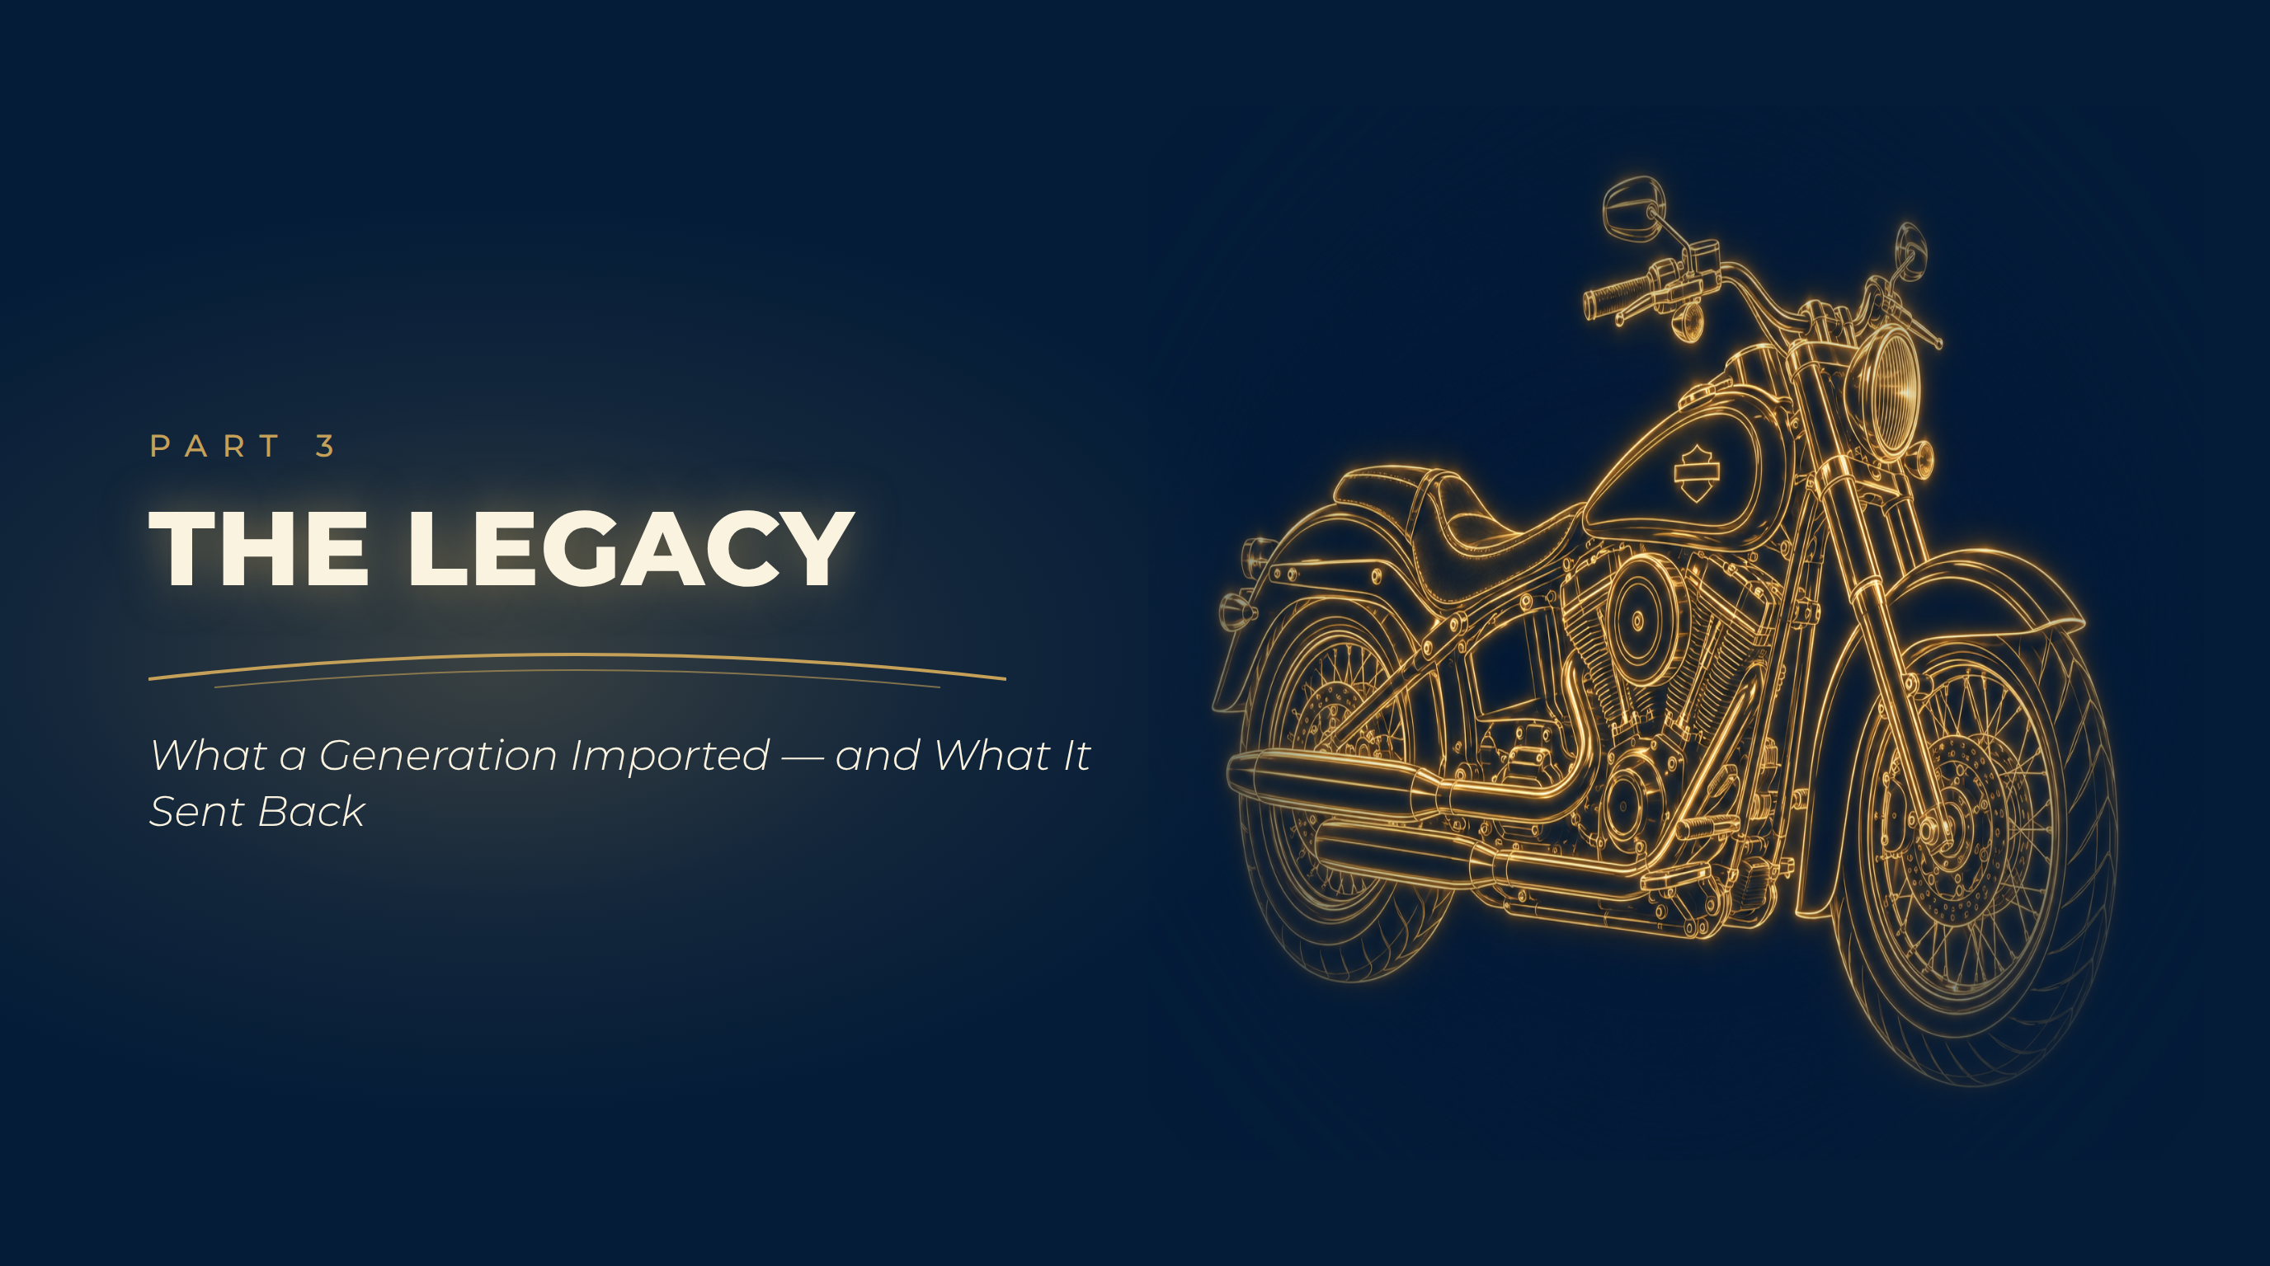
Notes:
The Legacy
What a Generation Imported — and What It Sent Back

Slide 16
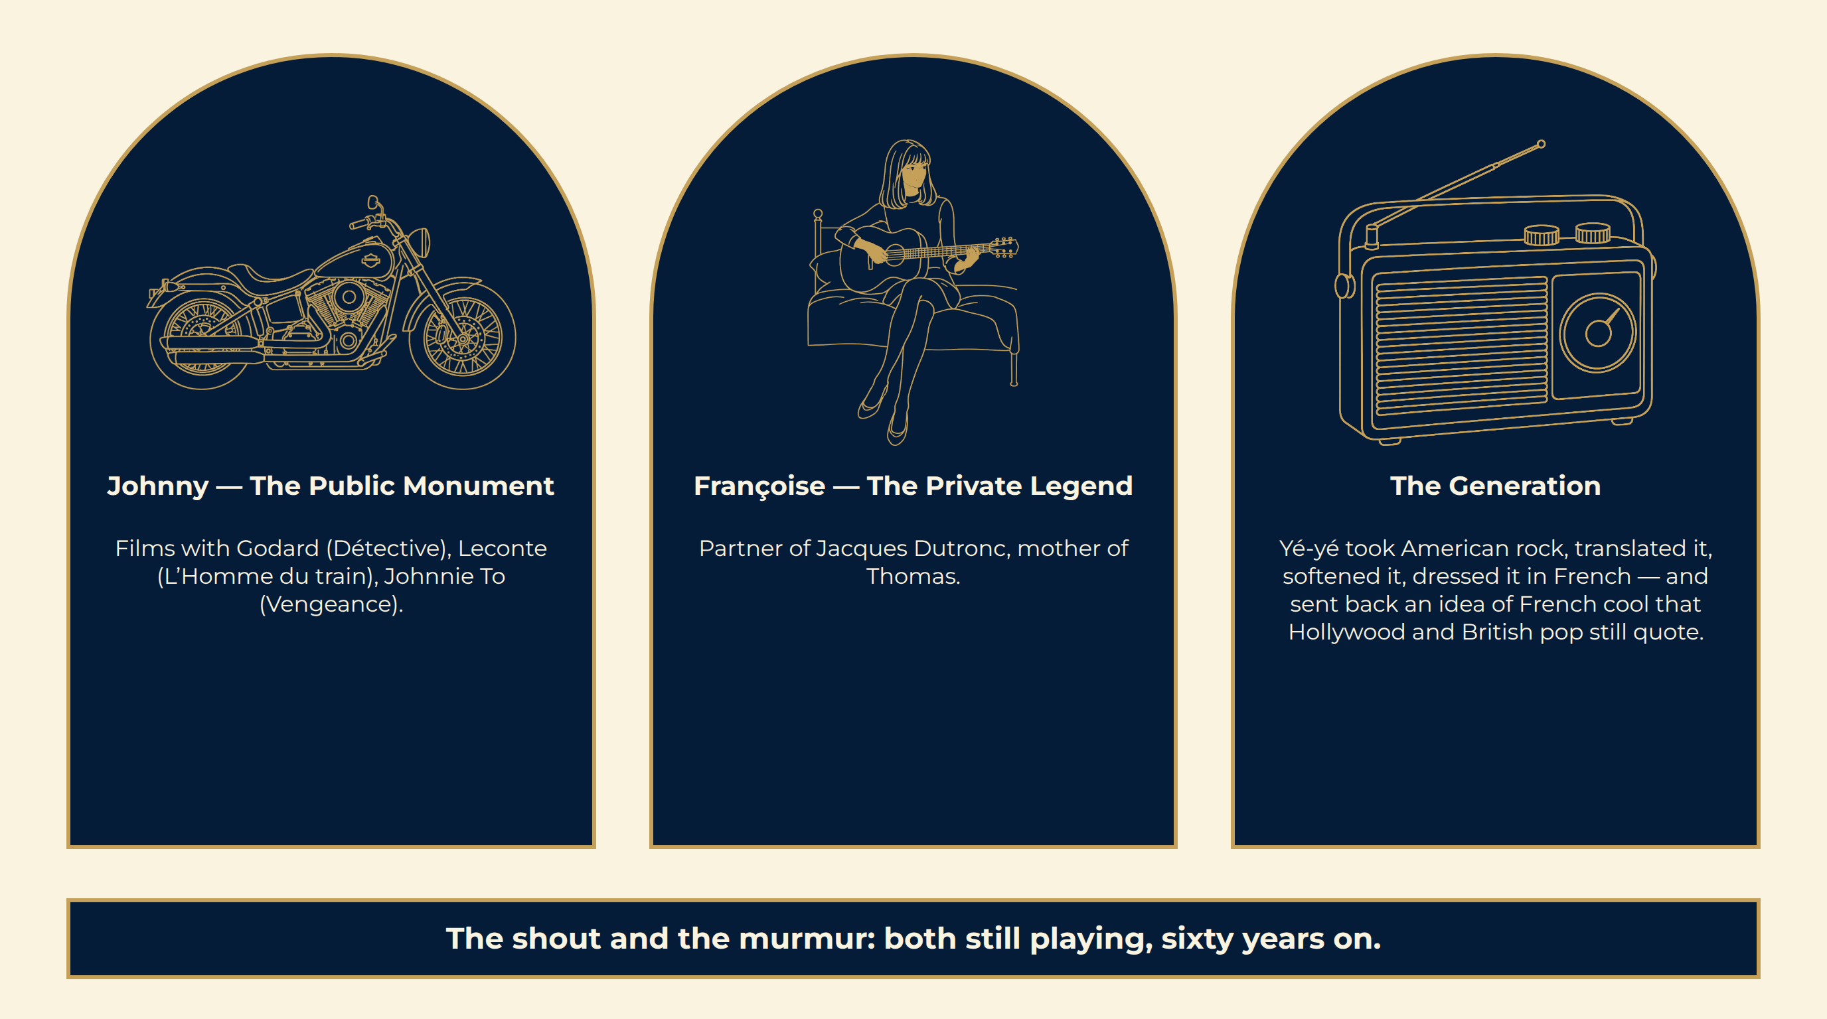
Notes:
Two Opposite Lives, One Legacy
The shout and the murmur: both still playing, sixty years on.

Slide 17
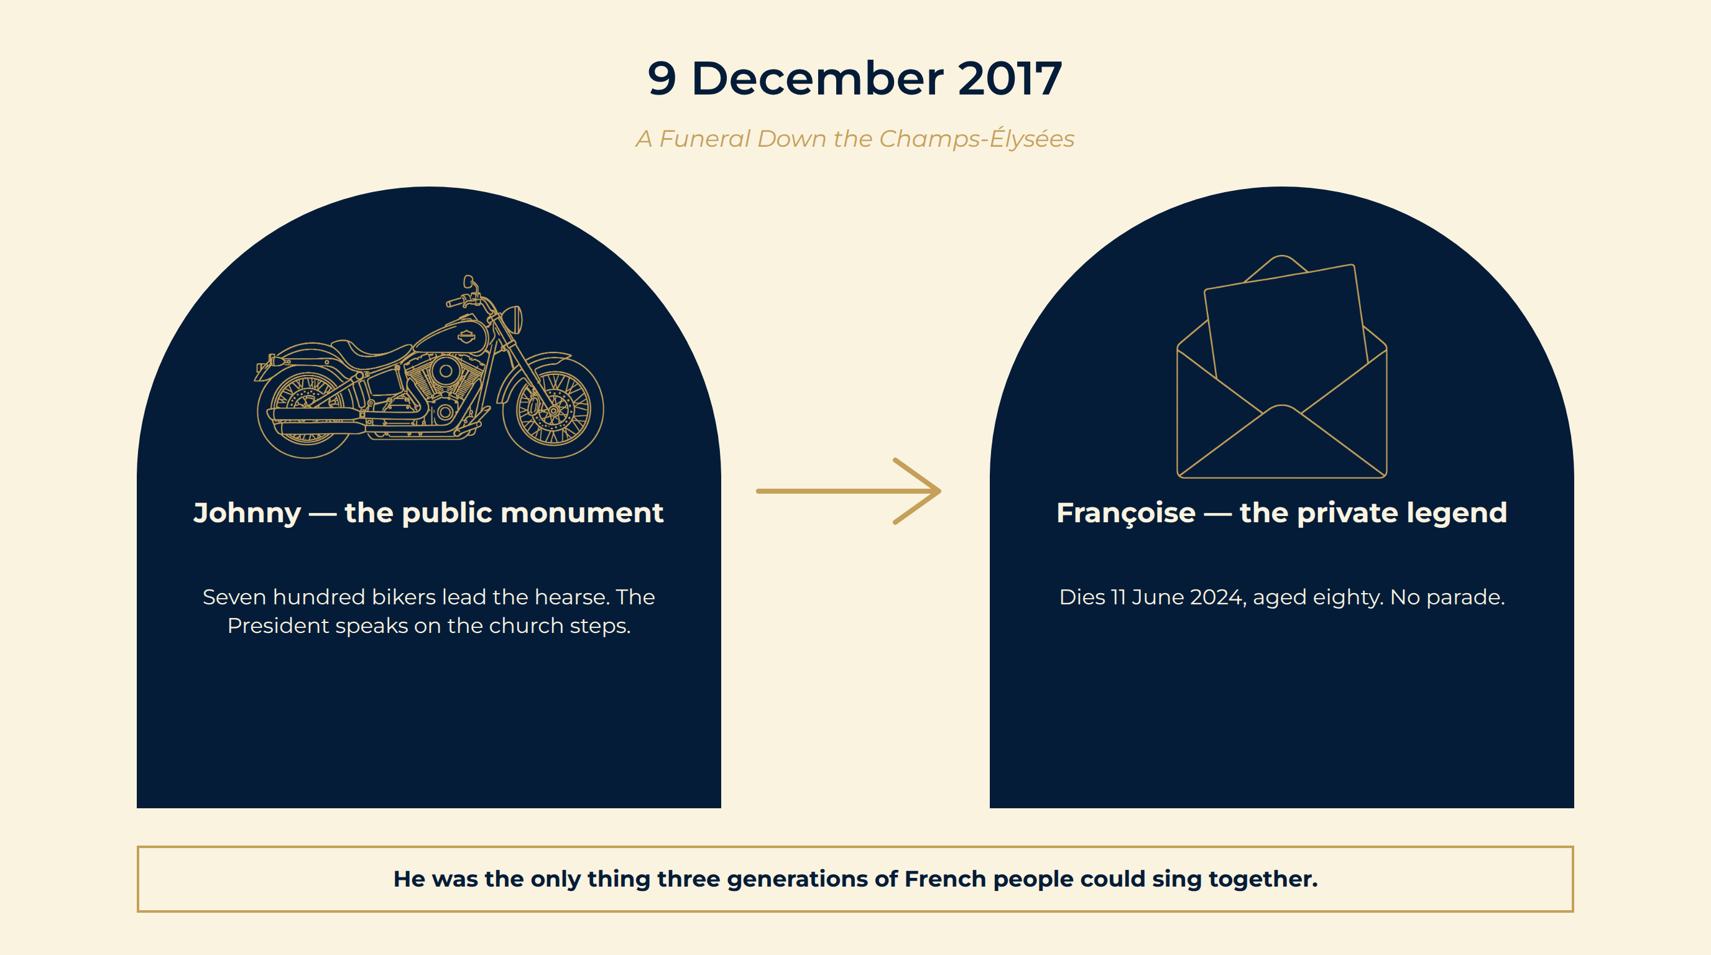
Notes:
9 December 2017
The procession. Seven hundred motorcycles lead the hearse from the Arc de Triomphe to the Madeleine. A million people line the avenue in the cold.
The State. The President of the Republic speaks on the church steps: “a part of France.” The man once called a hooligan is given the farewell of a head of state.
The afterlife. Buried on the island of Saint-Barthélemy.
Johnny — the public monument Seven hundred bikers lead the hearse. The President speaks on the church steps.
Françoise — the private legend Dies 11 June 2024, aged eighty. No parade.
He was the only thing three generations of French people could sing together.

Slide 18
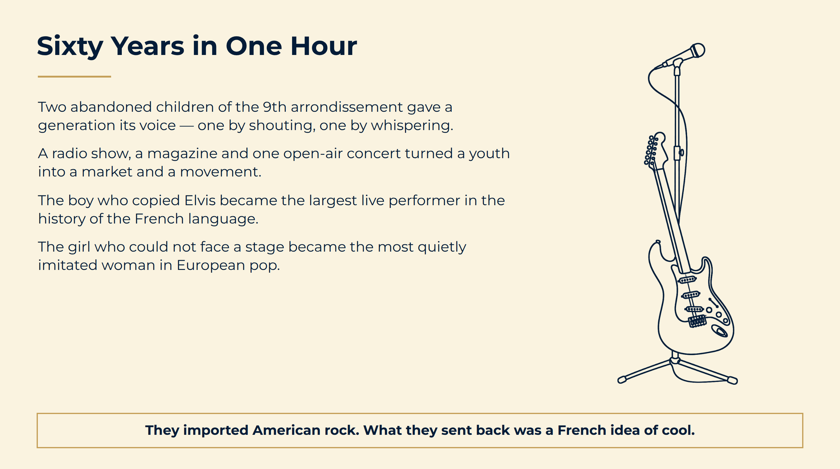
Notes:
Sixty Years in One Hour
They imported American rock. What they sent back was a French idea of cool.

Slide 19
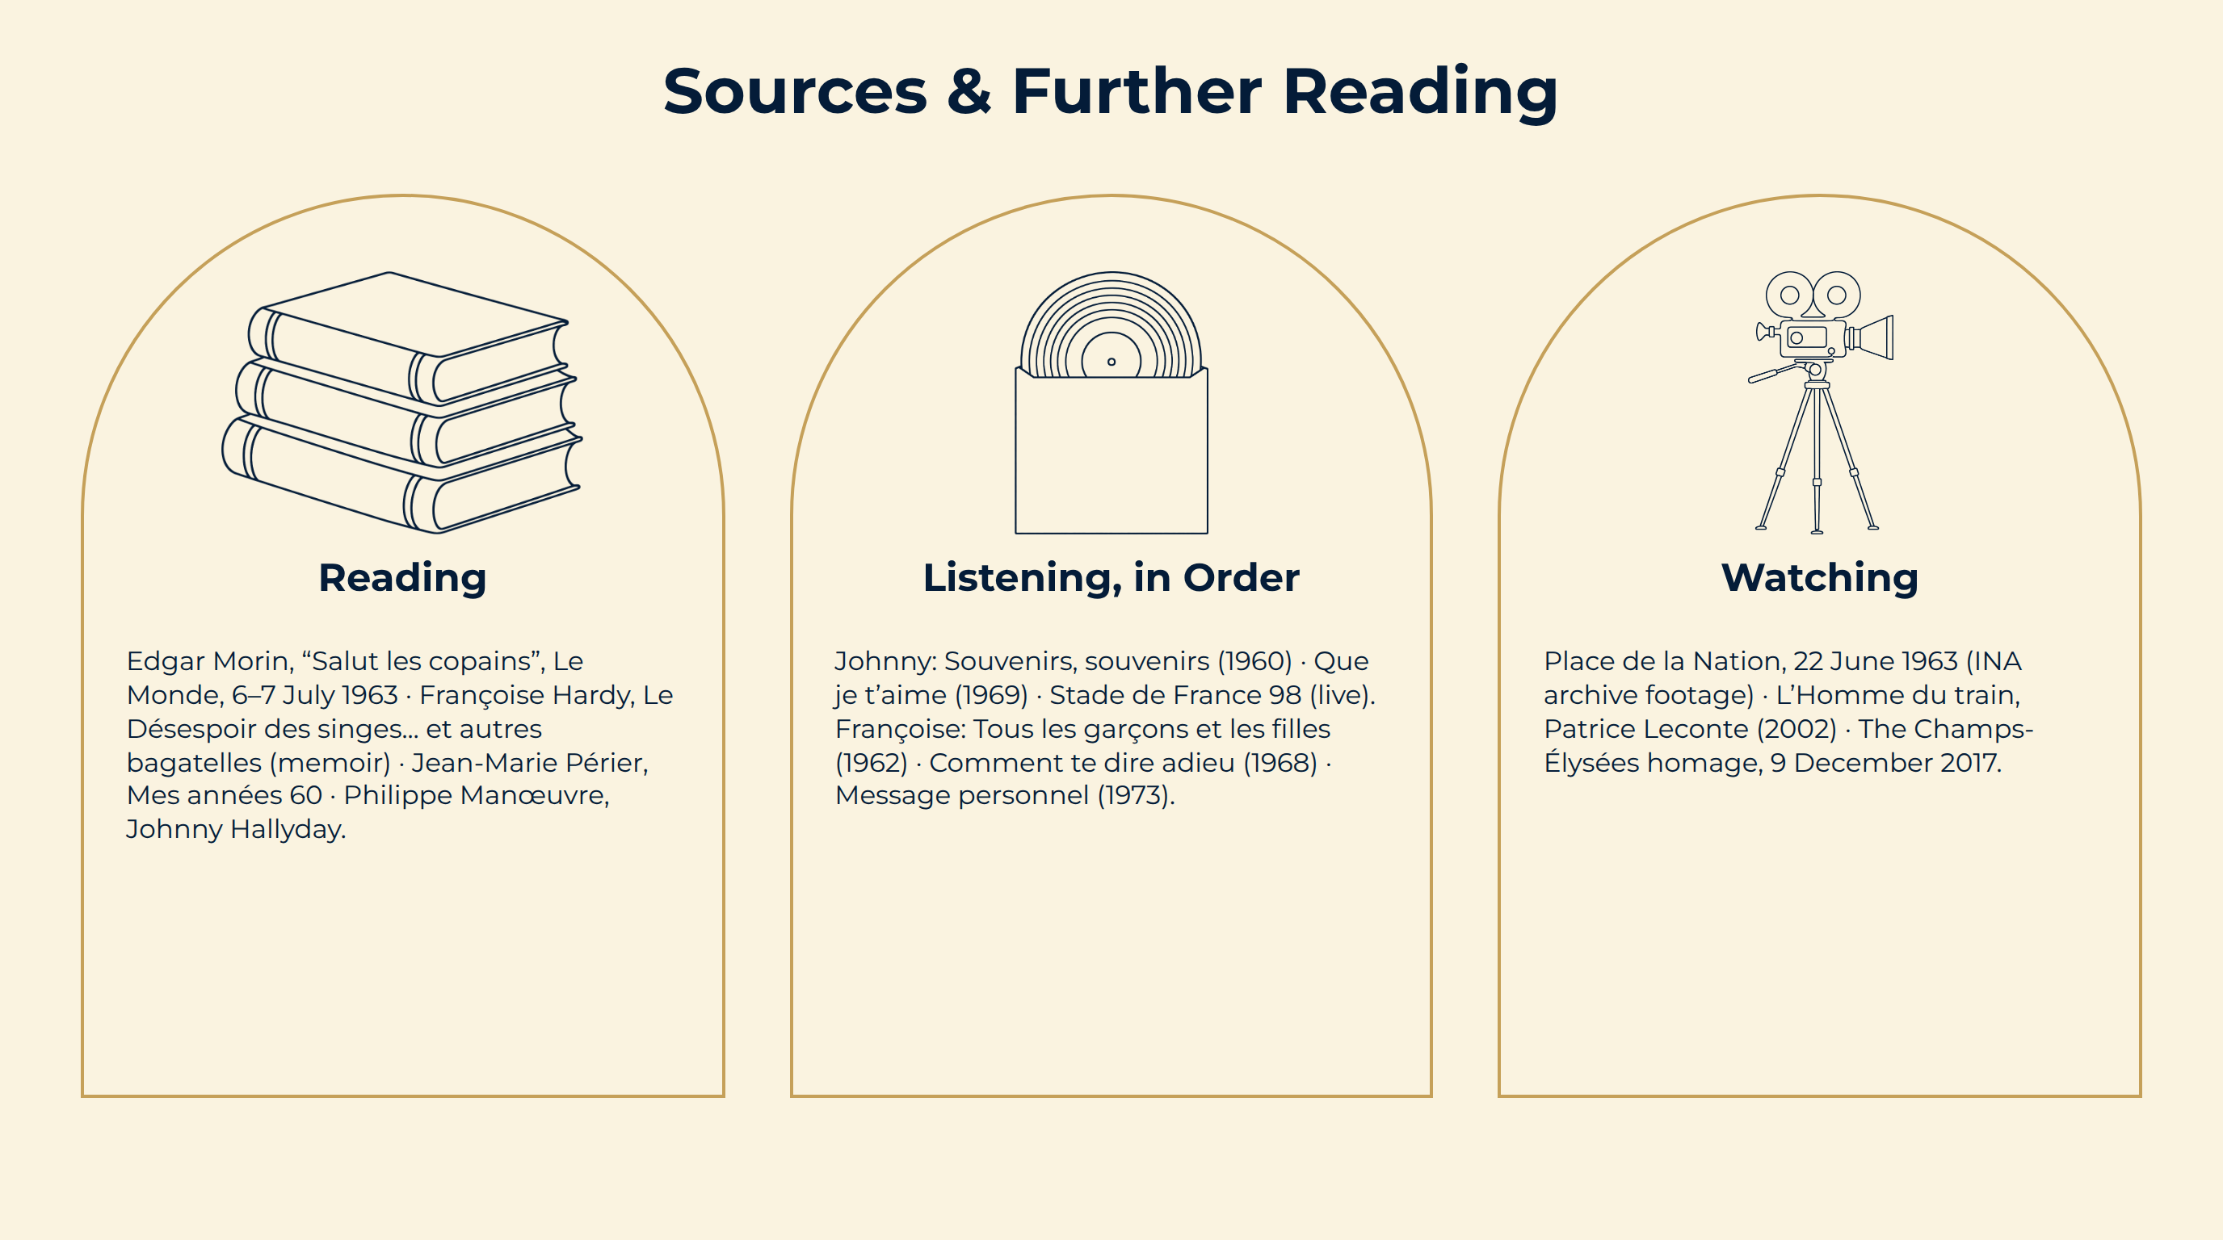
Notes:
Sources & Further Reading

