Slide 1

Notes:
THE DELON PARADOX
The Frenchman Who Conquered American Cinema Without Ever Leaving France

Slide 2
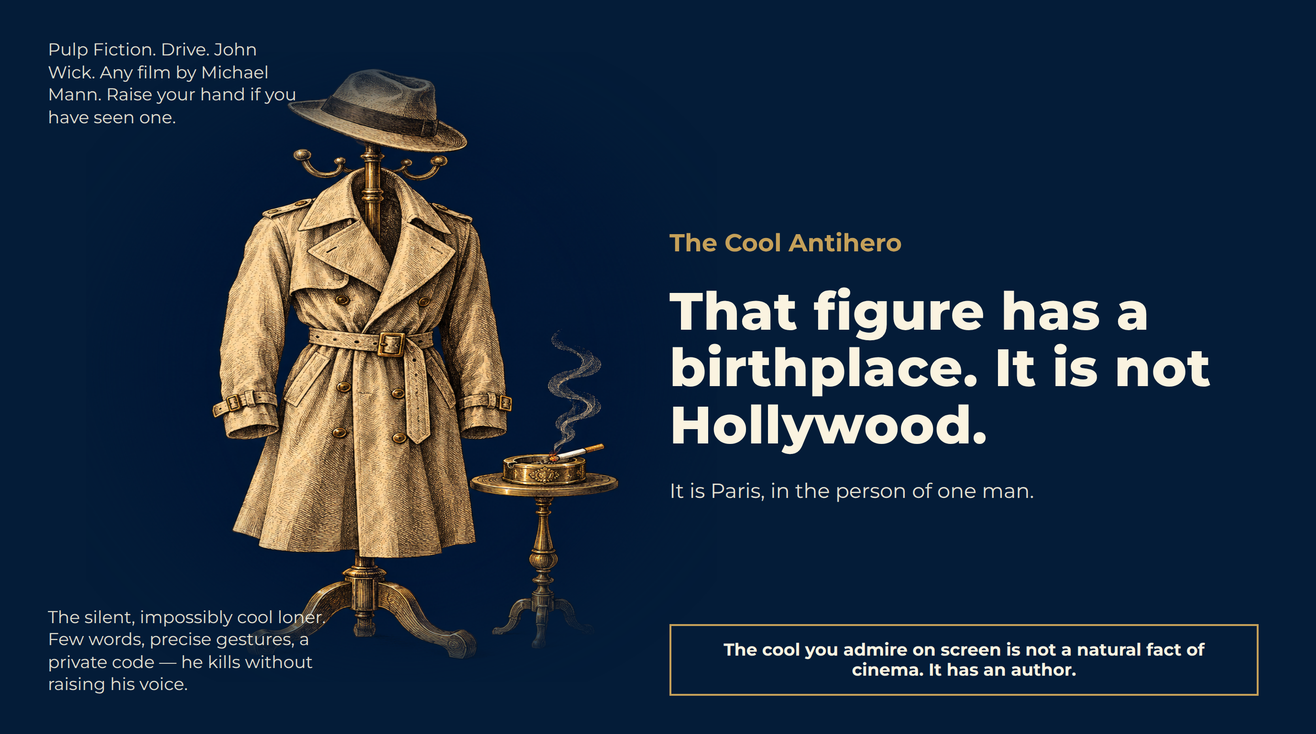
Notes:
The Cool Antihero
Pulp Fiction. Drive. John Wick. Any film by Michael Mann. Raise your hand if you have seen one.
The silent, impossibly cool loner. Few words, precise gestures, a private code — he kills without raising his voice.
That figure has a birthplace. It is not Hollywood.
It is Paris, in the person of one man.
The cool you admire on screen is not a natural fact of cinema. It has an author.

Slide 3
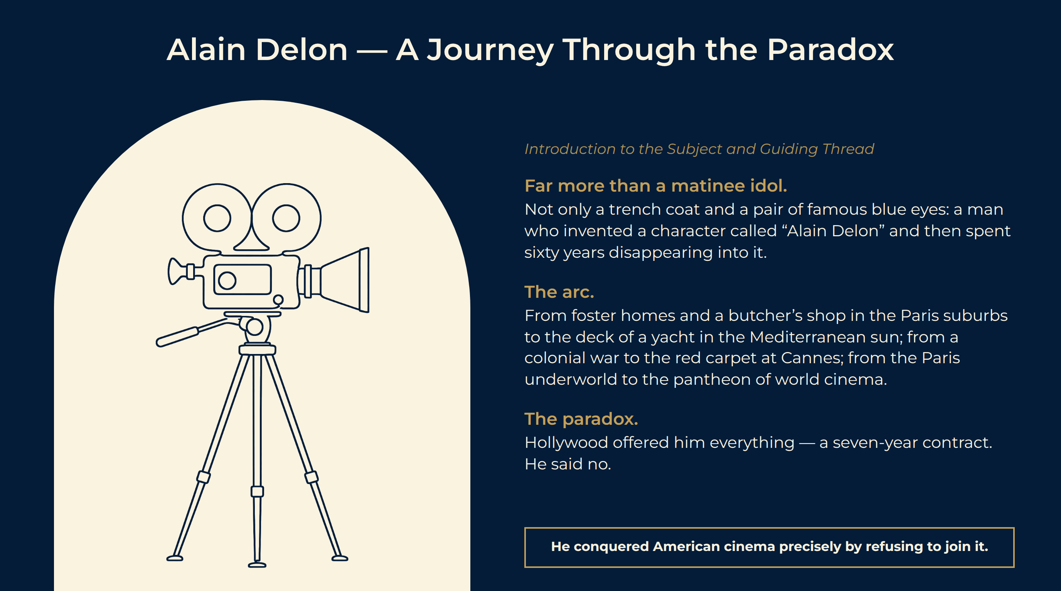
Notes:
Alain Delon — A Journey Through the Paradox
Far more than a matinee idol. Not only a trench coat and a pair of famous blue eyes: a man who invented a character called “Alain Delon” and then spent sixty years disappearing into it.
The arc. From foster homes and a butcher’s shop in the Paris suburbs to the deck of a yacht in the Mediterranean sun; from a colonial war to the red carpet at Cannes; from the Paris underworld to the pantheon of world cinema.
The paradox. Hollywood offered him everything — a seven-year contract. He said no.
He conquered American cinema precisely by refusing to join it.

Slide 4
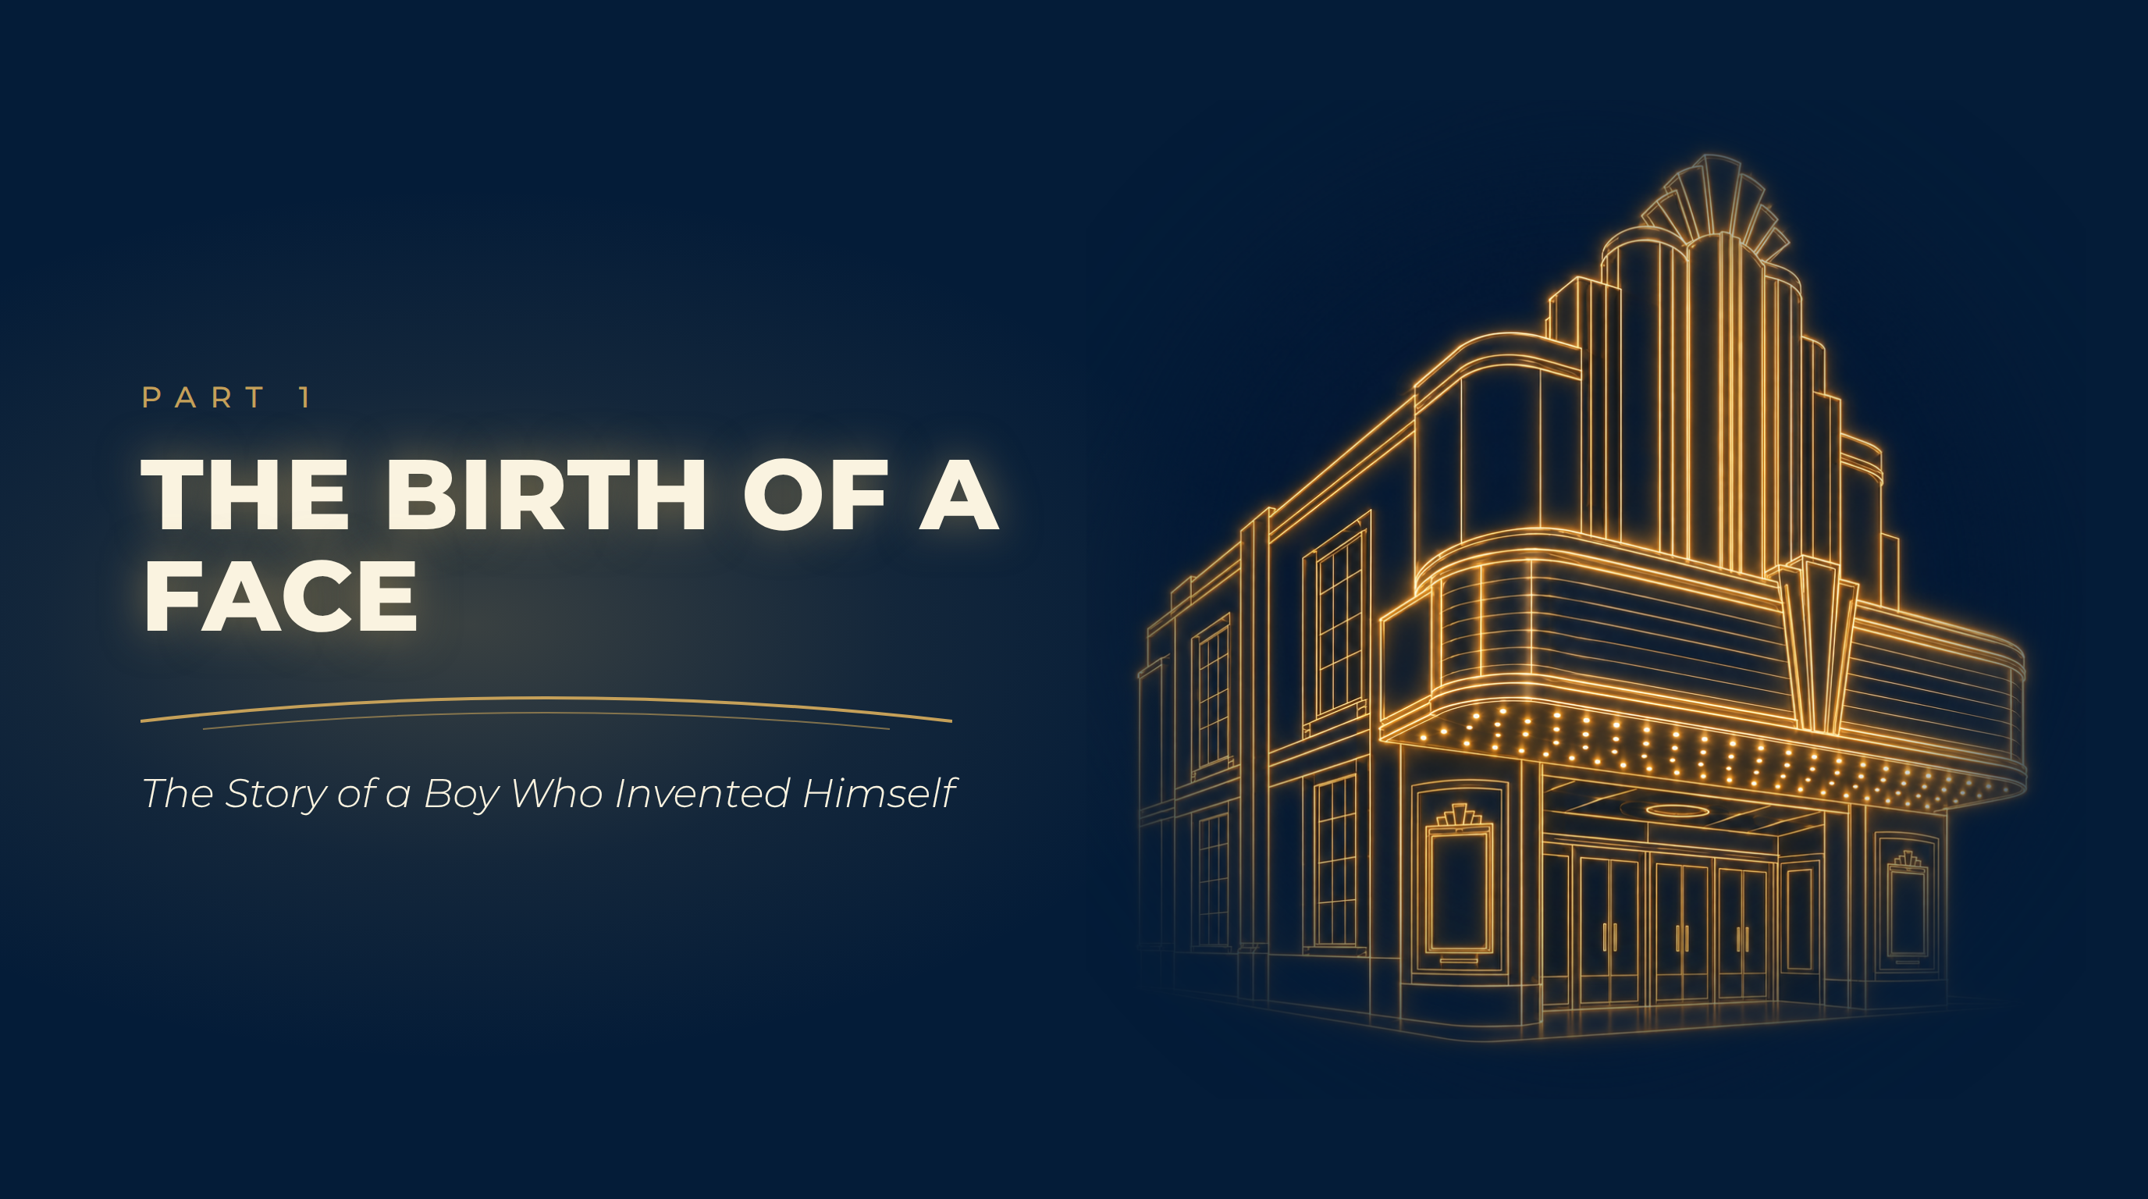
Notes:
The Birth of a Face
The Story of a Boy Who Invented Himself

Slide 5
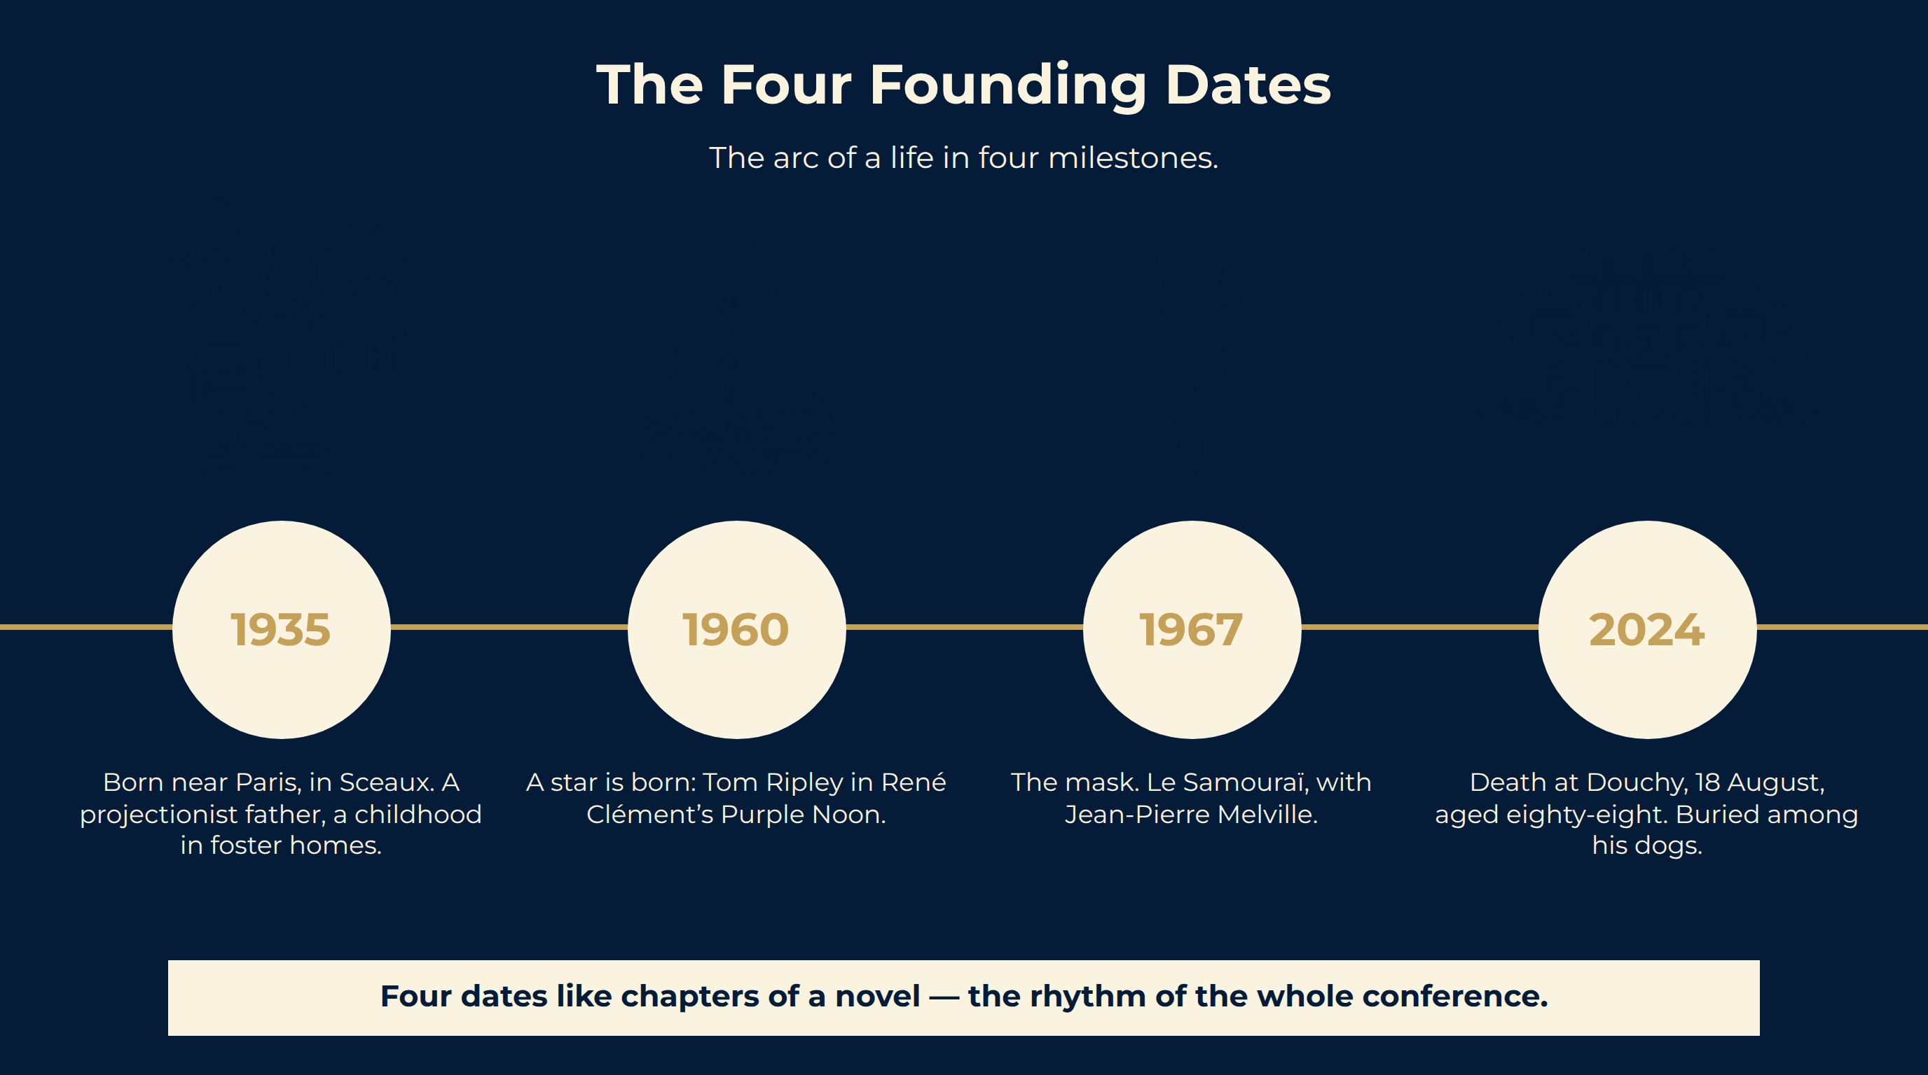
Notes:
The Four Founding Dates
Four dates like chapters of a novel — the rhythm of the whole conference.
The arc of a life in four milestones.

Slide 6
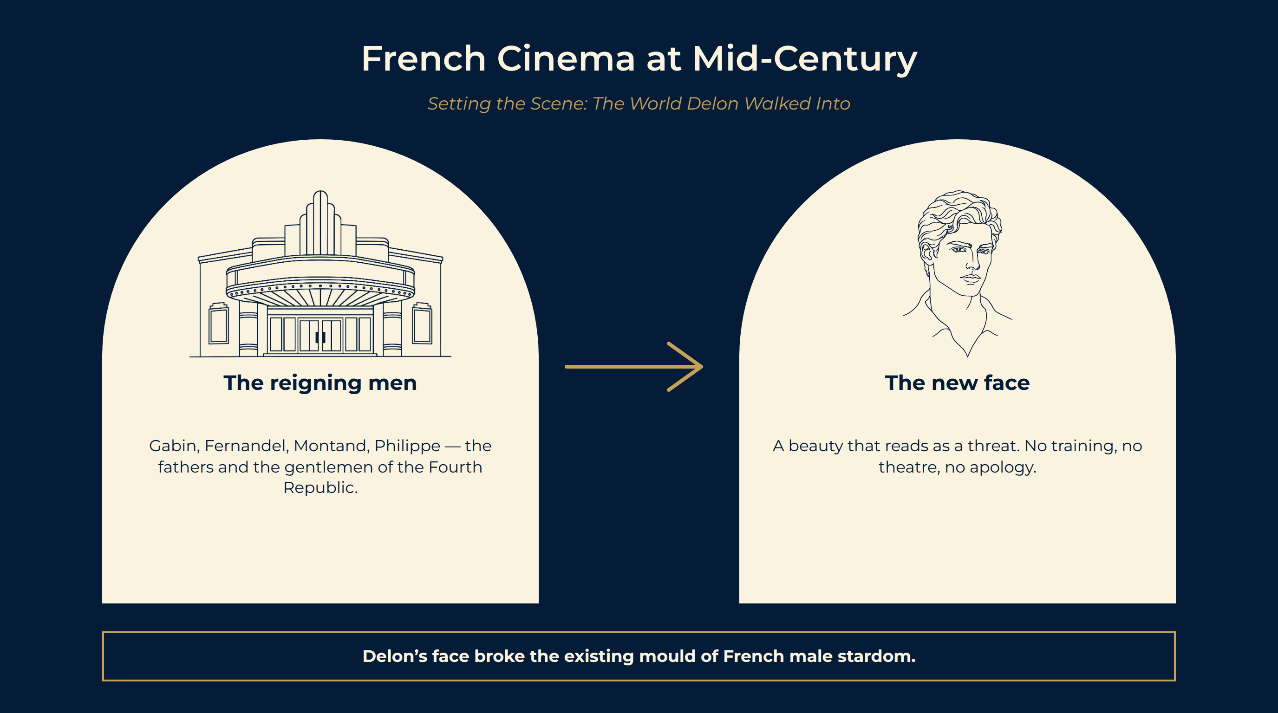
Notes:
French Cinema at Mid-Century
The mid-1950s. France is rebuilding after the Occupation.
A new kind of face. Beautiful in a way that feels almost dangerous. It gives nothing away.
Neither comparison captures it. Behind the beauty, you sense something cold, watchful, and possibly cruel.
The reigning men Gabin, Fernandel, Montand, Philippe — the fathers and the gentlemen of the Fourth Republic.
The new face A beauty that reads as a threat. No training, no theatre, no apology.
Delon’s face broke the existing mould of French male stardom.

Slide 7
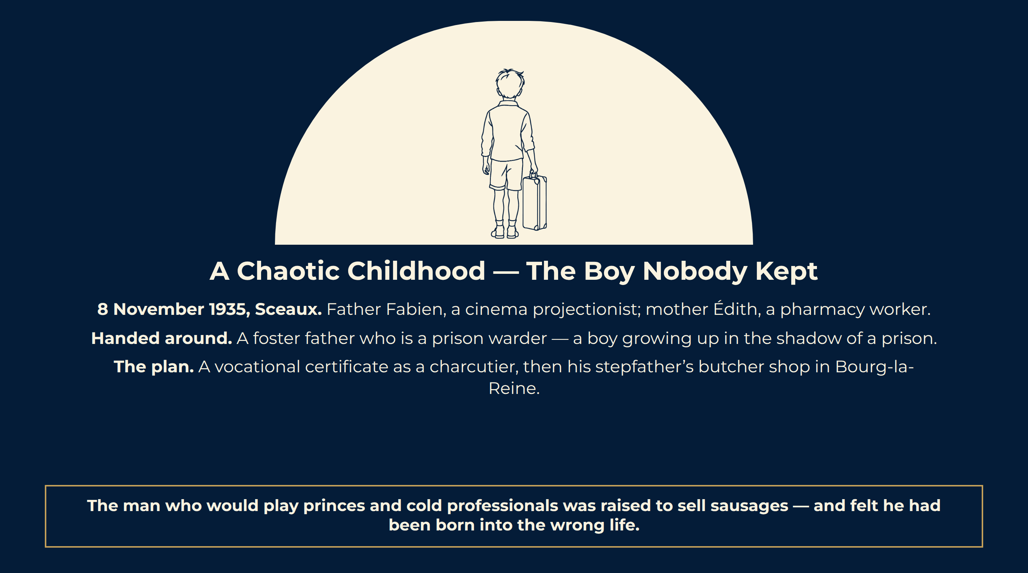
Notes:
A Chaotic Childhood — The Boy Nobody Kept
8 November 1935, Sceaux. Father Fabien, a cinema projectionist; mother Édith, a pharmacy worker.
Handed around. A foster father who is a prison warder — a boy growing up in the shadow of a prison.
The plan. A vocational certificate as a charcutier, then his stepfather’s butcher shop in Bourg-la-Reine.
The man who would play princes and cold professionals was raised to sell sausages — and felt he had been born into the wrong life.

Slide 8
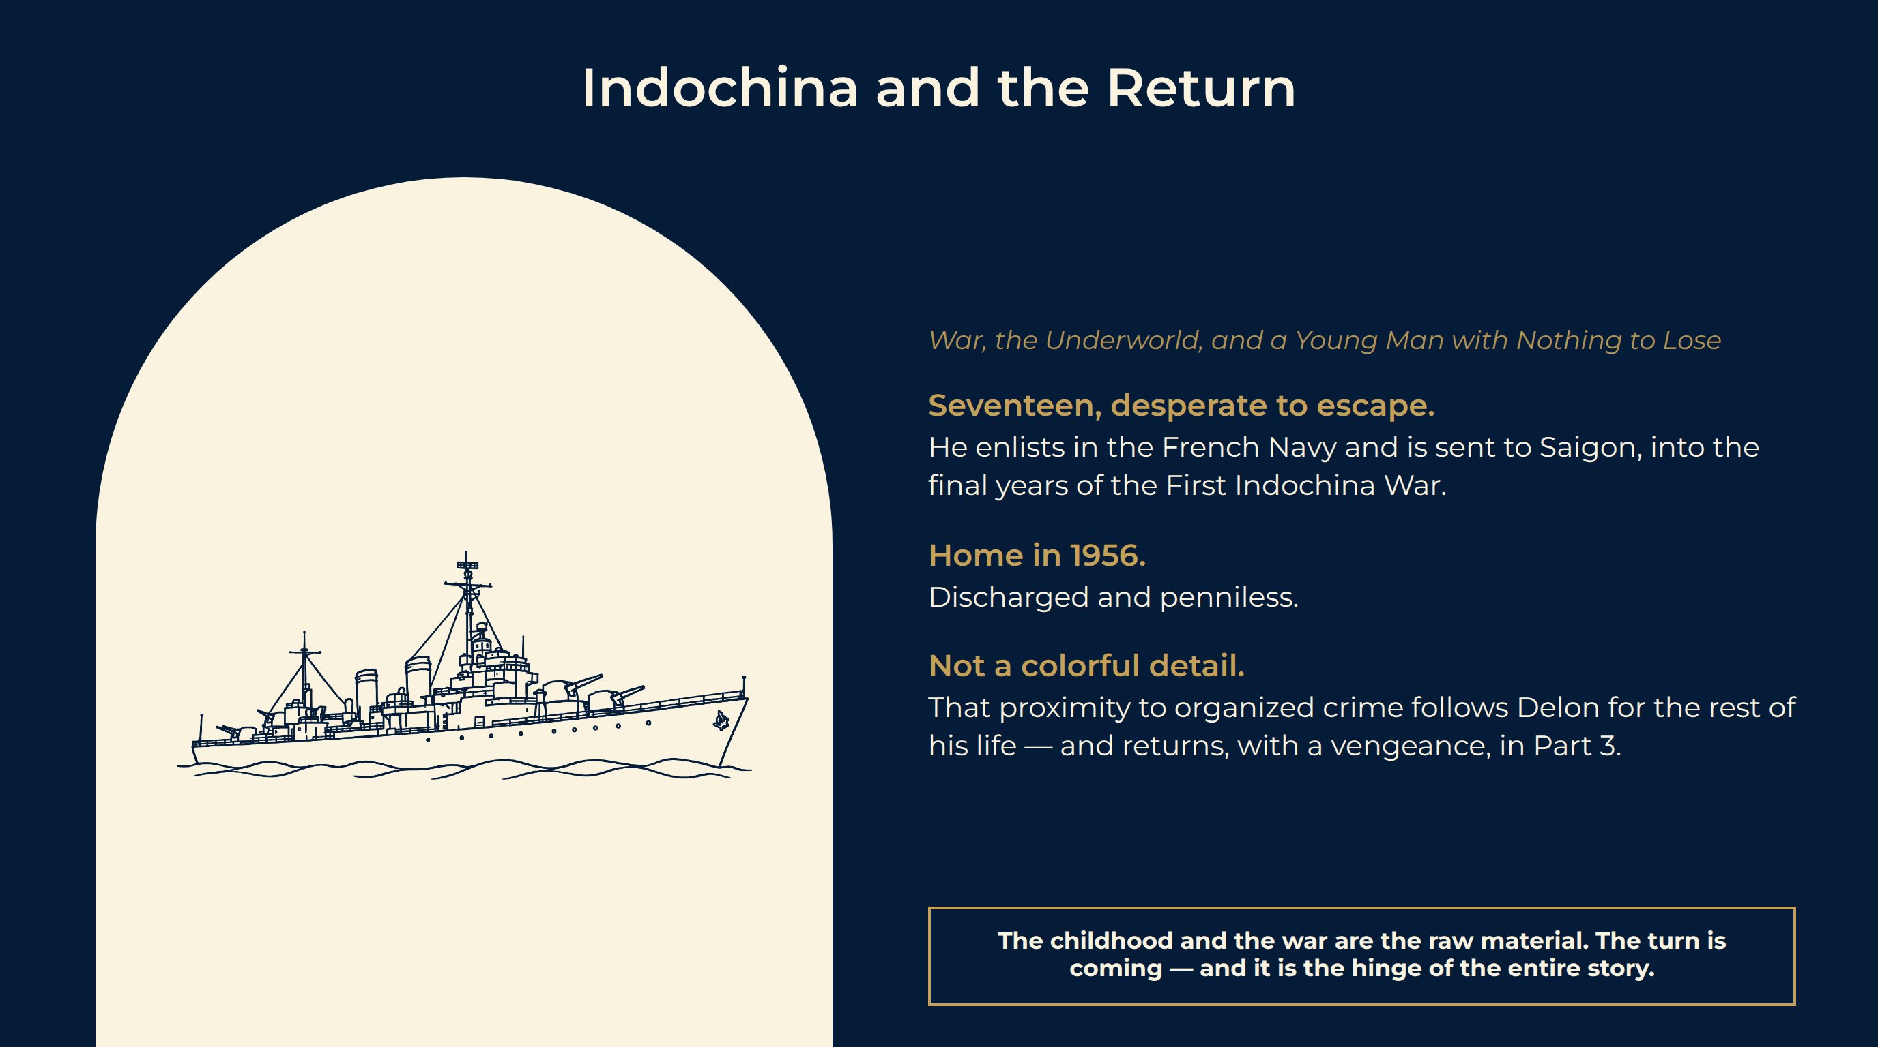
Notes:
Indochina and the Return
Seventeen, desperate to escape. He enlists in the French Navy and is sent to Saigon, into the final years of the First Indochina War.
Home in 1956. Discharged and penniless.
Not a colorful detail. That proximity to organized crime follows Delon for the rest of his life — and returns, with a vengeance, in Part 3.
The childhood and the war are the raw material. The turn is coming — and it is the hinge of the entire story.

Slide 9
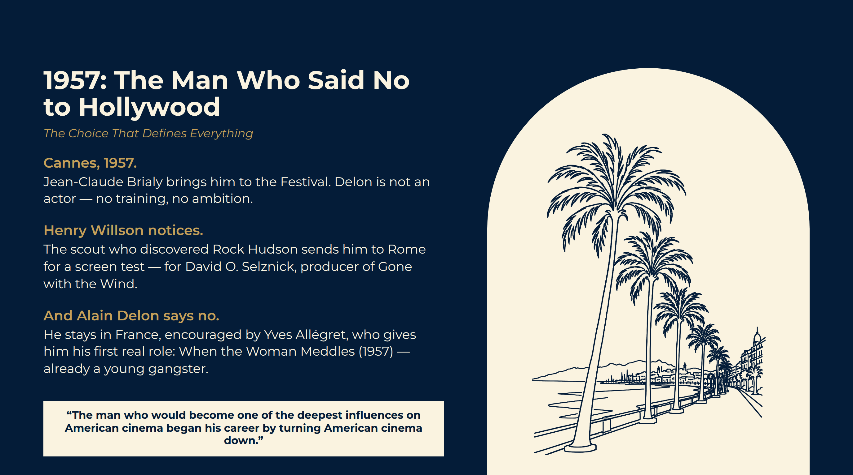
Notes:
1957: The Man Who Said No to Hollywood
Cannes, 1957. Jean-Claude Brialy brings him to the Festival. Delon is not an actor — no training, no ambition.
Henry Willson notices. The scout who discovered Rock Hudson sends him to Rome for a screen test — for David O. Selznick, producer of Gone with the Wind.
And Alain Delon says no. He stays in France, encouraged by Yves Allégret, who gives him his first real role: When the Woman Meddles (1957) — already a young gangster.
“The man who would become one of the deepest influences on American cinema began his career by turning American cinema down.”
“The man who would become one of the deepest influences on American cinema began his career by turning American cinema down.”

Slide 10
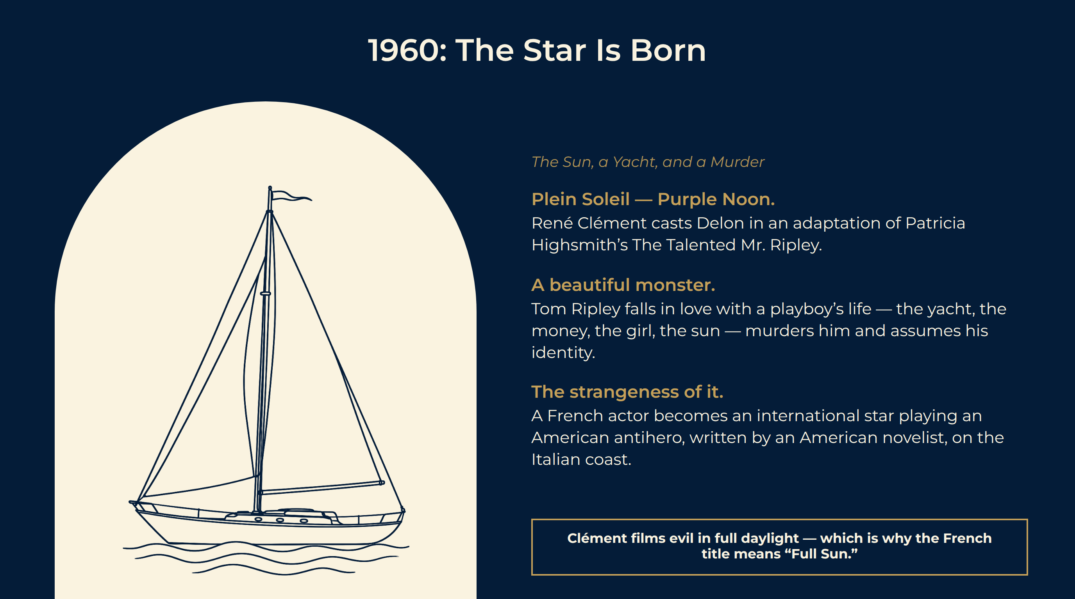
Notes:
1960: The Star Is Born
Plein Soleil — Purple Noon. René Clément casts Delon in an adaptation of Patricia Highsmith’s The Talented Mr. Ripley.
A beautiful monster. Tom Ripley falls in love with a playboy’s life — the yacht, the money, the girl, the sun — murders him and assumes his identity.
The strangeness of it. A French actor becomes an international star playing an American antihero, written by an American novelist, on the Italian coast.
Clément films evil in full daylight — which is why the French title means “Full Sun.”

Slide 11

Notes:
The Cross-Atlantic Mirror
You already know this character. Dennis Hopper for Wim Wenders in 1977. Matt Damon in Anthony Minghella’s 1999 version.
The payoff. Forty years before Matt Damon, a young Frenchman defined the role so completely that Patricia Highsmith herself called Delon her perfect Ripley.
Remember. The template for every beautiful, ambiguous con man on an American screen was set on a French one, in 1960, by a former sailor who had turned Hollywood down three years earlier.
The first American bridge — and it is load-bearing.

Slide 12
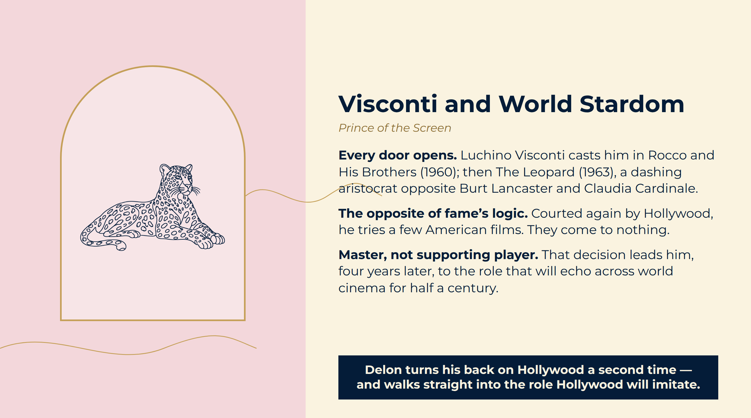
Notes:
Visconti and World Stardom
Every door opens. Luchino Visconti casts him in Rocco and His Brothers (1960); then The Leopard (1963), a dashing aristocrat opposite Burt Lancaster and Claudia Cardinale.
The opposite of fame’s logic. Courted again by Hollywood, he tries a few American films. They come to nothing.
Master, not supporting player. That decision leads him, four years later, to the role that will echo across world cinema for half a century.
Delon turns his back on Hollywood a second time — and walks straight into the role Hollywood will imitate.

Slide 13
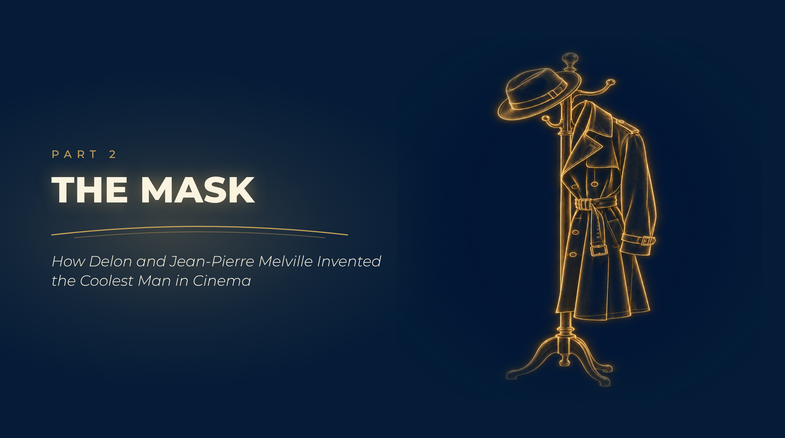
Notes:
The Mask
How Delon and Jean-Pierre Melville Invented the Coolest Man in Cinema

Slide 14
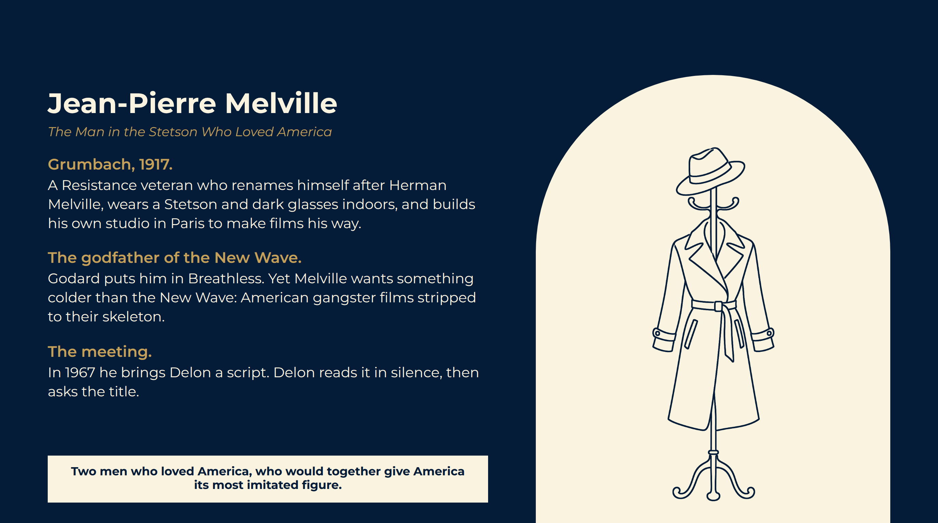
Notes:
Jean-Pierre Melville
Grumbach, 1917. A Resistance veteran who renames himself after Herman Melville, wears a Stetson and dark glasses indoors, and builds his own studio in Paris to make films his way.
The godfather of the New Wave. Godard puts him in Breathless. Yet Melville wants something colder than the New Wave: American gangster films stripped to their skeleton.
The meeting. In 1967 he brings Delon a script. Delon reads it in silence, then asks the title.
Two men who loved America, who would together give America its most imitated figure.

Slide 15
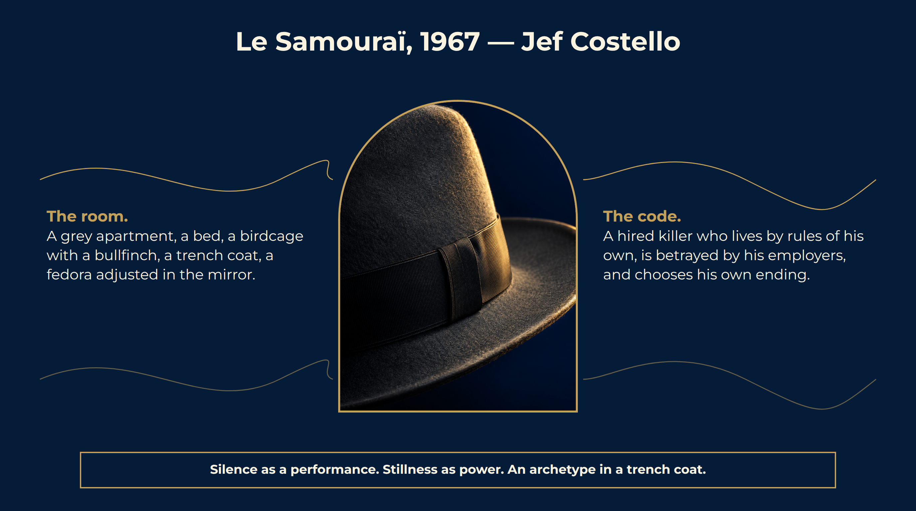
Notes:
Le Samouraï, 1967 — Jef Costello
The room. A grey apartment, a bed, a birdcage with a bullfinch, a trench coat, a fedora adjusted in the mirror.
The code. A hired killer who lives by rules of his own, is betrayed by his employers, and chooses his own ending.
The mask. Delon’s face does nothing — and the audience projects everything onto it.
Silence as a performance. Stillness as power. An archetype in a trench coat.

Slide 16

Notes:
Le Cercle Rouge, 1970
The cast. Delon, Bourvil in his last role, Yves Montand as an alcoholic ex-policeman, Gian Maria Volonté as the escaped convict.
Twenty-five minutes. A jewel robbery on the Place Vendôme filmed entirely without dialogue. White gloves, a tripod, a single rifle shot.
Un flic, 1972. The third and last Melville–Delon film, with Catherine Deneuve. Melville dies the following year, at fifty-five.
Melville Grumbach, 1917, the man who wore the Stetson
A trench coat and a hat The costume as a code
Silence Twenty-five minutes of heist without dialogue
The template The cool Hollywood copied for fifty years
Three films in five years that American directors are still copying shot for shot.

Slide 17

Notes:
Producer, Star, Brand
La Piscine, 1969. Jacques Deray, Romy Schneider, a villa above Saint-Tropez and a swimming pool.
Borsalino, 1970. Delon produces and stars opposite Belmondo.
Monsieur Klein, 1976. Joseph Losey’s film about a Parisian art dealer mistaken for a Jew under the Occupation.
He controlled the image, the money and the myth. Few actors have ever owned themselves so completely.

Slide 18
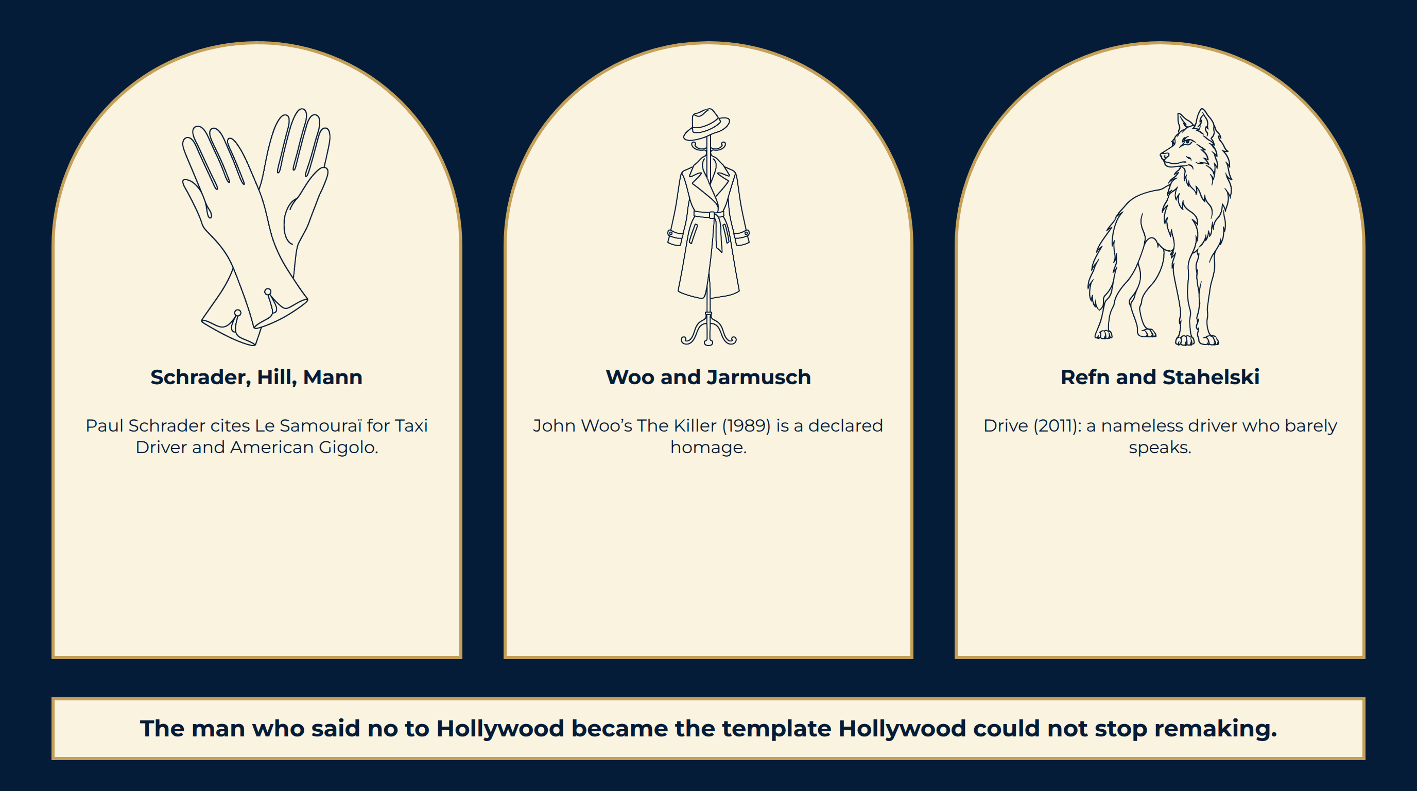
Notes:
The American Echo
The man who said no to Hollywood became the template Hollywood could not stop remaking.

Slide 19
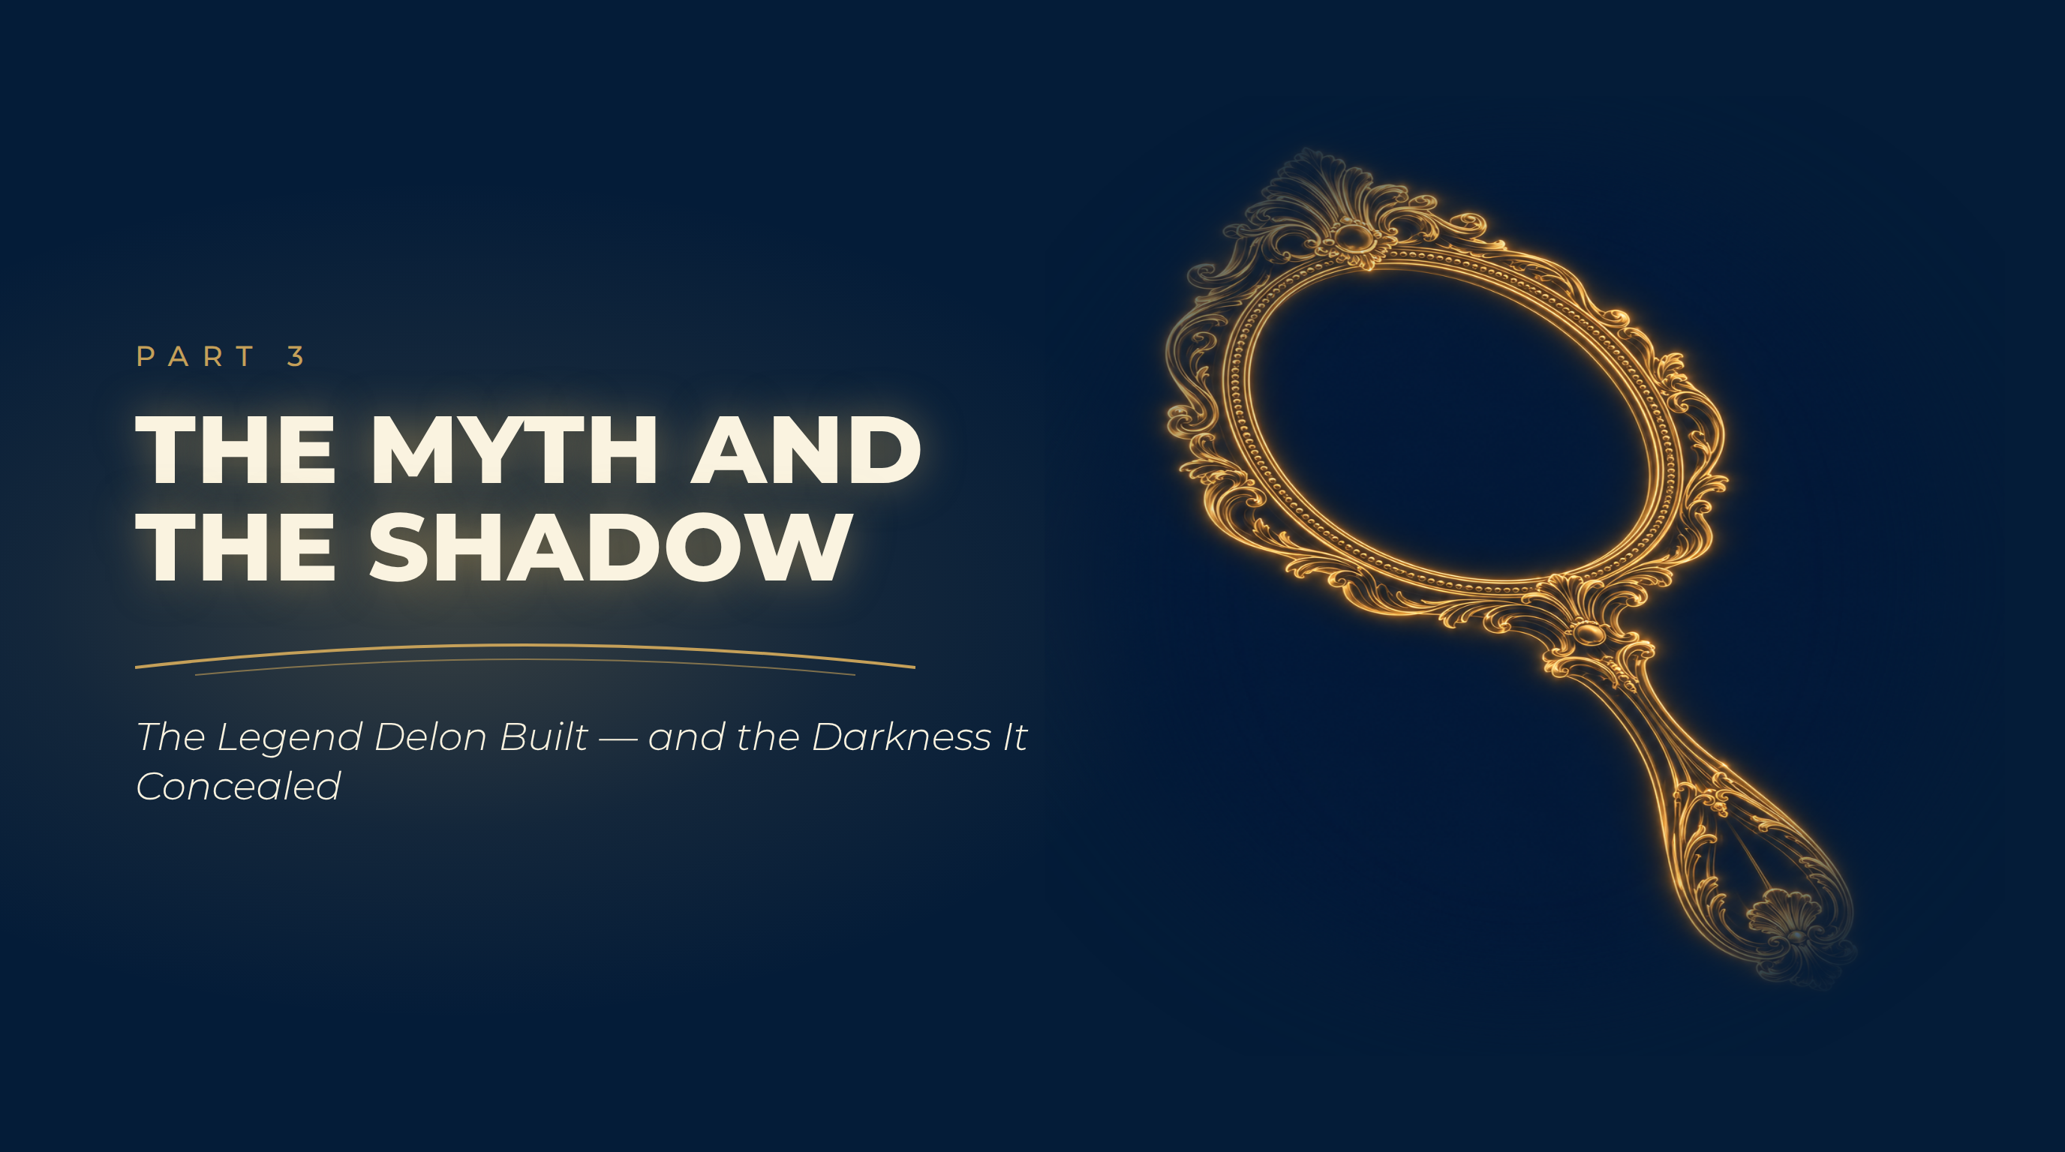
Notes:
The Myth and the Shadow
The Legend Delon Built — and the Darkness It Concealed

Slide 20
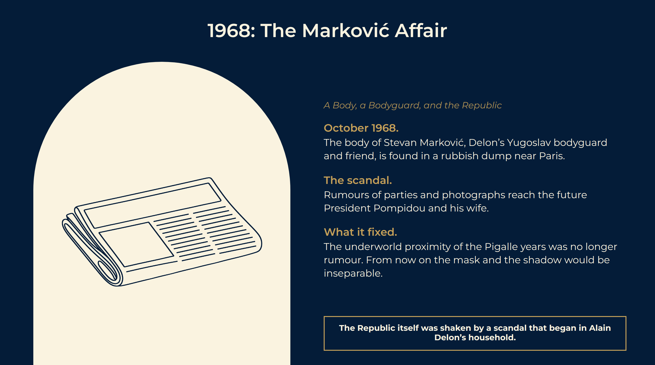
Notes:
1968: The Marković Affair
October 1968. The body of Stevan Marković, Delon’s Yugoslav bodyguard and friend, is found in a rubbish dump near Paris.
The scandal. Rumours of parties and photographs reach the future President Pompidou and his wife.
What it fixed. The underworld proximity of the Pigalle years was no longer rumour. From now on the mask and the shadow would be inseparable.
The Republic itself was shaken by a scandal that began in Alain Delon’s household.

Slide 21
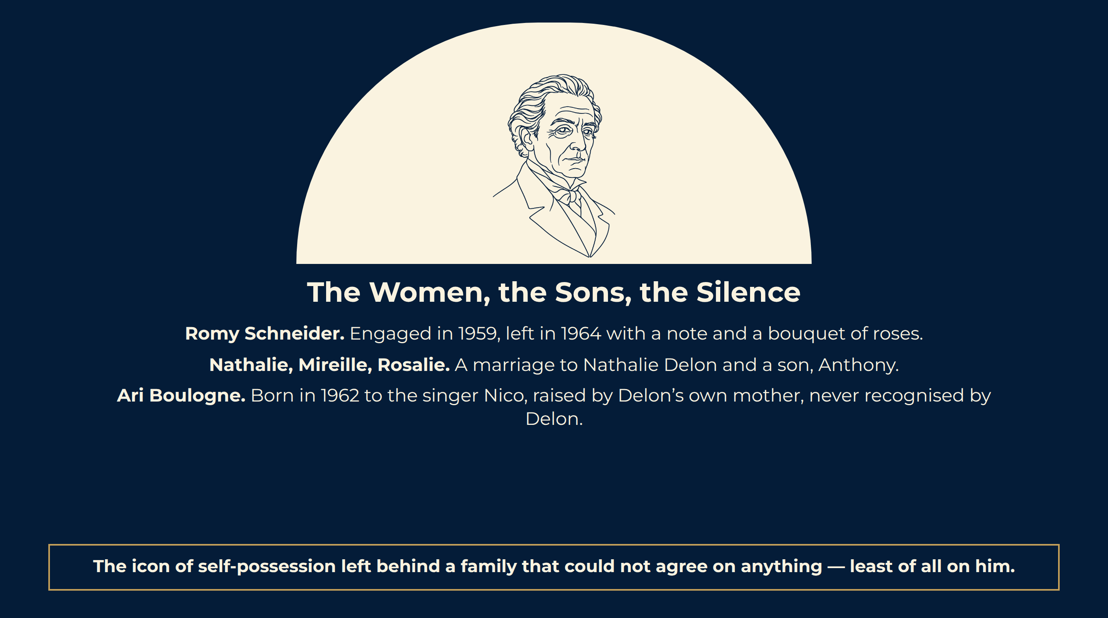
Notes:
The Women, the Sons, the Silence
Romy Schneider. Engaged in 1959, left in 1964 with a note and a bouquet of roses.
Nathalie, Mireille, Rosalie. A marriage to Nathalie Delon and a son, Anthony.
Ari Boulogne. Born in 1962 to the singer Nico, raised by Delon’s own mother, never recognised by Delon.
The icon of self-possession left behind a family that could not agree on anything — least of all on him.

Slide 22
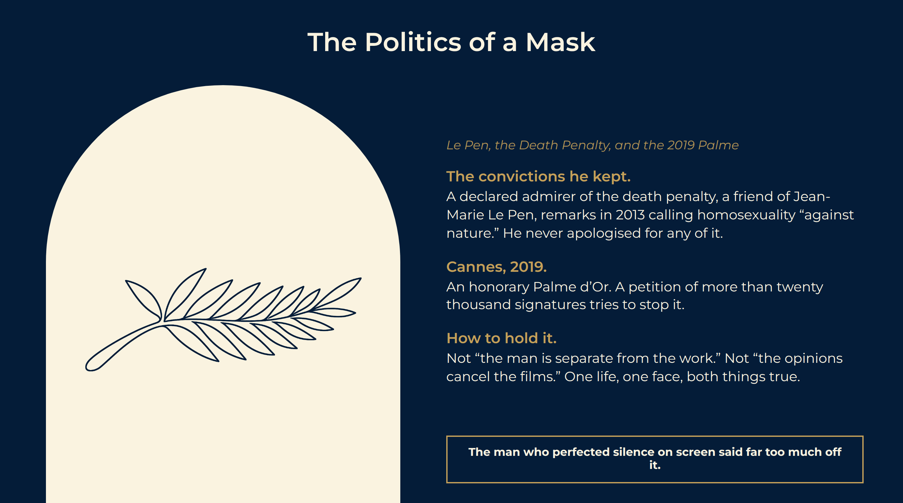
Notes:
The Politics of a Mask
The convictions he kept. A declared admirer of the death penalty, a friend of Jean-Marie Le Pen, remarks in 2013 calling homosexuality “against nature.” He never apologised for any of it.
Cannes, 2019. An honorary Palme d’Or. A petition of more than twenty thousand signatures tries to stop it.
How to hold it. Not “the man is separate from the work.” Not “the opinions cancel the films.” One life, one face, both things true.
The man who perfected silence on screen said far too much off it.

Slide 23

Notes:
Japan, the Brand, and the Mirror
Tokyo. In Japan he was, for decades, the Western face: cigarettes, perfume, watches and eyewear under his own name.
The Netflix mirror. In 2024 Andrew Scott plays Tom Ripley in black and white.
The afterlife. He is quoted every time a silent man in a good coat walks across an American screen. Most of the audience has never heard his name.
The paradox, complete: everywhere in American cinema, and nowhere in its credits.

Slide 24
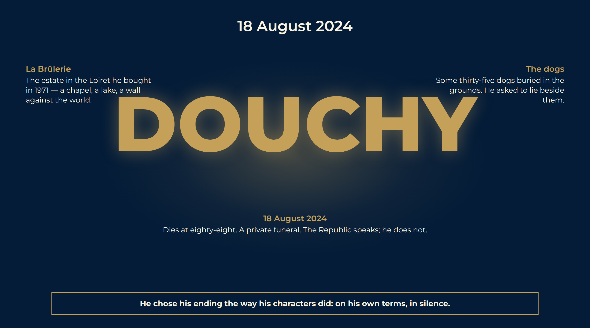
Notes:
18 August 2024
The estate. La Brûlerie, in the Loiret. A stroke in 2019, a bitter public war between his three children over his care, and a final year of silence.
The farewell. He dies at eighty-eight.
The last image. A man who trusted animals more than people, who said no to Hollywood twice, and who was, at the end, exactly as alone as Jef Costello.
La Brûlerie The estate in the Loiret he bought in 1971 — a chapel, a lake, a wall against the world.
The dogs Some thirty-five dogs buried in the grounds. He asked to lie beside them.
18 August 2024 Dies at eighty-eight. A private funeral. The Republic speaks; he does not.
He chose his ending the way his characters did: on his own terms, in silence.

Slide 25
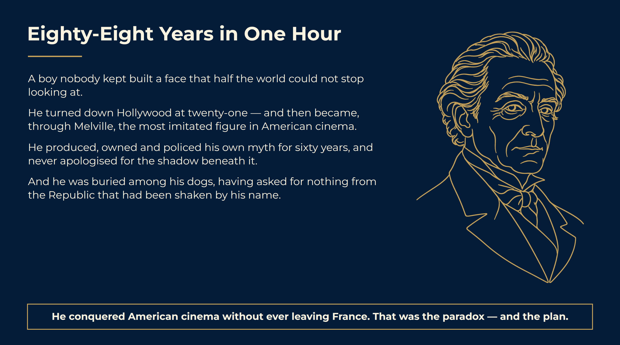
Notes:
Eighty-Eight Years in One Hour
He conquered American cinema without ever leaving France. That was the paradox — and the plan.

Slide 26
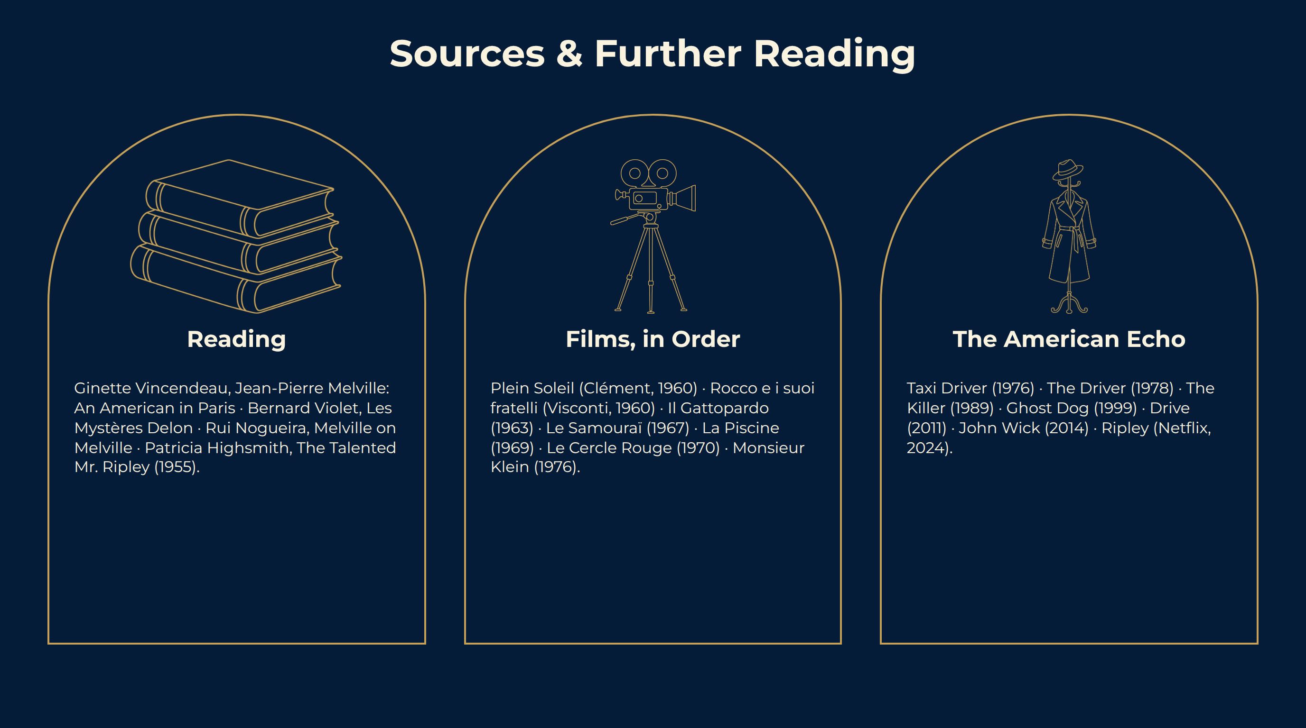
Notes:
Sources & Further Reading

