Slide 1
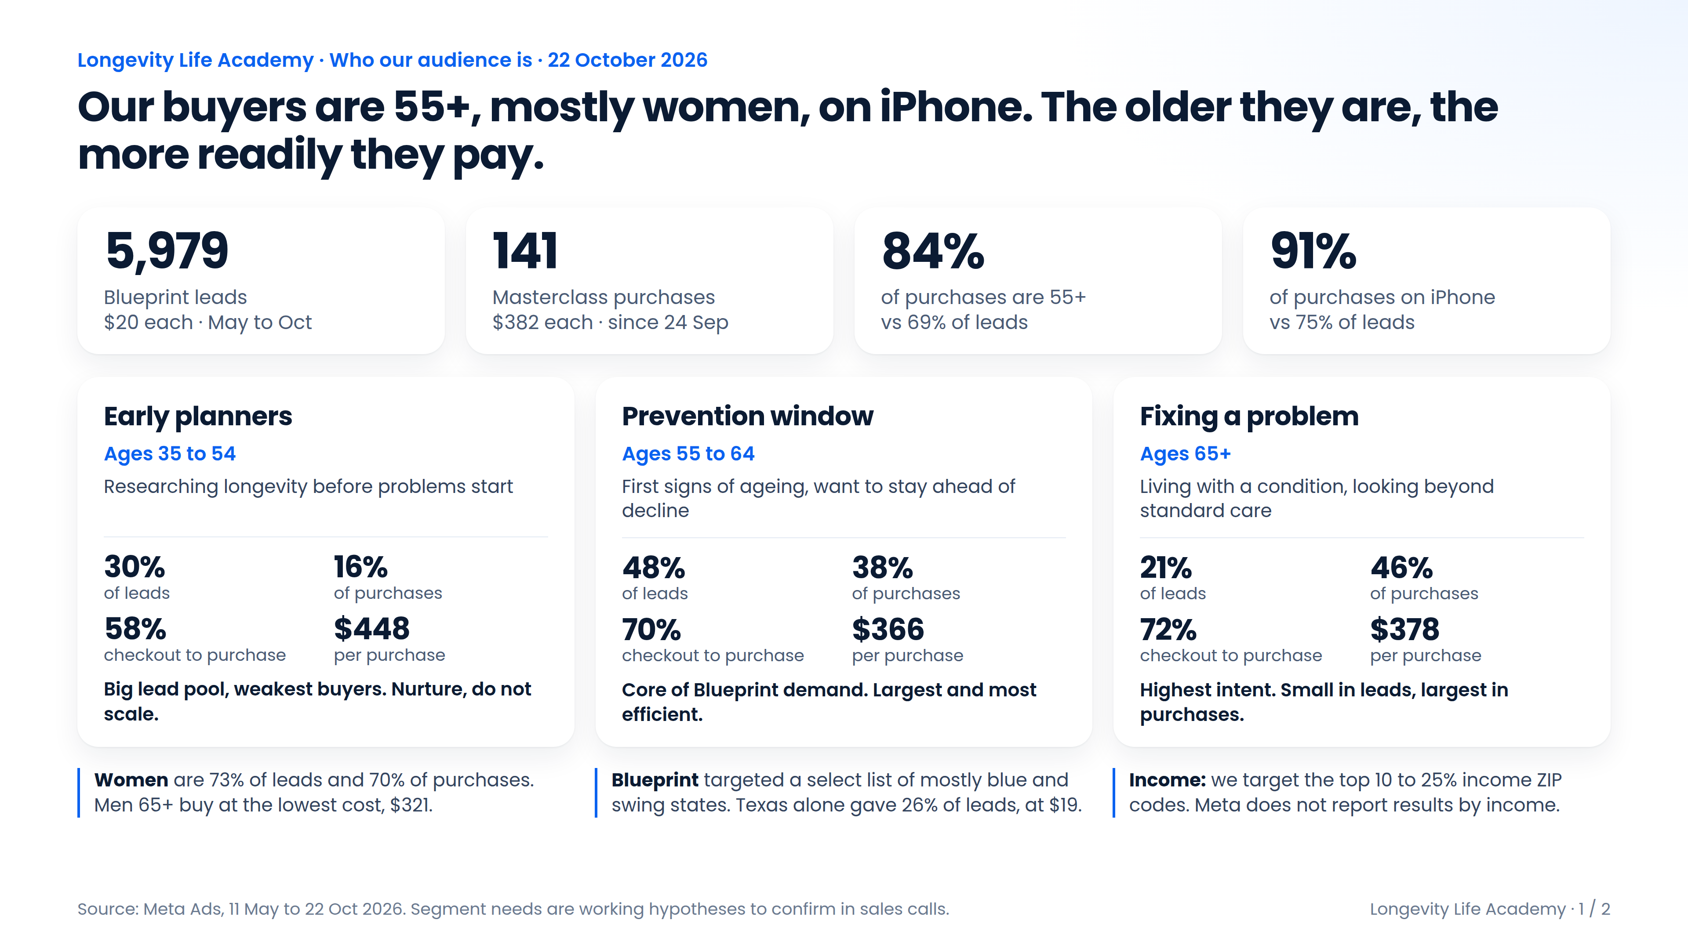
Notes:
Executive summary. Source: Meta Ads, 11 May to 22 Oct 2026.

Slide 2
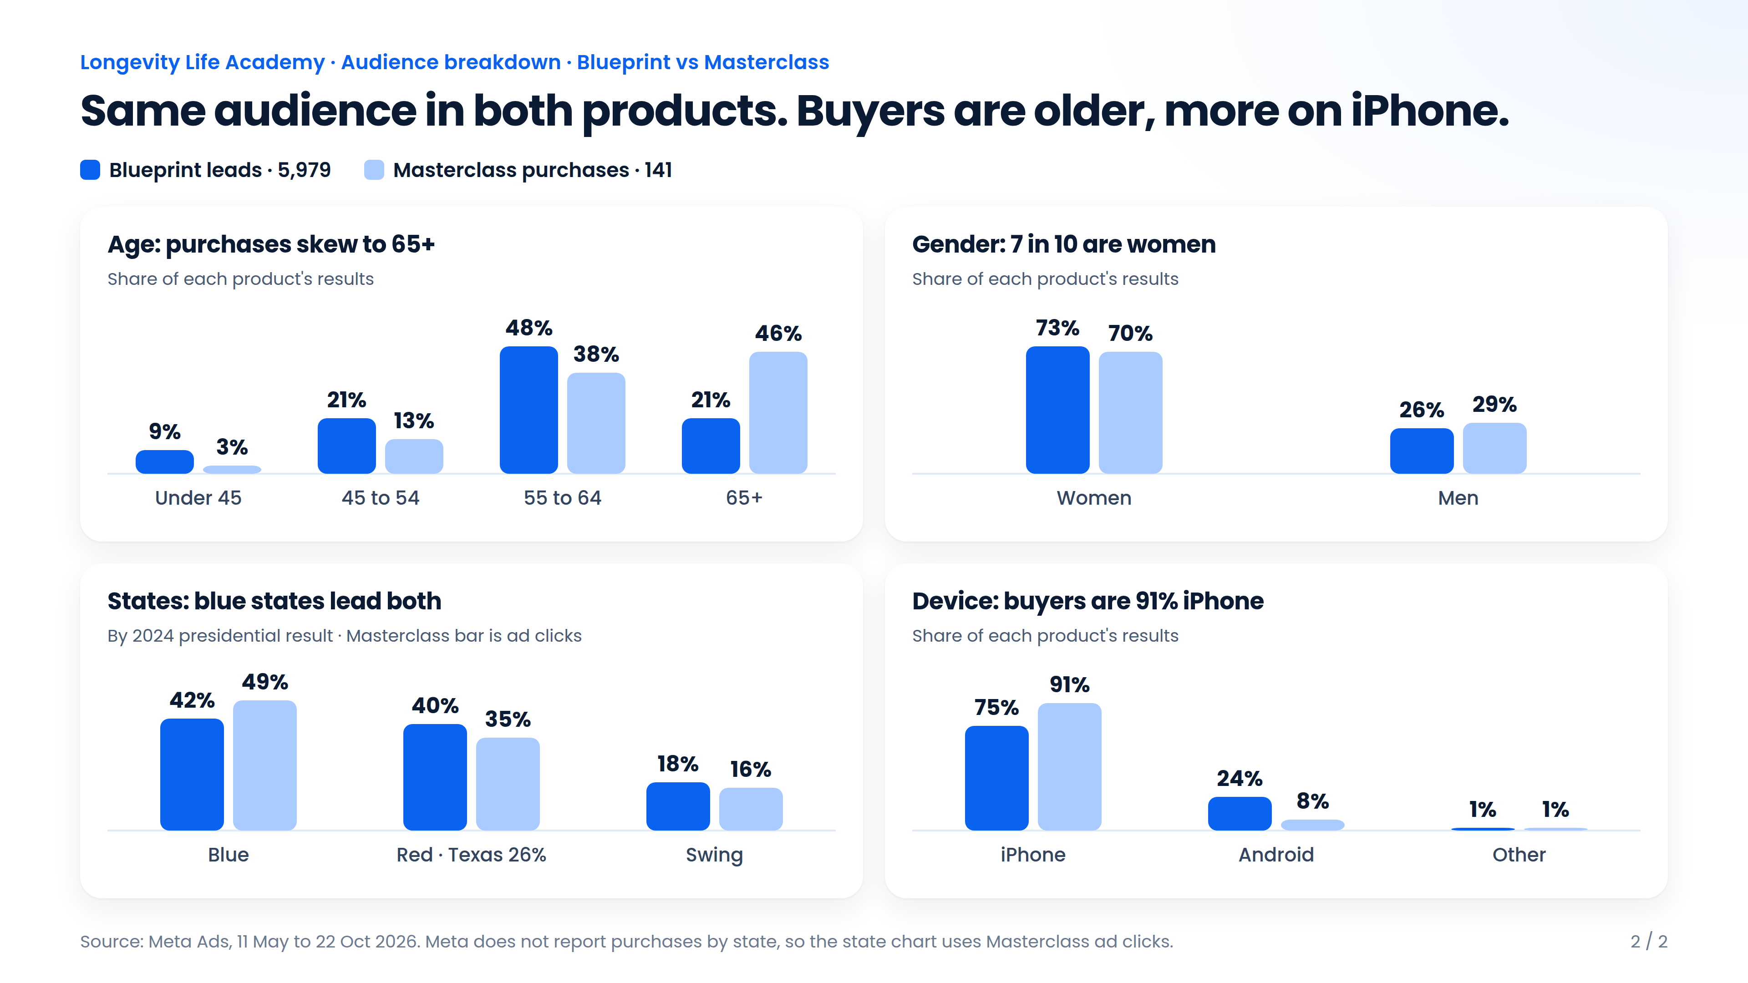
Notes:
Audience breakdown, Blueprint leads vs Masterclass purchases.

