Slide 1
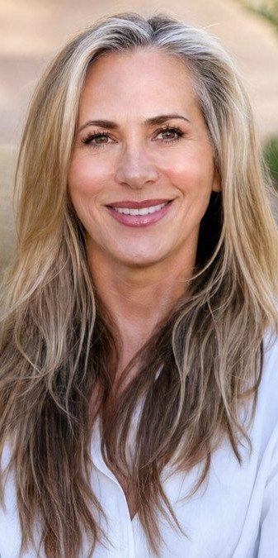
LONGEVITY LIFE ACADEMY · BOARD UPDATE · 18 OCTOBER 2026 · 1 / 6
What we built · three acquisition efforts
1
Lead generation. Launched Julie and Courtney films, video cutdowns and static ads across Meta. Re-tuned the campaigns, then reduced volume to focus on e-commerce.
2
Blueprint e-commerce. Launched self-service checkout and the first 3 online sales. Rebuilding the funnel with new ads, adapted pricing and sharper urgency.
3
Julie's Masterclass. Built from the ground up and launched 27 September: website, checkout and 45 emails. Launch creative: 66 ads across six test ad sets, presenter videos, banners, Reels and film cutdowns.
Longevity Life Academy · eTeacher Group · Board update
October 2026 operating targets · Launch assets: campaign library

Slide 2
LONGEVITY LIFE ACADEMY · BOARD UPDATE · 18 OCTOBER 2026 · 2 / 6
Next phase · fill both dates and grow Blueprint sales
COMBINED SIGN-UP TARGET
27 OCTOBER TARGET
14 NOVEMBER TARGET
BLUEPRINT CONVERSION TARGET
700
350
350
1 in 10–12
Across the two masterclass dates
Masterclass sign-ups
Masterclass sign-ups
Masterclass buyer → full-course buyer
1 · Lead generation
2 · Blueprint e-commerce
3 · Julie's Masterclass
Re-tune; keep volume controlled
Convert interest into course sales
Fill both dates; build the buyer base
• Julie and Courtney videos, cutdowns and static ads.
• Reduce volume to prioritise e-commerce.
• Refine targeting and creative using sales feedback.
• Sharpen the offer, landing page and checkout journey.
• Refresh creative across video, Reels and static formats.
• Convert masterclass buyers via sales follow-up and direct checkout.
• Drive sign-ups with the full paid-creative library.
• Launch the 72-hour IIBS, Rosen and Longevity email blitz.
• Follow up with buyers to reach the Blueprint conversion target.
Longevity Life Academy · eTeacher Group · Board update
October 2026 operating targets · Launch assets: campaign library

Slide 3

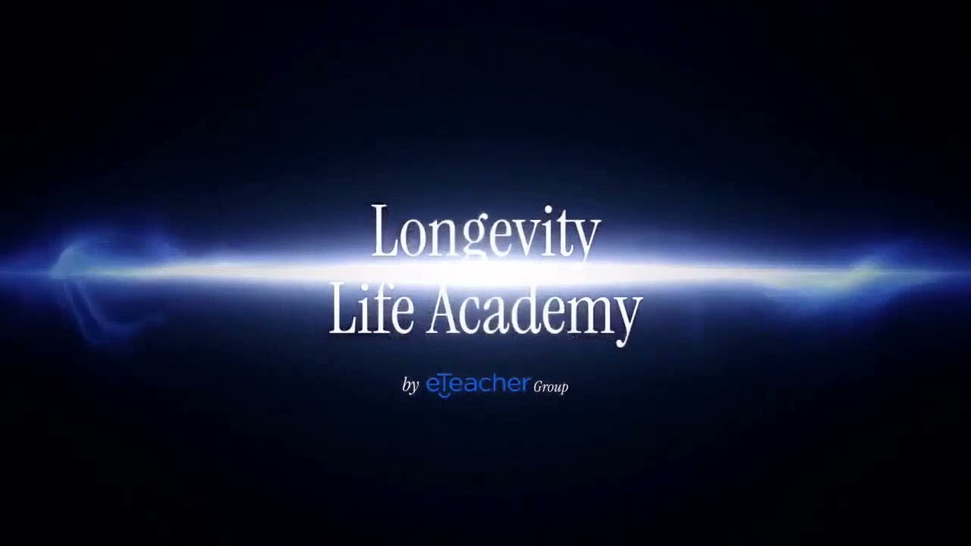
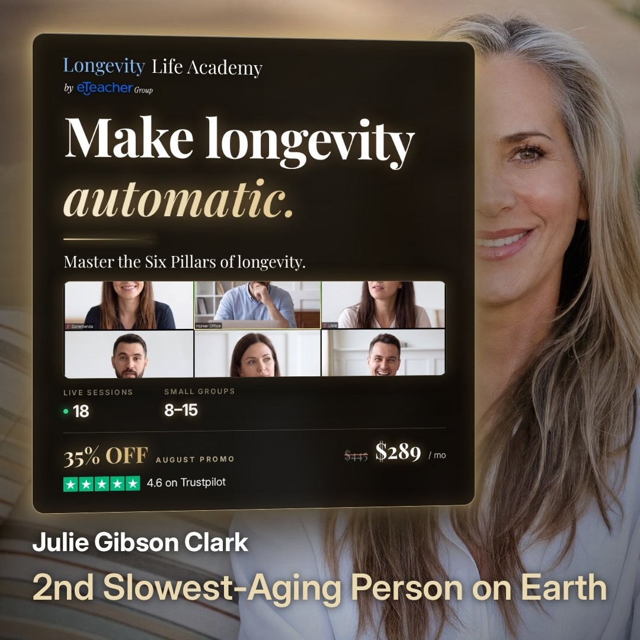
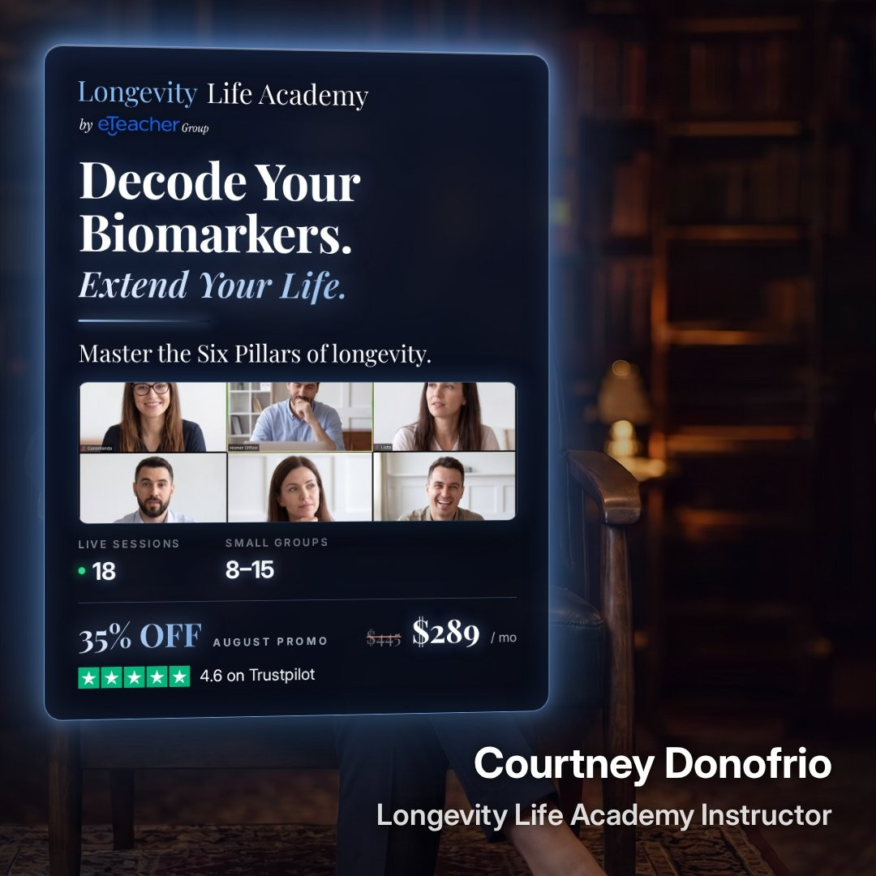
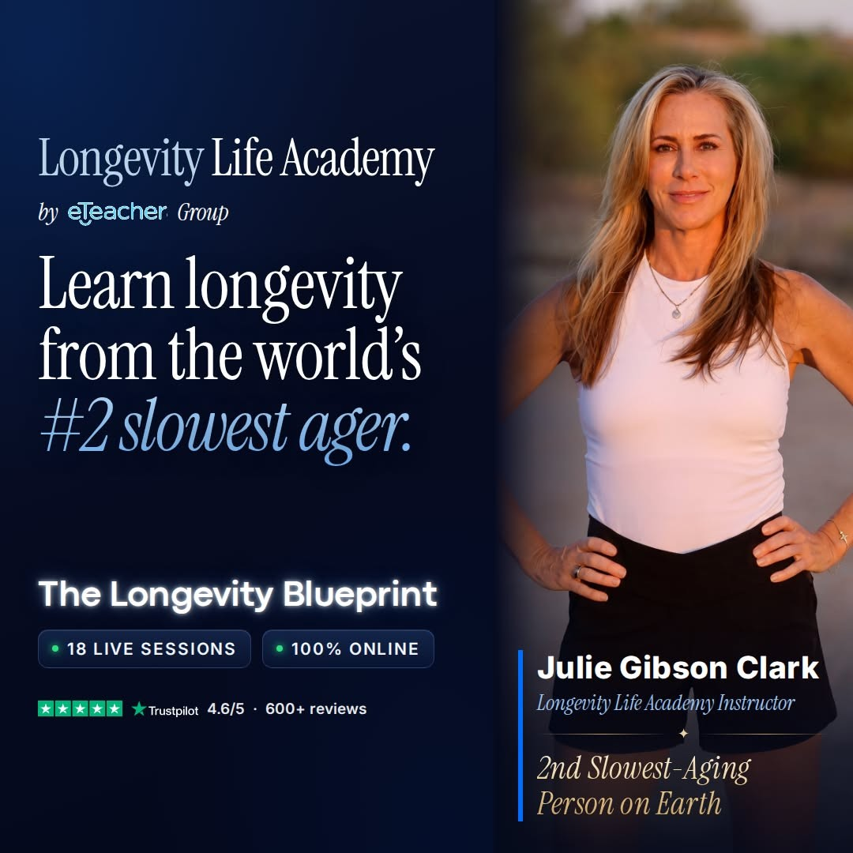
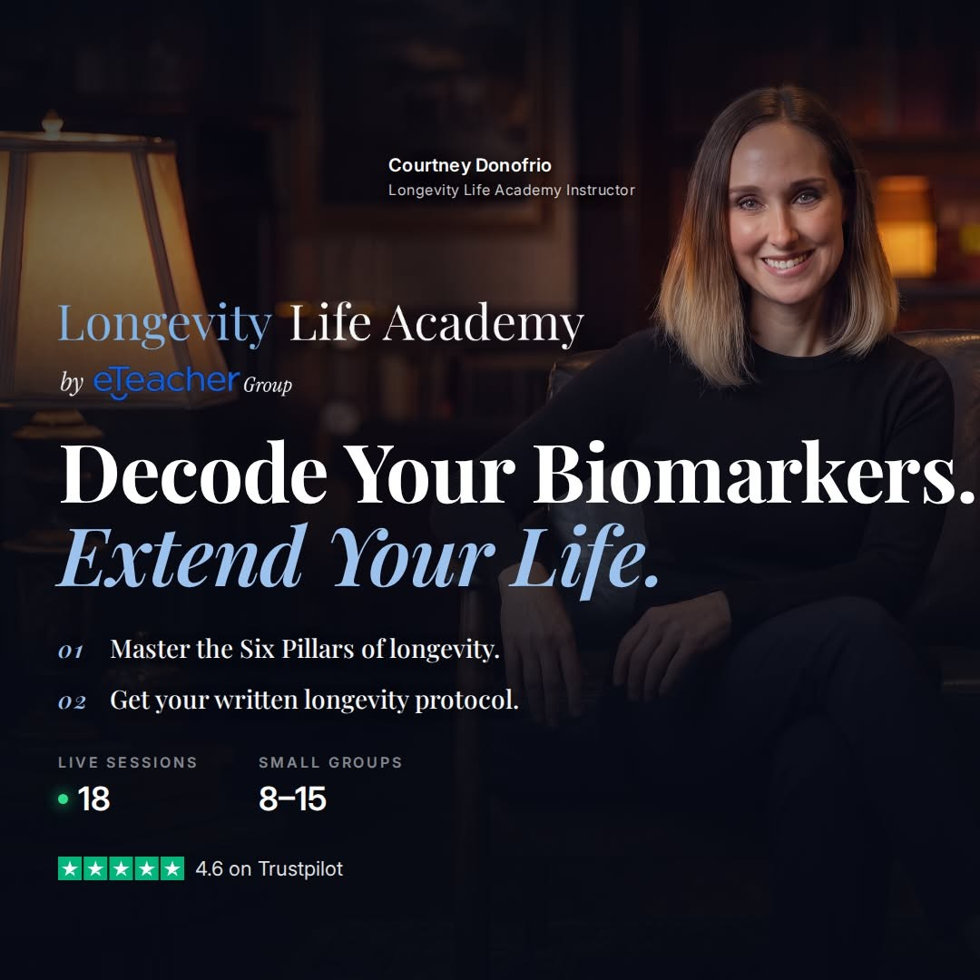
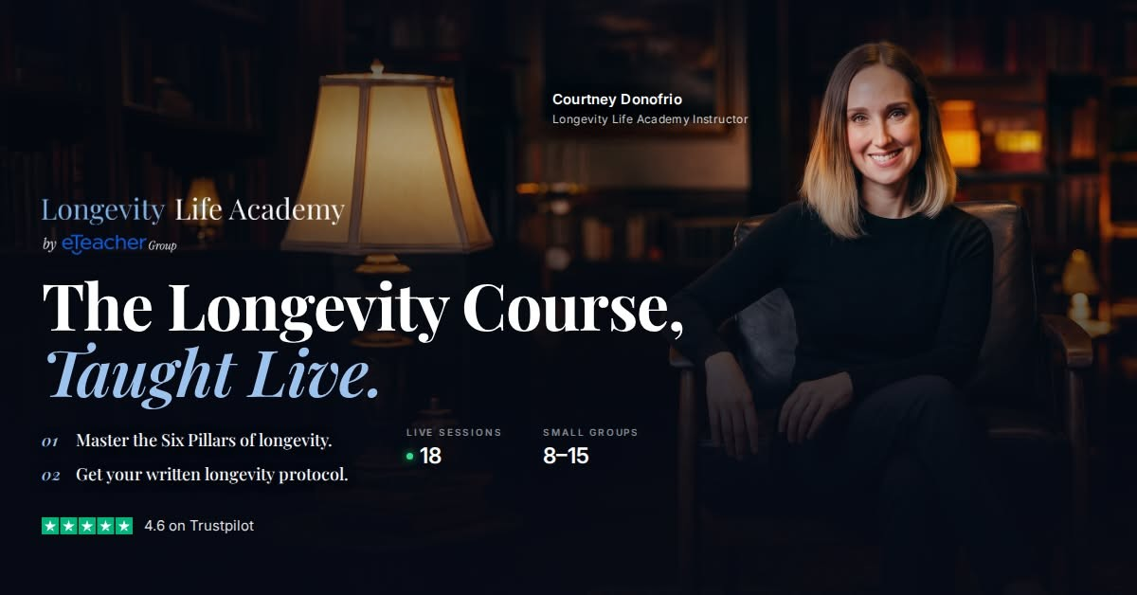
LONGEVITY LIFE ACADEMY · BOARD UPDATE · 18 OCTOBER 2026 · 3 / 6
Round 1 · films and ads until September
Julie Gibson Clark · full film · 2:19
Courtney · full film
Blueprint · Julie
Blueprint · Courtney
Blueprint · Ad#6
Lead gen · Ad#3
Lead gen · Ad#7
Longevity Life Academy · eTeacher Group · Board update
October 2026 operating targets · Launch assets: campaign library

Slide 4
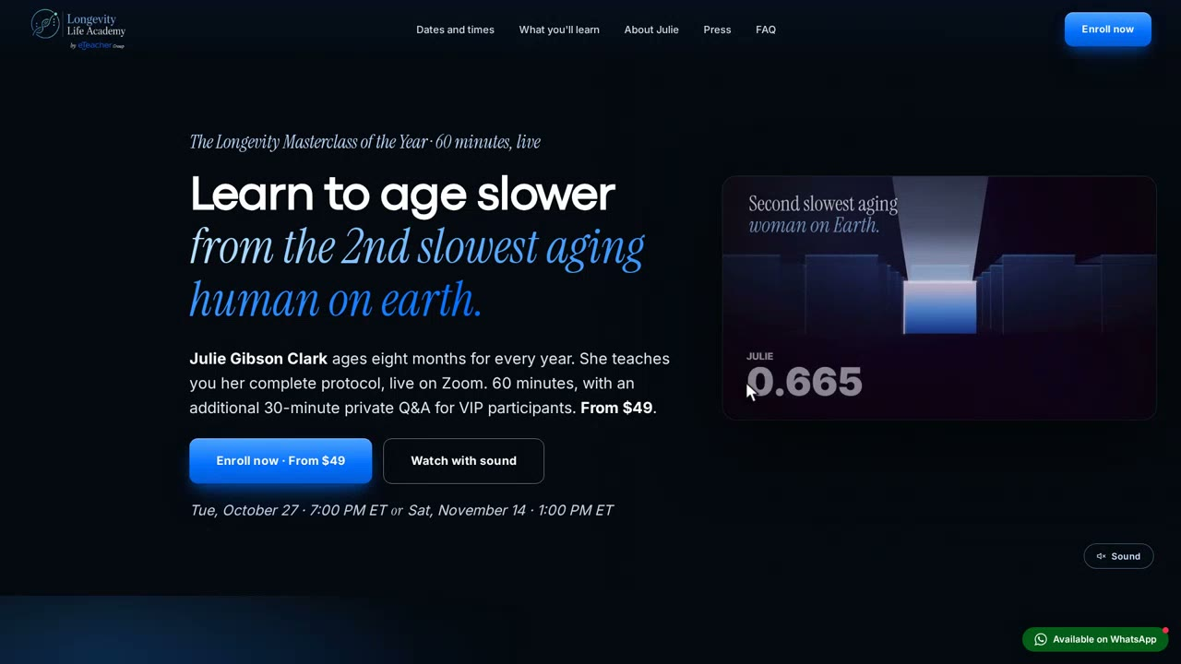
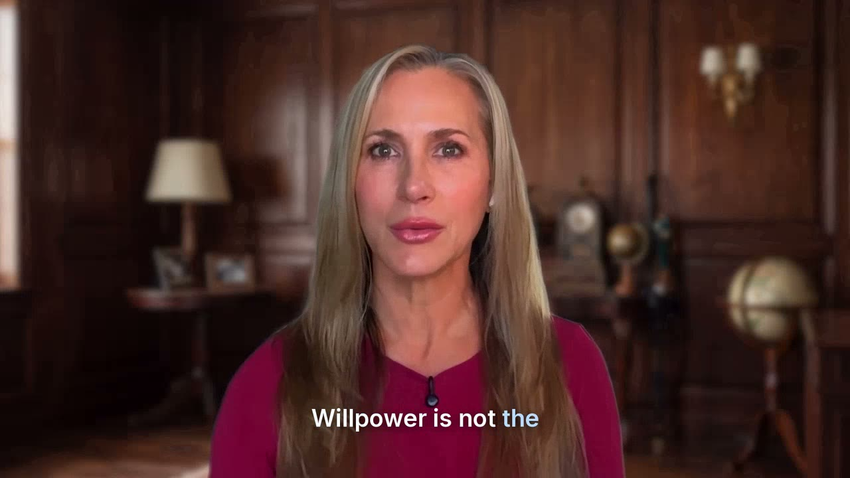
LONGEVITY LIFE ACADEMY · BOARD UPDATE · 18 OCTOBER 2026 · 4 / 6
Masterclass · the website and Julie's adapted film
longevitylifeacademy.com/julie-masterclass · 60 s walkthrough: hero → dates → VIP seat → payment
Julie's film adapted to the masterclass · 75 s · also 60 / 45 s in 4 ratios
Longevity Life Academy · eTeacher Group · Board update
October 2026 operating targets · Launch assets: campaign library

Slide 5
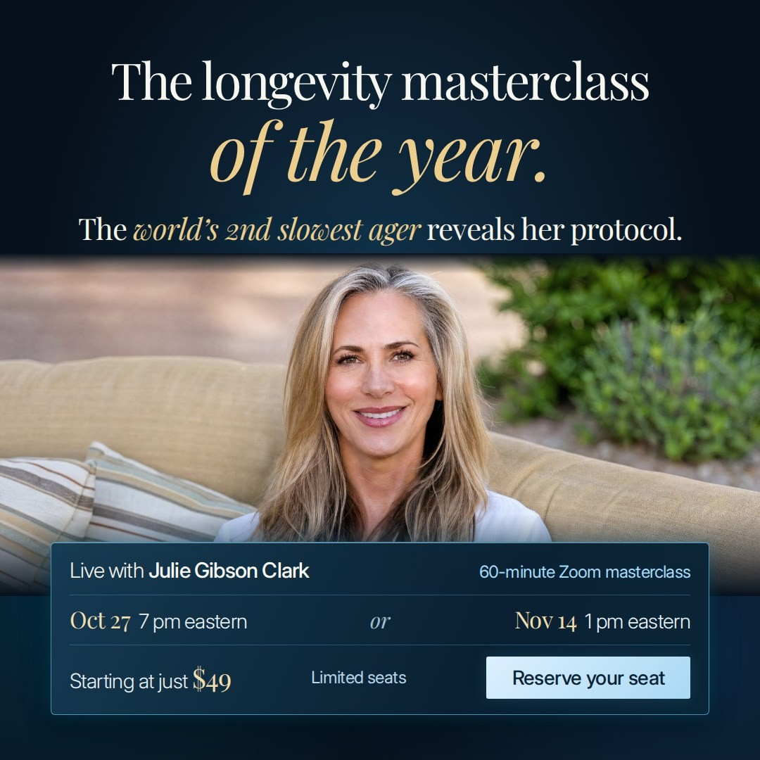
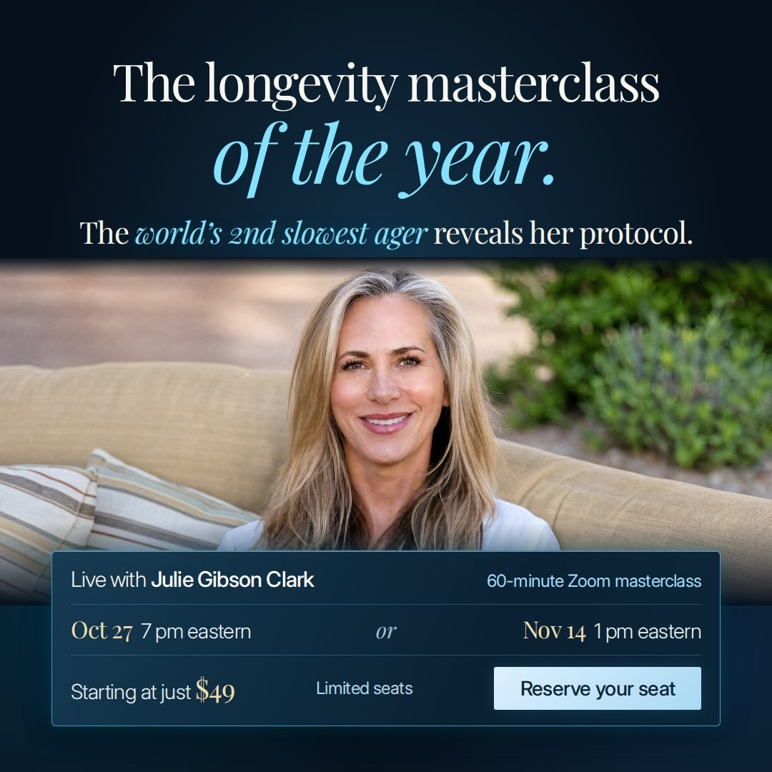
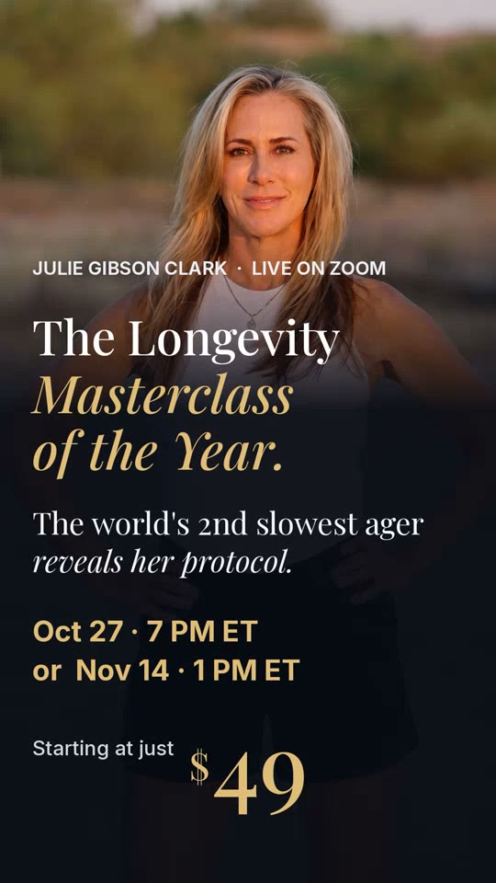
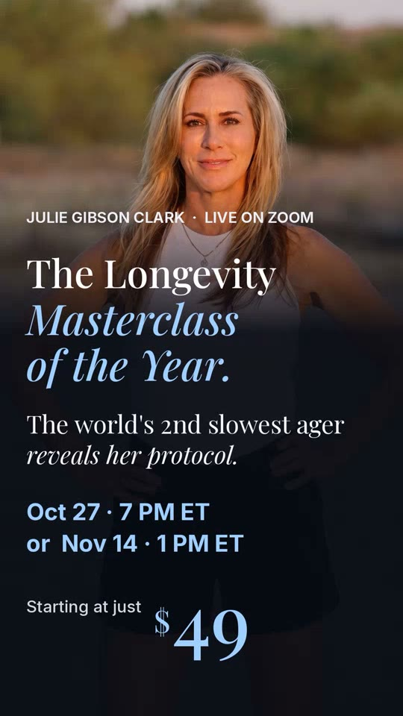
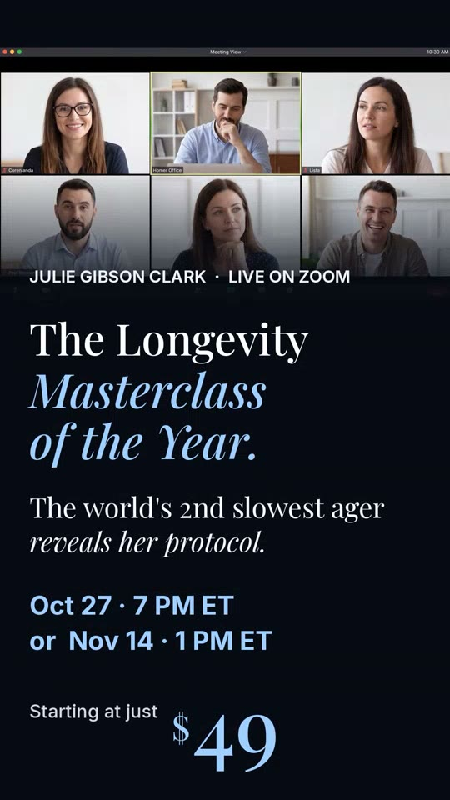
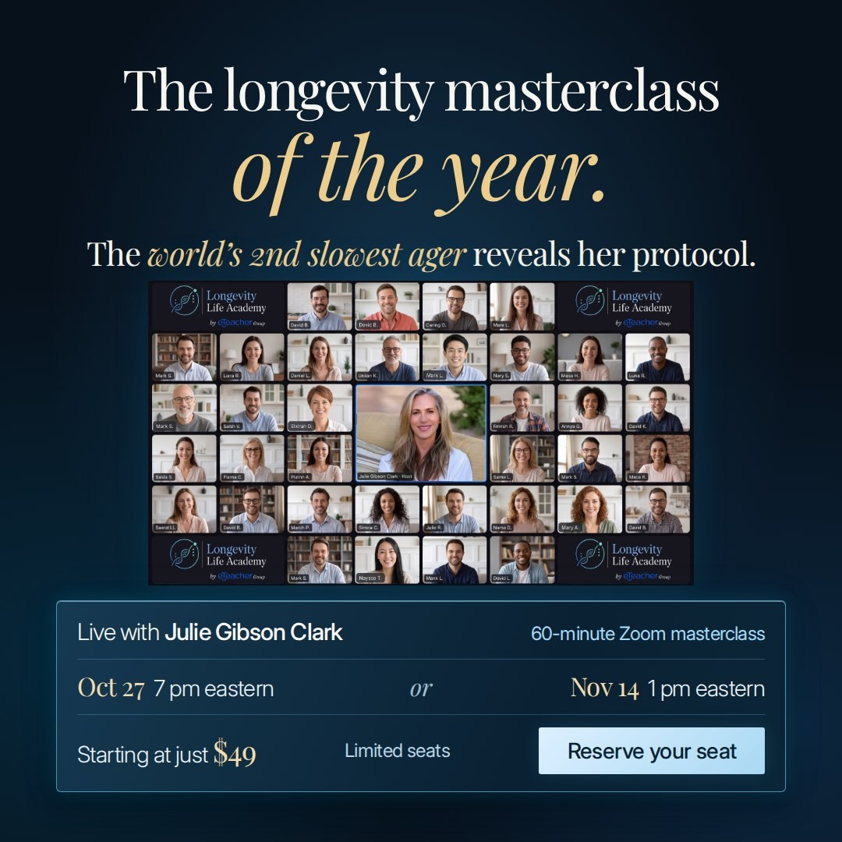
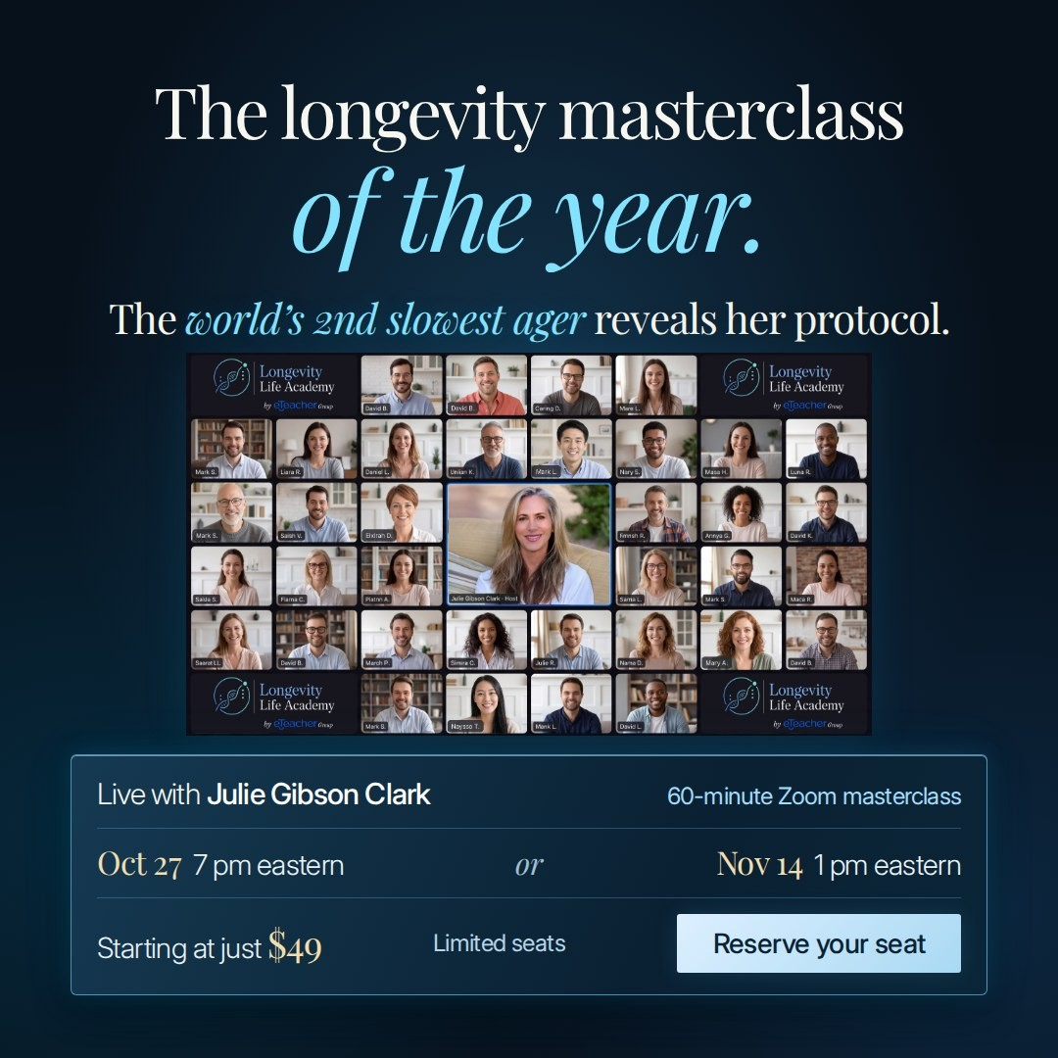
LONGEVITY LIFE ACADEMY · BOARD UPDATE · 18 OCTOBER 2026 · 5 / 6
Masterclass · banners and Reels with music
Four designs in every Meta size · 9:16 Reels cut to Julie's film soundtrack
card-gold
card-blue
card-gold Reels
card-blue Reels
zoom-blue Reels
zoom-gold
zoom-blue
Longevity Life Academy · eTeacher Group · Board update
October 2026 operating targets · Launch assets: campaign library

Slide 6
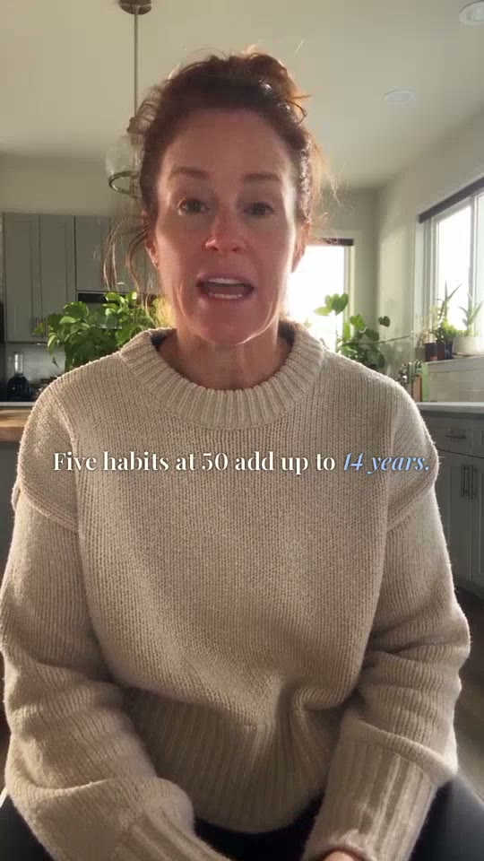
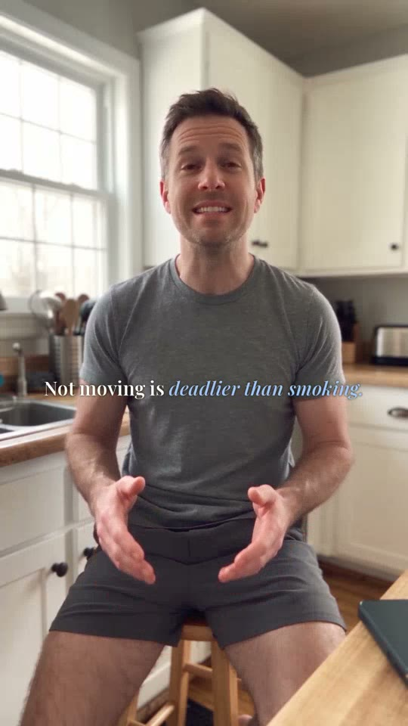
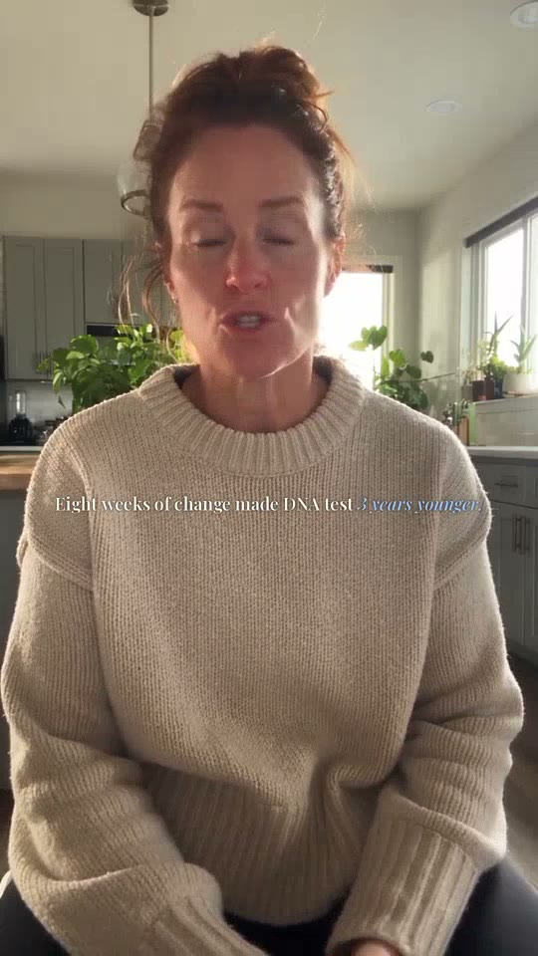
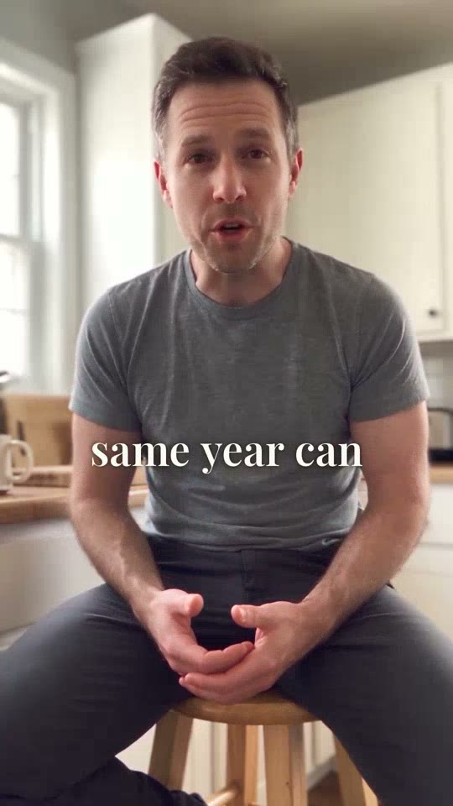
LONGEVITY LIFE ACADEMY · BOARD UPDATE · 18 OCTOBER 2026 · 6 / 6
Masterclass · eight presenter-video creatives
Four examples from the eight-video presenter series
Five habits
Deadlier than smoking
DNA 3 years younger
33 years apart
Longevity Life Academy · eTeacher Group · Board update
October 2026 operating targets · Launch assets: campaign library

