Slide 1
CHAPTER 1 · PUBLIC RELATIONS
Live Media Coverage
Round 1 + Round 2
Longevity Life Academy · eTeacher Group
Every placement below was opened and HTTP-verified on 27 July 2026.
Every row carries a direct article link — no index pages.

Slide 2
At a glance
Verified 27 July 2026, 08:05 IDT
9
4
499
33
direct article URLs
verified live
national-tier outlets
AP News ×2, USA TODAY ×2
total syndicated links
in the Round 1 bundle
ABC / NBC / CBS affiliate
domains carrying the release
Still in flight
Yahoo Finance and Business Insider are inside submission GLSYUK7, currently distributing. No public URL exists yet — they are not counted above. MarketWatch was never purchased. USA Today was rejected on 22 July and has not been republished.

Slide 3
Tier 1 — National flagship
Ordered by outlet authority. All four confirmed HTTP 200.
# | OUTLET | RELEASE | PUBLISHED | STATUS | DIRECT LINK
01 | AP News | Julie Gibson Clark joins LLA faculty | 23 Jul 2026 | LIVE | apnews.com →
02 | AP News | eTeacher Group launches Longevity Life Academy | 22 Jul 2026 | LIVE | apnews.com →
03 | IndyStar USA TODAY Network | eTeacher Group launches Longevity Life Academy | 20 Jul 2026 | LIVE | indystar.com →
04 | Cincinnati Enquirer USA TODAY Network | eTeacher Group launches Longevity Life Academy | 20 Jul 2026 | LIVE | cincinnati.com →
Source: live page loads verified 27 July 2026, 08:05 IDT.

Slide 4
Tier 2 — Financial & syndication
Trading-desk and market-data surfaces carrying the Julie Gibson Clark release.
# | OUTLET | WHAT IT IS | PUBLISHED | STATUS | DIRECT LINK
05 | StreetInsider | Institutional equities newsroom | 23 Jul 2026 | LIVE | streetinsider.com →
06 | Barchart | Market-data and futures platform | 23 Jul 2026 | LIVE | barchart.com →
07 | FinancialContent | Syndication layer feeding StreetInsider | 23 Jul 2026 | LIVE | financialcontent.com →
08 | MarketersMEDIA Newsroom | Originating wire newsroom | 23 Jul 2026 | LIVE | marketersmedia.com →
09 | Full distribution report | All 499 syndicated links, one page | 23 Jul 2026 | LIVE | report.prnow.io →
Source: live page loads verified 27 July 2026, 08:05 IDT. StreetInsider blocks automated clients but resolves normally in a browser.

Slide 5
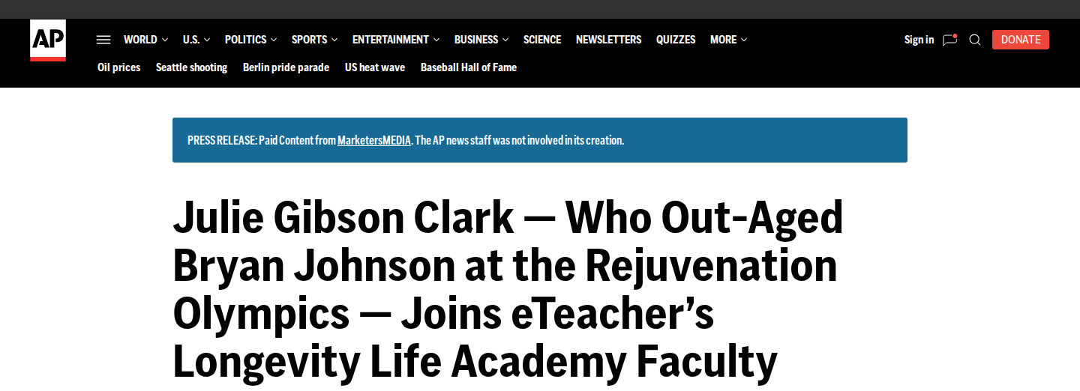
LIVE PLACEMENT 01
AP News
Open live page →
apnews.com — the Associated Press newsroom. Headline and Julie Gibson Clark angle carried in full, published 23 July 2026.

Slide 6
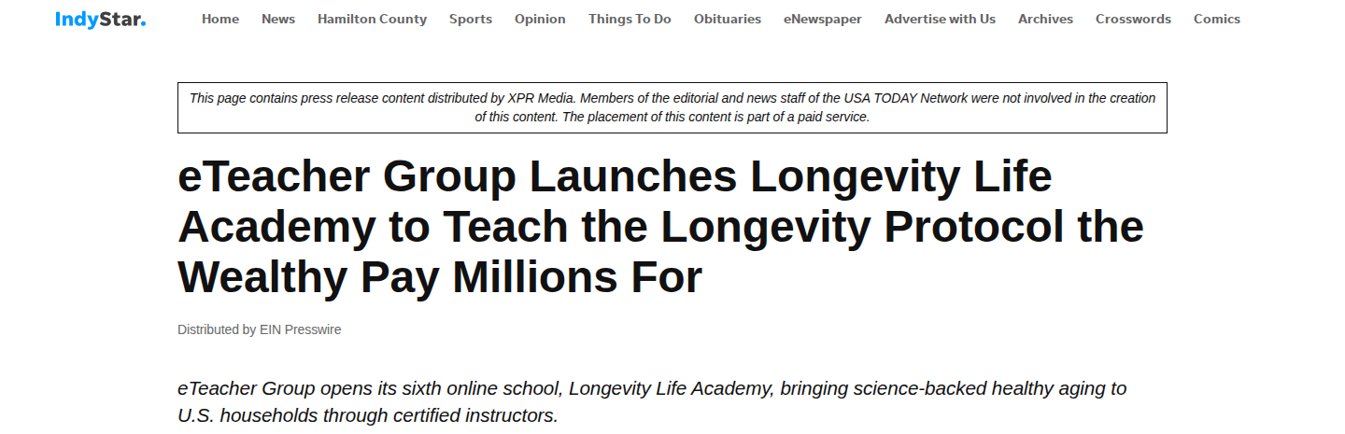
LIVE PLACEMENT 03
IndyStar · USA TODAY Network
Open live page →
indystar.com — Indianapolis Star, a Gannett daily inside the USA TODAY Network. Full launch release with the $8 trillion market framing.

Slide 7
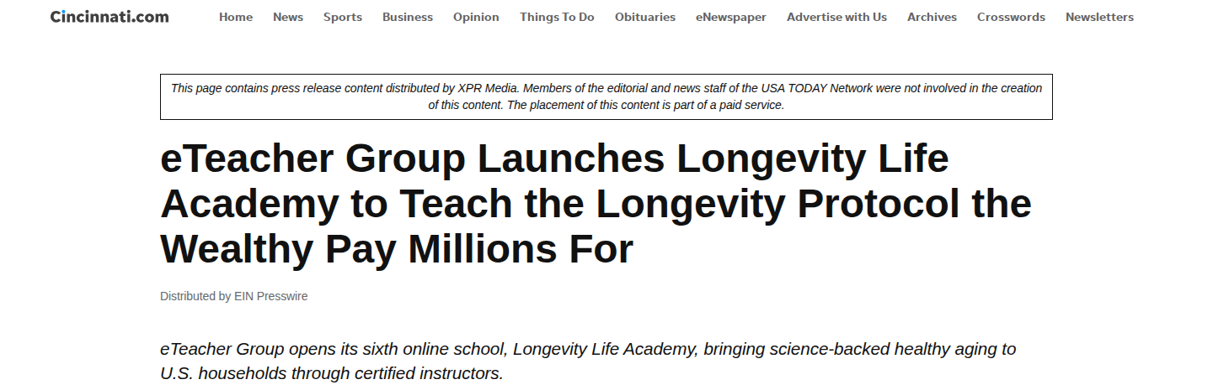
LIVE PLACEMENT 04
Cincinnati Enquirer · USA TODAY Network
Open live page →
cincinnati.com — second Gannett daily inside the USA TODAY Network carrying the identical launch release.

Slide 8
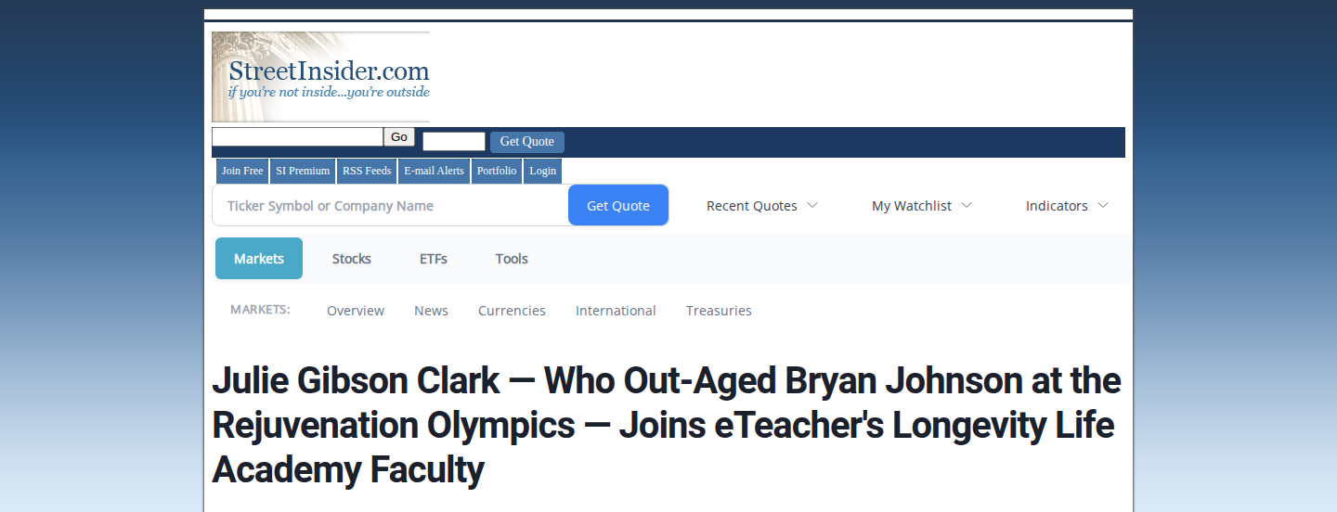
LIVE PLACEMENT 05 / 07
StreetInsider
Open live page →
StreetInsider.com — institutional equities newsroom, served through the FinancialContent syndication layer. Published 23 July 2026, 10:55 AM EDT.

Slide 9
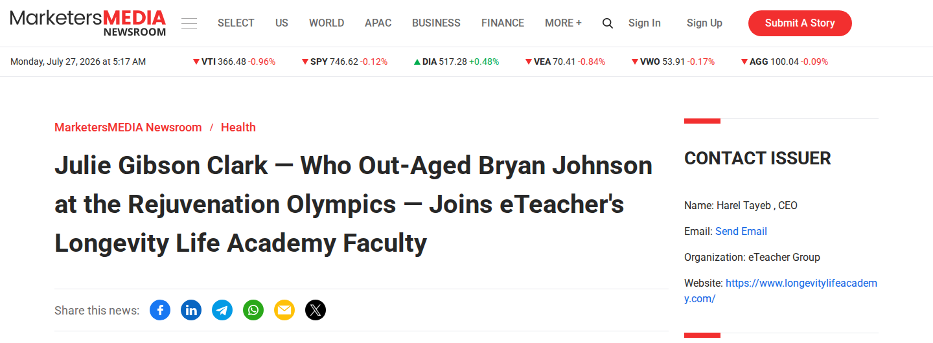
LIVE PLACEMENT 08
MarketersMEDIA Newsroom
Open live page →
news.marketersmedia.com — the originating wire newsroom. Contact block shows Harel Tayeb, CEO, eTeacher Group, longevitylifeacademy.com.

Slide 10
LIVE PLACEMENT 06
Barchart
Open live page →
Julie Gibson Clark — Who Out-Aged Bryan Johnson at the Rejuvenation Olympics — Joins eTeacher’s Longevity Life Academy Faculty
barchart.com · Story ID 3429825 · Published 23 July 2026
Barchart serves market data, futures and equities coverage to retail and professional traders. The page returns HTTP 200 and resolves normally in a browser; its CDN blocks automated screenshot clients, so the headline is reproduced here verbatim rather than captured.
barchart.com — market-data and futures platform. Page verified HTTP 200 on 27 July 2026.

Slide 11
Syndication footprint
What the 499-link Round 1 bundle actually contains, counted line by line.
SEGMENT | DOMAINS | WHAT IT IS
Named national outlets | 3 | AP News, Barchart, StreetInsider
FinancialContent network | 37 | markets.financialcontent.com syndication endpoints
TV affiliate finance pages | 33 | WKOW, WQOW, KTIV, KVOA, WAOW, WGEM, WREX, WSIL, WVVA, KBJR, KTTC, KWWL and others — real ABC / NBC / CBS station domains, finance-widget side
Regional newspapers | ~10 | Salisbury Post, Winchester Sun, Ironton Tribune, Farmville Herald, Charlotte Gazette, Smithfield Times, Demopolis Times, Pawtucket Times
Long-tail syndication | ~415 | Aggregator and filler domains with no editorial brand recognition
Source: full link export from the PRNow distribution report for submission 9G4BYEY, counted 27 July 2026.

Slide 12
Not live — stated plainly
So the coverage table above can be read without a footnote.
OUTLET | STATE | DETAIL
Yahoo Finance | Distributing | Inside submission GLSYUK7 on the Advanced V2 plan. No public URL yet.
Business Insider | Distributing | Same submission GLSYUK7. No public URL yet.
MarketWatch | Not purchased | Sold separately at $99. No order has been placed.
USA Today | Rejected | Declined 22 July 2026 — the release scored below the required editorial threshold. Credits were refunded. Not resubmitted.
Nothing on this slide is counted as coverage anywhere else in this deck.

Slide 13
Round 1 + Round 2, verified
9 direct article URLs live across AP News, the USA TODAY Network, StreetInsider, Barchart, FinancialContent and MarketersMEDIA — inside a 499-link syndication bundle.
Media contact
Harel Tayeb, CEO, eTeacher Group
omri.gitter@eteachergroup.com · +1-888-230-5110
https://www.longevitylifeacademy.com/

