Slide 1
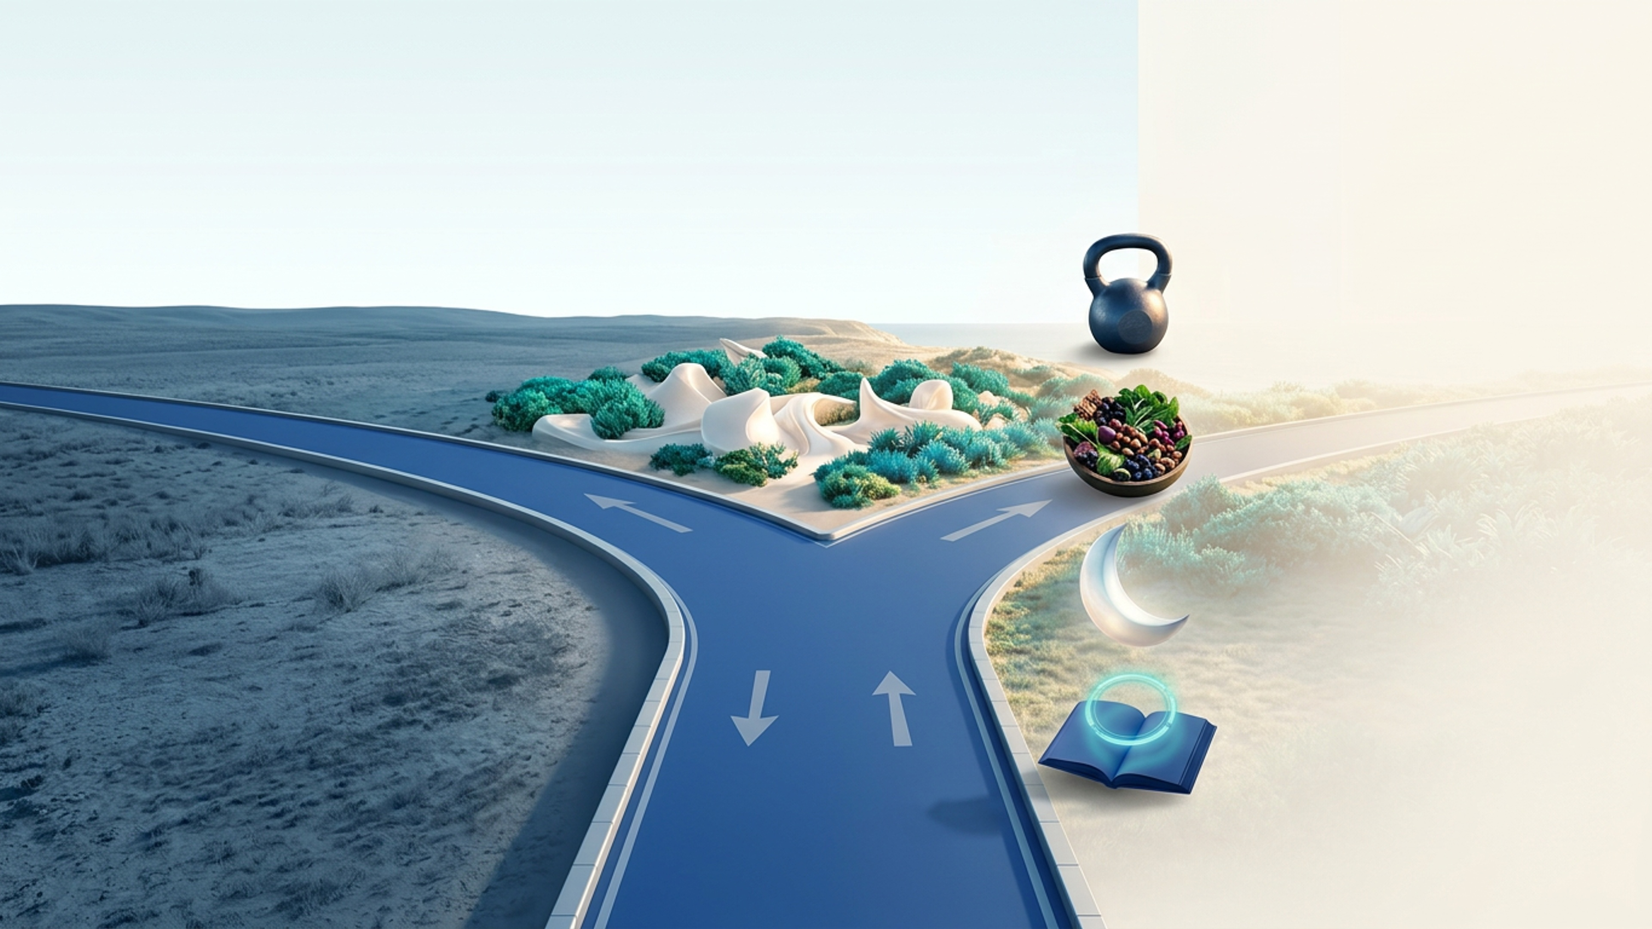


Take action.
Even one thing.
Choose action.
Toward a longer, better life.
Start moving.
A brisk walk after your biggest meal. Strength twice a week.
Watch your sugar.
Protein and fiber first. Fewer spikes.
Change nothing.
Protect your sleep.
Decline is the default.
Last meal three hours before bed.
Your protocol, with us.
The Longevity Blueprint. Eighteen live weeks, your numbers, a written protocol you keep.
Notes:
Take one action. The right road offers exercise, food choices, sleep, or creating your personal protocol through the Longevity Blueprint. The image is a metaphor, not a guarantee of an outcome.

Slide 2
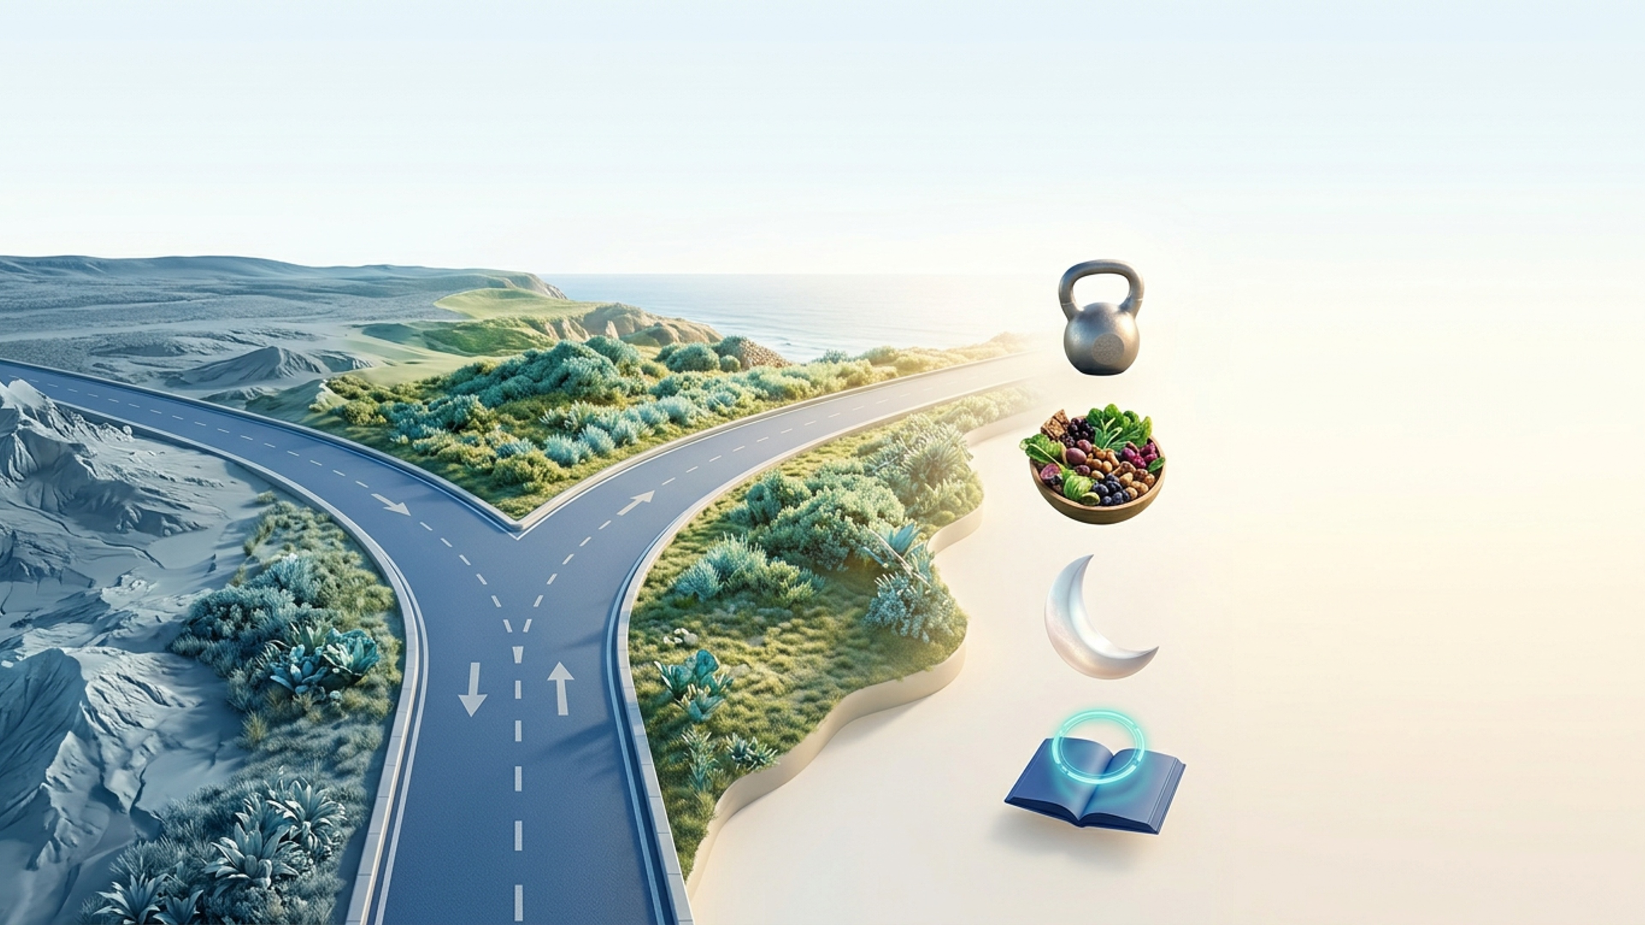
Take action.
Even one thing.
Choose action.
Toward a longer, better life.
Start moving.
A brisk walk after your biggest meal. Strength twice a week.
Watch your sugar.
Protein and fiber first. Fewer spikes.
Change nothing.
Protect your sleep.
Decline is the default.
Last meal three hours before bed.
Your protocol, with us.
The Longevity Blueprint. Eighteen live weeks, your numbers, a written protocol you keep.
Notes:
Take one action. The right road offers exercise, food choices, sleep, or creating your personal protocol through the Longevity Blueprint. The image is a metaphor, not a guarantee of an outcome.

Slide 3
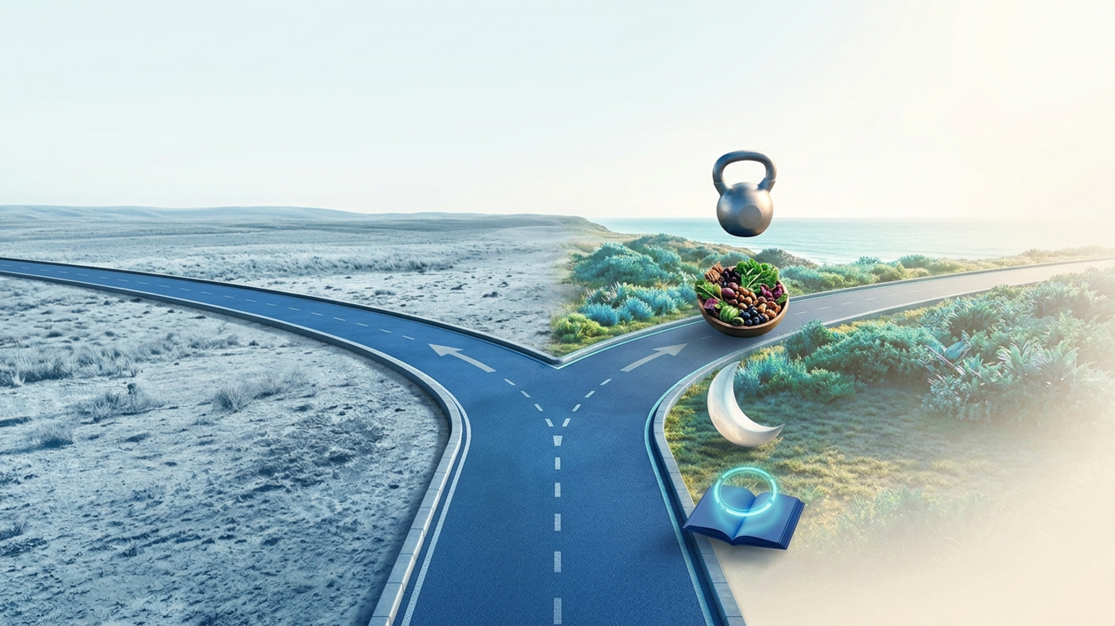
Take action.
Even one thing.
Choose action.
Toward a longer, better life.
Start moving.
A brisk walk after your biggest meal. Strength twice a week.
Watch your sugar.
Protein and fiber first. Fewer spikes.
Change nothing.
Protect your sleep.
Decline is the default.
Last meal three hours before bed.
Your protocol, with us.
The Longevity Blueprint. Eighteen live weeks, your numbers, a written protocol you keep.
Notes:
Take one action. The right road offers exercise, food choices, sleep, or creating your personal protocol through the Longevity Blueprint. The image is a metaphor, not a guarantee of an outcome.

