Slide 1

Notes:
Original image-based artwork. c26. Git commit 03c68be4d7ea1a12fc0a9342dca8e8f382574427; slide-canvas/closers/frames/c26.jpg

Slide 2
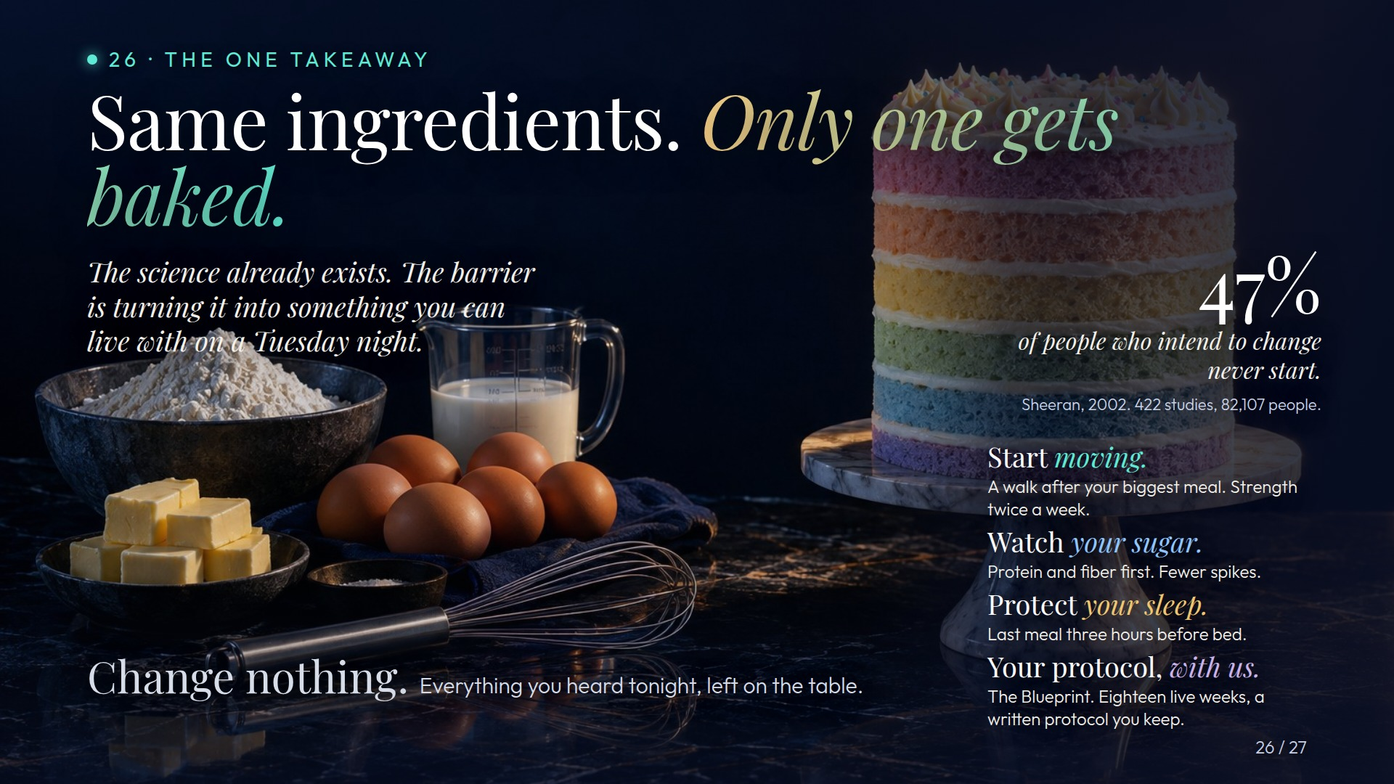
Notes:
Original image-based artwork. act3-a. Git commit 8258a553c39d48e868e7e48e856502b9e7552281; slide-canvas/closers/frames/act3-a.jpg

Slide 3

Notes:
Original image-based artwork. act3-b. Git commit 8258a553c39d48e868e7e48e856502b9e7552281; slide-canvas/closers/frames/act3-b.jpg

Slide 4

Notes:
Original image-based artwork. act3-c. Git commit 8258a553c39d48e868e7e48e856502b9e7552281; slide-canvas/closers/frames/act3-c.jpg

Slide 5

Notes:
Original image-based artwork. act2-a. Git commit 4b5b73be3493deed46e4a2af2c6c2bcaa11fc63e; slide-canvas/closers/frames/act2-a.jpg

Slide 6

Notes:
Original image-based artwork. act2-d. Git commit 4b5b73be3493deed46e4a2af2c6c2bcaa11fc63e; slide-canvas/closers/frames/act2-d.jpg

Slide 7
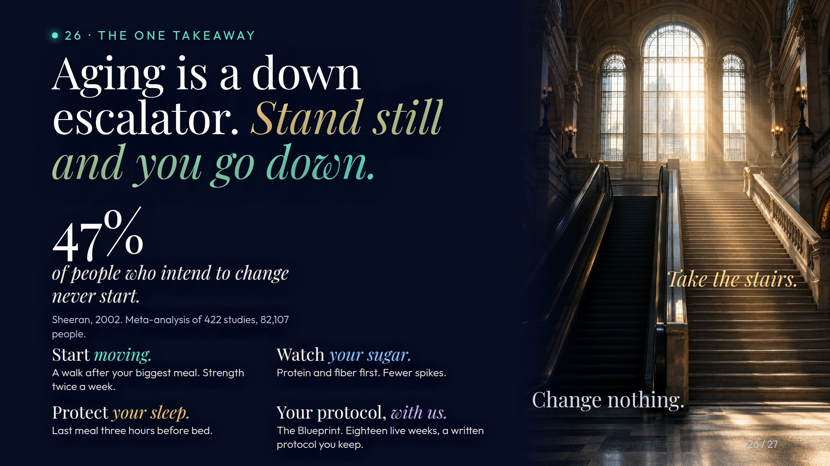
Notes:
Original image-based artwork. act2-e. Git commit 4b5b73be3493deed46e4a2af2c6c2bcaa11fc63e; slide-canvas/closers/frames/act2-e.jpg

Slide 8
Notes:
Original image-based artwork. act2-a. Git commit 6e32e4c92a862c7fdefd54e1b7c9f747eef1efb1; slide-canvas/closers/frames/act2-a.jpg

Slide 9
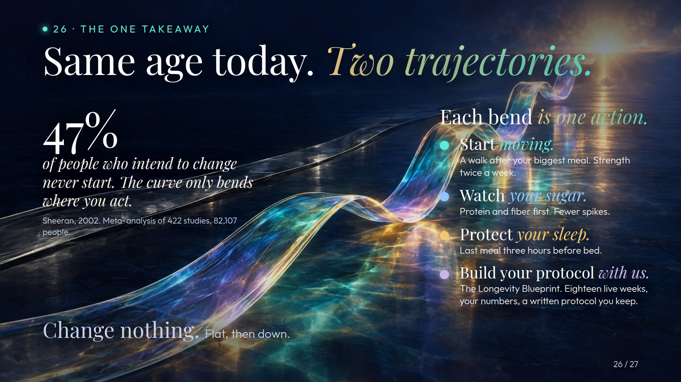
Notes:
Original image-based artwork. act2-b. Git commit 6e32e4c92a862c7fdefd54e1b7c9f747eef1efb1; slide-canvas/closers/frames/act2-b.jpg

Slide 10
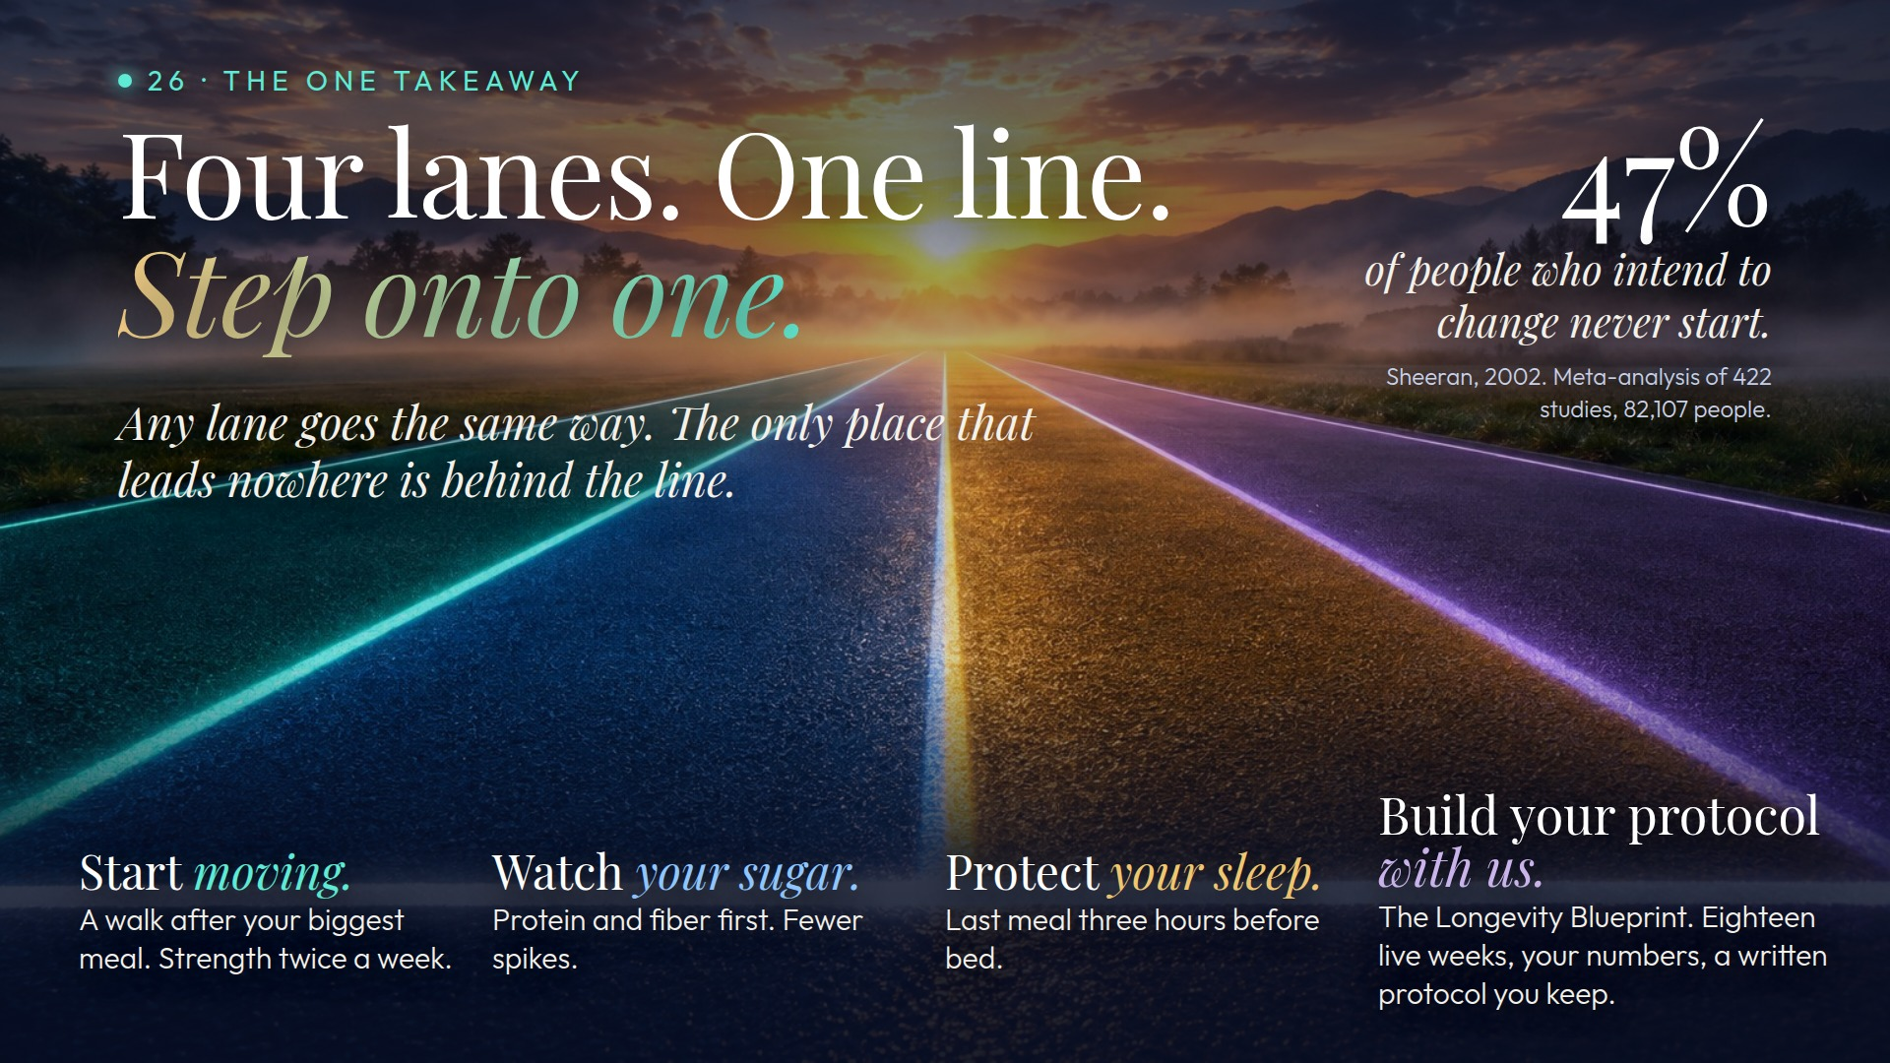
Notes:
Original image-based artwork. act2-c. Git commit 6e32e4c92a862c7fdefd54e1b7c9f747eef1efb1; slide-canvas/closers/frames/act2-c.jpg

Slide 11

Notes:
Original image-based artwork. act-a. Git commit 93ceffeb55299a76be5ff795e1360267bfd642cd; slide-canvas/closers/frames/act-a.jpg

Slide 12
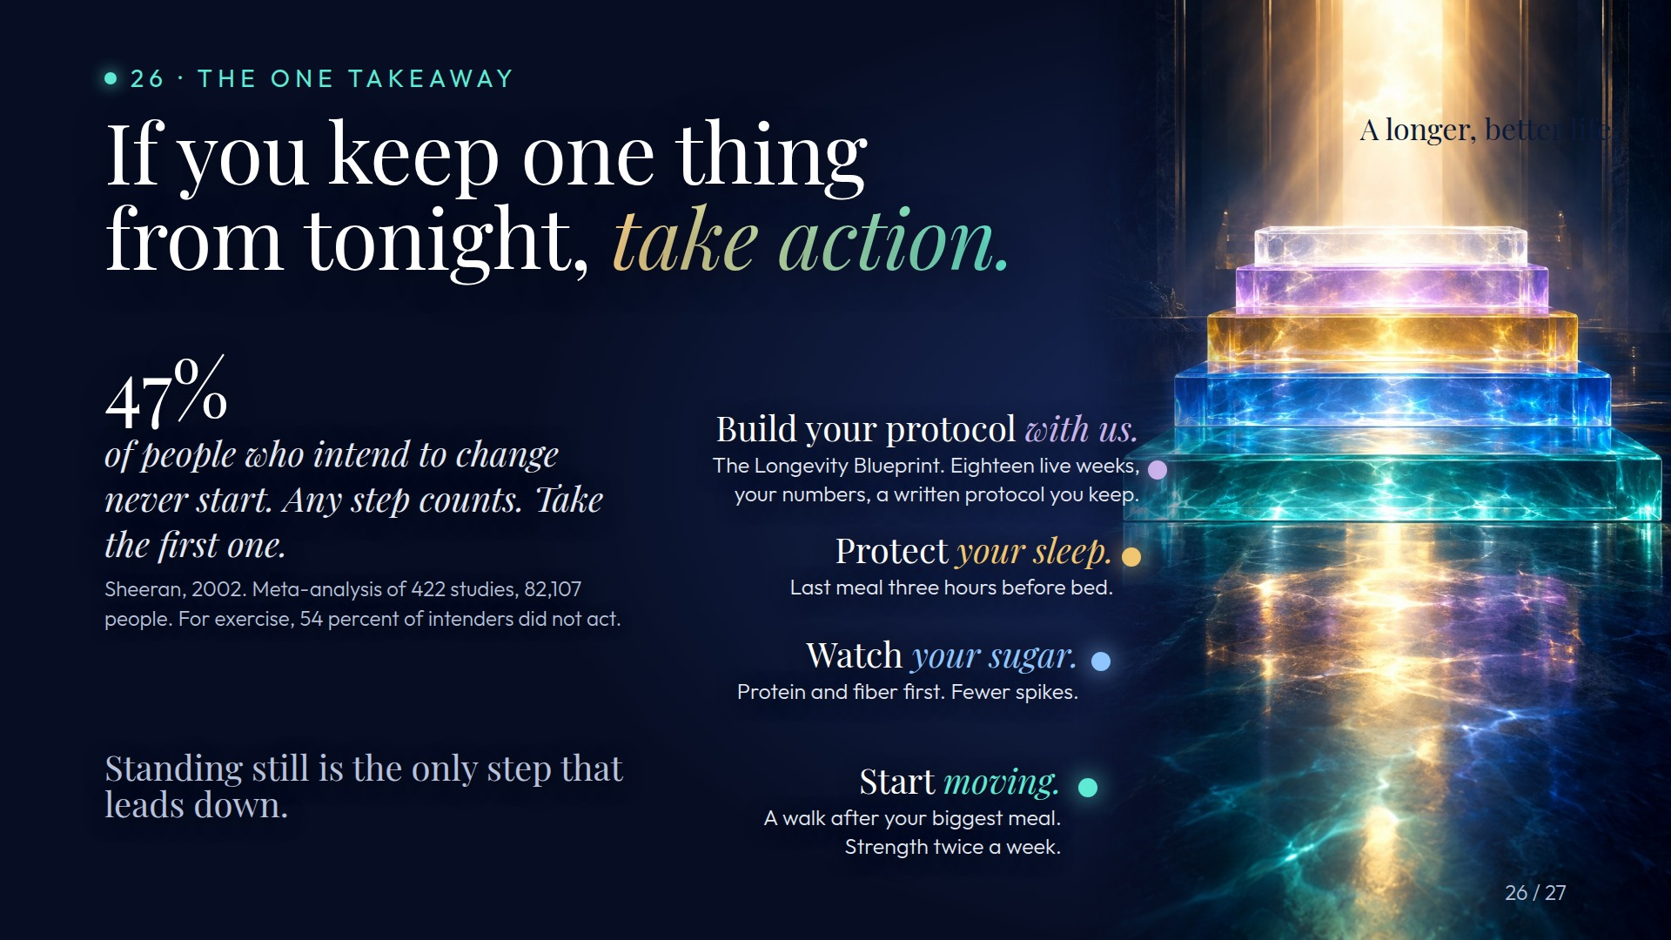
Notes:
Original image-based artwork. act-b. Git commit 93ceffeb55299a76be5ff795e1360267bfd642cd; slide-canvas/closers/frames/act-b.jpg

Slide 13

Notes:
Original image-based artwork. act-c. Git commit 93ceffeb55299a76be5ff795e1360267bfd642cd; slide-canvas/closers/frames/act-c.jpg

Slide 14
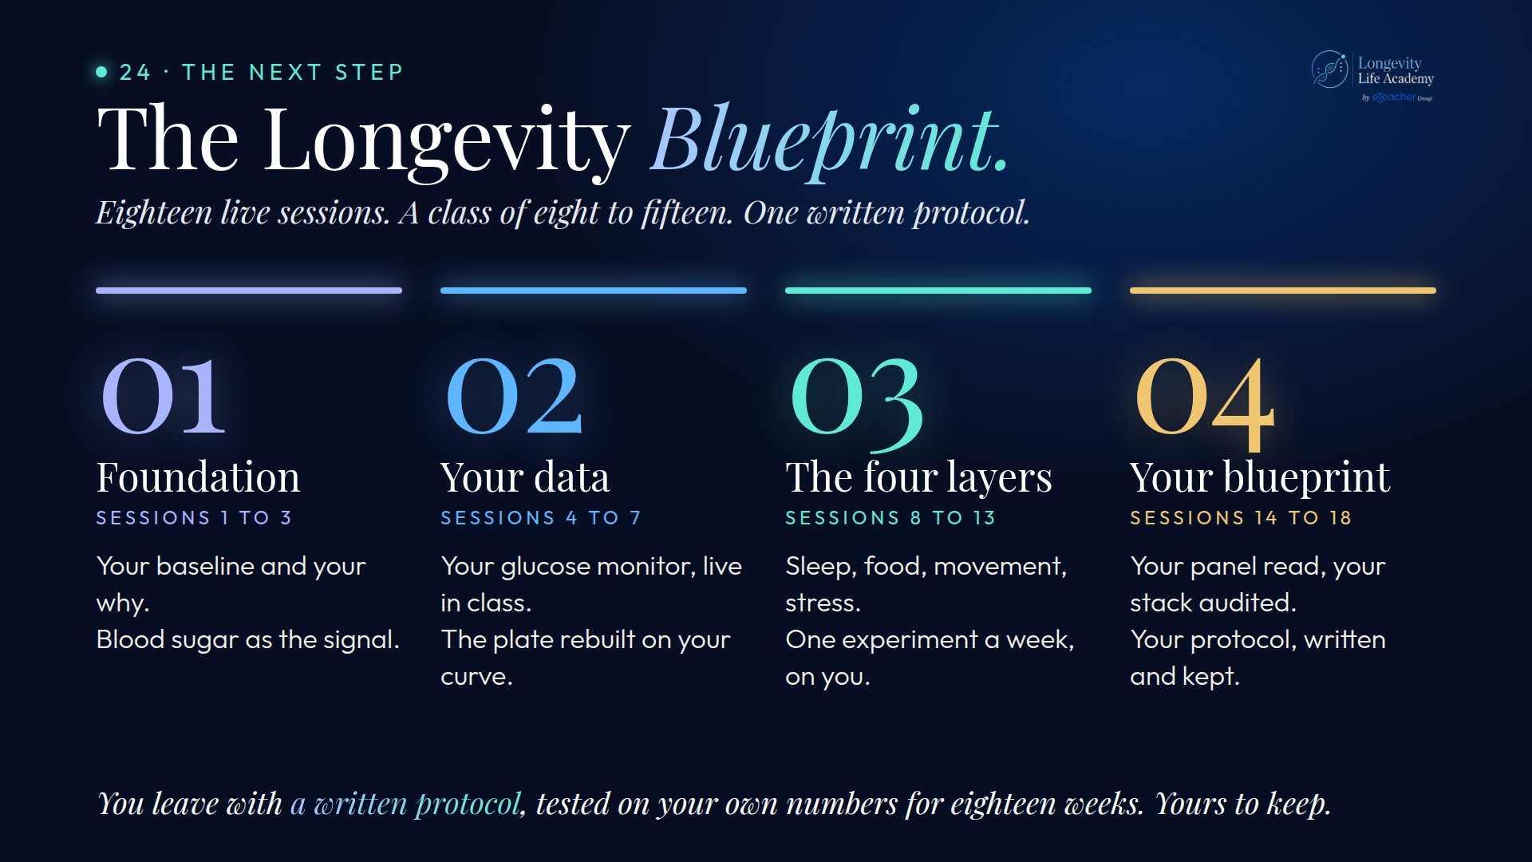
Notes:
Original image-based artwork. bp-4. Git commit 02bcf62326247448fccd5c99dd790382b2b7588c; slide-canvas/closers/frames/bp-4.jpg

Slide 15
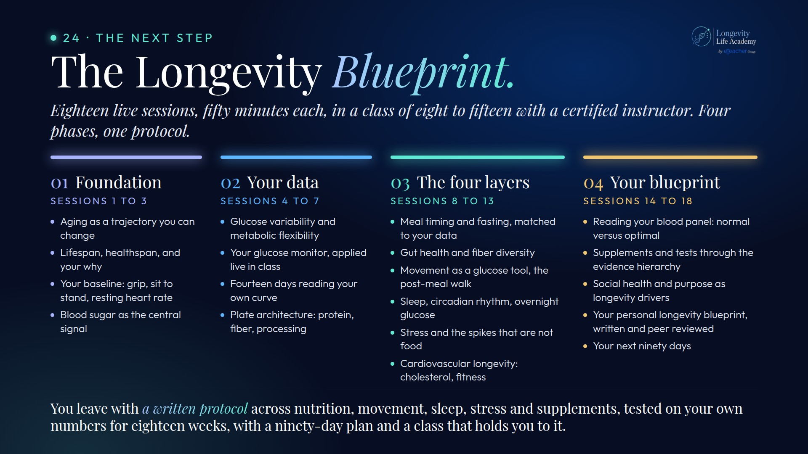
Notes:
Original image-based artwork. bp-cur. Git commit c1c4732bdd0e9c980a6b691c2c21a9c318b0a4ff; slide-canvas/closers/frames/bp-cur.jpg

Slide 16
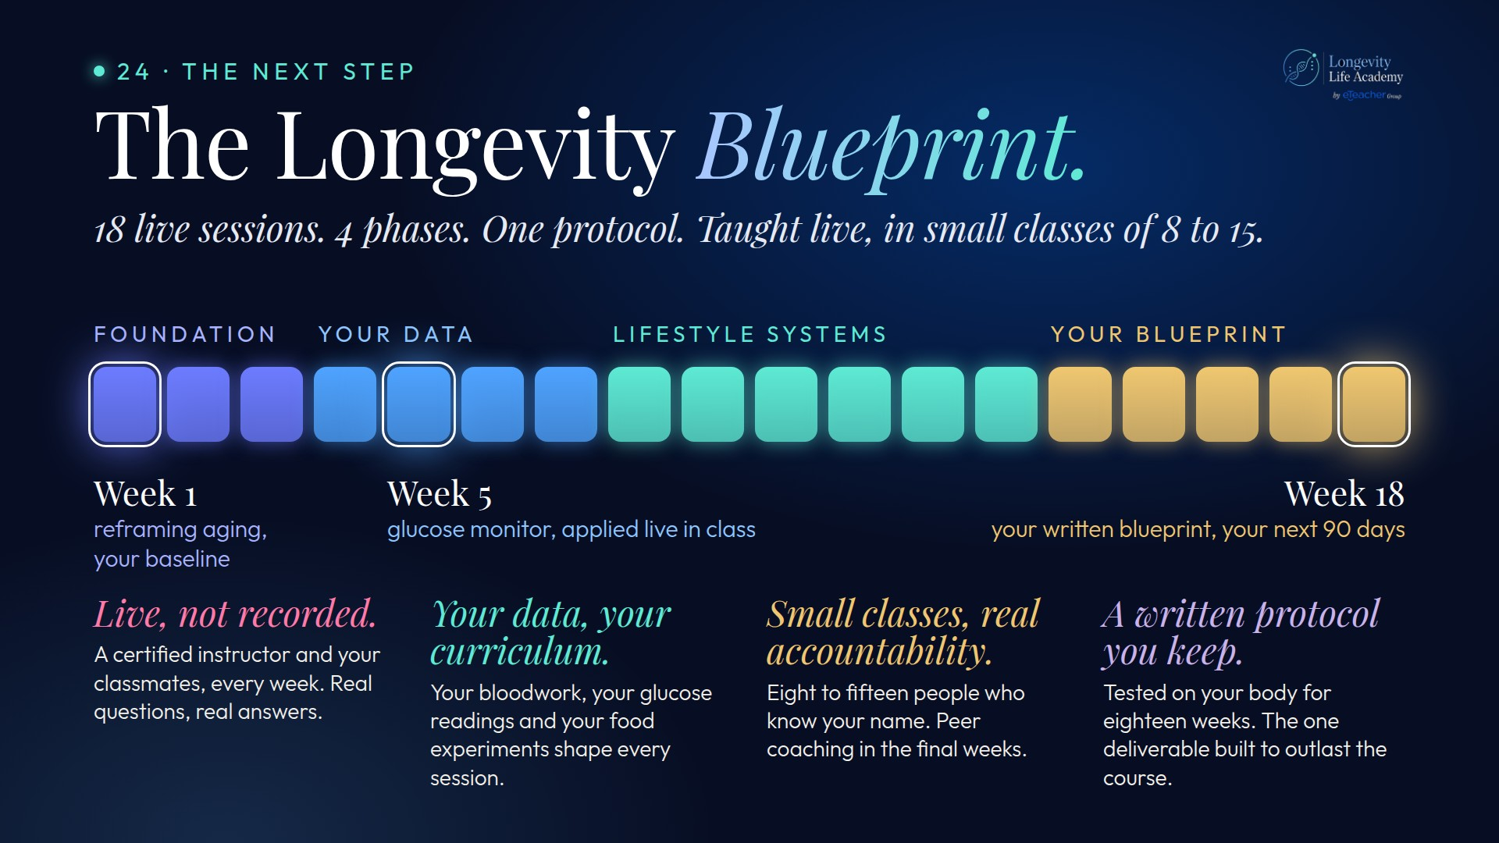
Notes:
Original image-based artwork. bp-site. Git commit e631dd85b7970b4272c9c5545404d8d6325e6b7c; slide-canvas/closers/frames/bp-site.jpg

Slide 17
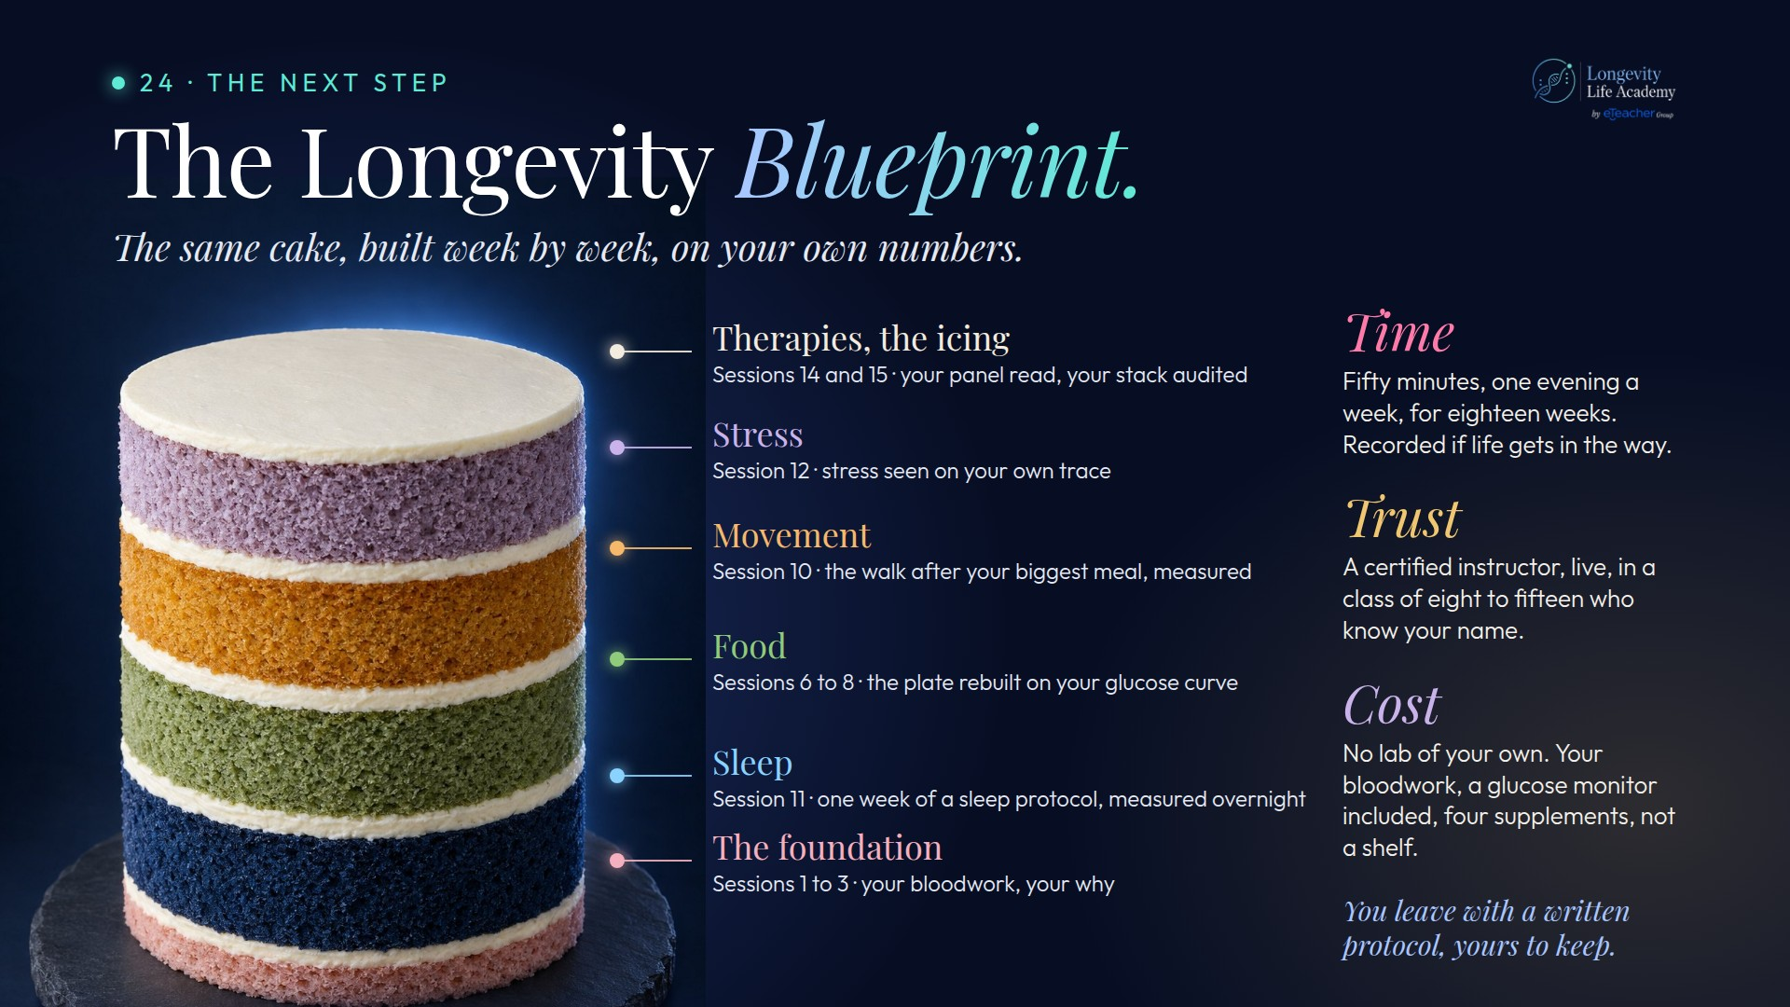
Notes:
Original image-based artwork. bp-cake. Git commit 58ff00c4b7c32250308c86339ed1b31d8f797698; slide-canvas/closers/frames/bp-cake.jpg

Slide 18
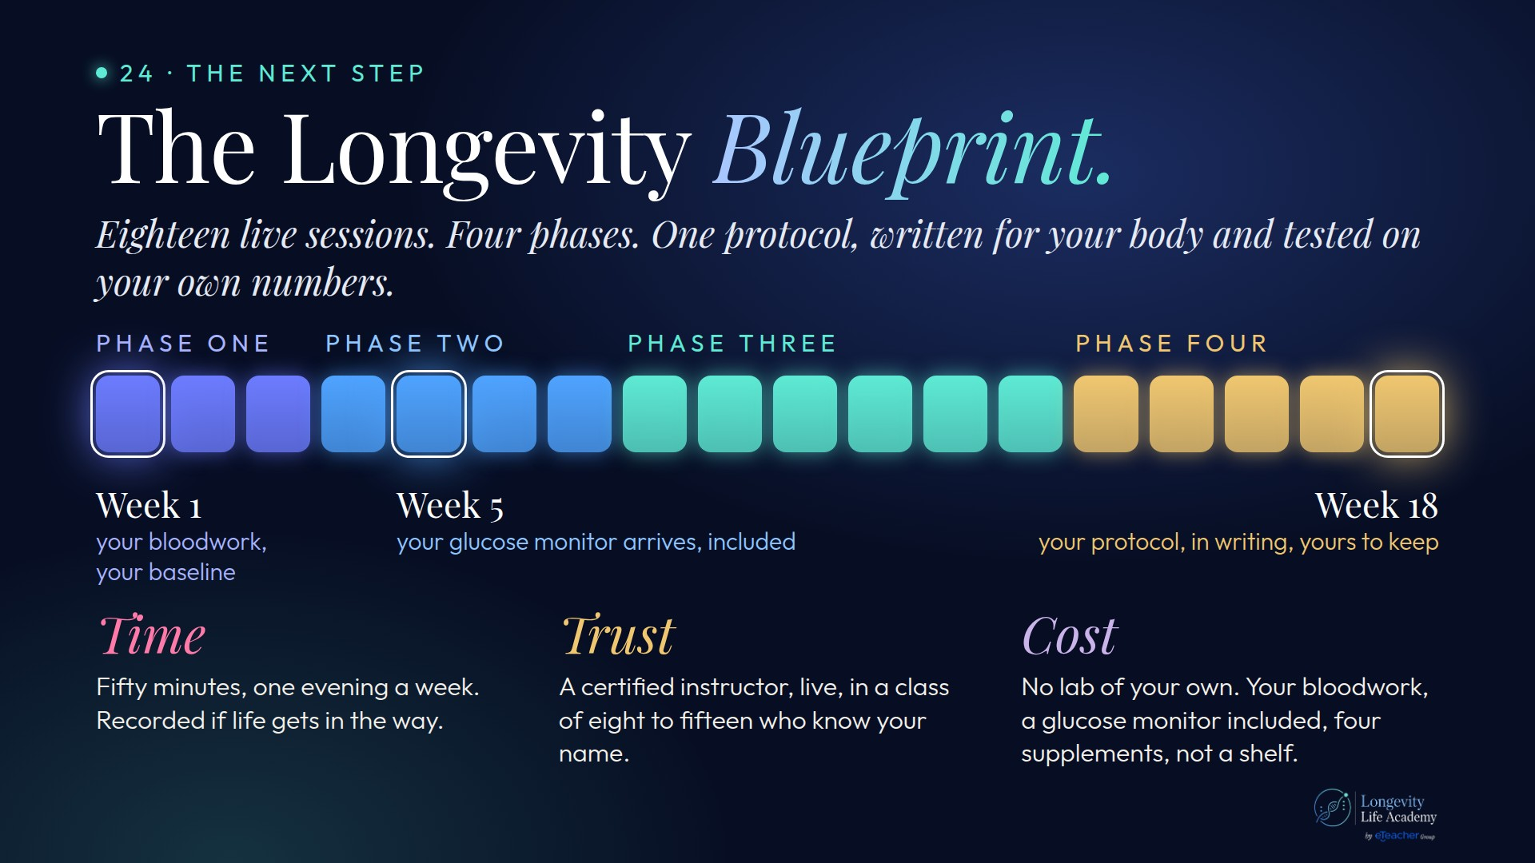
Notes:
Original image-based artwork. bp-big. Git commit b2120cbb1f07af192f8362fe758bcdc69dfe86ac; slide-canvas/closers/frames/bp-big.jpg

Slide 19
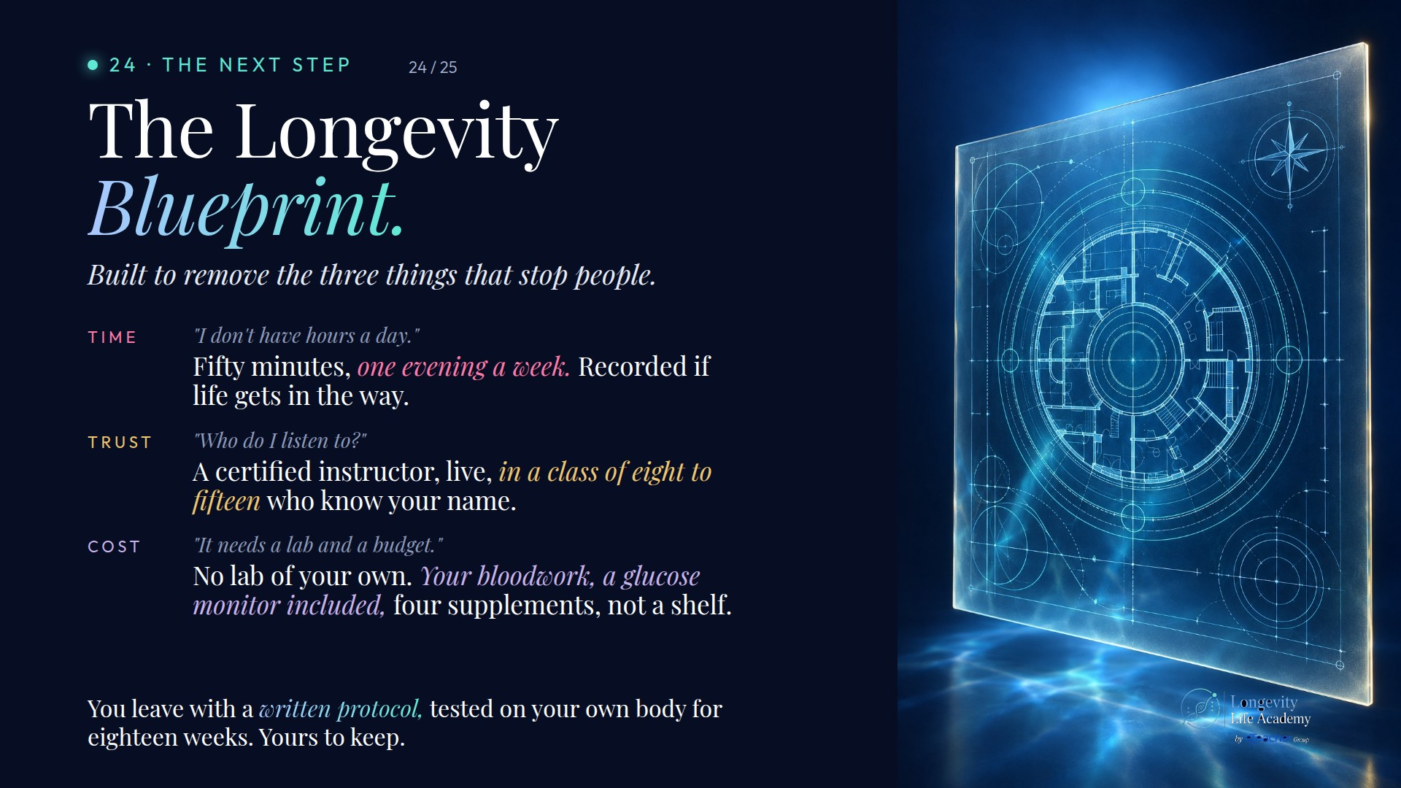
Notes:
Original image-based artwork. bp-sell. Git commit b2120cbb1f07af192f8362fe758bcdc69dfe86ac; slide-canvas/closers/frames/bp-sell.jpg

Slide 20
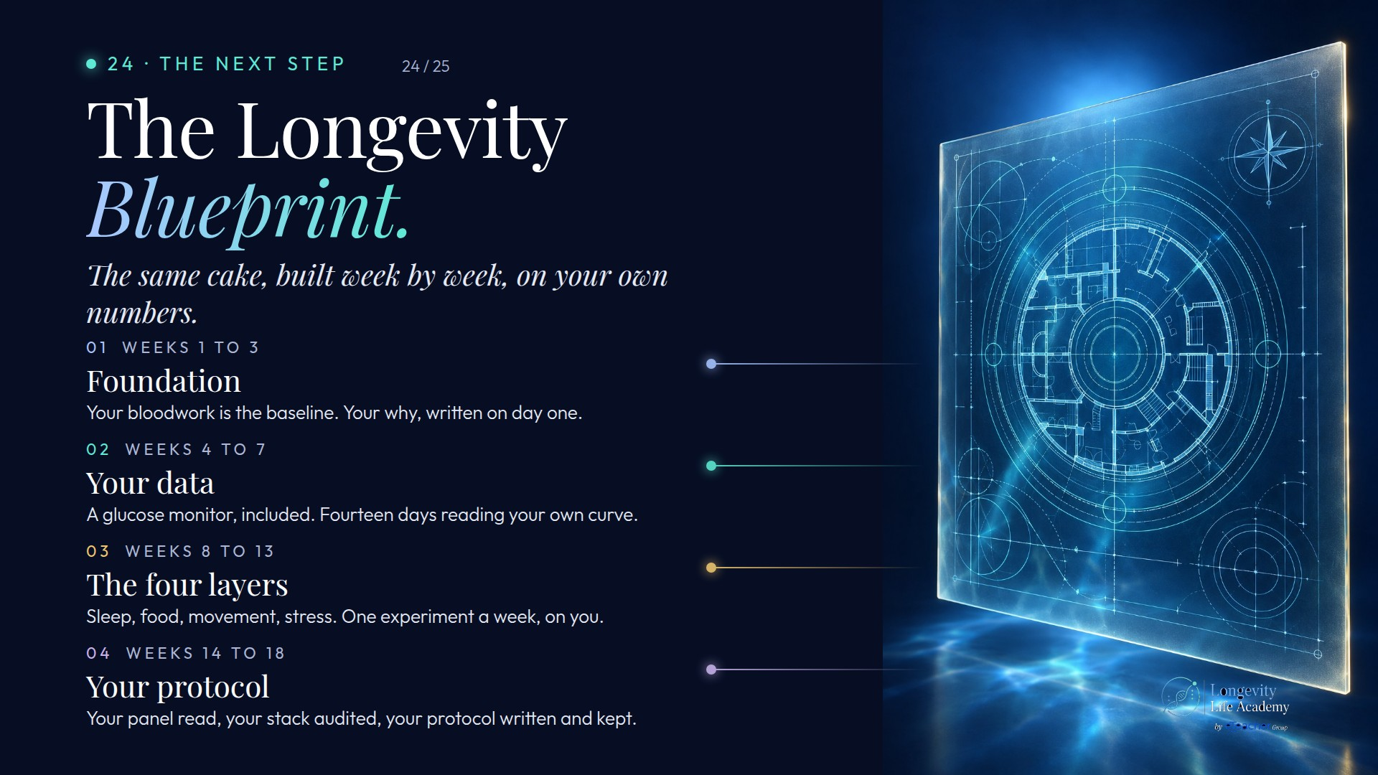
Notes:
Original image-based artwork. bp-d. Git commit 60975d21c840800f7031aeb42924ba1c3046b129; slide-canvas/closers/frames/bp-d.jpg

Slide 21
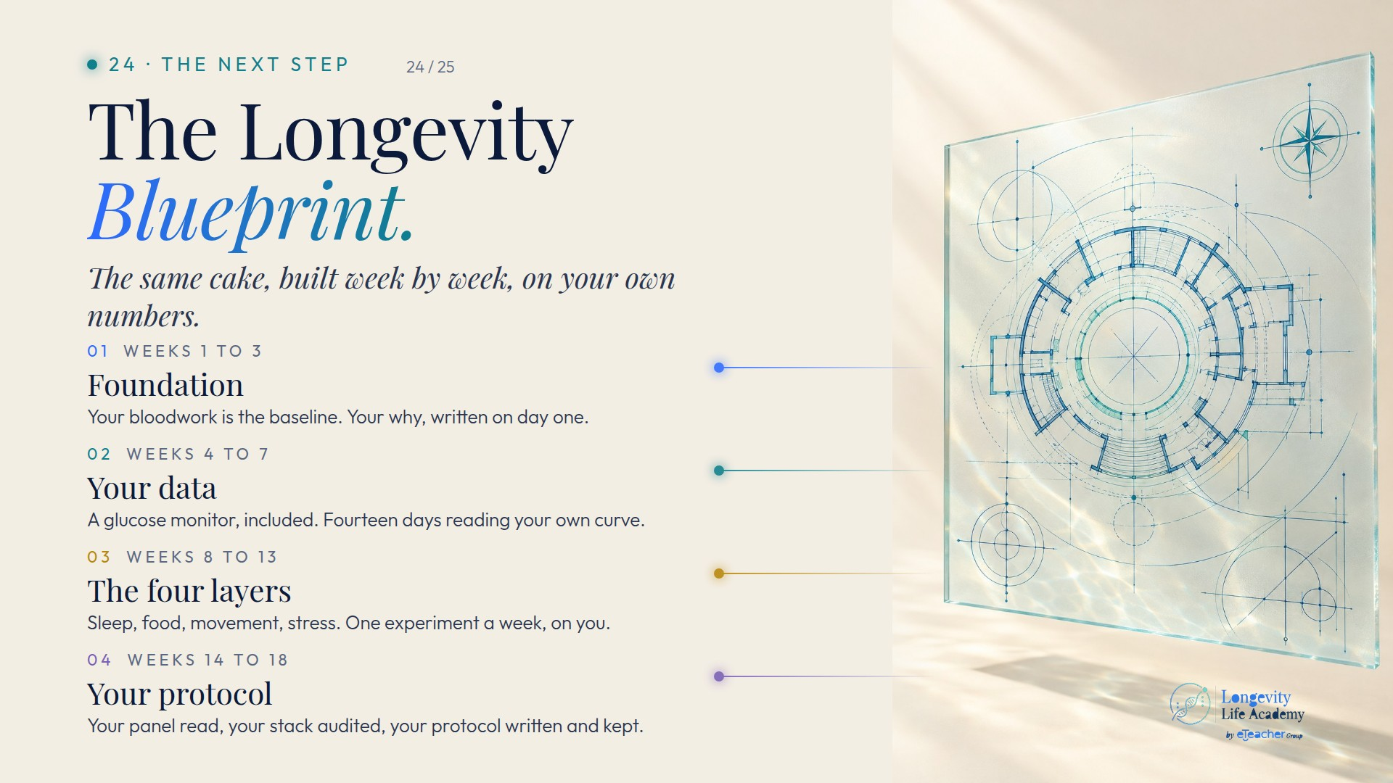
Notes:
Original image-based artwork. bp-l. Git commit 60975d21c840800f7031aeb42924ba1c3046b129; slide-canvas/closers/frames/bp-l.jpg

Slide 22

Notes:
Original image-based artwork. bp-d. Git commit fc9873086cf38909a46331569081ea49e23cc5b5; slide-canvas/closers/frames/bp-d.jpg

Slide 23

Notes:
Original image-based artwork. bp-l. Git commit fc9873086cf38909a46331569081ea49e23cc5b5; slide-canvas/closers/frames/bp-l.jpg

Slide 24
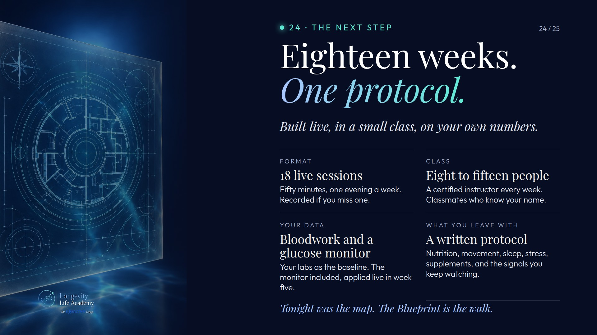
Notes:
Original image-based artwork. bp-spec. Git commit fc9873086cf38909a46331569081ea49e23cc5b5; slide-canvas/closers/frames/bp-spec.jpg

Slide 25
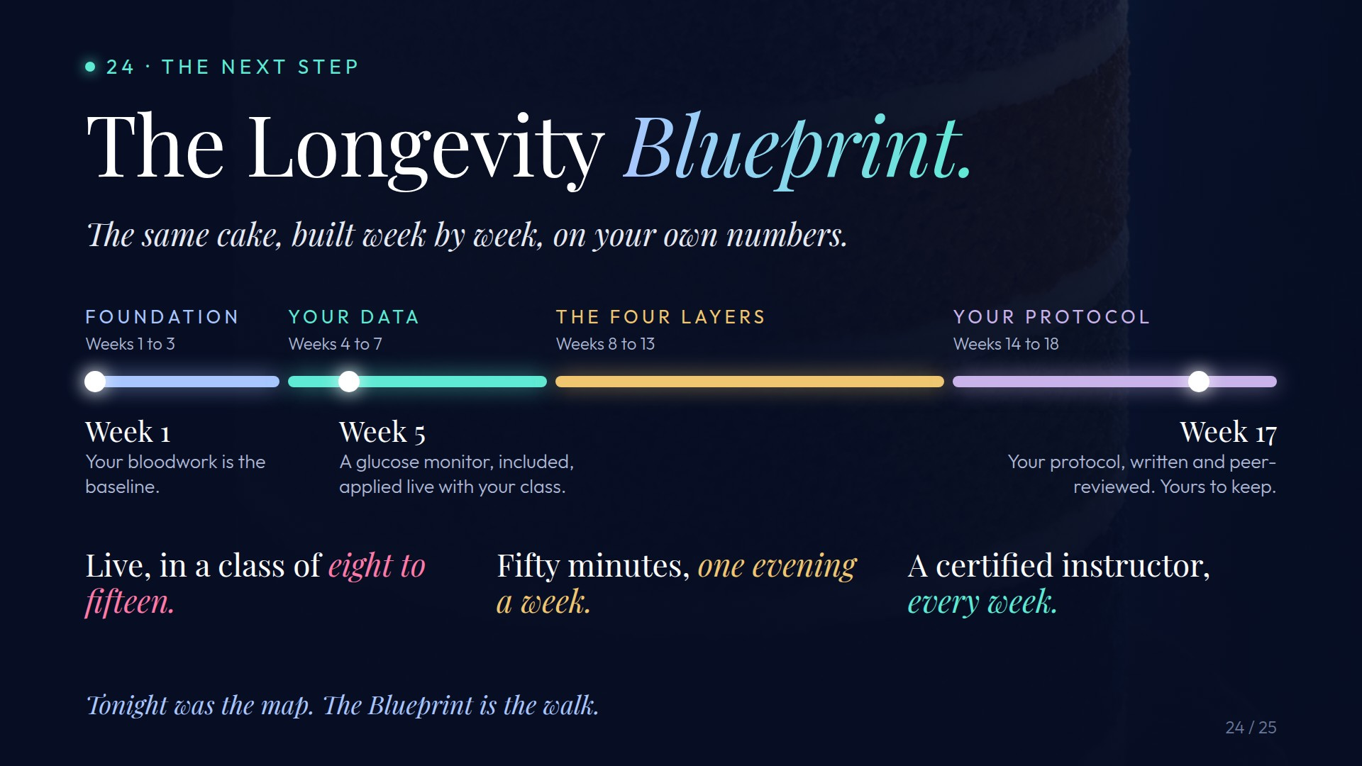
Notes:
Original image-based artwork. c24. Git commit 03c68be4d7ea1a12fc0a9342dca8e8f382574427; slide-canvas/closers/frames/c24.jpg

Slide 26
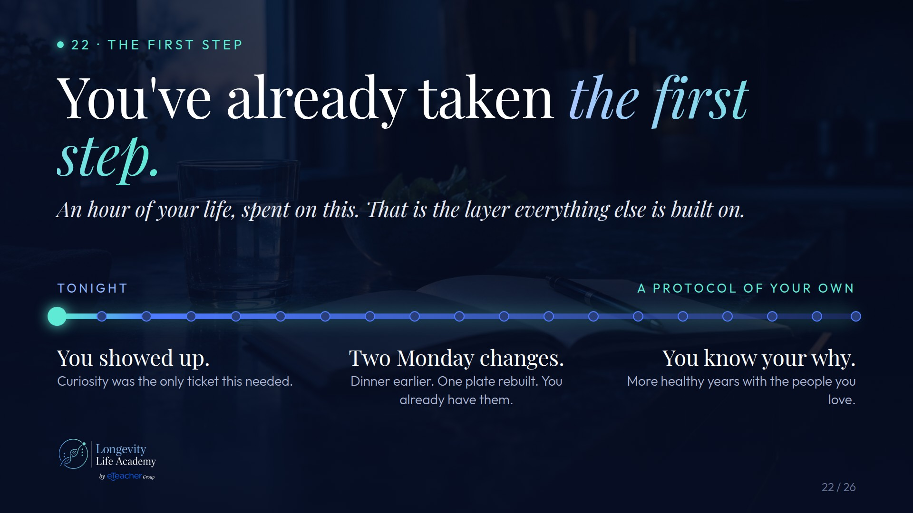
Notes:
Original image-based artwork. c22. Git commit 8d0635b19b0314bc9c849a5af6567988517a0ab7; slide-canvas/closers/frames/c22.jpg

Slide 27
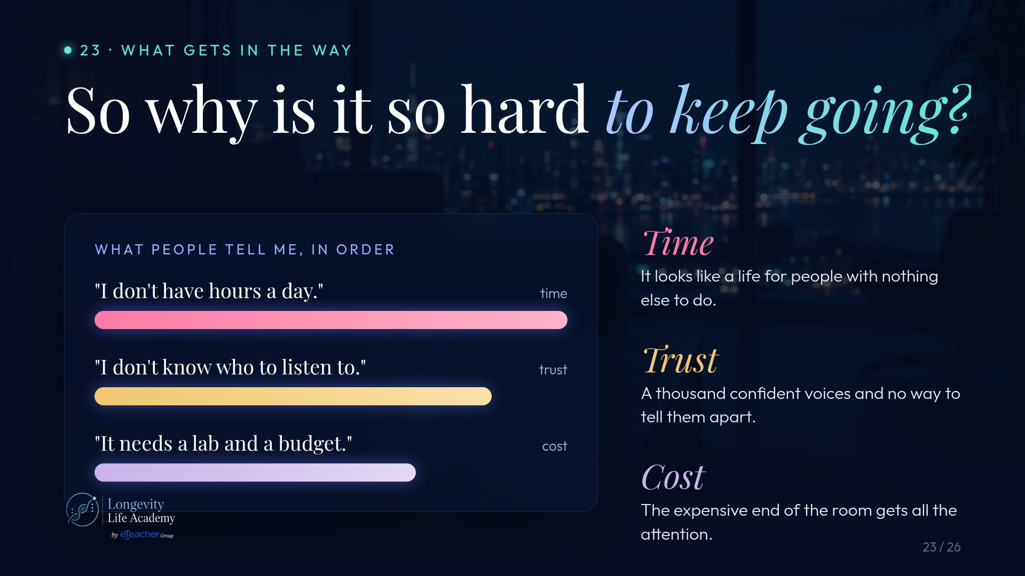
Notes:
Original image-based artwork. c23. Git commit 8d0635b19b0314bc9c849a5af6567988517a0ab7; slide-canvas/closers/frames/c23.jpg

Slide 28
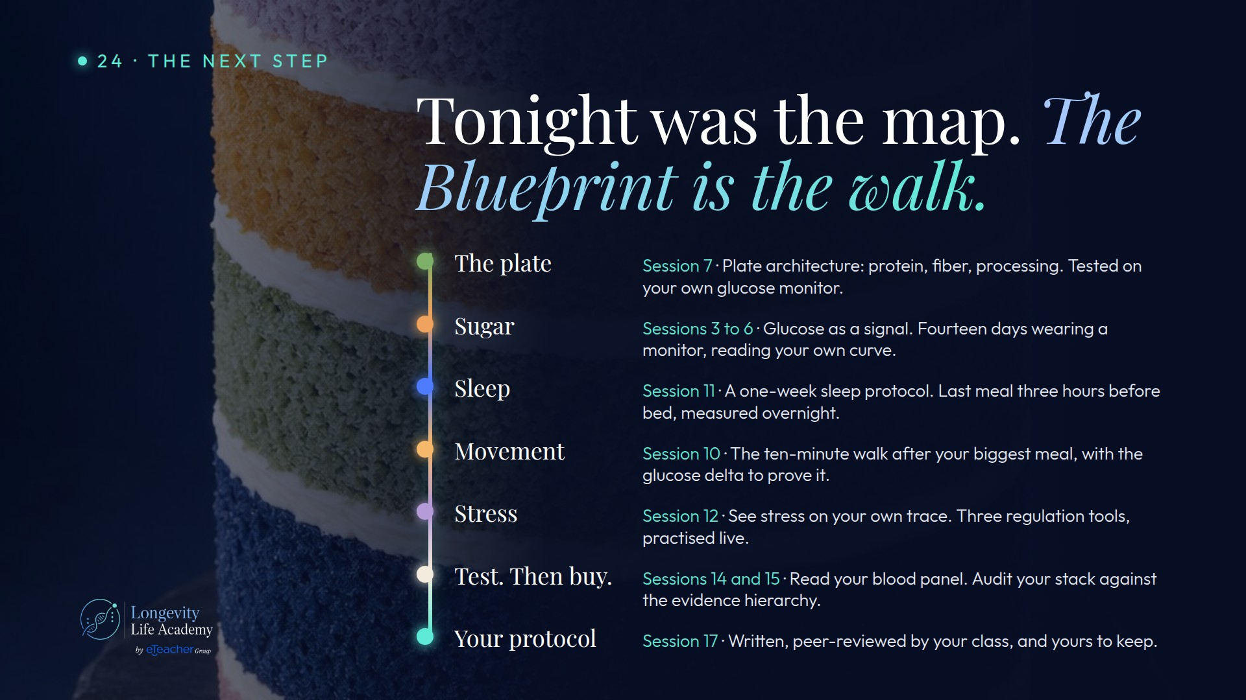
Notes:
Original image-based artwork. c24. Git commit 8d0635b19b0314bc9c849a5af6567988517a0ab7; slide-canvas/closers/frames/c24.jpg

Slide 29
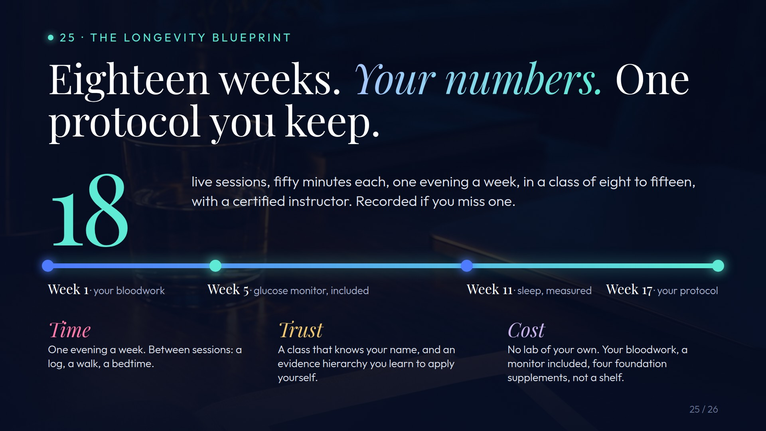
Notes:
Original image-based artwork. c25. Git commit 8d0635b19b0314bc9c849a5af6567988517a0ab7; slide-canvas/closers/frames/c25.jpg

Slide 30

Notes:
Original image-based artwork. c26. Git commit 8d0635b19b0314bc9c849a5af6567988517a0ab7; slide-canvas/closers/frames/c26.jpg

Slide 31
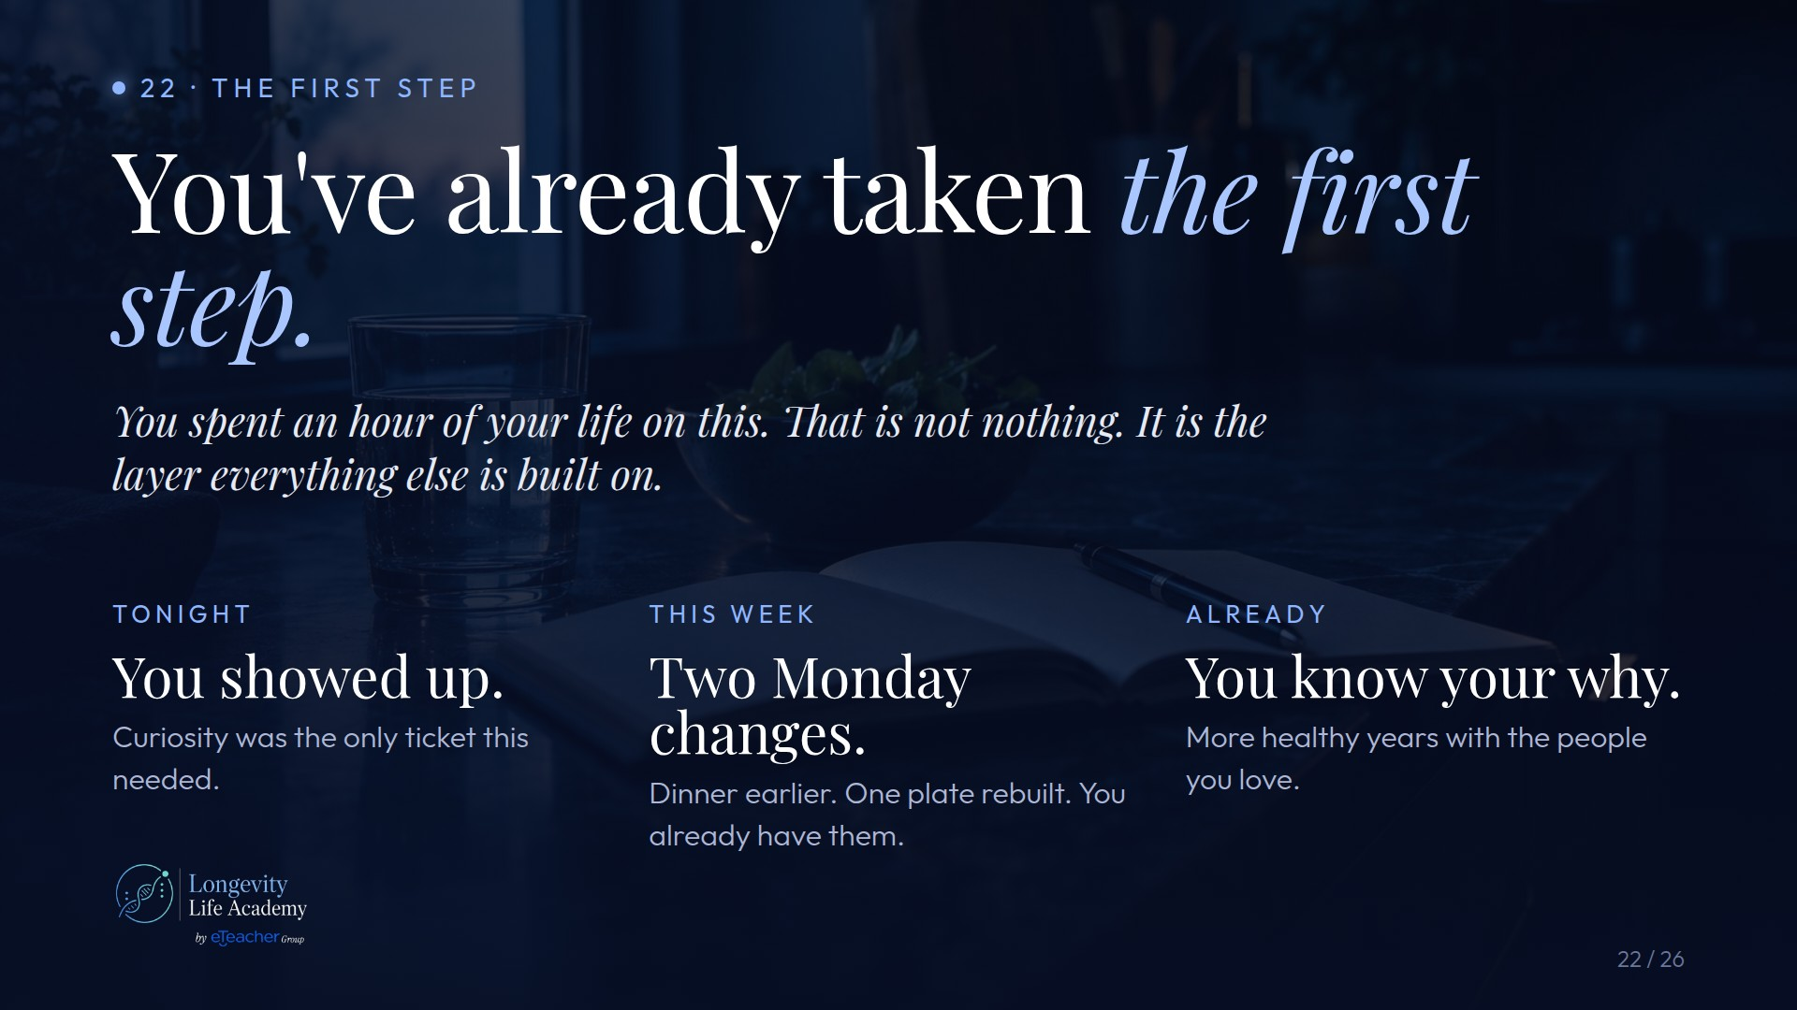
Notes:
Original image-based artwork. c22. Git commit 1b1e2e8f30c07ce2ffba5a38c068fa6a61437464; slide-canvas/closers/frames/c22.jpg

Slide 32
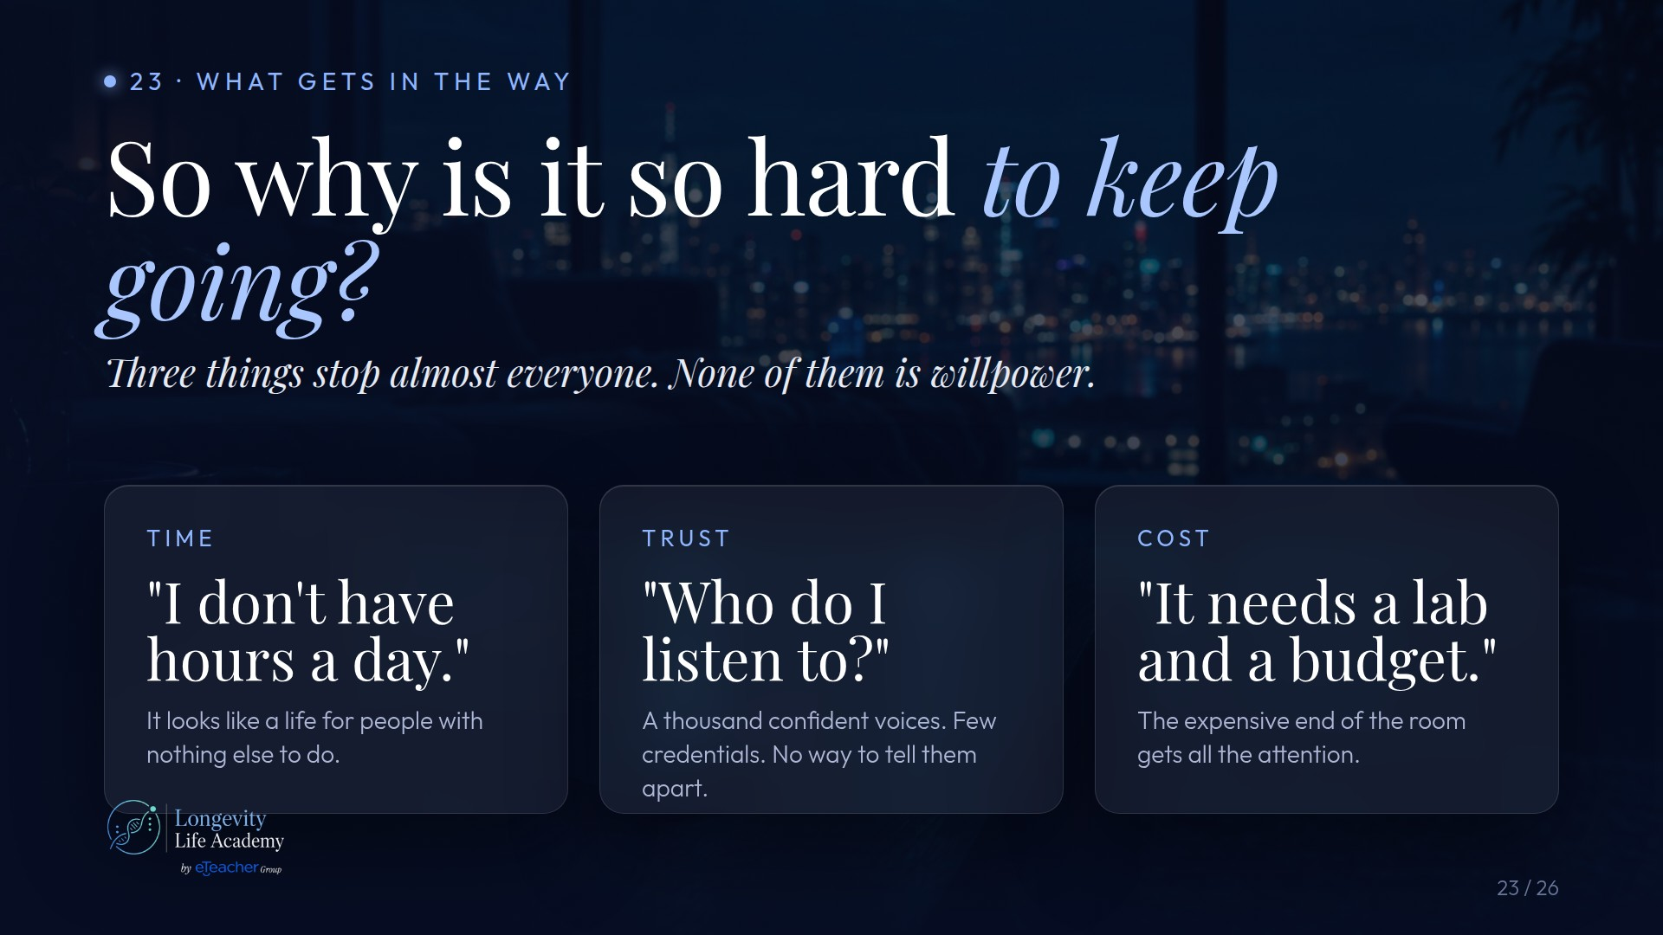
Notes:
Original image-based artwork. c23. Git commit 1b1e2e8f30c07ce2ffba5a38c068fa6a61437464; slide-canvas/closers/frames/c23.jpg

Slide 33
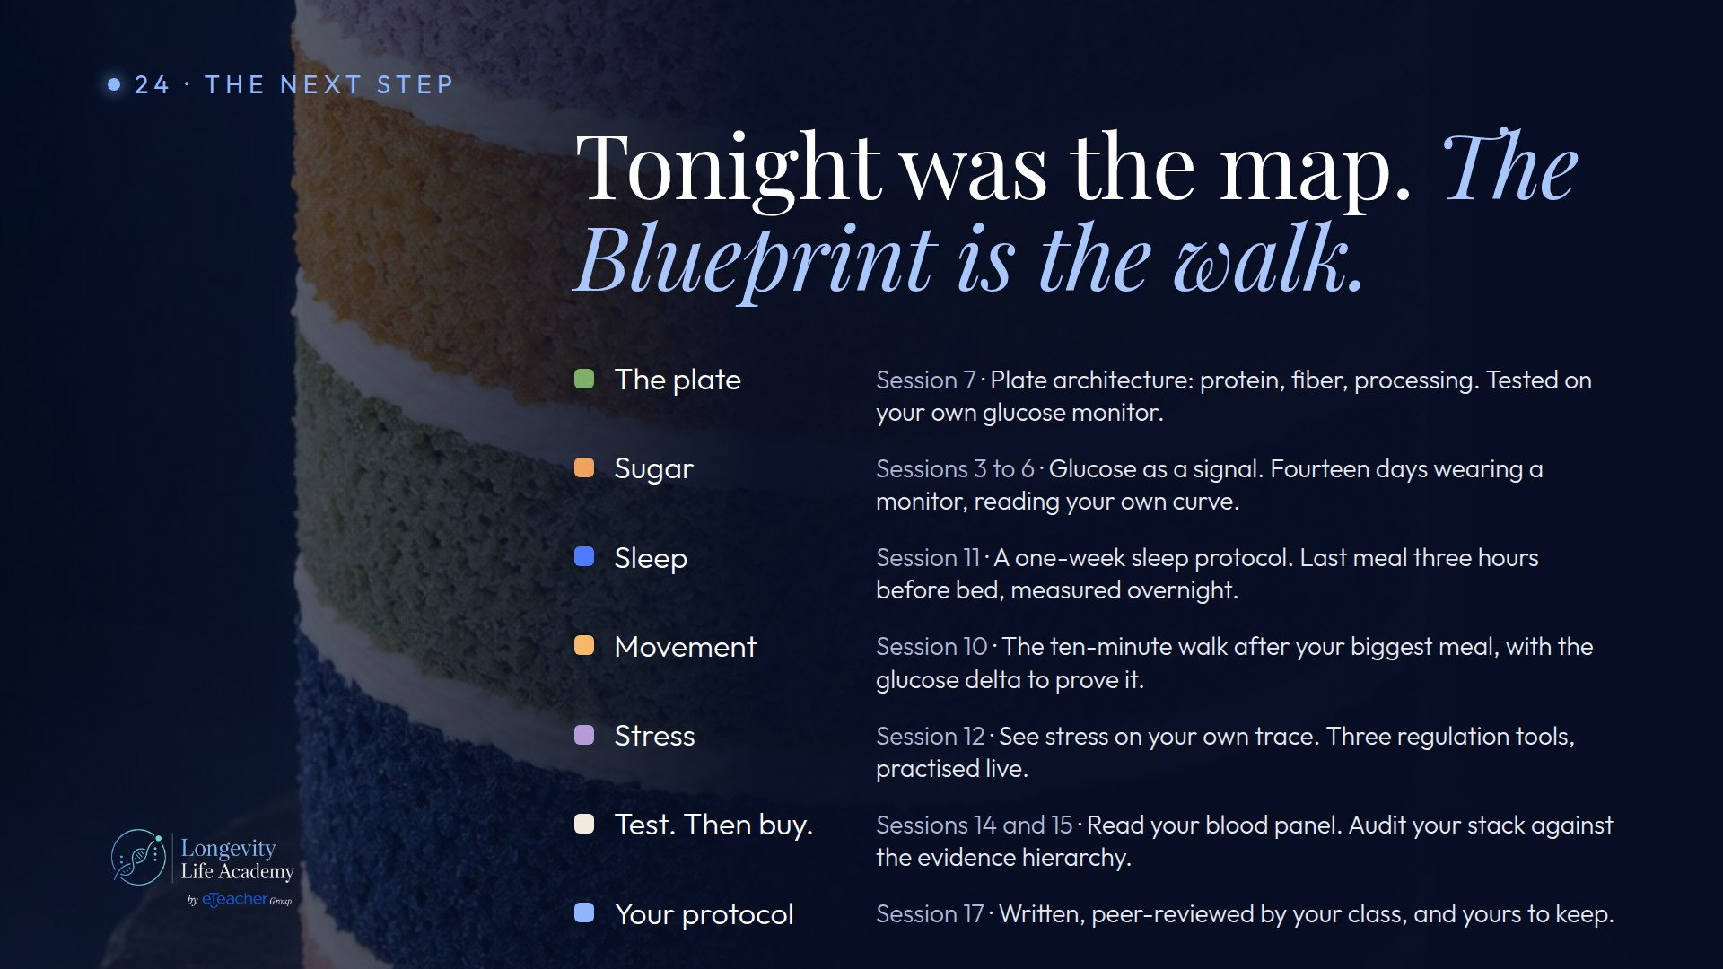
Notes:
Original image-based artwork. c24. Git commit 1b1e2e8f30c07ce2ffba5a38c068fa6a61437464; slide-canvas/closers/frames/c24.jpg

Slide 34
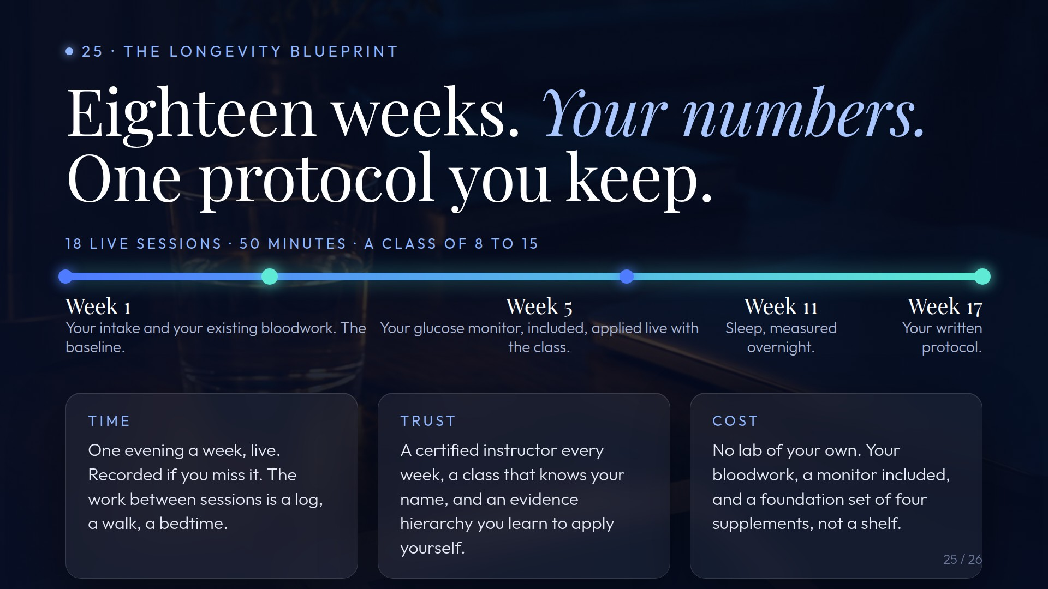
Notes:
Original image-based artwork. c25. Git commit 1b1e2e8f30c07ce2ffba5a38c068fa6a61437464; slide-canvas/closers/frames/c25.jpg

Slide 35

Notes:
Original image-based artwork. c26. Git commit 1b1e2e8f30c07ce2ffba5a38c068fa6a61437464; slide-canvas/closers/frames/c26.jpg

Slide 36

Notes:
Original image-based artwork. op-a. Git commit 7598554002d419586722ccc8ab69dbceb7595ad4; slide-canvas/closers/frames/op-a.jpg

Slide 37

Notes:
Original image-based artwork. op-b. Git commit 7598554002d419586722ccc8ab69dbceb7595ad4; slide-canvas/closers/frames/op-b.jpg

Slide 38
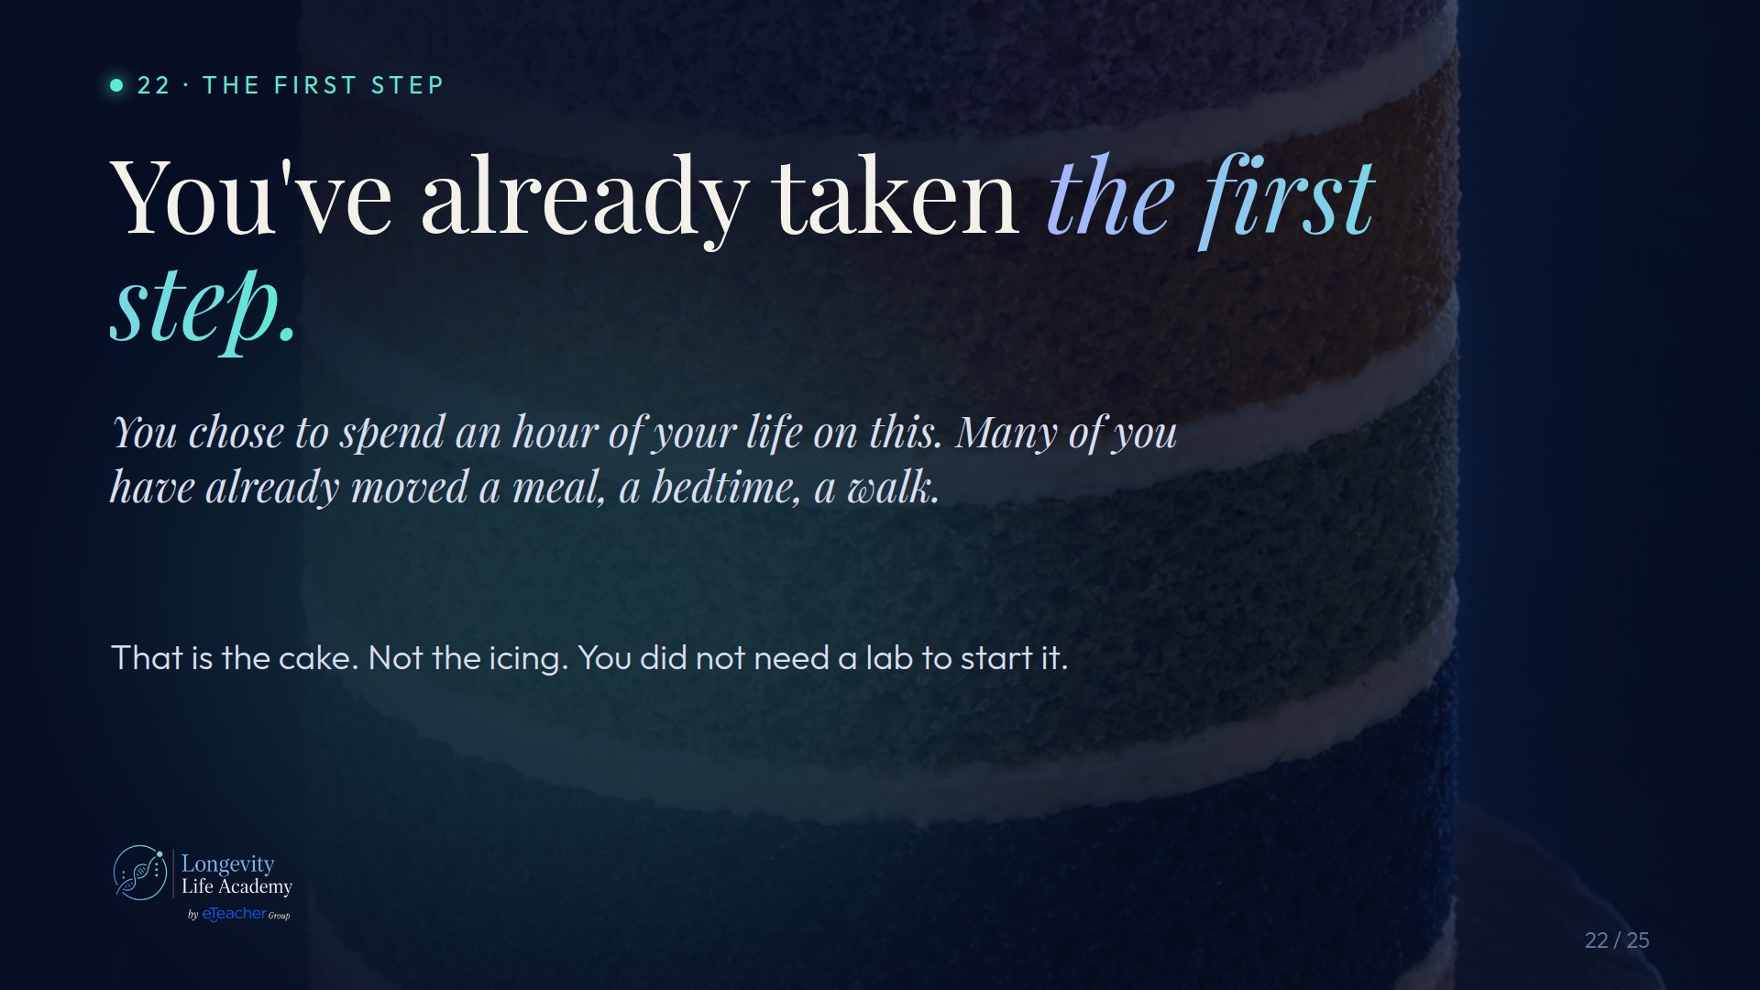
Notes:
Original image-based artwork. s1-a. Git commit 7598554002d419586722ccc8ab69dbceb7595ad4; slide-canvas/closers/frames/s1-a.jpg

Slide 39
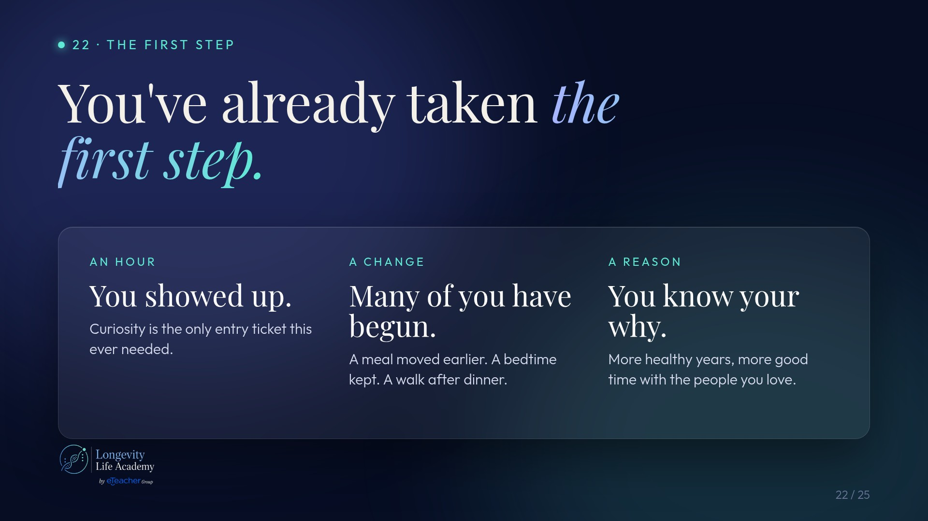
Notes:
Original image-based artwork. s1-b. Git commit 7598554002d419586722ccc8ab69dbceb7595ad4; slide-canvas/closers/frames/s1-b.jpg

Slide 40
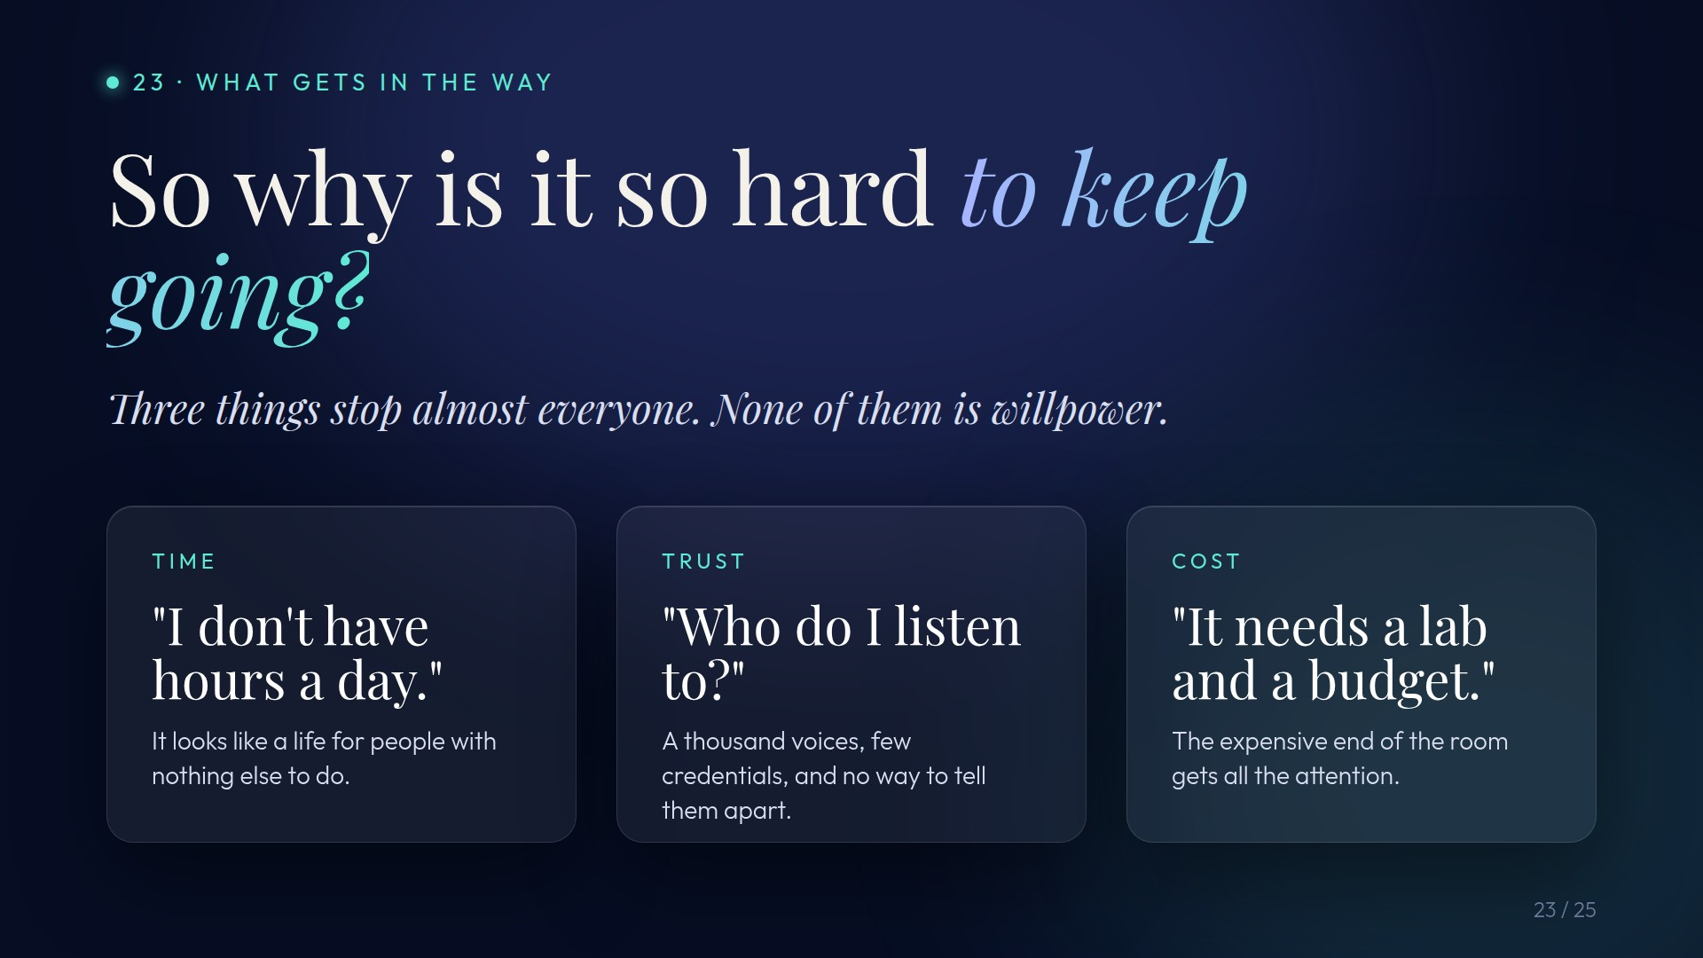
Notes:
Original image-based artwork. s2-a. Git commit 7598554002d419586722ccc8ab69dbceb7595ad4; slide-canvas/closers/frames/s2-a.jpg

Slide 41
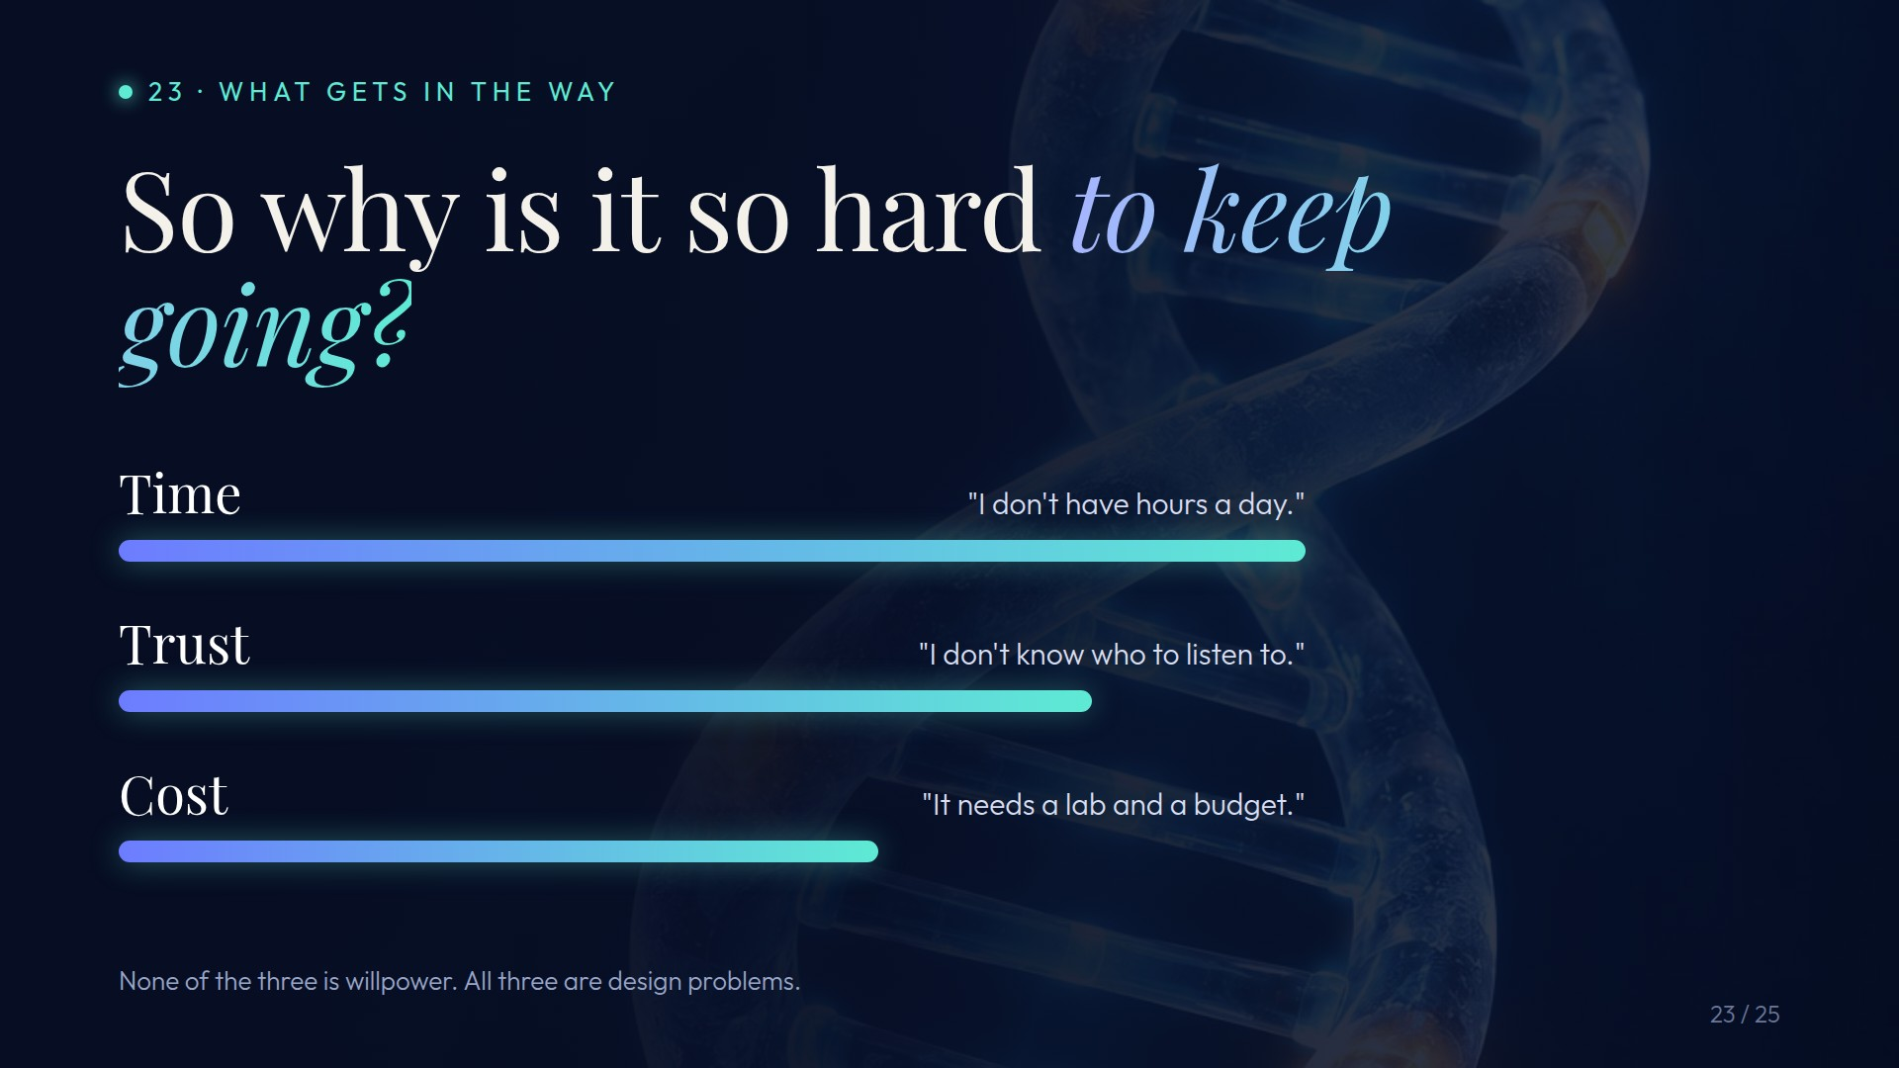
Notes:
Original image-based artwork. s2-b. Git commit 7598554002d419586722ccc8ab69dbceb7595ad4; slide-canvas/closers/frames/s2-b.jpg

Slide 42
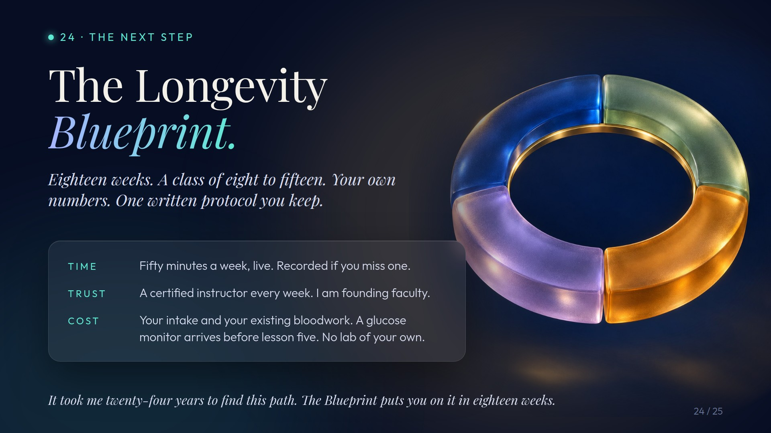
Notes:
Original image-based artwork. s3-a. Git commit 7598554002d419586722ccc8ab69dbceb7595ad4; slide-canvas/closers/frames/s3-a.jpg

Slide 43
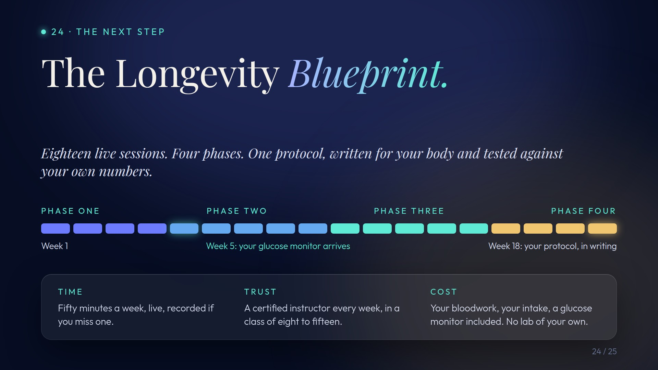
Notes:
Original image-based artwork. s3-b. Git commit 7598554002d419586722ccc8ab69dbceb7595ad4; slide-canvas/closers/frames/s3-b.jpg

Slide 44

Notes:
Original image-based artwork. s4-a. Git commit 7598554002d419586722ccc8ab69dbceb7595ad4; slide-canvas/closers/frames/s4-a.jpg

Slide 45

Notes:
Original image-based artwork. s4-b. Git commit 7598554002d419586722ccc8ab69dbceb7595ad4; slide-canvas/closers/frames/s4-b.jpg

