Slide 1
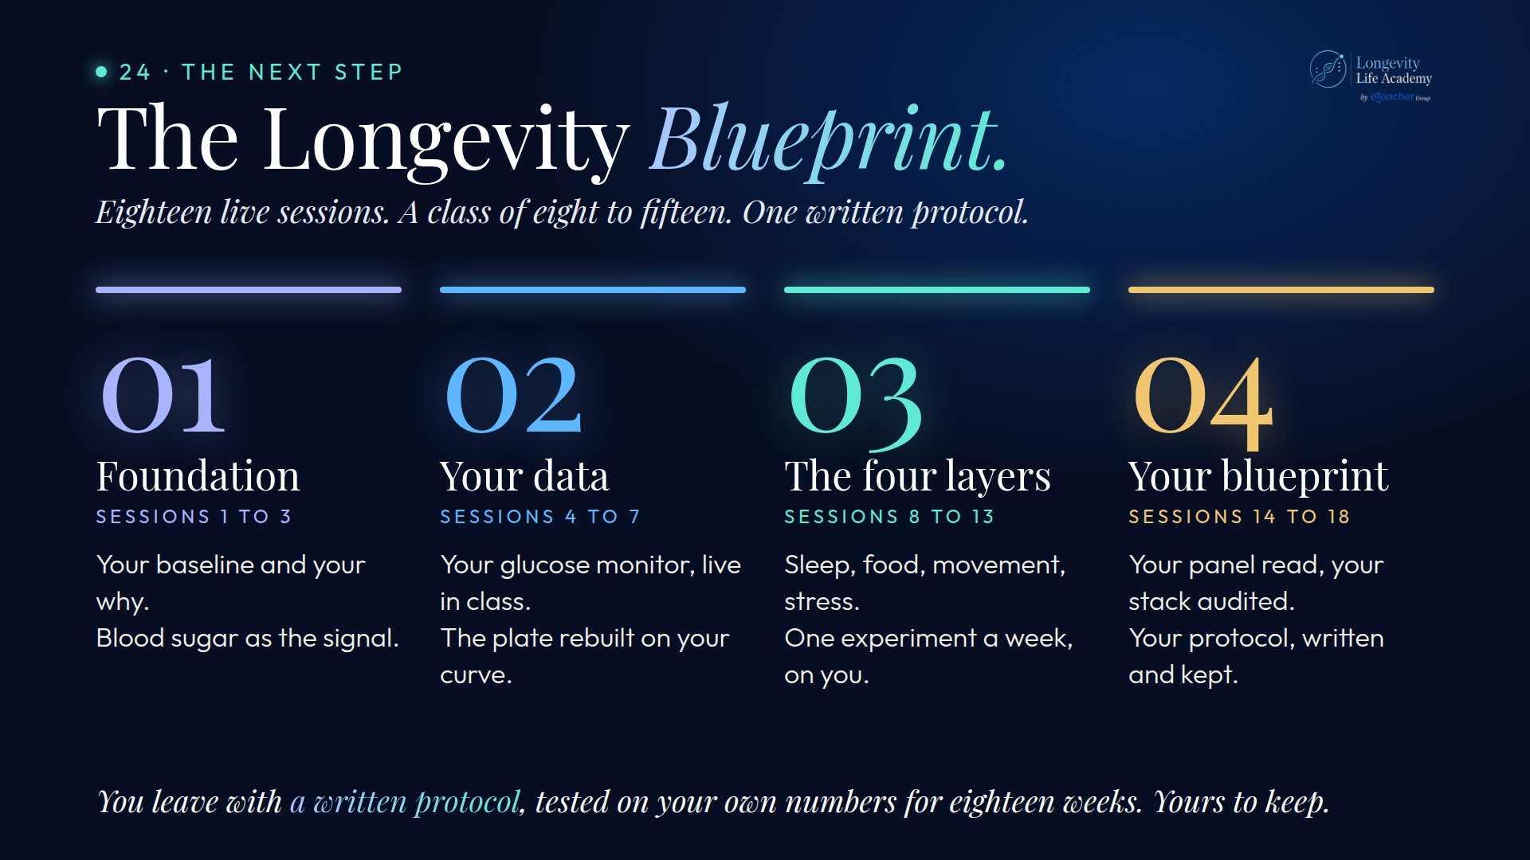
Notes:
Preserved original slide artwork, not editable text. bp-4
Original dimensions: 1920 × 1080 pixels.
Git commit 02bcf62326247448fccd5c99dd790382b2b7588c; slide-canvas/closers/frames/bp-4.jpg

