Slide 1
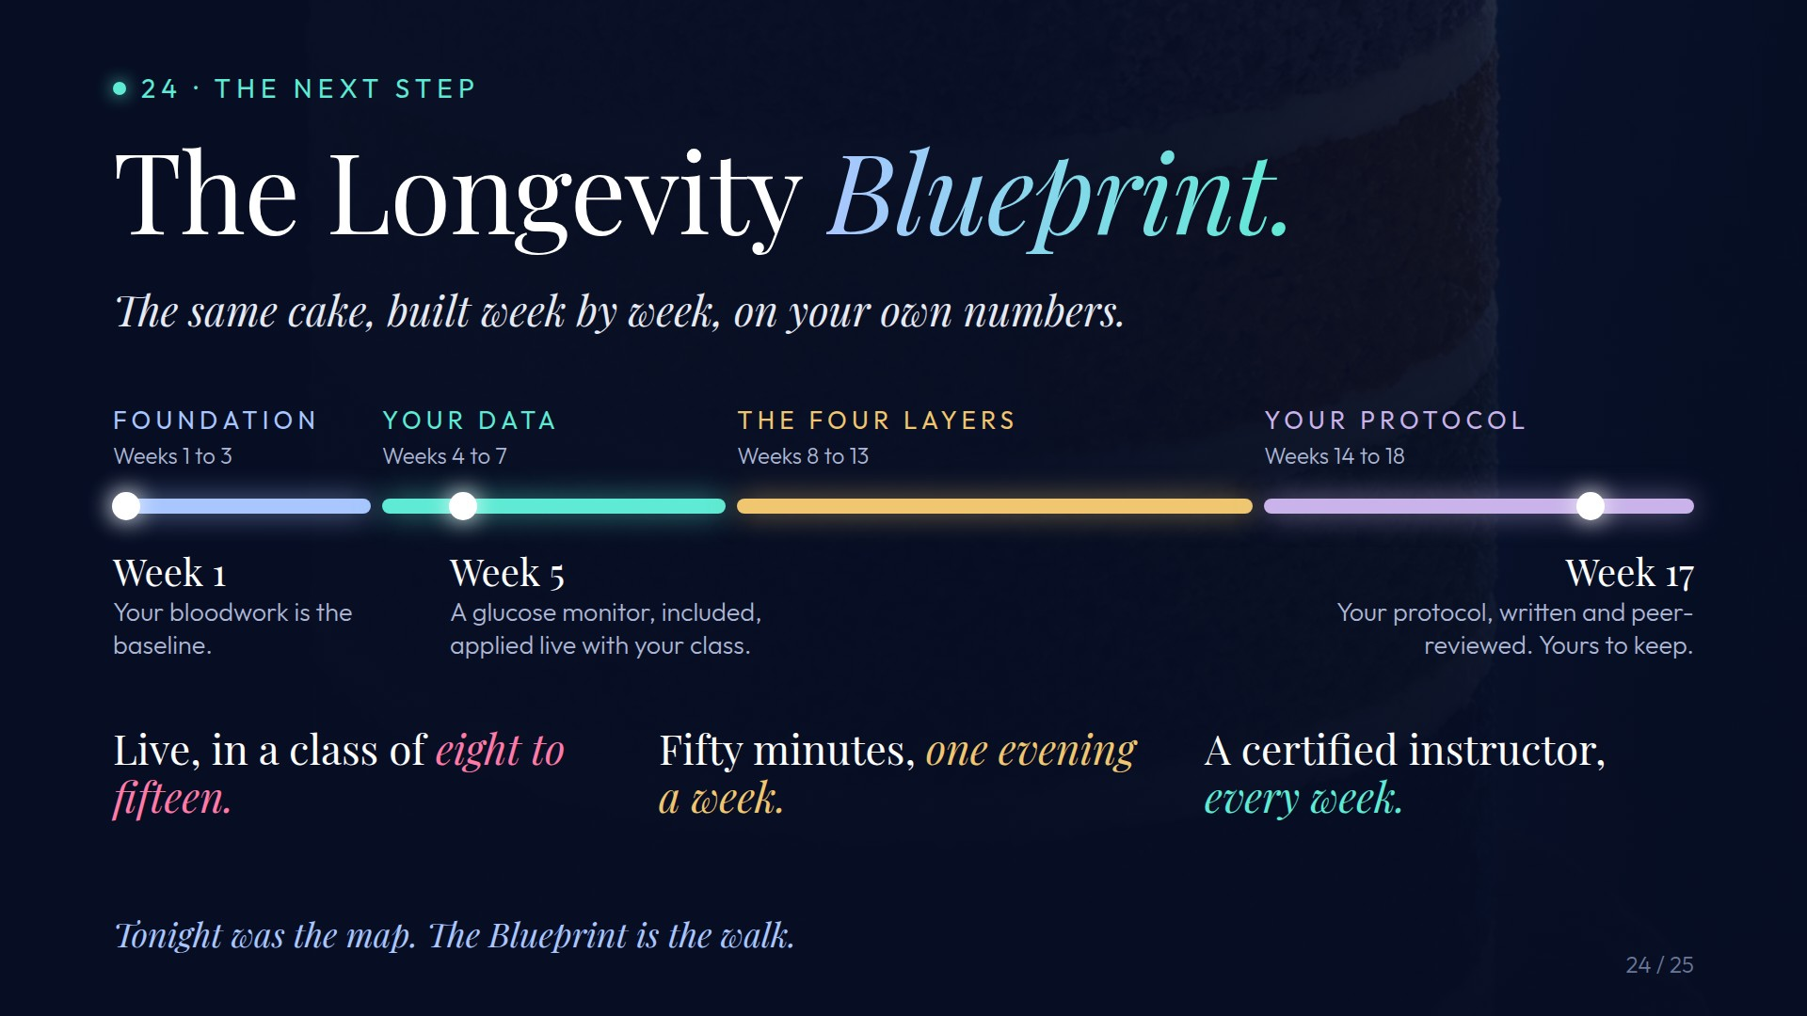
Notes:
Preserved original slide artwork, not editable text. c24
Original dimensions: 1920 × 1080 pixels.
Git commit 03c68be4d7ea1a12fc0a9342dca8e8f382574427; slide-canvas/closers/frames/c24.jpg

Slide 2

Notes:
Preserved original slide artwork, not editable text. c26
Original dimensions: 1920 × 1080 pixels.
Git commit 03c68be4d7ea1a12fc0a9342dca8e8f382574427; slide-canvas/closers/frames/c26.jpg

