Slide 1

Notes:
Preserved original slide artwork, not editable text. c22
Original dimensions: 1920 × 1080 pixels.
Git commit 1b1e2e8f30c07ce2ffba5a38c068fa6a61437464; slide-canvas/closers/frames/c22.jpg

Slide 2
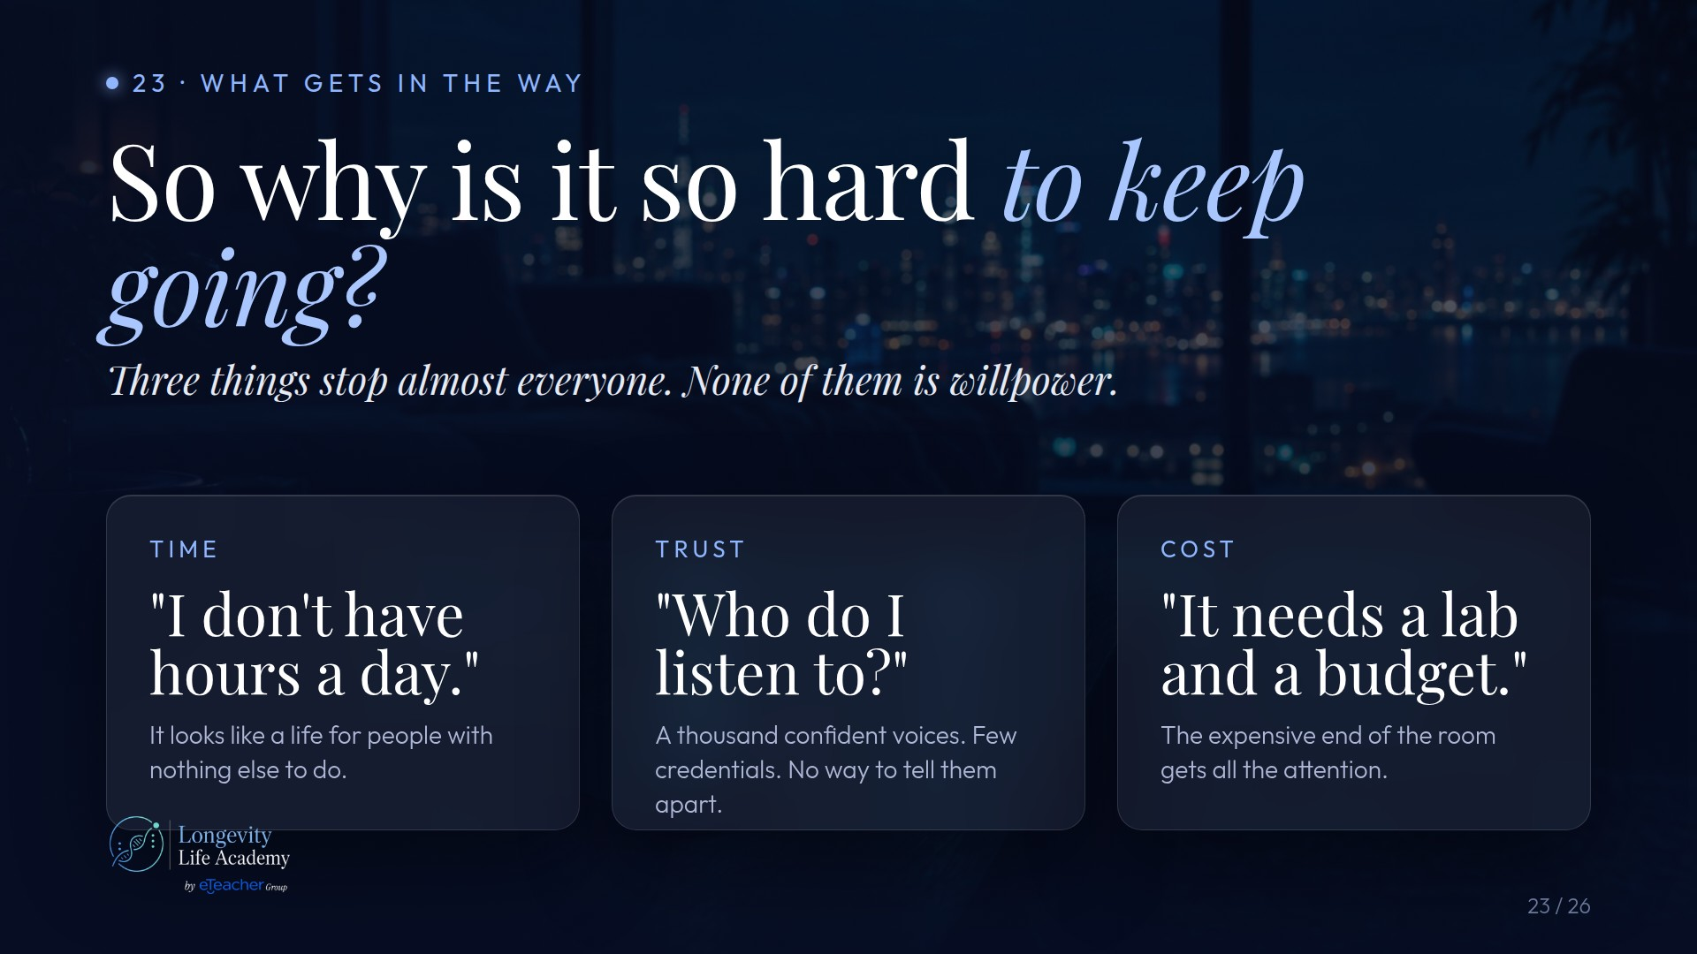
Notes:
Preserved original slide artwork, not editable text. c23
Original dimensions: 1920 × 1080 pixels.
Git commit 1b1e2e8f30c07ce2ffba5a38c068fa6a61437464; slide-canvas/closers/frames/c23.jpg

Slide 3
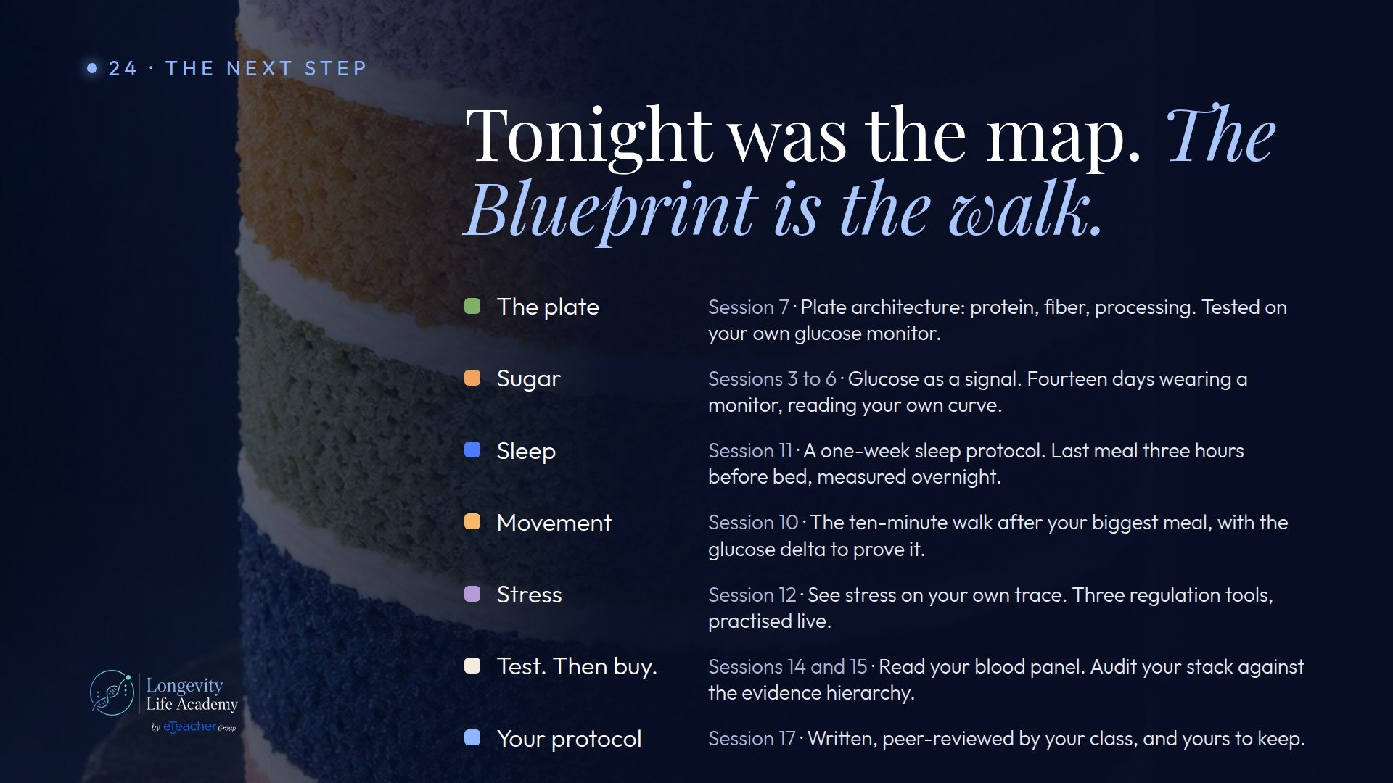
Notes:
Preserved original slide artwork, not editable text. c24
Original dimensions: 1920 × 1080 pixels.
Git commit 1b1e2e8f30c07ce2ffba5a38c068fa6a61437464; slide-canvas/closers/frames/c24.jpg

Slide 4

Notes:
Preserved original slide artwork, not editable text. c25
Original dimensions: 1920 × 1080 pixels.
Git commit 1b1e2e8f30c07ce2ffba5a38c068fa6a61437464; slide-canvas/closers/frames/c25.jpg

Slide 5

Notes:
Preserved original slide artwork, not editable text. c26
Original dimensions: 1920 × 1080 pixels.
Git commit 1b1e2e8f30c07ce2ffba5a38c068fa6a61437464; slide-canvas/closers/frames/c26.jpg

