Slide 1

Notes:
Preserved original slide artwork, not editable text. act2-a
Original dimensions: 1920 × 1080 pixels.
Git commit 4b5b73be3493deed46e4a2af2c6c2bcaa11fc63e; slide-canvas/closers/frames/act2-a.jpg

Slide 2

Notes:
Preserved original slide artwork, not editable text. act2-d
Original dimensions: 1920 × 1080 pixels.
Git commit 4b5b73be3493deed46e4a2af2c6c2bcaa11fc63e; slide-canvas/closers/frames/act2-d.jpg

Slide 3
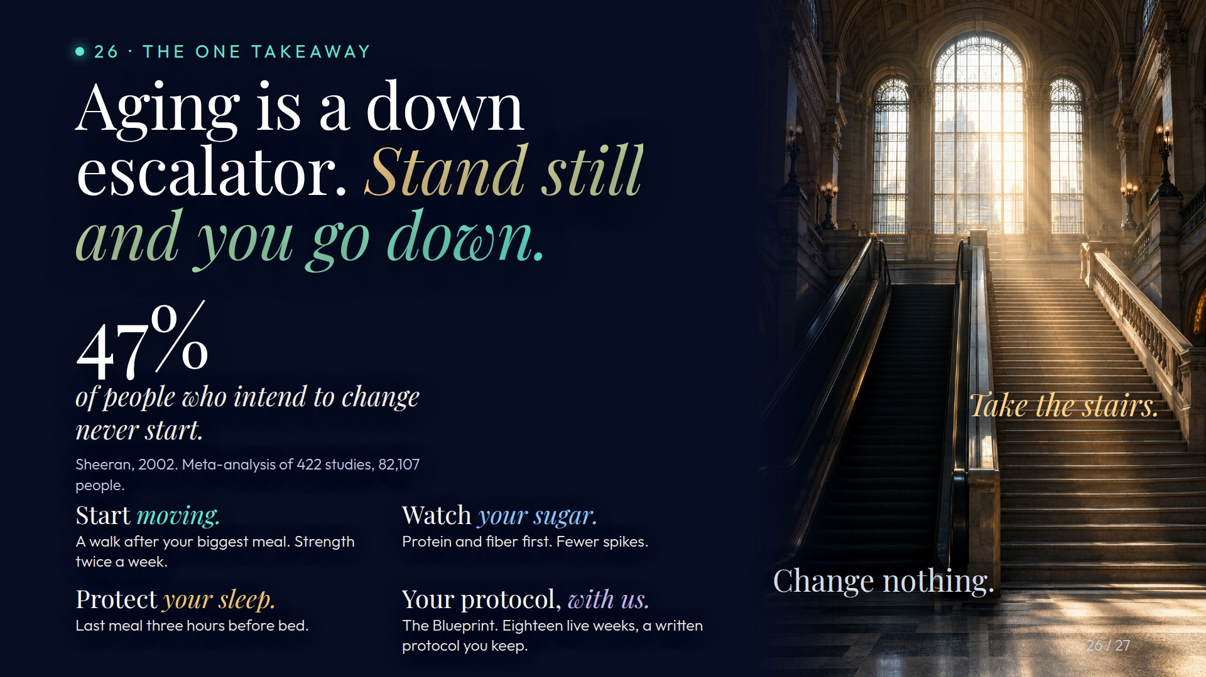
Notes:
Preserved original slide artwork, not editable text. act2-e
Original dimensions: 1920 × 1080 pixels.
Git commit 4b5b73be3493deed46e4a2af2c6c2bcaa11fc63e; slide-canvas/closers/frames/act2-e.jpg

