Slide 1
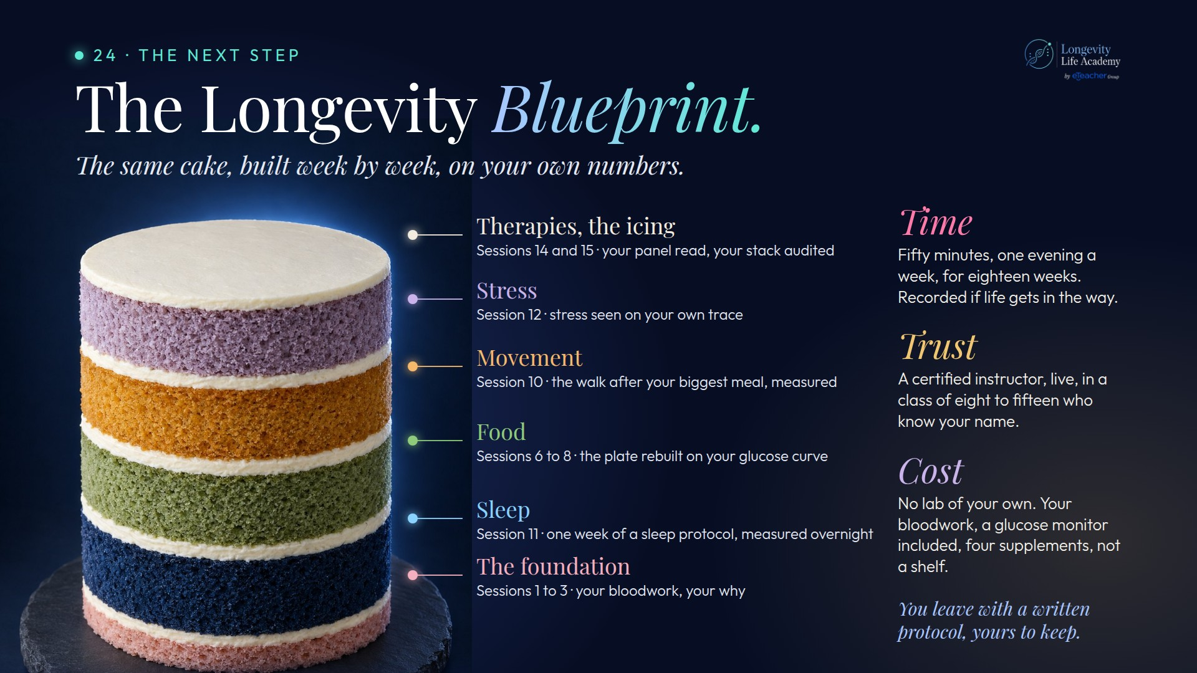
Notes:
Preserved original slide artwork, not editable text. bp-cake
Original dimensions: 1920 × 1080 pixels.
Git commit 58ff00c4b7c32250308c86339ed1b31d8f797698; slide-canvas/closers/frames/bp-cake.jpg

