Slide 1
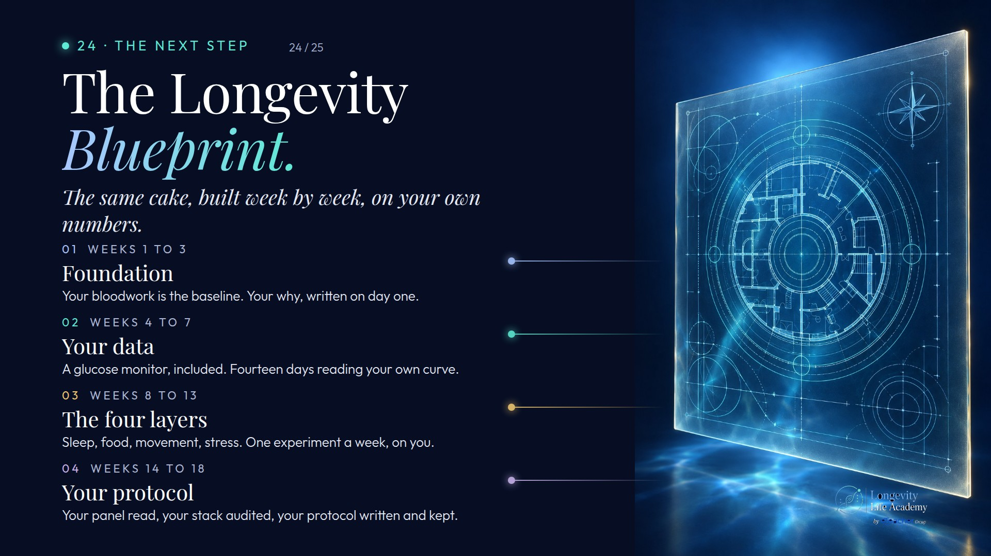
Notes:
Preserved original slide artwork, not editable text. bp-d
Original dimensions: 1920 × 1080 pixels.
Git commit 60975d21c840800f7031aeb42924ba1c3046b129; slide-canvas/closers/frames/bp-d.jpg

Slide 2
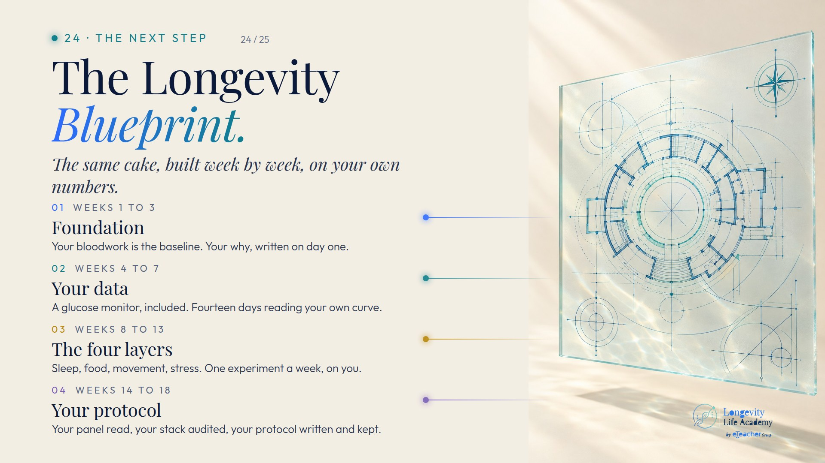
Notes:
Preserved original slide artwork, not editable text. bp-l
Original dimensions: 1920 × 1080 pixels.
Git commit 60975d21c840800f7031aeb42924ba1c3046b129; slide-canvas/closers/frames/bp-l.jpg

