Slide 1

Notes:
Preserved original slide artwork, not editable text. op-a
Original dimensions: 1920 × 1080 pixels.
Git commit 7598554002d419586722ccc8ab69dbceb7595ad4; slide-canvas/closers/frames/op-a.jpg

Slide 2

Notes:
Preserved original slide artwork, not editable text. op-b
Original dimensions: 1920 × 1080 pixels.
Git commit 7598554002d419586722ccc8ab69dbceb7595ad4; slide-canvas/closers/frames/op-b.jpg

Slide 3
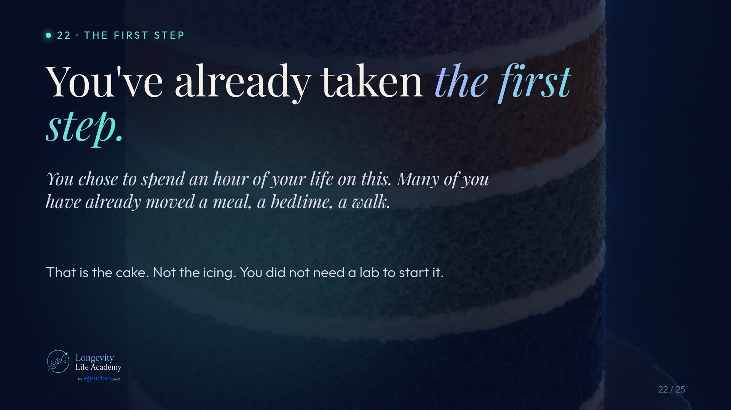
Notes:
Preserved original slide artwork, not editable text. s1-a
Original dimensions: 1920 × 1080 pixels.
Git commit 7598554002d419586722ccc8ab69dbceb7595ad4; slide-canvas/closers/frames/s1-a.jpg

Slide 4
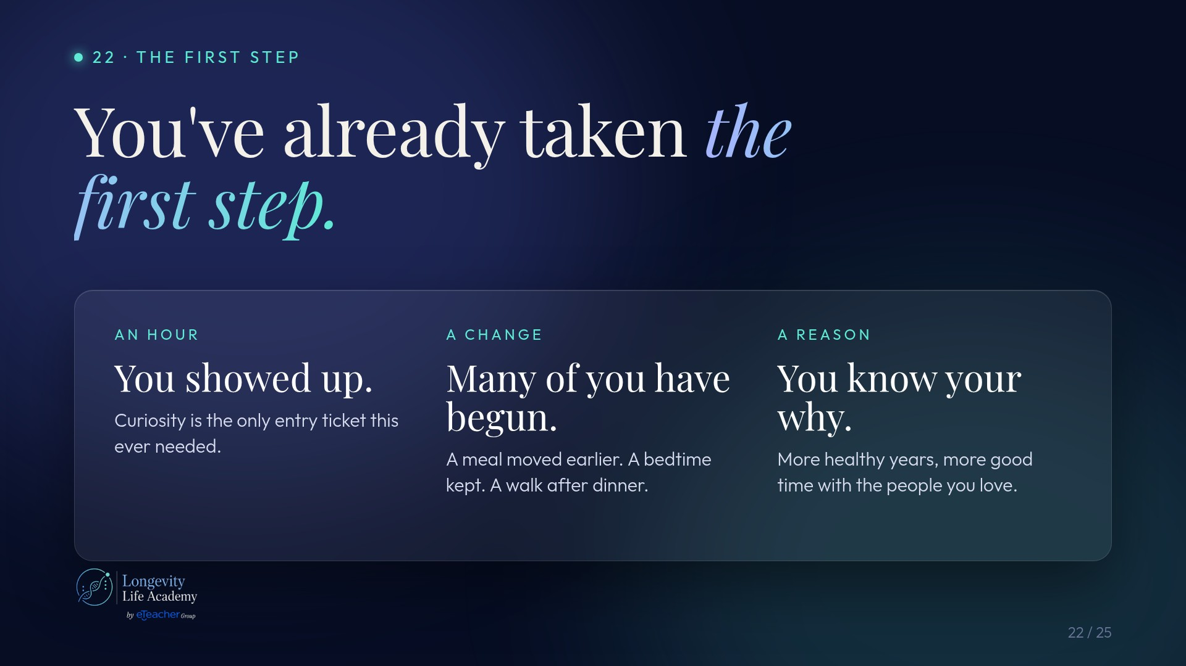
Notes:
Preserved original slide artwork, not editable text. s1-b
Original dimensions: 1920 × 1080 pixels.
Git commit 7598554002d419586722ccc8ab69dbceb7595ad4; slide-canvas/closers/frames/s1-b.jpg

Slide 5
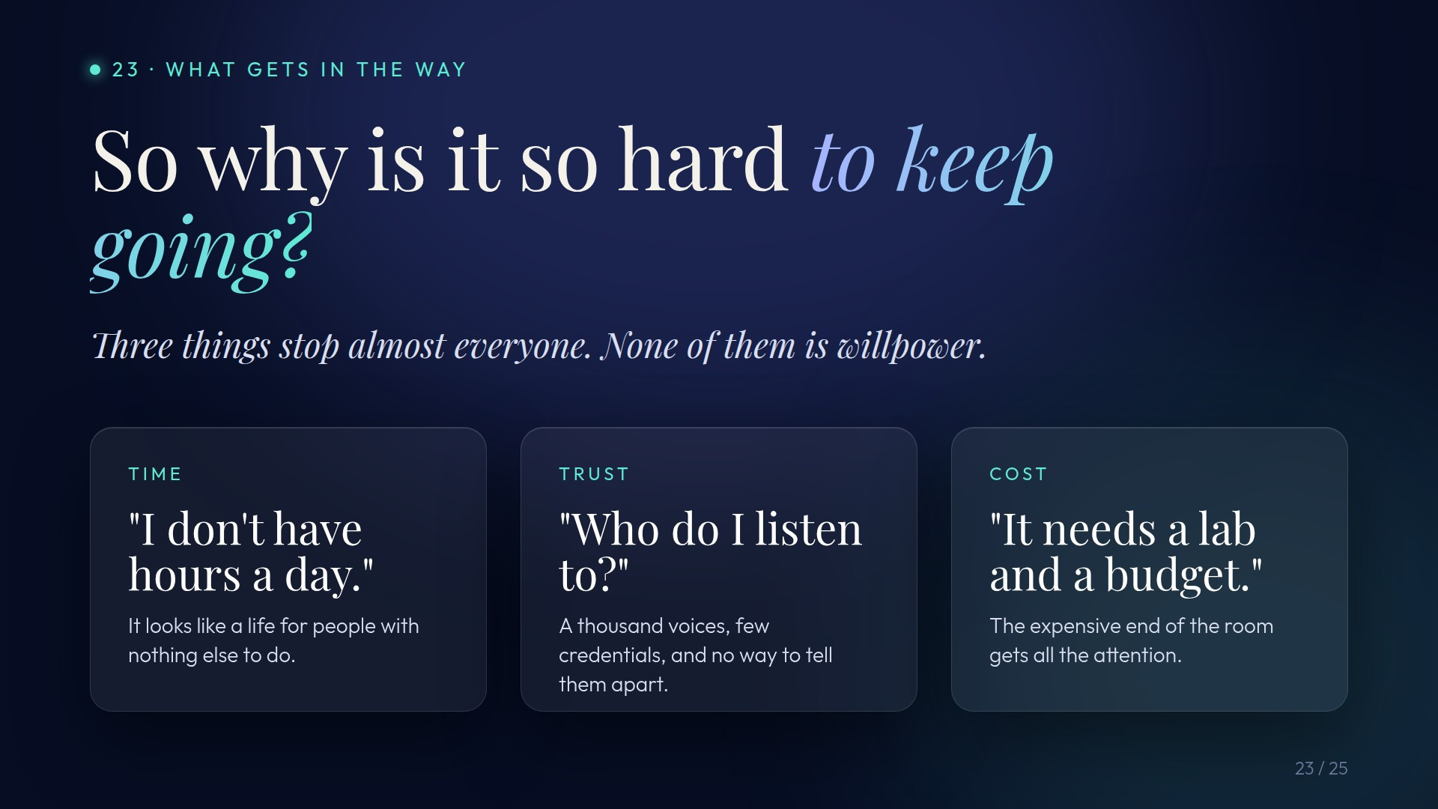
Notes:
Preserved original slide artwork, not editable text. s2-a
Original dimensions: 1920 × 1080 pixels.
Git commit 7598554002d419586722ccc8ab69dbceb7595ad4; slide-canvas/closers/frames/s2-a.jpg

Slide 6

Notes:
Preserved original slide artwork, not editable text. s2-b
Original dimensions: 1920 × 1080 pixels.
Git commit 7598554002d419586722ccc8ab69dbceb7595ad4; slide-canvas/closers/frames/s2-b.jpg

Slide 7
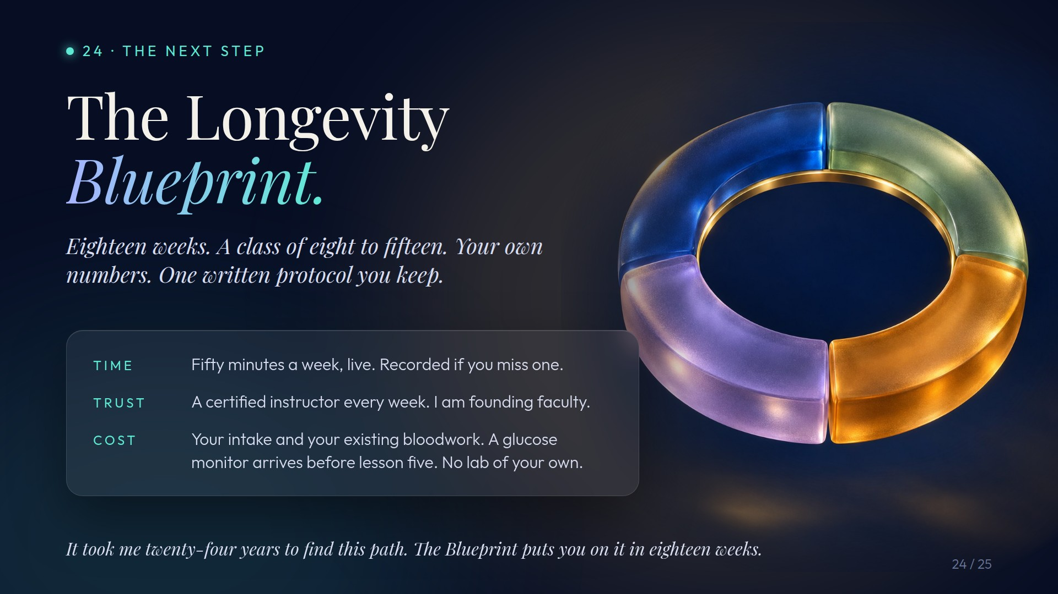
Notes:
Preserved original slide artwork, not editable text. s3-a
Original dimensions: 1920 × 1080 pixels.
Git commit 7598554002d419586722ccc8ab69dbceb7595ad4; slide-canvas/closers/frames/s3-a.jpg

Slide 8
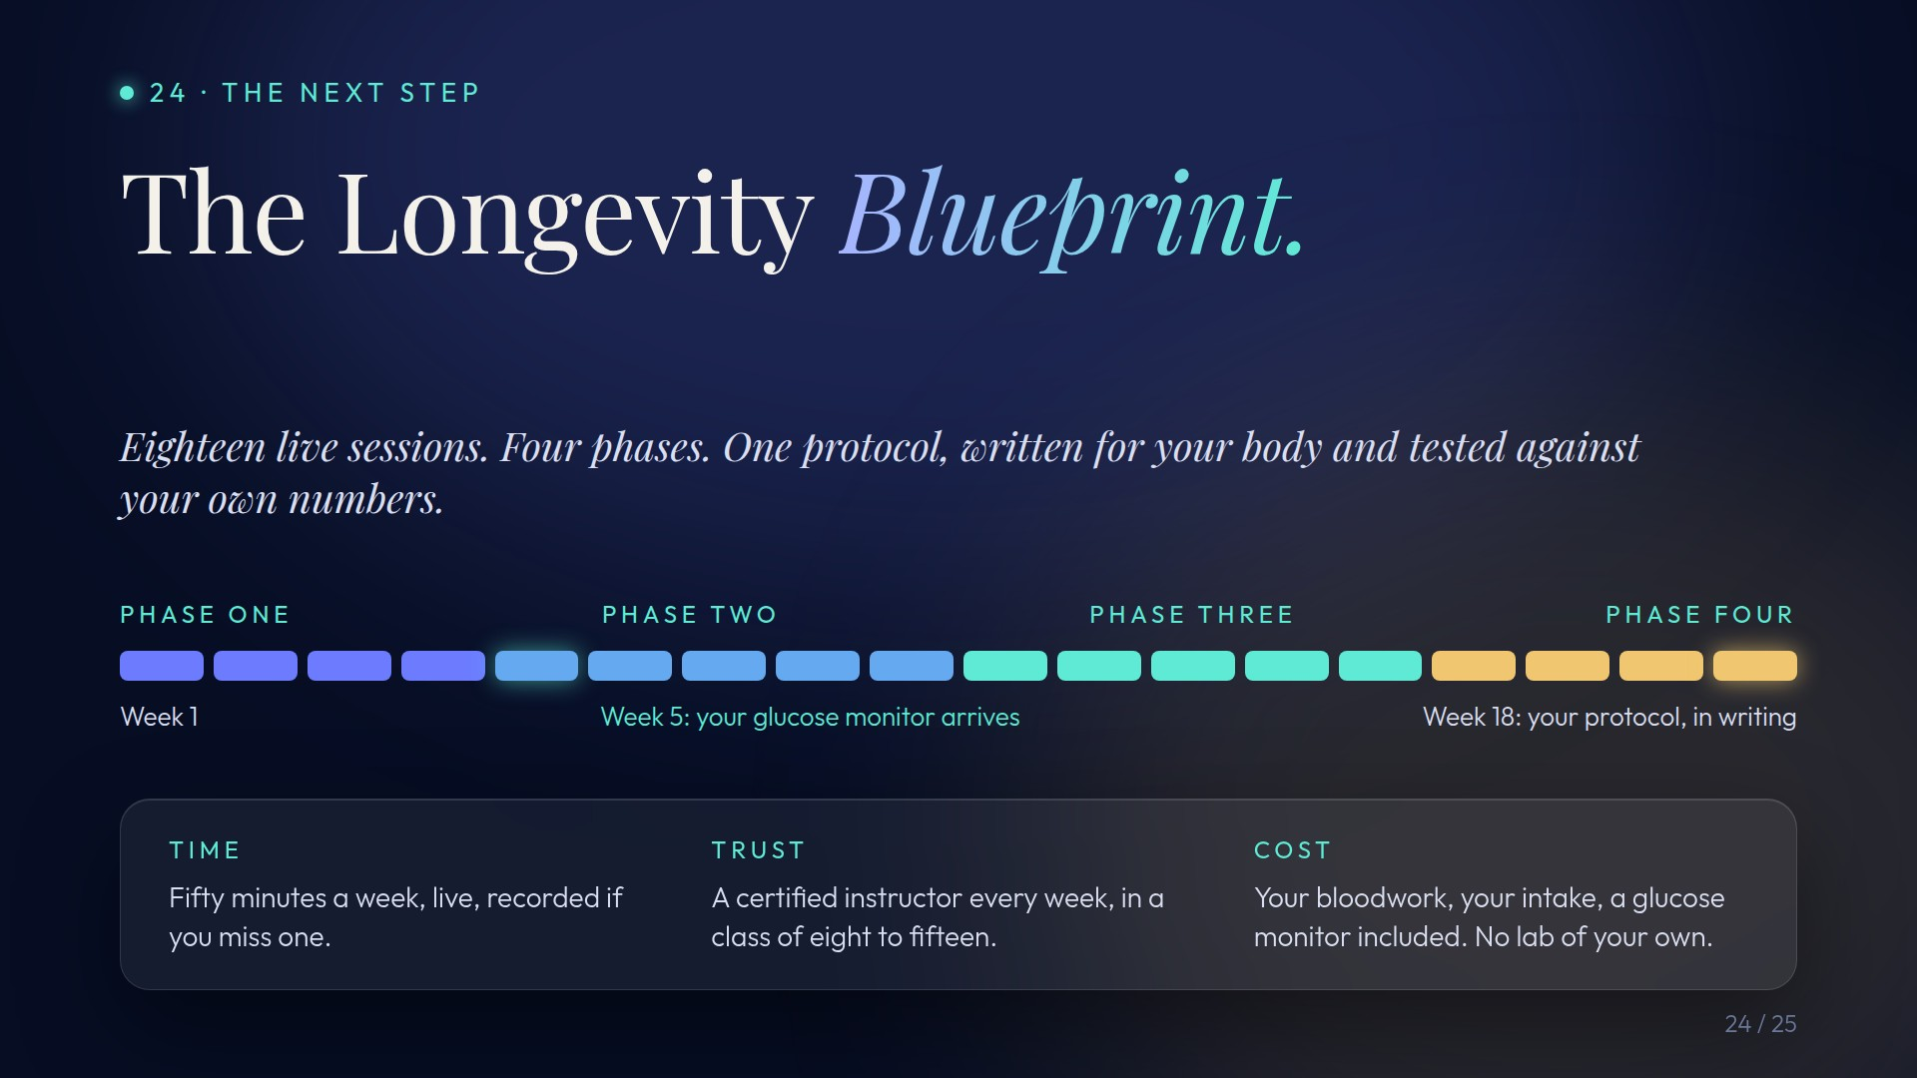
Notes:
Preserved original slide artwork, not editable text. s3-b
Original dimensions: 1920 × 1080 pixels.
Git commit 7598554002d419586722ccc8ab69dbceb7595ad4; slide-canvas/closers/frames/s3-b.jpg

Slide 9

Notes:
Preserved original slide artwork, not editable text. s4-a
Original dimensions: 1920 × 1080 pixels.
Git commit 7598554002d419586722ccc8ab69dbceb7595ad4; slide-canvas/closers/frames/s4-a.jpg

Slide 10

Notes:
Preserved original slide artwork, not editable text. s4-b
Original dimensions: 1920 × 1080 pixels.
Git commit 7598554002d419586722ccc8ab69dbceb7595ad4; slide-canvas/closers/frames/s4-b.jpg

